Slide 1
Block Diagram Reduction
UESTCHN3007 Dynamics & Control
Lecture 3
Dr Julien Le Kernec email: Julien.lekernec@glasgow.ac.uk
James Watt School of Engineering, University of Glasgow, UK

Slide 2
Outline
Apply Block Diagram Reduction Rules
Analyse Control System Subjected to a Disturbance

Slide 3
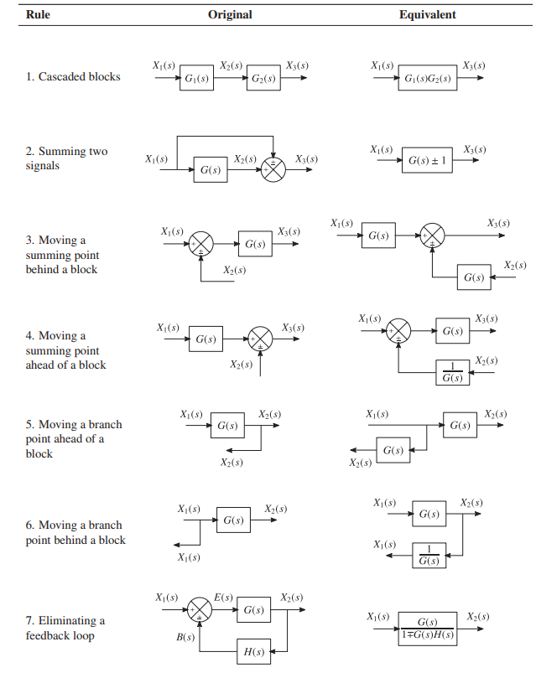

Slide 4
Example: Derive the overall transfer function
Notes:
First principle or reduced block diagram (using rule 1 and rule 7)

Slide 5
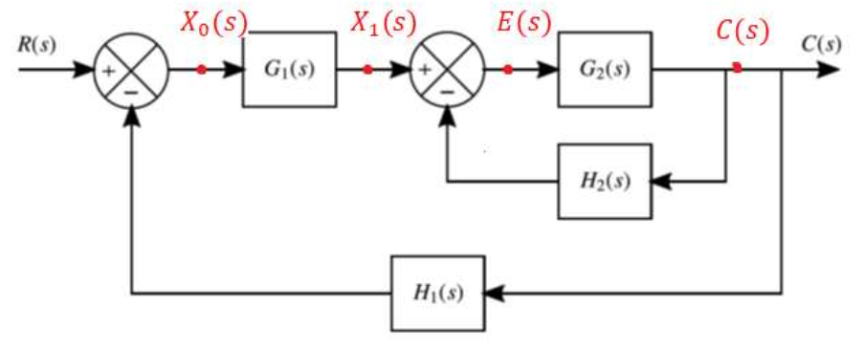
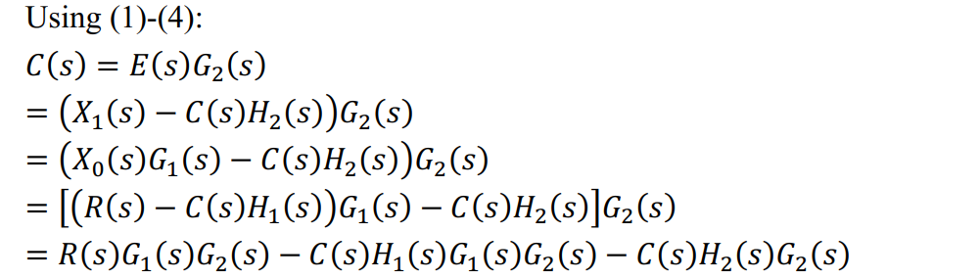
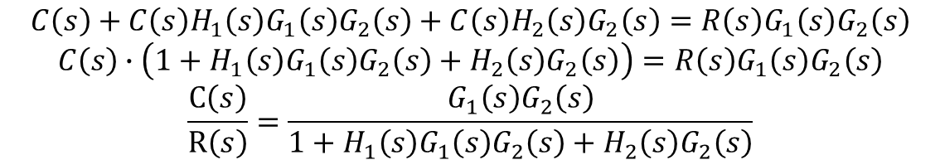
Example: Derive the overall transfer function
$C\left(s\right)=E\left(s\right)G_{2}\left(s\right)$ (1)
$E\left(s\right)=X_{1}\left(s\right)−C\left(s\right)H_{2}\left(s\right)$ (2)
$X_{1}\left(s\right)=X_{0}\left(s\right)G_{1}\left(s\right)$ (3)
$X_{0}\left(s\right)=R\left(s\right)−C\left(s\right)H_{1}\left(s\right)$ (4)
$$C\left(s\right)+C\left(s\right)H_{1}\left(s\right)G_{1}\left(s\right)G_{2}\left(s\right)+C\left(s\right)H_{2}\left(s\right)G_{2}\left(s\right)=R\left(s\right)G_{1}\left(s\right)G_{2}\left(s\right)$$
$$C\left(s\right)∙\left(1+H_{1}\left(s\right)G_{1}\left(s\right)G_{2}\left(s\right)+H_{2}\left(s\right)G_{2}\left(s\right)\right)=R\left(s\right)G_{1}\left(s\right)G_{2}\left(s\right)$$
$$\frac{C\left(s\right)}{R\left(s\right)}=\frac{G_{1}\left(s\right)G_{2}\left(s\right)}{1+H_{1}\left(s\right)G_{1}\left(s\right)G_{2}\left(s\right)+H_{2}\left(s\right)G_{2}\left(s\right)}$$
Notes:
First principle or reduced block diagram (using rule 1 and rule 7)

Slide 6
Example: Derive the overall transfer function
$C\left(s\right)=E\left(s\right)G_{2}\left(s\right)$ (1)
$E\left(s\right)=X_{1}\left(s\right)−C\left(s\right)H_{2}\left(s\right)$ (2)
$X_{1}\left(s\right)=X_{0}\left(s\right)G_{1}\left(s\right)$ (3)
$X_{0}\left(s\right)=R\left(s\right)−C\left(s\right)H_{1}\left(s\right)$ (4)
$$C\left(s\right)+C\left(s\right)H_{1}\left(s\right)G_{1}\left(s\right)G_{2}\left(s\right)+C\left(s\right)H_{2}\left(s\right)G_{2}\left(s\right)=R\left(s\right)G_{1}\left(s\right)G_{2}\left(s\right)$$
$$C\left(s\right)∙\left(1+H_{1}\left(s\right)G_{1}\left(s\right)G_{2}\left(s\right)+H_{2}\left(s\right)G_{2}\left(s\right)\right)=R\left(s\right)G_{1}\left(s\right)G_{2}\left(s\right)$$
$$\frac{C\left(s\right)}{R\left(s\right)}=\frac{G_{1}\left(s\right)G_{2}\left(s\right)}{1+H_{1}\left(s\right)G_{1}\left(s\right)G_{2}\left(s\right)+H_{2}\left(s\right)G_{2}\left(s\right)}$$
Notes:
First principle or reduced block diagram (using rule 1 and rule 7)

Slide 7
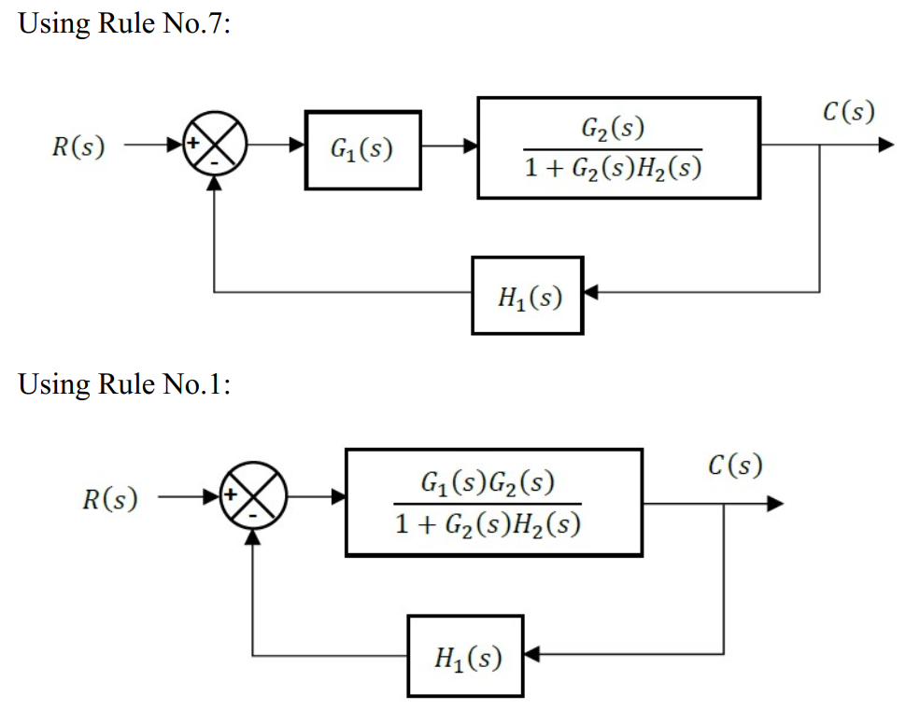
Example: Derive the overall transfer function
Notes:
First principle or reduced block diagram (using rule 1 and rule 7)

Slide 8
Example: Derive the overall transfer function
Notes:
First principle or reduced block diagram (using rule 1 and rule 7)

Slide 9
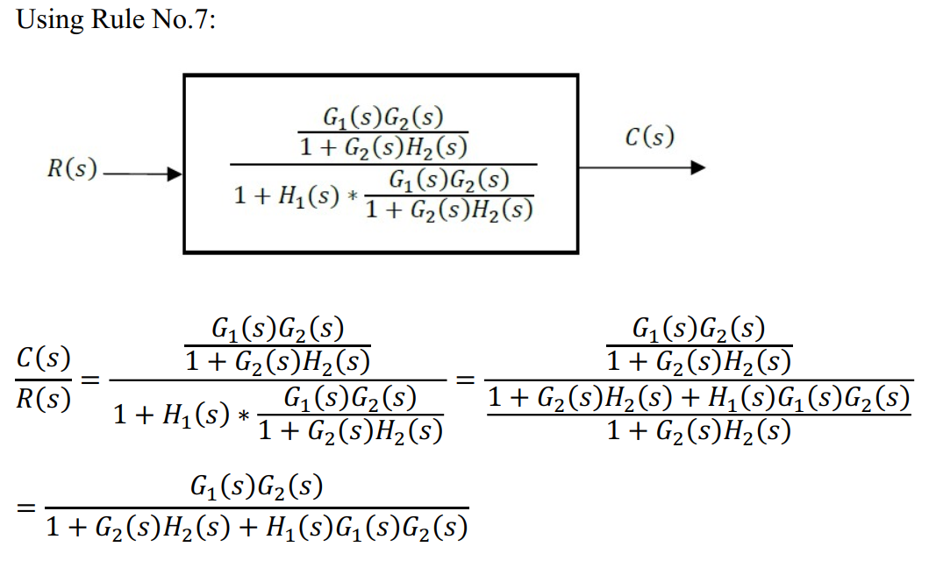
Example: Derive the overall transfer function
Notes:
First principle or reduced block diagram (using rule 1 and rule 7)

Slide 10
Example: Derive the overall transfer function
Notes:
First principle or reduced block diagram (using rule 1 and rule 7)

Slide 11
Exercise: Derive the overall transfer function
Notes:
Onion pealing First analyse the diagram from the most outside and decide what rule to use (rule 7 as it is a feedback loop), then move to the main branch… noticing it is a product of gain and another feedback loop . Unfortunately this FL is complicated because it’s main is part of another feedback loop. In this case we can move joining point to after the block using rule 6 to create a third FL. However when you do the reduction, you have to do it from inside out… starting from the last step and outwards

Slide 12
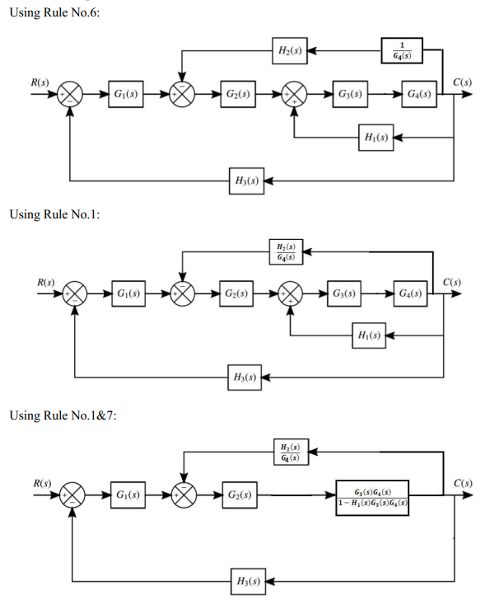
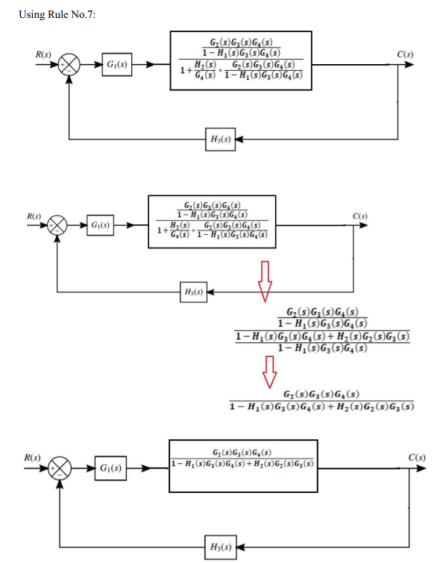
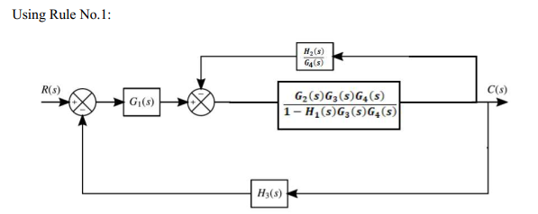

Slide 13
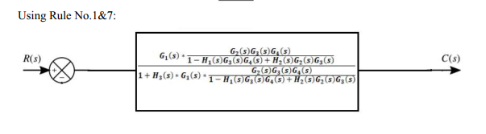
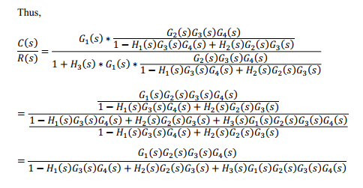

Slide 14
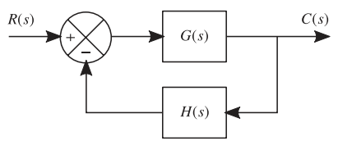
Closed-Loop Control System Subjected to a Disturbance
Suppress disturbances in the steady state operation of the plant.
Disturbance to the plant is incorporated by splitting the transfer function

Slide 15
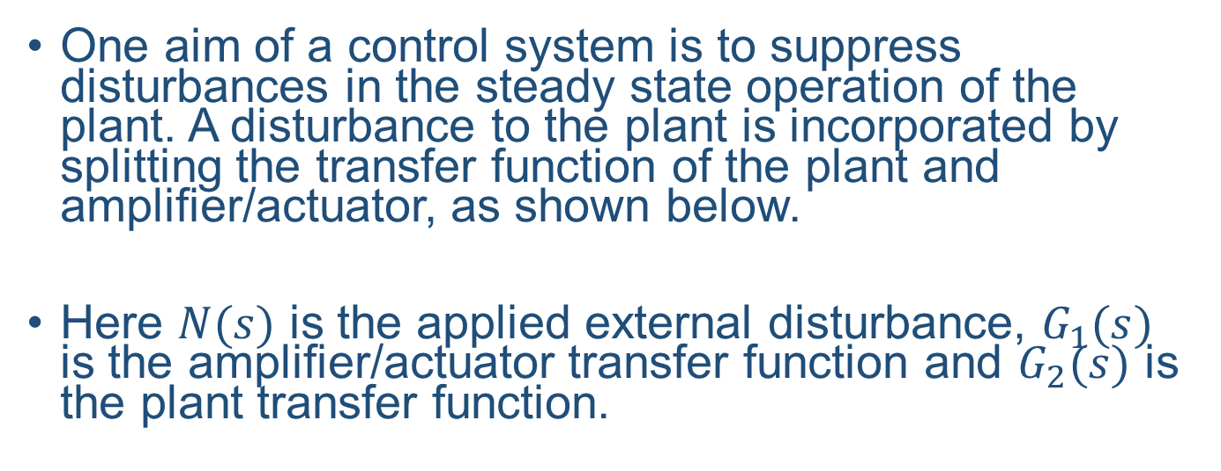
Closed-Loop Control System Subjected to a Disturbance
One aim of a control system is to suppress disturbances in the steady state operation of the plant. A disturbance to the plant is incorporated by splitting the transfer function of the plant and amplifier/actuator, as shown below.
Here $N(s)$ is the applied external disturbance, $G_{1}(s)$ is the amplifier/actuator transfer function and $G_{2}(s)$ is the plant transfer function.
Notes:
For example, a "gust alleviation" system in an aircraft senses a gust impinging on the aircraft and applies appropriate feedback control to maintain the desired flight path.

Slide 16
Closed-Loop Control System Subjected to a Disturbance
For linear systems, the principle of superposition holds, i.e. if the response to concurrent control inputs and disturbances is required, they can be evaluated individually, then summed together.

Slide 17
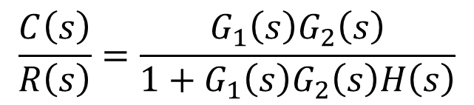
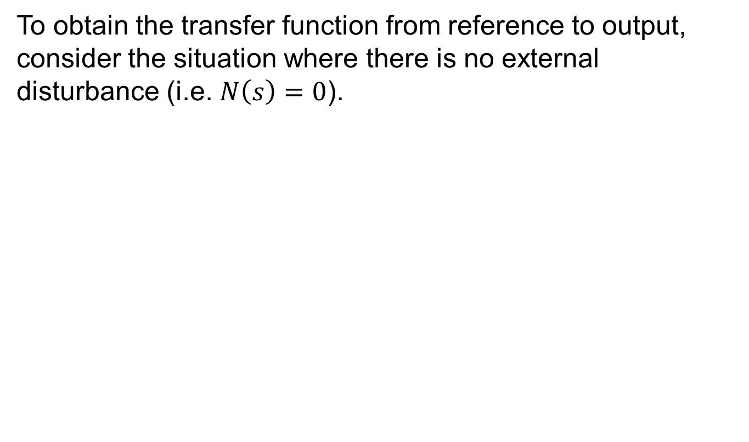
Closed-Loop Control System Subjected to a Disturbance
To obtain the transfer function from reference to output, consider the situation where there is no external disturbance (i.e. $N\left(s\right)=0$).
$$\frac{C\left(s\right)}{R\left(s\right)}=\frac{G_{1}\left(s\right)G_{2}\left(s\right)}{1+G_{1}\left(s\right)G_{2}\left(s\right)H\left(s\right)}$$

Slide 18
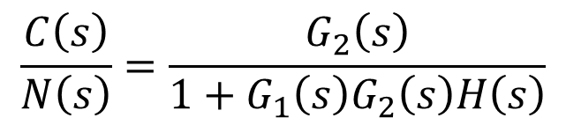
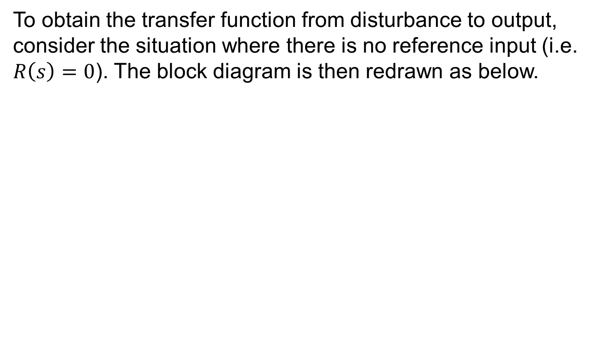
Closed-Loop Control System Subjected to a Disturbance
To obtain the transfer function from disturbance to output, consider the situation where there is no reference input (i.e. $R\left(s\right)=0$). The block diagram is then redrawn as below.
$$\frac{C\left(s\right)}{N\left(s\right)}=\frac{G_{2}\left(s\right)}{1+G_{1}\left(s\right)G_{2}\left(s\right)H\left(s\right)}$$

Slide 19
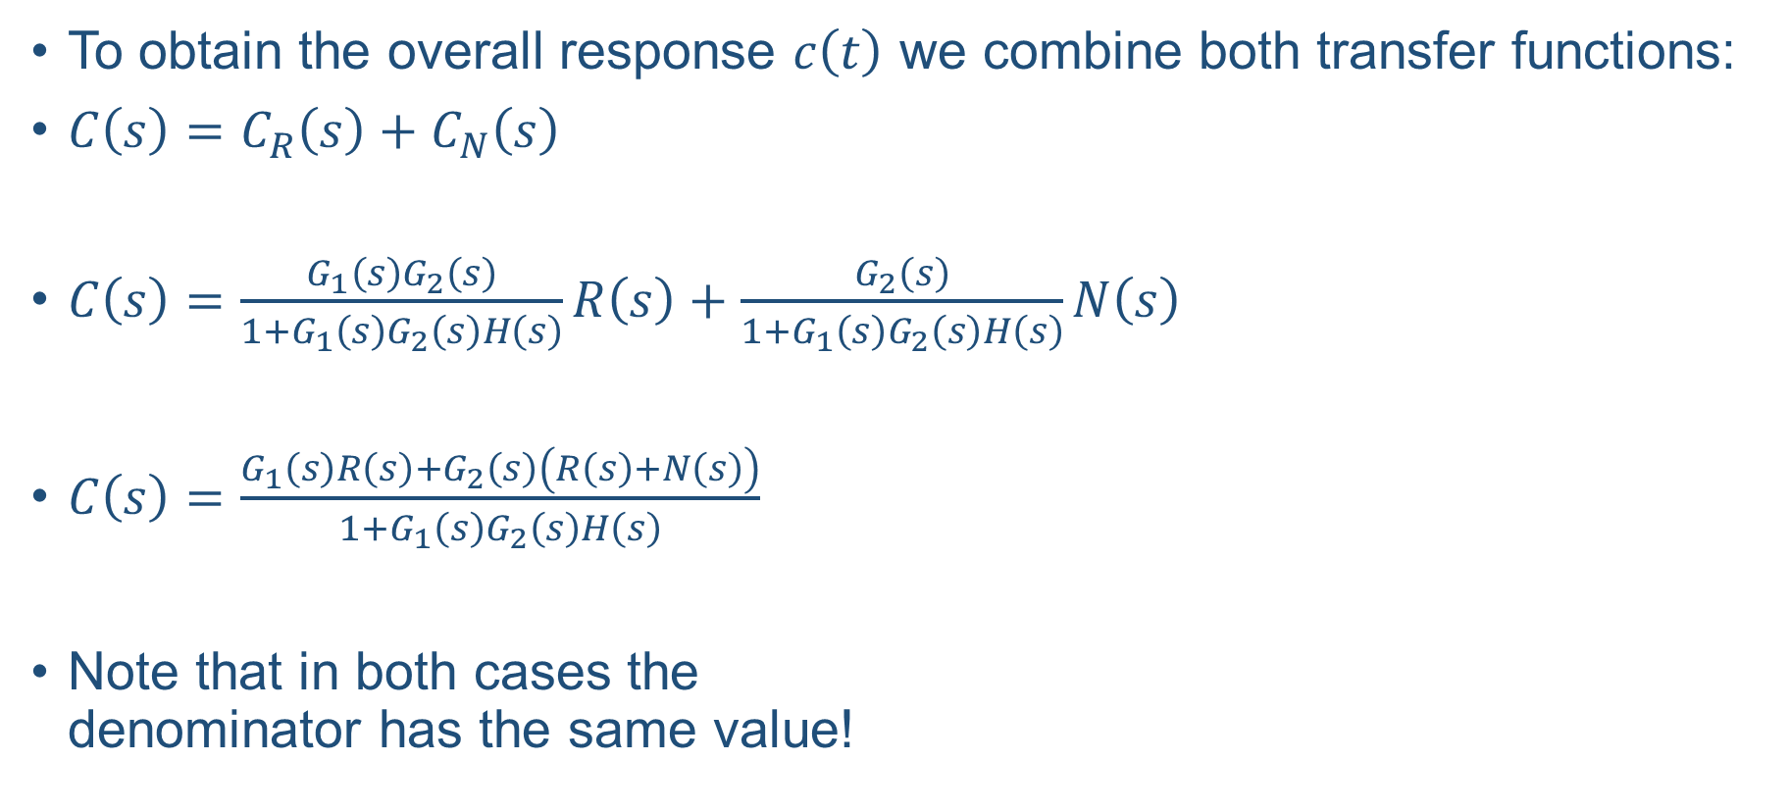
Closed-Loop Control System Subjected to a Disturbance
To obtain the overall response $c\left(t\right)$ we combine both transfer functions:
$C\left(s\right)=C_{R}\left(s\right)+C_{N}\left(s\right)$
$C\left(s\right)=\frac{G_{1}\left(s\right)G_{2}\left(s\right)}{1+G_{1}\left(s\right)G_{2}\left(s\right)H\left(s\right)}R\left(s\right)+\frac{G_{2}\left(s\right)}{1+G_{1}\left(s\right)G_{2}\left(s\right)H\left(s\right)}N\left(s\right)$
$C\left(s\right)=\frac{G_{1}\left(s\right)R\left(s\right)+G_{2}\left(s\right)\left(R\left(s\right)+N\left(s\right)\right)}{1+G_{1}\left(s\right)G_{2}\left(s\right)H\left(s\right)}$
Note that in both cases the denominator has the same value!
Notes:
For example, a "gust alleviation" system in an aircraft senses a gust impinging on the aircraft and applies appropriate feedback control to maintain the desired flight path.

Slide 20
Exercise - Derive the overall transfer function
Notes:
Do N(s) = 0 first and find its transfer function. Then make R(s)=0 and obtain its transfer function.

Slide 21
Summary
A complex block diagram can be reduced to describe the system as a single transfer function
Using superposition, the transfer function for the input and disturbances can be derived
References:
-Control Systems Engineering, 7th Edition, N.S. Nise
-UESTC3001 2019/20 Notes, J. Le Kernec

