Slide 1




Control 3 UESTC3001/UESTCHN3007 (2025-2026)

Slide 2

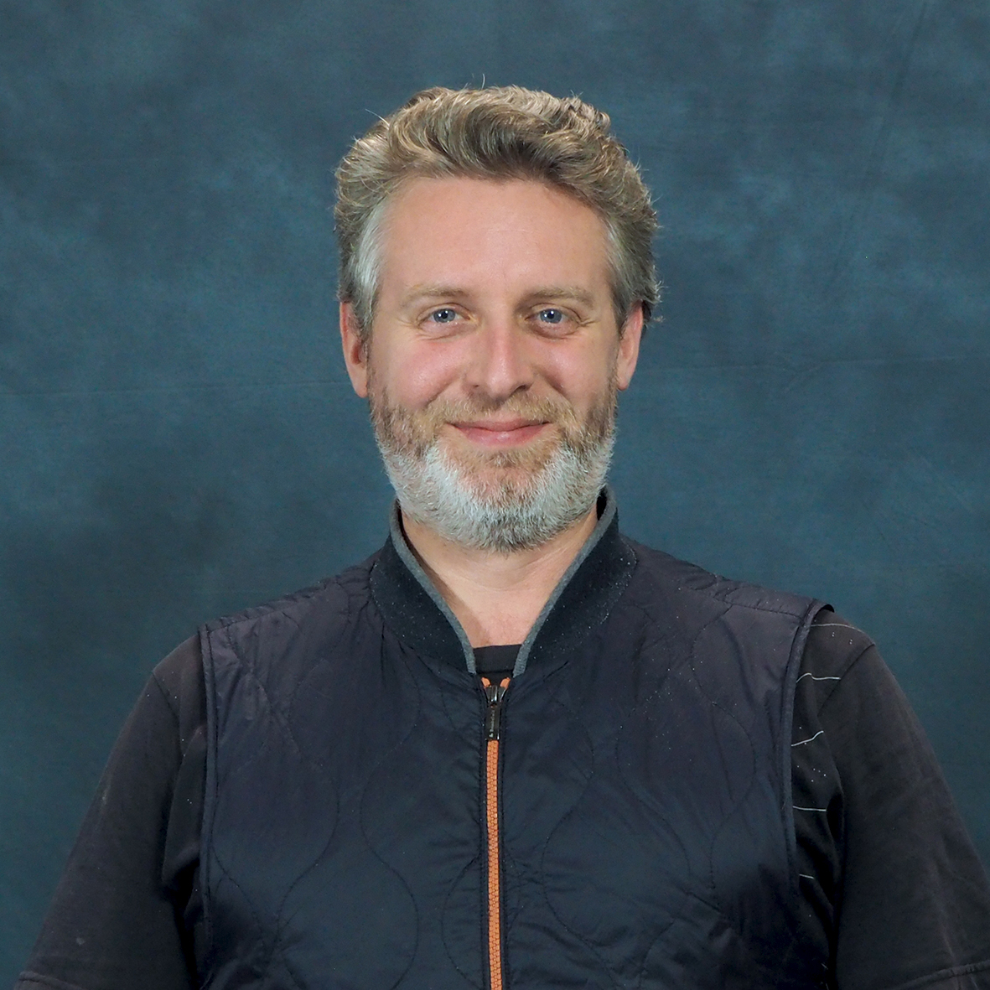
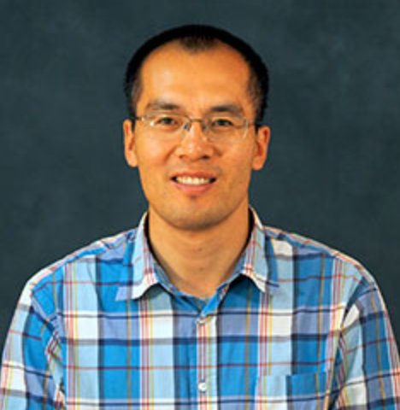
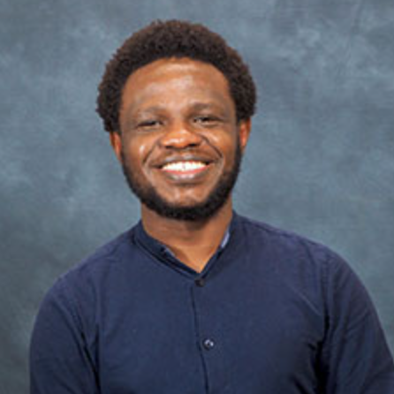
Teaching Team
Dr Julien Le Kernec (Block 1 & 3)
julien.lekernec@glasgow.ac.uk
Prof Chong Li (Block 2)
chong.li@glasgow.ac.uk
Dr Olaowula Popoola (Convenor & Block 4)
olaowula.Popoola@glasgow.ac.uk
Include
a photo

Slide 3
Course Aims
This course introduces the general behaviour of first-order and second-order dynamic systems, and shows how systems can be described by block diagrams. It goes on to analyse the characteristics and performance of feedback control systems, and also introduces a range of techniques including root locus and Nyquist.

Slide 4
Intended Learning Outcomes
By the end of the course students should be able to:
• Use time domain analysis techniques & concept of stability to estimate the behaviour of 1st and 2nd order dynamic systems;
• Represent control systems as block diagrams, and hence formulate their overall transfer functions;
• Analyse and estimate the performance of proportional–integral–differential (PID) feedback controllers;
• Use frequency domain analysis techniques, including Bode plots, Nyquist diagrams and the root locus method.

Slide 5
Course Syllabus
Overview/Refresher of Dynamic Systems
Basics of Control System and Analysis
Characteristics and Performance of Feedback Control Systems
Frequency Domain Analysis of Feedback Control Systems

Slide 6
Method of Delivery
This course will be timetabled in blocks
4 double sessions per teaching week
3 double lectures
1 tutorial
1 lab per block

Slide 7
Assessments and Minimum Requirement for Award of Credits
Assessment detail:
Students must submit at least 75% by weight of the components (including examinations) of the course’s summative assessment.
In accordance with the University's Code of Assessment reassessments are normally set for all courses which do not contribute to the honours classifications. For non honours courses, students are offered reassessment in all or any of the components of assessment if the satisfactory (threshold) grade for the overall course is not achieved at the first attempt. This is normally grade D3 for undergraduate students. Due to the nature of the coursework and sequencing of courses, it is not possible to reassess the coursework laboratory.

Slide 8



Resources
Recommended books (any of these is suitable):
R C Dorf, R H Bishop, Modern Control Systems, 12 ed, Pearson, 978-0131383104, 2010
K Ogata, Modern Control Engineering, 5 ed, Pearson, 978-0137133376, 2008
G F Franklin, J D Powell, A Emami-Naeini, Feedback Control of Dynamic Systems, 6 ed, Pearson, 978-0135001509, 2008

Slide 9
Tips to Help You Pass the Course
Expectations placed on Student Learning
It is expected that students work rather independently and take responsibility for their own work, collaborating with others when they see needed.
The university guidelines recommend that a student spend 10 hours per credit for a course. This course contains 32 hours of synchronous online tutor contact, 8 hours of labs. That means you ought to work at least 60 hours outside of class time on this course.
Attend class on time
During the class, pay attention and void doing other work
Don't disturb other students in the class
Engage with other students and create interaction during exercise times
Ask questions if you do not understand something, if you are wondering probably others are too
Study consistently throughout the semester and check your understanding

Slide 10
UESTC3001
Complaint procedure
Course Convener
Programme Director
GC UESTC CEDI Co-Director
Executive Dean
Associate Director of TNE
Director of TNE
Dr Olaoluwa Popoola olaowula.Popoola@glasgow.ac.uk
Prof Sajjad Hussain sajjad.hussain@glasgow.ac.uk
Prof Kelum Gamage kelum.gamage@glasgow.ac.uk
Prof David Young david.j.young@glasgow.ac.uk
Prof Sajjad Hussain sajjad.hussain@glasgow.ac.uk
Prof Scott Roy scott.roy@glasgow.ac.uk

Slide 11
UESTCHN3007
Complaint procedure
Course Convener
Programme Director
GC UESTC CEDI Co-Director
Executive Dean
Associate Director of TNE
Director of TNE
Dr Olaoluwa Popoola olaowula.Popoola@glasgow.ac.uk
Dr Julien Le Kernec julien.lekernec@glasgow.ac.uk
Prof Kelum Gamage kelum.gamage@glasgow.ac.uk
Dr Robert Partridge robert.partridge@glasgow.ac.uk
Prof Sajjad Hussain sajjad.hussain@glasgow.ac.uk
Prof Scott Roy scott.roy@glasgow.ac.uk

Slide 12



Finally, remember
YOU ARE RESPONSIBLE FOR
YOUR SUCESS
#UofGWorldChangers
@UofGlasgow

