Slide 1
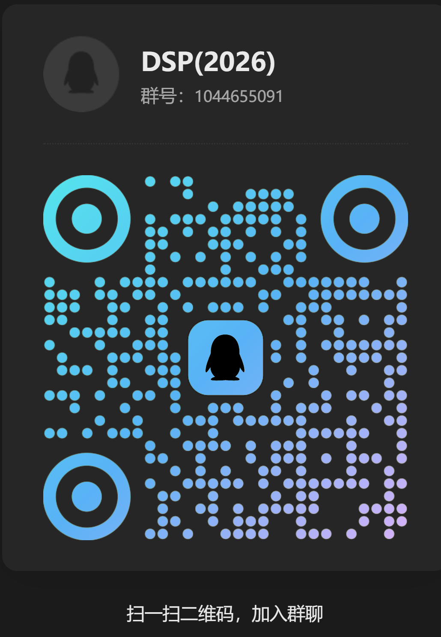
Digital Signal Processing
Lecturer ：利强
Office：科研楼C211
Email：LQ@uestc.edu.cn
TA：杨柳

Slide 2
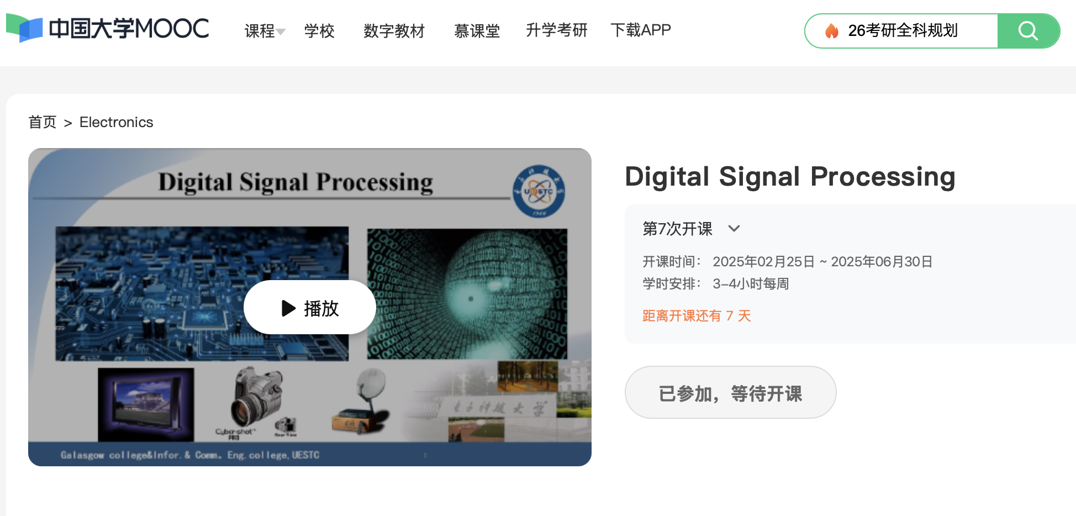
MOOC Website：
https://www.icourse163.org/course/UESTC-236010
https://www.icourse163.org/course/UESTC1-1458252163

Slide 3
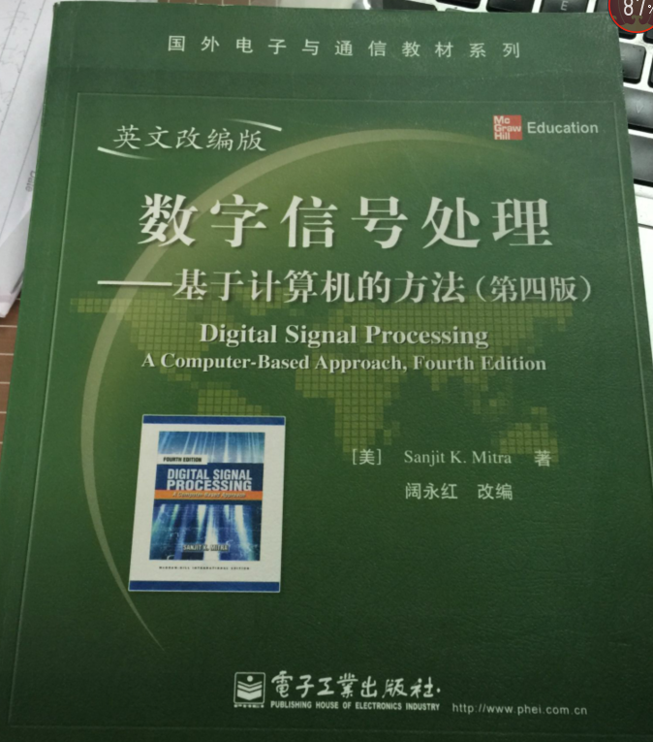
The Textbook
Digital Signal Processing----A Computer- Based Approach, Sanjit K.Mitra,4th Edition,McGraw-Hill,2014
电子工业出版社

Slide 4
Reference books
1. 奥本海姆（李玉柏等译），离散时间信号处理（原书第3版.精编版），机械工业出版社
2. 彭启琮等，数字信号处理,高等教育出版社
3. 彭启琮等,DSP与实时数字信号处理,电子科大出版社
4. 程佩青,数字信号处理教程,清华大学出版社
5.胡广书，数字信号处理——理论、算法与实现，清华大学出版社

Slide 5
Arrangement
1. Lectures，56 chs.（including course contents 48 chs. and presentations of course projects 8 chs.）
2. MOOC，about 32 chs.
3. Lab time，about 8 chs.

Slide 6
Grading
Course projects:25%
（1）Complete the design as required（Include MATLAB codes，graphs，result analysis etc.)
（2）Presentation
（3）Project report
2. Open Book Final Examation：75%
Only one exam
Total 6 questions in 3 hours
Refer to the questions in MOOC and Homework

Slide 7
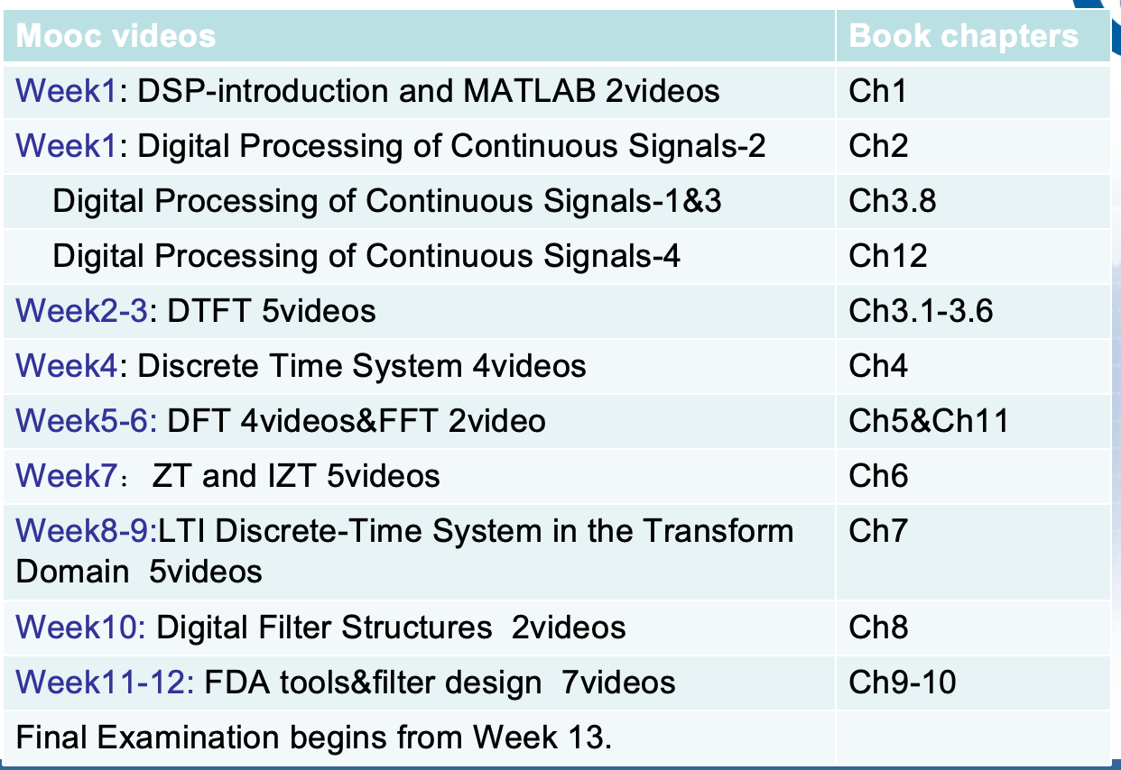
Contents of Mooc

Slide 8
Foreword
Characterization Of The Course
1.The Tech. Fields Used DSP:
Communication, Radio, Radar, Navigation, IT, etc
2. The Correlated Course:
Signals And Systems
Tech. Of DSP
Logic Circuit
DSP
Software Radio
Programm
VLSI,ASIC,……

Slide 9
Required Contents
§1
§2 2.1~2.5
§3* 3.1~3.9
§4 4.1~ 4.10
§5* 5.1~ 5.10
§6 6.1~6.7
§7 7.1~7.4
§8 8.1~8.6
§9 * 9.1~9.6
§10 * 10.1,10.2,10.5
§11 11.1~11.5
§A A.1~A.8

Slide 10
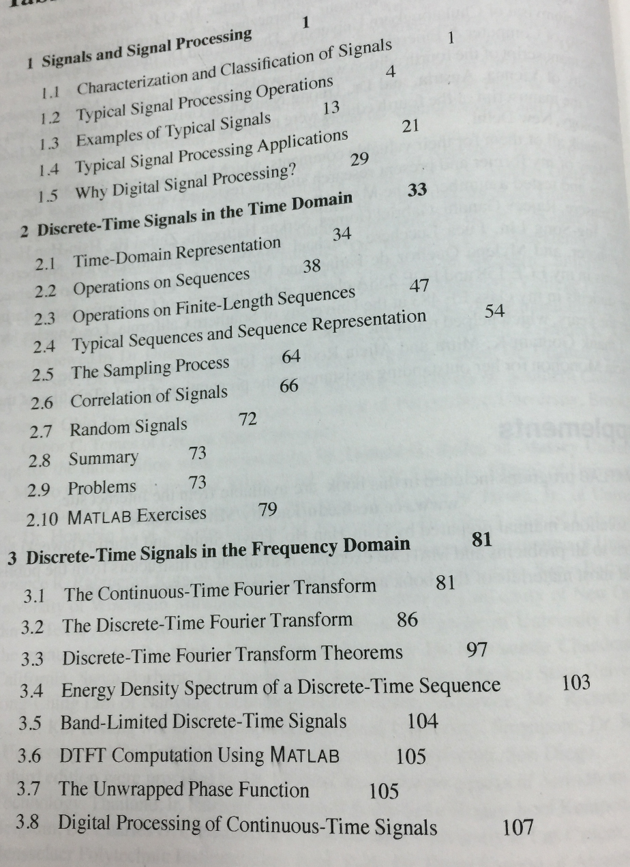
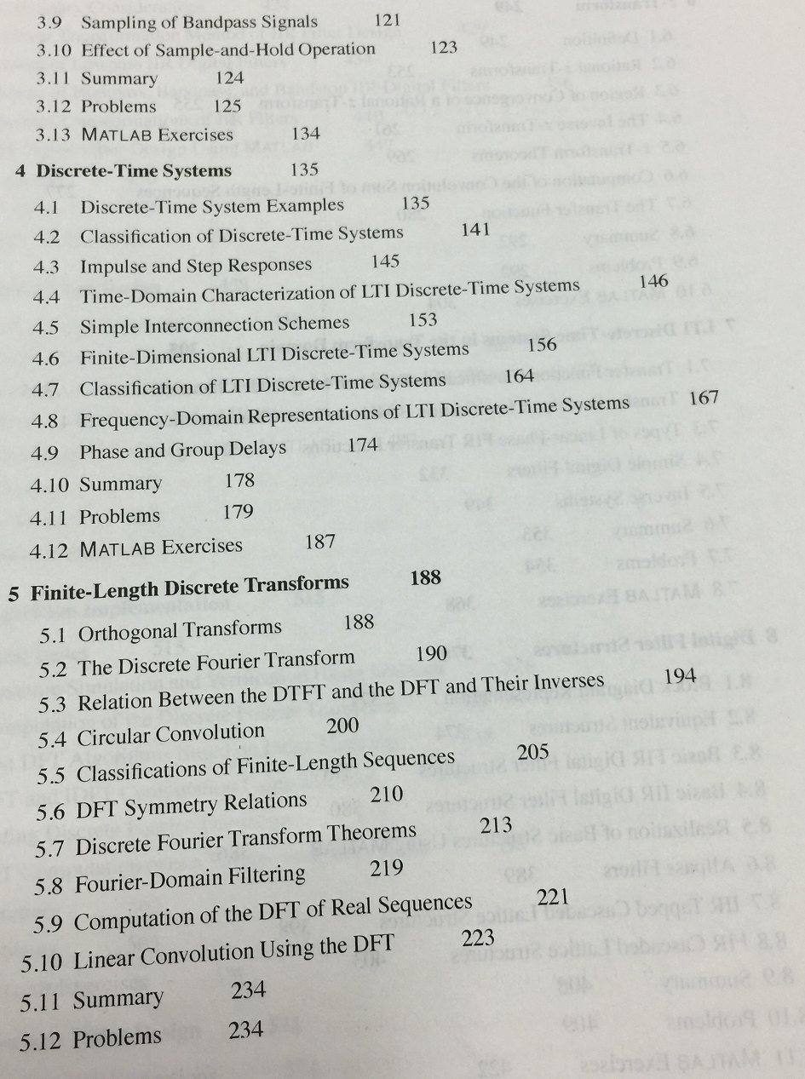

Slide 11
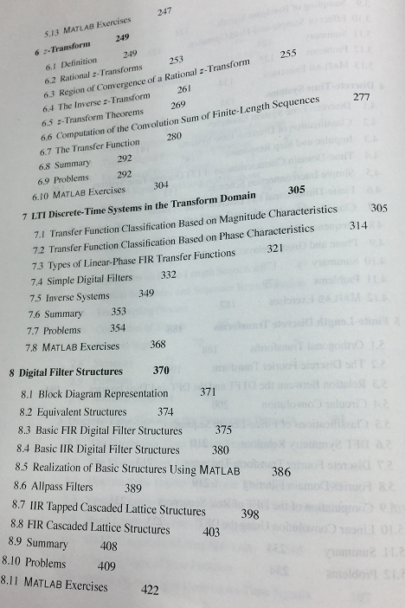
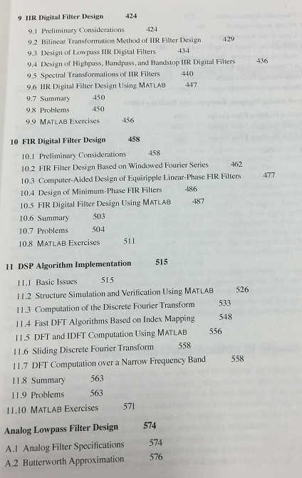

Slide 12
Projects：
Production and Detection of Dual-Tone Multi-Frequency (DTMF) Signals
In week 8
Digital Frequency Spectrum Analysis Based on DFT
In week 10

