Slide 1
Chapter 9 IIR Digital Filter Design
Preliminary Considerations
IIR Digital Filter Design Methods
MATLAB Functions in IIR Filter Design

Slide 2

Filter Design Objective
Objective
Determination of a realizable transfer function G(z) approximating a given frequency response specification is an important step in the development of a digital filter.
If an IIR filter is desired, G(z) should be a stable real rational function.
Digital filter design is the process of deriving the transfer function G(z).
(理解)

Slide 3
9.1 Preliminary Considerations
These are two issues that need to be considered before one can develop the digital transfer function G(z).
  The first and foremost issue is the development of a reasonable filter frequency response specification.
  The second issue is to determine whether an FIR or an IIR digital filter is to be designed.
(理解)

Slide 4

9.1.1 Digital Filter Specifications
Usually, either the magnitude and/or the phase response is specified for the design of digital filter for most applications;
In most practical applications, the problem of interest is the development of a realizable approximation to a given magnitude response specification.
We restrict to the magnitude approximation problem in this chapter.
(理解)
Notes:
*

Slide 5
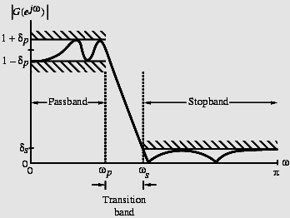




Digital Filter Design Specifications
The magnitude response |G(e^{jω})| of a digital lowpass filter may be specified below:
In the passband, we require
1- δ_{p} ≤ |G(e^{jω})| ≤ 1+ δ_{p},
δ_{p} : passband peak ripple
δ_{s} : stopband peak ripple
In the stopband, we require | G(e^{jω})| ≤ δs
ω_{p} : passband edge freq.
ω_{s}: stopband edge freq.
Mooc 内容（理解）
Notes:
*

Slide 6
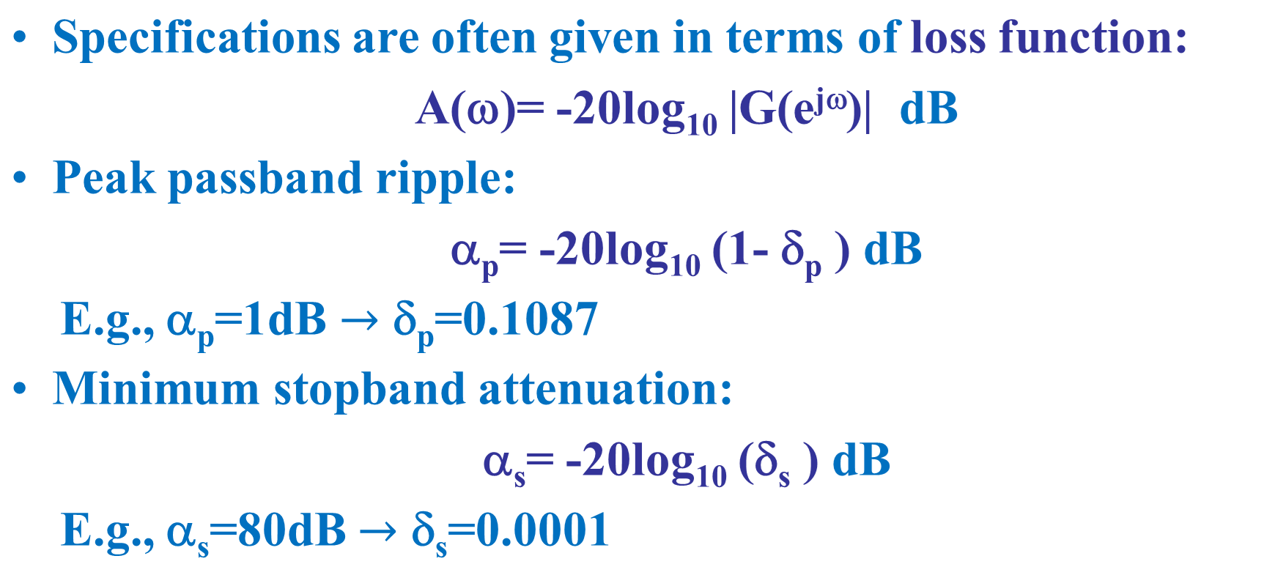
Digital Filter Design Specifications
Mooc 内容 (理解)
Notes:
*

Slide 7
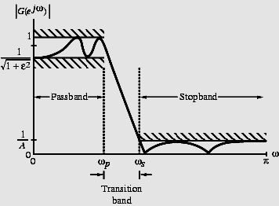
9.1.1 Digital Filter Specifications
Magnitude specifications may alternately be given in a normalized form as indicated below:
(理解)

Slide 8
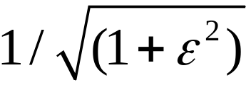
9.1.1 Digital Filter Specifications
Here, the maximum value of the magnitude in the passband is assumed to be unity.
- Maximum passband deviation, given by the minimum value of the magnitude in the passband.
1/A - Maximum stopband magnitude;
  Minimum stopband attenuation is: 20log₁₀(A) dB.
(理解)

Slide 9
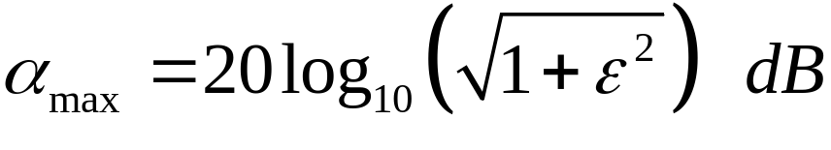

9.1.1 Digital Filter Specifications
For the normalized specification, maximum value of the gain function or the minimum value of the loss function is 0 dB.
Maximum passband attenuation:
For δ_{p}<<1, it can be shown that:
(理解)

Slide 10
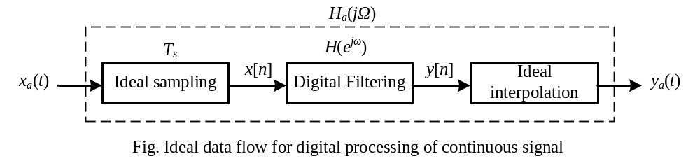

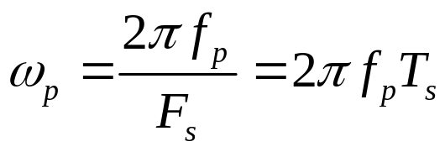
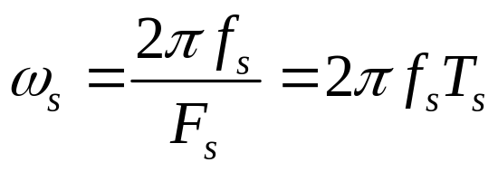
Digital Filter Design Specifications
In practice, passband edge frequency f_{p} and stopband edge frequency f_{s} are specified in Hz.
For digital filter design, normalized angular edge frequencies can be computed in radians as
where F_{s} and T_{s} are sampling frequency and sampling interval
Mooc 内容
Notes:
*

Slide 11
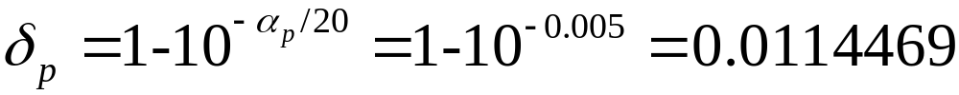
9.1.1 Digital Filter Specifications
Example 9.1
Let α_{p}=0.1dB, and α_{s}= 35dB. Determine the δ_{p} and δ_{s}
(理解)

Slide 12
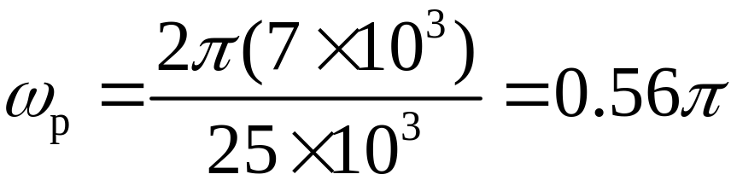
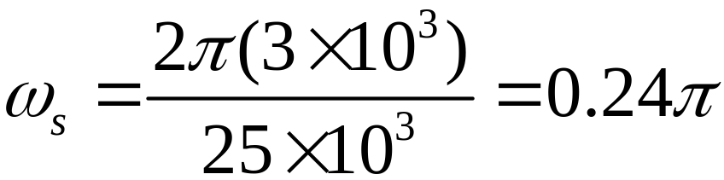
9.1.1 Digital Filter Specifications
Example 9.2
Let F_{p}= 7 kHz, F_{s}= 3 kHz, and F_{T}=25 kHz
Then
(理解)

Slide 13
9.1.2 Selection of the Filter Type
The objective of digital filter design is to develop a casual, stable transfer function G(z) which meets the FR specifications.
Whether IIR or FIR should be selected?
IIR: lower order to reduce computational complexity; but must be stable.
FIR: linear phase; always stable; but higher order.
(理解)

Slide 14
9.1.3 Basic Approach to IIR Digital Filter Design
Most common approach to IIR filter design:
Convert the digital filter specifications into analog lowpass prototype one.
Determine the analog lowpass filter H_{a}(s) meeting these specifications.
Transform it into the desired digital filter transfer function G(z).
(理解)

Slide 15
9.1.3 Basic Approach to IIR Digital Filter Design
Why this approach has been widely used:
(1) Analog approximation techniques are highly advanced.
(2) They usually yield closed-form solutions.
(3) Extensive tables are available for analog filter design.
(4) Many applications require digital simulation of analog systems.
(理解)

Slide 16
9.1.3 Basic Approach to IIR Digital Filter Design
The basic idea is to apply a mapping from s-domain to the z-domain so that the essential properties of the analog frequency response are preserved. [H_{a}(s) ---＞ G(z)]
This implies that the mapping should be:
(1) The imaginary axis in the s-plane be mapped onto the unit circle of the z-plane.
(2) A stable analog transfer function be transformed into a stable digital transfer function.
(理解)

Slide 17

9.1.4 IIR Digital Filter Order Estimation
After the type of the digital filter has been selected, the next step in the filter design process is to estimate the filter order N.
For the design of IIR LPF, the order of H_{a}(s) is estimated from its specifications using the appropriate formula given in Eq.(A.9), (A.17), or (A.27), depending on which approximation is desired.
Then the order of G(z) can be determined automatically from the transformation being used to convert H_{a}(s) into G(z).
(理解)

Slide 18
9.1.5 Scaling the Digital Transfer function
In magnitude scaling, the transfer function G(z) is multiplied by a constant K so that the maximum magnitude of the KG(z) in the passband is unity; it has a maximum gain of 0dB.
If G_{max} is the maximum value of |G(e^{jω})| in the passband, then K=1/ G_{max}
  For a lowpass G(z) with a maximum magnitude at DC, K=1/G(1);
  For a highpass G(z) with a maximum magnitude at ω=π, K=1/G(-1);
  For a bandpass G(z), K=1/Ge^{jωc}, where ω_{c} is the center frequency of the passband.
(理解)

Slide 19
Appendix A: Analog Filter Design
Analog Filter Specifications
Butterworth approximation
Chebyshev approximation
Type1 Type2
Elliptic approximation
Analog Lowpass Filter Design Using MATLAB
(掌握)

Slide 20










Analog Lowpass Filter Specifications
Ω_{p} -passband edge frequency
Ω_{s} -stopband edge frequency
δ_{p} -peak ripple value in the passband
δ_{s} -peak ripple value in the stopband
(掌握)

Slide 21
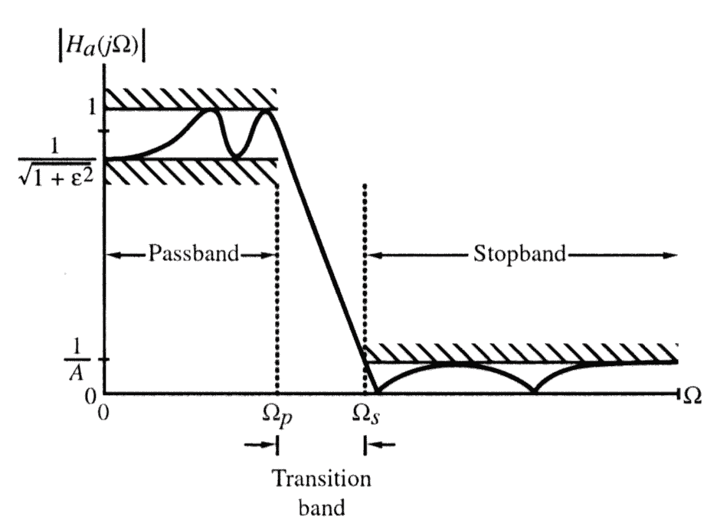
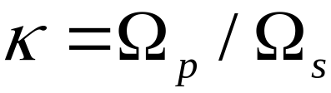
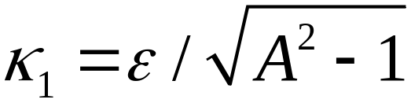
Normalized magnitude specifications for an analog lowpass filter
Transtion ratio or selectivity parameter:
Discrimination parameter:
(掌握)

Slide 22
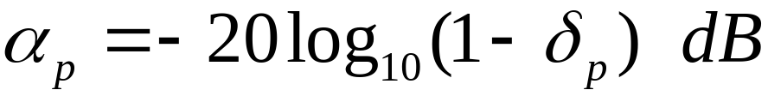
In the passband, defined by 0≤ Ω ≤ Ω_{p}
1-δ_{p} ≤ |H_{a}(jΩ)| ≤ 1+ δ_{p} , |Ω| ≤ Ω_{p}
In the stopband, defined by Ω_{s} ≤ Ω ≤ ∞,
|H_{a}(jΩ)| ≤ δ_{s} , Ω_{s} ≤ Ω ≤ ∞
Peak passband ripple
Minimum stopband attenuation
(掌握)
Notes:
|H_{a}(jΩ)| approximates unity within an error of ±δ_{p} ;
|H_{a}(jΩ)| approximates zero within an error of δ_{s}
*

Slide 23
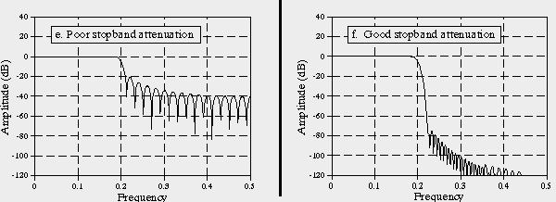
Attenuation function or Loss function
(掌握)

Slide 24
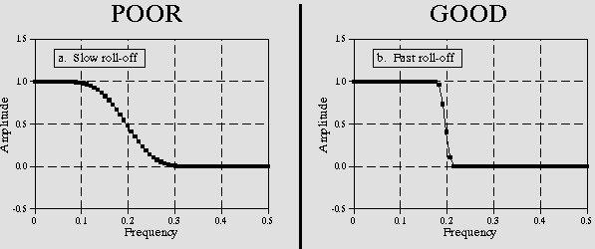
Transition ratio or Selectivity parameter
(掌握)

Slide 25
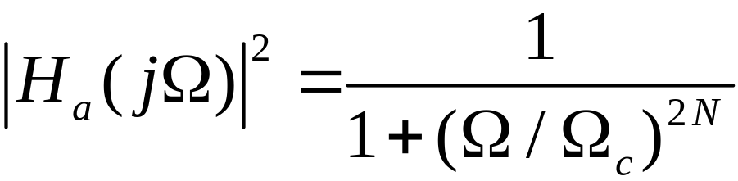
Appendix A: Analog Filter Design
Butterworth Approximation
The magnitude-square response of an N-th order analog lowpass Butterworth filter is given by:
The Butterworth lowpass filter thus is said to have a maximally-flat magnitude at Ω = 0.
(掌握)

Slide 26
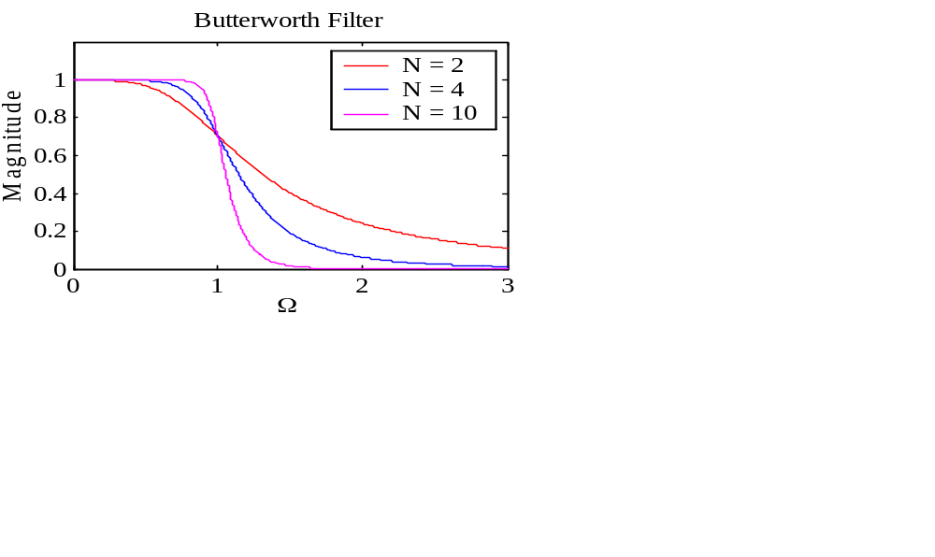
Butterworth Approximation
Gain in dB is: G(Ω)=10log₁₀|H_{a}(jΩ)|²
As G(0)=0 and
G(Ω_{c})=10log₁₀(0.5)≅ -3 dB
Ω_{c} is called 3-dB cutoff frequency.
Typical magnitude responses with Ω_{c} =1 are shown in right.
(掌握)

Slide 27
Butterworth Approximation
Two parameters completely characterizing a Butterworth lowpass filter are Ω_{c} and N.
These are determined from the specified bandedges Ω_{p} and Ω_{s} , and minimum passband magnitude , and maximum stopband ripple 1/A.
(掌握)

Slide 28
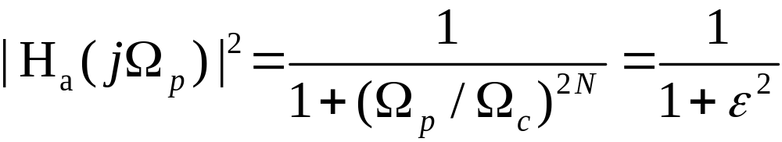
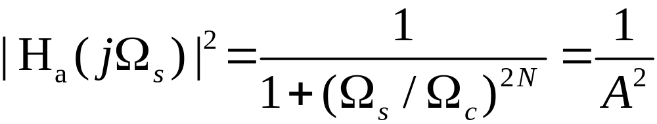
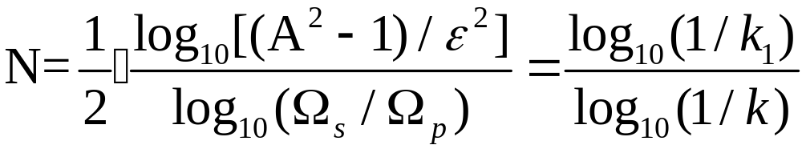
Butterworth Approximation
Ω_{c} and N are thus determined from:
Solving the above, we get:
(掌握)
Notes:
Since order N must be an integer, value obtained is rounded up to the next highest integer.
This value of N is used to determine Ω_{c} by satisfying either the stopband edge (Ω_{s}) or the passband edge (Ω_{p}) specification exactly.
*

Slide 29
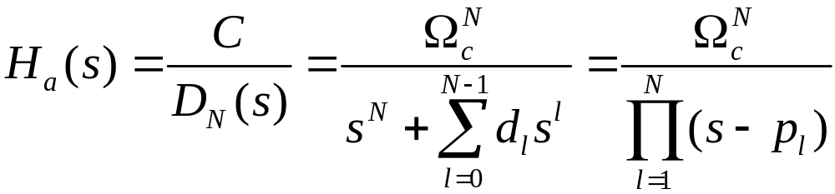







Transfer function of an analog Butterworth lowpass filter is given by:
Where,
Butterworth Polynomial :
N
1
1
1
2
1
1.4142136
1
3
1
2.0000000
2.0000000
1
4
1
2.6131259
3.4142136
2.6131259
1
(掌握)

Slide 30
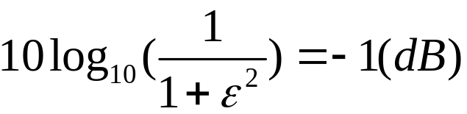

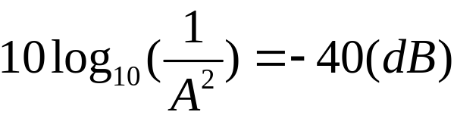

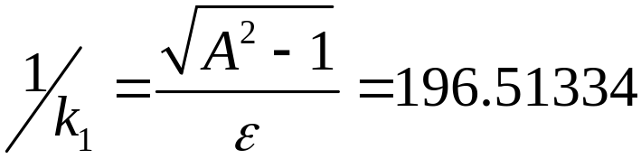
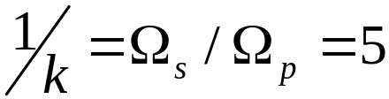
Example
Determine the lowest order of Butterworth LPF with a 1-dB cutoff frequency at 1kHz and minimum attenuation of 40dB at 5kHz.

Slide 31
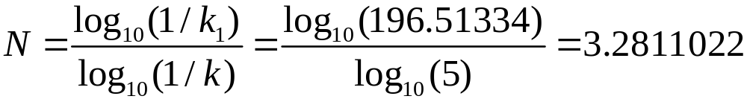
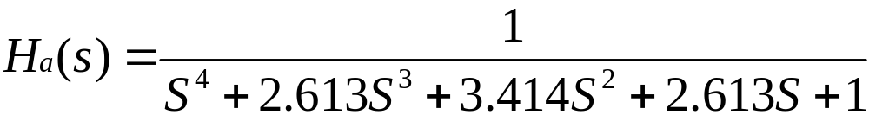
So we get:
The nearest integer N=4.
From the Butterworth Polynomial:

Slide 32
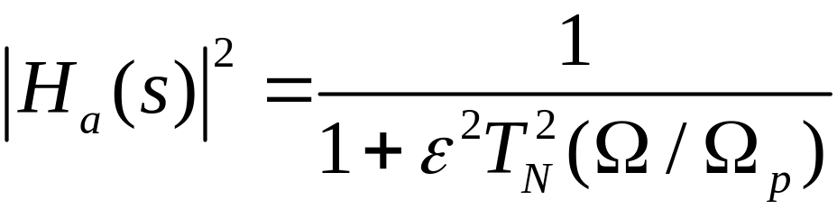
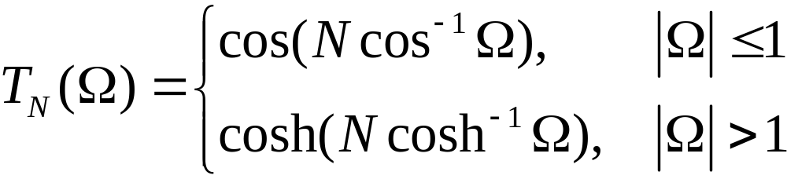
Analog Filter Design
Chebyshev Approximation
The magnitude-square response of an N-th order analog lowpass Type 1 Chebyshev filter is given by:
where T_{N}(Ω) is the Chebyshev polynomial of order N:
(理解)

Slide 33
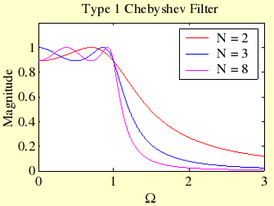
Chebyshev Approximation
Typical magnitude response plots of the analog lowpass Type 1 Chebyshev filter are shown below:
(理解)

Slide 34
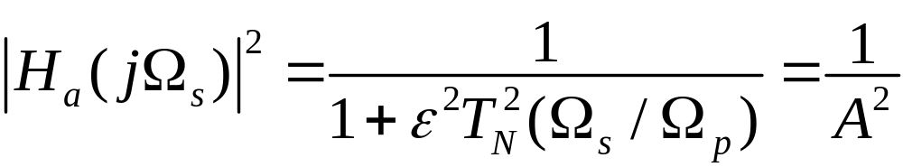
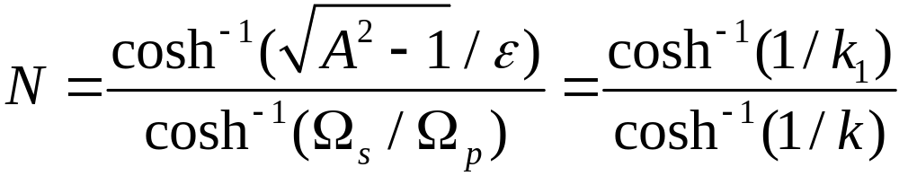
Chebyshev Approximation
If at Ω = Ω_{s} the magnitude is equal to 1/A, then
Solving the above we get:
Order N is chosen as the nearest integer greater than or equal to the above value.
(理解)

Slide 35
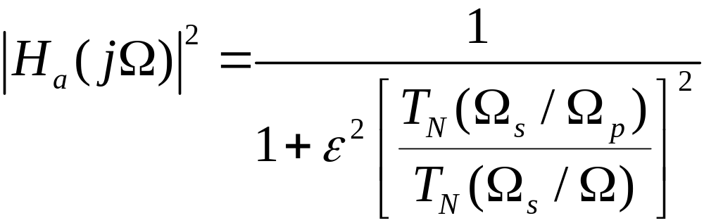
Chebyshev Approximation
The magnitude-square response of an N-th order analog lowpass Type 2 Chebyshev (also called inverse Chebyshev) filter is given by:
where T_{N}(Ω) is the Chebyshev polynomial of order N.
(理解)

Slide 36
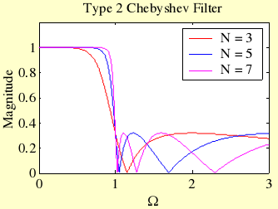
Chebyshev Approximation
Typical magnitude response plots of the analog lowpass Type 2 Chebyshev filter are shown below:
(理解)

Slide 37
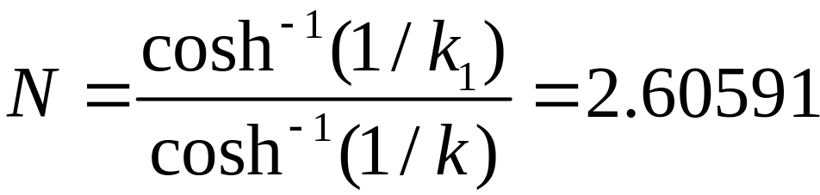
Chebyshev Approximation
The order N of the Type 2 Chebyshev filter is determined from given ε, Ω_{s}, and A using:
Example - Determine the lowest order of a Chebyshev lowpass filter with a 1-dB cutoff frequency at 1kHz and a minimum attenuation of 40 dB at 5kHz.
(理解)

Slide 38
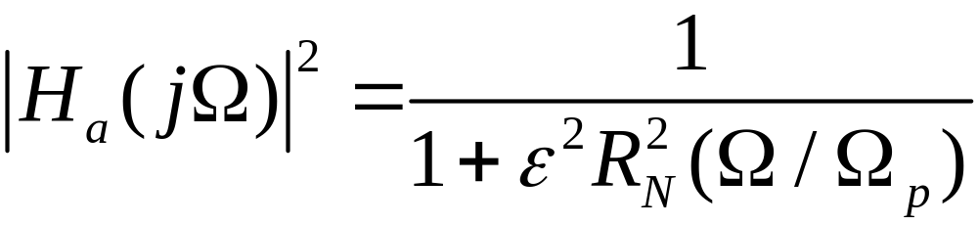
Analog Filter Design
Elliptic Approximation
The square-magnitude response of an elliptic lowpass filter is given by:
where R_{N}(Ω) is a rational function of order N satisfying R_{N}(1/Ω)=1/R_{N}(Ω) ,
with the roots of its numerator lying in the interval 0< Ω <1 and the roots
of its denominator lying in the interval 1< Ω < ∞.
(理解)

Slide 39
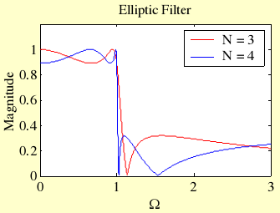
Elliptic Approximation
Typical magnitude response plots are shown below:
(理解)

Slide 40
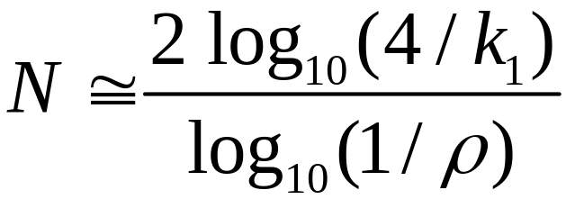
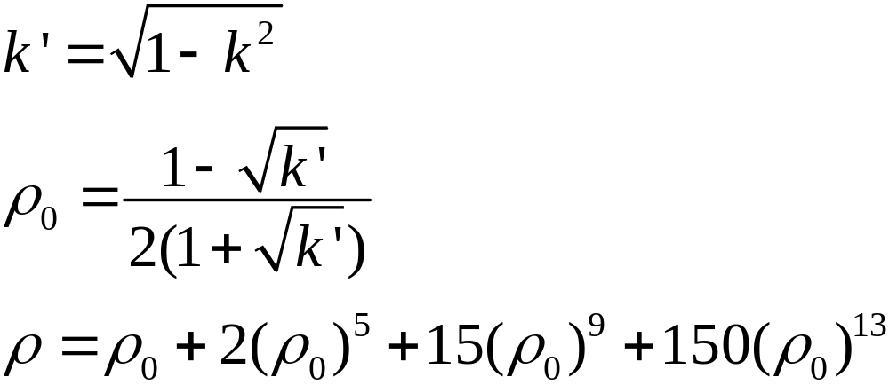
Elliptic Approximation
For given Ω_{p}, Ω_{s}, ε, and A, the filter order can be estimated using:
where
(理解)

Slide 41
Elliptic Approximation
Example
Determine the lowest order of a elliptic lowpass filter with a 1-dB cutoff frequency at 1 kHz and a minimum attenuation of 40 dB at 5 kHz.
Note: k = 0.2 and 1/k₁=196.5134
Substituting these values we get:
k’=0.979796, ρ₀=0.00255135, ρ=0.0025513525
hence N = 2.23308
Choose N = 3.
(理解)

Slide 42
A Comparison of the Analog Filter Types
The Butterworth filter has the widest transition band, with a monotonically decrease gain response.
The elliptic filter has the narrowest transition band, with the equiripple passband and equiripple stopband response.
The magnitude response of the Type2 Chebyshev filter in the passband is nearly identical to that of the Butterworth.
The Butterworth and Chebyshev filters have a nearly linear phase response over about 3/4 of passband, whereas the elliptic filter has a nearly linear phase response over about 1/2 of the passband.
(理解)

Slide 43
Analog Lowpass Filter Design Using MATLAB
Example: Design an analog lowpass filter of lowest order with a 1-dB cutoff frequency at 1kHz and a minimum attenuation of 40 dB at 4kHz.
[N,Wn] = buttord(Wp, Ws, Rp, Rs, 's');
[num,den] = butter(N,Wn,'s');
[N,Wn] = ellipord(Wp, Ws, Rp, Rs, ‘s’);
[num,den] = ellip(N, Rp, Rs, Wn, ‘s’);
[N,Wn] = cheb1ord(Wp, Ws, Rp, Rs, 's');
[num,den] = cheby1(N,Rp,Wp,'s');
[num,den] = cheby2(N,Rs,Ws,'s');
omega = [0: 200: 12000*pi];
h = freqs(num, den, omega);
(自学)

Slide 44
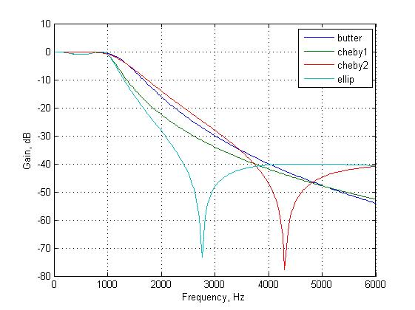
(自学)

Slide 45
9.2 The Design Methods of IIR Filter
The core idea of design this kind of filter is to convert an analog transfer function H_{a}(s) into a digital one G(z).
There are two common methods:
(1) The impulse invariance method
(Problem9.6—P.520)
(2) The bilinear transformation method
(9.2—P.494)

Slide 46

Supplement: The Impulse Invariance Method
The Main Idea:
If a prototype causal analog transfer function H_{a}(s) is wanted, and its impulse response is h_{a}(t), the impulse response of the digital transfer function G(z) satisfies:
x
a
(
t
)
y
a
(
t
)
h
a
(
t
)
x
(
n
)
=
x
(
nT
)
y
(
n
)
=
y
(
nT
)
a
a
g
[
n
]
=
h
(
nT
)
a
(了解)

Slide 47
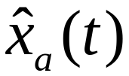
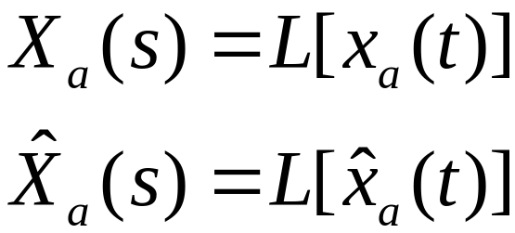
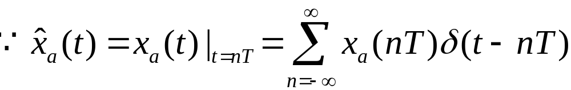
The Relationship Between ZT and LT
LT - used in continuous signal analysis
ZT - used in discrete signal analysis
Given continuous signal x_{a}(t) , sampled signal , their LT are:
(了解)

Slide 48
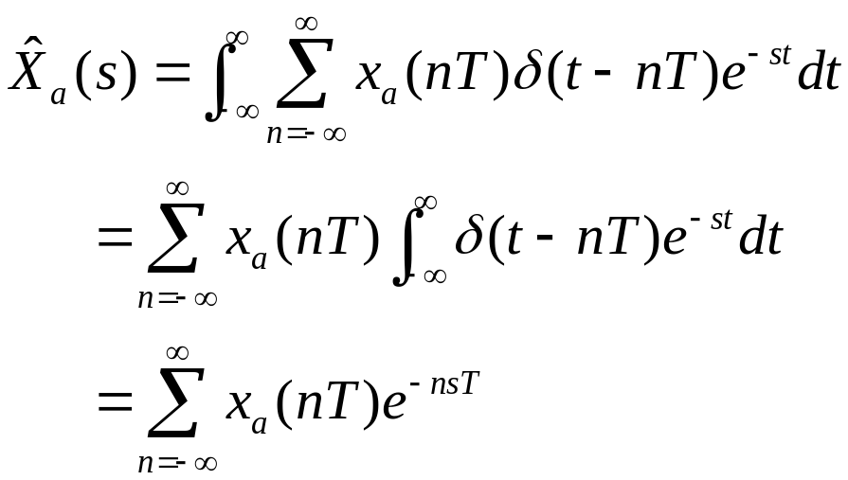

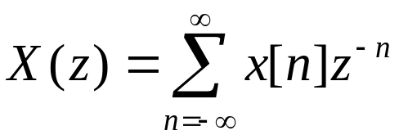


The ZT of the sampled sequence
So we can see: when , ZT=LT.
The relationship between them is a kind of mapping from s-plane to z-plane.
(了解)

Slide 49
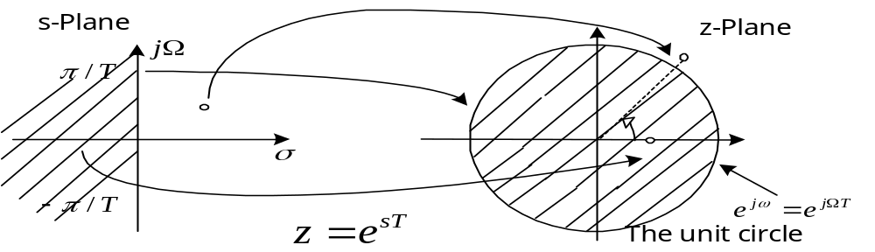
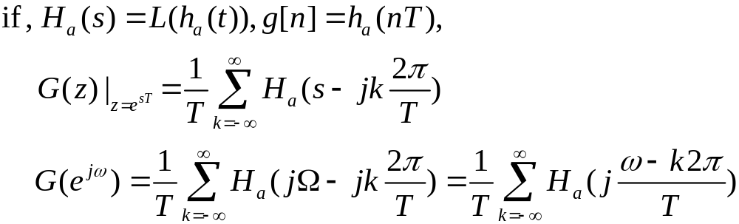

(了解)

Slide 50
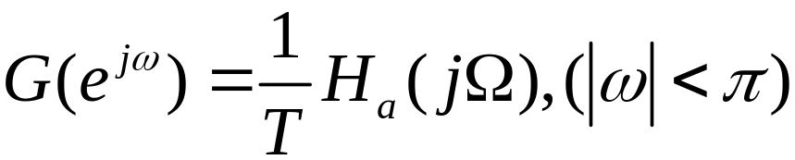



Discussion:
The mapping satisfies the essential properties ( jΩ-axis mapped onto the unit circle, stable region in s-plane mapped into the stable region in z-plane).
The relation of the normalized angular frequency ω and the analog angular frequency Ω is ω= ΩT .
when Nyquist theorem is satisfied,
If is not band-limited , obtained by this method is overlapped in frequency-domain.
(了解)

Slide 51





The Design Steps:
(1)Expand H_{a}(s) into partial-fractional:
(2)Based on , we can get:
Proof:
(了解)

Slide 52




(3)Usually, we scale T to , and get:
∵From equation:
We can see the frequency response is inverse proportion of T. So we should amend it by:
(了解)

Slide 53

Discussion: Ha(s) and G(z)
The single pole s_{k} in s-plane mapping into the single pole z=e^{skT} in z-plane.
They both have the same coefficients A_{k} .
If the analog filter is stable, that is Re[s_{k}]<0 , then after conversion, the poles meet:|e^{skT}|<1, so the digital filter is stable.
The impulse invariance method only ensure relationship of the poles between s and z-plane; but for zeros, they don’t exist.
(了解)

Slide 54



Using the impulse invariance method, we get:
Example
If , the sampling period is T.
Then:
(了解)

Slide 55




Note： is overlapped in the frequncy-domain.
When T=1，
(了解)

Slide 56










9.2.1 The Bilinear Transformation
Transformation theory:
For conquering the effect of multi-value mapping from s to z-plane, we want to find a new mapping:
0
0
-1
0
1
s-plane
-plane
z-plane
(掌握)

Slide 57



The Bilinear Transformation Method
The bilinear transformation from s to z-plane:
So, The relation between G(z) and H_{a}(s) is :
Note: the parameter T has no effect on the expression for G(z), and we can choose T=2 to simplify the design procedure.
(掌握)

Slide 58


Discussion:
Inverse bilinear transformation for T=2 is:
For s=σ₀+jΩ₀
Thus, σ₀= 0 → |z| = 1
σ₀< 0 → |z| < 1
σ₀> 0 → |z| > 1
This mapping also satisfies the essential properties.
(掌握)

Slide 59



For z=e^{jω} with T = 2 we have:
So, Ω = tan(ω/2)
This introduces a distortion in frequency axis called frequency wrapping.
(掌握)

Slide 60





Thus, we must first prewarp the critical bandedge frequencies
and to find their analog equivalents and by using following equation:
Ω = tan(ω/2)
(掌握)

Slide 61
The design steps:
(1) Prewarp (ω_{p}, ω_{s}) to find their analog equivalents (Ω_{p}, Ω_{s});
(2) Design the analog prototype filter H_{a}(s);
(3) Obtain the digital filter G(z) by applying bilinear
transformation to H_{a}(s);
Bilinear transformation preserves the magnitude response of analog filter only if piecewise constant magnitude.
Bilinear transformation does not preserve phase response of analog filter.
(掌握)

Slide 62


9.2.2 Design of Low-Order Digital Filters
Example – Consider:
Applying bilinear transformation to the above we get the transfer function of a first-order digital lowpass Butterworth filter
(掌握)

Slide 63


Design of Low-Order Digital Filters
Rearranging terms we get:
where
(掌握)

Slide 64


Design of Low-Order Digital Filters
Consider the second-order analog notch transfer function:
where |H_{a}(jΩ₀)| = 0 and |H_{a}(j0)| = |H_{a}(j∞)| = 1
Ω₀ is called the notch frequency
If |H_{a}(jΩ₂)| = |H_{a}(jΩ₁)| = then B = Ω₂ - Ω₁ is the 3-dB notch bandwidth
(掌握)

Slide 65


Then
where
(掌握)

Slide 66
Example - Design a 2nd-order digital notch filter operating at a sampling rate of 400 Hz with a notch frequency at 60 Hz, 3-dB notch bandwidth of 6 Hz
  Thus ω₀ = 2π(60/400) = 0.3 π
  B_{w} = 2π(6/400) = 0.03 π
  From the above values we get:
α = 0.90993
β = 0.587785
(掌握)

Slide 67



Thus
The gain and phase responses are shown below
(掌握)

Slide 68





9.3 Design of Lowpass IIR Digital Filters
Consider G(z) with a maximally flat magnitude , with a passband ripple not exceeding 0.5dB; , with the minimum stopband attenuation at the stopband edge frequency is 15dB.
Base on this requirement, if we get:
(掌握)

Slide 69







1. The Bilinear Transformation Method
(1) Prewarpping:
(2) Design the prototype analog filter H_{a}(s)
passband ripple 0.5dB
stopband attenuation 15dB
(掌握)

Slide 70


The least order of Butterworth LPF is: N=3
Using Eq.(A.8), we get the 3-dB cutoff frequency:
The third-order normalized lowpass Butterworth transfer function with Ω_{c}=1 is:
(掌握)

Slide 71



Then the denormalized lowpass Butterworth TF is:
(3) Design the digital filter G(z) by applying bilinear transformation
to H_{a}(s):
(掌握)

Slide 72



2. The Impulse Invariance Method
The third-order lowpass Butterworth transfer function which has 3-dB frequency at is:
We can get the poles and represent it as
(了解)

Slide 73




It is partial-fractional expressed as:
Then we get digital transfer function as:
(了解)

Slide 74

Finally,
Discussion:
Magnitude and gain responses of G(z) derived by The Impulse Invariance Method and The Bilinear Translation Method are shown below:
(了解)

Slide 75


Slide 76






Ex: Use a IIR digital filter to implement a Butterworth 3rd-order LPF with
sampling interval , cutoff frequency: .
① Determine normalized frequency
② Determine normalized cutoff frequency
③ Prewarping frequency to find the equivalent analog cutoff frequency
④ Choose the analog prototype filter
(掌握)

Slide 77







Determine the transfer function of the desired digital filter using the bilinear
transformation
⑥ Choose filter structure
1/6
x[n]
y[n]
3
-1/3
3
(掌握)

Slide 78
9.4 Design of Highpass, Bandpass and Bandstop IIR Digital Filters
There are two approaches as follows:
Design other type analog filters firstly, then transform it
into digital ones : Step1→Step5
(2) Design digital lowpass filter firstly, then transform it into
other type digital filters: Step1→Step5
Please look at P.501 to learn the detailed design procedure.
(理解)

Slide 79
9.5 Spectral Transformations of IIR filters
Solving: to modify the characteristics of a filter to meet the new
specifications without repeating the filter design procedure.
There are several conditions:
(1) Lowpass-to-lowpass transformation.
(2) Other transformation.
Please look at P.509 Table 9.1 to learn the detailed design procedure.
(理解)

Slide 80
9.6 IIR Digital Filter Design Using MATLAB
Order Estimation:
buttord, cheb1ord, cheb2ord, ellipord
Filter Design:
butter, cheby1, cheby2, ellip
Filter Test: freqz
Spectral Transformations:
iirlp2lp, iirlp2hp, iirlp2bp, iirlp2bs
bilinear
(自学)

Slide 81
(1) Determine filter order N, frequency scaling factor Wn.
[ N, Wn ] = buttord ( Wp, Ws, Rp, Rs )
[ N, Wn ] = cheb1ord ( Wp, Ws, Rp, Rs )
[ N, Wn ] = cheb2ord ( Wp, Ws, Rp, Rs )
[ N, Wn ] = ellipord ( Wp, Ws, Rp, Rs )
(自学)

Slide 82
(2) Determine the coefficients of the transfer function.
[ b, a ] = butter ( N, Wn )
[ b, a ] = cheby1 ( N, Rp, Wn )
[ b, a ] = cheby2 ( N, Rs, Wn )
[ b, a ] = ellip ( N, Rp, Rs, Wn )
(自学)

Slide 83
Example 9.3
Design of a Type 1 Chebyshev IIR digital highpass filter, Specifications:
F_{p}=700Hz, F_{s} = 500Hz,
α_{p}=1 dB, α_{s}=32dB, F_{T}=2 kHz
Normalized angular bandedge frequencies
ω_{p} =2πF_{p}/ F_{T}= 2π×700/2000=0.7π
ω_{s} = 2πF_{s}/ F_{T}= 2π×500/2000=0.5π
(自学)

Slide 84


Prewarping these frequencies we get
For the prototype analog lowpass filter choose Ω_{p} = 1
Using , we get Ω_{s} = 1.9626105
Analog lowpass filter specifications:
Ω_{p} = 1, Ω_{s} = 1.926105 , α_{p}=1 dB, α_{s}=32 dB
(自学)

Slide 85
MATLAB code fragments used for the design
[N, Wn] = cheb1ord(1, 1.9626105, 1, 32, ‘s’)
[B, A] = cheby1(N, 1, Wn, ‘s’);
[BT, AT] = lp2hp(B, A, 1.9626105);
[num, den] = bilinear(BT, AT, 0.5);
Using cheby1 design HP filter directly:
  Wp=0.7; Ws=0.5;
  Rp=1; Rs=32;
  [N,Wn] = cheb1ord(Wp, Ws, Rp, Rs);
  [b,a] = cheby1(N, Rp, Wn,‘high’);
(自学)

Slide 86
Digital Filter Design Using FDATool
Digital Filter Design Specifications
Introduction to FDATool
FIR & IIR Filter Design with FDATool
Mooc 内容（自学）

Slide 87

Introduction to FDATool
FDATool is a MATLAB toolbox that helps design digital filters in a visual manner
FDATool can be used to design various filters, such as
  FIR low-pass, high-pass, band-pass and band-stop filters
  IIR low-pass, high-pass, band-pass and band-stop filters
Type “fdatool” in the MATLAB command window to start TDATool
Mooc 内容（自学）
Notes:
*

Slide 88

Mooc 内容（自学）
Notes:
*

Slide 89



FIR Digital Filter Design
Example 1: Design an FIR lowpass filter with the specifications
Mooc 内容（自学）
Notes:
*

Slide 90



FIR Digital Filter Design
Example 2: Design an FIR highpass filter with the specifications
Mooc 内容（自学）
Notes:
*

Slide 91



IIR Digital Filter Design
Example 3: Design an IIR lowpass filter with the specifications
Mooc 内容（自学）
Notes:
*

Slide 92



IIR Digital Filter Design
Example 4: Design an IIR highpass filter with the specifications
Mooc 内容（自学）
Notes:
*

Slide 93
Homework:
9.2, 9.4, 9.9(a), 9.10(a),9.11(a), 9.12, 9.14,9.16,9.30
M9.1, M9.5, M9.8

