Slide 1
Chapter 2 Vector Analysis
Wuqiong Luo

Slide 2
Contents
2.1 Vector algebra
2.2 Orthogonal Coordinate Systems
2.3 Gradient of a Scalar Field
2.4 Divergence of a Vector Field
2.5 Curl of a Vector Field
2.6 Solenoidal and irrotational fields
2.7 Laplacian Operations
2.8 Helmholtz’s Theorem

Slide 3
2.1 Vector Algebra
1. Scalars and Vectors
Scalar：A quantity has only magnitude (Length, area, volume, temperature, density, energy…).
Vector：A quantity has both magnitude and direction (Force, displacement, velocity, acceleration, electric field intensity, magnetic field intensity…).
Fields：The distribution of a quantity in space will constitute a field. Hence, there are scalar fields and vector fields.

Slide 4
Vector algebra
1. Scalars and Vectors
Graphical representation of Vector：
A segment of a directed straight-line.
Algebraic representation ：
Magnitude
of Vector：
Vector A
Unit Vector：
Constant Vector：with constant magnitude and fixed direction.
Thinking： Unit Vector = Constant Vector ?

Slide 5
Vector algebra
Vector in Cartesian Coordinates
z
y
x

Slide 6
Vector algebra
2. Algebraic operation of vectors
（1）Addition and Subtraction of Vectors
Commutative law
Addition
Associative law
Subtraction

Slide 7
Vector algebra
（2）A vector multiplied by a scalar
（3）Scalar product (dot product)
θ
Angle
——Commutative law

Slide 8

Vector algebra
（4）Vector product (cross product)
In components:
In determinant:
AB
sin
θ
θ
X
If ,then

Slide 9
Vector algebra
（5）Vector Operations
—— Distributive law
—— Distributive law
—— Scalar triple product
—— Vector triple product
Prove them after class

Slide 10

Exercise：
1. Result in value
2. Result in graph
1. Express in three components
2. Express in magnitude and phase

Slide 11
2.2 Orthogonal Coordinate Systems
1. Cartesian Coordinates
z
z
=
z
0
（plane）
Variable
P
Unit vector
o
点
P(x₀,y₀,z₀)
Position
y
y
=
y
0
（plane）
Line element
x
x
=
x
0
（plane）
Surface element
z
d
z
d
x
o
d
y
y
Volume element
x

Slide 12
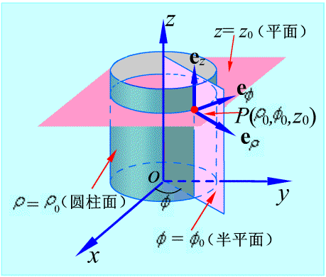
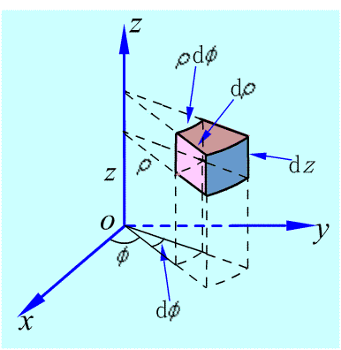
Vector algebra
2. Cylindrical Coordinates
Variable
Unit vector
Position
Line element
Surface element
Volume element

Slide 13
Operation in cylindrical coordinate systems

Slide 14
Exercise：
E.g. Calculte the integral of function f along the side surface of a cylinder with radius of 1, and height of h, where 。

Slide 15
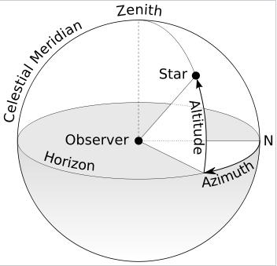
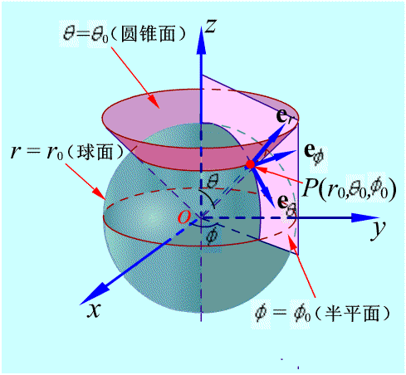
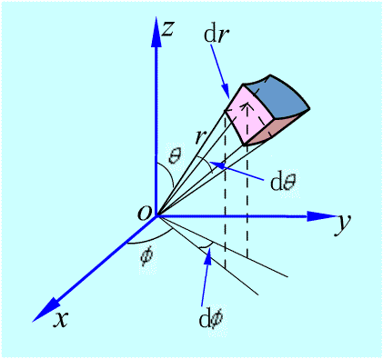
Vector algebra
3. Spherical Coordinates
Variable
Unit vector
Position
Line element
Surface element
Volume element

Slide 16
Exercise：
E.g. Calculte the integral of function f on the surface of a sphere with radius of 1, where

Slide 17
Vector algebra
4. Relationships
y
Cartesian
and
Cylindrical
φ
φ
Unit circle
o
x
Cartesian and cylindrical
Cylindrical
and
Spherical
z
θ
θ
Cartesian
and
Spherical
θ
Unit circle
o
ρ
Cylindrical and spherical

Slide 18
Notes:
Cartesian system: usually applied in the questions with surface symmetry, e.g., infinitely large surface
Cylindrical coordinates system: usually applied in the questions with axial symmetry, e.g., the field near to a charged long line.
Spherical coordinates system: usually applied in the questions with point symmetry, e.g., the field due to a point charge.

Slide 19
2.3 Gradient of a Scalar Field
Scalar field and Vector field
A field is a spatial distribution of a quantity, which may or may not be a function of time.。
If the quantity is a scalar，it is called scalar field;
Ex.：Temperature、Potential、Altitude…
If the quantity is a vector，it is called vector field;
Ex：Velocity of flow、Gravity、Electric、Magnetic…
If it is a function of time, it is called a time-varying field; otherwise it is called a static field.
Expression for static field ：
Expression for time-varying field ：

Slide 20
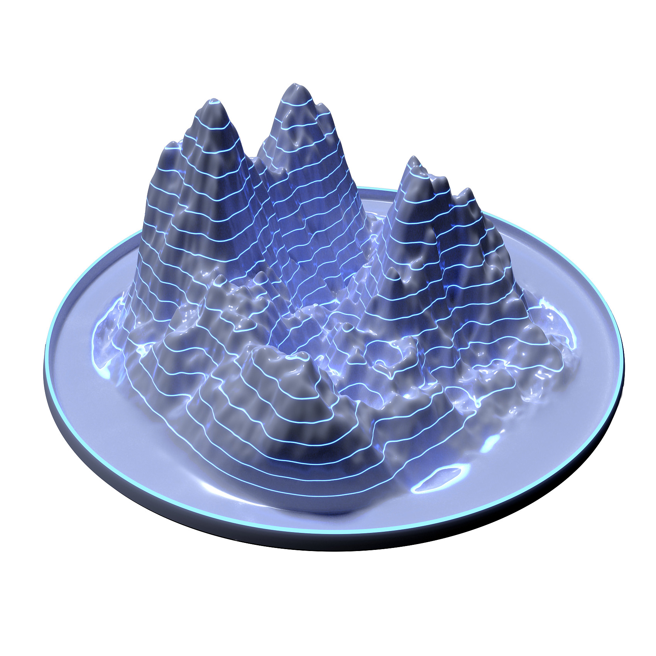
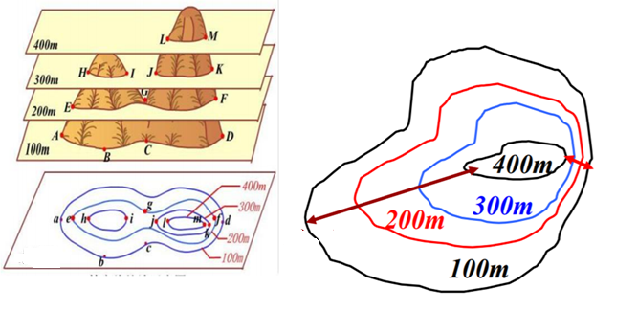
Radar1
Target
Radar 3
Radar 2
Quickly changed
Slowly changed

Slide 21
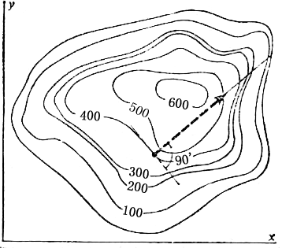
Level surface
Level surface: Surface on which the scalar function is equal to a constant;
It describes the distribution of physical quantities in space visually.
Equation：
Level surface (line)
Characteristics：
When the constant C take a series of different values, a series of different level surfaces will be obtained, forming the level surface family;
These surfaces fill up all the space of the scalar field；
These surfaces cannot intersect with each other.

Slide 22
2. Directional derivative
—— is directional cosines
Directional derivative: describes the spatial rate of change of a scalar field;
—— u(M) increases along line；
M₀
—— u(M) decreases along line;
M
—— u(M) with no change;
Characteristics：directional derivative is related to M₀ as well as line direction.
Q：What is the maximum spatial rate of change and where?

Slide 23
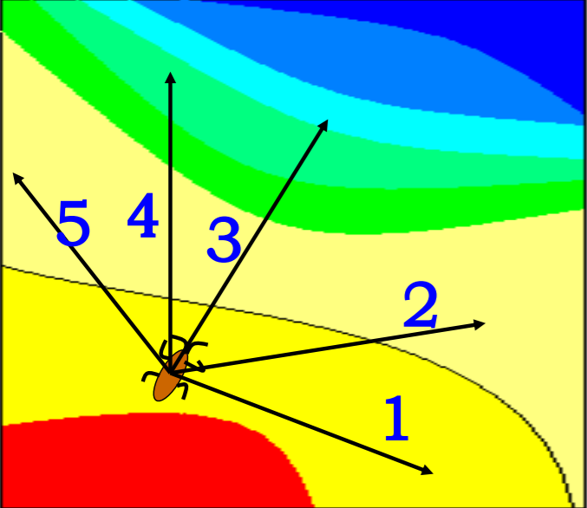
Q：which direction is the best way to skip?
Q：which direction we get the maximum change?
Gradient

Slide 24
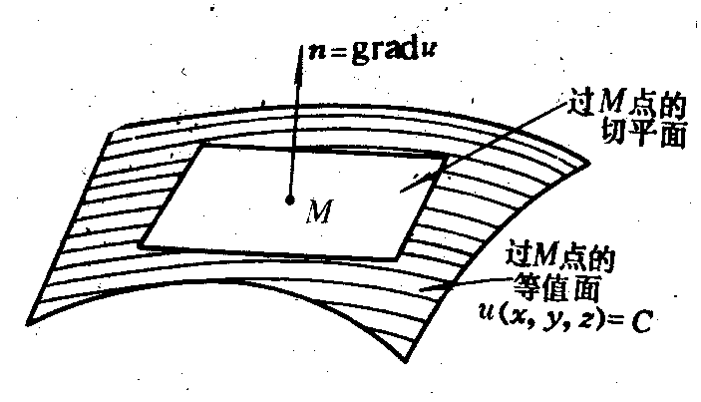
3. Gradient of a scalar field （ or gradu ）
Gradient of a scalar field is a vector;
Describe the maximum spatial rate of change of the scalar field at a point, and the direction of maximum value;
Direction of a gradient at some position is perpendicular to the level surface of the scalar field at the position.
The directional derivative at a position is the projection of the gradient at this position.

Slide 25
Expression of gradient：
Cartesian
Coordinates:
Cylindrical
Coordinates:
Spherical
Coordinates:
Basic equations：

Slide 26
Example1
Give a scalar ϕ (x,y,z) = x²＋y²－z, find:
(1) the gradient of ϕ at the point P(1,1,1),
and the unit vector of that gradient;
(2) the directional derivative of ϕ along the unit vector:
then compare the results and draw a conclusion.
Solution: (1) from the expression of gradient:

Slide 27
The unit vector of the gradient:
(2) from the relationship of the directional derivative and gradient, the directional derivative along the e_{l}:
For a certain point, the value of the directional derivative:

Slide 28
However the gradient of that point is:
Obviously， describe the maximum value of ϕ at the point P, the maximum directional derivative, so always is:

Slide 29
Exercise：

Slide 30
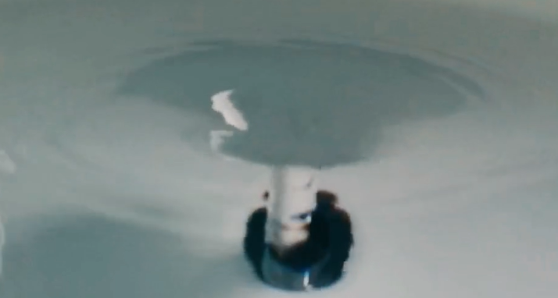
2.4 Flux and divergence of a vector field
Concept：the tangent direction of each point represents the direction of the vector field.
【浴缸放水竟产生有趣漩涡】 https://www.bilibili.com/video/BV1sd4y1J7nV/?share_source=copy_web&vd_source=c775de3b4c88257d02639e487d4cbec4

Slide 31
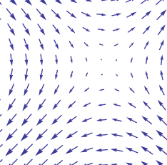
1. Vector line
Describe the distribution of the vector field visually
M
O
Vector line
Vector line equation：

Slide 32
2. Flux of a vector field
Q：How to quantitatively describe the size of the vector field？Flux;
and：
Surface element
—— surface element；
——The normal unit vector of surface element；
—— the flux through ds.
If the surface S is closed，the direction of S is outward, the flux of the vector field on the closed surface is:

Slide 33
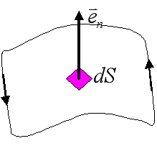

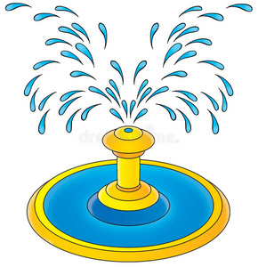
About surface element:
1. What is surface element?
A surface surrounded by a closed line/curve
Its area is small
Its direction is , it is orthogonal to the area
2. How to decide ?
For un-enclosed surface, it obeys RHR
For closed surface, outward

Slide 34
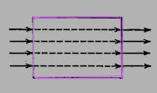
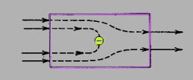

The physical meaning of flux
three kinds of possible results:
The vector line are equally in and out
The remained vector line goes in to the closed surface
The remained vector line is out from the closed surface
Flux on the closed surface build the relationship between the flux of a vector field on a closed surface and the source which produce the field.

Slide 35
3. Divergence of a vector field
Definition：the net outward flux of a per unit volume as the volume about the point tends to zero.

Slide 36
Expression of divergence in
Cartesian coordinates

Slide 37

Deduction the expression of divergence in Cartesian coordinates
let the volume element ΔV enclosed point P to be a cube, and the field at P is F(x₀, y₀, z₀). Using the expansion of Taylor series:
z
Δ
z
P
Δ
x
Δ
y
o
y
x
In Cartesian coordinates
The flux flowing out from the surface elements (both front and back surfaces)
and
is:

Slide 38
For the same reason，flux through other surface elements could be obtained, then：
According to the definition of divergence：

Slide 39
The expression of divergence：
Cartesian
Coordinates:
Cylindrical
Coordinates:
Spherical
Coordinates:
The related formulas of divergence：

Slide 40
Exercise：

Slide 41
4. The divergence theorem
The relationship between flux and divergence：
V
S
S₁
S₂
e_{n2}
e_{n1}
Subdivided volume

Slide 42
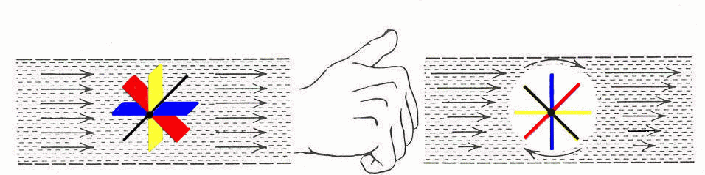
2.5 Circulation and curl of the vector field
Circulation and vortex source of the vector field

Slide 43
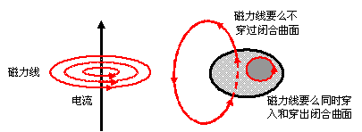
The relationship between the circulation and the current of the magnetic field：
Magnetic induction
line through the surface
Magnetic
induction
line
Or Magnetic induction line
also runs in and out of the surface

Slide 44
The definition of circulation：
the circulation of a vector field around a closed path is defined as the scalar line integral of the vector over the path.
dl is the tangential direction of the line with much small length.
If circulation is non-zero, there exists some vortex source on the surface bounded by C。

Slide 45
2. Curl of a vector field（ ）
（1）Circulation area density
Circulation of closed curve around the unit surface element boundary:
Known as the circulation area density of vector field at the point M along the direction of
Characteristic：The value is related to the direction of point M.

Slide 46
The circulation area density of surface element at any orientation, is the projection of the maximum circulation area density at that point:
（2）Curl of a vector field

Slide 47
Expression of 、 、 in Cartesian coordinates
deduction:
z
3
C
4
M
2
Δz
Δy
1
o
y
x

Slide 48
Then
So
and

Slide 49
The calculation formula of curl:
Cartesian
Coordinates:
Cylindrical
Coordinates:
Spherical
Coordinates:

Slide 50
Exercise：

Slide 51
The relevant formula of curl：
The divergence of a vector’s Curl is zero
The curl of a scalar’s gradient is zero

Slide 54
3. Stokes's Theorem
The relationship between the circulation and rotation：
Equally results in the opposite direction, will be cancelled by each other.
Surface subdivision

Slide 55
4. The difference of divergence and curl

Slide 56
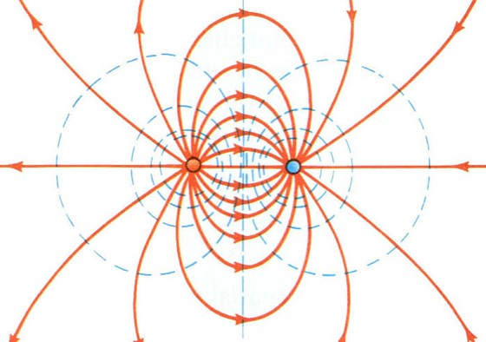

Slide 57
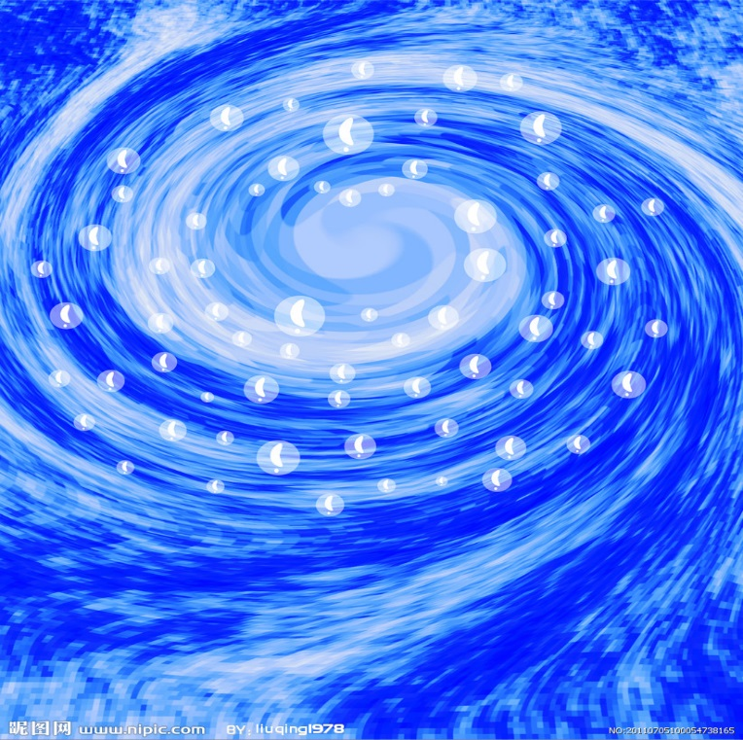
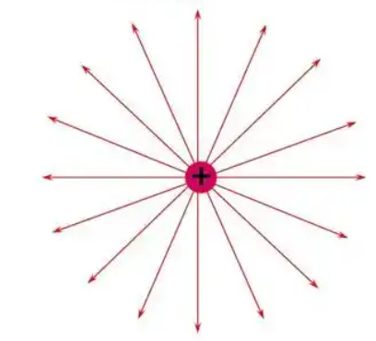
2.6 Irrotational field and solenoidal field
1. Sources of vector field
Divergence source
Vortex source

Slide 58
2. Classification of the vector field according to the field sources
（1）Irrotational field
Vector field has only divergence source without curl source:
， line integral independent with path，a conservative field。
Irrotational field can be expressed using the gradient of a scalar field:
Example：Electrostatic field

Slide 59
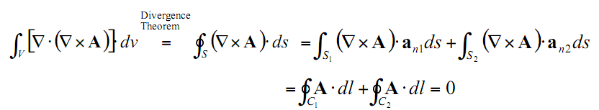
（2）Solenoidal field
Vector field has only curl source without divergence source:
Feature：
Solenoidal field: can be expressed as the curl of another vector field
Example: Static magnetic field

Slide 60
（3）Irrotational and solenoidal field
(Source is outside the discussed region)
（4）Normal field neither solenoidal nor irrotational
This field can be decomposed into two parts：irrotational part and solenoidal part;
Irrotational part
Solenoidal part

Slide 61
2.7 Laplacian operation
Scalar laplacian
operation
—— Laplasse
operation
Equation：
Cartesian
Coordinates:
Cylindrical
Coordinates:
Spherical
Coordinates:

Slide 62
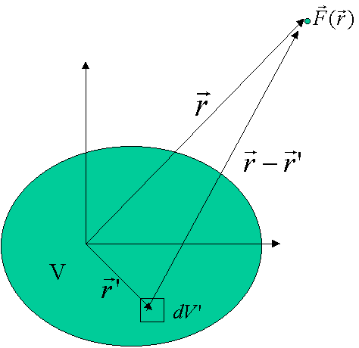
2.8 Helmholtz’s Theorem
Helmholtz’s Theorem:
In an unbounded region, a vector field is determined to within an additive constant if both its divergence and its curl are specified everywhere：
Where ：

Slide 63
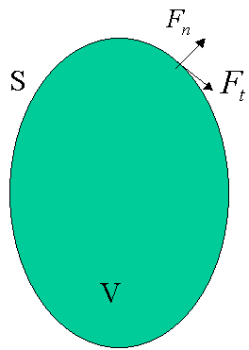
Vector field confined within a region bounded by a surface, is determined if its divergence and curl throughout the region, as well as the normal component of the vector over the bounding face, are given.
Bounded area

Slide 64
Homework
2-1, 2-2, 2-5, 2-9, 2-17, 2-20, 2-23, 2-26, 2-29, 2-32, 2-34

