Slide 1
Chapter 3 Static Electric Fields
Wuqiong Luo

Slide 2
Contents
3.1 Introduction
3.2 Fundamental Postulates of Electrostatics in Free Space
3.3 Coulomb’s Law
3.4 Gauss’s Law and Applications
3.5 Electric Potential
3.6 Conductors in Static Electric Field
3.7 Dielectrics in Static Electric Field
3.8 Electric Flux Density and Dielectric Constant
3.9 Boundary Conditions for Electrostatic Fields
3.10 Capacitance and Capacitors
3.11 Electrostatic Energy and Forces

Slide 3

3
3.1 Introduction
Fundamental Physical Quantities：Source；Field
Source：Charge , Current
Charge
Current
Movement
Electric Field
Magnetic field
What is the model for charge?

Slide 4

4
1. Charge and Charge Density
• Charge is one of basic elements of substance
• In 1897, Joseph John Thomson found charge in experiment in Britain.
• Between 1907 — 1913，Robert Andrews Millikan precisely measured the charge of electron through Oil Drop experiment, the charge is:
e =1.602 177 33×10⁻¹⁹ (Unit：C )

Slide 5
5
2. Form of the existed Charge（Four）：
Volume Charge、Surface Charge、Line Charge、Point Charge
(1). Volume Charge Density
Unit：C/m³
Relation between total charge q and density：

Slide 6
6
(2). Surface Charge Density
Unit: C/m²
If the surface charge density on a certain surface is known, the total charge q on this surface is:

Slide 7
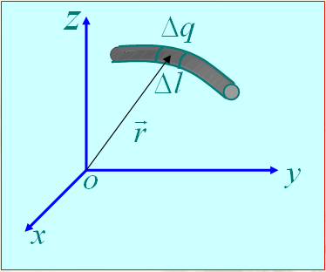
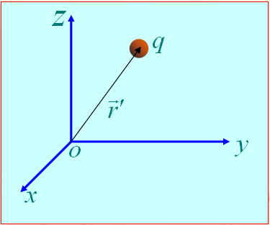
7
(3). Line Charge Density
Unit: C / m
If the line charge density on a certain line is known, the total charge q on this line is:
(4). Point Charge
The density of
point charge
Unit point charge: volume→0; density →∞,
volume·density=1
Delta function: the density of unit point charge

Slide 8
3.2 Fundamental Postulates of Electrostatics in Free Space
Distributions of electric field lines
⊕

⊕
⊕
⊕
⊕
⊕
Electric field tube
A positive
point charge
A negative
point charge





Two parallel
charge plates

Slide 9
3.2 Fundamental Postulates of Electrostatics in Free Space
Electric field intensity and Electric Flux
Electric field intensity is defined as the force per unit charge
The flux of the electric field intensity through a surface is called electric flux, and it is denoted as , given by Ψ, i.e.

Slide 10
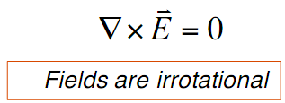
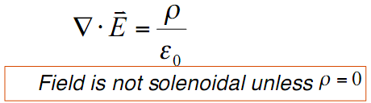
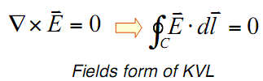
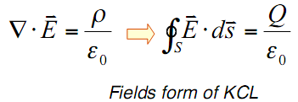
Two Fundamental Postulates of Electrostatics in Free Space
where is the volume charge density of free charges (C/m3), and is the permittivity of free space, universal constant.
Two postulates are concise, simple, and independent of any coordinate system; and they can be used to derive all other relations, laws and theorems in electrostatics!
Their integral form can be obtained by using Stokes theorem and Divergence theorem as

Slide 11
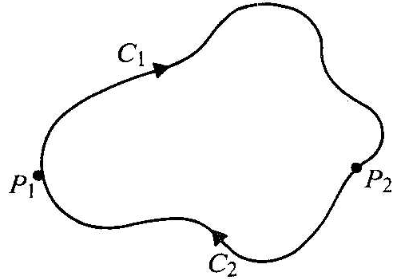
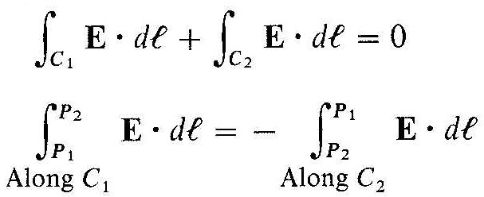
Gauss’s law: the total outward flux of the electric field intensity over any closed surface in free space is equal to the total charge enclosed in the surface divided by
The scalar line integral of the static electric field intensity around any closed path vanishes. It is independent of the path; it depends only on the end points.
Q: What is the difference between integral form and Differential form?

Slide 12
12
Conclusion
Divergence of electrostatic field （ Differential form ）
Flux of electrostatic field
Gauss' law （ Integral form ）
Curl of electrostatic field
Circulation of electrostatic field（ Integral form ）
Curl of electrostatic field （ Differential form ）
Conclusion ：
Electrostatic field is irrotational and conservative, so the work of electric field forces has nothing to do with the path;
Electrostatic field is radical, starts from positive charges and ends to negative charges.

Slide 13
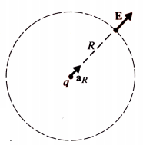
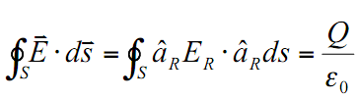


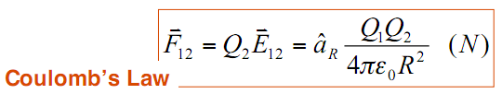
3.3 Coulomb’s Law
A single point charge, Q, sits in origin of a boundless free space, its E field must be everywhere radial and has the same intensity at all points on the spherical surface.
Therefore,
When a point charge Q2 is placed in the ﬁeld of another point charge Q1 at the origin, a force F12 is experienced by Q2 due to electric field intensity E12 of Q1 at Q2
The permittivity of air is essentially the same as that of the free space:

Slide 14
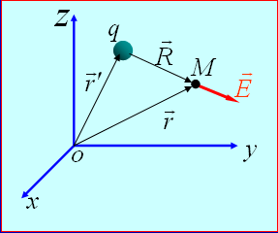
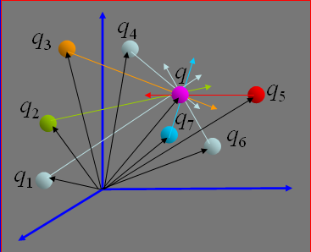
If a single point charge, Q, sits in an arbitrary location of a boundless free space, its E field would be:
Electric field created by a group of n discrete point charges q₁, q₂,… q_{n}, The principal of superposition applies:
Q: What if the charges are continuous distributed?

Slide 15
15
Electric field intensity generated by volume distribution charges whose volume density is
Electric field intensity generated by surface distribution charges whose surface density is
Electric field intensity generated by line distribution charges whose line density is

Slide 16
16
Electric field intensities of several typical charge distributions
Electric field intensity of uniformly charged straight line segment：
(finite)
uniformly charged straight line segment
(infinite)
Electric field intensity of uniformly charged ring：
uniformly charged straight ring

Slide 17
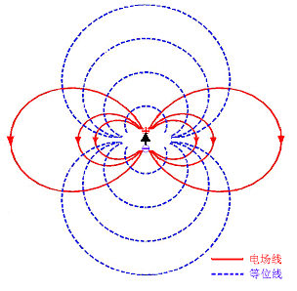
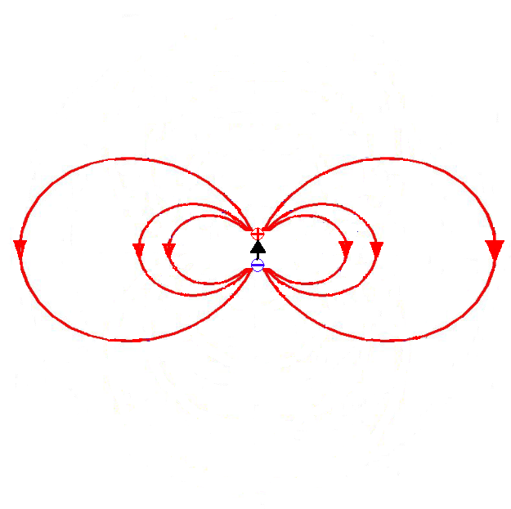
The electric field intensity in far field produced by an electric dipole.
where (electric moment), and thedirection of is from negtive charge to the positive charge
z
r₁
+q
⊕
r
θ
l
O
r₂
y
x

-q
Electric field lines
Electric field lines
Equipotential surfaces

Slide 18
Example 1 Find the electric field intensity caused by a line charge with length L and charge density .
Solution: Let the z-axis of a cylindrical coordinate system coincide with the line charge and the mid point of the line be at the origin.
Since it is rotationally symmetrical, the field is independent of the angle φ .
It is impossible to apply Gauss’ law to calculate the field because the direction of the electric field intensity cannot be found out in advance. We have to evaluate directly the electric potential and the electric field intensity.

Slide 19
Establish the Cartesian Coordinates so that field point M is on the surface passing through the origin point and perpendicular to z-axis
Considering
We have

Slide 20
If the length L → ∞ , then θ₁ → 0, θ₂ → π and
This result is the same as that of Example 3.

Slide 21
21
Example 2 Calculate the electric field intensity at arbitrary point on the axis of uniformly charged circular thin disc.
Field point：
z
P(0,0,z)
Source point：
r
R
b
a
y
dS
x
uniformly charged circular thin ring
since

Slide 22

3.4 Gauss’s Law and Applications
Gauss’ law follows directly from the divergence postulate of electrostatics by the application of divergence theorem.
Gauss’s law asserts that the total outward flux of the E-field over any closed surface in free space is equal to the total charge enclosed in the surface divided by .
Gauss’s law is particularly useful in determining the E field of charge distributions with some symmetry conditions. On the other hand, when symmetry conditions do not exist, Gauss’s law would not be of much help.

Slide 23
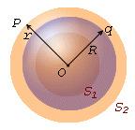
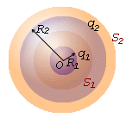
The condition of using Gauss's law to calculate the electric field strength
Condition for simple calculation： can be moved outside from the integral sign, simplified the integral equation to algebra equation.
Under which circumstances， can be move to outside the integral sign？
is uniform distribution on the S！Or integral result is known!
Where can we find this problem?
When the problem is symmetric!
Spherical symmetric distribution ：Including uniformly charged spherical surface ，sphere and multi layer concentric spherical shell etc.
Multi-layer concentric
Spherical shell
Uniformly charged sphere
Charged spherical shell

Slide 24
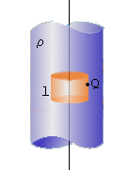
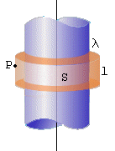
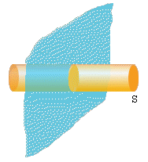
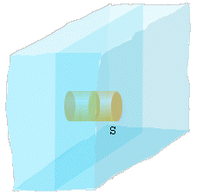
Axial symmetrical distribution ：Such as infinite uniformly charged straight line 、 Cylindrical surface 、 cylindrical shell, etc.
Infinite plane charge ：Such as infinitely large uniform charged plane 、flat, etc.
(a)
(b)

Slide 25
Example 3 Solving the electric field generated by a uniformly charged sphere in vacuum . Known sphere radius is a ，and the charge density is ρ ₀ 。
Solution：（1） Field strength of a certain point outside the sphere
ρ₀
r
r
( r ≥ a )
a
（2） Field strength of a certain point inside the sphere
E
a
r
（r < a）

Slide 26

Discussion
Find the electric field generated by a uniformly charged surface in vacuum
Gaussian surface：Concentric spherical surface with radius of r
0
∝
1
r
2

Slide 27
Understand the discontinuity of E-field on the surface r=R
Find the E-field with
for the uniformly charged shell

Slide 28
Applying surface model is the reason for the discontinuity of E-field on the surface. For real application, the volume charge density should be applied for the accurate calculation.
Thickness
is zero
Thickness
is lagre
Thickness
is small

Slide 29
Example 1 Assume that an infinitely long charged cylinder of radius a is placed in free space. The density of the charge is ρ . Calculate the electric field intensities inside and outside the cylinder.
Solution: Choose a cylindrical coordinate system. Since the cylinder is infinitely long, for any z the environment remain the same. Hence the field is independent of the coordinate variable z.
z
S₁
ρ
L
y
x
Since it is symmetrical about any plane of z = constant, the electric field intensity must be perpendicular to the z-axis, and coplanar with the radial coordinate r.
a
In addition, the cylinder is rotationally symmetrical. Thus the field must be independent of the angle φ .

Slide 30
Construct a cylindrical Gaussian surface of radius r and length L. Applying Gauss’ law, we have
Since the direction of the electric field intensity coincides with the outward normal of lateral surface S₁ of the cylinder everywhere and is perpendicular to the normal to the upper or the lower end faces, the left side of the surface integral becomes
For r < a , the charge , and the electric field intensity is

Slide 31
When r > a, the charge , we have
where can be considered as the charge per unit length, so that the electric field can be thought of as caused by a line charge with density . In view of this we can derive the electric field intensity caused by an infinite line charge with line density as
For this example, it is easy to calculate the electric field intensity using Gauss’ law. If we directly calculate the electric field intensity from the distribution of the charge, it will be very complicated.

Slide 32
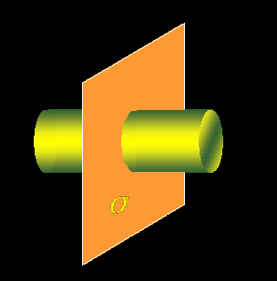
Example 7 Determine the electric field intensity of an infinite planar charge with a uniform surface charge density σ。
The collection of infinite uniform charged straight line
is normal to the infinite planar
How to build the Gaussian surface?

Slide 33
Build the Gaussian surface
Gauss’s Law：
The direction of E depends on the sign of the charge

Slide 34
3.5 Electric Potential
Electric Potential (scalar field)
since
and
We can define a scalar electric potential ϕ such that
Advantage：change the vector problem into scalar problem
The physical meaning of the electric potential ϕ at a point is the amount of work needed to move a unit of positive charge from a reference point to a specific point inside the field without producing an acceleration., Hence
( q is the amount of the charge)

Slide 35
Equipotential surfaces
Equipotential surfaces are the surfaces on which the electric potential are equalized, and the equation is
The electric field lines are perpendicular to the equipotential surfaces everywhere.
The distribution density of equipotential surfaces can indicate the intensity of the electric field.
⊕
⊕
⊕
⊕
⊕
E
⊕
ϕ





Electric field lines
Equipotential surfaces

Slide 36
The relationship between E and ϕ
Find ϕ
Find E
The differential equation of ϕ
In the homogeneous medium
Scalar poisson equation
Charge
Sub-1
When，
Sub-2
Laplace equation

Slide 37
Solve the problem in homogeneous medium using electric potential
With point charge
Point charge: volume→0; density →∞,
volume·density=1
Delta function: the density of unit point charge
Sub

Slide 38
Solve the problem in homogeneous medium using electric potential
With arbitrary charge source：(superposition）
Volume charge source
Surface charge source
Linear charge source

Slide 39
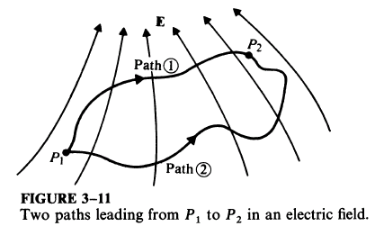
Voltage - potential difference
Potential difference between P1 and P2
Work by the electric force
Q: Choosing different integral path will change the result of voltage?

Slide 40
Potential reference point
Electrostatic potential is not unique, could be different with a constant value;
To determine the potential of a point by choosing a reference point
The potential difference between any two points is independent of the reference point
Choose reference point
Set the reference point as zero potential
Determine the potential
The principle to choose a reference point
The potential expressions is meaningful;
The potential expressions is the simplest;
Only one reference point for one problem.

Slide 41
Example 8 Find the potential and electric field of an electric dipole.
z
Solution: In the spherical system
+q
d
o
－q
Electric dipole
Binomial expansion， ，so
So
is the dipole moment，directed from the negative charge to positive charge

Slide 42
Equipotential line equation：
Differential equation of electric field line：
E-field
Equ-line
So
E-field for dipole

Slide 43
Example 9 Find the potential and electric field of an uniformly charged line with the length of 2L and charge density of .
z
Solution: In the cylindrical system
L
y
x
-L
Choose a proper reference point to determine the C, for example , then C=0

Slide 44
The electric potential produced by the infinite long line charge source
Choose a certain point，for example，ρ= a ，then
How to choose the most
useful reference point？

Slide 45
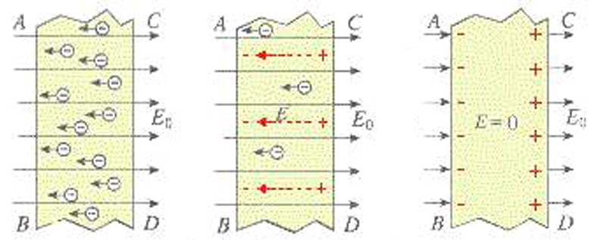
3.6 Conductors in Static Electric Field
Assume a conductor was stationed in a static electric field.
The field will in the conductor exerting a force on the charges and making them move away from one another.
This movement will continue until all the charges reach the conductor surface and redistribute themselves in such a way that both the charge and the field inside vanish.

Slide 46


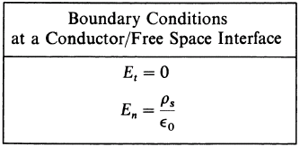
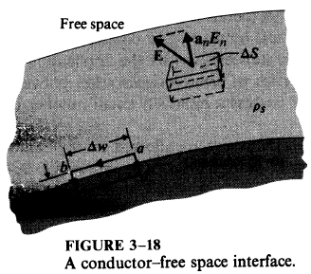
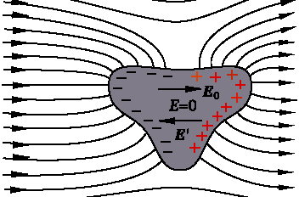
The tangential component of the electric field must be zero.
E field on a conductor surface is everywhere normal to the surface.
The charge distribution on the surface of a conductor depends on the shape of the surface.

Slide 47
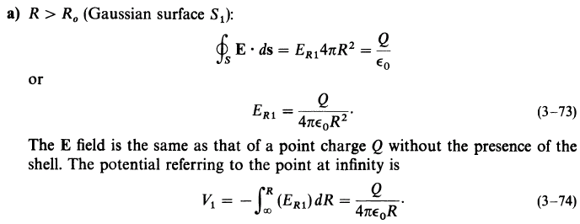
Example 10 A positive point charge Q is at the center of a spherical conducting shell. Determine E and ϕ as functions of the radial distance R.

Slide 48
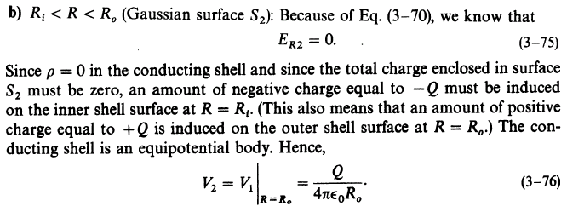

Slide 49
The electric field intensity has discontinuous jumps, while the potential remains continuous;
A discontinuous jump in potential would mean an infinite electric field intensity.

Slide 50
When medium exist in space：
what will happen to the static electric fields produced by the charges?

Slide 51
3.7 Dielectrics in Static Electric Field
Three cases for the EM response：
Polarization: the bound charges in dielectric will be displaced due to the electric fields;
magnetization: macroscopic magnetic moment results under the influence of an external magnetic field;
conduction: the motion of the free electrons by an external E field.
* Parameters：
Dielectric constant (permittivity) ε
Permeability μ
conductivity σ

Slide 52
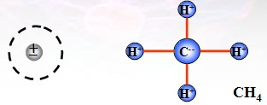

Nonpolar molecules: the centers of the positive and negative charges of an atom overlap each other, dipole moment will be zero. - CO₂ ,H₂ , O₂ , CH₄
Polar molecules: the centers of the positive and negative charges of an atom are separated, have a finite dipole moment. - H₂O, HCl , CO, SO₂

Slide 53
Polarization of dielectrics
1. Phenomenon
⊕
⊕
⊕
⊕
1）With external E field, dielectric will have polarization ：
Nonpolar molecules:
displacement polarization
Polar molecules:
orientation polarization
2）The magnitude of the polarization is determined by the number of electric dipole moments in the medium.


⊕

⊕

⊕
⊕


⊕
⊕




⊕

⊕
⊕
⊕




Nonpolar
Polar
No E field
⊕
⊕
⊕
⊕
⊕
E

⊕



⊕


⊕
⊕
⊕
⊕

⊕

⊕



⊕

⊕

⊕
⊕
⊕
⊕






Nonpolar
Polar
With E field

Slide 54
2. Polarization Intensity
Definition ：the vector sum of the electric
moments per unit volume
⊕
⊕
⊕
⊕
⊕
E

⊕



⊕


⊕
⊕
⊕
⊕

⊕

⊕



⊕

⊕

⊕
⊕
⊕
⊕






Nonpolar
Polar
With E field

Slide 55
Discussion
1）Without E field
Nonpolar molecules：
2）With external E field
and
Polar molecules ：
n is the number of polarized molecules per unit volume
⊕
⊕
⊕
⊕

⊕

⊕
⊕
⊕
⊕
⊕


⊕
⊕
⊕
⊕
⊕
⊕
⊕
⊕










⊕

⊕
⊕
⊕
⊕

⊕


⊕
⊕
⊕
⊕
⊕





⊕


⊕
⊕

⊕
⊕
⊕
⊕
⊕



⊕
⊕




⊕
⊕
⊕

⊕





⊕

⊕
⊕
⊕
⊕
⊕





Nonpolar
Polar
⊕
⊕
⊕
⊕





⊕
No E field





E

Slide 56
Conclusion
1） The magnitude of the polarization intensity is related to the dielectric material.
2） The magnitude of the polarization intensity is also related to the intensity of the applied electric field .
After the polarization, the additional electric field will be generated in the space.
The total electric field in the medium is
Experimental observation shows：
For linear and isotropic media ， is proportional to
in which,
is called the electric susceptibility

Slide 57
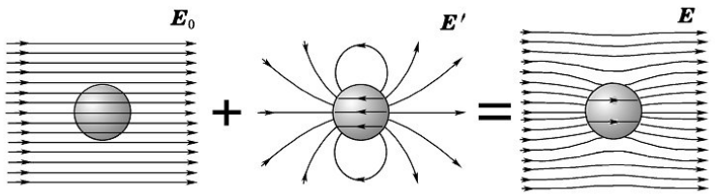
Additional electric field
Inside： the opposite direction with the applied electric field, weaker
Outside：mainly the same direction with the applied electric field, some place stronger and some place weaker

Slide 58
Further discussion
After the dielectric polarization, there might be net charges inside, which is polarized volume charge density .
After the dielectric polarization, net charges might appear on the interface, which is polarized surface charge density .
⊕
⊕
⊕
⊕
⊕
⊕

⊕

⊕
⊕
⊕
⊕



⊕

⊕

⊕

⊕
⊕
⊕



⊕

S

⊕
⊕
⊕

⊕
⊕




⊕
⊕
⊕
⊕



⊕


⊕
⊕
⊕
⊕
⊕





⊕
⊕
⊕
⊕
⊕





⊕
⊕

⊕

⊕
⊕

⊕


⊕






E


Slide 59
Calculation of polarized volume charge density
⊕
⊕

⊕
⊕
⊕

⊕
Principle：each polarized molecules could be considered as a dipole moment, that
⊕
⊕

⊕

⊕

⊕


⊕
⊕

⊕
⊕
⊕



S
⊕
⊕




⊕
⊕
⊕
⊕


⊕

⊕
⊕
⊕




⊕
⊕

⊕
⊕
⊕




⊕
⊕

⊕
⊕
⊕



⊕
⊕


⊕



⊕
⊕
⊕
⊕
As shown in the figure，if the negtive charge is inside of ΔV, the corresponding positive charge is out of it.
⊕


⊕






E

Then the total polarized charge outside of ds with the negative charges of the dipole moments in ΔV is,
Since，

Slide 60
so，
Calculation of polarized surface charge density
On the interface：
⊕
⊕
⊕
⊕
⊕
⊕
⊕

⊕


⊕


⊕
⊕

⊕
⊕
⊕

⊕


⊕

Since，

⊕
⊕



⊕
⊕

⊕

⊕
⊕
⊕
⊕



⊕


⊕
⊕
⊕
⊕


so，

⊕


⊕
⊕
⊕



⊕
⊕


⊕

⊕

⊕
⊕
⊕

⊕


⊕







Discussion: if a medium with two different types of dielectric is placed in a static filed, the polarized surface charge density should be:
n
Dielectric1
Dielectric 2

Slide 61

The total charge of the body after polarization must remain zero

Slide 62
3.8 Electric Flux Density and Dielectric Constant
Q:When there is a medium in space, the polarization charge will generate an additional electric field, which affects the total electric field distribution. When calculate the total field, is it necessary to calculate the additional electric field in advance.
Define Electric flux density :
Unit：C/m²
The total outward flux of the electric flux density over any closed surface is equal to the total free charge enclosed in the surface
So
Integral form

Slide 63
Conclusion
The problem of electrostatic field can be described by the following basic equations in the space of the medium :
（Differential
form ）
（Integral form ）
The process of solving the problem ：
,
,

Slide 64
constitutive relationship :
Dielectric constant
Relative permittivity
（Dimensionless ）
Classification and constitutive relationship of medium
Homogeneous and inhomogeneous media
Isotropic and anisotropic media
Time varying and time invariant medium
Linear and nonlinear media
Deterministic and random media
Dispersive and non dispersive media

Slide 65
For anisotropic dielectrics, the relationship between the electric flux density and the electric field intensity can be written as:
In addition, the permittivity of a homogeneous dielectric is independent of the space coordinates.
The relationship between the electric flux density and the electric field intensity is dependent upon the direction of applied electric field.
The permittivity of linear dielectrics is independent of the magnitude of the electric field intensity.

Slide 66

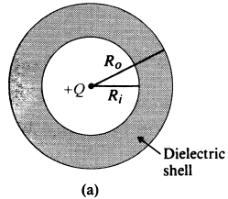
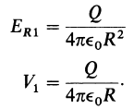
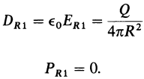
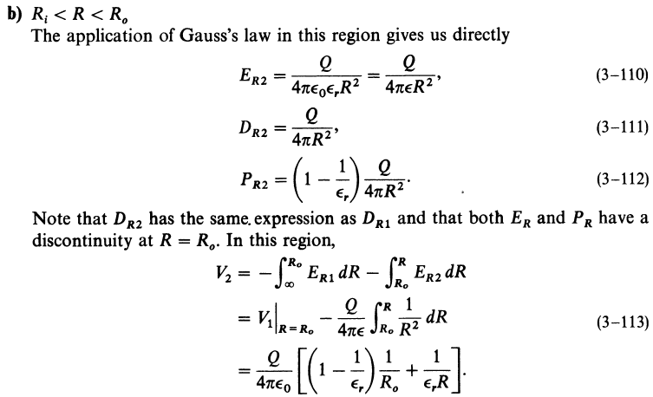

Slide 67

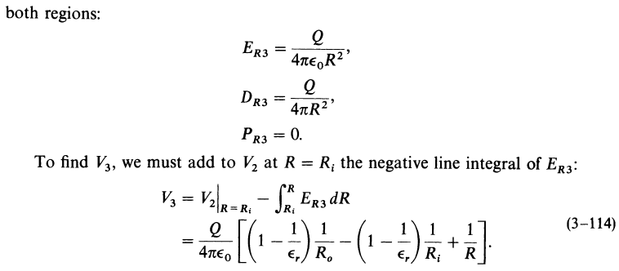

Slide 68
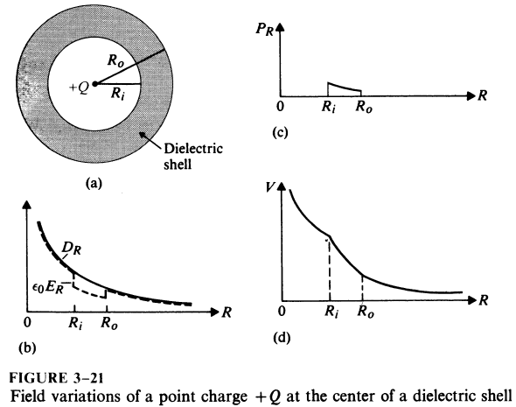

Slide 69
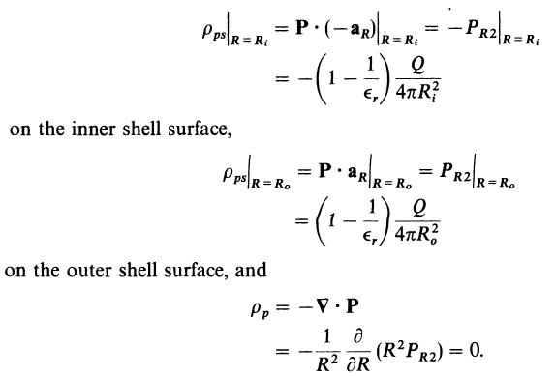
There is no net polarization volume charge inside the dielectric shell.
Negative polarization surface charges exist on the inner surface and positive polarization surface on the outer surface.

Slide 70
3.9 Boundary Conditions for Electrostatic Fields
What is the boundary condition?
Why to study BC?
Sub1
How to discuss BC?
Sub2
A real EM question is come forward in terms of a specific space. The space may be composed by different media. BC outline the relationship that are satisfied by the EM vectors on that boundary surface between any two different media, that is the basic quality for the EM field on the surface of different media.

Slide 71
Physical：due to the abrupt change of the characteristic parameters on the both sides of an interface, the field on the two side will change as well. The integral form of the Maxwell’s equation lost meaning on the both sides of the interface, the BC is necessary.
Mathematics：Maxwell’s equations are integral functions, the solution of them are not determinative, the BC play the role of identify the determinative solution
The integral form of Maxwell’s equation is still suitable for the surface of different media, which is helpful derive the expression of the BC in terms of different media

Slide 72
（1）The tangential directional BC
On the dual sides of the interface of medias, selecting a small loop as the graph herein, and setting Δh →0，Since
Or
The tangential component of an E field is continuous across an interface
Sub1
Sub2

Slide 73
（2） The normal directional BC
Defining a point P on the interface between two medias，and drawing a flat cylinder surface S enclosing the point.
Sub1
S
P
Sub2
Δh→0，then
so
if
or
The normal component of D field is discontinuous across an interface where a surface charge exists;
the amount of discontinuity being equal to the surface charge density.

Slide 74
74
Basic equation (general problems)
Differential
forms ：
Integral
forms ：
Constitutive relations：
Boundary conditions (general problems)
Or
Special problems According to the classification of medium
Perfect dielectric
conductor

Slide 75
75
Ideal dielectric
The natural boundary conditions on the dielectric surface
Sub1
Direction relation of the field vector at the two sides of the interface
Sub2
Conductor
Electrostatic balance
Sub
The electric field inside the conductor is zero
Boundary conditions on the surface of a conductor
Conductor
OR

Slide 76
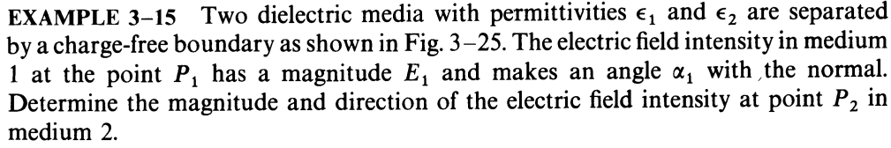
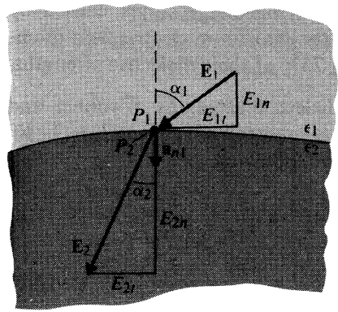
Solution: there is no free charge on the surface, from the boundary condition
Q: Whether ε₁ is large or smaller than ε₂?

Slide 77
Boundary conditions of electrostatic potential (arbitrary electrostatic field)
Typical conditions for electrostatic field
The interface between two perfect medium (No free charge ）
On the surface of conductors
constant ，

Slide 78
Ex Two infinite grounded conductor planes are located at x=0 and x=a, there is a uniformly charged plane at x=b with surface charge density of . Find the electric potential and electric field intensity between these two plane.
Solution:
y
o
b
a
x
Two infinite plane
So

Slide 79
Determine the coefficient
Applying the B.C.
So

Slide 80
Question:
Shall it be solved by electric intensity?

Slide 81
Method Two
The three boards might be considered as two parallel plates capacitors, and the electric intensity should direct to
So we assume
Gauss‘s Law
Find boundary conditions:
According to B.C. of petential

Slide 82
3.10 Capacitance and Capacitors
A conductor in an electrostatic field is an equipotential body.
Suppose the potential due to a charge Q is U. Increasing the total charge will increase the potential as well;
The ratio Q/U remains unchanged.
Capacitors can have advantage such as Storage, filtering, phase shift, blocking, bypass, frequency selection etc.
Capacitors can have disadvantage such as electromagnetic compatibility problems

Slide 83
83
Capacitance
Isolated conductor capacitance
Capacitance of the capacitor composed of two conductors
Conductors form part of the capacitor system in a multi-conductor system

Slide 84
84
The factors to determine
The capacitance
Depends on the structure, size, shape and the surrounding dielectric of the conductor system.
Independent to the charge and the electric potential of the conductor.

Slide 85
85
Method for solving capacitance
（Electrical capacitance is independent of the charge quantity and potential of the conductor）
Method One ：
Method two：
Assume charge q /±q of the conductor/ between two conductors
Find the potential / voltage of the conductor/ between two conductors
Assume the potential / voltage of the conductor/ between two conductors
Solve the charge q on the conductor surface .
According to the
definition for capacitance

Slide 86
86
Ex: Concentric spherical capacitor with inner conductor radius of a and outer conductor radius of b, homogeneous medium with ε Find the Capacitance of the spherical capacitor.
Solution：Charge q ，according to Gauss theorem
The voltage between the concentric conductor:
Capacitance:
Capacitance for Isolated conductor ball

Slide 87
Ex: Coaxial line (of infinite length) with inner conductor radius a and outer conductor radius b, a dielectric of permittivity εis filled up in between. Find the capacitance per unit length.
87
Solution: assume the line charge density is and for the inner and outer conductor, applying Gauss’s Law and the electric field between two conductor is:
Potential difference between inner and outer conductor
Coaxial line
the capacitance
per unit length:

Slide 88
Ex: The parallel dual-transmission line with the conductor radius of a, and distance of D (D >> a ), find the capacitance per unit length of this system
88
Solution: assume the line charge density is and for two conductors, since D >> a , the charge is considered to be uniformly distributed on the surface, and the electric field between two conductor is:
Potential difference between two conductors is:
the capacitance
per unit length:

Slide 89
Discussion：draw the equal circuit (connection of capacitors) of the following structures

Slide 90
3.11 Electrostatic Energy
Under the influence of electrostatic fields, a positively charged body will be moved along the direction of the electric field. In this case, work is being done by the field.
In order to do this work the electrostatic field must lose energy, implying that the electrostatic field has stored energy.
If the charged body is moved into the electrostatic field from infinity by an applied force, work is being done against the electric force.
This work will become part of the energy stored in the field, and the total energy of the electrostatic field will be increased.

Slide 91
The total energy stored in an electrostatic field can be determined from the work done to assemble the charges giving rise to the field.
Calculate the energy of an isolated body with charge Q. Assuming that the charge Q with element dq was moved in from infinity.
Since there was no field in space at the beginning, the applied force did not need to do the work to move in the first element dq.

Slide 92
When the element dq that followed was moved in, the applied force had to do the work against the electric field.
Let the final electric potential of the body be Φ and the final charge on it be Q. At the moment when the charge of the body is increased to , the electric potential of the charged body is then .
In this way, when the charges of all bodies are increased by the same ratio α, the work by the applied force, and hence the incremental electrostatic energy of the charged system is

Slide 93
So the toal electrostatic energy should be calculated as,
Applying
We also get
If there are n bodiescharged with , the total energy of the system is given by

Slide 94
If the charge is distributed in a volume, on a surface, or at a line, considering , then the total energy of the body with the distributed charge can be written accordingly as
Where ϕ is the electric potential at the element volume dV, the element surface dS, or the element line dl , respectively.
From the point of view of the field, the electrostatic energy is distributed in the entire space where the electric field is found. We now discuss how to calculate the energy density of electro-static field.
The energy density of electrostatic field is denoted by small letter character w_{e}.

Slide 95
Suppose the charges distributing in volume V is Q.
Integral will be unchanged if the integral is in a infinite sphere
We can see that the energy density of the electrostatic field is

Slide 96
For linear isotropic dielectrics, , we have
The energy of an electrostatic field is proportional to the square of the magnitude of the field intensity. Consequently, the energy does not obey the principle of superposition.
The total energy is not equal to the sum of their energies when they exist on their own.
Reason: When the second charged body is introduced, work needs to be done against the electric field due to the first charged body, and this work done becomes the energy stored in the field. This energy is called mutual energy, while the energy is called self energy when the charged body is alone.

Slide 97
Calculated by potential
Distribution of Body Charge
Distribution of plane Charge
Storage of Capacitor energy
—— Charge of the i conductors
Where:
—— potential of the i conductors

Slide 98
Calculated by distribution
energy density of electric field ：
Total energy of electric field ：
Integral region is the whole space of the electric field
For linear and isotropic medium

Slide 99
Ex. Find the energy of a conducting sphere with radius a and charge Q. The permittivity of the dielectric around the conductor is ε .
Solution: Three methods can be used.
(1) The electric potential of a conducting sphere with radius a and charge Q is
We find
(2) Since the surface of a conductor is an equipotential surface, and

Slide 100
(3) The electric field intensity caused by a conducting sphere with charge Q is
And the energy density is
Integrating over the region outside the conductor gives
Three results above are in agreement !

Slide 101
Homework
3-5, 3-11, 3-12, 3-22, 3-25, 3-33, 3-37, 3-40

