Slide 1
Chapter 7 Time-Varying Fields and Maxwell’s Equations
Wuqiong Luo

Slide 2
Contents
7.1 Faraday’s Law of Electromagnetic Induction
7.2 Maxwell’s Equations
7.3 Electromagnetic Boundary Conditions
7.4 Wave Equations and Their Solutions
7.5 Potential Functions
7.6 Time-Harmonic Fields

Slide 3
7.1 Faraday’s Law of Electromagnetic Induction
In 1820, Oersted: discovered magnetic effect on current.
In 1831, Faraday: discovered law of electromagnetic induction.
Faraday’s Law of electromagnetic induction
- Reveal the time varying magnetic field generate the electric field;
- It is an experimental law and can be considered as a postulate;
Important conclusions ：
- Under time-varying conditions, Electric field and magnetic field will be induced mutually by each other, forming a unified electromagnetic field .

Slide 4
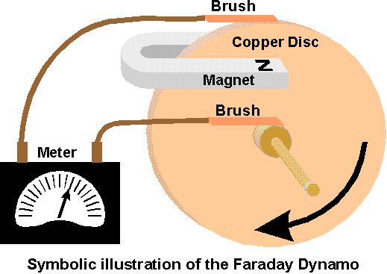
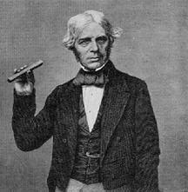
Michael Faraday
22nd, Spt,1791—25th, Aug, 1867

Slide 5
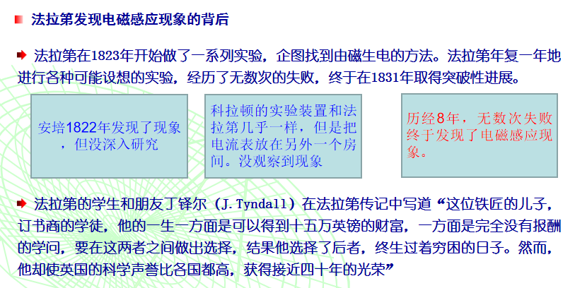
Extend reading

Slide 6
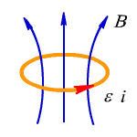

Expression of Faraday's law of electromagnetic induction
The electromotive force (EMF) induced in a stationary closed circuit is equal to the negative rate of increase of the magnetic flux linking the circuit.
The negative sign
- oppose the change--- lenz’s Law

Slide 7
As：
thus：
Understanding of induced electric field ：
The changing magnetic field is the source of the electric field.
The induced electric field is a rotational field.

Slide 8
The sources of the electric field have two kinds: Charge, Magnetic field (change with time)
2. Several conditions made magnetic flux change in the loop
(1) Magnetic field changes with time while Loop is invariant.
The corresponding differential form is

Slide 9
( 2 ) The motion of a conductor loop in a constant magnetic field
Which is called motional electromotive force , this is the working principle of the generator.
( 3 ) The loop moves in a time varying magnetic field

Slide 10
Ex. A uniform magnetic field B vertical through a rectangular ring with a length of a and a width of b , as shown in figure. In the following three cases, solve the induction electromotive force .
（1） , Rectangular loop is static ；
（2） , the width b of rectangular loop equals a constant, but the long side increases with time because sliding conductor L moves with velocity ;
（3） ，and sliding conductor L in rectangular loop moves with velocity .
y
a
L
b
Solution：(1) Uniform magnetic field do simple harmonic change with time, and loop is static , thus induction electromotive force in the loop is generated by the change of magnetic field, so:
o
x
x
Rectangular ring in uniform magnetic field

Slide 11
( 2 ) Uniform magnetic field is constant magnetic field, the sliding conductor on the loop do uniform motion at speed of , thus the induction electromotive force in the loop is generated by the movement of conductor L in the magnetic field, so
or
( 3 ) The induced electromotive force in the rectangular circuit is produced by the magnetic field variation and the movement of the sliding conductor L in the magnetic field, so

Slide 12
7.2 Maxwell’s Equations
Time varying state ：
Static state ：
☞
☞
☞

Slide 13
Discussion on Ampere’s circuiltal Law
For S1:
Disagreement!
For S2:
Conclusion: midification should be made to Ampere’s circuital Law

Slide 14
1. Total current law
Under the condition of time-varying situation, the charge distribution changes with time, according to current continuity equation, we got
Appear contradictory
As
Not applied in the case of time-varying
Is there other curl source of magnetic field?
Modify to

Conflict resolution
The time varying electric field will give rise to a magnetic field

Slide 15
Total current law ：
—— Differential Form
—— Integral Form
Total current law reveals that not only the conduction current can induce magnetic field, but also the time-varying electric field can give rise to a magnetic field. It forms an exchange in the nature between the time-varying magnetic field and the time-varying electric field.

Slide 16
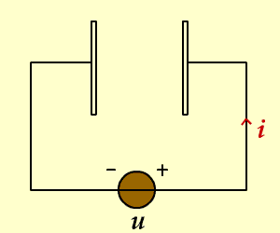
2. Displacement current density
The rate of change over time of electric displacement vector can produce magnetic field, just like current, so it is called "displacement current”.
The displacement current only indicates the rate of change of the electric field, which is different from the conduction current, and it has no heat effect.
The introduction of the displacement current is a vital step in the establishment of Maxwell equations. It reveals the important physical concept of the time varying electric field generate magnetic field.
Attention：
In an insulating medium, there is no conduction current, but there is a displacement current.
In an ideal conductor, there is no displacement current, but there is a conduction current.
In the general medium, there are both the conduction current and the displacement current.

Slide 17
3.Maxwell equations —— Basic equations of electromagnetic field
Differential form
Integral form

Slide 18
4. Constitutive relation of medium
The constitutive relation of an isotropic linear medium is
Substitute into the Maxwell equations ，we got
Restricted form of Maxwell equation
（ Homogeneous medium ）

Slide 19
7.3 Electromagnetic Boundary Conditions
When letting the height of the flat closed path approach zero, the area bounded by the path approaches zero, causing the surface integrals of and to vanish;
So the boundary conditions for time-varying case are exactly the same as for static electric fields and for static magnetic fields;

Slide 20
1. The general expressions of boundary conditions
The free surface charge density on the interface
Medium 1
The free surface current density on the interface
Medium 2

Slide 21
2. The boundary conditions of ideal dielectric interface
that is J_{S}＝0、ρ_{S}＝0，so

The tangential component of is continuous

The tangential component of is continuous

The tangential component of is continuous

The tangential component of is continuous
3. The boundary conditions on the surface of the ideal conductor

The charge density of ideal conductor on the surface is equal to the normal component of

The normal component of on the surface of ideal conductor equals zero

The tangential component of on the surface of ideal conductor equals zero

The current density of ideal conductor on the surface is equal to the tangential component of
E2、D2、H2、B2 all equal to zero

Slide 22
Electromagnetic Field
Starting point
Conditions
Maxwell’s equations
Constitutive relations
Boundary conditions

Slide 23
7.4 Wave Equations
Similarly , we can get that

Slide 24
Equations of electric field and magnetic field
Maxwell’s equations Wave equations:
Time-varying electric field and magnetic field exist in the form of waves
Wave equation of source-free region

Slide 25
Face the problems :
Single medium environment!
Solution of wave equations!
Analysis methods：
Make full use the characteristics of time varying electromagnetic field.

Slide 26
Questions：
In the electrostatic field analysis ，
how to find its characteristics?
How about in the static magnetic field?
In the time-varying electromagnetic field
analysis, will it play the same role?

Slide 27
7.5 Potential Functions
The introduction of potential functions
Characteristic
The divergence of the magnetic vector potential can be arbitrary!
Calculation of electromagnetic field by means of potential function
Questions：
How to calculation a potential functions ？
Is it beneficial to calculate the electromagnetic field by means of potential functions?

Slide 28
Potential function equations
（ D'Alembert Equations ）

Slide 29
Proof

Slide 30
Similarly

Slide 31
Potential function equations
Disadvantages ：
The scalar potential function and the vector potential functions can not be separated!

Slide 32
Normal conditions of potential functions
Coulomb's gauge ：
Disadvantages ：
The scalar potential function and the vector potential functions can not be separated!

Slide 33
Normal conditions of potential functions
Lorentz’s gauge ：
Features ：
The electric potential function and the magnetic vector potential function can be separated!
The magnetic vector potential only depends on the current, and the electric potential function only depends on the charge!
The potential functions can be found directly by the Lorentz’s gauge (no need to solve the differential equations)!

Slide 34
Question：
What is the role of the potential
functions in the time-varying
electromagnetic field ？

Slide 35

Wave equations of electromagnetic field
Potential functions
Conclusion ：
The two methods is just as simple in the source-free region
The potential equations are much simpler in the source region

Slide 36
7.6 Time-Harmonic Fields
Concept of time-harmonic electromagnetic fields
The physical quantity changes with the time in accordance with the sine law, so it is also called the sine electromagnetic field problem.

Slide 37
The favorable factors for solving the problems of time-harmonic electromagnetic fields
Time and space can be Separated to solution！
That is： It can be independent of each other to analyze the physical quantity of spatial variation and temporal variation.
Method：
The time-space relation of physical quantity can be expressed by the complex number
Methods of Real number representation or instantaneous representation
Method of complex representation

Slide 38
When calculate the time-harmonic quantity about time derivative and integral , the complex representation is more advantageous
Derivative
Integral

Slide 39
The complex representation of Maxwell’s equations ──Complex vector Maxwell’s equations

Slide 40
Complex representation of wave equations in the passive region ──Helmholtz’s equations
Instantaneous vector
Complex vector

Slide 41
The complex representation of the potential function equations in the active region
Instantaneous vector
Complex vector
Lorentz’s condition
Field based on potential functions

Slide 42
The simple representation of conductive medium──Complex dielectric constant

Slide 43
Medium loss tangent
For electromagnetic wave, the imaginary part of the complex permittivity of the medium will make the attenuation of the electromagnetic wave。Therefore, in terms of electromagnetic wave propagation，dielectric constant / magnetic permeability with imaginary part of the medium is also called loss medium,
The ratio of the real and imaginary parts, called loss tangent ：
Dielectric
Magnetic
Conductive medium
—— Weakly conducting medium
and good insulator
Classification of conductive medium
The Ratio of conduction current and displacement current
—— Normal conducting medium
—— Good conductor

Slide 44
Complex representation of wave equation in lossy medium
Source-free region
Lorentz’s condition
source region
Field based on potential functions

Slide 45
Ex. Find the instantaneous value of the following field in the form of a complex vector
Solution：since
So

Slide 46
Ex. The Complex vector of electric field intensity is
k_{z} and E_{xm} are constant value. Find the instantaneous value of the electric field intensity
Solution:

Slide 47
Summary
Faraday’s Law of electromagnetic induction
Maxwell’s Equations
Electromagnetic Boundary Conditions
Wave Equations
Time-Harmonic Fields
Lorentz’s gauge ：

Slide 48
Homework
7-2, 7-4, 7-7, 7-10, 7-13, 7-17, 7-18, 7-25

