Slide 1

Power Electronics
Introduction
(Week 11 & 12)
Dr Atif Jafri
Atif.Jafri@glasgow.ac.uk

Slide 2
With Prof Lianping Hou
Electric Circuits
Power Switches
Uncontrolled and Controllable Switches
Heatsinks
With me (Prof Atif Jafri)
Switched Mode Power Supplies (DC-DC converters)
DC-AC converters (Inverters)
Applications and Systems
Snubber Circuits
Week-11
Week-12

Slide 3
Power Electronics
Switched Mode DC-DC Converters I:
Concepts and Buck Converter
Dr Atif Jafri
Atif.Jafri@glasgow.ac.uk
Please read Chapter 7 in the textbook
POWER ELECTRONICS
Converters, Applications, and Design

Slide 4
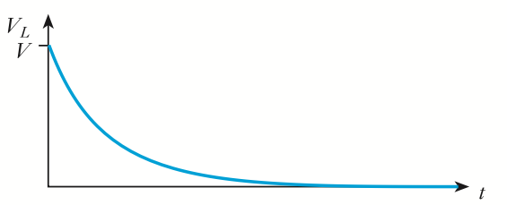
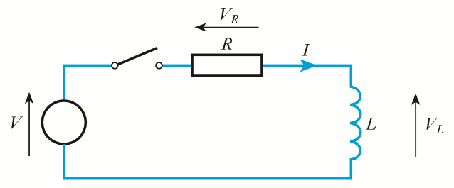
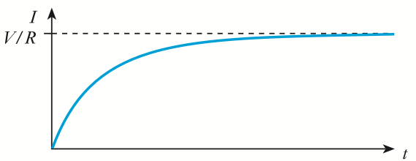
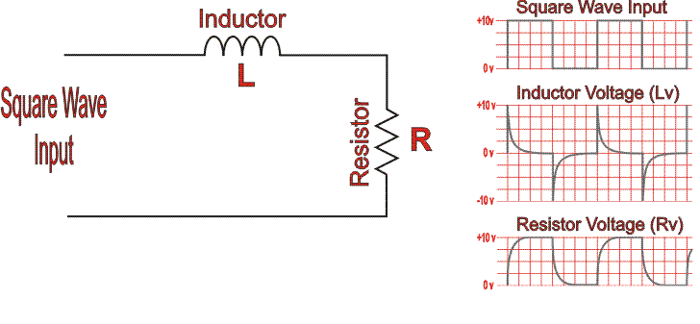
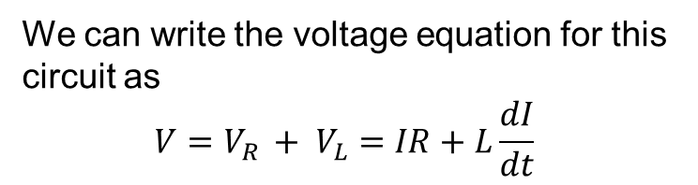
Background: RL Circuit
Recall the basic RL series circuit :
We can write the voltage equation for this circuit as
$$V=V_{R }+ V_{L}=IR+L\frac{dI}{dt}$$

Slide 5

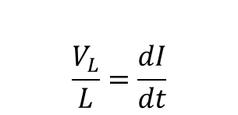



Background: RL Circuit
$$V=V_{R }+ V_{L}=IR+L\frac{dI}{dt}$$
When the value of R is very small, we can neglect the $"IR"$ term
Hence rate of change in current is constant.
$$\frac{V_{L}}{L}=\frac{dI}{dt}$$
$$\frac{dI}{dt}$$
I
$$\frac{V_{L}}{L}$$
t
t
As the current in the inductor rises, energy is stored in the magnetic field.

Slide 6

When the switch is opened, the inductor tries to maintain the current flowing through it and thus the voltage across the inductor reverses.
Sudden Switch Off will result in Voltage Spike, and Large dv/dt
It is necessary to provide a return path for the inductor current when the switch is opened, and this is usually done by adding a diode across the inductor which is called as freewheeling or flyback diode.
Switch
Inductor
current
Inductor
voltage
-0.7 V = diode
conduction
voltage drop

Slide 7
Background: Energy in Inductor
The energy stored in an inductor is ½LI². When current through the inductor is increasing, additional energy is being stored in the magnetic field. If the current is decreasing, then energy is being removed from the magnetic field. Assuming a perfect inductor, the energy (i.e., number of joules) returned to the circuit is exactly the same as was originally added.
I
trap
release
Energy
In
Energy
Out
t
For Power Conversion, released power from energy storage devices is expected to be delivered to the load as much as possible. Dissipative Energy Recovery is not acceptable.
We will see how to recover the trapped energy in switch-mode power conversion?

Slide 8
With this background knowledge, now we will explore following:
Where we need DC – DC converters?
Why switched mode DC – DC converter?
What are different types of DC – DC converter?
How they work?
Expression for output voltage, average current, etc.
Important waveforms
Numerical Problems

Slide 9
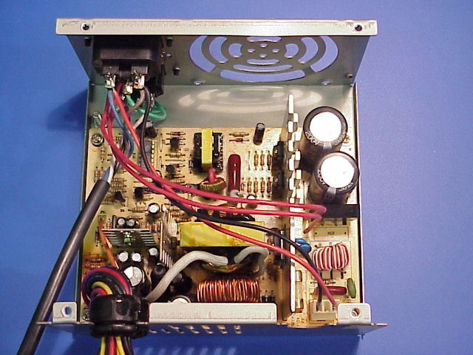
Where we need DC – DC converters
In a mobile phone, battery voltage is converted into multiple different DC voltages for the microprocessor, display, RF amplifier and camera.
All PC power supplies provide at least +5VDC, +12VDC, and -12VDC. Some power supplies also provide +3.3VDC, -5VDC
AC Source
Rectifier
DC-DC Convertor
+5V
-5V
+12V
240V
mains
Single DC
-12V
Solution: DC-DC Converters
DC-DC converters are power electronic circuits that convert a dc voltage to a different dc voltage level, often providing a regulated output.
Linear DC-DC Converters
Switching DC-DC Converters or Switched Mode Power Supplies(SMPS)

Slide 10
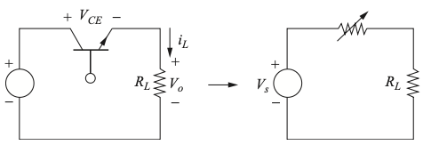
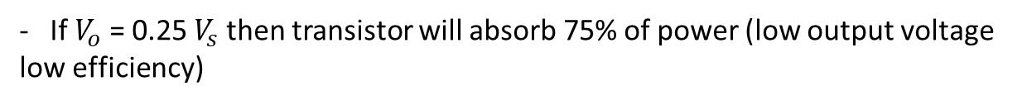
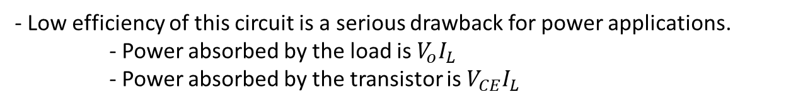
Why switched mode DC – DC converter
Linear DC-DC Converters
By adjusting the transistor base current, the output voltage may be controlled over a range of 0 to roughly Vs.
Alternative is Switching Converters
- This type of circuit is called a linear dc-dc converter or a linear regulator because the transistor operates in the linear region, rather than in the saturation or cutoff regions.
- Low efficiency of this circuit is a serious drawback for power applications.
- Power absorbed by the load is $V_{o}I_{L}$
- Power absorbed by the transistor is $V_{CE}I_{L}$
- If $V_{o}$ = 0.25 $V_{s}$ then transistor will absorb 75% of power (low output voltage low efficiency)

Slide 11
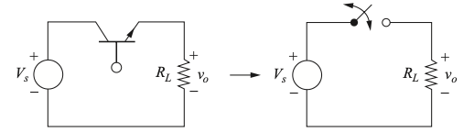
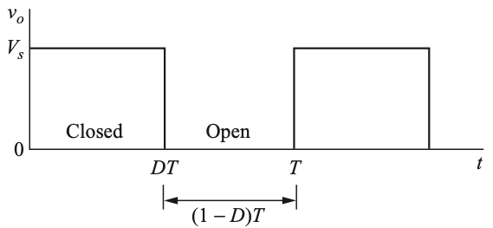

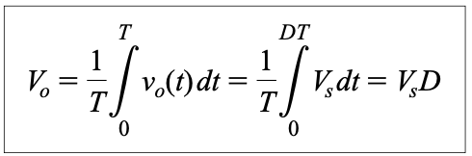


Why switched mode DC – DC converter
Switching DC-DC Converters or Switched Mode Power Supplies(SMPS)
In a switching converter circuit, the transistor operates as an electronic switch by being completely ON or completely OFF (saturation or cutoff for a BJT or the triode and cutoff regions of a MOSFET).
Average Voltage
$$D=\frac{t_{on}}{t_{on}+t_{off}}= \frac{t_{on}}{T}$$
$t_{on}=DT$ and $t_{off}=(1− D)T$

Slide 12
What are different types of DC – DC converter
SMPSs come in many different varieties. For the purposes of this course, we will consider three of the most used types:
1. The step-down or “buck” converter. [Vout < Vin]
2. The step-up or “boost” converter. [Vout > Vin]
3. The “buck-boost” [Vout <> Vin]
4. The flyback converter. [Vout <> Vin]
The basic SMPS block diagram is as follows:
Unregulated
DC Voltage
Averaging
circuit
Regulated
DC output
Control
The two important components here are the switch (usually a MOSFET) and the averaging circuit that will include an inductor.

Slide 13
The Buck Converter
How it works?
Important waveforms
Expression for output voltage
Based on average voltage of inductor
Based on change in current of inductor
Numerical Problems

Slide 14
The Buck Converter
Switch on
Charging
Switch
V_{L}
Circuit State I
Control
R_{L}
V_{IN}
V_{Out}
D
C
The circuit shows the SMPS circuit for a buck converter. When the switch is first closed, current starts to flow through the inductor and into the capacitor. The voltage across the inductor, V_{L}, is the difference between the input voltage V_{IN} and the output voltage V_{Out}. The diode is reverse biased 偏置 (“off”) by the supply voltage V_{IN} and does not conduct any current. The rate of change of current into the capacitor is limited by the inductor (V = L di/dt). At some point T_{off} the switch is opened. At this point the current through the inductor has risen to I_{Max} and the energy in the inductor (½LI²) is stored in its magnetic field.

Slide 15
Discharging
Switch
Circuit State II
Control
R_{L}
V_{IN}
V_{Out}
D
C
As soon as the switch is opened, the potential on the switched side of the inductor goes sharply negative (but the current continues to flow) as the energy in the magnetic field tries to maintain the current through the inductor. This has the effect of bringing the diode into conduction (hence V_{L} = -V_{Out} + 1V), thereby completing the circuit and enabling the current to continue to flow into the capacitor. As the energy in the inductor falls so the current diminishes but the capacitor continues to be charged (more slowly). If we ignore the diode voltage drop, the voltage across the inductor is now –V_{Out}.
The switching frequency, supply voltage and inductor value are all chosen such that there is always current flowing in the inductor. This is called continuous mode, i.e., continuous current in the inductor.
All of the circuitry necessary to implement the control function is available in an IC.

Slide 16
Buck converter switching waveforms.
Voltage across
switch.
Current through
switch
offset from zero
Current through
Inductor
V_{Supply} - V_{Out}
Voltage across
Inductor*
-V_{Out}
closed
V_{L}
open
V_{L}
I_{L}
I_{L}
V_{L}=V_{IN}-V_{OUT}
Energy in => I ↑
V_{OUT}
V_{L}=-V_{OUT}
Energy out* => I ↓
V_{IN}
V_{IN}
V_{OUT}
C
* Ignoring the voltage drop across the diode, which we will do to simplify the analysis.

Slide 17
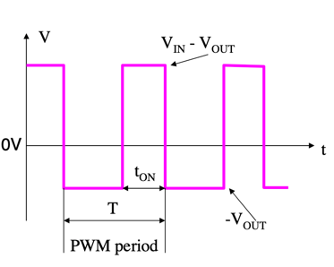
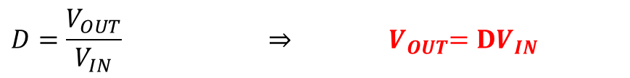
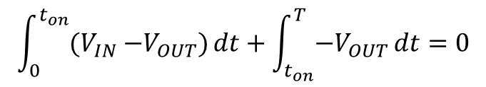
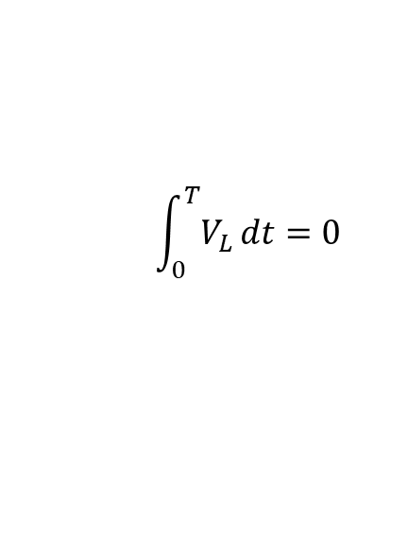
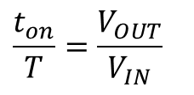

Buck converter Input/Output Voltage Relation
The integral of inductor voltage is equal to the change in the inductor flux linkage.
The net change of flux linking the inductor over one time period of repetition is zero, which is a necessary condition for steady-state operation
$$\int_{0}^{T}{V_{L}}dt=0$$
$$\int_{0}^{t_{on}}{{(V}_{IN} −V_{OUT})}dt+\int_{t_{on}}^{T}{{−V}_{OUT}}dt=0$$
${(V}_{IN} −V_{OUT})$ $t_{on} −V_{OUT}T+V_{OUT}t_{on}=0$
$V_{IN}t_{on}−V_{OUT}$ $t_{on} −V_{OUT}T+V_{OUT}t_{on}=0$
$$V_{IN}t_{on}=V_{OUT}T ⇒$$
$$\frac{t_{on}}{T}=\frac{V_{OUT}}{V_{IN}}$$
$$D=\frac{V_{OUT}}{V_{IN}} ⇒{ V}_{OUT}=DV_{IN}$$

Slide 18
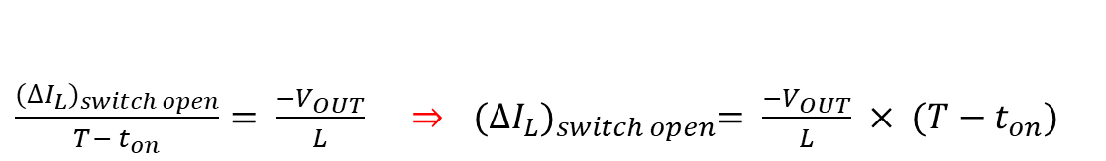
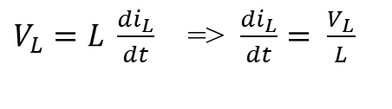
Buck converter inductor current change
offset from zero
Current through
inductor
Computing the change in inductor current using following expression:
$V_{L}=L \frac{di_{L}}{dt}$ => $\frac{di_{L}}{dt}= \frac{V_{L}}{L}$
When switch is closed:
$\frac{{(∆I_{L})}_{switch closed}}{ t_{on}}= \frac{V_{IN} −V_{OUT}}{L} ⇒$ ${(∆I_{L})}_{switch closed}= \frac{V_{IN} −V_{OUT}}{L} × t_{on}$
When switch is open:
$\frac{{(∆I_{L})}_{switch open}}{T− t_{on}}= \frac{{−V}_{OUT}}{L}$ $⇒$ ${(∆I_{L})}_{switch open}= \frac{−V_{OUT}}{L} × {(T−t}_{on})$

Slide 19








Buck converter Input/Output Voltage Relation using change in inductor current
offset from zero
Current through
inductor
We can prove input ~ output voltage relation by using Net change in inductor current is zero over one period
$${\left(∆I_{L}\right)}_{switch closed}+ {\left(∆I_{L}\right)}_{switch open}=0.$$
$\frac{V_{IN} −V_{OUT}}{L} × t_{on}$ + $\frac{−V_{OUT}}{L} × {(T−t}_{on})$ = 0
$\frac{V_{IN} −V_{OUT}}{L} × t_{on}$ = $\frac{V_{OUT}}{L} × {(T−t}_{on})$
$\frac{V_{IN} −V_{OUT}}{V_{OUT}}$= $\frac{{(T−t}_{on}) }{t_{on}}$
$\frac{V_{IN} }{V_{OUT}} −1$= $\frac{T}{t_{on}}$ $−1$
$\frac{V_{IN} }{V_{OUT}}$= $\frac{T}{t_{on}}$
=>
$\frac{V_{OUT} }{V_{IN}}$= $\frac{t_{on}}{T}$
=>
$\frac{V_{OUT} }{V_{IN}}$=$D$
$V_{OUT}$ =$DV_{IN}$

Slide 20
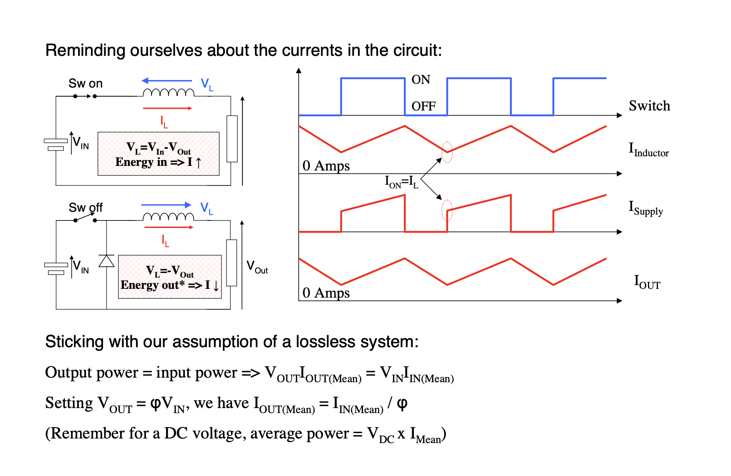
Input ~ Output Power (Loss less system)
D
D

Slide 21



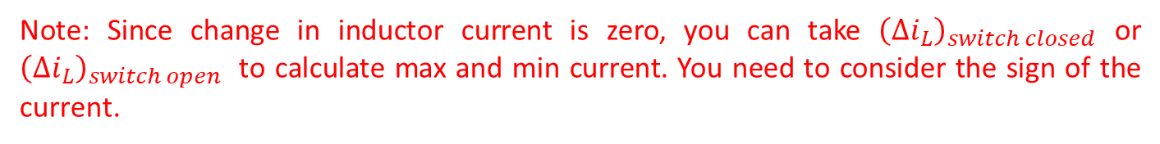
Minimum and Maximum Inductor Current
$$I_{L,avg}=\frac{V_{OUT}}{R} or \frac{{Power}_{avg,OUT}}{V_{OUT}}$$
$$I_{L,max}= I_{L,avg}+\frac{{\left(∆i_{L}\right)}_{switch closed}}{2}$$
$$I_{L,min}= I_{L,avg}−\frac{{\left(∆i_{L}\right)}_{switch closed}}{2}$$
Note: Since change in inductor current is zero, you can take ${\left(∆i_{L}\right)}_{switch closed}$ or ${\left(∆i_{L}\right)}_{switch open}$ to calculate max and min current. You need to consider the sign of the current.

Slide 22
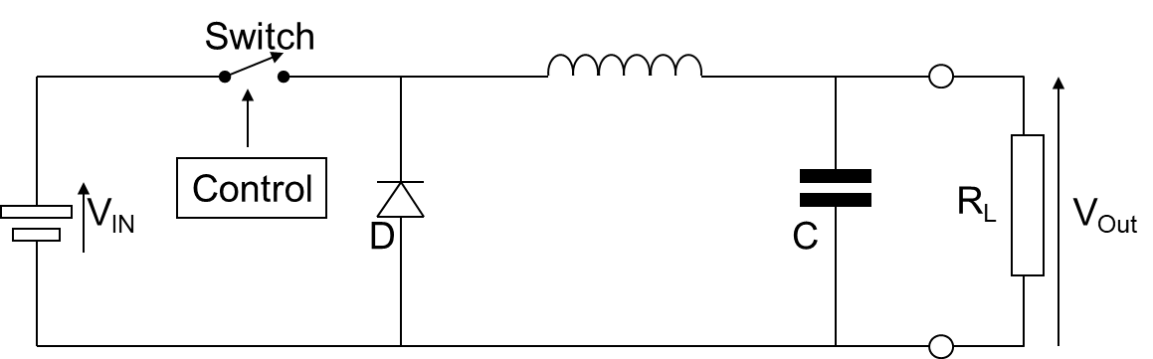

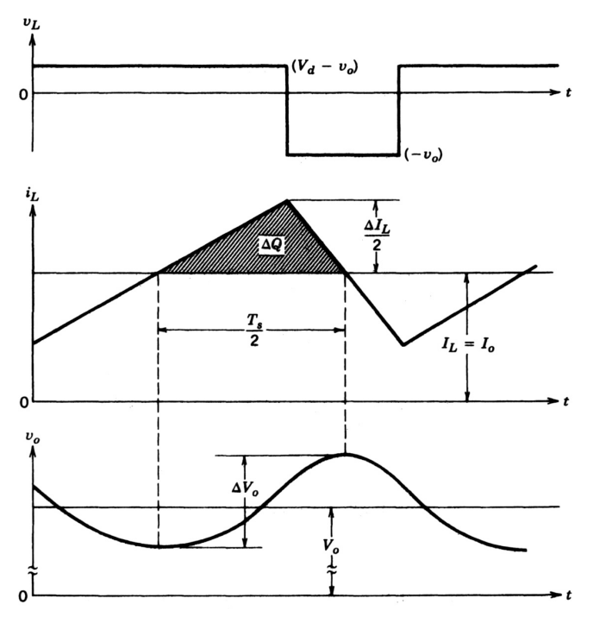





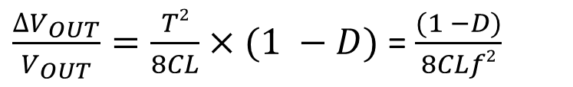
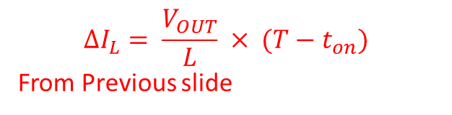

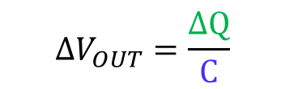
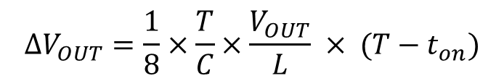

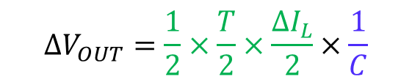


Buck converter Output Voltage Ripples
So far, the capacitor was assumed to be very large to keep the output voltage constant.
In practice, the output voltage cannot be kept perfectly constant with a finite capacitance.
The variation in output voltage, or ripple, is computed from the voltage-current relationship of the capacitor.
$$∆Q= C ∆V_{OUT}$$
$$∆V_{OUT}=\frac{∆Q}{C}$$
$${(V}_{IN} −V_{OUT})$$
$$∆V_{OUT}=\frac{1}{2}×\frac{T}{2}×\frac{∆I_{L}}{2}×\frac{1}{C}$$
$$−V_{OUT}$$
$$∆I_{L}= \frac{V_{OUT}}{L} × {(T−t}_{on})$$
From Previous slide
$$I_{L}$$
$$\frac{ T }{2}$$
$$∆V_{OUT}=\frac{1}{8}×\frac{T}{C}×\frac{V_{OUT}}{L} × {(T−t}_{on})$$
$$V_{OUT}$$
$${T−t}_{on}=T(1 −D)$$
$$∆V_{OUT}$$
$\frac{∆V_{OUT}}{V_{OUT}}=\frac{T2}{8CL}×(1 −D)$ = $\frac{(1 −D)}{8CLf2}$
$$V_{OUT}$$

Slide 23
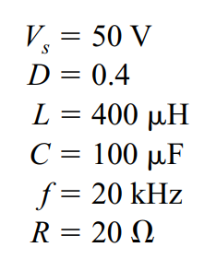





Buck tutorial.
A buck converter has following parameters. Determine output voltage, average, minimum and maximum inductor current and output voltage ripple.
$$V_{IN}$$
$V_{OUT}$ =$DV_{IN}$
$$I_{L,avg}= \frac{V_{OUT}}{R}$$
$=\frac{20}{20}=1A$

Slide 24




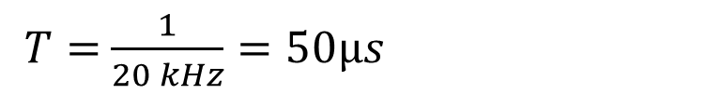

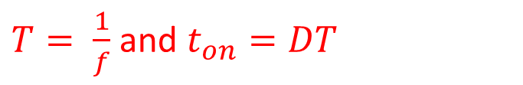

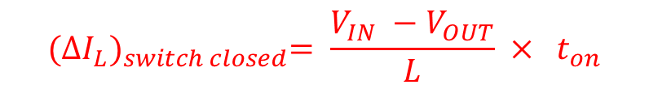
Buck tutorial.
A buck converter has following parameters. Determine output voltage, average minimum and maximum inductor current and output voltage ripple.
$$V_{IN}$$
$${(∆I_{L})}_{switch closed}= \frac{V_{IN} −V_{OUT}}{L} × t_{on}$$
$T= \frac{1}{f}$ and $t_{on}=DT$
$$= \frac{50−20}{400μH} ×20μs$$
$T=$ $\frac{1}{20 kHz}=50μs$
$$= 1.5A$$
$t_{on}$ $=0.4×50=20μs$
$$I_{L,max}= I_{L,avg}+\frac{{\left(∆i_{L}\right)}_{switch closed}}{2}$$
$$I_{L,min}= I_{L,avg}−\frac{{\left(∆i_{L}\right)}_{switch closed}}{2}$$
$$=1+\frac{1.5}{2}=1.75A$$
$$=1−\frac{1.5}{2}=0.25A$$

Slide 25
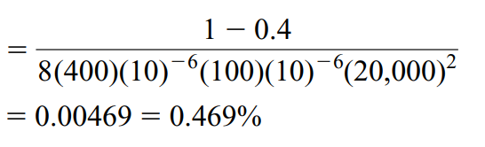

Buck tutorial.
A buck converter has following parameters. Determine output voltage, average minimum and maximum inductor current and output voltage ripple.
$$V_{IN}$$
Output voltage ripple:
$$\frac{∆V_{OUT}}{V_{OUT}}=\frac{(1 −D)}{8CLf2}$$

Slide 26
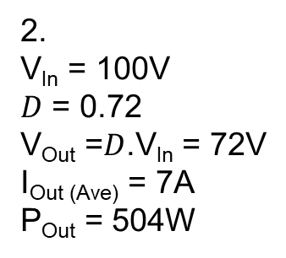
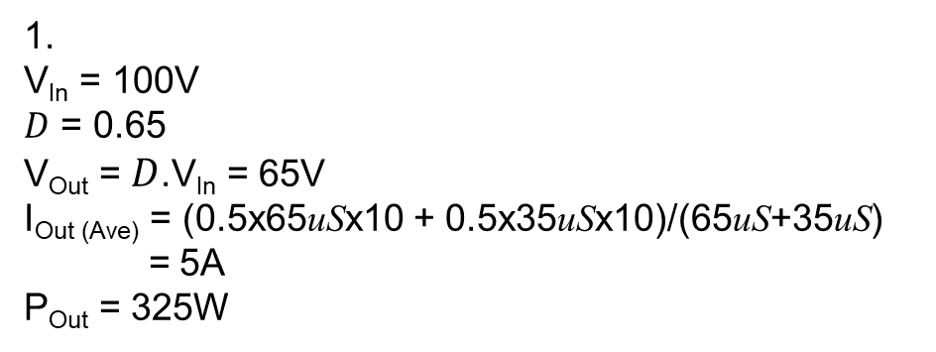
Buck tutorial.
Determine the mean output voltage, current and power for the following operating points. Assume 100% conversion efficiency and continuous mode operation. V_{In}=100V
I_{Out}
I_{Out}
65uS
35uS
10A
36uS
14uS
10A
1
2
4A
0A
t
t
1.
V_{In} = 100V
$D$ = 0.65
V_{Out} = $D$.V_{In} = 65V
I_{Out (Ave)} = (0.5x65uSx10 + 0.5x35uSx10)/(65uS+35uS)
= 5A
P_{Out} = 325W
2.
V_{In} = 100V
$D$ = 0.72
V_{Out} =$D$.V_{In} = 72V
I_{Out (Ave)} = 7A
P_{Out} = 504W

Slide 27
Switched-mode Power Supplies (SMPS)开关电源
We saw how the linear power supply was very easy to build but suffered from relatively low efficiency. Where efficiency is an important consideration, the SMPS should be the supply of choice. For even moderately-sized power supplies the advantages of the SMPS efficiency can be considerable:
Heatsinks 散热片can be smaller;
A cooling fan is not usually needed;
The power density 功率密度(watts per cm³) is greater.
The weight is lower.
However, against these advantages, the following disadvantages must be considered:
1. The SMPS is electrically very noisy.

