Slide 1

Power Electronics
Switched Mode DC-DC Converters I:
Boost Converter, Buck-Boost Converter
Dr Atif Jafri
Atif.Jafri@glasgow.ac.uk
Please read Chapter 7 in the textbook
POWER ELECTRONICS
Converters, Applications, and Design

Slide 2
The Boost Converter
How it works?
Important waveforms
Expression for output voltage
Based on average voltage of inductor
Based on change in current of inductor
Numerical Problems

Slide 3
The boost (step-up) converter. (V_{Out} > V_{In})
D
V_{IN}
Control
R_{L}
V_{Out}
C
Switch
The boost converter is used to increase the output voltage (V_{Out}) above the input voltage (V_{In}).
As in the case of the buck converter we will assume the circuit operates in continuous mode, i.e., current is always flowing in the inductor.
If we disregard the switch for a moment and examine the circuit, we see that in the steady state the output voltage is connected to the input voltage via an inductor (assume zero resistance) and a diode. As with the buck, ignore the voltage drop across the diode.

Slide 4
V_{L}
Current
D
V_{IN}
Control
R_{L}
V_{Out}
C
Switch
Now consider the circuit when the switch is closed.
Any voltage on capacitor C will ensure the diode is reverse biased and therefore the output circuit is “disconnected” from the input. [Because the diode’s anode is connected to ground via the switch.]
The inductor is connected across the supply (V_{In}) and hence current will start to build through it with the energy being stored in the magnetic field. During this phase, V_{L} = V_{In}.
V_{L}
Sw on
Current
Switch ON: Charging the inductor !!!
V_{IN}
V_{L}=V_{In}
Energy in => I ↑

Slide 5
V_{L}
Current
D
V_{IN}
Control
R_{L}
V_{Out}
C
Switch
Switch OFF: Discharging the inductor !!!
When the switch is opened, the inductor wants to maintain the current flow and with the supply side of the inductor still held at V_{IN}, the potential at the opposite side of the inductor rises until the diode starts to conduct. The inductor voltage during this phase is the difference between the input voltage (V_{IN}) and the output voltage (V_{OUT}).
So V_{L} = V_{IN} – V_{OUT}
As energy is transferred from the inductor’s magnetic field so the current flowing through the inductor and diode falls.
V_{L}
Sw off
Current
V_{IN}
V_{L}= V_{IN} - V_{OUT}
Energy out => I ↓
V_{Out}

Slide 6
Waveforms for the boost converter
±V_{L}
Current
D
V_{IN}
Control
R_{L}
V_{Out}
C
Switch
Shut
Open
Switch
V_{IN}
Inductor
voltage
V_{IN} -V_{OUT}
Inductor current
(= supply current)
Diode current
(=output current)
Note that current always flows in the inductor (continuous mode again)

Slide 7
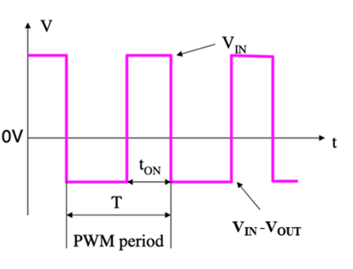

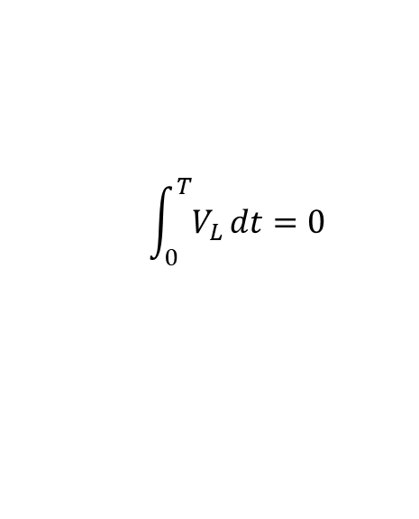




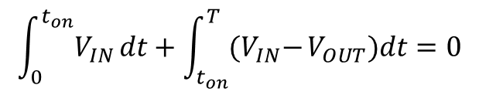

Boost converter Input/Output Voltage Relation
The integral of inductor voltage is equal to the change in the inductor flux linkage.
The net change of flux linking the inductor over one time period of repetition is zero, which is a necessary condition for steady-state operation.
$$\int_{0}^{T}{V_{L}}dt=0$$
$$\int_{0}^{t_{on}}{V_{IN}}dt+\int_{t_{on}}^{T}{{(V}_{IN}−}V_{OUT})dt=0$$
$$V_{IN}t_{on}+V_{IN}{T − V_{IN}t}_{on}−V_{OUT}{T+V_{OUT}t}_{on}=0$$
($V_{IN}−V_{OUT}{)T={−V}_{OUT}t}_{on}$
($V_{IN}−V_{OUT})=−V_{OUT}\frac{t_{on }}{T}$
$$V_{IN}−V_{OUT}=−V_{OUT}D$$
$$V_{IN}=V_{OUT}−V_{OUT}D$$
$$V_{IN}=V_{OUT}(1−D)$$
$$V_{IN}=V_{OUT}\left(1−D\right) ⇒{ V}_{OUT}= \frac{V_{IN}}{1−D}$$

Slide 8
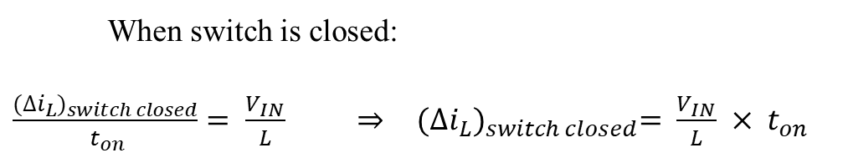

Boost converter Inductor Current Change
Inductor current
(= supply current)
Inductor current
Computing the change in current using following expression:
$v_{L}=L \frac{di_{L}}{dt}$ => $\frac{di_{L}}{dt}= \frac{v_{L}}{L}$
When switch is closed:
$\frac{{(∆i_{L})}_{switch closed}}{ t_{on}}= \frac{V_{IN}}{L} ⇒$ ${(∆i_{L})}_{switch closed}= \frac{V_{IN}}{L} × t_{on}$
When switch is open:
$\frac{{(∆i_{L})}_{switch open}}{T− t_{on}}= \frac{V_{IN} − V_{OUT}}{L}$ $⇒$ ${(∆i_{L})}_{switch open}= \frac{V_{IN} − V_{OUT}}{L} × {(T−t}_{on})$

Slide 9


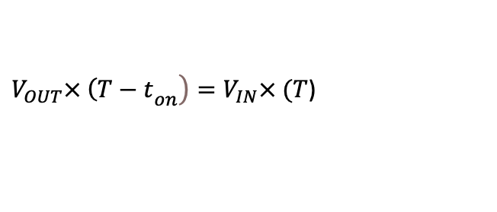

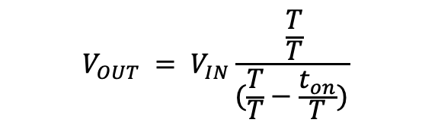

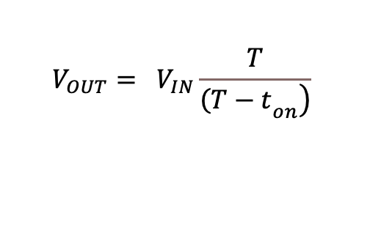
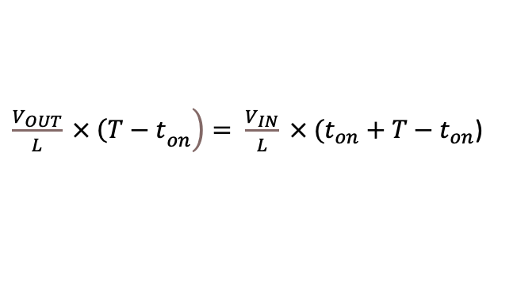
Boost converter Input/Output Voltage Relation
Inductor current
(= supply current)
Inductor current
Net change in inductor current over one period is zero.
$${(∆i_{L})}_{switch closed}+ {(∆i_{L})}_{switch open}=0.$$
$$\frac{V_{IN}}{L} × t_{on}+\frac{V_{IN} − V_{OUT}}{L} × {(T−t}_{on})=0$$
=>
$$\frac{V_{IN}}{L} × t_{on}+\frac{V_{IN} }{L} × {(T−t}_{on})− \frac{ V_{OUT}}{L} × {(T−t}_{on})=0$$
$\left.\frac{V_{OUT}}{L} × {\left(T−t\right.}_{on}\right)= \frac{V_{IN}}{L} × (t_{on}$ ${+ T−t}_{on}$)
=>
$\left.V_{OUT}× {\left(T−t\right.}_{on}\right)=V_{IN}× (T$)
$$V_{OUT}= V_{IN}\frac{T}{\left.{\left(T−t\right.}_{on}\right)}$$
$$V_{OUT} = V_{IN}\frac{ \frac{T}{T}}{(\frac{T}{T}−\frac{t_{on}}{T})}$$
=>
Duty cycle of switching signal = $D= \frac{t_{on}}{T}$
$$V_{OUT} = V_{IN}\frac{ 1}{\left(1− D\right)}$$

Slide 10
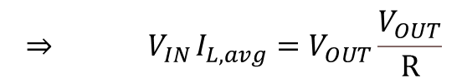



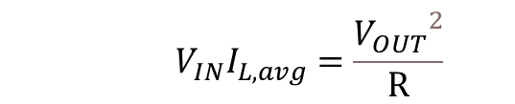


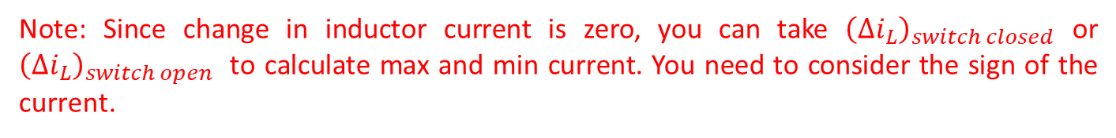

Minimum and Maximum Inductor Current
Assuming lossless system
$$⇒{ V}_{IN}I_{L, avg}=V_{OUT}\frac{V_{OUT}}{R}$$
$$P_{IN}=P_{OUT }$$
$$⇒{ V}_{IN}I_{L,avg}=V_{OUT}I_{OUT }$$
$${ V}_{IN}I_{L,avg}=\frac{{V_{OUT}}^{2}}{R}$$
$${ ⇒ V}_{IN}I_{L,avg}=(\frac{V_{IN}}{1−D})^{2}×\frac{1}{R}$$
$$I_{L,avg}=\frac{V_{IN}}{(1−D)^{2}R}$$
$$I_{L,max}= I_{L,avg}+\frac{{\left(∆i_{L}\right)}_{switch closed}}{2}$$
$$I_{L,min}= I_{L,avg}−\frac{{\left(∆i_{L}\right)}_{switch closed}}{2}$$
Note: Since change in inductor current is zero, you can take ${\left(∆i_{L}\right)}_{switch closed}$ or ${\left(∆i_{L}\right)}_{switch open}$ to calculate max and min current. You need to consider the sign of the current.

Slide 11
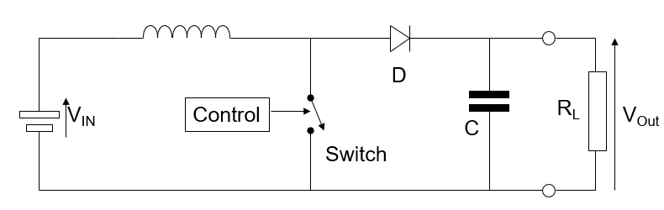

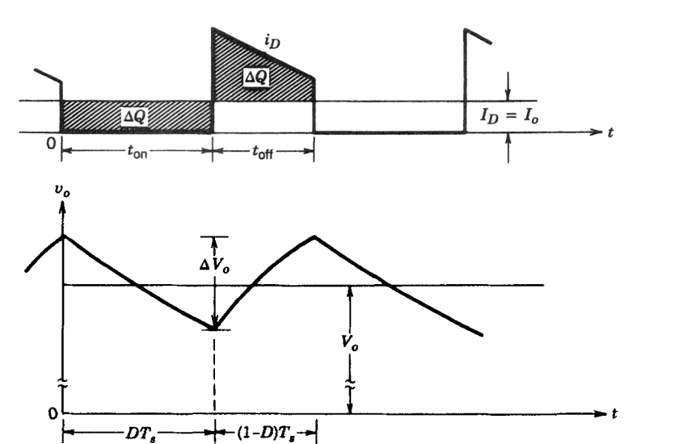




Boost converter Output Voltage Ripples
Assuming that all the ripple current component of the diode current flows through the capacitor and its average value flows through the load resistor.
$$∆Q= C ∆V_{OUT}$$
$$∆V_{OUT}=\frac{∆Q}{C}$$
$$∆V_{OUT}=\frac{I_{o}t_{on}}{C}$$
$$∆V_{OUT }=\frac{V_{OUT}t_{on}}{R C}$$
$$\frac{∆V_{OUT }}{V_{OUT}}=\frac{t_{on}}{R C}$$
$$\frac{∆V_{OUT }}{V_{OUT}}=\frac{DT}{R C}$$

Slide 12
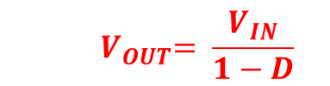

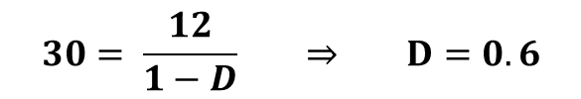
Boost tutorial.
A boost converter has following parameters. Determine duty cycle, average, minimum and maximum inductor current and output voltage ripple.
$$V_{IN}=12 V$$
$V_{OUT}=30 V$
$L=120 μH$
$$C=48 μF$$
$$R=50 ohm$$
$$f=50 KHz$$
$${ V}_{OUT}= \frac{V_{IN}}{1−D}$$
$$30= \frac{12}{1−D} ⇒ D=0.6$$

Slide 13

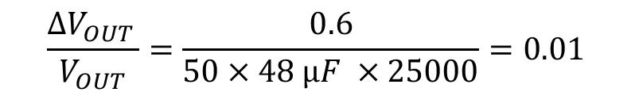


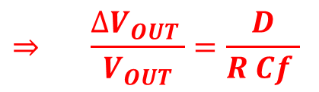
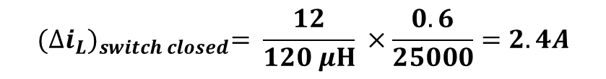
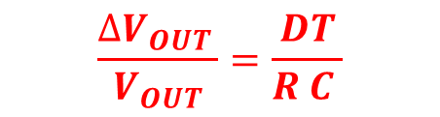
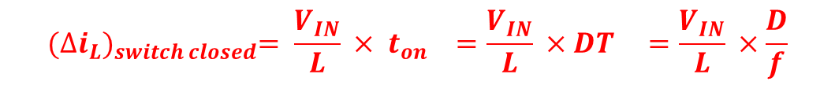

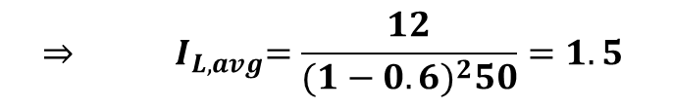

Boost tutorial.
A boost converter has following parameters. Determine duty cycle, average, minimum and maximum inductor current and output voltage ripple.
$$V_{IN}=12 V$$
$V_{OUT}=30 V$
$L=120 μH$
$$C=48 μF$$
$$R=50 ohm$$
$$f=50 KHz$$
$$I_{L,avg}=\frac{V_{IN}}{(1−D)^{2}R}$$
$${⇒ I}_{L,avg}=\frac{12}{(1−0.6)^{2}50}=1.5$$
$${(∆i_{L})}_{switch closed}= \frac{V_{IN}}{L} × t_{on} =\frac{V_{IN}}{L} ×DT =\frac{V_{IN}}{L} ×\frac{D}{f}$$
$${(∆i_{L})}_{switch closed}= \frac{12}{120 μH} ×\frac{0.6}{25000}=2.4A$$
$$I_{L,max}= I_{L,avg}+\frac{{\left(∆i_{L}\right)}_{switch closed}}{2}$$
$$I_{L,min}= I_{L,avg}−\frac{{\left(∆i_{L}\right)}_{switch closed}}{2}$$
$$I_{L,max}=1.5+1.2=2.7A$$
$$I_{L,min}=1.5−1.2=0.3A$$
$$\frac{∆V_{OUT }}{V_{OUT}}=\frac{DT}{R C }$$
$$⇒ \frac{∆V_{OUT }}{V_{OUT}}=\frac{D}{R Cf }$$
$$\frac{∆V_{OUT }}{V_{OUT}}=\frac{0.6}{50×48 μF ×25000}=0.01$$

Slide 14
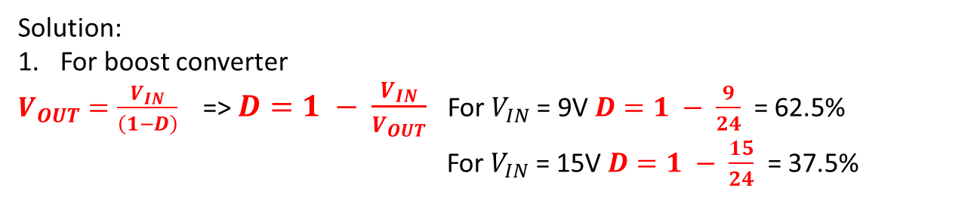
Example.
A boost converter is required to provide a constant 24V / 100W output from an input voltage that varies between 9V and 15V. For a switching frequency of 20KHz and assuming 100% efficiency and operation in continuous mode, determine the following:
1. The required PWM duty cycle range to maintain a 24V DC output.
2. The average input current when the input voltage is 15V.
3. The value of the inductor required if the instantaneous current through the inductor at the end of the PWM period is zero. Calculate the value for both 9V and 15V input.
Solution:
For boost converter
$V_{OUT}=\frac{V_{IN}}{\left(1−D\right)}$ => $D=1 − \frac{V_{IN}}{V_{OUT}}$ For $V_{IN}$= 9V $D=1 − \frac{9}{24}$ = 62.5%
For $V_{IN}$= 15V $D=1 − \frac{15}{24}$ = 37.5%
2. Assuming 100% efficiency:

Slide 15
3. For a boost converter. the inductor current = input current. At 15V, D=37.5% and I_{IN(AVE)}=6.67A. We know that at the end of the PWM period the inductor current is zero, hence we can construct the current waveform:
I_{MAX} = 2 x I_{AVE} = 13.33A
18.75μS
31.25μS
I_{MAX} = 13.33A
I_{AVE} = 6.67A
V_{IN}
A
B
(V_{IN} - V_{OUT})
f = 20KHz, D = 37.5% => T_{ON} = 18.75μS

Slide 16
The Buck-Boost Converter
How it works?
Important waveforms
Expression for output voltage
Based on average voltage of inductor
Based on change in current of inductor
Numerical Problems

Slide 17
The buck-boost converter (V_{OUT} <> V_{IN}).
Switch
D
Control
V_{IN}
R_{L}
V_{Out}
C
The Buck-Boost converter is able to produce output voltages that are higher or lower than the input voltage. Once again, we will consider the continuous mode system. Note that the output is negative with respect to the 0V side of the input voltage.
V_{IN}
V_{OUT}
Buck-boost
0V
0V

Slide 18
Switch
Charging
D
Control
V_{IN}
V_{L}
R_{L}
V_{OUT}
C
Current
Before starting …
… Notice that when the switch is open there is no connection between the input to the supply and its output. Hence, we can conclude that the supply is capable of delivering 0V output regardless of the input voltage for a 0% duty cycle on the switch.
With the switch closed, the input voltage is imposed across the inductor and the current through the inductor starts to rise. The diode is “off” since the cathode is more positive than the anode.
Hence for the “on” period, V_{L} = V_{IN}.
Note that with the diode reverse biased, the only route for the current to take that completes the circuit is back through the supply to the converter.

Slide 19
Switch
Discharging
D
Control
V_{IN}
V_{L}
R_{L}
V_{OUT}
C
Current
When the switch is opened the voltage on the inductor reverses polarity, the diode starts to conduct and hence the inductor current flows into the capacitor.
During this “off” period, V_{L} = V_{OUT} and this is maintained as the current in the inductor falls to its value at the end of the PWM period.
Note that with the switch opened there is no return path for current through the input to the converter and hence the only route the inductor current can follow is into the capacitor and load.
Also note that the capacitor will supply current to the load when there is no current contribution from the inductor.

Slide 20
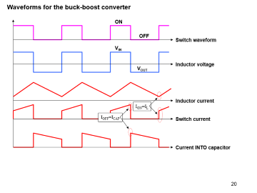
Waveforms for the buck-boost converter
ON
OFF
Switch waveform
V_{IN}
Inductor voltage
V_{OUT}
Inductor current
I_{ON}=I_{L}
I_{OFF}=I_{CAP}
Switch current
Current INTO capacitor

Slide 21
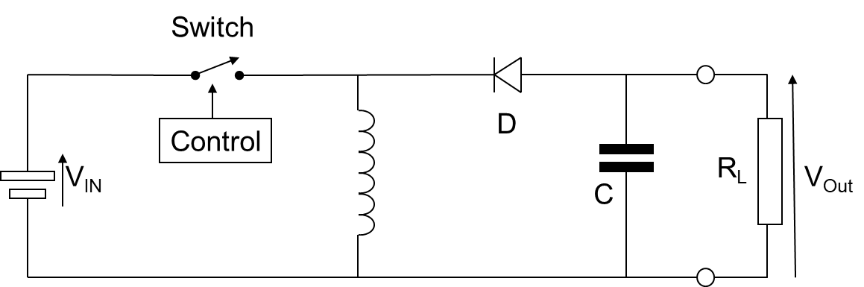

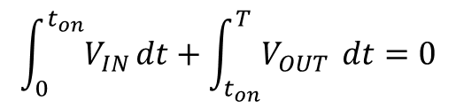

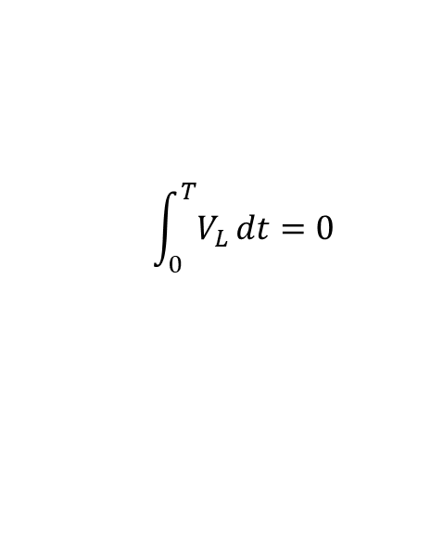



Buck-boost converter Input/Output Voltage Relation
$$\int_{0}^{T}{V_{L}}dt=0$$
$$\int_{0}^{t_{on}}{V_{IN}}dt+\int_{t_{on}}^{T}{V_{OUT}} dt=0$$
$$V_{IN}t_{on}+V_{OUT}{T−V_{OUT}t}_{on}=0$$
$$V_{IN}t_{on}= {{{−V}_{OUT}T+V}_{OUT }t}_{on}$$
$$V_{IN}DT=−V_{OUT}T+V_{OUT}DT$$
$$V_{IN}D=−V_{OUT}(1−D)$$
$${ V}_{OUT}= \frac{−V_{IN}D}{1−D}$$
Polarity is opposite than the input

Slide 22
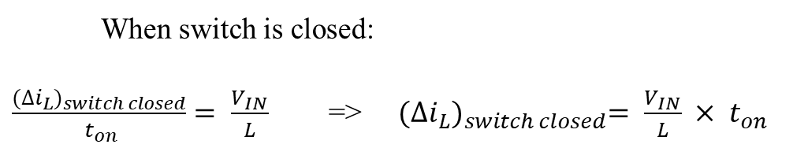

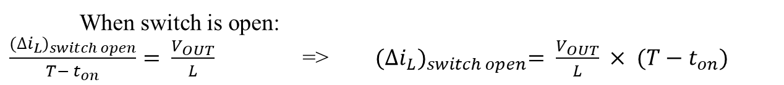
Buck-boost converter change in inductor current
Inductor current
Computing the change in current using following expression:
$v_{L}=L \frac{di_{L}}{dt}$ => $\frac{di_{L}}{dt}= \frac{v_{L}}{L}$
When switch is closed:
$\frac{{(∆i_{L})}_{switch closed}}{ t_{on}}= \frac{V_{IN}}{L}$ => ${(∆i_{L})}_{switch closed}= \frac{V_{IN}}{L} × t_{on}$
When switch is open:
$\frac{{(∆i_{L})}_{switch open}}{T− t_{on}}= \frac{V_{OUT}}{L}$ => ${(∆i_{L})}_{switch open}= \frac{V_{OUT}}{L} × {(T−t}_{on})$

Slide 23
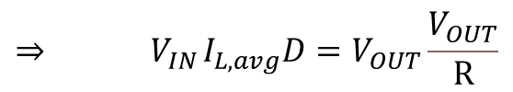



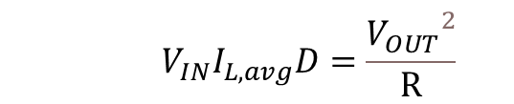


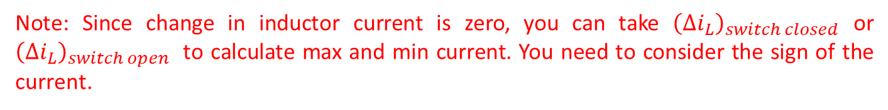

Minimum and Maximum Inductor Current
Assuming lossless system
$$⇒{ V}_{IN}I_{L, avg}D=V_{OUT}\frac{V_{OUT}}{R}$$
$$P_{IN}=P_{OUT }$$
$$⇒{ V}_{IN}I_{IN}=V_{OUT}I_{OUT }$$
$${ V}_{IN}I_{L,avg}D=\frac{{V_{OUT}}^{2}}{R}$$
$$⇒ I_{L,avg}=\frac{{(V}_{OUT})^{2}}{V_{IN}D}×\frac{1}{R}$$
$$I_{L,avg}=(V_{IN}\frac{ D}{\left(1−D\right)})^{2}×\frac{1}{V_{IN}DR}$$
$$I_{L,avg}=\frac{V_{IN}D}{(1−D)^{2}R}$$
$$I_{L,max}= I_{L,avg}+\frac{{\left(∆i_{L}\right)}_{switch closed}}{2}$$
$$I_{L,min}= I_{L,avg}−\frac{{\left(∆i_{L}\right)}_{switch closed}}{2}$$
Note: Since change in inductor current is zero, you can take ${\left(∆i_{L}\right)}_{switch closed}$ or ${\left(∆i_{L}\right)}_{switch open}$ to calculate max and min current. You need to consider the sign of the current.

Slide 24
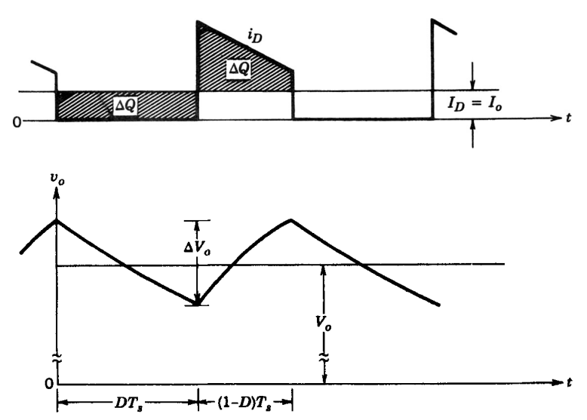





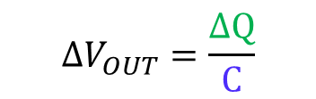
Buck-Boost converter Output Voltage Ripples
Assuming that all the ripple current component of the diode current flows through the capacitor and its average value flows through the load resistor.
$$∆Q= C ∆V_{OUT}$$
$$∆V_{OUT}=\frac{∆Q}{C}$$
$$∆V_{OUT}=\frac{I_{o}t_{on}}{C}$$
$$∆V_{OUT }=\frac{V_{OUT}t_{on}}{R C}$$
$$\frac{∆V_{OUT }}{V_{OUT}}=\frac{t_{on}}{R C}$$
$$\frac{∆V_{OUT }}{V_{OUT}}=\frac{DT}{R C}$$

Slide 25
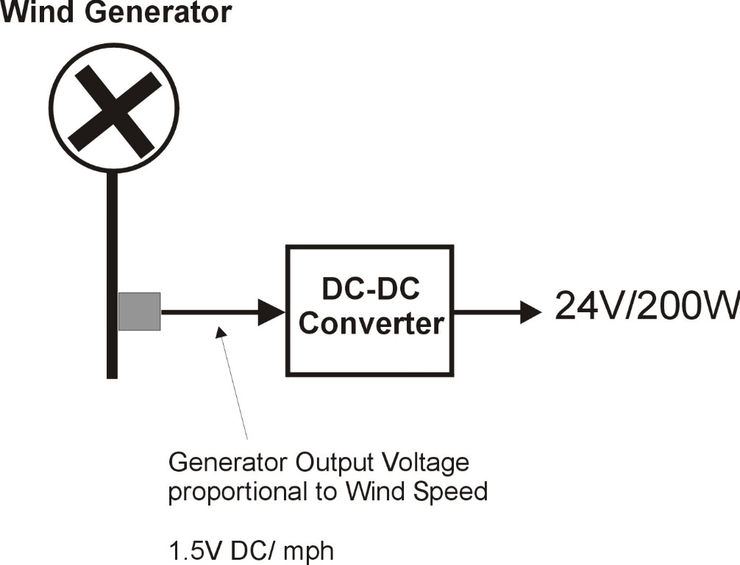
Question.
A small wind turbine generates 1.5V DC per MPH of wind speed.
For operation over the range 8 MPH to 32 MPH, determine the following:
1. The type of converter to be used;
2. The required range of duty cycle for these wind speeds;
3. The average input current to the converter at 32MPH;
4. The peak input current @ 32 MPH assuming operation at the boundary condition.

Slide 26
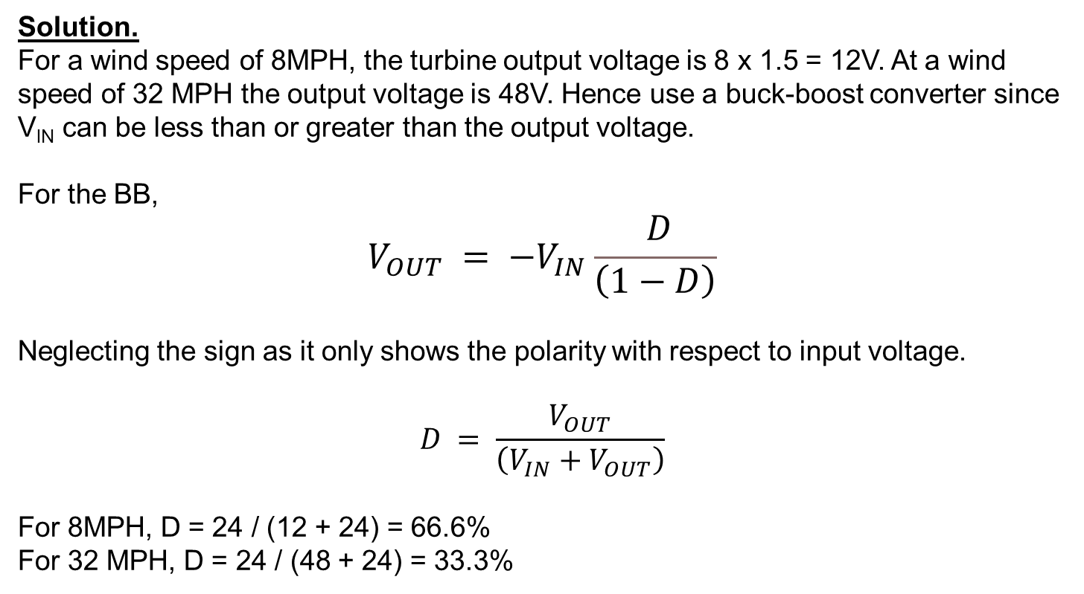
Solution.
For a wind speed of 8MPH, the turbine output voltage is 8 x 1.5 = 12V. At a wind speed of 32 MPH the output voltage is 48V. Hence use a buck-boost converter since V_{IN} can be less than or greater than the output voltage.
For the BB,
$$V_{OUT} = −V_{IN}\frac{ D}{\left(1−D\right)}$$
Neglecting the sign as it only shows the polarity with respect to input voltage.
$$D = \frac{V_{OUT}}{\left(V_{IN}+V_{OUT}\right)}$$
For 8MPH, D = 24 / (12 + 24) = 66.6%
For 32 MPH, D = 24 / (48 + 24) = 33.3%

Slide 27

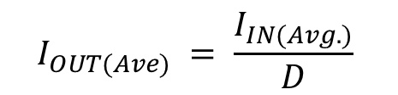

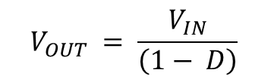


Converter summary
Type | Voltage Equation | Current Equation
Buck (V_{OUT} < V_{IN})
Boost (V_{OUT} > V_{IN})
Buck-boost (V_{OUT} <> V_{IN})
$$I_{OUT(Ave)} = \frac{I_{IN(Avg.)}}{D}$$
$V_{OUT}$ =$DV_{IN}$
$$V_{OUT} = \frac{V_{IN}}{\left(1− D\right)}$$
$I_{OUT}$ =$(1−D)I_{IN(Avg.)}$
$$V_{OUT} = −V_{IN}\frac{ D}{\left(1−D\right)}$$
$$I_{OUT(Ave)} = −I_{IN(Avg)}\frac{ 1−D}{D}$$

Slide 28
The following diagrams summarise the energy flow in the circuit for each converter type during the storage and release phases of operation.
Charging the Inductor
Discharging the Inductor
Storage
Release
Buck
Buck
Boost
Buck-boost
Buck-boost
Switch ON
Switch OFF

Slide 29
What have we learned so far?
DC-DC Converters
Switched Mode Power Supplies (Converters)
Buck Converter
Boost Converter
Buck-Boost Converter

