Slide 1

Power Electronics
Flyback Converter and
Snubber Circuit (缓冲电路)
Please read section 10-4-2 of Chapter 10
And Chapter 27 in the textbook

Slide 2
Flyback Converter

Slide 3

The buck-boost converter (V_{OUT} <> V_{IN}).
In the last lecture we saw that the Buck-Boost converter is able to produce output voltages that are higher or lower than the input voltage depending upon the duty cycle.
$$V_{OUT} = −V_{IN}\frac{ D}{\left(1−D\right)}$$
Switch
D
Control
V_{IN}
R_{L}
V_{Out}
C
Yes, it is possible through use of transformer in flyback converter.
V_{IN}
V_{OUT}
Buck-boost
0V
0V
In the circuit above, the input and output are not electrically isolated. The question is, can we provide electrical isolation between input and output?

Slide 4
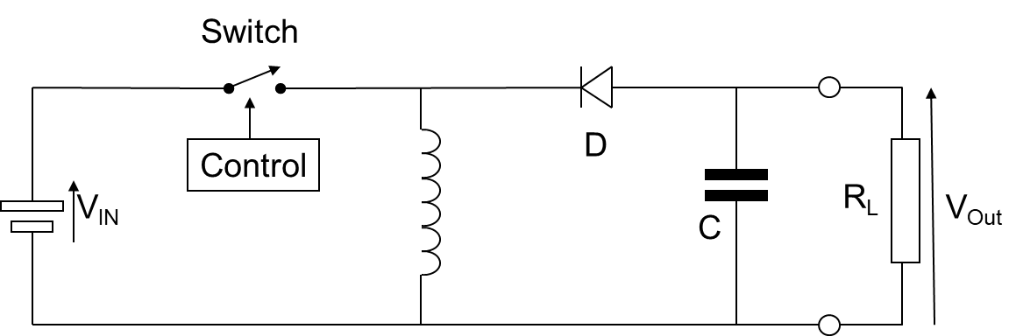
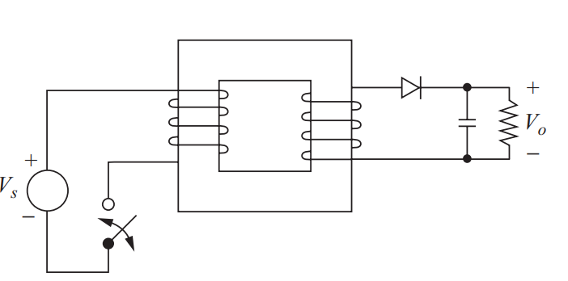

The Flyback Converter (V_{OUT} <> V_{IN}).
Flyback converters are derived from the buck-boost converters.
$$V_{OUT} = −V_{IN}\frac{ D}{\left(1− D\right)}$$

Slide 5
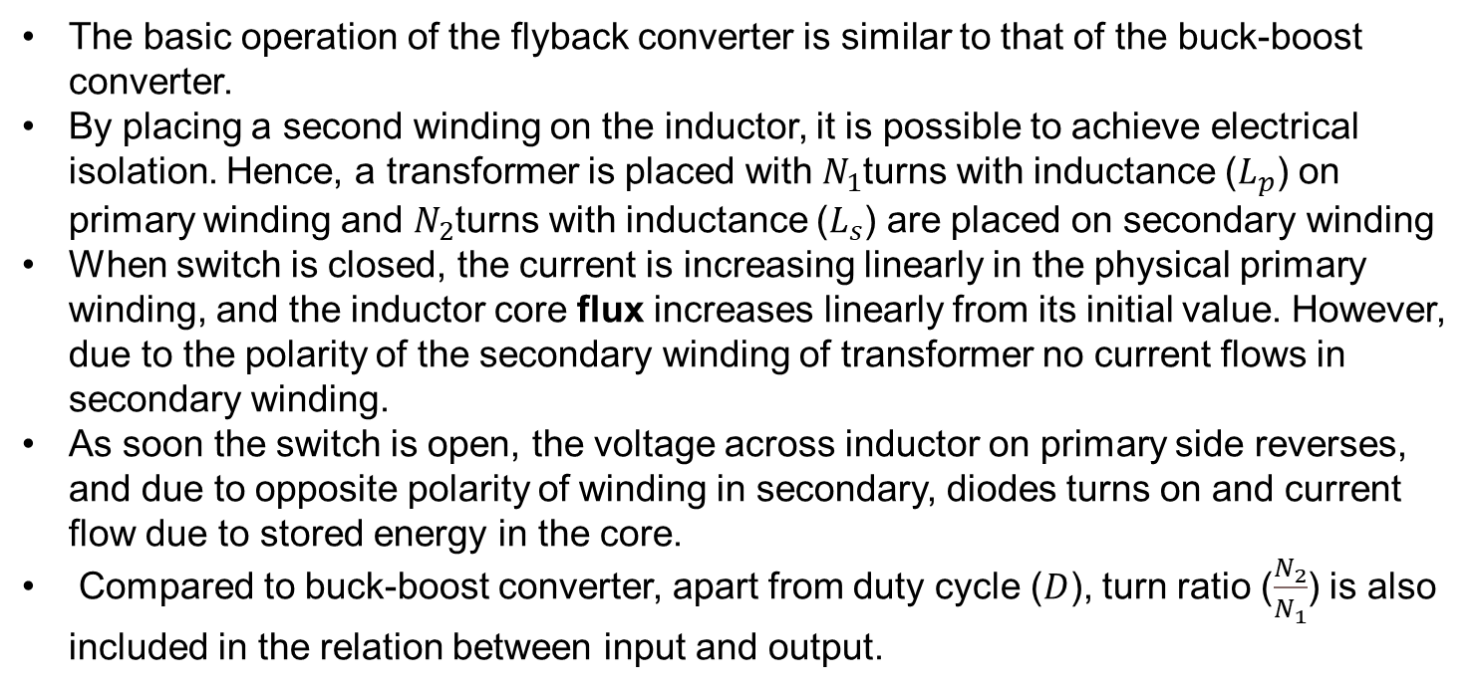
The Flyback Converter (V_{OUT} <> V_{IN}).
The basic operation of the flyback converter is similar to that of the buck-boost converter.
By placing a second winding on the inductor, it is possible to achieve electrical isolation. Hence, a transformer is placed with $N_{1}$turns with inductance ($L_{p}$) on primary winding and $N_{2}$turns with inductance ($L_{s}$) are placed on secondary winding
When switch is closed, the current is increasing linearly in the physical primary winding, and the inductor core flux increases linearly from its initial value. However, due to the polarity of the secondary winding of transformer no current flows in secondary winding.
As soon the switch is open, the voltage across inductor on primary side reverses, and due to opposite polarity of winding in secondary, diodes turns on and current flow due to stored energy in the core.
Compared to buck-boost converter, apart from duty cycle ($D$), turn ratio ($\frac{N_{2}}{N_{1}}$) is also included in the relation between input and output.

Slide 6
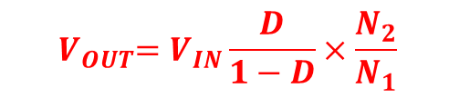
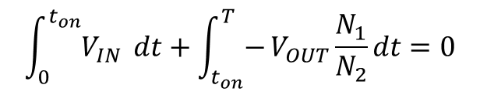
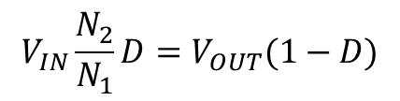
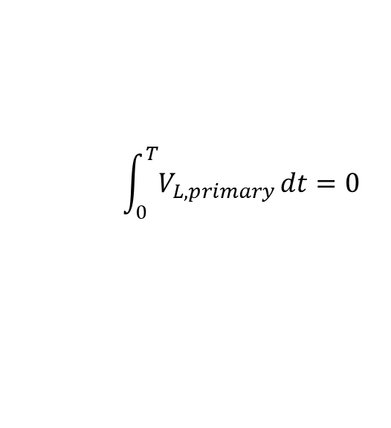
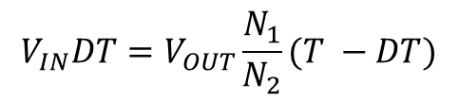
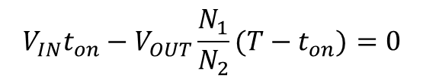
Boost converter Input/Output Voltage Relation
The integral of inductor voltage is equal to the change in the inductor flux linkage.
The net change of flux linking the inductor over one time period of repetition is zero, which is a necessary condition for steady-state operation.
$$\int_{0}^{T}{V_{L,primary}}dt=0$$
$$\int_{0}^{t_{on}}{V_{IN} }dt+\int_{t_{on}}^{T}{−}V_{OUT}\frac{N_{1}}{N_{2}}dt=0$$
$$V_{IN}t_{on}−V_{OUT}{\frac{N_{1}}{N_{2}}(T−t}_{on})=0$$
$$V_{IN}DT=V_{OUT}\frac{N_{1}}{N_{2}}(T −DT)$$
$$V_{IN}\frac{N_{2}}{N_{1}}D=V_{OUT}(1−D)$$
$${ V}_{OUT}=V_{IN}\frac{D}{1−D}×\frac{N_{2}}{N_{1}}$$

Slide 7
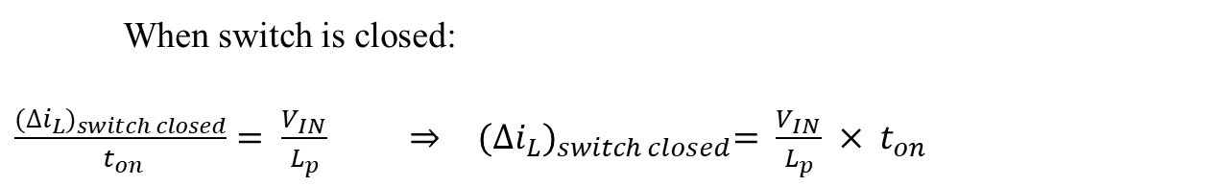

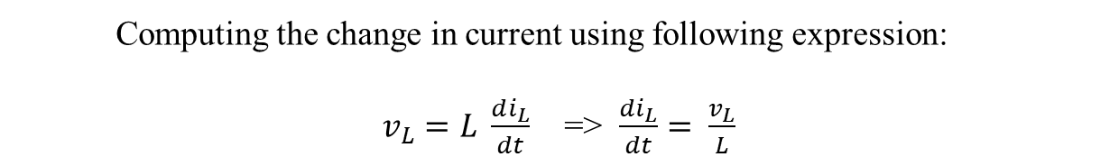

Boost converter Inductor Current Change
Inductor current
(= supply current)
Inductor current
Computing the change in current using following expression:
$v_{L}=L \frac{di_{L}}{dt}$ => $\frac{di_{L}}{dt}= \frac{v_{L}}{L}$
When switch is closed:
$\frac{{(∆i_{L})}_{switch closed}}{ t_{on}}= \frac{V_{IN}}{L_{p}} ⇒$ ${(∆i_{L})}_{switch closed}= \frac{V_{IN}}{L_{p}} × t_{on}$
$⇒$ ${(∆i_{L})}_{switch closed}= \frac{V_{IN}}{L_{p}} ×DT$
When switch is open:
$\frac{{(∆i_{L})}_{switch open}}{T− t_{on}}=−\frac{V_{OUT}\frac{N_{1}}{N_{2}}}{L_{p}}$ $⇒$ ${(∆i_{L})}_{switch open}={−V}_{OUT}\frac{N_{1}}{N_{2}}\frac{1}{L_{p}} × {(T−t}_{on})$
$⇒$ ${(∆i_{L})}_{switch open}={−V}_{OUT}\frac{N_{1}}{N_{2}}\frac{1}{L_{p}} ×T(1−D)$

Slide 8










Minimum and Maximum Inductor Current
Assuming lossless system
$$P_{IN}=P_{OUT }$$
$$⇒{ V}_{IN}I_{IN}=V_{OUT}I_{OUT }$$
$$⇒{ V}_{IN}I_{Lp, avg}D=V_{OUT}\frac{V_{OUT}}{R}$$
$${ V}_{IN}I_{Lp,avg}D=\frac{{V_{OUT}}^{2}}{R}$$
$$⇒ I_{Lp,avg}=\frac{{(V}_{OUT})^{2}}{V_{IN}D}×\frac{1}{R}$$
$$I_{Lp,avg}=(V_{IN}\frac{ D}{\left(1−D\right)}\frac{N_{2}}{N_{1}})^{2}×\frac{1}{V_{IN}DR}$$
$$I_{Lp,avg}=\frac{V_{IN}D}{(1−D)^{2}R}(\frac{N_{2}}{N_{1}})^{2}$$
$$I_{Lp,max}= I_{Lp,avg}+\frac{{\left(∆i_{Lp}\right)}_{switch closed}}{2}$$
$$I_{Lp,min}= I_{Lp,avg}−\frac{{\left(∆i_{Lp}\right)}_{switch closed}}{2}$$
Output Ripple (same as Buck-Boost Converter)
$$\frac{∆V_{OUT }}{V_{OUT}}=\frac{DT}{R C}$$

Slide 9
Snubber Circuit

Slide 10
Protection of Switching Devices and Circuits
The function of a snubber circuit is to reduce the electrical stresses placed on a device during switching by a power electronics converter to levels that are within the electrical ratings of the device.
It must be emphasized that snubbers are not a fundamental part of a power electronic converter circuit. The snubber circuit is an addition to the basic converter, which is added to reduce the stresses on an electrical component, usually a power semiconductor device.

Slide 11
Snubber Circuits for Hard-Switched Converters
Function of Snubber Circuit
Limiting device voltages during turn-off transients
Limiting device currents during turn-on transients
Limiting the rate-of-rise (di/dt) of currents through the semiconductor device at device turn-on
Limiting the rate-of-rise (dv/dt) of voltages across the semiconductor device at device turn-off
Shaping the switching trajectory of the device as it turns on/off
From the circuit topology perspective, there are three broad classes of snubber circuits
Unpolarized series R-C snubbers:
Used to protect diodes and thyristors
Used to Mitigate Ringing
Polarized R-C snubbers:
Used as turn-off snubbers to shape the turn-off switching trajectory of controlled switches. Limit dv/dt during device turn-off
Used as overvoltage snubbers to clamp voltages applied to controlled switches to safe values;
Polarized L-R snubbers
Used as turn-on snubbers to shape the turn-on switching trajectory of controlled switches;
Limit di/dt during device turn-on

Slide 12
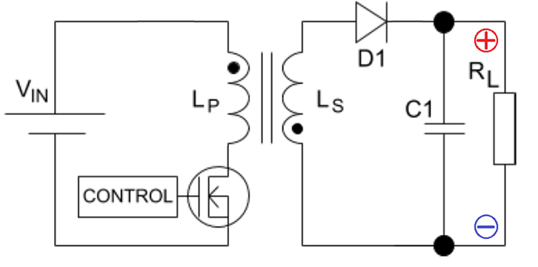

Ringing Effect.
Real electronic switches have a “parasitic” capacitance between their terminals, and circuit board tracks introduce stray inductance between components.
Ideal Flyback Converter
Actual Flyback Converter
At switching, this capacitance rings with the inductance at the undamped resonant frequency:
$f_{o }$= $\frac{1}{2π\sqrt{LC}}$
In these “parasitic” circuits there is usually very low resistance to dissipate the power in the oscillations and they can last for a considerable number of cycles.

Slide 13
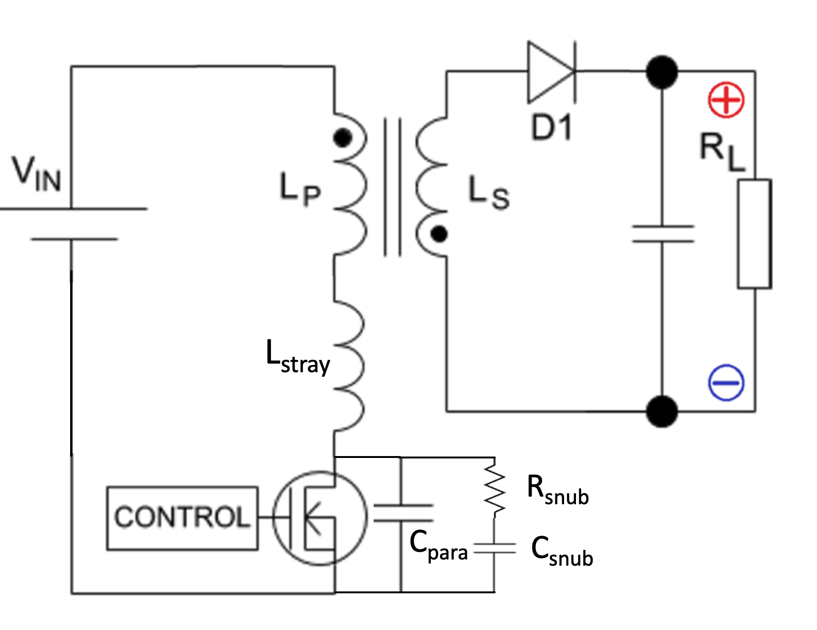
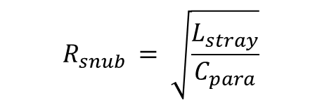
Ringing in Flyback Converter and Series RC Snubber Circuit
Snubbers are used extensively to prevent “ringing” when a circuit is switched on or off. Consider, the flyback converter shown below:
The RC snubber will, if properly designed, damp the ringing and limit the overshoot at switching. Optimum performance is obtained when the snubber capacitance is 3X the parasitic capacitance and the resistor value equals the characteristic impedance of the un-modified resonant circuit.
The characteristic impedance is given by
$$R_{snub }= \sqrt{\frac{L_{stray}}{C_{para}}}$$

Slide 14






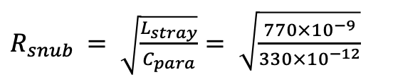
Example.
The switch in an SMPS has a parasitic capacitance of 330pF and the stray inductance due to circuit board layout is 770nH. What is the undamped ringing frequency? An RC snubber is to be used to reduce the power dissipation in the switch and to control the ringing. What are the optimum values for R & C?
$f_{o }$= $\frac{1}{2π\sqrt{LC}}$
= $\frac{1}{2π\sqrt{770×{10}^{−9}×330×{10}^{−12}}}$
$R_{snub }= \sqrt{\frac{L_{stray}}{C_{para}}}= \sqrt{\frac{770×{10}^{−9}}{330×{10}^{−12}}}$
Damped response.
$$C_{snub }=3×C_{para}=990 pF⇒C_{Total }=1320pF$$
$f_{new }$= $\frac{1}{2π\sqrt{LC_{Total }}}$
Notes:
Switched-mode power supply(SMPS)

Slide 15
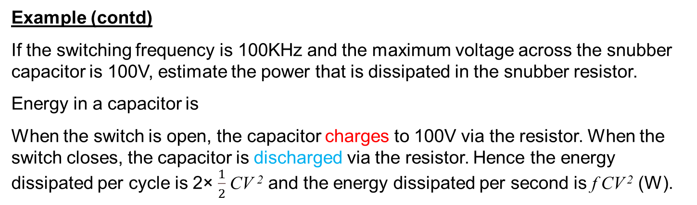
Example (contd)
If the switching frequency is 100KHz and the maximum voltage across the snubber capacitor is 100V, estimate the power that is dissipated in the snubber resistor.
Energy in a capacitor is
When the switch is open, the capacitor charges to 100V via the resistor. When the switch closes, the capacitor is discharged via the resistor. Hence the energy dissipated per cycle is 2× $\frac{1}{2}$CV ² and the energy dissipated per second is f CV ² (W).
P = f CV ² = 10⁵ x 990pF x100² = 0.990W
Caveat: This works for
_{Osc} << T_{Switch}
=RC => _{Osc} = 47.5nS
T_{Switch} = 1/F = 10μS, so OK.
=770nH
Note that the current from the snubber flows through the switch when the switch is closed.
=48Ω
= 990pF
=330pF

Slide 16
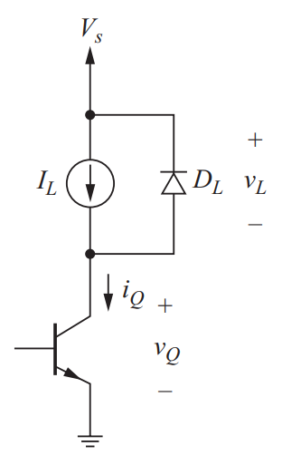
Polarized R-C snubber – Turn-off Snubber
Diode
OFF state
Transistor ON state

Slide 17
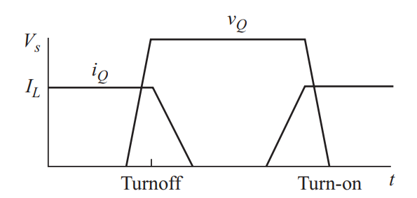
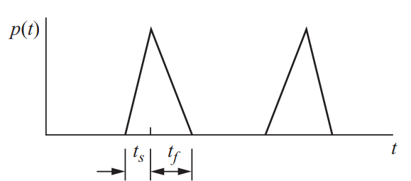
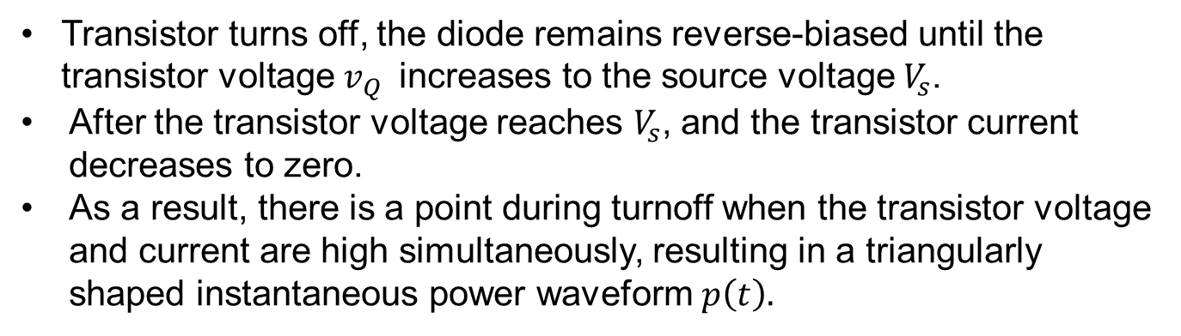
Polarized R-C snubber – Turn-off Snubber
Transistor turns off, the diode remains reverse-biased until the transistor voltage $v_{Q }$ increases to the source voltage $V_{s}$.
After the transistor voltage reaches $V_{s}$, and the transistor current decreases to zero.
As a result, there is a point during turnoff when the transistor voltage and current are high simultaneously, resulting in a triangularly shaped instantaneous power waveform $p\left(t\right).$

Slide 18
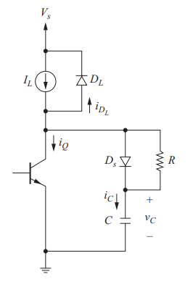
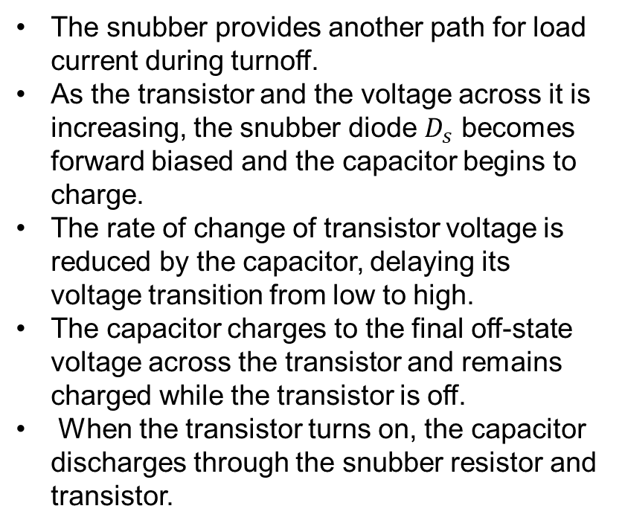
Polarized R-C snubber – Turn-off Snubber
The snubber provides another path for load current during turnoff.
As the transistor and the voltage across it is increasing, the snubber diode $D_{s}$ becomes forward biased and the capacitor begins to charge.
The rate of change of transistor voltage is reduced by the capacitor, delaying its voltage transition from low to high.
The capacitor charges to the final off-state voltage across the transistor and remains charged while the transistor is off.
When the transistor turns on, the capacitor discharges through the snubber resistor and transistor.
Turn-Off Snubber

Slide 19
Polarized R-C snubber – Turn-off Snubber
All the capacitor energy is dissipated in the resistor, which is easier to cool than the transistor.
No additional energy dissipation occurs in the transistor due to the turn-off snubber.
The peak current the transistor must conduct is not increased due to the turn-off snubber when it turns-on.
Turn-Off Snubber

Slide 20
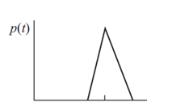
Turn off Snubber - Problem Solving
The converter and snubber in Fig. has V_{s} 100 V and I_{L} 5 A. The switching frequency is 100 kHz with a duty ratio of 50 percent, and the transistor turns off in 0.5µs. (a) Determine the turnoff losses without a snubber if the transistor voltage reaches Vs in 0.1µs. (b) Determine the transistor turnoff losses and the resistor power with the snubber added if 12.5 nF capacitor is used.
0.1µs
0.5µs
Solution: (a)
Transistor voltage reaches 100 V while the current is still at 5 A, resulting in a peak instantaneous power of (100 V)(5 A) 500 W.
The base of the power triangle is 0.6 µs, making the energy = 0.5(500 W)(0.6 µs) 150 µJ.

Slide 21
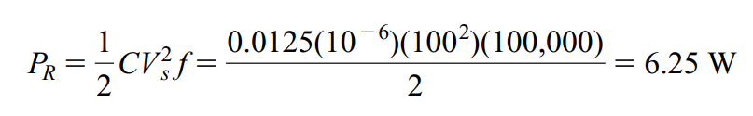
Turn off Snubber - Problem Solving
The converter and snubber has V_{s} 100 V and I_{L} 5 A. The switching frequency is 100 kHz with a duty ratio of 50 percent, and the transistor turns off in 0.5µs. (a) Determine the turnoff losses without a snubber if the transistor voltage reaches Vs in 0.1µs. (b) Determine the transistor turnoff losses and the resistor power with the snubber added if 12.5 nF capacitor is used.
Solution: (b)

Slide 22
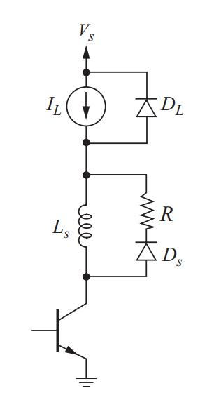
Polarized R-L snubber – Turn-on Snubber
Turn-on snubbers protect the device from simultaneously high voltage and current during turn-on.
As with the turn-off snubber, the purpose of the turn-on snubber is to modify the voltage-current waveforms to reduce power loss.
An inductor in series with the transistor slows the rate of current rise and can reduce the overlap of high current and high voltage.
The snubber diode is off during turn-on. During turnoff, the energy stored in the snubber inductor is dissipated in the resistor.
Turn - ON Snubber

Slide 23
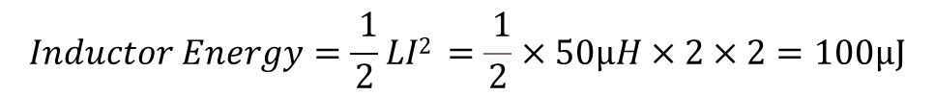
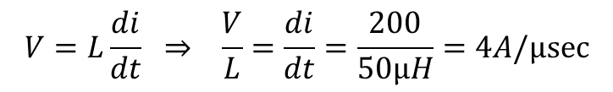
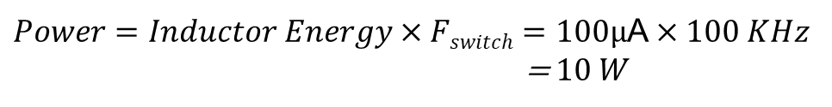
Example
In the circuit shown, the switch operates at 100KHz. The supply voltage is 200V. If the peak current in the switch is 2 amps, what power is dissipated in the resistor when switch is open?
What is the rate of rise of current limited to if the voltage
at A is 200V when the switch is closed?
A
=68Ω
50μH
$$Inductor Energy=\frac{ 1}{2}LI2 =\frac{ 1}{2}×50µH×2×2=100µJ$$
I_{Switch}=2A
F_{Switch}=100KHz
I
$Power=Inductor Energy×Fswitch=100µ$A $×100 KHz$
= $10 W$
$$V=L\frac{di}{dt} ⇒ \frac{V}{L}=\frac{di}{dt}=\frac{200}{50µH}=4A/µsec$$
Voltage at A

Slide 24
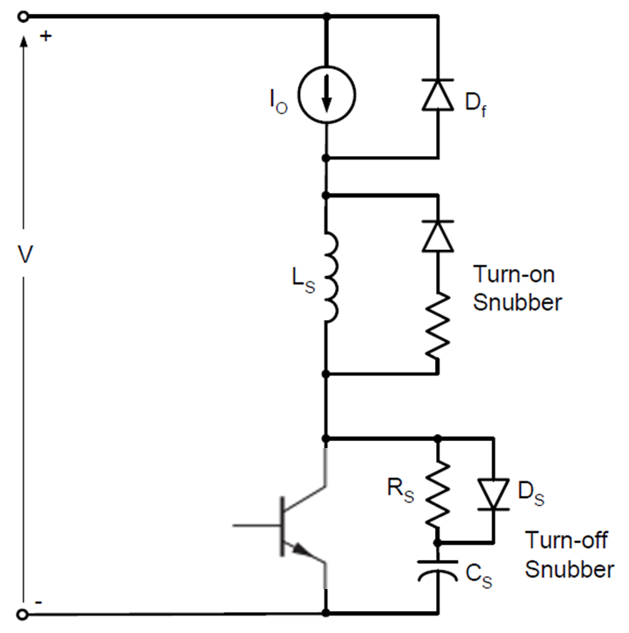
Summary of Snubber Circuit
Polarized R-L snubber
Polarized R-C snubbers

Slide 25
There are two key points to note about snubber circuit design:
There is always a degree of experimentation needed to tune a snubber’s operation. It is impossible to precisely design the circuit (although the desired function can be predicted).
The final circuit will probably be a compromise. A capacitive snubber that controls a voltage spike at turn-off may cause a current spike at turn-on. Similarly, controlling a current spike on one edge may cause a voltage spike on the other.
I
C
When switch opens, capacitor charges up, limiting dV/dt. (Desired)
When switch closes, capacitor is shorted, causing current spike. (Undesired)

Slide 26
What we learned?
Snubber Circuits
Why? -> functions
Where? -> protection
How? -> configurations
Classes of Snubber Circuits
Types of Snubber circuits
Series RC to mitigate ringing
Voltage snubbers (turn off)
Current snubbers (turn on)

