Slide 1

Power Electronics
DC-AC Converters (Inverters)
逆变器
Dr Atif Jafri
Atif.Jafri@glasgow.ac.uk
Please read Chapter 8 in the textbook

Slide 2
Scheme of Study
Fundamental
Types of Inverters
Half-bridge Inverter
Ideal Circuit Diagram
Operation
Output Waveform
Harmonics
Practical Circuit Diagram
Avoiding shoot through

Slide 3
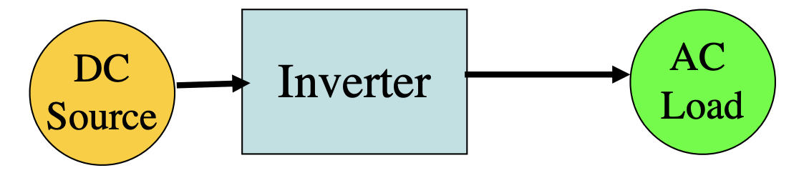
Fundamentals
DC-AC Converters are known as inverters
Role is to convert a DC signal to AC
Ideally, output should be sinusoidal.
In reality, these are non-sinusoidal and contain harmonics
This is fine for low and medium power applications
Divided into two main types
Single Phase
Three Phase
Semiconductor devices typically used
The basic building block is the ‘Bridge’ circuit
https://www.youtube.com/watch?v=qVeERT4nyz8

Slide 4
Inverter Types
- Half and Full Bridge
Half Bridge Inverter (Ideal)
Full Bridge Inverter (Ideal)

Slide 5
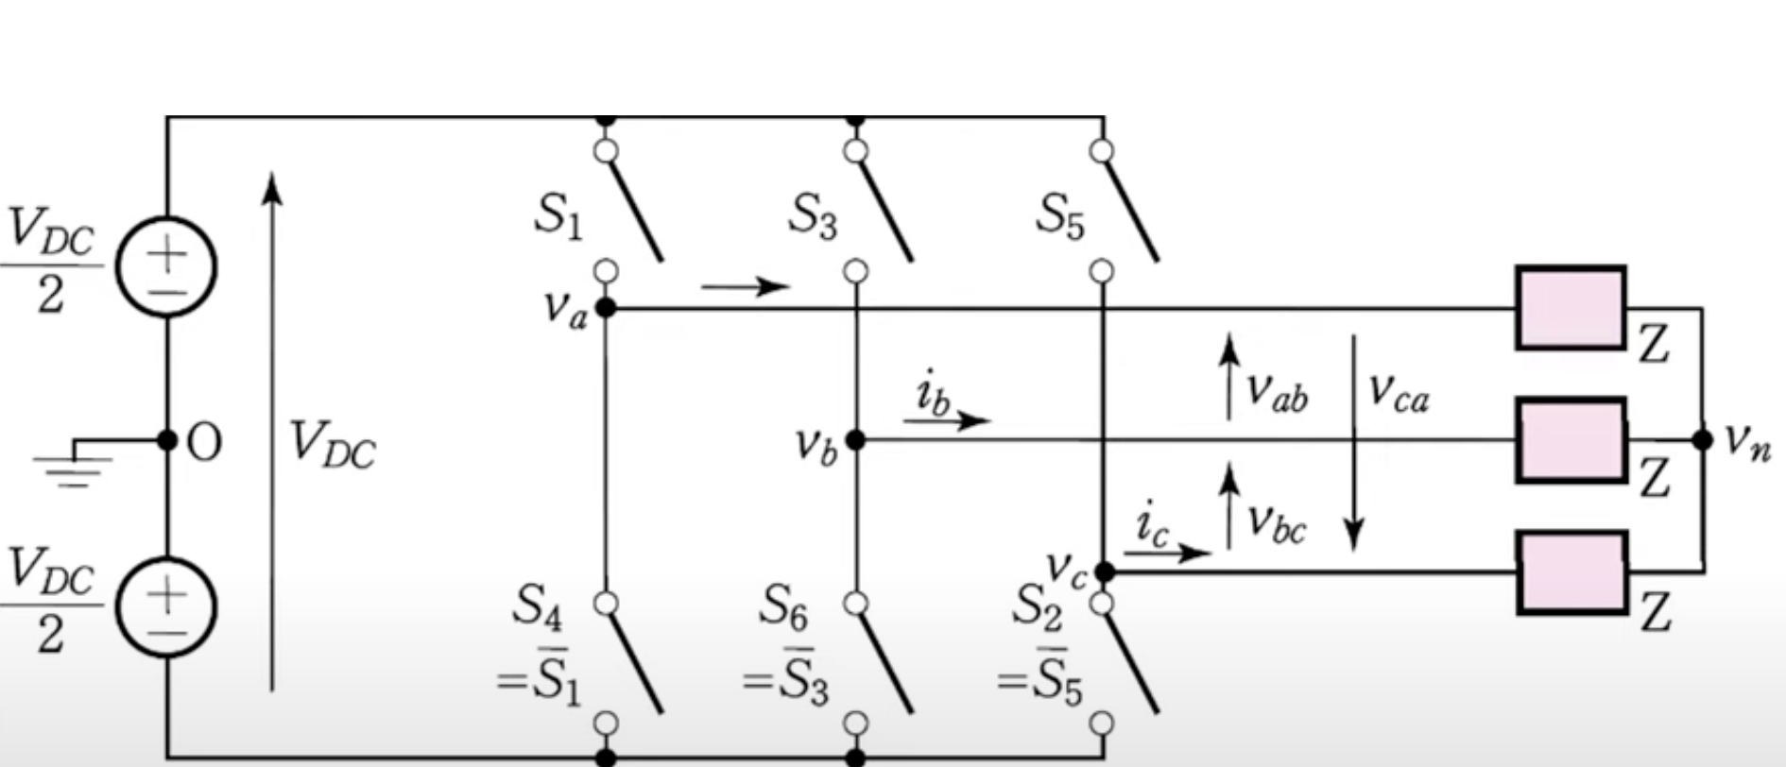
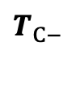


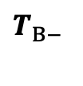

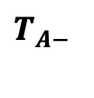
Inverter Types
3-Leg (For 3-phase inverter)
$$T_{A+}$$
$$T_{B+}$$
$$T_{C+}$$
$$T_{A− }$$
$$T_{B− }$$
$$T_{C− }$$
3-Leg Inverter (Ideal)

Slide 6
Schemes of Inverters to study
Phase Output | Bridge | Switching Schemes | Ideal Circuit Diagram Operation Output Waveform Harmonics Practical Circuit Diagram Avoiding shoot through
Single Phase | Half | Square Wave
 |  | Pules Width Modulation
 | Full | Square Wave
 |  | Pules Width Modulation (Bipolar & Unipolar)
Three Phase | 3-Leg | Square Wave
 |  | Pules Width Modulation

Slide 7
Schemes of Inverters to study
Phase Output | Bridge | Switching Schemes | Operation in different switching schemes Output Waveform Harmonics Practical Circuit Avoiding shoot through
Single Phase | Half | Square Wave
 |  | Pules Width Modulation
 | Full | Square Wave
 |  | Pules Width Modulation (Bipolar & Unipolar)
Three Phase | 3-Leg | Square Wave
 |  | Pules Width Modulation

Slide 8
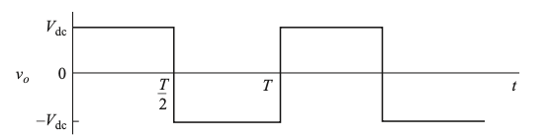

Operation
- Square Wave Switching
Half Bridge Inverter (Ideal)
Closed
Open
Open
Closed

Slide 9
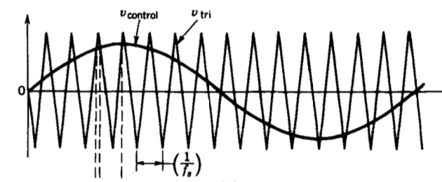
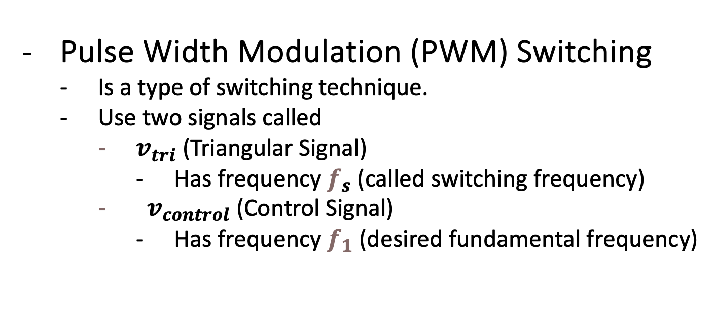
Operation
Pulse Width Modulation (PWM) Switching
Is a type of switching technique.
Use two signals called
$v_{tri}$ (Triangular Signal)
Has frequency $f_{s}$ (called switching frequency)
${ v}_{control}$ (Control Signal)
Has frequency $f_{1}$ (desired fundamental frequency)
v
v
v

Slide 10







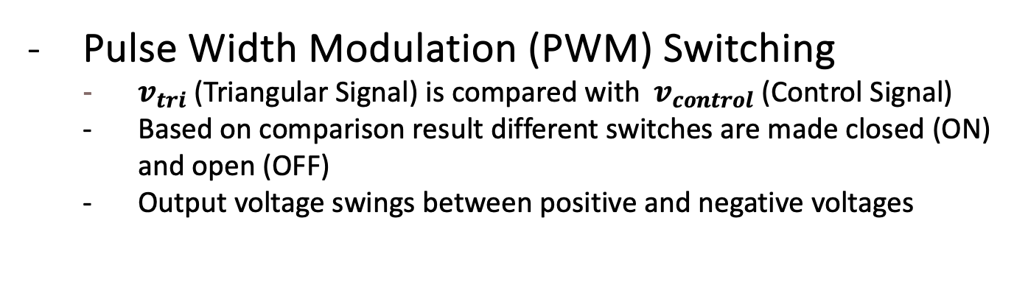

Operation
Pulse Width Modulation (PWM) Switching
$v_{tri}$ (Triangular Signal) is compared with${ v}_{control}$ (Control Signal)
Based on comparison result different switches are made closed (ON) and open (OFF)
Output voltage swings between positive and negative voltages
$$T_{A+}$$
$$o$$
$$A$$
$v_{Ao}$ = + $\frac{V_{dc}}{2}$
$$T_{A−}$$

Slide 11



Operation
Pulse Width Modulation (PWM) Switching
$v_{tri}$ (Triangular Signal) is compared with${ v}_{control}$ (Control Signal)
Based on comparison result different switches are made closed (ON) and open (OFF)
Output voltage swings between positive and negative voltages
$$T_{A+}$$
$$o$$
$$A$$
$$T_{A−}$$
$v_{Ao}$ = - $\frac{V_{dc}}{2}$

Slide 12

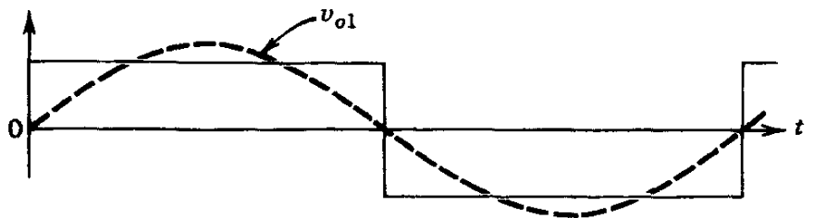

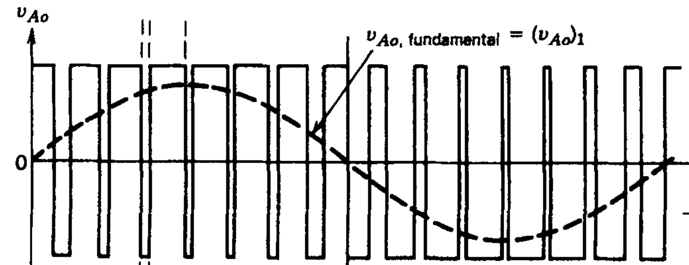




Harmonics
What are harmonics?
Pure Sinusoid is required.
The output is different both in square-wave and PWM switching
There is need to analyze the presence of other sinusoids having frequencies multiple of desired sinusoid, called harmonics, available in output.
Desired
Actual
$$T_{A+}$$
Output (Square Wave Switching)
$$o$$
$$A$$
Desired
Actual
$$T_{A−}$$
Output (PWM Switching)

Slide 13
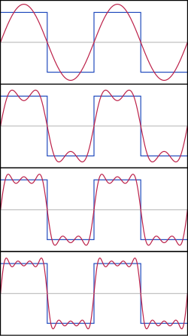
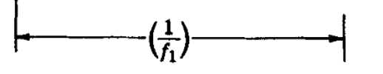



Harmonics
Harmonics in Square Wave Switching
There is need to analyze the presence of other sinusoids having frequencies multiple of desired sinusoid, called harmonics, available in output.
$$T_{A+}$$
$$o$$
$$A$$
$$T_{A−}$$

Slide 14
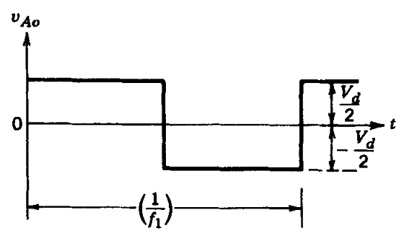

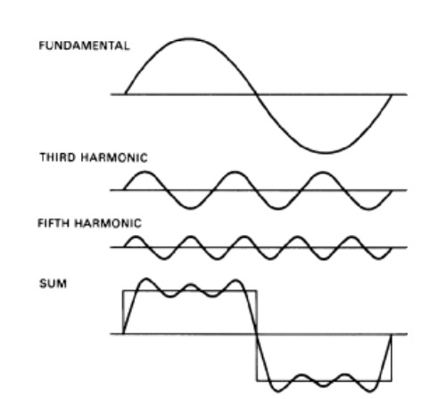
Harmonics
Harmonics in Square Wave Switching
There is need to analyze the presence of other sinusoids having frequencies multiple of desired sinusoid, called harmonics, available in output.
$$T_{A+}$$
-
$$o$$
$$A$$
$$T_{A−}$$

Slide 15

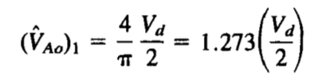
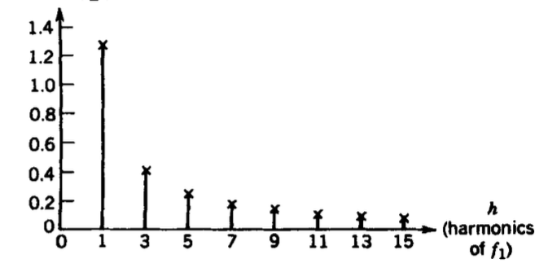
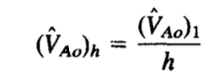
Harmonics
Harmonics in Square Wave Switching
There is need to analyze the presence of other sinusoids having frequencies multiple of desired sinusoid, called harmonics, available in output.
$$T_{A+}$$
$$o$$
$$A$$
-
$$T_{A−}$$
Fourier Series

Slide 16
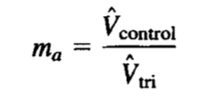


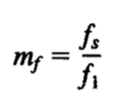


Harmonics
Harmonics in PWM Switching
To analyze “harmonics” for PWM switching we need to understand two new terms:
Amplitude Modulation Ratio and Frequency Modulation Ratio.
Amplitude Modulation Ratio
v
v
v
Peak Value of Control Signal
Peak Value of Triangular Signal
Frequency Modulation Ratio
Frequency of triangular signal
also called switching frequency
Frequency of control signal also
called desired fundamental frequency

Slide 17

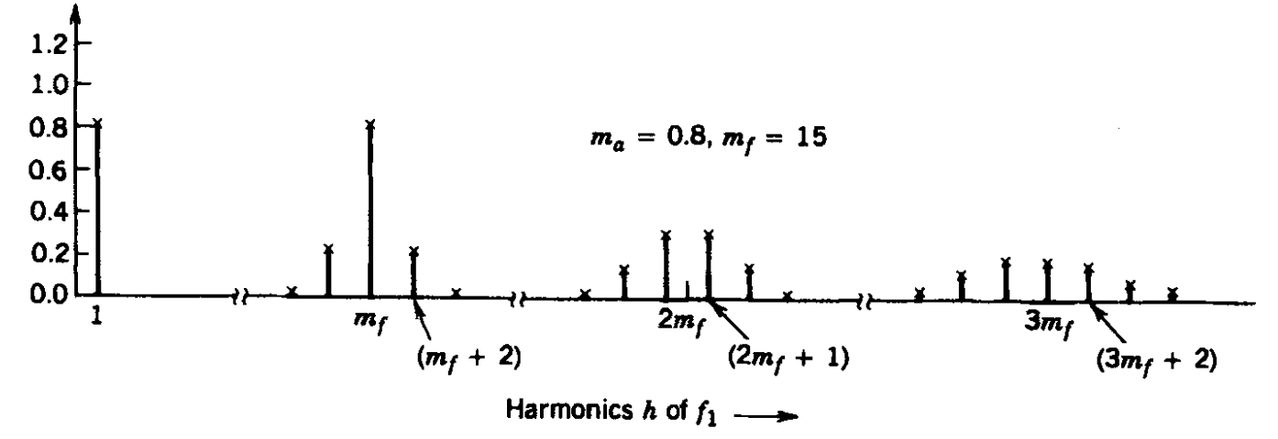

Harmonics
Harmonics in PWM Switching

Slide 18
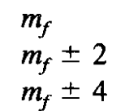
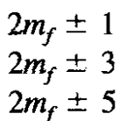
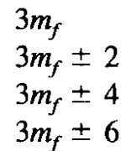

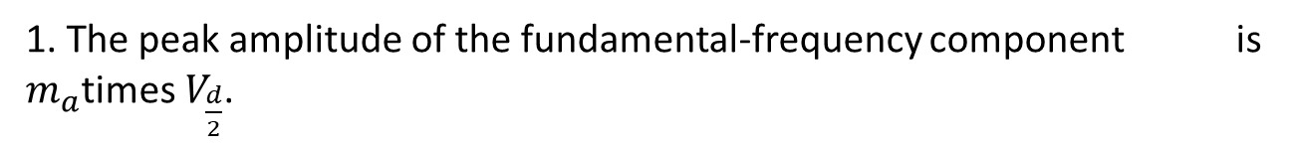
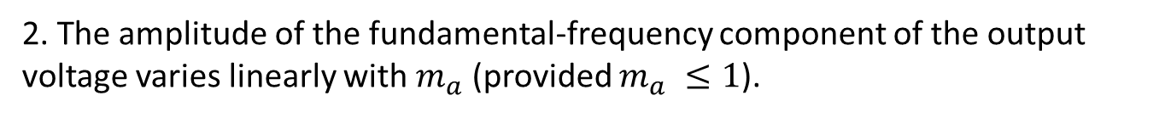
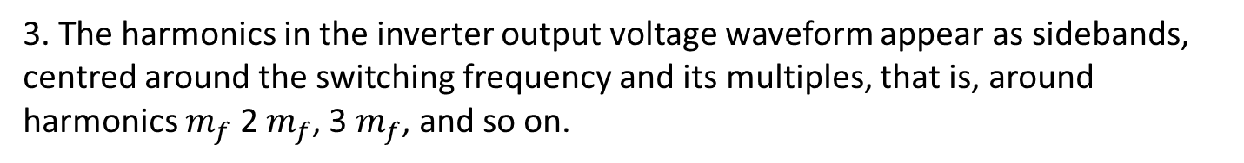
Harmonics
Harmonics in PWM Switching
1. The peak amplitude of the fundamental-frequency component is $m_{a}$times $V_{\frac{d}{2}}$.
2. The amplitude of the fundamental-frequency component of the output voltage varies linearly with $m_{a}$ (provided $m_{a} ≤1$).
3. The harmonics in the inverter output voltage waveform appear as sidebands, centred around the switching frequency and its multiples, that is, around harmonics $m_{f}$ 2 $m_{f}$, 3 $m_{f}$, and so on.

Slide 19
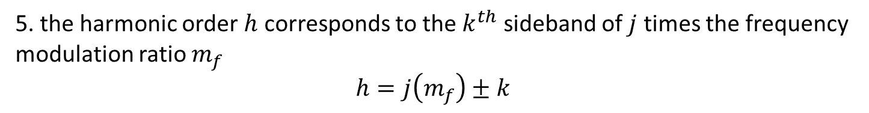
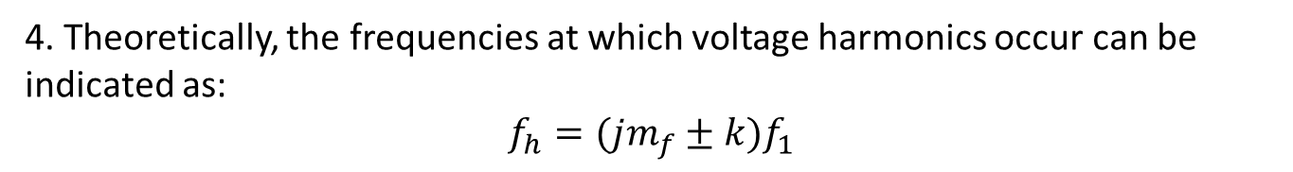
Harmonics
Harmonics in PWM Switching
4. Theoretically, the frequencies at which voltage harmonics occur can be indicated as:
$$f_{h}=(jm_{f}±k)f_{1}$$
5. the harmonic order $h$ corresponds to the $k^{th}$ sideband of $j$ times the frequency modulation ratio $m_{f}$
$$h=j\left(m_{f}\right)±k$$

Slide 20
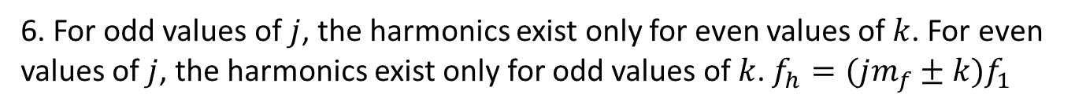
Harmonics
Harmonics in PWM Switching
6. For odd values of $j$, the harmonics exist only for even values of $k$. For even values of $j$, the harmonics exist only for odd values of $k$. $f_{h}=(jm_{f}±k)f_{1}$

Slide 21
Practical Half Bridge Inverter
Made through real components
Square Wave Switching
Both switches on
Shoot Through
Avoiding
Shoot through

Slide 22
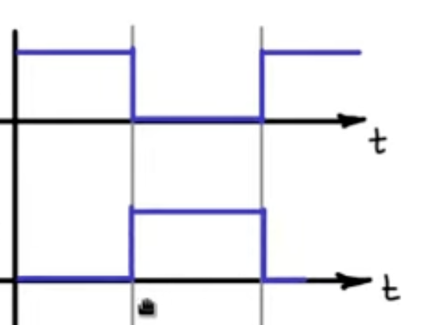
Practical Half Bridge Inverter
Made through real components
PWM Switching
Both switches on
Shoot Through

Slide 23
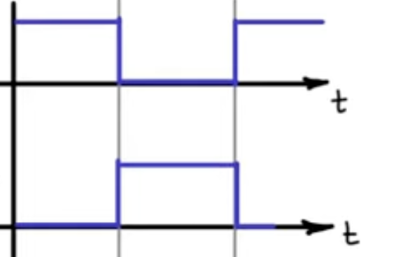
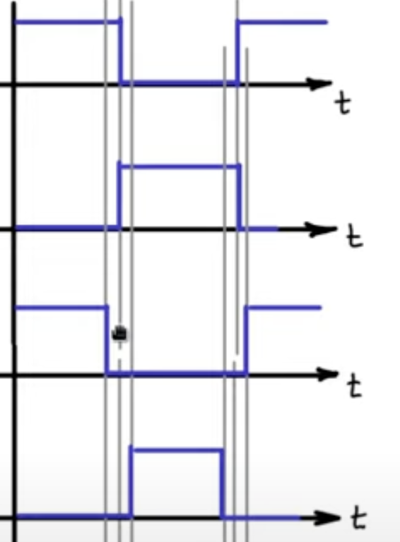




Practical Half Bridge Inverter
Made through real components
Avoiding shoot through in PWM Switching
$$T_{+}$$
Causing Shoot Through
$$T_{−}$$
$$T_{+}$$
Additional of blanking time to avoid shoot through
$$T_{−}$$
Blanking Time

Slide 24
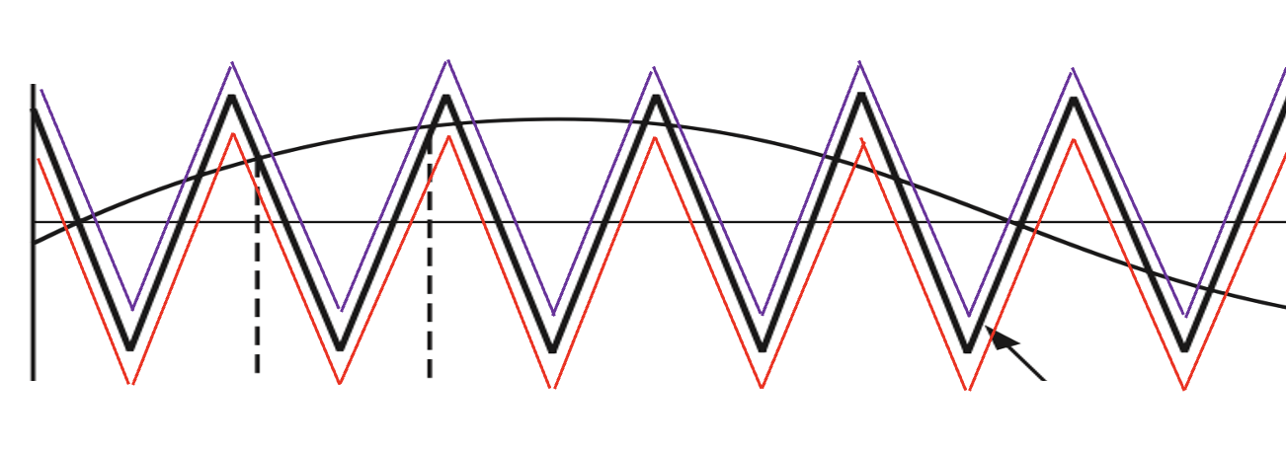




Avoiding Shoot through
$$v_{control}$$
$$v_{tri+}$$
$$v_{tri}$$
$$v_{tri−}$$
Blanking Time

