Slide 1

Power Electronics
DC-AC Converters (Inverters)
逆变器
Dr Atif Jafri
Atif.Jafri@glasgow.ac.uk
Please read Chapter 8 in the textbook

Slide 2
Schemes of Inverters to study
Phase Output | Bridge | Switching Schemes | Operation in different switching schemes Output Waveform Harmonics Practical Circuit Avoiding shoot through
Single Phase | Half | Square Wave
 |  | Pules Width Modulation
 | Full | Square Wave
 |  | Pules Width Modulation (Bipolar & Unipolar)
Three Phase | 3-Leg | Square Wave
 |  | Pules Width Modulation
So far studied Single Phase Inverter

Slide 3
Schemes of Inverters to study
Phase Output | Bridge | Switching Schemes |  | Ideal Circuit Diagram Operation Output Waveform Harmonics Practical Circuit Diagram Avoiding shoot through
Single Phase | Half | Square Wave
 |  | Pules Width Modulation
 | Full | Square Wave
 |  | Pules Width Modulation
 |  | Bipolar | Unipolar
Three Phase | 3-Leg | Square Wave
 |  | Pules Width Modulation

Slide 4
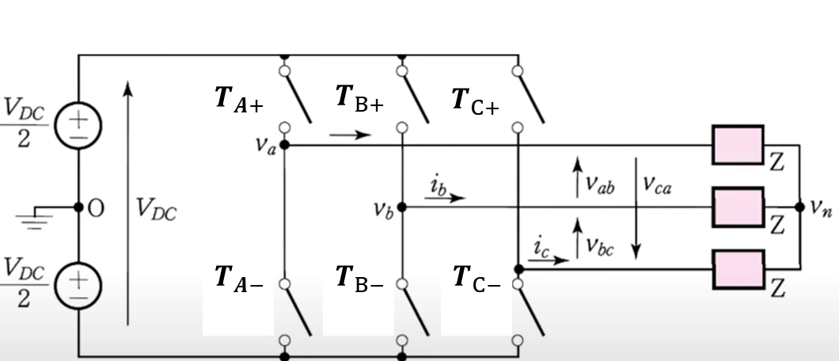
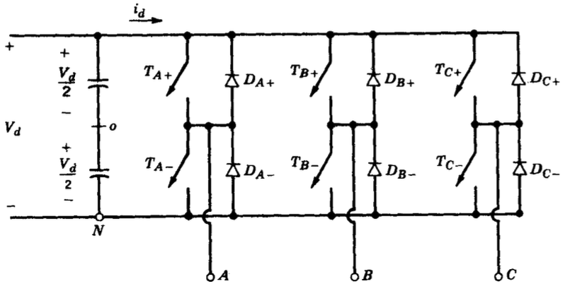
Inverter Types
- 3-Leg for 3 Phase Inveter
3 Phase Inverter (Ideal)
3-Phase Inverter with Flyback Diodes
Figures used in the literature for 3-Phase Inverter

Slide 5
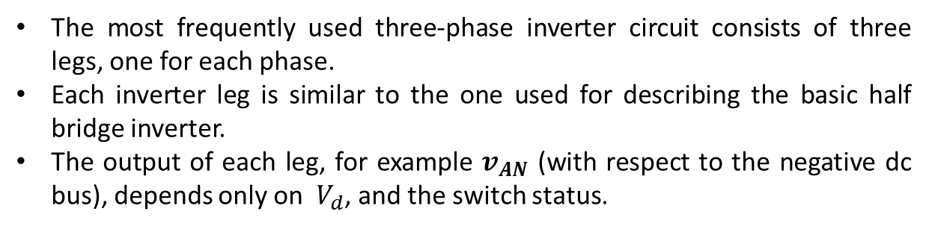
Operation
The most frequently used three-phase inverter circuit consists of three legs, one for each phase.
Each inverter leg is similar to the one used for describing the basic half bridge inverter.
The output of each leg, for example $v_{AN}$ (with respect to the negative dc bus), depends only on $V_{d}$, and the switch status.

Slide 6
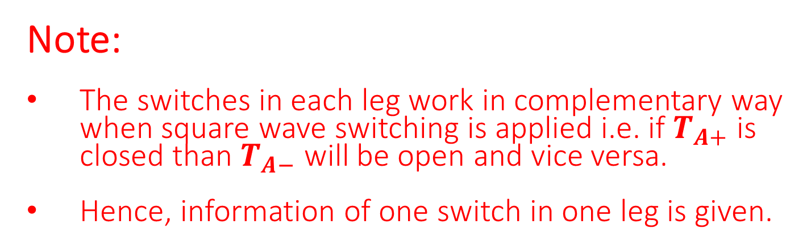
Operation – Square Wave
Note:
The switches in each leg work in complementary way when square wave switching is applied i.e. if $T_{A+}$ is closed than $T_{A−}$ will be open and vice versa.
Hence, information of one switch in one leg is given.

Slide 7




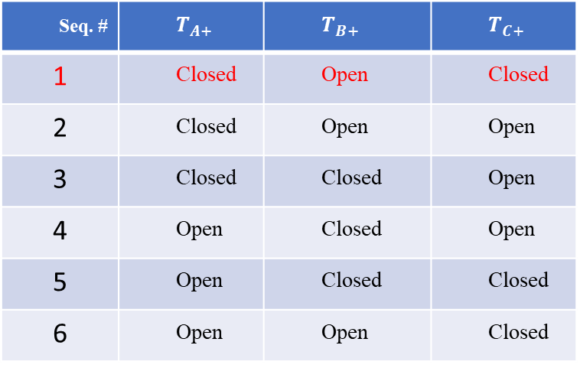
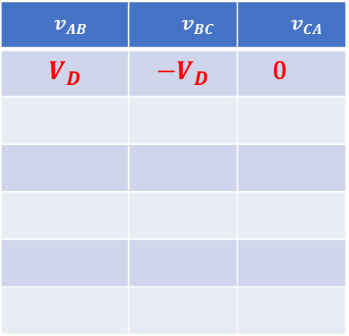
Operation – Square Wave
$$V_{D}$$
$$0$$
$$V_{D}$$
Seq. # | $$T_{A+}$$ | $$T_{B+}$$ | $$T_{C+}$$
1 | Closed | Open | Closed
2 | Closed | Open | Open
3 | Closed | Closed | Open
4 | Open | Closed | Open
5 | Open | Closed | Closed
6 | Open | Open | Closed
$$v_{AB}$$ | $$v_{BC}$$ | $$v_{CA}$$
$$V_{D}$$ | $${−V}_{D}$$ | 0

Slide 8
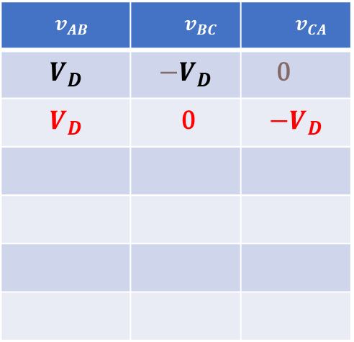
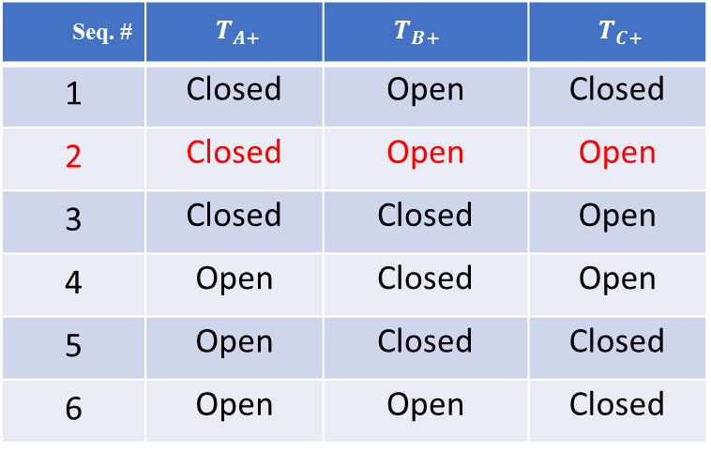
Operation – Square Wave
$$V_{D}$$
$$0$$
$$0$$
Seq. # | $$T_{A+}$$ | $$T_{B+}$$ | $$T_{C+}$$
1 | Closed | Open | Closed
2 | Closed | Open | Open
3 | Closed | Closed | Open
4 | Open | Closed | Open
5 | Open | Closed | Closed
6 | Open | Open | Closed
$$v_{AB}$$ | $$v_{BC}$$ | $$v_{CA}$$
$$V_{D}$$ | $${−V}_{D}$$ | 0
$$V_{D}$$ | 0 | $${−V}_{D}$$

Slide 9

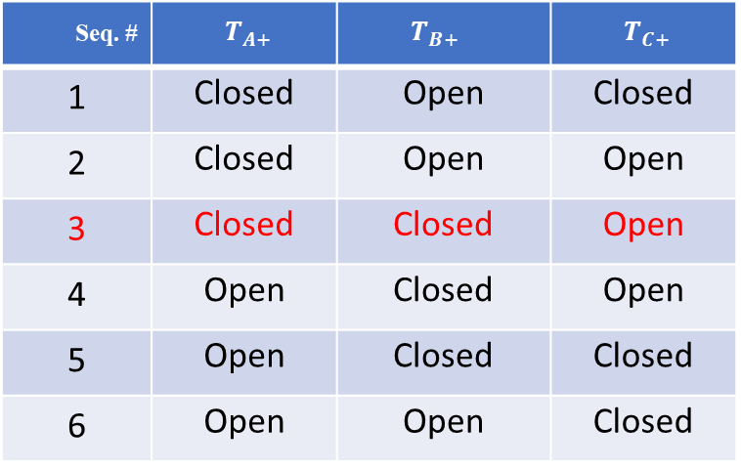
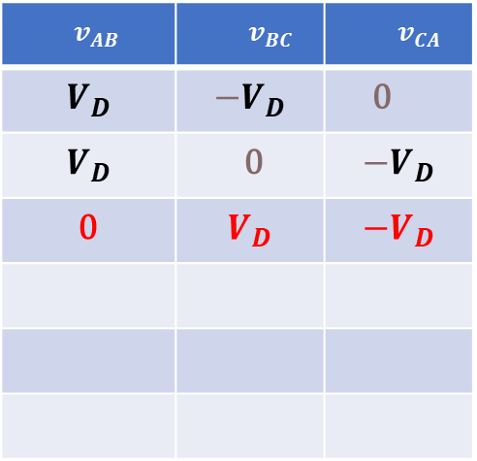
Operation – Square Wave
$$V_{D}$$
$$V_{D}$$
$$0$$
Seq. # | $$T_{A+}$$ | $$T_{B+}$$ | $$T_{C+}$$
1 | Closed | Open | Closed
2 | Closed | Open | Open
3 | Closed | Closed | Open
4 | Open | Closed | Open
5 | Open | Closed | Closed
6 | Open | Open | Closed
$$v_{AB}$$ | $$v_{BC}$$ | $$v_{CA}$$
$$V_{D}$$ | $${−V}_{D}$$ | 0
$$V_{D}$$ | 0 | $${−V}_{D}$$
0 | $$V_{D}$$ | $${−V}_{D}$$

Slide 10
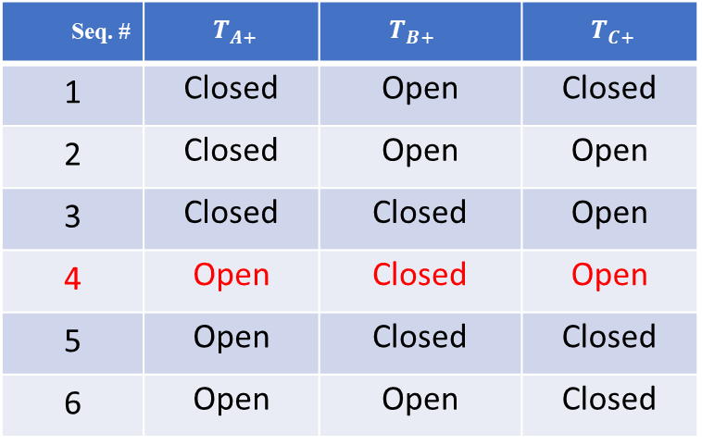
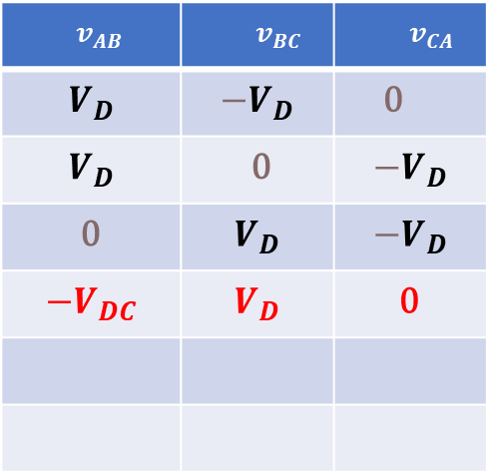
Operation – Square Wave
$$0$$
$$V_{D}$$
$$0$$
Seq. # | $$T_{A+}$$ | $$T_{B+}$$ | $$T_{C+}$$
1 | Closed | Open | Closed
2 | Closed | Open | Open
3 | Closed | Closed | Open
4 | Open | Closed | Open
5 | Open | Closed | Closed
6 | Open | Open | Closed
$$v_{AB}$$ | $$v_{BC}$$ | $$v_{CA}$$
$$V_{D}$$ | $${−V}_{D}$$ | 0
$$V_{D}$$ | 0 | $${−V}_{D}$$
0 | $$V_{D}$$ | $${−V}_{D}$$
$${−V}_{DC}$$ | $$V_{D}$$ | 0

Slide 11


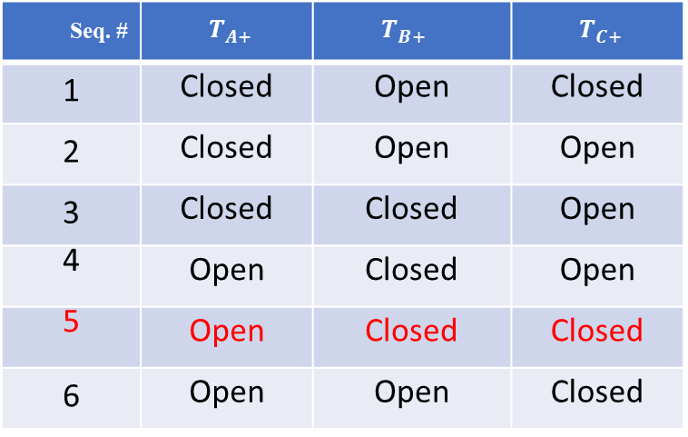
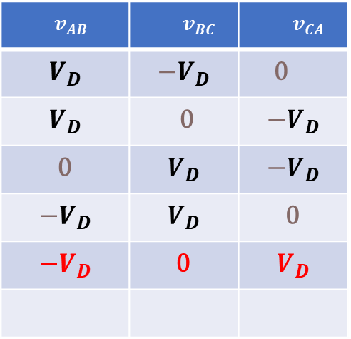
Operation – Square Wave
$$0$$
$$V_{D}$$
$$V_{D}$$
Seq. # | $$T_{A+}$$ | $$T_{B+}$$ | $$T_{C+}$$
1 | Closed | Open | Closed
2 | Closed | Open | Open
3 | Closed | Closed | Open
4 | Open | Closed | Open
5 | Open | Closed | Closed
6 | Open | Open | Closed
$$v_{AB}$$ | $$v_{BC}$$ | $$v_{CA}$$
$$V_{D}$$ | $${−V}_{D}$$ | 0
$$V_{D}$$ | 0 | $${−V}_{D}$$
0 | $$V_{D}$$ | $${−V}_{D}$$
$${−V}_{D}$$ | $$V_{D}$$ | 0
$${−V}_{D}$$ | 0 | $$V_{D}$$

Slide 12

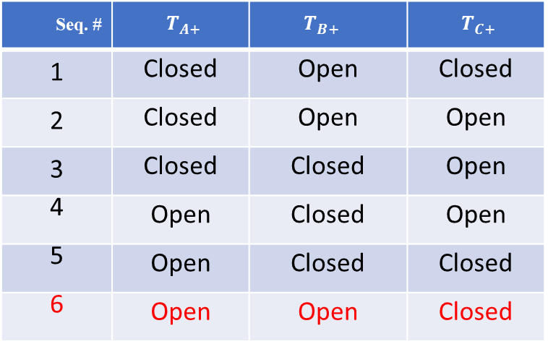
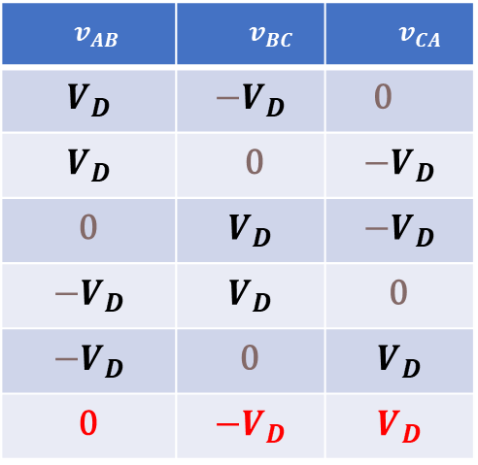
Operation – Square Wave
$$0$$
$$0$$
$$V_{D}$$
Seq. # | $$T_{A+}$$ | $$T_{B+}$$ | $$T_{C+}$$
1 | Closed | Open | Closed
2 | Closed | Open | Open
3 | Closed | Closed | Open
4 | Open | Closed | Open
5 | Open | Closed | Closed
6 | Open | Open | Closed
$$v_{AB}$$ | $$v_{BC}$$ | $$v_{CA}$$
$$V_{D}$$ | $${−V}_{D}$$ | 0
$$V_{D}$$ | 0 | $${−V}_{D}$$
0 | $$V_{D}$$ | $${−V}_{D}$$
$${−V}_{D}$$ | $$V_{D}$$ | 0
$${−V}_{D}$$ | 0 | $$V_{D}$$
0 | $${−V}_{D}$$ | $$V_{D}$$

Slide 13
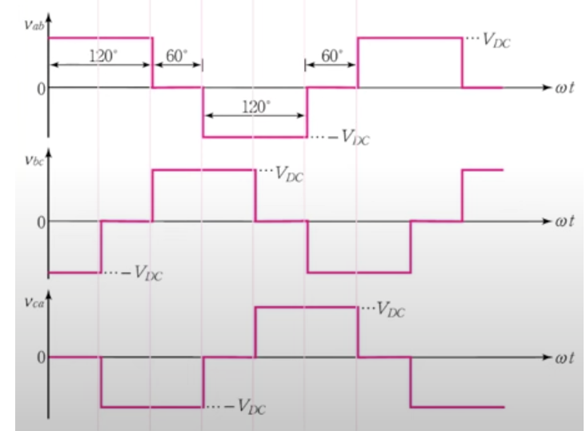
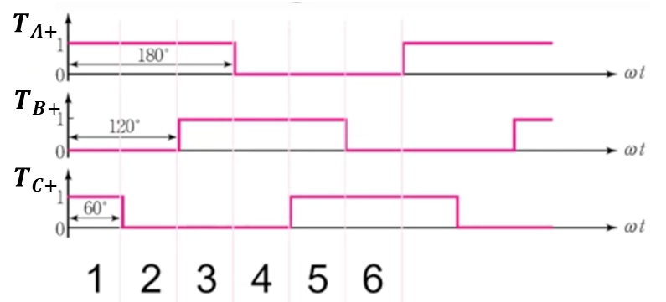


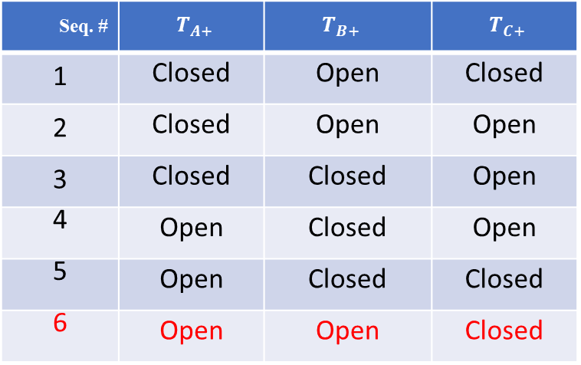


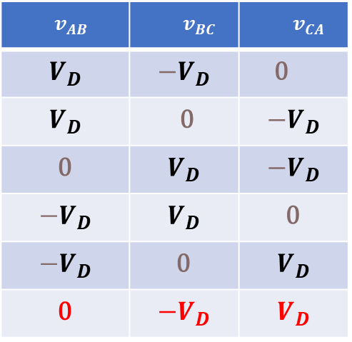

Operation – Square Wave
Seq. # | $$T_{A+}$$ | $$T_{B+}$$ | $$T_{C+}$$
1 | Closed | Open | Closed
2 | Closed | Open | Open
3 | Closed | Closed | Open
4 | Open | Closed | Open
5 | Open | Closed | Closed
6 | Open | Open | Closed
$$v_{AB}$$ | $$v_{BC}$$ | $$v_{CA}$$
$$V_{D}$$ | $${−V}_{D}$$ | 0
$$V_{D}$$ | 0 | $${−V}_{D}$$
0 | $$V_{D}$$ | $${−V}_{D}$$
$${−V}_{D}$$ | $$V_{D}$$ | 0
$${−V}_{D}$$ | 0 | $$V_{D}$$
0 | $${−V}_{D}$$ | $$V_{D}$$
$$V_{D}$$
$${−V}_{D}$$
$$V_{D}$$
$${−V}_{D}$$
$$V_{D}$$
$${−V}_{D}$$

Slide 14
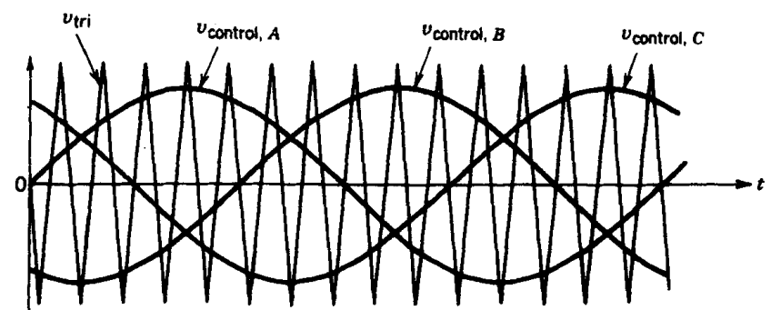
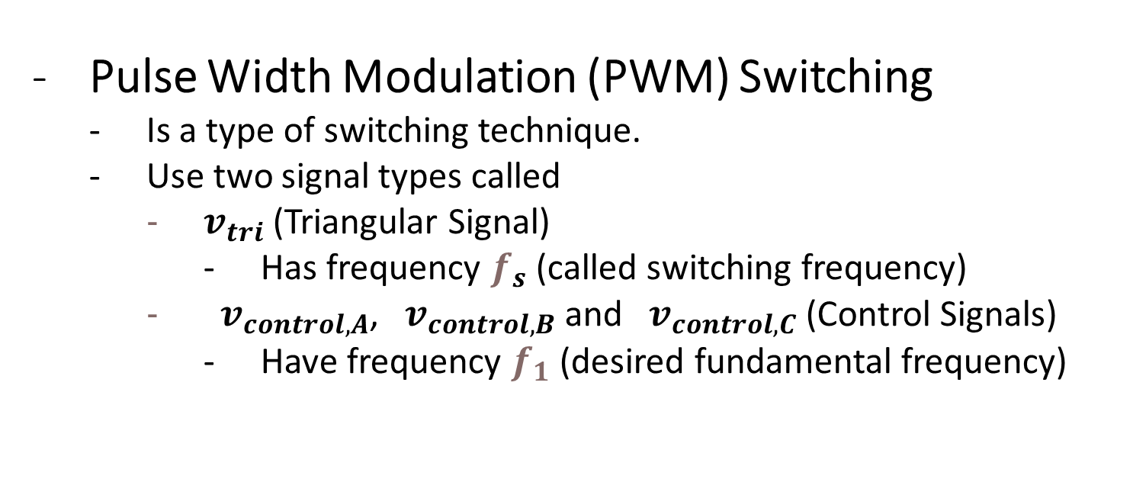
Operation
Pulse Width Modulation (PWM) Switching
Is a type of switching technique.
Use two signal types called
$v_{tri}$ (Triangular Signal)
Has frequency $f_{s}$ (called switching frequency)
${ v}_{control, A}$, ${ v}_{control, B}$ and ${ v}_{control, C}$ (Control Signals)
Have frequency $f_{1}$ (desired fundamental frequency)

Slide 15
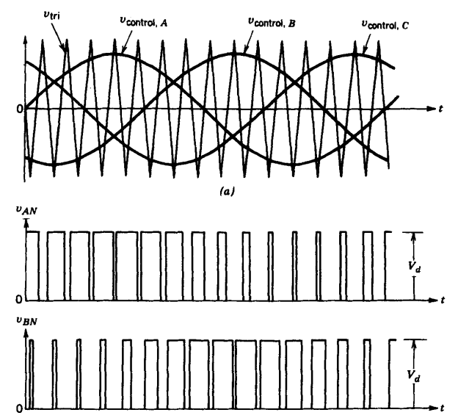
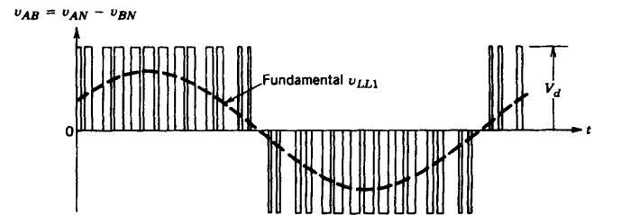


Operation
Pulse Width Modulation (PWM) Switching
$v_{control, A}$ > $V_{tri}$
$v_{control, B}$ > $V_{tri}$

Slide 16


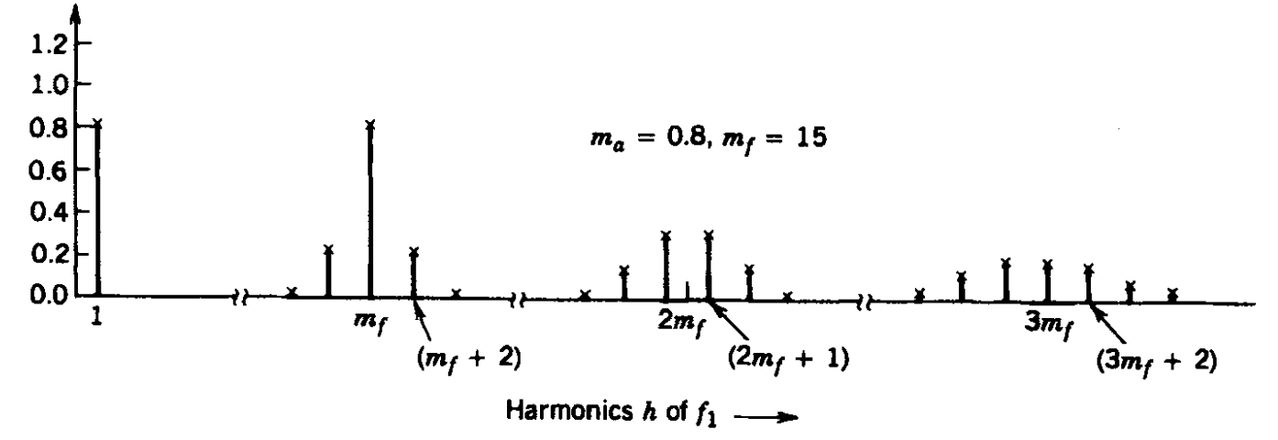
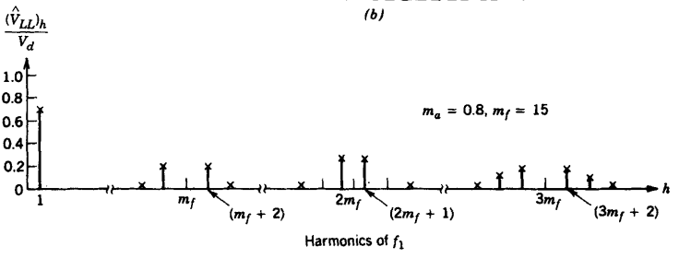
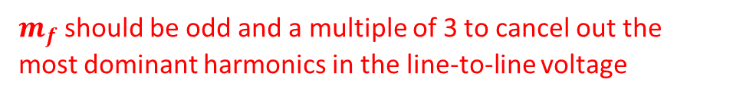
Harmonics
Harmonics in PWM Switching
The harmonics in the output of any one of the legs
In the three-phase inverters, only the harmonics in the line-to-line voltages are of concern.
$m_{f}$should be odd and a multiple of 3 to cancel out the most dominant harmonics in the line-to-line voltage

Slide 17
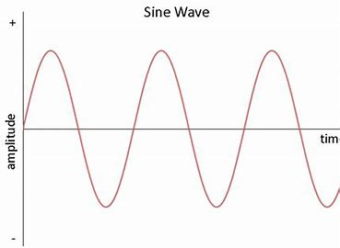
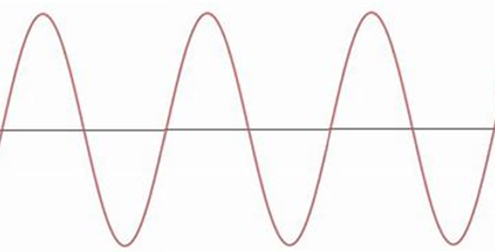

$m_{f}$ = 3 which is odd and multiple of 3
Phase-A
Phase-B
Hence, this is how the third harmonic in $v_{AB}$ will be eliminated from output

Slide 18
Practical Inverter
The hardware used in half bridge inverter can be used for each leg of three phase inverter to control the switching.
Similarly same techniques can be adopted to avoid the shoot through in both square wave and PWM switching mode.

Slide 19
Summary
Single Phase Inverter Studied
Half Bridge
Square Wave Switching
PWM Switching
Operation, Output Voltage, Harmonics, Inverter made through real components and avoiding shoot through
Full Bridge
Square Wave Switching
PWM Switching
Bipolar
Unipolar
Operation, Output Voltage, Harmonics, Inverter made through real components and avoiding shoot through
Three Phase Inverter
Square Wave Switching
PWM Switching
Operation, Output Voltage, Harmonics etc.

Slide 20
Power Electronics
Applications and Systems
Dr Atif Jafri
Atif.Jafri@glasgow.ac.uk

Slide 21
Applications - High level
Topics covered so far
Power Supplies
Inverters
Applications
Residential applications
Industrial applications
Electric Utility applications
Motor drive applications
Electric Vehicles

Slide 22
Residential Applications
Residential homes and buildings are the endpoint of approximately 35% of the total electricity generated in the United States, which corresponds to approximately 8.5% of the total primary energy usage.
The residential applications include space heating and air conditioning, refrigeration and freezing, water heating, lighting, cooking, television, clothes washer and dryer, and many other miscellaneous appliances.

Slide 23
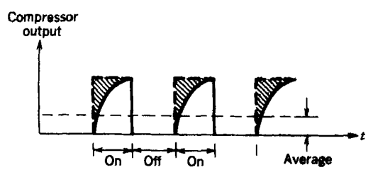
SPACE HEATING AND AIR CONDITIONING
Approximately 25-30% of the electric energy in an all-electric home is used for space heating and air conditioning.
- In a conventional heat pump, the compressor operates essentially at a constant speed when the motor is running.
- The compressor output in this system is matched to the building heating or cooling load by cycling the compressor on or off

Slide 24
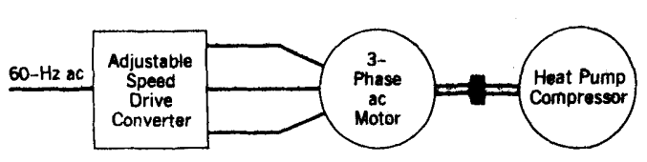
SPACE HEATING AND AIR CONDITIONING
In a load-proportional capacity modulated heat pump, the speed of the compressor motor and hence the compressor output are adjusted to match the building heating or cooling load.
Eliminating the on or off cycling of the compressor.
The loss in the compressor output due to on-off cycling is eliminated in the load proportional capacity-modulated heat pump, where the speed of the compressor and, hence, the compressor output are adjusted to equal the building load.

Slide 25
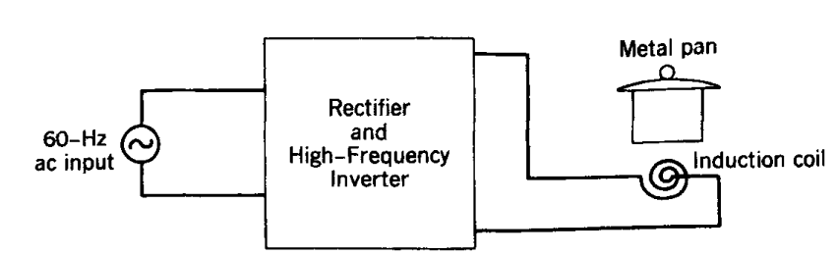
INDUCTION COOKING
In a standard electric or gas cooking range, a significant amount of heat escapes to the surroundings, thus resulting in poor thermal efficiency.
The 60-Hz ac input is converted to a high-frequency ac in a range of 25-40 kHz, which is supplied to an induction coil.
This induces circulating currents in the metal pan on top of the induction coil, thus directly heating the pan.

Slide 26
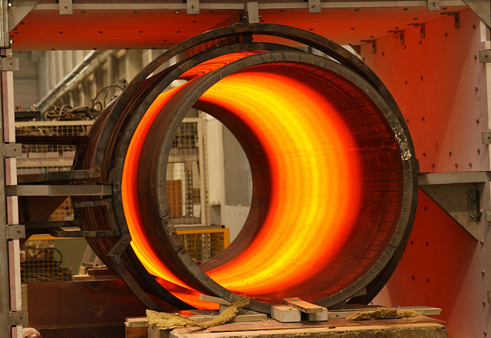

Industrial Applications
Industrial applications include applications such as induction heating and welding.

Slide 27

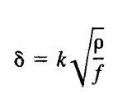
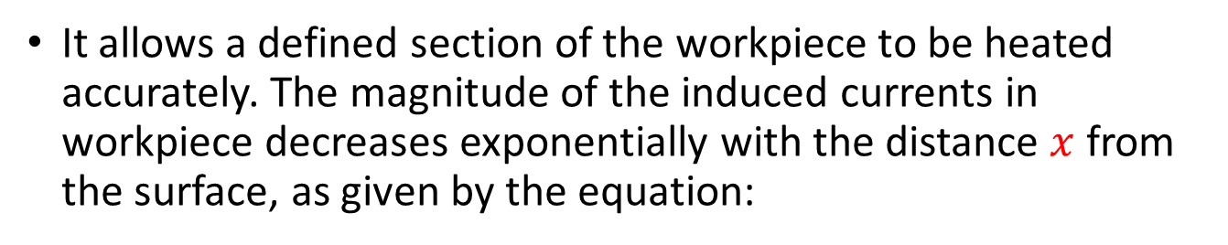
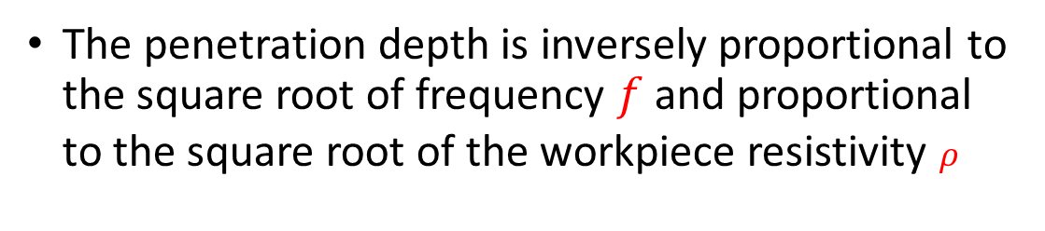
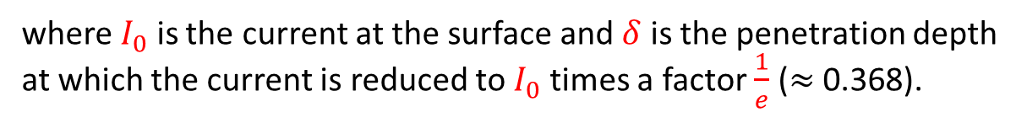
Induction Heating
In induction heating, the heat in the electrically conducting workpiece is produced by circulating currents caused by electromagnetic induction.
Induction heating is clean, quick, and efficient.
It allows a defined section of the workpiece to be heated accurately. The magnitude of the induced currents in workpiece decreases exponentially with the distance $x$ from the surface, as given by the equation:
where $I_{0}$ is the current at the surface and $δ$ is the penetration depth at which the current is reduced to $I_{0}$ times a factor $\frac{1}{e}$ ($≈$0.368).
The penetration depth is inversely proportional to the square root of frequency $f$and proportional to the square root of the workpiece resistivity $ρ$

Slide 28
Induction Heating
The induction frequency is selected based on the application.
A low frequency such as the utility frequency may be used for induction melting of large workpieces.
High frequencies of up to a few hundred kilohertz are used for forging, soldering, hardening, and annealing.

Slide 29
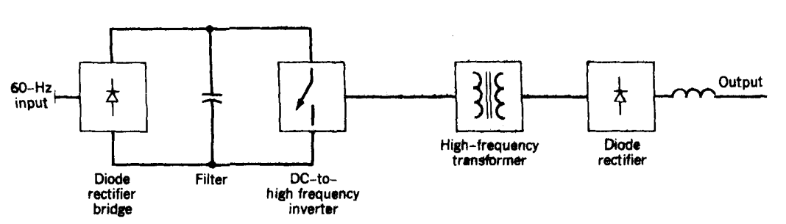
Electric Welding
In electric arc welding, the melting energy is provided by establishing an arc between two electrodes, one of which is the metallic workpiece being welded.
The voltage-current characteristic of the welder depends on the type of welding process employed.
Typical rated voltage and current are 50 V and 500 A dc, respectively.
In all welding applications, the output needs to be electrically isolated from the utility input. This electrical isolation is provided by either a 60-Hz power transformer or a high.

Slide 30
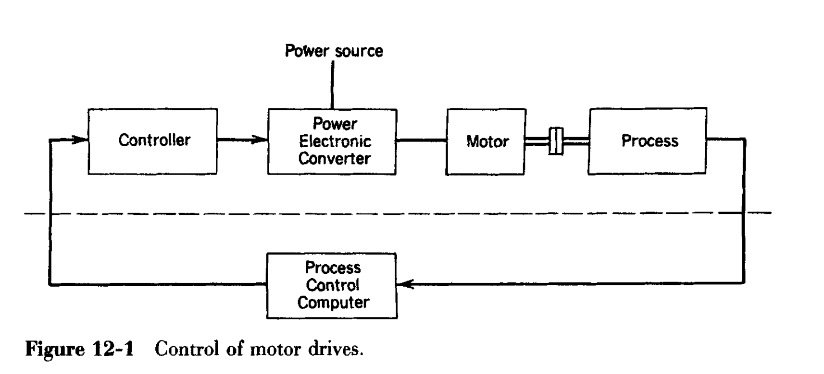
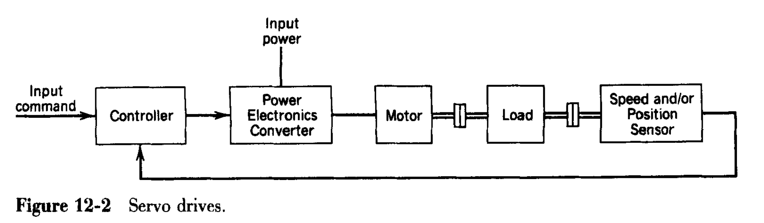
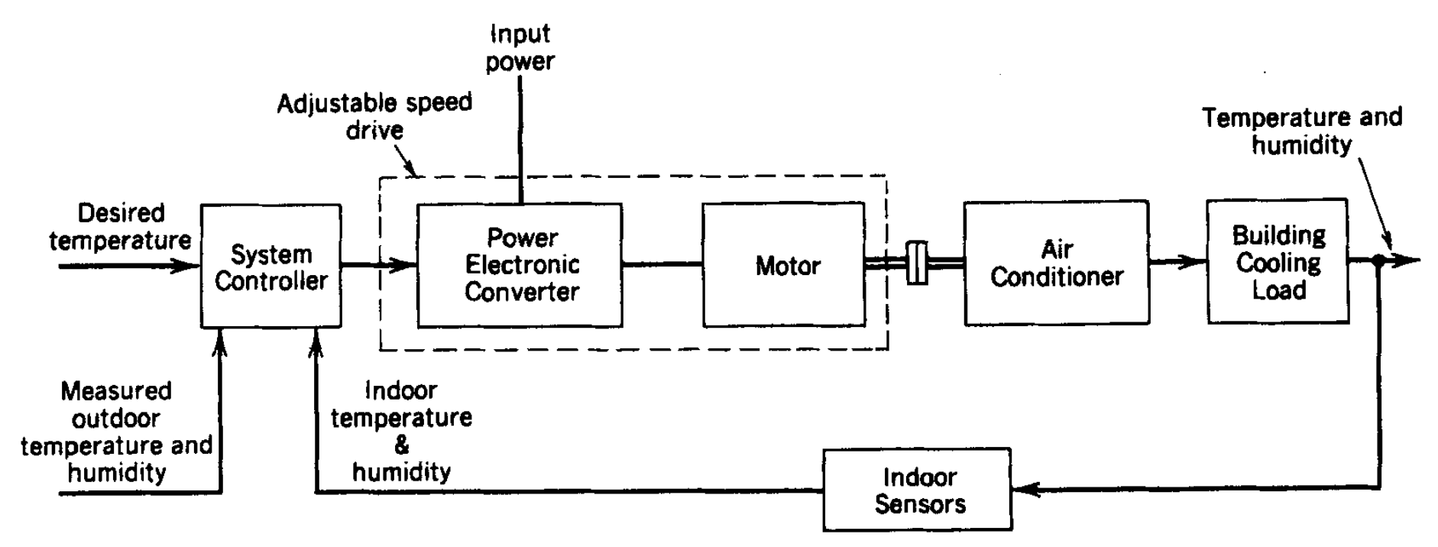
Motor drive applications

Slide 31
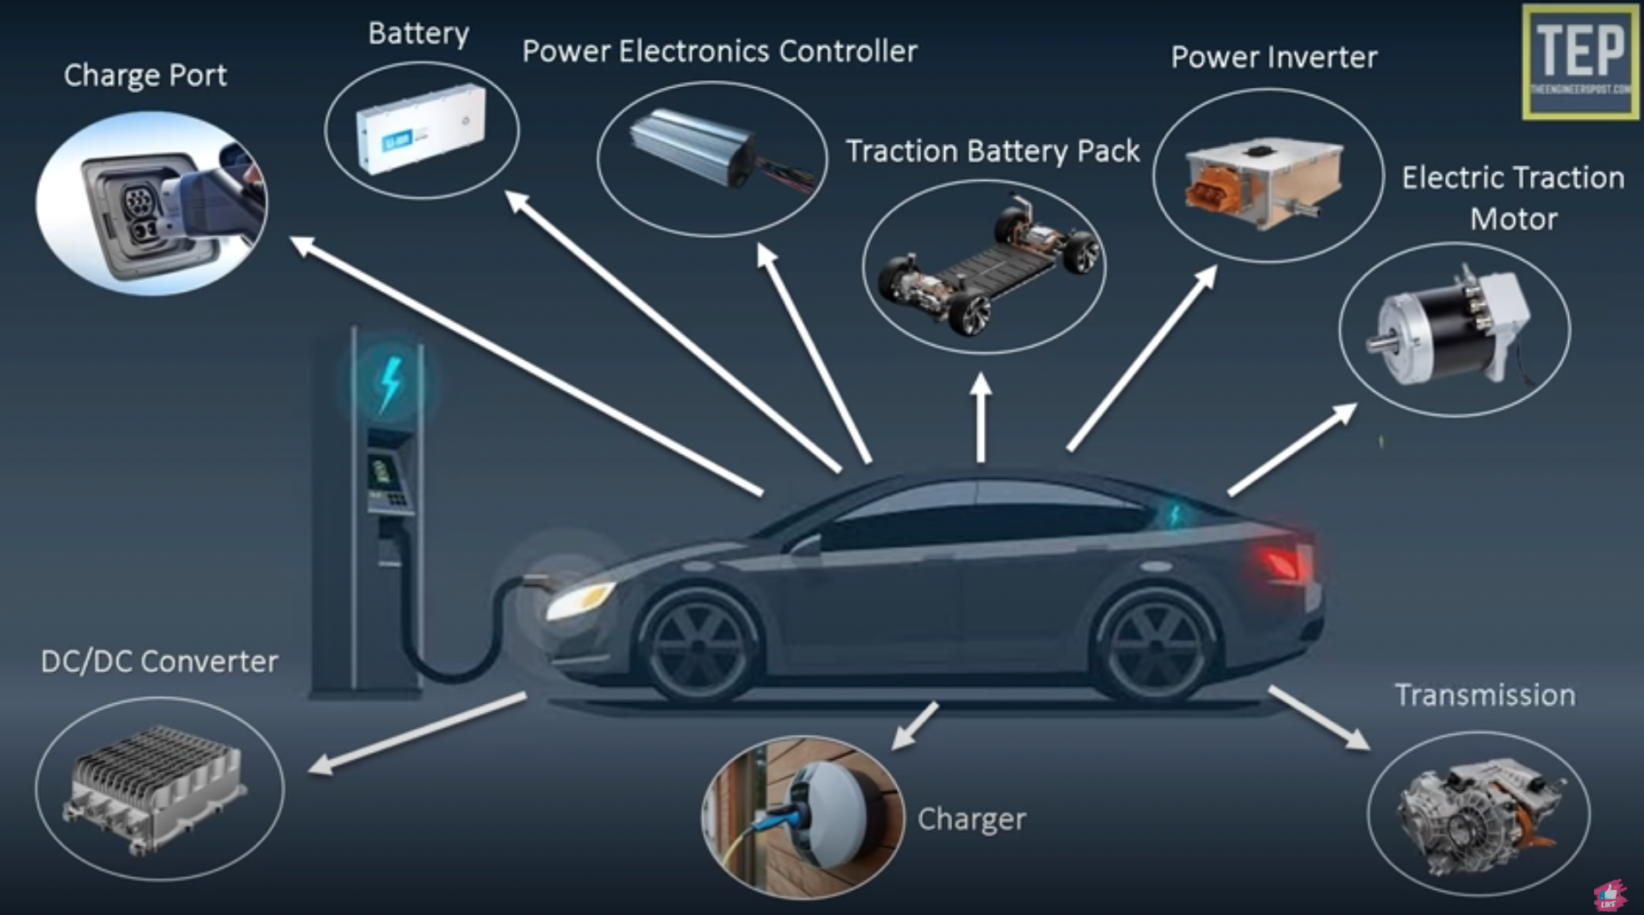
Electric Vehicle

Slide 32
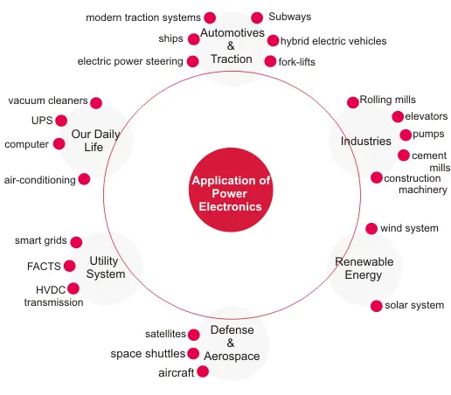

Slide 33
Additional links for self study
Electric Vehicle – parts and functions
https://www.youtube.com/watch?v=tJfERzrG-D8
Applications
https://www.youtube.com/watch?v=6KHJ5JA4BbY
https://www.electrical4u.com/application-of-power-electronics/

