Slide 1
Problem Solving

Slide 2
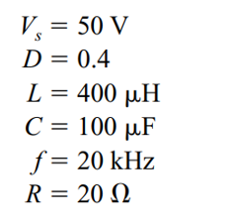
Buck
Assuming ideal components, calculate (a) the output voltage , (b) the maximum and minimum inductor current, and (c) the output voltage ripple.

Slide 3

Boost
A boost converter has following parameters. Determine duty cycle, average, minimum and maximum inductor current and output voltage ripple.
$$V_{IN}=12 V$$
$V_{OUT}=30 V$
$L=120 μH$
$$C=48 μF$$
$$R=50 ohm$$
$$f=50 KHz$$

Slide 4
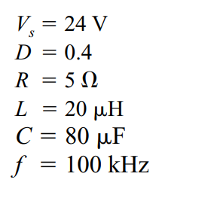
Buck-Boost
Determine the output voltage, inductor current average, maximum and minimum values, and the output voltage ripple

