Slide 1
Term Review

Slide 2
Topic 1 Time-Domain Analysis of Discrete Time Signals and Systems
Requirements:
(1) Time domain expression of discrete signals and systems
(2) Basic operations and typic sequences
(3) Difference Equation
(4) LTI system，causal system, stable system
(5) Convolution sum.
The corresponding ranges in the book ：2.1---2.5,
4.1--4.7

Slide 3
1. Time domain expression of discrete time signals and systems
The time domain representation of discrete time signals is as follows.
It is represented by a sequence x[n].
（1） Descriptive way.
（2）Graphical way.
The time domain representation of discrete time systems is as follows:
（1） Unit sample response h[n] 。
（2） Linear difference equations with constant coefficients.

Slide 4
2 Basic operations and typic sequences
Basic Operations of Discrete Time Signals：
Addtion，Multiplication of a constant，unit delay or unit advance，modulation or windowing，time-reversal，convolution，......
Typic Sequences：
δ[n]，μ[n]，R_{N}[n]，Acos(ω₀n+Φ) or Asin(ω₀n+Φ)，e^{j(ω0n+Φ)，}α^{n}，......
The fundamental period dertermination of sinusiodal signals and exponential signals.

Slide 5
3 Difference Equation
A LTI system is usually described by a linear difference equation with constant coefficients.
The unit sample response of the system can be solved by iterative method in time domain according to the initial conditions of the system.
Different initial conditions of the system will make the system properties expressed by the same difference equation be different.

Slide 6
4 System classifications
Definition and properties of a linear system
Definition and properties of a time-invariant system
The definition and properties of a causal system
The definition and properties of a stable system
It is required to judge the properties of a given system according to the definition of the above system properties.

Slide 7
5 Convolution sum
The definition of convolution ：
Convolution operation: by using the basic operation（time-reversal, time-shift, addtion）, sketch and discuss the convolution sum.
Convolution properties: （1）Commutative law （2）Associative law（3）Distributive law.

Slide 8
Topic 2 :Discrete Time Fourier Transform（DTFT）
Requirements: understanding of the discrete time Fourier transform (DTFT). Including：
（1）DTFT descriptions in the time domain and in the frequency domain.
（2） The definition and properties of DTFT.
The corresponding range in the book ：3.1---3.7

Slide 9
Calculation and properties of DTFT
Definition of DTFT transform pairs ：
Spectrum characteristics :
Periodic function (so frequency domain can be expanded into Fourier Series)
Commonly used transform pairs. Table 3.3
Basic theorems and symmetry properties: Table 3.1,3,2,3.4

Slide 10
Topic 3: z-transform
（1）The definition of z-transform and its relationship with DTFT
（2）Commonly used z-transform pairs
（3） Rational z-transform
（4）Calculation of IZT by the partial fraction expantion method
（5）Properties of z-transform
Corresponding range in the book: 6.1 -- 6.6

Slide 11
The Definition of ZT
The definition of ZT：
Note: the ROC of z-transform must be indicated.
Several convergence cases (on z plane) ： 6.3
Commonly used transformation pairs (mainly used for IZT determination)：Table 6.1
Basic Theorem： table 6.2

Slide 12
Topic 4: Analysis of Transform Domain of Discrete Time Systems
(1) The concept of frequency response of LTI discrete time systems.
(2) Phase delay and group delay.
(3) Definition of transfer function.
(4) System analysis based on transfer function.
(5) System classifcation by magnitude response.
(6) System classifcation by phase response.
(7) Linear phase LTI discrete time system.
Corresponding ranges of the book: 4.8, 4.9, 6.7, 7.1--7.4

Slide 13
1 Transfer Function H (z)
Transfer function H(z) equals to z-transform of the impulse response h[n].
According to the difference equation of the system, the transfer function of the system can be obtained by：
According to the transfer function, the zero- pole plot of the system is drawn to judge the stability of the system.

Slide 14
2 Frequency Response
The frequency response H(e^{jω}) equals to DTFT of the impulse response h[n] .
The transfer function H (z) equals to z-transform of the impulse response h[n].
The frequency response H(e^{jω}) can be obtained from the transfer function H(z) of the system ：
Two components of the frequency response: magnitude response and phase response.

Slide 15
2 Frequency Response
Magnitude response characteristics: the magnitude response can be qualitatively analyzed by zero-pole positions（frequency response geometric interpretation）.
Phase response characteristics: understanding the concepts of zero phase,linear phase,maximam phase and minmum phase systems.

Slide 16
3. Other Concepts
Energy Spectral Density
Band Limited Discrete Time Signals
Unwrapped Phase Function
Phase Delay and Group Delay

Slide 17
4 FIR & IIR System
The difference between FIR and IIR systems.
（1）Input and output relationship
（2）Transfer function
（3）Zero-pole plot
The characteristics of 4 types linear phase FIR system and the determination of their zero locations.

Slide 18
Topic 5: Digital Processing of Continuous Signals
Understand the digital processing process of continuous signals and the corresponding frequency domain concept。
The corresponding range in the book ：3.8--3.9
Understand the digital processing steps of continuous signal, and explain the function of each step.
Deeply understand the time domain and frequency domain characteristics of ideal sampling, and be able to derive their time domain and frequency domain expressions.

Slide 19
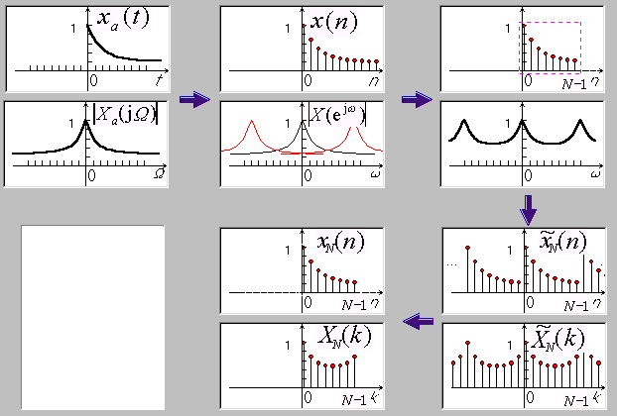

Slide 20
Topic 6: Frequency Spectrum of Discrete Time Signals
The definition of DFT and characteristics in time domain and frequency domain.
The relationship between DFT and DTFT.
Properties of DFT.
The engineering calculation of DFT :
（1）DFT calculations of real sequences
（2）The ideas of FFT algorithm
（3）Using DFT to calculate linear convolution

Slide 21
1. Calculation and properties of DFT
The definition of DFT transformation pairs：
Spectrum characteristics:
Discrete periodic sequence(so in time / frequency domain it can be expanded as Fourier Series)
Basic properties and symmetry properties

Slide 22
2. FFT
Requirements: understand the FFT algorithm and its applications
Using the properties of W_{N} to reduce computation complexity：
１、 Properties of W_{N}
Symmetry ：
Periodicity ：
Reducibility:

Slide 23
The basic idea of FFT
Because the direct calculation of DFT and IDFT is time-consuming, the calculation of DFT can be simplified according to the properties of W_{N}.
Decimation in time (radix-2): the sequence is divided into two groups according to the parity of N, and the N-point DFT can be obtained by combining the N/2-point DFT of these two subsequences.
Decimation in frequency (radix-2): the sequence is divided into two parts according to the order of N, and the influence on the spectrum is divided according to the odd and even of k by deduction. N-point DFT can be obtained by combining the two N/2-point DFT.
module ３？ module ４？…….

Slide 24
Basic skills of FFT
Compute DFTs of two N-point real sequences: firstly, combine them into an N-point complex sequence (two real sequences are set to the real part and imaginary part of the complex sequence respectively), and then calculate the N-point complex sequence DFT by DFT symmetry relations.
Compute DFT of a 2N point real sequence: firstly, turn it into an N-point complex sequence (take the even and odd points of the sequence as the real and imaginary parts of the complex sequence respectively), and then calculate DFT of the N-point complex sequence. Finally, the DFT of the original real sequence is obtained from the DFT of the complex sequence by DFT symmetry relations.

Slide 25
3 The Relationship of Several Transformations
The relationship between ZT and DTFT ：
DTFT is the z-transform on the unit circle in z plane.
The relationship between DTFT and DFT：
DFT is the uniform interval (2π/N) sampling of DTFT on the unit circle in z plane.
Linear convolution and circular convolution have their own definitions, application scope and relationship.

Slide 26
Topic 7: The Realization Structures of Digital Filters
Requirements: ：
（1） The description of block diagram and signal flow graph.
Commonly used structures of digital filters:
（2） IIR direct form realizion, cascade realizion and parallel realization
（3） FIR direct realization and cascade realizaton
Corresponding range: 8.1-8.5

Slide 27
1 Block Diagram and Signal Flow Graph
Given the block diagram, the difference equation（input-output relationship） can be got .
To design a realization strucure in form of a block diagram for a given difference equation.
Master how to use transpose theorem (seeking equivalent structure), the definition of canonic structure and noncanonic structure.

Slide 28
2 Basic Structure of IIR filter
Direct realization: easy to implement, but inconvenient to adjust zero and pole.
Direct form I: obtained completely from the difference equation (noncanonic structure).
Direct form II: canonic structure, derived from form I.
Cascade realization: composed of first-order and second-order nodes in cascade form. It is convenient to adjust the zeros and poles, but it will increase the amount of calculation.
Parallel realization: convenient to adjust poles, and by partial fractional expansion to get, which is convenient to discuss the properties of the system represented by a series of sub transfer functions.

Slide 29
3 Basic Structure of FIR filter
Direct realization: easy to implement, but inconvenient to adjust zeros.
Cascade realization: composed of first-order and second-order nodes in cascade form. It is convenient to adjust the zeros, but it will increase the amount of calculation.
Linear-phase realization: reducing number of multipliers by using of symmtric or antisymmtric coefficents .
Polyphase realization: making polyphase decomposition to filter coefficients，suitable for multirate signal processing

Slide 30
Topic 8: Design of Digital Filters
Requirements：
(1) Understand the physical concepts of digital filter parameters (passband edge frequency, stopband edge frequency, passband ripple, stopband ripple, order, etc.).
(2) The basic analog filter approximations.
(3) IIR filter Design-- the bilinear transformation.
The corresponding ranges in the book ：9.1---9.6, A.1--A.4

Slide 31
1 Physical meaning of digital filter specifications
Characteristics of digital filter :
Passband edge frequency ω_{p}
Passband ripple δ_{p}
Stopband edge frequency ω_{s}
stopband ripple δ_{s}
Peak passband ripple α_{p}
Stopband attenuation α_{s}
Order N.
Analog angular frequencies are normalized to digital angular frequencies: ω=ΩT

Slide 32
2 IIR Lowpass Filter Design：
Design of IIR filter ：
Impulse invariance method, Bilinear transformation method.
From the basic idea of each design method to understand them.
Design steps of bilinear transformation method ：
(1) The given bandedge frequencies is prewarpped (2) Analog prototype filter H_{a}(s) is designed.
（3）The transfer function of digital filter is obtained by bilinear transformation:

Slide 33
3 FIR Filter Design：
Window fourier series method, frequency sampling method. From the basic idea of each design method to understand them.
Design steps of window fourier series method ：
(1）The corresponding ideal impulse response is found out according to the design requirements.
（2）Looking up table 10.2 to find out the window that meets the specifications, determining the order of the filter, and adding the window to the idea impulse response (pay attention to delay).
（3） Check the result to see if it meets the design requirements, otherwise redesign.

Slide 34
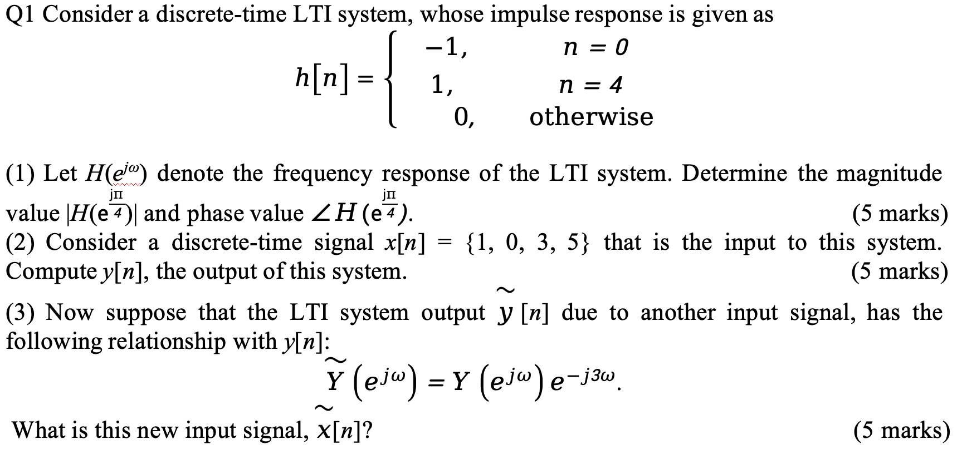
Example 1：

Slide 35
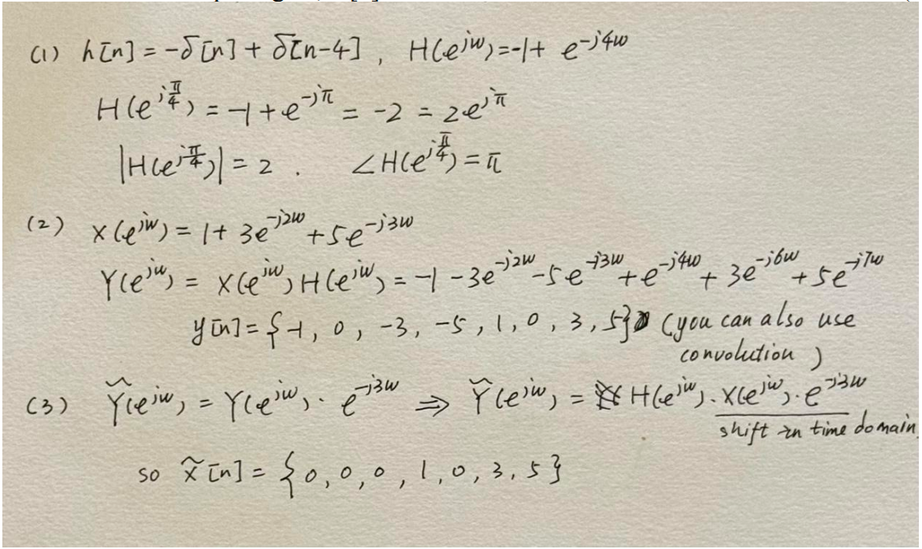
Solution：

Slide 36
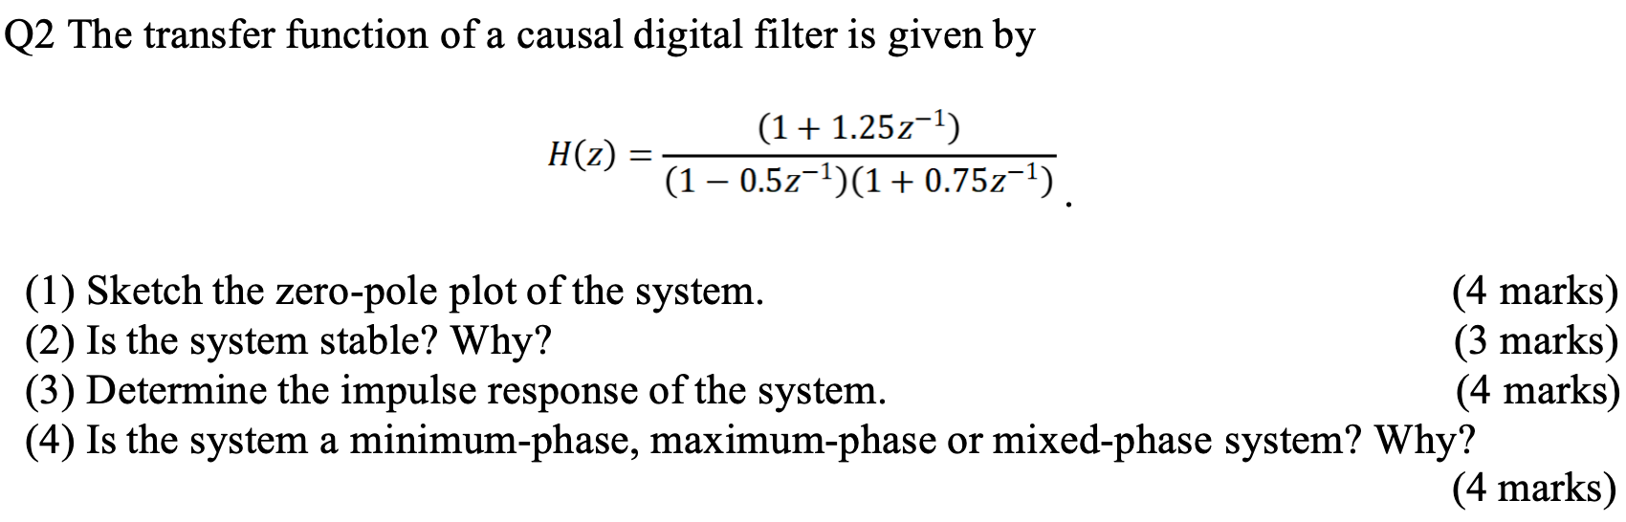
Example 2：

Slide 37
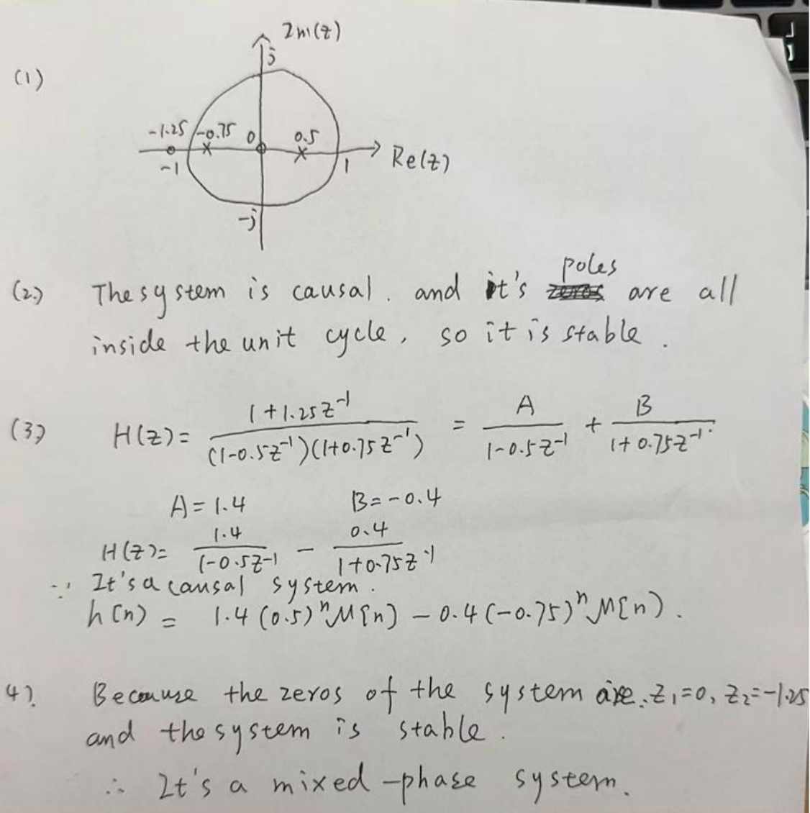
Solution：

