Slide 1
System Analysis and Design 😔

Slide 2
Introduction to system analysis and design
1

Slide 3

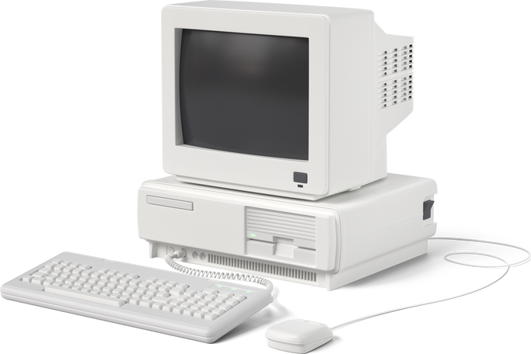
What is System
System is a group of elements or components which work together to accomplish a common task.

Slide 4


What is System Analysis & Design?
In very simple words, system analysis and desing is a study in which we learn how to analyze an existing system and create a better one.

Slide 5
System Analysis
System analysis is a process of studying and observing a system to know how it works and to identify its goal and purposes.
System analysis is conducted for the purpose of studying a system or its parts in order to identify its objectives.
It specifies “What the system should do.”

Slide 6
System Design
It is a process of planning a new system or replacing an existing system
It is done by defining its components or modules to satisfy the specific requirements.
It focuses on “how to accomplish the objective of the system”.

Slide 7









Slide 8
Information System and its types
2
Transaction Processing System (TPS)
Management Information System (MIS)
Decision Support System (DSS)
Experts System

Slide 9
Introduction
An Information system is a combination of hardware and software and telecommunication networks that people build to collect, create and distribute useful data, typically in an organization. It defines the flow of information within the system. The objective of an information system is to provide appropriate information to the user, to gather the data, process the data and communicate information to the user of the system.

Slide 10
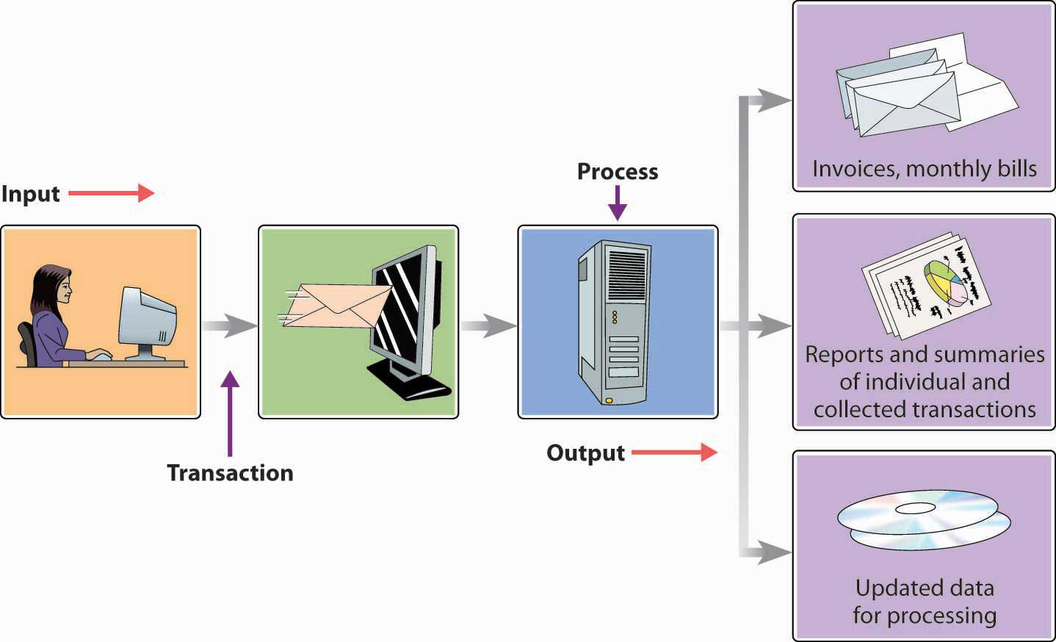
Transaction Processing System (TPS)
Transaction Processing System are information system that process data resulting from the occurrences of business
Their objective are to provide transaction in order to update records and generate reports i.e. to perform store keeping function
The transaction is preformed in two ways: Batching processing and Online transaction processing.
Example: Bill system, payroll system, Stock control system

Slide 11
Management Information System (MIS)
Management Information System is designed to take relatively raw data available through a Transaction Processing System and convert them into a summarized and aggregated form for the manager, usually in a report format. It reports tending to be used by middle management and operational supervisors.
Many different types of report are produced in MIS. Some of the reports are a summary report, on-demand report, ad-hoc reports and an exception report.
Example: Sales management systems, Human resource management system.

Slide 12
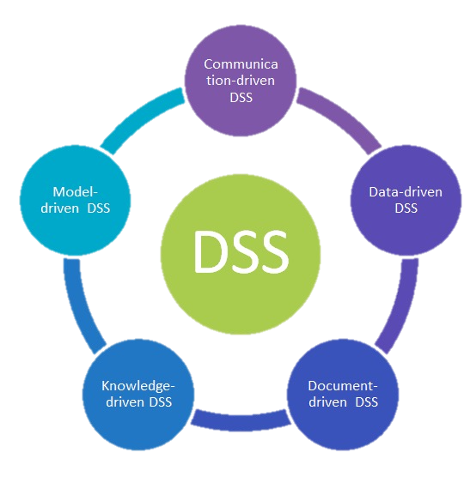
Decision Support System(DSS)
Decision Support System is an interactive information system that provides information, models and data manipulation tools to help in making the decision in a semi-structured and unstructured situation.
Decision Support System comprises tools and techniques to help in gathering relevant information and analyze the options and alternatives, the end user is more involved in creating DSS than an MIS.
Example: Financial planning systems, Bank loan management systems

Slide 13
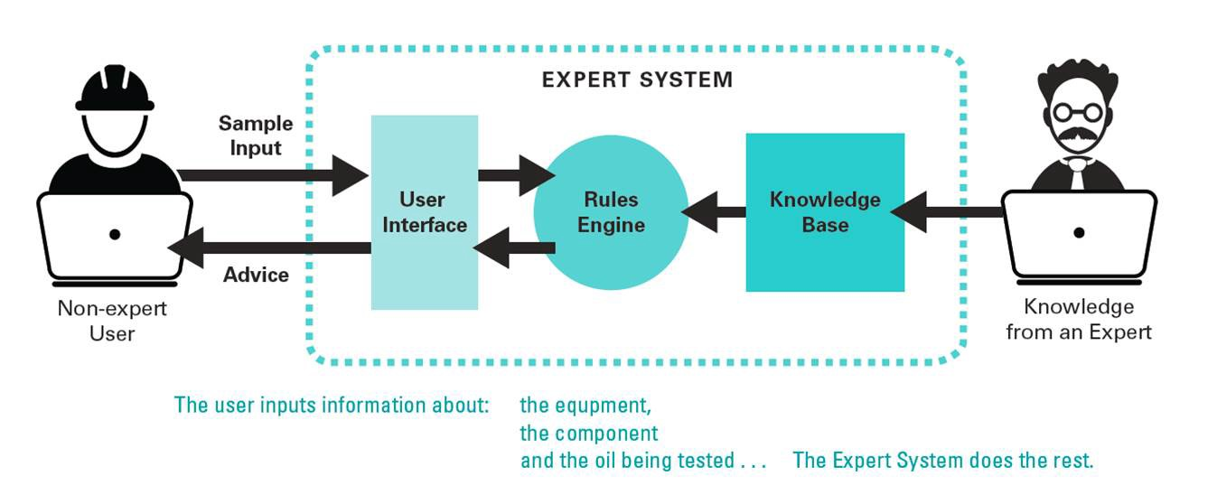
Experts System
Experts’ systems include expertise in order to aid managers in diagnosing problems or in problem-solving. These systems are based on the principles of artificial intelligence research.
Experts Systems is a knowledge-based information system. It uses its knowledge about a specify are to act as an expert consultant to users. Knowledgebase and software modules are the components of an expert system. These modules perform inference on the knowledge and offer answers to a user’s question.

Slide 14
Stakeholders of Information systems
3
IS Manager
System Analyst
Programmers
Business Manager

Slide 15
Stakeholders of Information systems
Any person that is interested or affected by an information system is called
stakeholders of IS. It often includes both technical and non-technical people and include internal workers and external workers or individuals.
Major stakeholder are as follows:
IS Manager
System Analysis
Programmer
Business Managers
Other IS Manager and Technicians

Slide 16
IS Manager
IS Manager are involved in allocating resources rather than actual development process.
Oversees approved system development process
Should attend review meeting and maintain status report

Slide 17
System Analyst
A system analyst is an IT professional who specializes in analyzing, designing and implementing information systems.
Needs four skills:
Analytical skills: skills enable to understand the organization and its function.
Technical skills: skills help to understand the potential and the limitation of IT.
Management skills: skills help to manage project, resources, risk and change.
Interpersonal skills: skills help to work with end users as well as with other analysts’ programmer.

Slide 18
Programmers
Programmers convert the system specifications given to them by the analysts into instruction the computer can understand.
Also writes program documentation and program for testing system.
Previously considered as an art but now code is improved as structural programming.
In structural programming, all computing instructions can be represented through the use of three simple structure: sequence, repetition and selection.
Very labor-intensive job.

Slide 19
Business Manager
Business managers are functional department heads and corporate
executives.
They have power to fund development project and to allocate the resources necessary for the projects.
They are able to set general requirement and constraints for development project.
They set direction for system development, propose and approve projects, determine relative importance of projects and assign to other people in organization.

Slide 20
SDLC and life cycle models
4
(waterfall, Spiral, Prototype)

Slide 21
Software Development
It is that set of actions required in efficiently transforming a user’s needs into an effective software solution.
It defines the activities required for building the software incorporating the methods and practices to be adopted .
It also includes the activities essential for planning the project ,tracking its progress and managing the complexities while building software.

Slide 22
Types of Software Product
A software product starts its life as an idea or concept.
Software can be of two types:-
Generic Products
Customized Products

Slide 23
Software Development Life Cycle(SDLC)
The series of steps through which a software product goes through (from conceptualization until retirement) is known as Software development life cycle
It is the period of time that begins when a software is conceived and ends when the software is no longer available for use
The SDLC aims to produce high-quality software that meets or exceeds customer expectations, reaches completion within times and cost estimates.
SDLC typically includes a concept phase ,requirement phase, design phase, implementation phase, test phase, installation and checkout phase, operation and maintenance phase and sometimes retirement phase
The phase listed above may overlap, be performed iteratively, be combined or be omitted depending upon the software development approach(methodology) used.

Slide 24
Software Life Cycle Model
Software life cycle model describes how and in what order the different phases of the software development life cycle are put together to conceive ,design, develop and maintain the software product.
The most used, popular and important SDLC models are given below:
Waterfall model
Incremental model
Iterative model
Agile model
Spiral model
Prototype model

Slide 25
Stages in Software Development Life Cycle
Analysis
Specifications
Design
Prototyping
Coding
Testing
Implementation
Operation
Maintenance
Implementation
Design
Analysis
Testing
Maintenance
Deployment

Slide 26
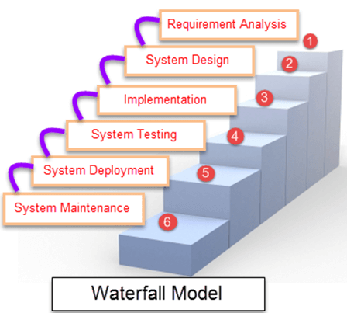
Waterfall Model
Waterfall Model is a sequential model that divides software development into pre-defined phases. Each phase must be completed before the next phase can begin with no overlap between the phases. Each phase is designed for performing specific activity during the SDLC phase. It was introduced in 1970 by Winston Royce.

Slide 27
Advantages of Waterfall Model
This model is simple and easy to understand and use.
It is easy to manage due to the rigidity of the model – each phase has specific deliverables and a review process.
In this model phases are processed and completed one at a time. Phases do not overlap.
Waterfall model works well for smaller projects where requirements are clearly defined and very well understood.

Slide 28
Disadvantages of Waterfall Model
Once an application is in the testing stage, it is very difficult to go back and change something that was not well-thought out in the concept stage.
No working software is produced until late during the life cycle.
High amounts of risk and uncertainty.
Not a good model for complex and object-oriented projects.
Poor model for long and ongoing projects.
Not suitable for the projects where requirements are at a moderate to high risk of changing.

Slide 29
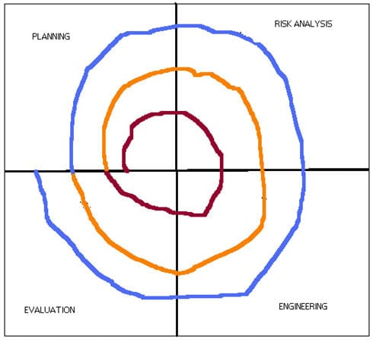
Spiral Model
The spiral model is a combination of sequential and prototype models. This model is best used for large projects which involve continuous enhancements. There are specific activities that are done in one iteration (spiral) where the output is a small prototype of the large software. The same activities are then repeated for all the spirals until the entire software is built.
A spiral model has 4 phases described below:
Planning phase
Risk analysis phase
Engineering phase
Evaluation phase.

Slide 30
Advantages of Spiral Model
Development is fast
Larger projects / software are created and handled in a strategic way
Risk evaluation is proper.
Control towards all the phases of development.
More and more features are added in a systematic way.
Software is produced early.
Has room for customer feedback and the changes are implemented faster

Slide 31
Disadvantages of Spiral Model
Risk analysis is important phase so requires expert people.
Is not beneficial for smaller projects.
Spiral may go infinitely.
Documentation is more as it has intermediate phases.
It is costly for smaller projects

Slide 32
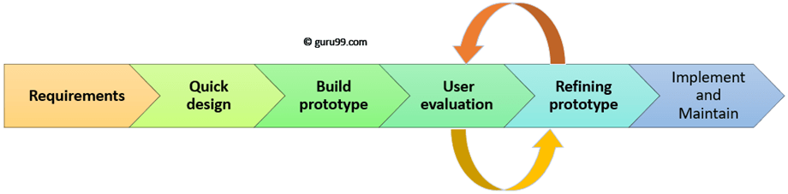
Prototyping Model
Prototyping Model is a software development model in which prototype is built, tested, and reworked until an acceptable prototype is achieved. It also creates base to produce the final system or software. It works best in scenarios where the project’s requirements are not known in detail. It is an iterative, trial and error method which takes place between developer and client.

Slide 33
Advantages of Prototyping Model
Users are actively involved in development. Therefore, errors can be detected in the initial stage of the software development process.
Missing functionality can be identified, which helps to reduce the risk of failure as Prototyping is also considered as a risk reduction activity.
Helps team member to communicate effectively
Customer satisfaction exists because the customer can feel the product at a very early stage.
There will be hardly any chance of software rejection.

Slide 34
Disadvantages of Prototyping Model
Prototyping is a slow and time taking process.
The cost of developing a prototype is a total waste as the prototype is ultimately thrown away.
Prototyping may encourage excessive change requests.
Some times customers may not be willing to participate in the iteration cycle for the longer time duration.
There may be far too many variations in software requirements when each time the prototype is evaluated by the customer.
Poor documentation because the requirements of the customers are changing.

Slide 35
Introduction to analysis and design tools
5
Analysis
General types of case tools
Rapid Application Development (RAD)

Slide 36
Analysis
Software analysis and design includes all activities, which help the transformation of requirement specification into implementation.
Requirement specifications specify all functional and non-functional expectations from the software.

Slide 37
General types of case tools
Diagramming tools enable graphical representation.
Computer displays and report generators help prototype how systems “look and feel”.
Analysis tools automatically check for consistency in diagrams, forms, and reports.
A central repository provides integrated storage of diagrams, reports, and project management specifications.

Slide 38
Rapid Application Development (RAD)
Decreases design and implementation time
Involves: extensive user involvement, prototyping, integrated CASE tools, code generators
More focus on user interface and system function, less on detailed business analysis and system performance

Slide 39
Thanks!
Any questions?
You can find me at:
@andipstha

