Slide 1
Information system and its types

Slide 2

Introduction
An Information system is a combination of hardware and software and telecommunication networks that people build to collect, create and distribute useful data, typically in an organization. It defines the flow of information within the system. The objective of an information system is to provide appropriate information to the user, to gather the data, process the data and communicate information to the user of the system. Following is the TYPE of information system

Slide 3
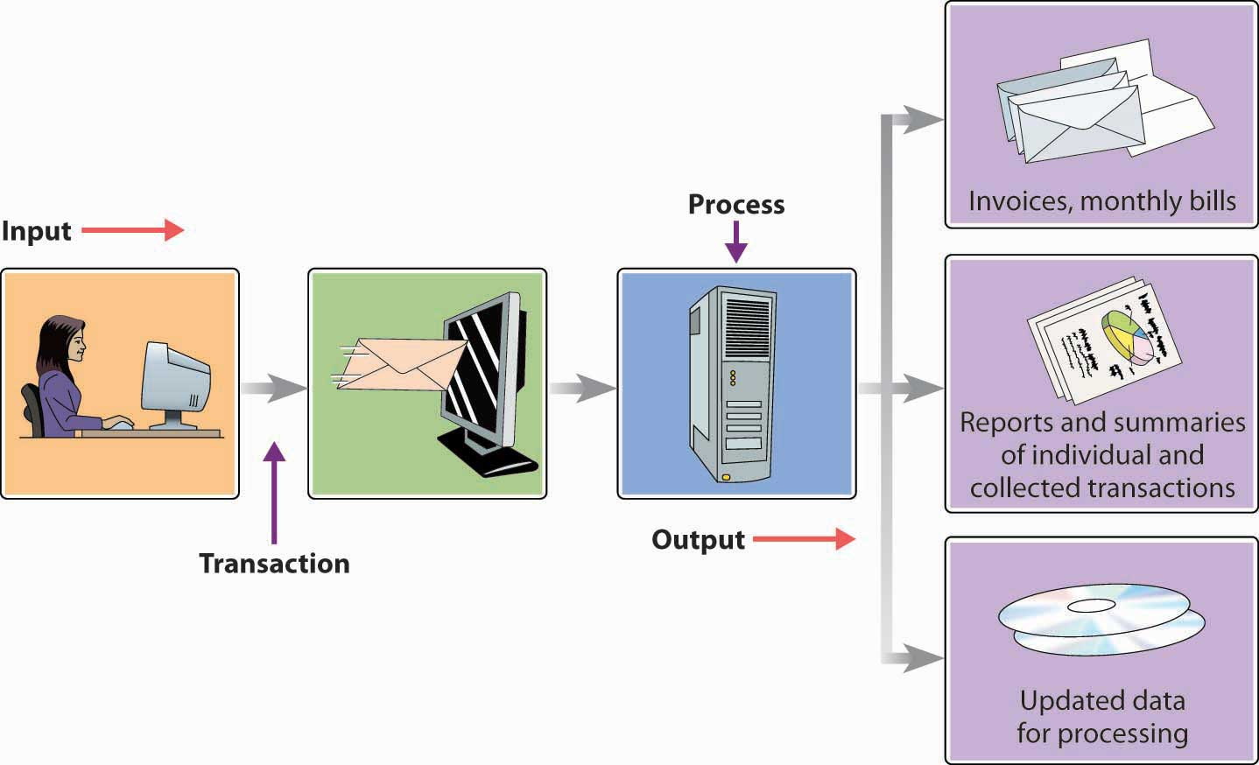
Transaction Processing System (TPS):
Transaction Processing System are information system that processes data resulting from the occurrences of business transactions
Their objectives are to provide transaction in order to update records and generate reports i.e. to perform store keeping function
The transaction is performed in two ways: Batching processing and Online transaction processing.
Example: Bill system, payroll system, Stock control system

Slide 4
Management Information System (MIS):
Management Information System is designed to take relatively raw data available through a Transaction Processing System and convert them into a summarized and aggregated form for the manager, usually in a report format. It reports tending to be used by middle management and operational supervisors.
Many different types of report are produced in MIS. Some of the reports are a summary report, on-demand report, ad-hoc reports and an exception report.
Example: Sales management systems, Human resource management system.

Slide 5
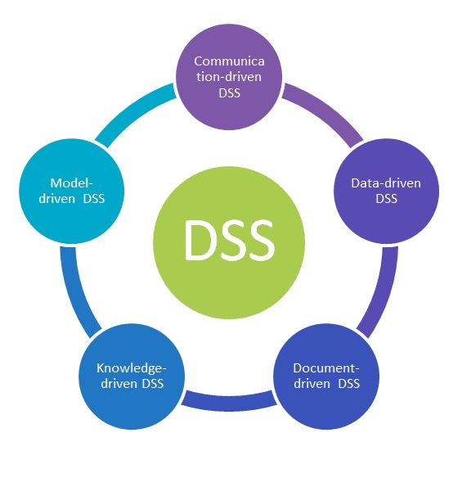
Decision Support System (DSS):
Decision Support System is an interactive information system that provides information, models and data manipulation tools to help in making the decision in a semi-structured and unstructured situation.
Decision Support System comprises tools and techniques to help in gathering relevant information and analyze the options and alternatives, the end user is more involved in creating DSS than an MIS.
Example: Financial planning systems, Bank loan management systems

Slide 6
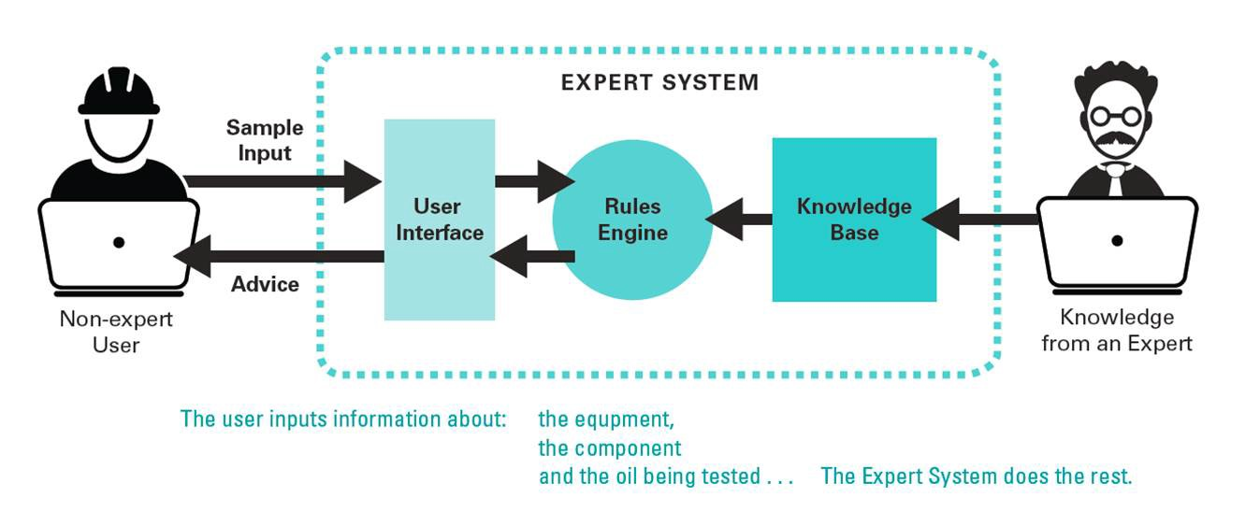
Experts System:
Experts’ systems include expertise in order to aid managers in diagnosing problems or in problem-solving. These systems are based on the principles of artificial intelligence research.
Experts Systems is a knowledge-based information system. It uses its knowledge about a specify are to act as an expert consultant to users.
Knowledgebase and software modules are the components of an expert system. These modules perform inference on the knowledge and offer answers to a user’s question.

