Slide 1
Software Development
It is that set of actions required in efficiently transforming a user’s needs into an effective software solution.
It defines the activities required for building the software incorporating the methods and practices to be adopted .
It also includes the activities essential for planning the project ,tracking its progress and managing the complexities while building software.

Slide 2
Types of Software Product
A software product starts its life as an idea or concept.
Software can be of two types:-
1.Generic Products
2.Customized Products

Slide 3
Software Development Life Cycle(SDLC)
The series of steps through which a software product goes through (from conceptualization until retirement) is known as Software development life cycle
It is the period of time that begins when a software is conceived and ends when the software is no longer available for use
The SDLC aims to produce high-quality software that meets or exceeds customer expectations, reaches completion within times and cost estimates.

Slide 4
SDLC
SDLC typically includes a concept phase ,requirement phase,design phase,implementation phase,test phase,installation and checkout phase,operation and maintenance phase and sometimes retirement phase
The phase listed above may overlap, be performed iteratively,be combined or be omitted depending upon the software development approach(methodology) used.

Slide 5
Software Life Cycle Model
Software life cycle model describes how and in what order the different phases of the software development life cycle are put together to conceive ,design, develop and maintain the software product.
The most used, popular and important SDLC models are given below:
1.Waterfall model
2.Incremental model
3.Iterative model
4.Agile model
5.Spiral model
6.Prototype model

Slide 6
Stages in Software Development Life Cycle
1.Analysis
2.Specifications
3.Design
4.Prototyping
5.Coding
6.Testing
7.Implementation
8.Operation
9.Maintenance

Slide 7
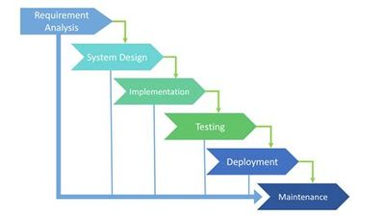

Slide 8
Waterfall model
Waterfall Model is a sequential model that divides software development into pre-defined phases. Each phase must be completed before the next phase can begin with no overlap between the phases. Each phase is designed for performing specific activity during the SDLC phase. It was introduced in 1970 by Winston Royce.

Slide 9
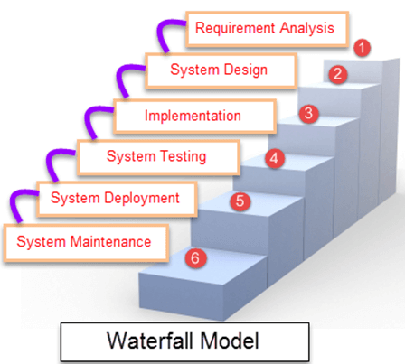

Slide 10
Advantages of waterfall model
This model is simple and easy to understand and use.
It is easy to manage due to the rigidity of the model – each phase has specific deliverables and a review process.
In this model phases are processed and completed one at a time. Phases do not overlap.
Waterfall model works well for smaller projects where requirements are clearly defined and very well understood.

Slide 11
Disadvantages of waterfall model
Once an application is in the testing stage, it is very difficult to go back and change something that was not well-thought out in the concept stage.
No working software is produced until late during the life cycle.
High amounts of risk and uncertainty.
Not a good model for complex and object-oriented projects.
Poor model for long and ongoing projects.
Not suitable for the projects where requirements are at a moderate to high risk of changing.

Slide 12
The spiral model is a combination of sequential and prototype models. This model is best used for large projects which involve continuous enhancements. There are specific activities that are done in one iteration (spiral) where the output is a small prototype of the large software. The same activities are then repeated for all the spirals until the entire software is built.
A spiral model has 4 phases described below:
Planning phase
Risk analysis phase
Engineering phase
Evaluation phase.

Slide 13
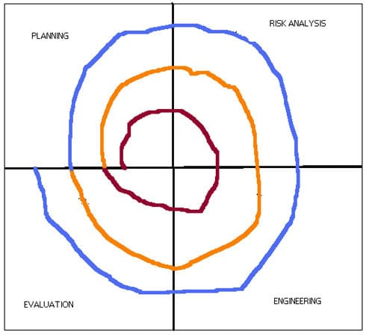

Slide 14
Advantages of using Spiral Model:
Advantages of using Spiral model are as follows:
Development is fast
Larger projects / software are created and handled in a strategic way
Risk evaluation is proper.
Control towards all the phases of development.
More and more features are added in a systematic way.
Software is produced early.
Has room for customer feedback and the changes are implemented faster

Slide 15
Disadvantages of using Spiral model:
Disadvantages of Spiral model are as follows:
Risk analysis is important phase so requires expert people.
Is not beneficial for smaller projects.
Spiral may go infinitely.
Documentation is more as it has intermediate phases.
It is costly for smaller projects

Slide 16
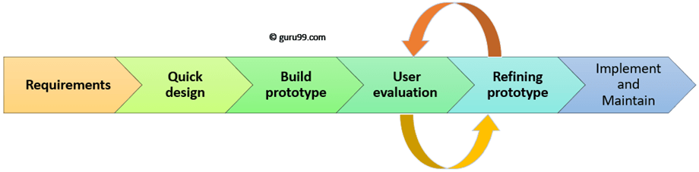
Prototyping Model is a software development model in which prototype is built, tested, and reworked until an acceptable prototype is achieved. It also creates base to produce the final system or software. It works best in scenarios where the project’s requirements are not known in detail. It is an iterative, trial and error method which takes place between developer and client.

Slide 17
Advantages of the Prototyping Model
Here, are important pros/benefits of using Prototyping models:
Users are actively involved in development. Therefore, errors can be detected in the initial stage of the software development process.
Missing functionality can be identified, which helps to reduce the risk of failure as Prototyping is also considered as a risk reduction activity.
Helps team member to communicate effectively
Customer satisfaction exists because the customer can feel the product at a very early stage.
There will be hardly any chance of software rejection.

Slide 18
Disadvantages of the Prototyping Model
Here, are important cons/drawbacks of prototyping model:
Prototyping is a slow and time taking process.
The cost of developing a prototype is a total waste as the prototype is ultimately thrown away.
Prototyping may encourage excessive change requests.
Some times customers may not be willing to participate in the iteration cycle for the longer time duration.
There may be far too many variations in software requirements when each time the prototype is evaluated by the customer.
Poor documentation because the requirements of the customers are changing.

