Slide 1
Library Books Management System
The Fusion

Slide 2
Table of Contents
01.
Problem Statement
03.
Scope
02.
Objectives
04.
System Flow
Here you could describe the topic of the section
Here you could describe the topic of the section
Here you could describe the topic of the section
Here you could describe the topic of the section

Slide 3
Table of Contents
05.
Waterfall Model
07.
Conclusion
06.
Use case diagram
Here you could describe the topic of the section
Here you could describe the topic of the section
Here you could describe the topic of the section

Slide 4
01
About Generation of ‘27
You could enter a subtitle here if you need it

Slide 6
A Library books management system is an infrastructure that allows user to search books and add/remove.
Students are allowed to take only three books,
Students are not allowed to check whether the book in available,
There is no online services,
Students are not informed before the dead line of the book renew,
Students are not allowed to get access to the library book management system.

Slide 7
Objectives
The main objectives behind the development of this project are as follows:
To utilize the information of Books.
To store and retrieve books items.
To manage records of students who have withdrawn the book.
To store and access item in books stocks.
To manage the particular records of student.
To generate the report of books.
To provide the details of issue books.
To provide the details of issue books.

Slide 8
Scope
To assist the staff in capturing the effort spent on their respective working areas.
To utilize resources in an efficient manner by increasing their productivity through automation.
The system generates types of information that can be used for various purposes.

Slide 9
START
LOGIN
Insert
Record
Display
Record
Update
Record
Delete
Record
Delete
Record
END

Slide 10
Methodology
Research
Analysis
Data Study
Comparison
Venus is the second planet from the Sun
Neptune is very far away from Earth
Despite being red, Mars is a cold place
Jupiter is the biggest planet of them all

Slide 11
“This is a quote, words full of wisdom that someone important said and can make the reader get inspired.”
—Someone Famous

Slide 12
Study Objectives
Mercury
Venus
Mars
Mercury is the closest planet to the Sun and the smallest of them all
Venus has a beautiful name and is the second planet from the Sun
Despite being red, Mars is actually a cold place full of iron oxide dust

Slide 13
Introduction
Title of the Thesis
Venus has a beautiful name and is the second planet in the Solar System. It’s terribly hot—even hotter than Mercury—and its atmosphere is extremely poisonous

Slide 14
This Is a Map
Venus
Venus is the second planet from the Sun
Mercury
Mercury is the smallest planet
Earth
Earth is the only planet with life

Slide 15
Literature Review
Theory 01
Theory 02
Mercury is the closest planet to the Sun and the smallest of them all
Despite being red, Mars is actually a cold place full of iron oxide dust

Slide 16
Bibliographic References
AUTHOR (YEAR): Title of the publication. Publisher
AUTHOR (YEAR): Title of the publication. Publisher
AUTHOR (YEAR): Title of the publication. Publisher
AUTHOR (YEAR): Title of the publication. Publisher
AUTHOR (YEAR): Title of the publication. Publisher
AUTHOR (YEAR): Title of the publication. Publisher

Slide 17
Secondary Objectives
Mercury
Venus
Mars
Saturn
Earth
Jupiter
Mercury is the closest planet to the Sun
Venus has a beautiful name and is the second planet
Despite being red, Mars is actually a cold place
Saturn is a gas giant and has several rings
Earth is the third planet from the Sun
Jupiter is a gas giant and the biggest one

Slide 18
Awesome
Words

Slide 19

Your Work
You can replace the image on the screen with your own work. Just delete this one, add yours and center it properly

Slide 20
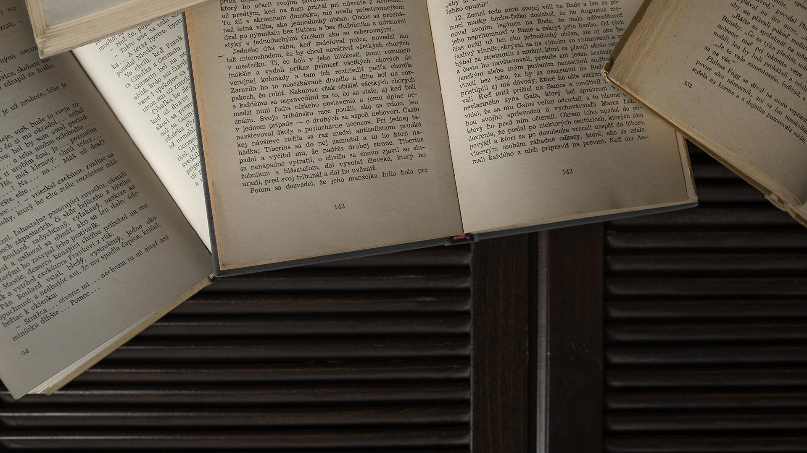
A Picture Is Worth a Thousand Words

Slide 21
Schedule
1st Phase
2nd Phase
1st Week
Mo
Tu
We
Th
Fr
Sa
Su
2nd Week
Mo
Tu
We
Th
Fr
Sa
Su
3rd Phase
4th Phase

Slide 22
1,927
Big numbers catch your audience's attention

Slide 23
Table
 | Test 1 | Test 2 | Test 3 | Test 4
Indicator 1
Indicator 2
Indicator 3
Indicator 4

Slide 24
Timeline
Mercury
Mars
Mercury is the closest planet to the Sun
Now
Mars is actually a very cold place
Venus
1927
2027
Venus is the second planet from the Sun

Slide 25

A Picture Always Reinforces the Concept
Images reveal large amounts of data, so remember: Use an image instead of a long text

Slide 26
Important Percentages
33.5%
26.7%
18.2%
Mercury is the closest planet to the Sun
Despite being red, Mars is a cold place
Saturn is the ringed one and a gas giant

Slide 27
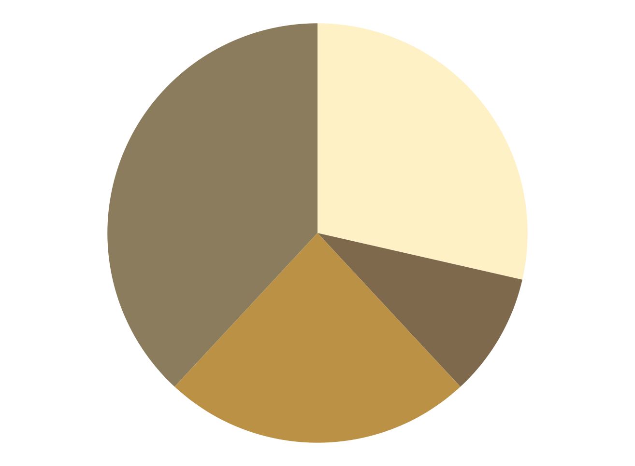
Methodology
Research
Analysis
Venus has a beautiful name, but it’s terribly hot
Jupiter is the biggest planet in the Solar System
Data Study
Comparison
Despite being red, Mars is actually a cold place
Saturn is the ringed one and a gas giant
To modify this graph, click on it, follow the link, change the data and paste the new graph here

Slide 28
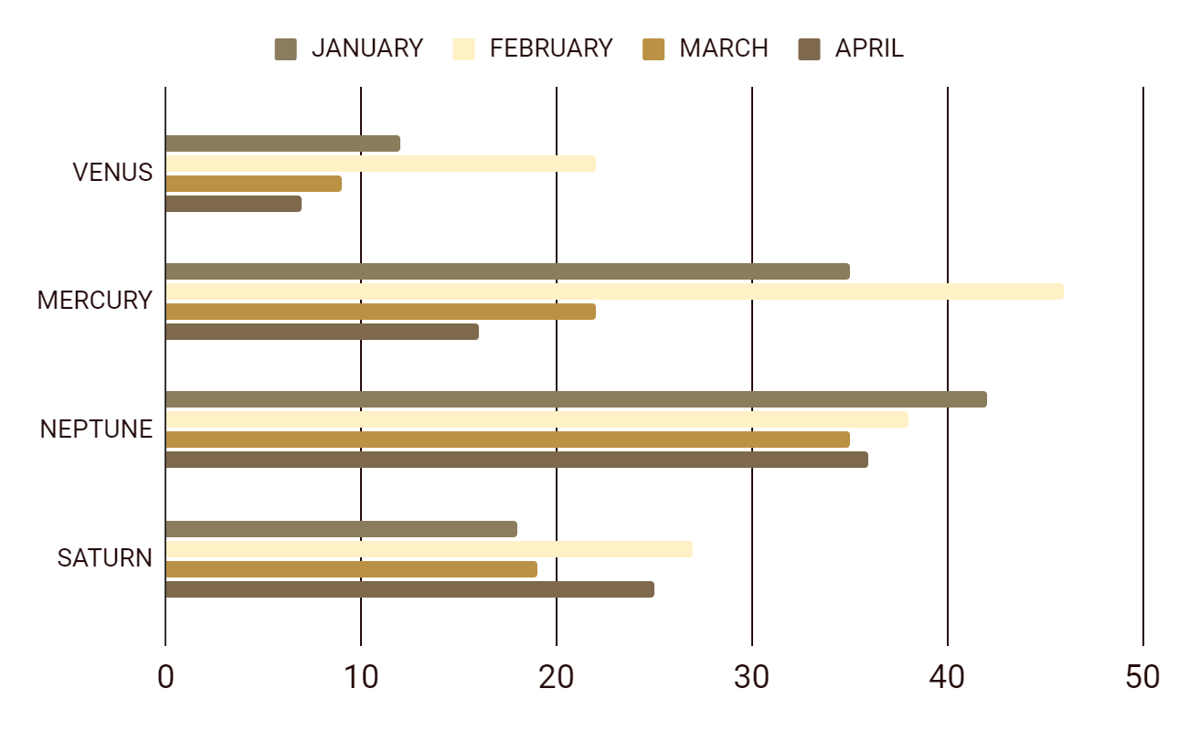
Results Analysis
To modify this graph, click on it, follow the link, change the data and paste the new graph here

Slide 29
Conclusions
Conclusion A
Conclusion C
Conclusion B
Conclusion D
Here you can talk about the conclusions
Here you can talk about the conclusions
Here you can talk about the conclusions
Here you can talk about the conclusions

Slide 30
Thanks
Do you have any questions?
youremail@freepik.com
+91 620 421 838
yourcompany.com
Please keep this slide for attribution

Slide 31
Instructions for use (free users)
In order to use this template, you must credit Slidesgo by keeping the Thanks slide.
You are allowed to:
Modify this template.
Use it for both personal and commercial purposes.
You are not allowed to:
Sublicense, sell or rent any of Slidesgo Content (or a modified version of Slidesgo Content).
Distribute this Slidesgo Template (or a modified version of this Slidesgo Template) or include it in a database or in any other product or service that offers downloadable images, icons or presentations that may be subject to distribution or resale.
Use any of the elements that are part of this Slidesgo Template in an isolated and separated way from this Template.
Delete the “Thanks” or “Credits” slide.
Register any of the elements that are part of this template as a trademark or logo, or register it as a work in an intellectual property registry or similar.
For more information about editing slides, please read our FAQs or visit Slidesgo School:
https://slidesgo.com/faqs and https://slidesgo.com/slidesgo-school

Slide 32
Resources
Vectors
Glasses with books for literacy day
International literacy day with lots of books
International literacy day celebration
Photos
Glasses on old books in library
Old books on library table
Ink pen on opened old notebook

Slide 33


