Slide 1
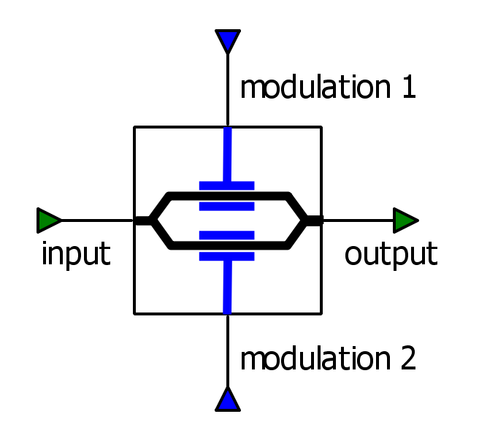


Source
MQAM Mapping
RRC & Up-conversion
Hilbert Transform
Fiber
Loop
LASER
Isolator
Polarization
Controller
SSB
Optical Signal

