Slide 1
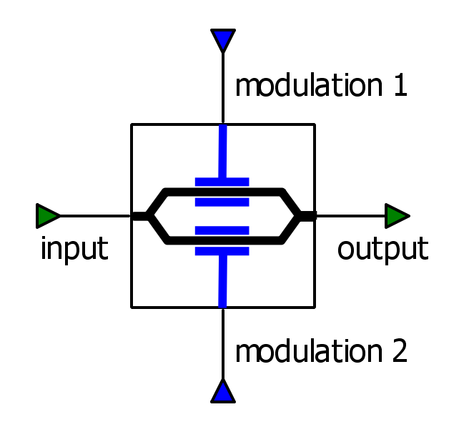
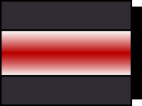




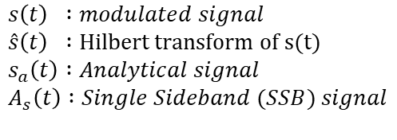



Generate bit sequence
Represent bit information as a symbolic information
Binary to decimal for MQAM
MQAM Mapping
$$I$$
RRC Filter
IQ modulator
$$s(t)$$
RRC Filter
Q
$$s(t)$$
Fiber
Loop
LASER
Hilbert Transformer
Real
$$\hat{s}(t)$$
$$s_{a}\left(t\right)=s\left(t\right)+\hat{s}(t)$$
Imag
$$A_{s}\left(t\right)$$
SSB
Optical Signal
$$\hat{s}(t)$$
MZM modulator
$$s\left(t\right) :modulated signal$$
$$\hat{s}\left(t\right) :Hilbert transform of s(t)$$
$$s_{a}\left(t\right) :Analytical signal$$
$$A_{s}\left(t\right) :Single Sideband (SSB) signal$$

Slide 2















$$A_{s}(t)$$
COUPLER
Kramers-Kronig Algorithm
$$PD$$
$$A\left(t\right)$$
$${\text{|}∙\text{|} }^{2}$$
$$I(t)\text{∝}{|A(t)|}^{2}$$
$$\sqrt{A(t)}$$
$$\text{|}∙\text{|}$$
$$ln⁡(∙)$$
$$FFT$$
$$IFFT$$
$$exp⁡\{i(∙)\}$$
$$i∙sgn(ω)$$
$$A_{0} exp⁡(iπBt)$$
LO
Demodulation
DSP
$${CD }^{−1}$$
$${{A\left(t\right)=A}_{s}\left(t\right) +A}_{0} exp(iπBt)$$

