Slide 1
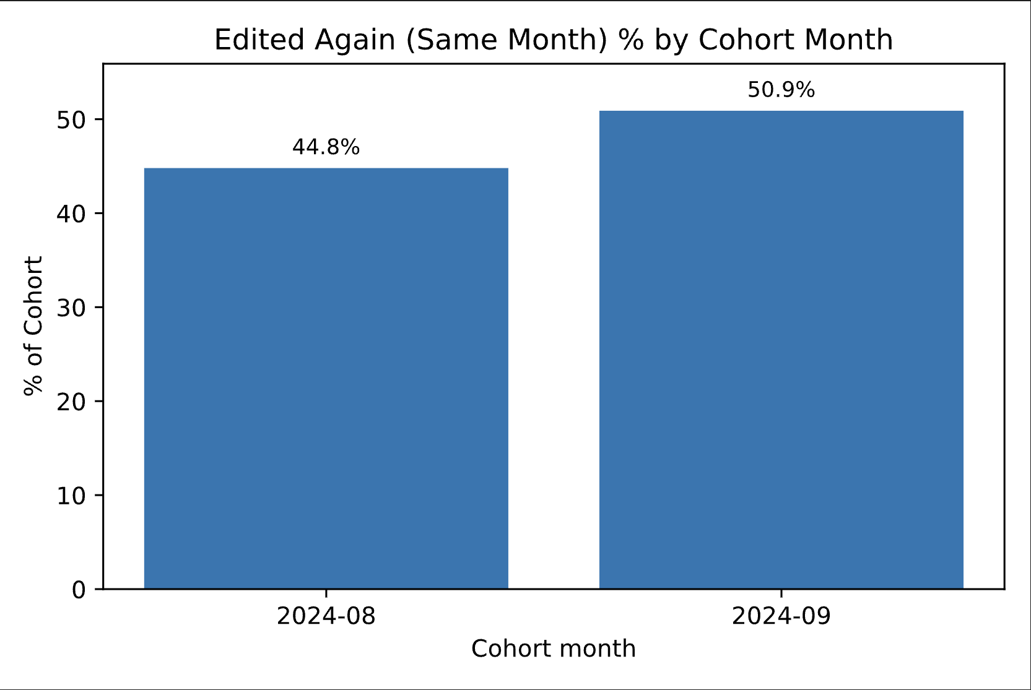
Tracking New Wikipedia Editors: Who Comes Back?
Problem & Motivation:
Wikipedia relies on volunteer editors, but many new users stop after their first edit.
Our goal: measure early retention and understand when newcomers drop off.
Data & Method:
Collected August–September 2024 edit data using the MediaWiki API
Built a Python pipeline to find each user’s first and next edit (t₀ → t₁)
Analysis & Result:
Analyzed retention rates — same-month, within 7 days, and next-month activity
Found that ~45–50% of newcomers make another edit within a week; but few persist later
Takeaway Line:
Early engagement is strong, but most new editors leave after their first few edits.
Team Members: Andisha Safdariyan (as3254), Danish Safdariyan (ds968), Sayed Najiullah Basharat (sb2286)

