Slide 1

My Safe Space
Tasneem Appaduray Alpha Mkhatshwa Andiswa Mkhonto

Slide 2



UN Chosen Goal

Slide 3
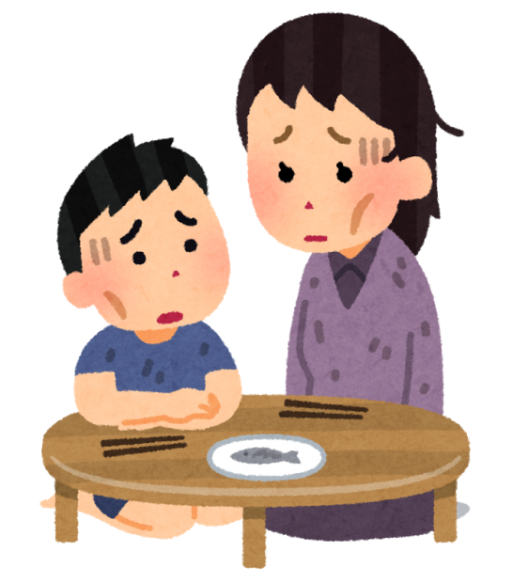
Problem Statement
Some girls can’t afford to buy sanitary pads
Sometimes Girls get Menstrual accidents are embarrassed to tell anyone
Fear of Bulling if you ask for help
Girls can’t go to school because they don’t have pads to put on.
During this Pandemic its hard to do school work
Many Teenagers don’t know much about for example safe sex.
No food in some households

Slide 4
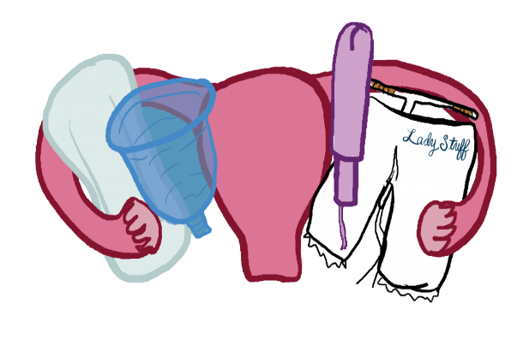
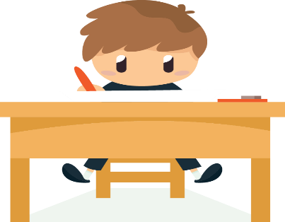

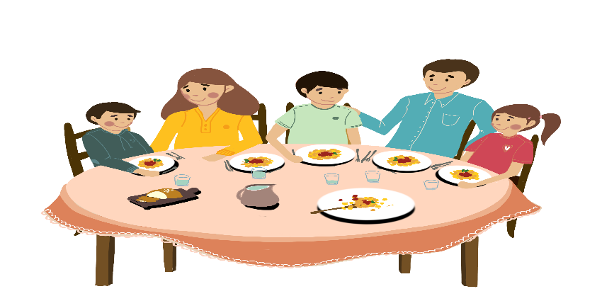
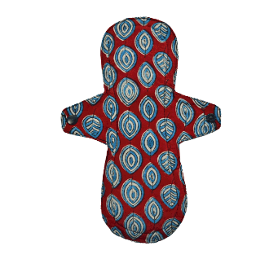

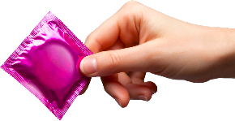
Solution
Good Health and Well-Being
Quality Education
Zero Hunger
Help in Homework's
Learn about Sensitive Topics
Ask for food
Sanitary Pads, condoms etc.

Slide 5





Technology used
Biometric library
Alert library
Geo-fencing

Slide 6

Our Solution Uniqueness
Helps in emergencies
Communities come together to land a helping hand
Geo-fencing for finding location faster
Alert Technology

Slide 7
THANK YOU

