Slide 1
RECOMMENDATION: Don’t Buy
NASDAQ: EVLV
Evolv Technology Holdings
M&A Valuation Analysis & Acquisition Recommendation
Presented by: Pablo, Andiwam, Angel
Notes:
Welcome the audience. Introduce yourselves and the company: Evolv Technology Holdings, ticker EVLV on NASDAQ. Set up the question we'll answer: should we acquire this company at the current market price? Spoiler: our recommendation is PASS. Hand off to next presenter.

Slide 2
Company Overview
AI-powered weapons detection delivered through Security-as-a-Service
Who is Evolv?
CORE PRODUCTS
Founded 2013 | Headquartered in Waltham, MA
Evolv Express
Evolv develops touchless, walk-through AI screening systems that detect concealed firearms, IEDs, and tactical knives without requiring people to stop, empty pockets, or be wanded. The frictionless approach distinguishes Evolv from traditional metal detector checkpoints and positions it as a next-generation alternative.
Walk-through AI screener — 3,600+ people/hour per lane
Evolv eXpedite
AI-driven bag screening for high-clutter environments
Evolv Insights
Real-time SaaS analytics on visitor flow and alarms
Business Model
Multi-year Security-as-a-Service subscription bundling hardware, software, AI updates, and support — recurring revenue with high gross margins at scale.
Visual Gun Detection
Camera-based firearm detection system
EVLV | M&A Valuation
3 / 10
Notes:
Quick company background. Founded 2013, based in Waltham, MA. The key innovation is touchless walk-through screening — no need to stop, empty pockets, or be wanded. Four product lines, all sold through multi-year SaaS subscriptions, which is what makes this an interesting recurring-revenue story (vs traditional security hardware vendors).

Slide 3
Industry Position & Scale
Differentiated by throughput, regulatory standing, and customer breadth
1,200+
4B+
3,600
QATT
Customers globally
People screened to date
People/hour throughput
DHS SAFETY Act designation
Sectors Served
Professional sports • Entertainment & venues • Healthcare systems • Education (K-12 & higher ed) • Government & corporate offices
WHY THIS MATTERS FOR VALUATION
The DHS SAFETY Act QATT certification is a regulatory moat — it reduces legal liability for venues that deploy Evolv and is extremely difficult for competitors to obtain. Combined with the frictionless model, this positions Evolv well for the K-12 school safety market, a large and largely unaddressed opportunity now seeing legislative tailwinds.
EVLV | M&A Valuation
4 / 10
Notes:
Scale matters. 1,200+ customers, 4 billion+ people screened. The throughput number — 3,600 people per hour per lane — is 10x what traditional metal detectors handle. The QATT designation from DHS is a real moat: it shields deploying organizations from legal liability and is hard for competitors to replicate. School safety is a particularly large untapped market.

Slide 4
Industry Trends & Risks
Strong tailwinds, but early-stage market introduces meaningful execution risk
✓ TAILWINDS
✗ RISKS
AI shift in security
Early-stage market
Industry moving from traditional checkpoints to AI-powered, high-throughput systems
Adoption curve still uncertain; many target customers have never deployed AI screening
DHS funding
Competitive pressure
Significant federal allocation toward AI-enabled screening at federal facilities and transit hubs
Threat from CEIA, Knightscope, and adjacent video-AI companies entering the space
School safety legislation
Execution risk
Multiple U.S. states have enacted or proposed K-12 screening mandates
Company has not yet achieved consistent profitability; operating leverage thesis unproven
Data flywheel
Premium valuation
Real-world screening data continuously improves AI detection models
Trading multiple already prices in significant future growth, leaving little margin of safety
EVLV | M&A Valuation
5 / 10
Notes:
Tailwinds are real and structural. AI shift, government funding, school safety legislation, and the data flywheel from billions of screenings. But — and this is critical — the market is still early-stage. Adoption isn't proven at scale. Competition is rising. The premium valuation already prices in significant future growth, leaving very little margin of safety if execution stumbles.

Slide 5
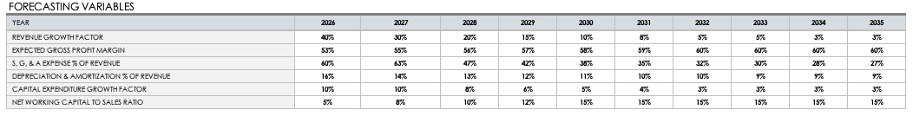
Forecast Assumptions
10-year DCF projection from FY2026 to FY2035
Key Drivers
Revenue Growth
40% in 2026 fading to 3% by 2035; total revenue reaches about $509M
Gross Margin Expansion
53% → 60% as subscription mix grows and hardware costs deleverage
Operating Leverage
S,G&A drops from 60% to 27% of revenue as fixed costs spread
Tax Shield (NOLs)
$348.9M in NOL carryforwards = no federal tax until 2034
EVLV | M&A Valuation
6 / 10
Notes:
Walk through the four big assumptions. Revenue growth 40%→3% — aggressive front-loading reflecting current momentum. Gross margin 53%→60% reflecting subscription mix shift. The biggest swing factor is S,G&A leverage from 60% to 27% — that's the operating leverage thesis. The NOL shield ($348.9M) is a real benefit any acquirer would inherit.

Slide 6
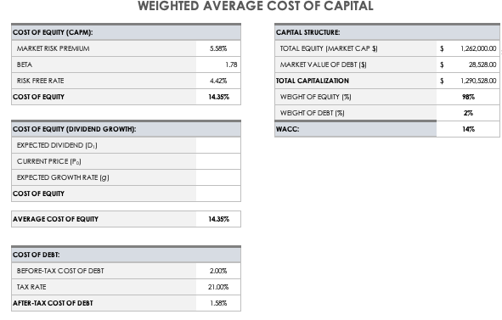
WACC & Cost of Capital
Capital structure is ~98% equity — cost of equity dominates the WACC
Cost of Equity (CAPM)
Risk-Free Rate (Rf)
4.42%
+ Beta (β)
1.78
× Equity Risk Premium
5.58%
= Cost of Equity
14.35%
Capital Structure
Equity 98%
Debt 2%
Total Equity: $1.26B Total Debt: $28.5M After-tax Kd: 1.58%
WACC = 14.07%
EVLV | M&A Valuation
7 / 10
Notes:
WACC of 14.07% is high but justified. Beta 1.78 reflects elevated risk for a small-cap unprofitable company. Capital structure is essentially all equity — debt barely moves the needle. Note: if you used a lower WACC like 9-10%, you'd get a higher intrinsic value, but our beta-implied cost of capital is the right number for this risk profile.

Slide 7
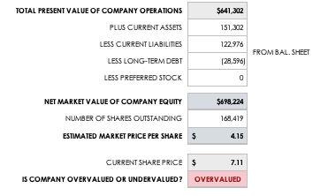
DCF Output & Intrinsic Value
From discounted cash flows to per-share intrinsic value
Valuation Bridge
PV of Operations (10-yr FCF + TV)
$641M
+ Current Assets
$151M
− Current Liabilities (BS adj.)
($94M)
= Equity Value
$698M
÷ Shares Outstanding
168.4M
INTRINSIC VALUE / SHARE
$4.15
vs. $7.25 market
EVLV | M&A Valuation
8 / 10
Notes:
Walk through the math. PV of operations is $641M — sum of 10 years of discounted FCFs plus the discounted terminal value. Add current assets, subtract liabilities, you get equity value of $698M. Divide by 168.4M shares = $4.15. The terminal value is most of the present value, which is typical for companies with negative early FCF.

Slide 8
Executive Summary
Evolv is overvalued by ~75% relative to our intrinsic value estimate
INTRINSIC VALUE / SHARE
CURRENT MARKET PRICE
PREMIUM TO INTRINSIC
$4.15
$7.11
~75%
DCF model output
as of valuation date
Holds in upside case
OUR RECOMMENDATION
PASS — Do not pursue acquisition at the current price
Even under our optimistic scenario, the intrinsic value ($6.44) remains below the current price. A control premium on top of an already overvalued price is hard to justify without specific, quantifiable synergies.
EVLV | M&A Valuation
2 / 10
Notes:
Key numbers to internalize: intrinsic value $4.15, market price $7.25, premium ~75%. Even our optimistic sensitivity case (Bull) only gets to $6.44, still below market. The conclusion holds regardless of which scenario you stress-test. This is the headline of the entire presentation.

Slide 9
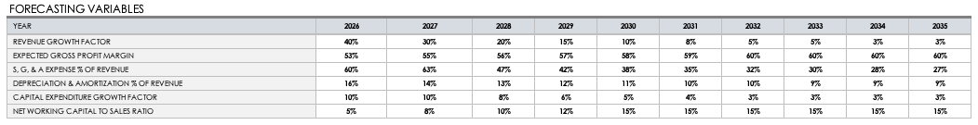
Sensitivity Analysis
Conclusion holds the same across Bull/Base/Bear scenarios
BASE CASE
$4.15
Forecast assumptions as projected
In the Base case ($4.15), Evolv's intrinsic value remains below the current market price of $7.25.
EVLV | M&A Valuation
9 / 10
Notes:
This is the rigor check. Three scenarios: Bear ($2.28), Base ($4.15), Bull ($6.44). Bull case includes 15% faster revenue growth, 2pp higher gross margins, 3pp lower S,G&A. Even with all of those favorable adjustments, intrinsic value is still below the $7.25 market price. The recommendation does not depend on conservative assumptions — it holds across the scenario range.

Slide 10
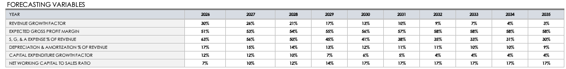
Sensitivity Analysis
Conclusion holds across Bull/Base/Bear scenarios
BEAR CASE
$2.28
Slower growth, weaker margin expansion, higher opex burn
In the Bear case ($2.28), Evolv's intrinsic value remains below the current market price of $7.25.
EVLV | M&A Valuation
9 / 10
Notes:
This is the rigor check. Three scenarios: Bear ($2.28), Base ($4.15), Bull ($6.44). Bull case includes 15% faster revenue growth, 2pp higher gross margins, 3pp lower S,G&A. Even with all of those favorable adjustments, intrinsic value is still below the $7.25 market price. The recommendation does not depend on conservative assumptions — it holds across the scenario range.

Slide 11
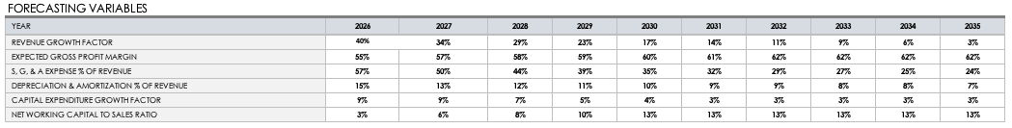
Sensitivity Analysis
Conclusion holds across Bull/Base/Bear scenarios
BULL CASE
$6.44
Stronger growth, faster margin expansion, lower opex
Even in the Bull case ($6.44), Evolv's intrinsic value remains below the current market price of $7.25.
EVLV | M&A Valuation
9 / 10
Notes:
This is the rigor check. Three scenarios: Bear ($2.28), Base ($4.15), Bull ($6.44). Bull case includes 15% faster revenue growth, 2pp higher gross margins, 3pp lower S,G&A. Even with all of those favorable adjustments, intrinsic value is still below the $7.25 market price. The recommendation does not depend on conservative assumptions — it holds across the scenario range.

Slide 12
Acquisition Recommendation
Final verdict and conditions for revisiting
PASS
DO NOT PURSUE AT CURRENT PRICE
Acquisition would require a control premium on top of an already overvalued price.
WHEN TO RECONSIDER
Quantifiable cross-sell synergies
Acquirer with adjacent customer base where Evolv's products can be sold without significant additional sales cost
Platform integration value
Acquirer can integrate Evolv's detection technology into existing security platforms, creating value not available to standalone buyers
Material price correction
Stock declines to within 10-15% of intrinsic value, narrowing the premium gap to acceptable levels
Thank you | Questions?
Notes:
Land the conclusion firmly. PASS at current price. We listed three specific conditions where we'd reconsider: quantifiable cross-sell synergies, platform integration value, or a material price correction. Without one of those, the financial case is not there. Thank the audience and open for questions.

