Slide 1

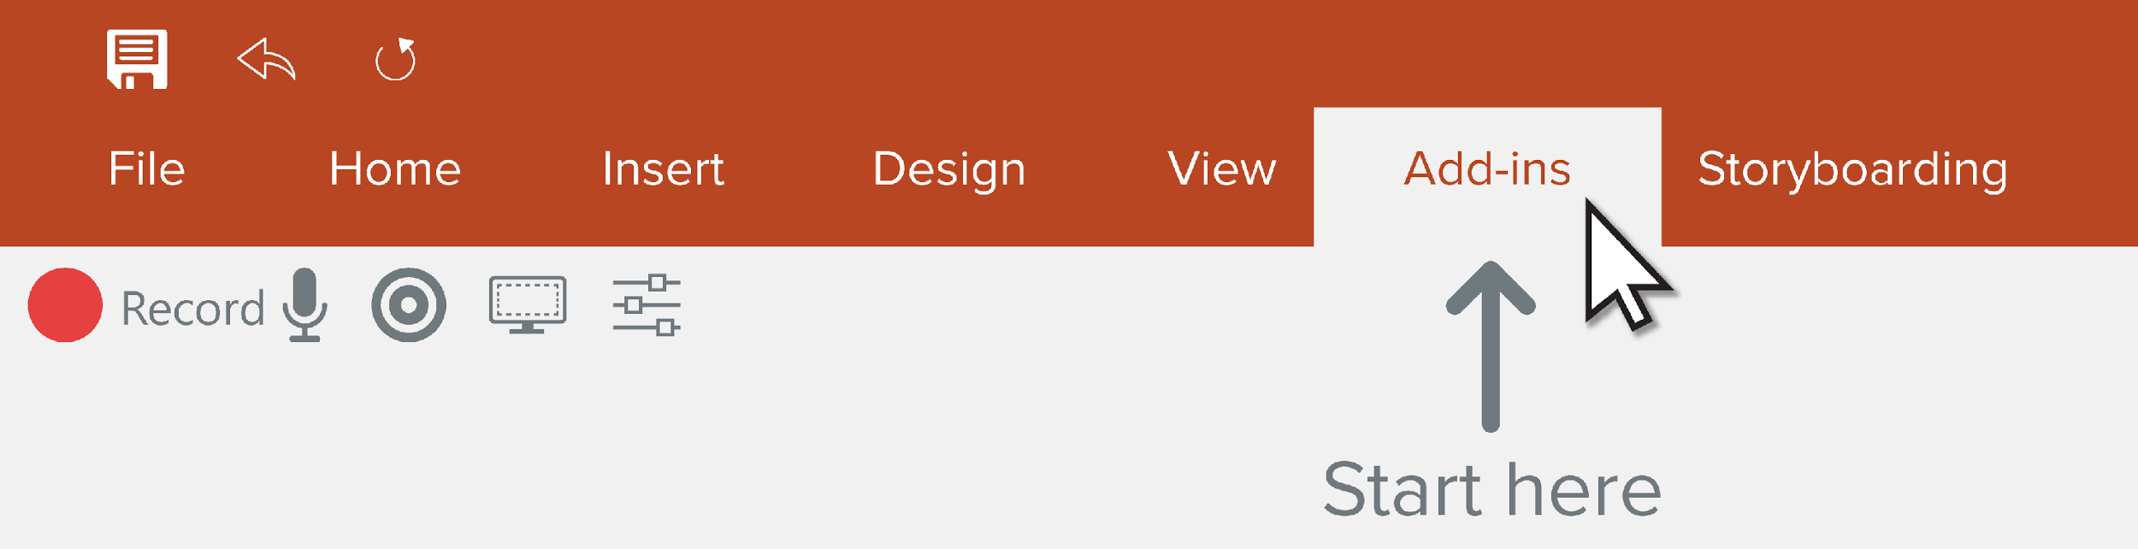
Record a Presentation
Use the Camtasia Add-in to record your presentations. Start by going to the Add-ins tab.

Slide 2



Camtasia Recording Toolbar
Begin
recording
Toggle camera
recording
Adjust specific
recording options
Toggle microphone
recording
Display camera
preview

Slide 3




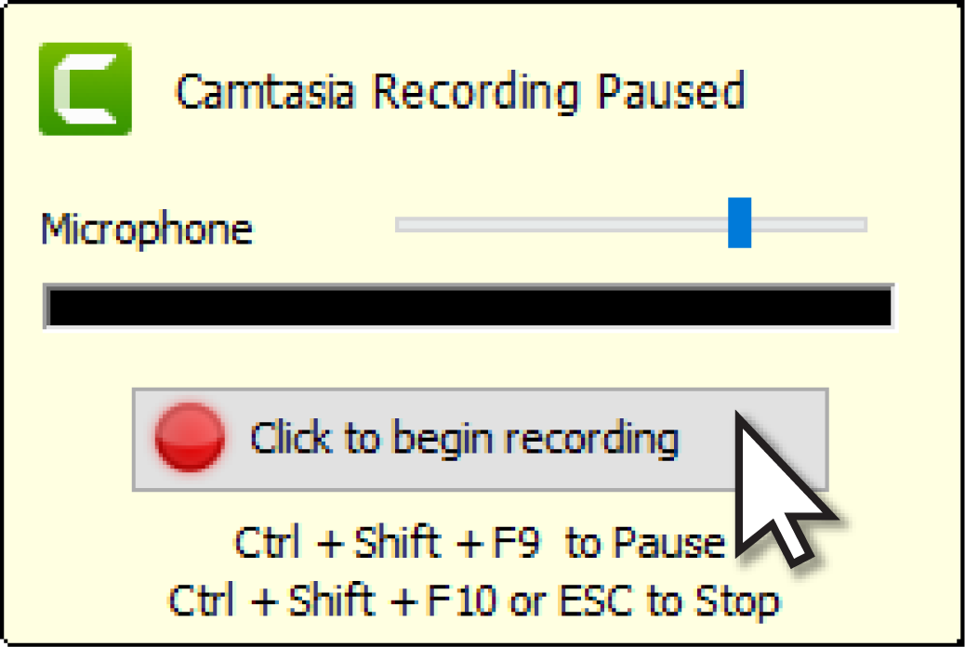

Start a Recording
Select recording options
Press the record button
Test your audio and then
start your recording

Slide 4




Finish a Recording
End your presentation
and give it a name
Choose to produce or edit
your video

