Slide 1
Introduction to Git and GitHub
By MMED 2015 mentors
Eva, Ivy, Joseph & Roxy
AIMS – South Africa, Muizenberg

Slide 2
What is Git?
Git is an open source version control system/software.
Why version control?
Multiple people can work on one project, simultaneously without getting 'conflicted copies‘
Access to historical versions of the file before different edits were made
Undo specific edits without loosing all work that has been done previously
At any point in time you can see who made what edits and when

Slide 3
What is GitHub ?
GitHub is a web-based Git repository hosting service
Offers version control and source code management
It has a graphical interface for windows desktop
For the purpose of this clinic we have chosen to use another user friendly graphical interface “SmartGit”, compatible with Windows, Mac, and Linux

Slide 4
Git commands chart
Web Interface
Repository
(On GitHub)
Clone
Pull
Commit
Local Repository
(SmartGit)
Push

Slide 5
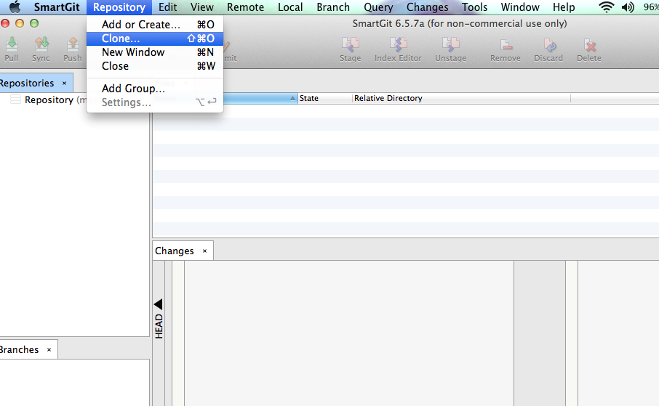
Local clone of an online repository
Step 1
Notes:
<number>

Slide 6
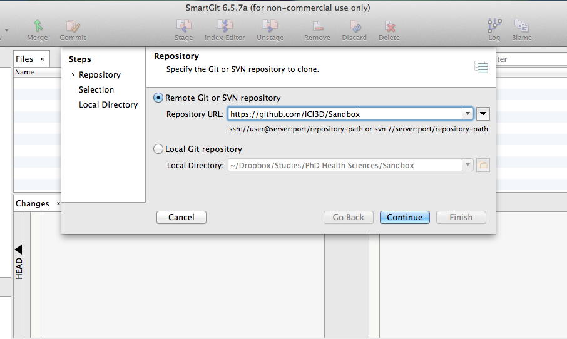
Step 2
Notes:
<number>

Slide 7
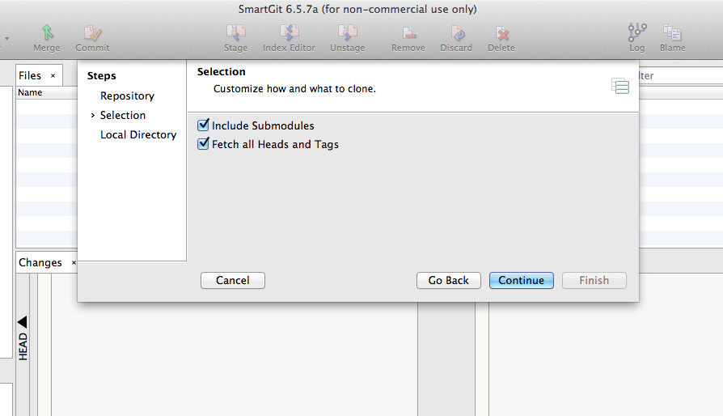
Step 3

Slide 8
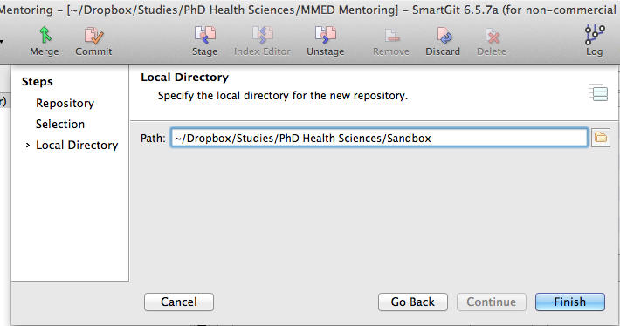
Step 4

Slide 9
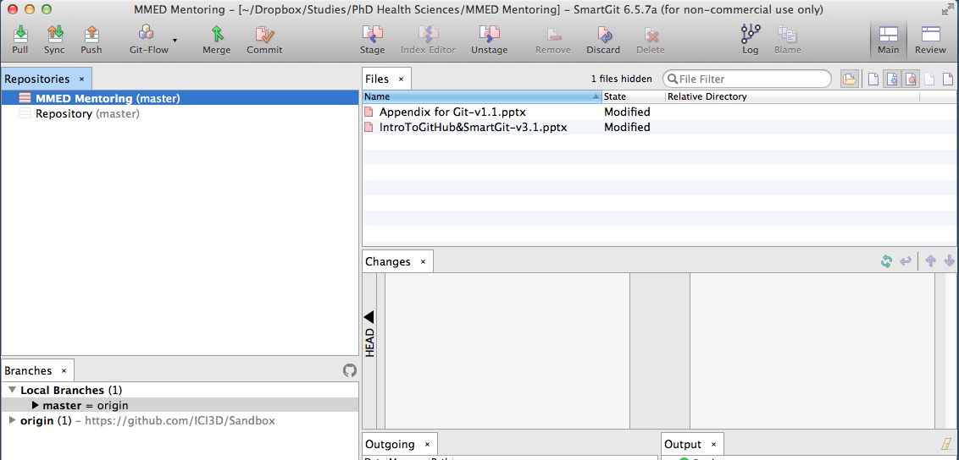
After cloning…
Local Files have been modified
View Branches

Slide 10
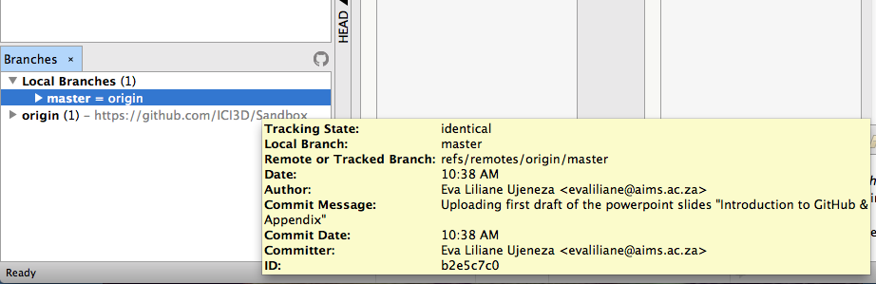
Zoom in and look at the ‘Branches’ tab

Slide 11
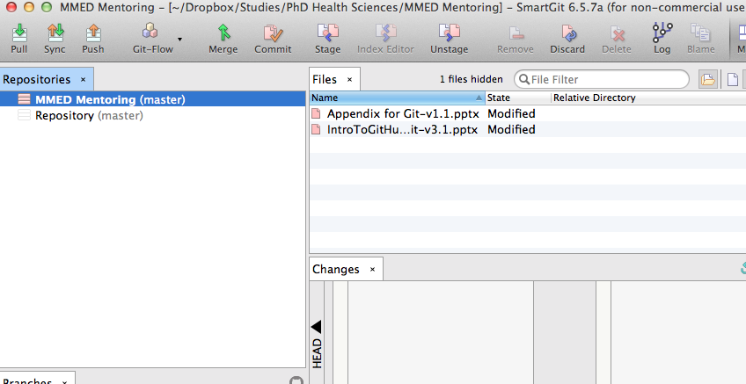
Commit
Tells Git that the current state of all your files is important
Make sure that new files have been added first
Step 1: Click on ‘Commit’
Notes:
<number>

Slide 12
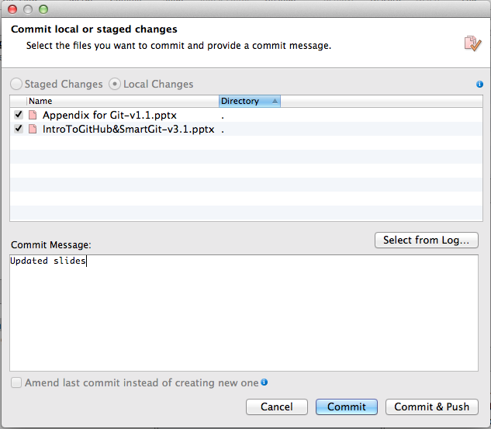
Step 2
Notes:
<number>

Slide 13
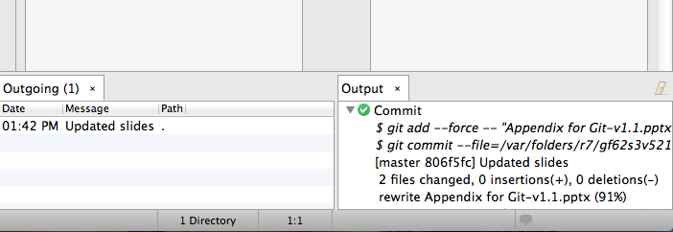
Step 3: View the Output Tab to confirm changes have been ‘Committed’

Slide 14
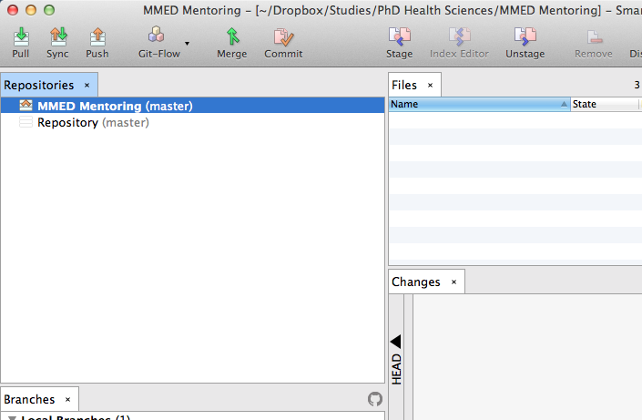
Push/Pull
Push: sending your committed changes to the online repository
Pull: grabbing the most recently updated version of the online repository
Step 1: Click on ‘Push’
Notes:
<number>

Slide 15
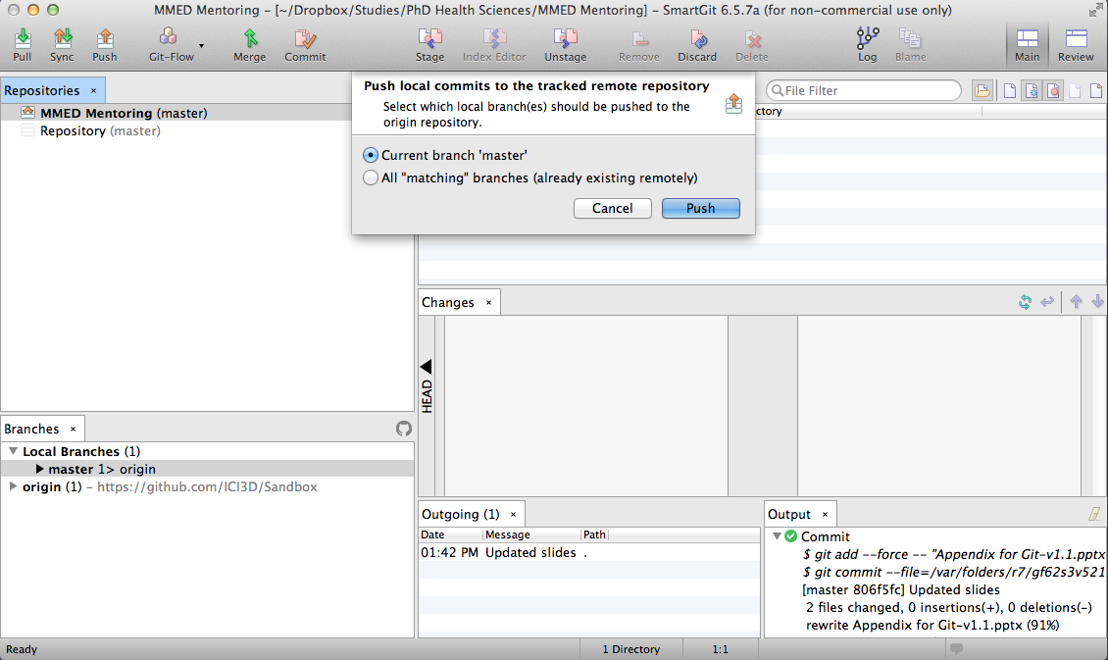
Step 2

Slide 16
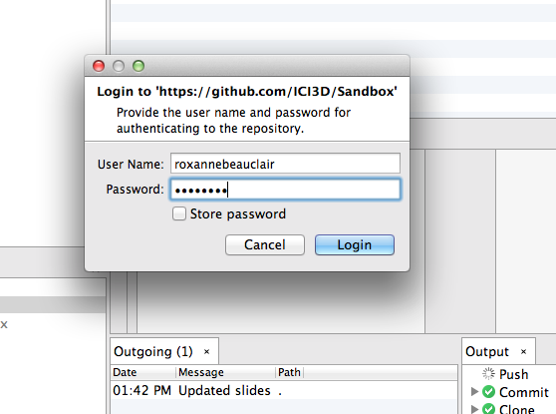
Step 3: You may have to enter your GitHub Username and Password!

Slide 17
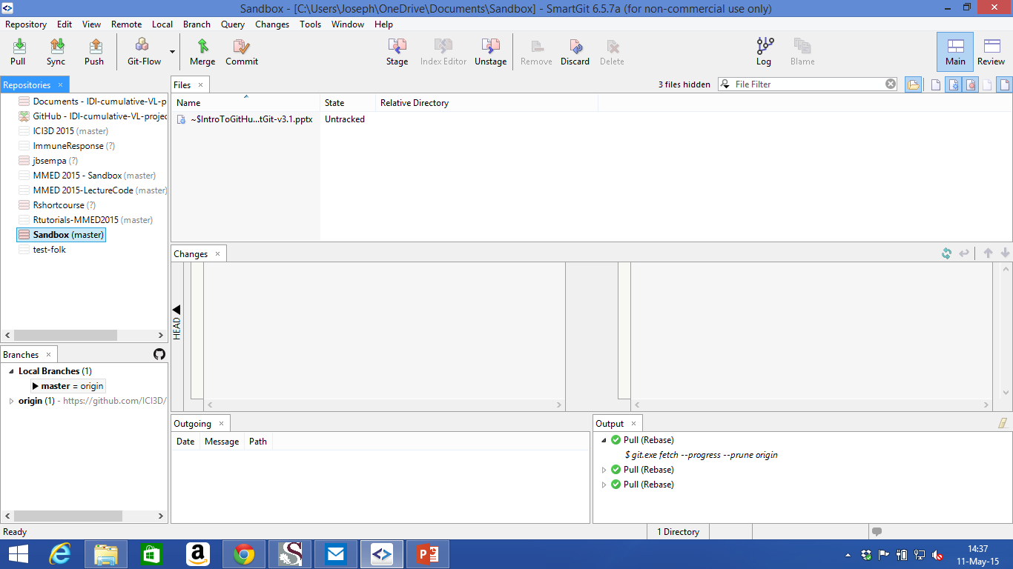
Pull
Step 1: Click on ‘Pull’

Slide 18
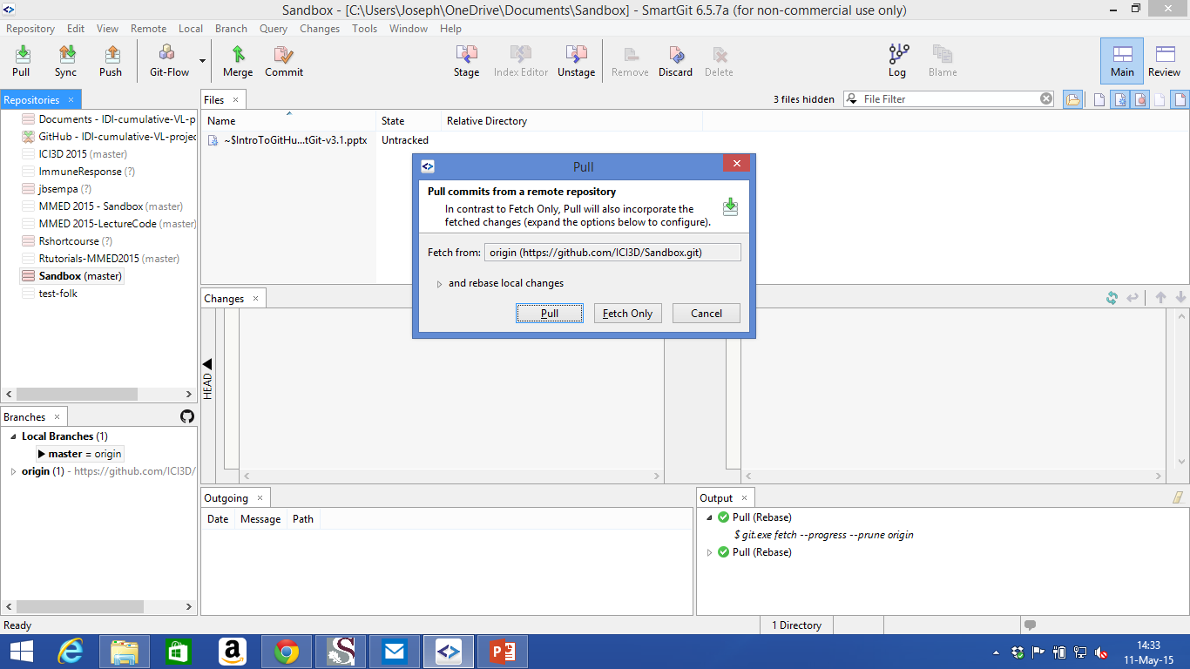
Step 2: In the dialogue box, click ‘Pull’

Slide 19
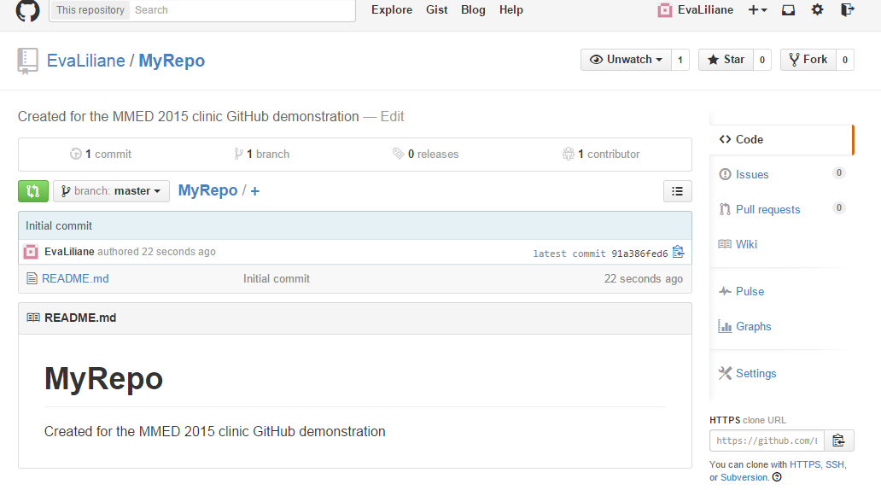
Your GitHub Wiki, Profile and more
Create a wiki page
Page 1 (Home): Self Introduction
Page 2: Research interests
Page 3: MMED expectations
Edit your github profile
Click on your username and then on “Edit Profile”
Upload a picture
Modify your GitHub settings
Go through the different settings.

