Slide 1
Introduction to Git and GitHub
By MMED 2015 mentors
Eva, Joseph, Roxy & Ivy
AIMS – South Africa, Muizenberg

Slide 2
Why version control?
What is Git?
Git is an open source version control system/software.
Multiple people can work on one project, simultaneously without getting 'conflicted copies‘
Access to historical versions of the file before different edits were made
Undo specific edits without loosing all work that has been done previously
At any point in time you can see who made what edits and when

Slide 3
What is GitHub ?
GitHub is a web-based Git repository hosting service
Offers version control and source code management
It has a graphical interface for windows desktop.
For the purpose of this clinic we have chosen to use another user friendly graphical interface “SmartGit”, compatible with Windows, Mac, and Linux.

Slide 4
Git commands chart
Web Interface
Repository
(On GitHub)
Clone
Pull
Commit
Local Repository
(SmartGit)
Push

Slide 5
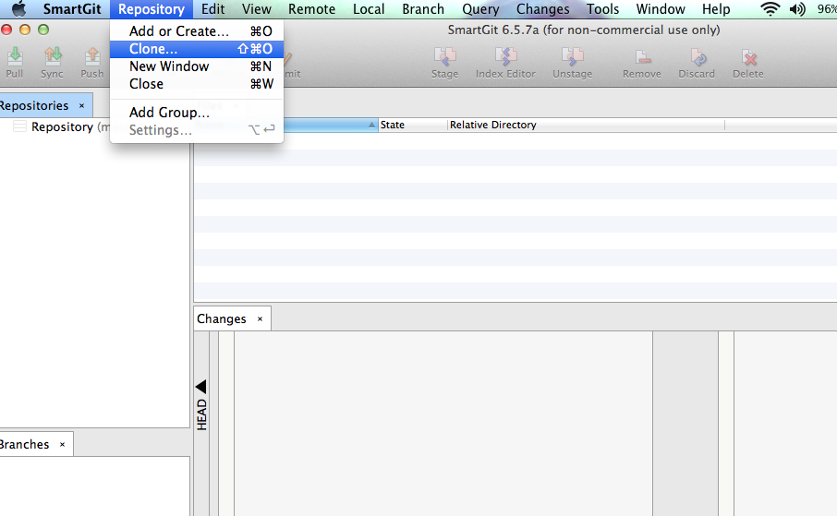
Local clone of an online repository
Step 1
Notes:
Open SmartGit and while there do the following
Step 1: Click on Clone / New to bring up the dialogue box “Clone / Add / Create Repository”
Step 2: Click on the most right icon opposite “Source Path/ URL”. This will take you to a list of your online repositories under your username. While there pick the repository you want to clone
Step 3: Click on the most right icon opposite “Destination Path”. This will help you choose a local folder on your machine where you want to host the repository. This folder MUST be empty else you will receive an error message
After process to click on Clone

Slide 6
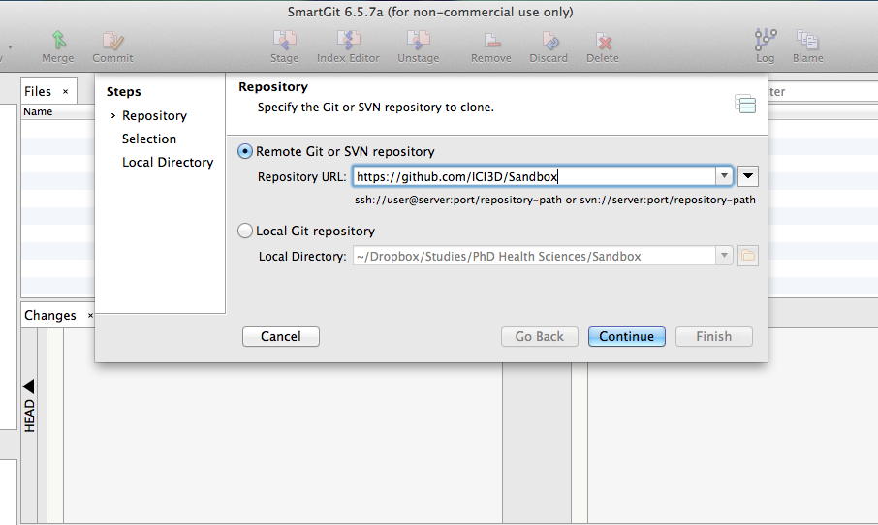
Step 2
Notes:
Ref: https://github.com/GSoft-SharePoint/Dynamite/wiki/Git-step-by-step:-Part-1
For Linux:
git branch –a list all local and remote branches
git branch –r list only remote branches
git branch list only local branches
git show-branch list branches with their commits.
git remote list all available remote (-v adds the url after the name)

Slide 7
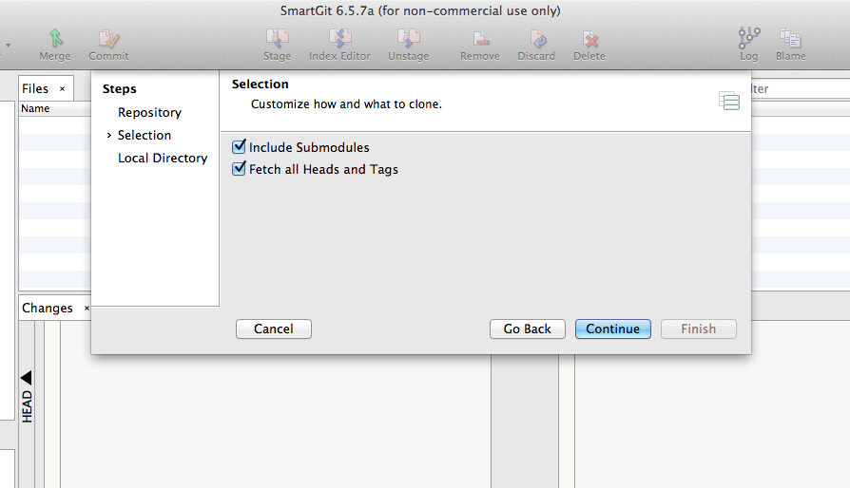
Step 3

Slide 8
Step 4

Slide 9
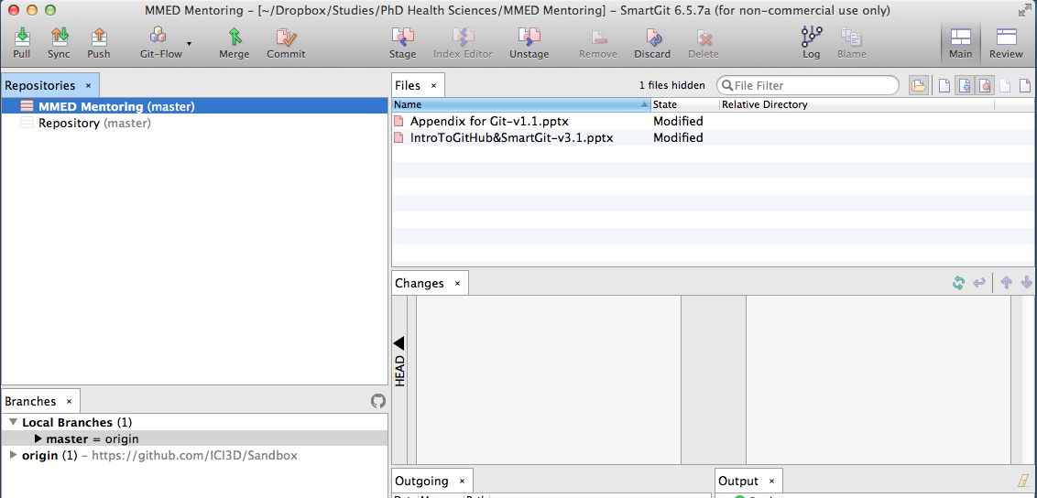
After cloning…
Local Files have been modified
View Branches

Slide 10
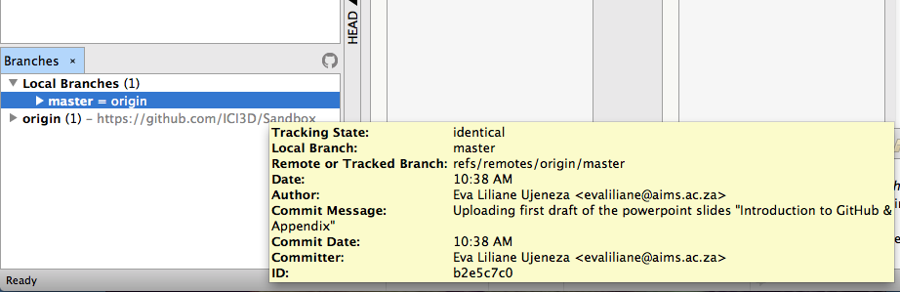
Zoom in and look at the ‘Branches’ tab

Slide 11
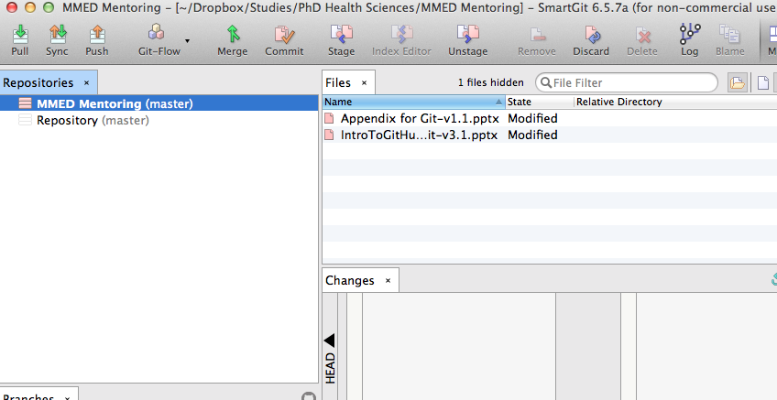
Commit
Tells Git that the current state of all your files is important.
Make sure that new files have been added first.
Make sure that new files have been added first.
Step 1: Click on ‘Commit’
Notes:
Reference: https://github.com/GSoft-SharePoint/Dynamite/wiki/Git-step-by-step:-Part-2

Slide 12
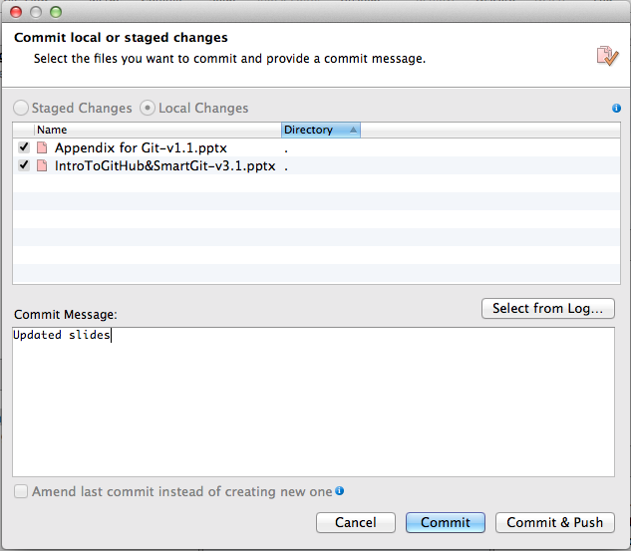
Step 2
Notes:
Step 1: Click commit (at the top of the screen) then you will get a window on the right.
Step 2: In this window under ‘Commit message’ box, you add a message to show what exactly that commit is for.
Click commit on the bottom right
Step 3: See the commit message on the commit you’ve just made
Reference: https://github.com/GSoft-SharePoint/Dynamite/wiki/Git-step-by-step:-Part-2

Slide 13
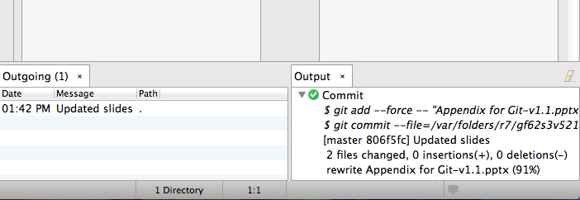
Step 3: View the Output Tab to confirm changes have been ‘Committed’.

Slide 14
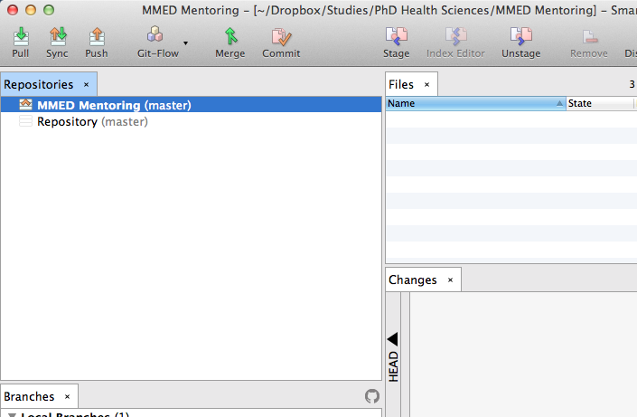
Push/Pull
Push: sending your committed changes to the online repository
Pull: grabbing the most recently updated version of the online repository
Step 1: Click on ‘Push’
Notes:
Click on Push at the top of the screen. This gives you an option to select which branches you want to push
Checking the develop branch, you want your local development branch to track it remote.
Click on ‘OK’ in the bottom right. See the output that follows

Slide 15
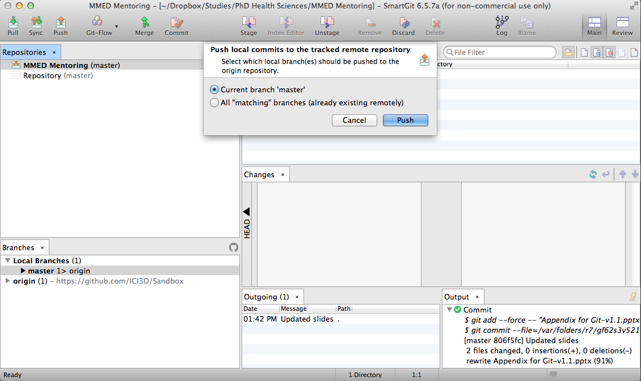
Step 2

Slide 16
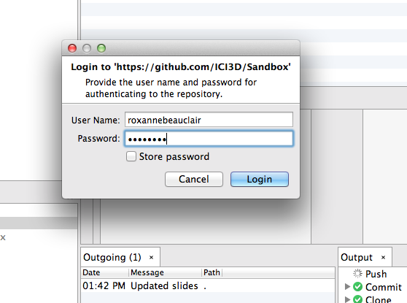
Step 3: You may have to enter your GitHub Username and Password!

Slide 17
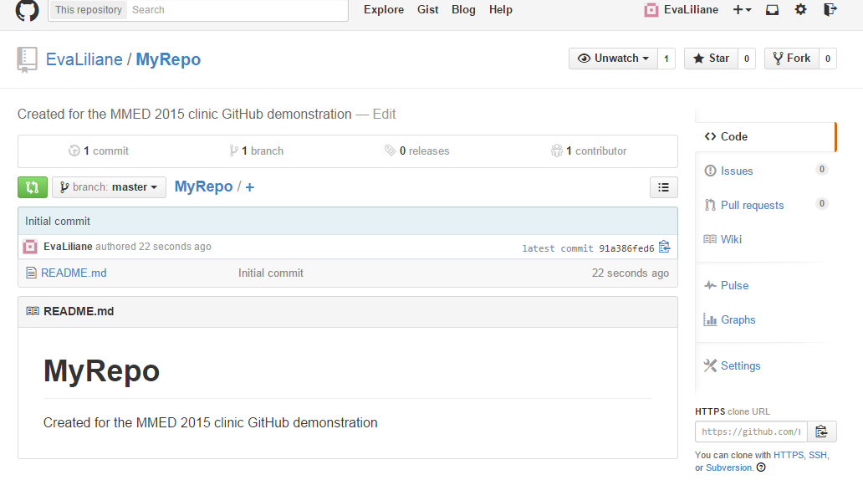
Your GitHub Wiki, Profile and more
Create a wiki page
Page 1 (Home): Self Introduction
Page 2: Research interests
Page 3: MMED expectations
Edit your github profile
Click on your username and then on “Edit Profile”.
Upload a picture
Modify your github settings
Go through the different settings.

