Slide 1
Introduction to Git and GitHub
By MMED 2015 mentors
Eva, Joseph, Roxy & Ivy
AIMS – South Africa, Muizenberg

Slide 2
Why version control?
What is Git?
Git is an open source version control system/software.
Multiple people can work on one project, simultaneously without getting 'conflicted copies‘
Gain access to historical versions of the file before different edits were made
You can undo specific edits loosing all work that has been done
You can see at any point in time you can see who made what edits and when

Slide 3
What is GitHub ?
GitHub is a web-based Git repository hosting service
Offers version control and source code management
It has a graphical interface for windows desktop.
For the purpose of this clinic we have chosen to use another user friendly graphical interface “SmartGit”, compatible with Windows, Mac, and Linux.

Slide 4
Git commands chart
Clone
Web Interface
Repository
(On GitHub)
Pull
Commit
Local Repository
(SmartGit)
Push

Slide 5
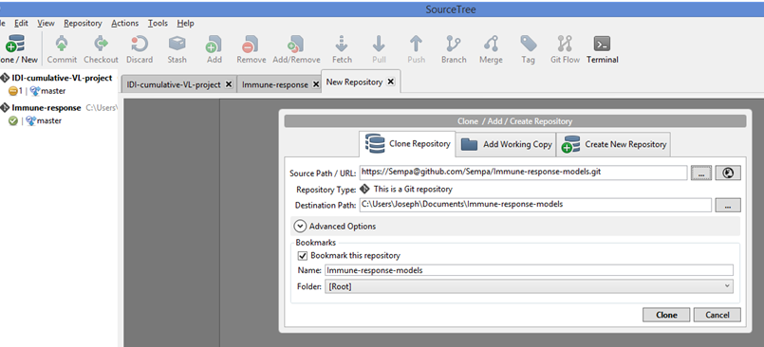
Local clone of an online repository
SmartGit
Step 1
Step 2
Step 3
Notes:
Open SmartGit and while there do the following
Step 1: Click on Clone / New to bring up the dialogue box “Clone / Add / Create Repository”
Step 2: Click on the most right icon opposite “Source Path/ URL”. This will take you to a list of your online repositories under your username. While there pick the repository you want to clone
Step 3: Click on the most right icon opposite “Destination Path”. This will help you choose a local folder on your machine where you want to host the repository. This folder MUST be empty else you will receive an error message
After process to click on Clone

Slide 6
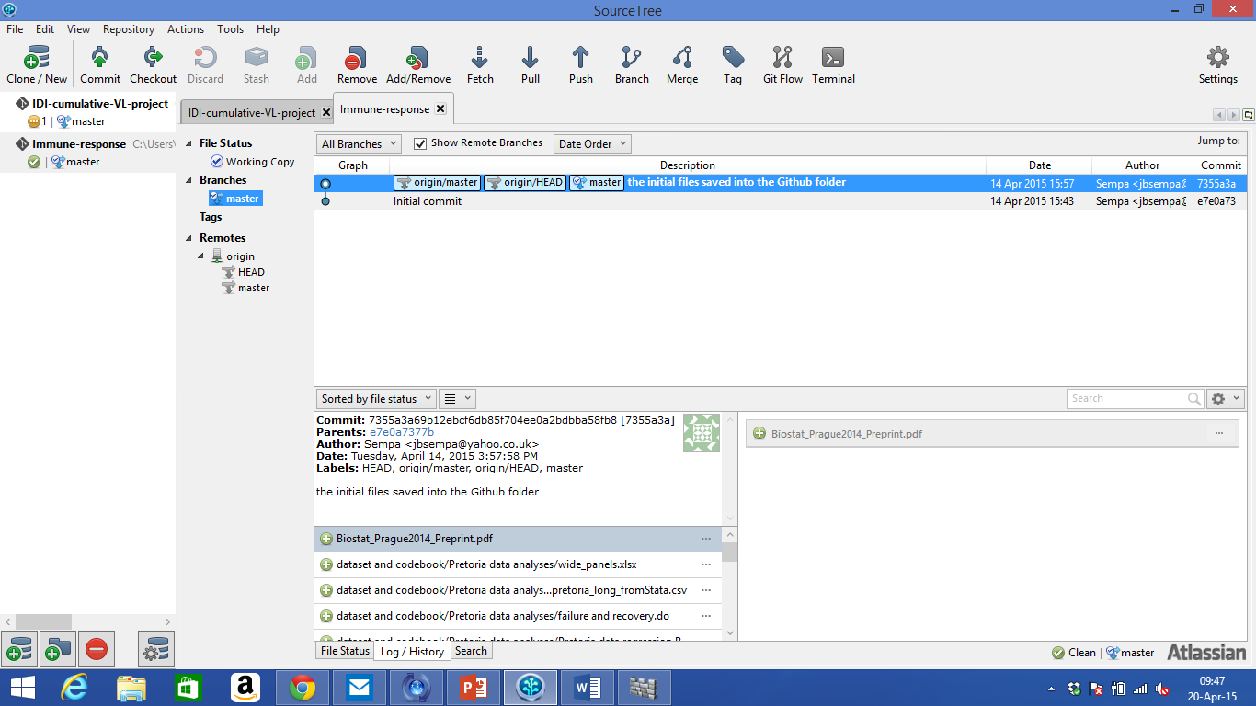
After cloning …
Notes:
Ref: https://github.com/GSoft-SharePoint/Dynamite/wiki/Git-step-by-step:-Part-1
For Linux:
git branch –a list all local and remote branches
git branch –r list only remote branches
git branch list only local branches
git show-branch list branches with their commits.
git remote list all available remote (-v adds the url after the name)

Slide 7
Commit
Remember, committing is telling git that the current state of all your files is important. Make sure that new files have been added first.
Note: You need to have made change(s) to a file in the local repository.
SmartGit
A: Shows you have unsaved changes
B: Allows you to stage changes. First click on the files that you want to commit then click on ‘B’
Notes:
Reference: https://github.com/GSoft-SharePoint/Dynamite/wiki/Git-step-by-step:-Part-2

Slide 8
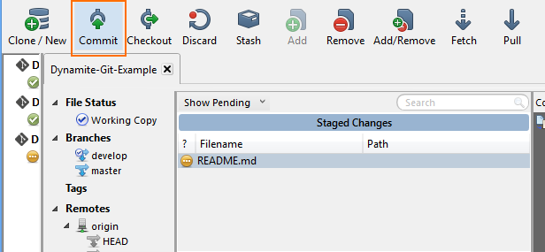
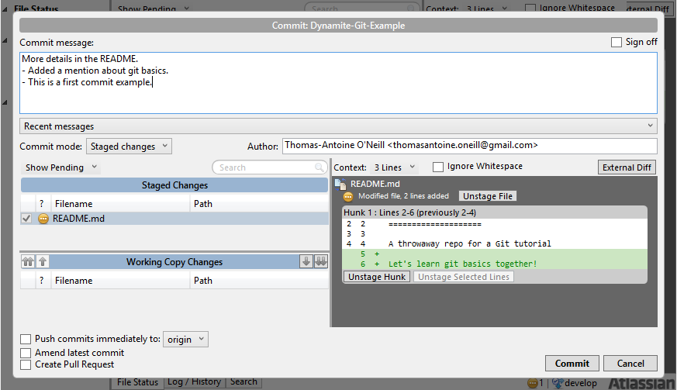
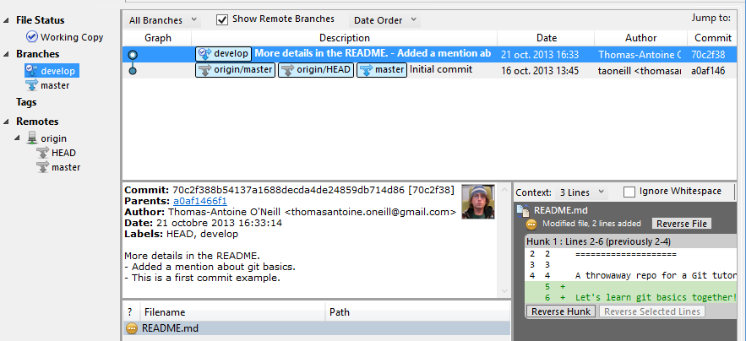
Commit with SmartGit
1
2
3
Notes:
Step 1: Click commit (at the top of the screen) then you will get a window on the right.
Step 2: In this window under ‘Commit message’ box, you add a message to show what exactly that commit is for.
Click commit on the bottom right
Step 3: See the commit message on the commit you’ve just made
Reference: https://github.com/GSoft-SharePoint/Dynamite/wiki/Git-step-by-step:-Part-2

Slide 9

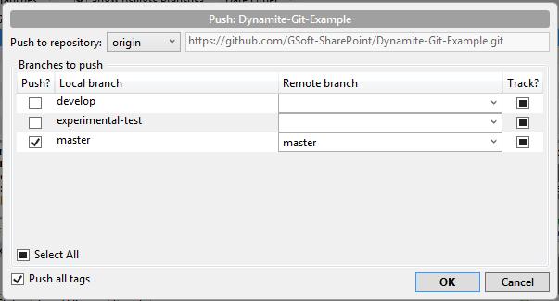
Push/Pull
11
SmartGit
Assuming you are working from one station / PC
21
Notes:
Click on Push at the top of the screen. This gives you an option to select which branches you want to push
Checking the develop branch, you want your local development branch to track it remote.
Click on ‘OK’ in the bottom right. See the output that follows

Slide 10
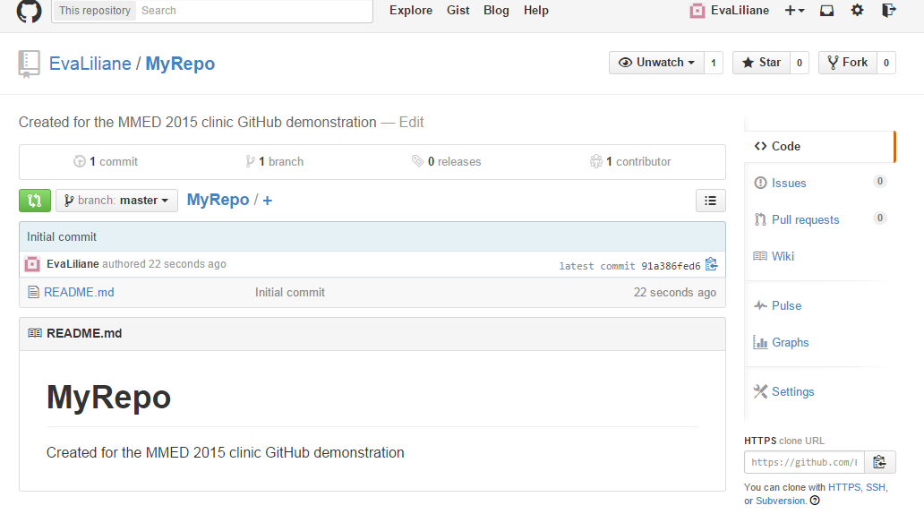
Your GitHub Wiki, Profile and more
Create a wiki page
Page 1 (Home): Self Introduction
Page 2: Research interests (at lest 2 paragrahs)
Page 3: MMED expectations
Edit your github profile
Click on your username and then on “Edit Profile”. Upload a picture.
Modify your github settings
Go through the different settings.

