Slide 1


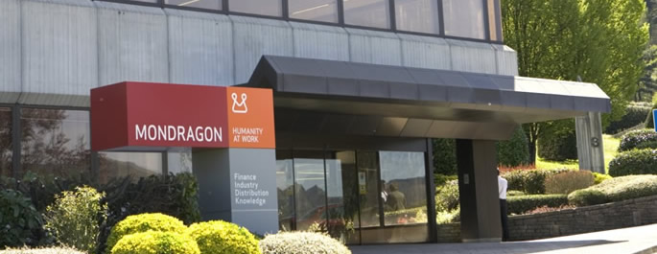
MONDRAGON CORPORATION

Slide 2



DIVISIONS
MAIN FIELDS
HOUSEHOLD APPLIANCES
AUTOMOTION
COMPONENTS
CIVIL CONSTRUCTION
FINANCIAL
INDUSTRIAL SYSTEMS
INDUSTRIAL
ENGINEERING AND SERVICES
DISTRIBUTION
TOOLINGS AND SYSTEMS
RESEARCH AND EDUCATIONAL CENTERS
EQUIPMENT
INDUSTRIAL AUTOMATION
TOOL MACHINES
Entrepreneurial structure
in depth: www.mcc.es
intro
mcc
mise
companies
sectors
references

Slide 3
ELECTRICAL AND CONTROL ENGINEERING

Slide 4
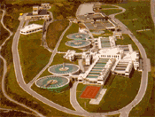
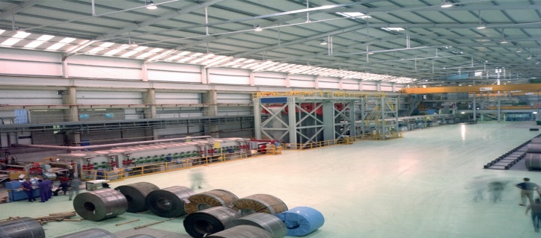
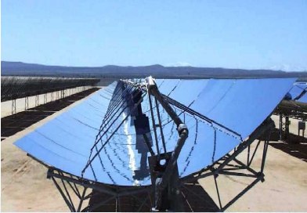
MSI works diverse range of industries
Water Treatment Plants
  Desalination Plants
  WWTP
  WTP
Metal Industry (Siderurgy)
Energy

Slide 5
SCOPE OF SUPLY
Engineering
Electrical Equipment (MV & LV)
Control System
Erection and electrical installation
Commissioning
After Sales Service

Slide 6
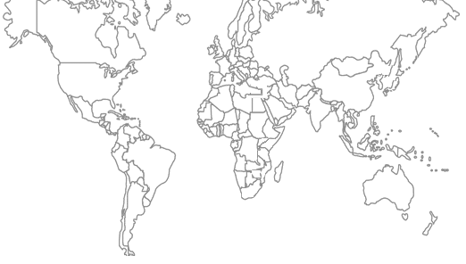
MSI grupo
Spain
Mexico
Algerie
Australia
C MONDRAGON SISTEMAS 2004 V 1.4

Slide 7
MSI grupo
MSI International Branches
MSI branches offer the following Services::
  Local Engineering Development
  Procurement
  Project Management
  MCC´s and Control Panels
Services given with Local Standards knowlegde:
Location::
  México
  Argelie
  Spain
  Australia
C MONDRAGON SISTEMAS 2004 V 1.4

Slide 8
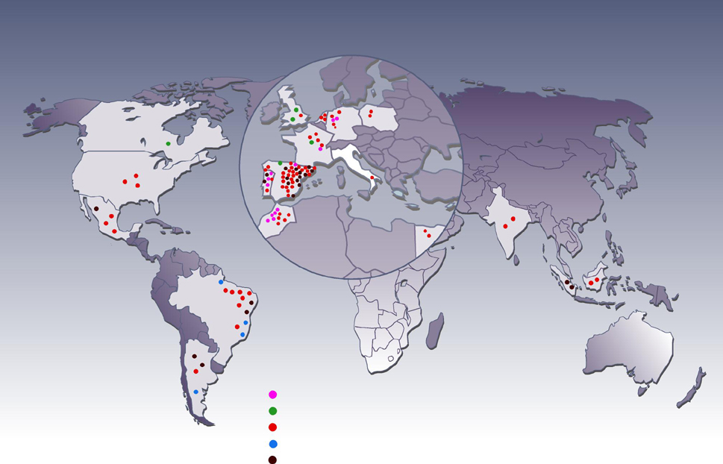
Projects all around the world
Líneas de inspección, pulido, aplanado
Cizallas rotativas
Líneas de corte longitudinal, corte transversal, corte longitudinal+transversal, apiladores, alimentación a prensa, manutención
Skin pass, laminadores,
Líneas de galvanizado, decapado, recocido, hornos, aplanado bajo tensión, pintura, desengrase
Depuradoras

Slide 9
Projects all around the world
MSI has over 100 references outside our borders.
These projects are spread around the world and on five continents.
This extensive international experience has led us to have as partners in implementing these projects to local companies .
These local firms have different characters:
Electrical Installation Companies.
Companies with capacity for achievement of Engineering.
Control and Automation companies.
CURRENTLY 90% OF PROJECTS IN EXECUTION ARE INTERNATIONAL PROJECTS

Slide 10
MSI International Partners
These international partners allows us to provide diferent services to our customers:
- Engineering according to local standards.
- Economic optimization of the Staff (MSI-local staff mix).
- Local Fabrication for Cabinets
MSI leaves a local knowledge of the project for an agile after-sales service.

Slide 11
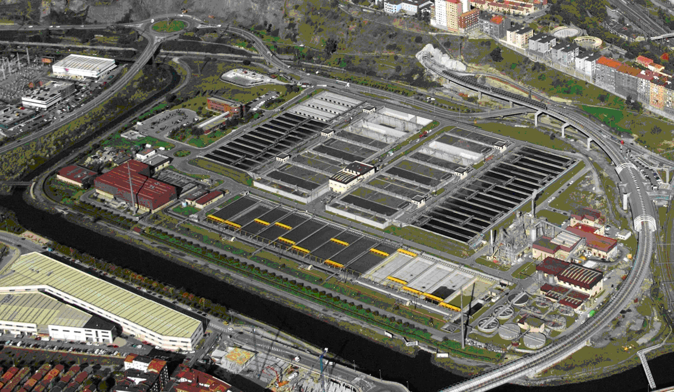
WATER TREATMENT PLANTS REFERENCES

Slide 12
Last Projects
Desalination Plant Adelaide (2010-2012)
Country : Australia
Customer: ACCIONA
Water treatment capacity: 300.000 m3/day
Scope of suply:
-Control Engineering
Control panels
SCADA system
Commissioning
After sales services

Slide 13
Last Projects
Desalination Plant MOSTAGANEM (2008-2011)
Country : Argelia
Customer: INIMA-AQUALIA
Water treatment capacity: 227.000 m3/day
Scope of suply:
Electrical turn key project including:
-MV Cells
Transformers
MV & LV distribution
MV & LV Installation and Cabling
MCC-s
Control System (PLC, Drives,…)
CCTV System
Engineering, program and commisioning

Slide 14
Last Projects
Desalination Plant FOUKA (2008-2011)
Country : Argelia
Customer: ACCIONA AGUA
Water treatment capacity : 120.000 m3/day
Scope of suply:
Electrical turn key project including:
-MV Cells
- MV & LV Installation and Cabling
-MCC-s
-Control System (PLC, Drives,…)
-Engineering, program and commisioning

Slide 15
Last Projects
WWTP EAST ALEJANDRIA (2009-2011)
Country : Egypt
Customer: DEGREMONT
Water treatment capacity: 800.000 m3/day
Scope of suply:
-Control Engineering
Control panels
SCADA system
Commissioning
After sales services

Slide 16
Last Projects
WWTP GABAL AL SAFAR (El Cairo) (2009-2011)
Country : Egypt
Customer: DEGREMONT
Scope of suply:
Automation System

Slide 17
Last Projects
WWTP SEIXAL (Lisboa) (2009)
Country : Portugal
Customer: CADAGUA
Scope of suply:
Electrical turn key project including:
-MV Cells
-Transformers
-MV & LV distribution
-MV & LV Installation and Cabling
-MCC-s
-Automation System Control (PLC, Drives,…)
-Engineering, program and commisioning

Slide 18
Last Projects
WWTP SHANGANAGH (Dublin) (2009)
Country : Irland
Customer: DRACE
Scope of suply:
Electrical turn key project including:
-MV Cells
-Transformers
-MV & LV distribution
-MV & LV Installation and Cabling
-MCC-s
-Automation System Control (PLC, Drives,…)
-Engineering, program and commisioning

Slide 19
Last Projects
WTP QUERETARO (2009)
Country : MEXICO
Customer: AQUALIA
Scope of suply:
Electrical turn key project including:
-MV Cells
-Transformers
-MV & LV distribution
-MV & LV Installation and Cabling
-MCC-s
-Engineering, program and commisioning

Slide 20
Last Projects
WTP IBIUR (2009)
Country : Spain
Customer: DRACE
Scope of suply:
Electrical turn key project including:
-MV Cells
-Transformers
- MV & LV distribution
- MV & LV Installation and Cabling
- MCC-s
- Automation System Control (PLC, Drives,…)
- Engineering, program and commisioning

Slide 21
Last Projects
WTP SIDI LAHDJEL (2007-2008)
Country : Argelia
Customer: DEGREMONT
Water treatment Capacity: 560.000 m3/day
Scope of suply:
CCM-s and Automation System

Slide 22
Last Projects
WTP KOUDIAT (2009)
Country : Argelia
Customer: DEGREMONT
Water treatment Capacity: 450.000 m3/day
Scope of suply:
CCM-s and Automation System

Slide 23
Last Projects
TELECONTROL IBAI EDER
Country : Spain
Customer: Consorcio Aguas Guipuzcoa
Scope of suply:
Telecontrol Systems via Cable and Radio
26 remote stations

Slide 24
Last Projects
TELECONTROL VALDIZARBE
Country : Spain
Customer: Mancomunidad de Valdizarbe (Navarra)
Scope of suply:
Telecontrol Systems via Cable and Radio
31 remote Stations

Slide 25
Last Projects
TELECONTROL NILSA
Country : Spain
Customer: NILSA (Navarra)
Scope of suply:
Telecontrol Systems via GSM
18 remote Stations

