Slide 1

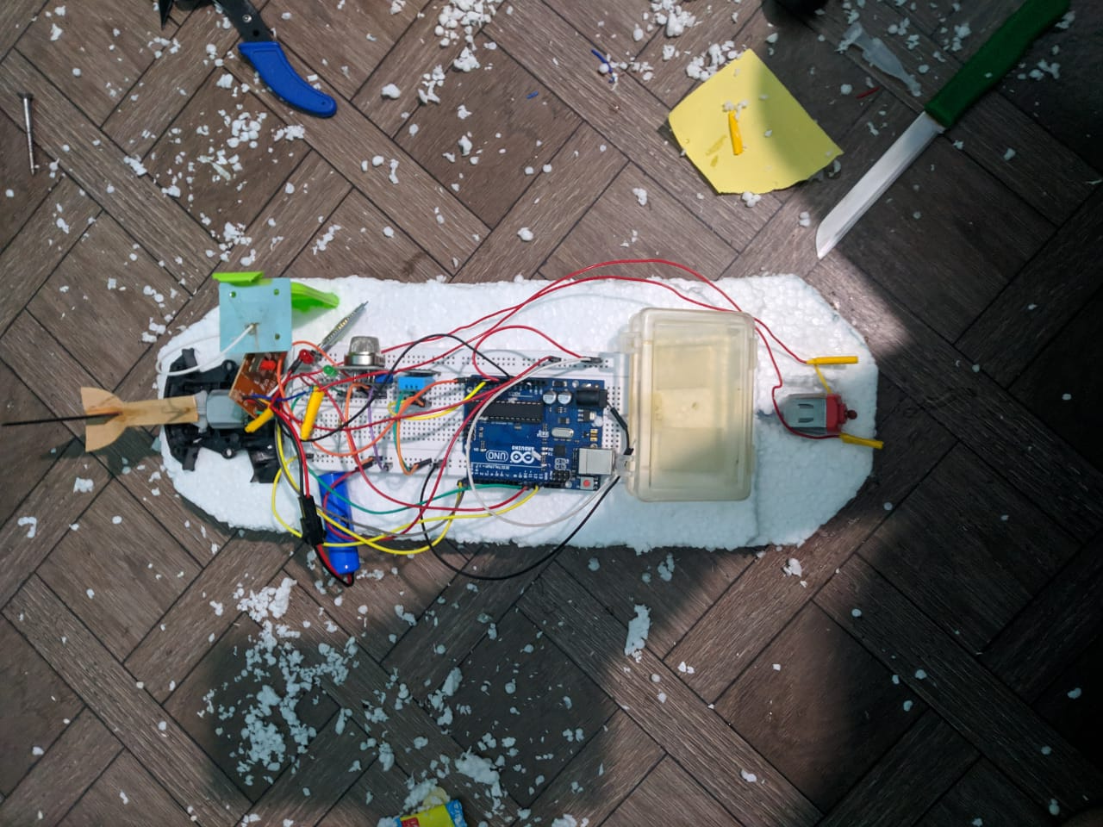
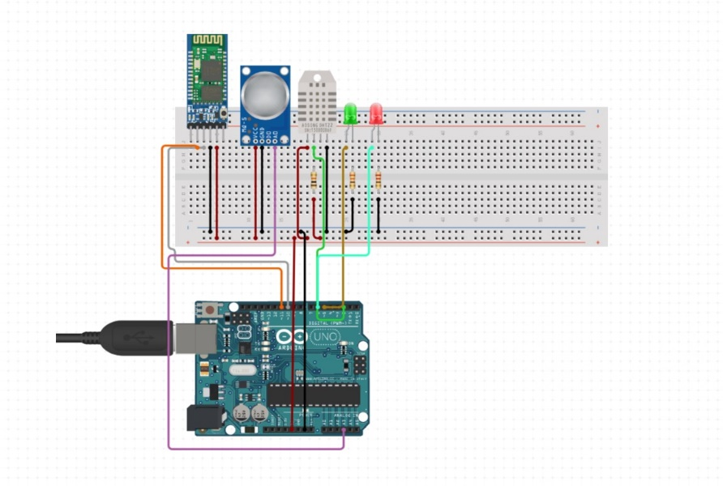




<remote control boat water body excavator>
OUR AIM:
1.TO DETECT THE TEMPERATURE
2.TO CHECK THE HUMIDTY
3.TO DETECT THE QUALITY OF AIR OF A WATER BODY
PRACHETH T PES1UG20CS469
VARUN RAMURS PES1UG20CS48
VARUN SR PES1UG20CS491
Dr.JAYASHREE

