Slide 1
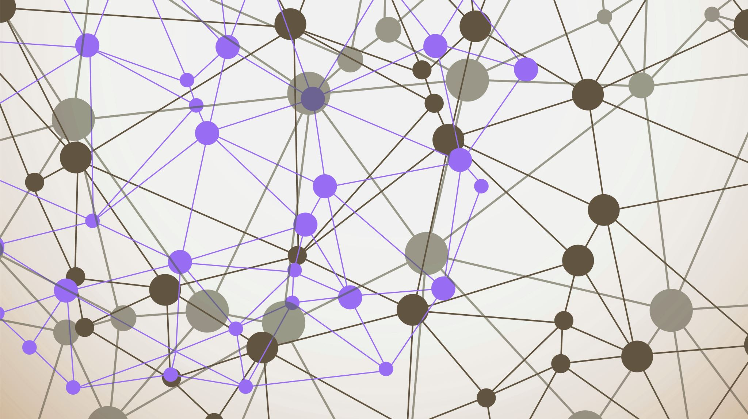
Garbage Detection using Deep Convolutional Neural Networks
By Ayush Govind, Pracheth Thamankar and Tanish Praveen

Slide 2
Introduction
Goal: To automate the process of garbage detection by using deep neural networks. For any given image, the garbage should be localized as well as classified by using the constructed model.
The model is trained using a dataset of 7000 images annotated according to the COCO JSON format. The dataset is created using Taco dataset as well as image transplantation and manually obtained images.
Multiple different models are trained and tested to determine which performs the best for the given problem. Yolo, Faster R-CNN, Detectron2 etc. are some of the models used.

Slide 3
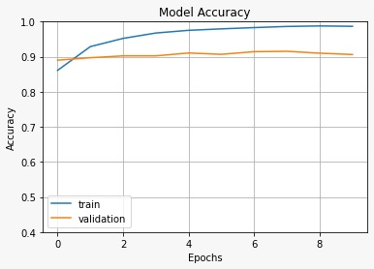
Literature Review
Base Paper - Classification of Organic and Solid Waste Using Deep Convolutional Neural Networks – R Faria, F Ahmed (2021)
Their model classified images into 4 classes of waste – Plastic, Metal, Glass and Organic Waste, using VGG-16 with an accuracy of 88%
Previously, we were able to achieve similar results, by classifying images into 7 classes of waste – Plastic, Metal, Glass, Paper, E-waste, Biomedical and Organic Waste. Using EfficientNet we obtained an accuracy of 92%.

Slide 4
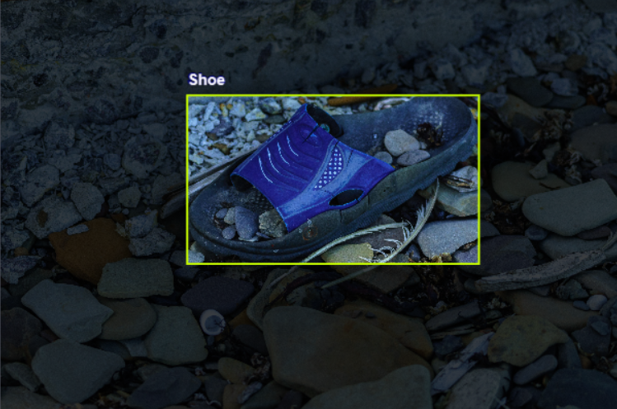
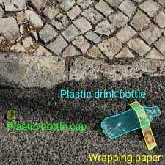
DATA COLLECTION
Our dataset consists of nearly 7k images – 6k training, 571 validation and 291 testing images respectively.
Object type can be any one of 59 subclasses and Waste Type will belong to one of 6 superclasses (Plastic, Metal, Glass, Paper, Textile, Organic)
1500 images were taken from the Taco dataset, which is readily available online.
The dataset was made according to the COCO JSON format.

Slide 5
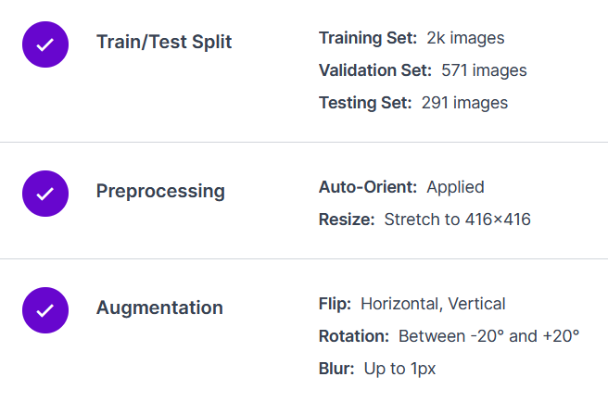
DATA COLLECTION- Roboflow API
Data Preprocessing – Auto-Orient and Resizing (416x416 px)
Data Augmentation – Horizontal flip, Vertical flip, Rotation (-20 to +20 degrees), Blur (upto 1px)
Exporting – Conversion from COCO format to Yolo v5, Yolo v7 formats.
API key used to import into Google colab

Slide 6
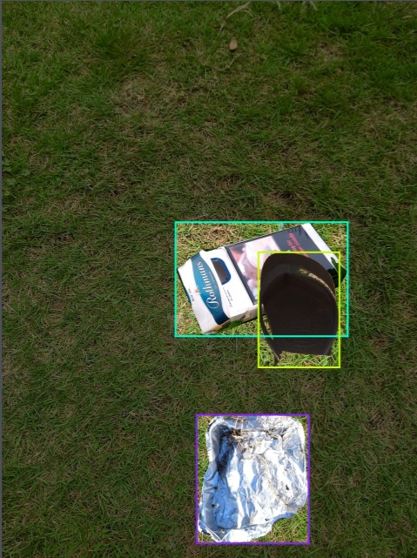
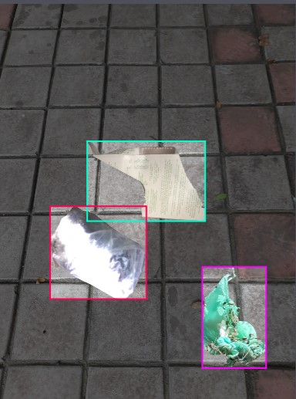
DATA COLLECTION- IMAGE Transplantation
The data set was expanded using object transplantation method
Individual objects from existing dataset were masked and cropped into various background images to create new suitable images
Initially the dataset had 1500 images
Using image transplantation around 500 objects were transplanted into 9 background images to obtain an additional 1500 images
Each transplaned image has 1-4 transplanted objects

Slide 7
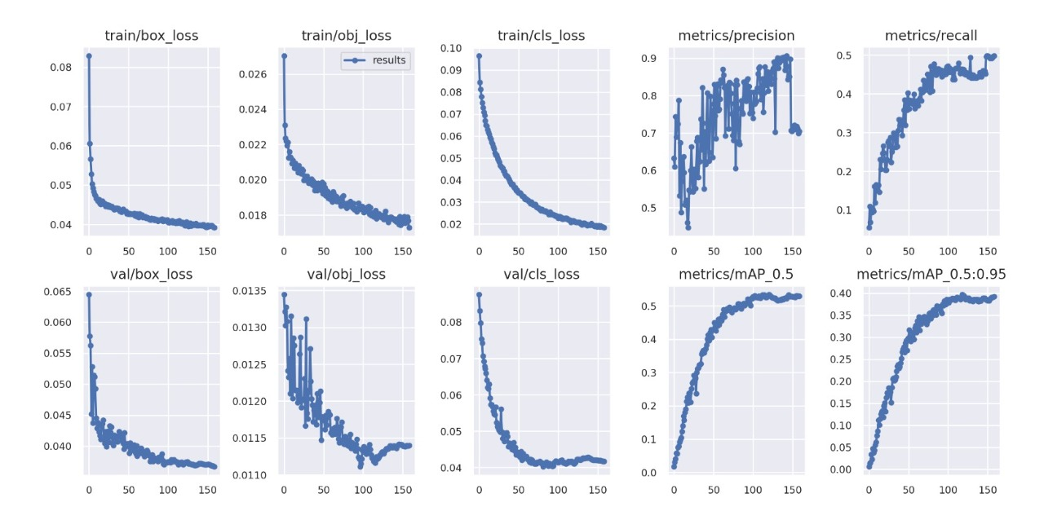

Roboflow 2.0 Object Detection Model

Slide 8
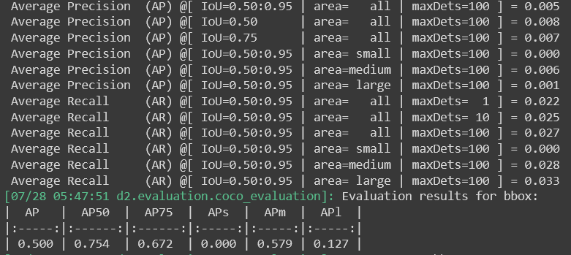
Detectron2 (Faster R-CNN)
Detectron2 is Facebook AI Research's next generation library that provides state-of-the-art detection and segmentation algorithms.
It comes equipped with algorithms for Instance Segmentation, Panoptic Segmentation, Object Detection, Keypoint Detection etc.
For Object Detection, we have used a Faster R-CNN model to train on our dataset.

Slide 9
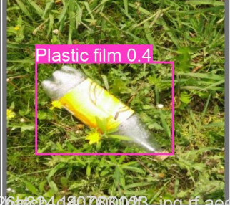
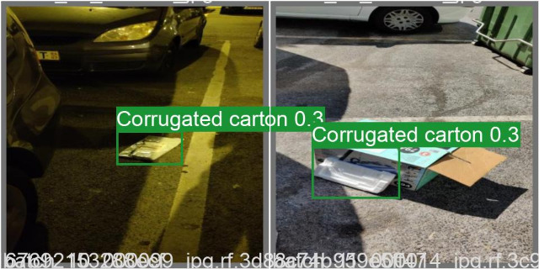
Yolo v5
YOLO stands for You Only Look Once
Instead of using Region Proposals, Yolo scans each area once by placing multiple anchor boxes over the image
Yolo is a state of the art algorithm that computes at a high speed and therefore can be used to perform detection in live feed videos of high FPS
Average Precision obtained – 80%

Slide 10
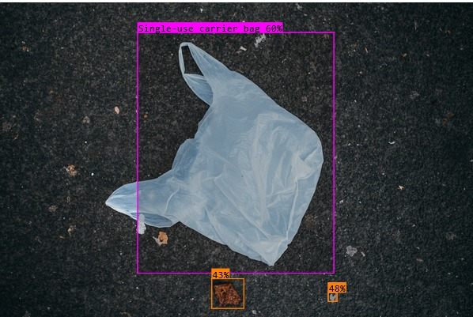
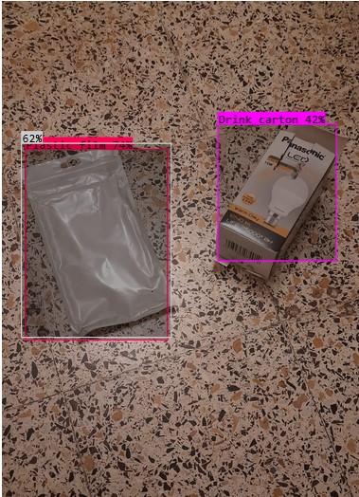
Conclusion
The best performing Object Detection model was the Roboflow Detection model
F1 score of the model can be calculated using precision and recall
The F1 score of our model is 0.59 with a precision of 0.86 and recall of 0.43
Yolo and Detectron did not perform as well as the number of epochs were insufficient and the hyperparameters required more tuning

