Slide 1
Tenants Association
Dragoi edith
Enoiu andra
Costache theodor

Slide 2
User Authentification
There are 2 types of user: normal user and administrator
Each type of user have different access to the site
Normal user can see:
Add building details
Add apartment details
Pay invoices
Admin has access to :
Manage invoice
See list of buildings. Edit and delete them.
See list of apartments. Edit and delete them.
See list of reports about paid/unpaid invoices.

Slide 3
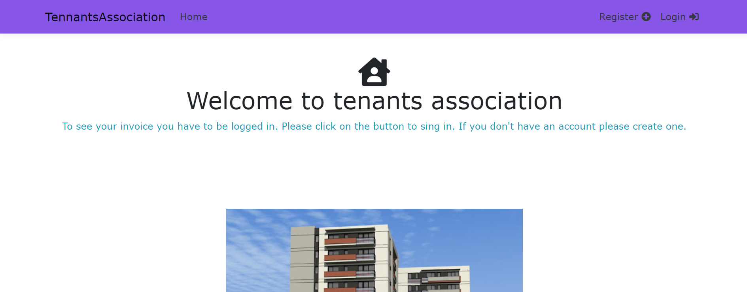
Home page
On the home page the user if is not logged in then he/she will not have access to other features.
If the user is logged in as user then he/she will be able to see their profile and see/pay the invoices.
If the user is logged in as admin then he/she can manage invoices, see reports and also see the profile page.

Slide 4
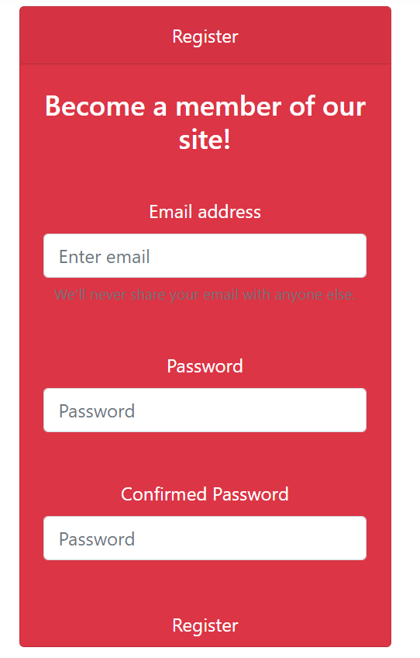
Register Page
On the register page, any user can create an account in order to use the features of the site.
The requirements for making an account are:
Valid email
Password that contains at least:
one uppercase,
one lowercase,
one digit and
one special character.

Slide 5
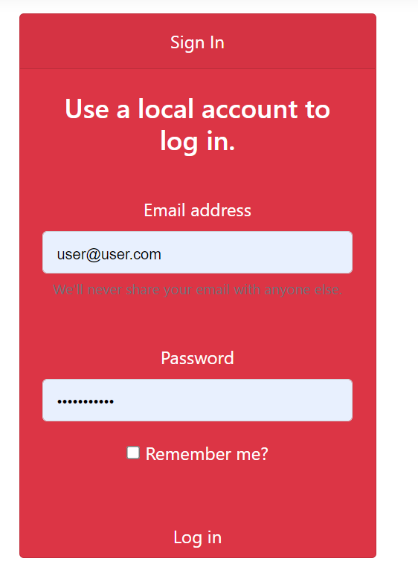
Log in Page
After you successfully made an account, you can log in to the site.
Here, you have the option for remember me and forgot password.
After logging in, there will be available a profile page.

Slide 6
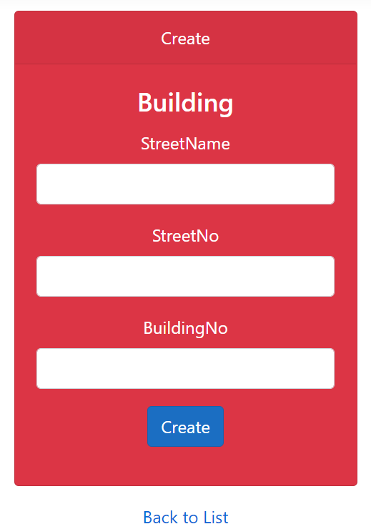
Add building details Page
This form is meant to add the building details (street name, street number and building number).
Here both the user and the admin have access.
After introducing all the details, only the admin can see the list of all the buildings.

Slide 7
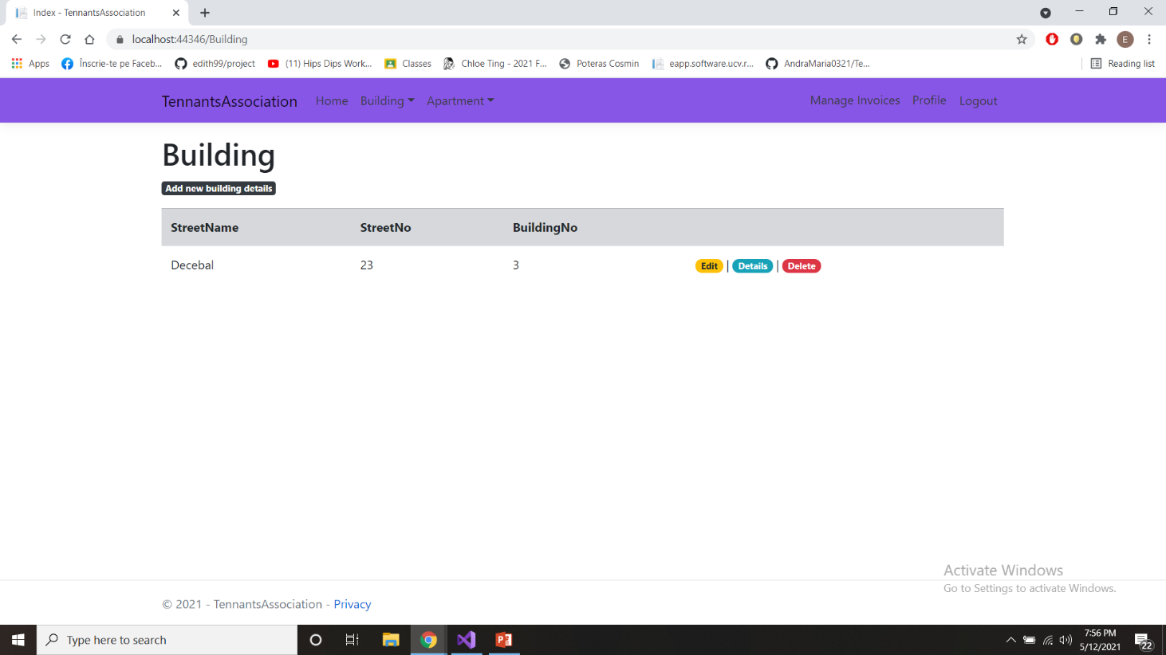
List of buildings
On this page, the admin can edit, delete, or see details in other form for every building in the list.

Slide 8
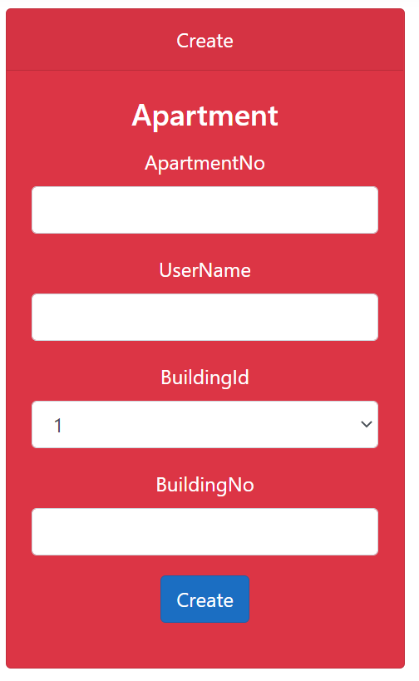
Add apartment details
This form is meant to add the apartment details (apartment number, user details and building number).
One apartment belongs to one user, so the data for the user are mandatory.
Here both the user and the admin have access.
After introducing all the details, only the admin can see the list of all the apartments, from where he/she can edit, delete, or see details in other form for every apartement in the list.

Slide 9
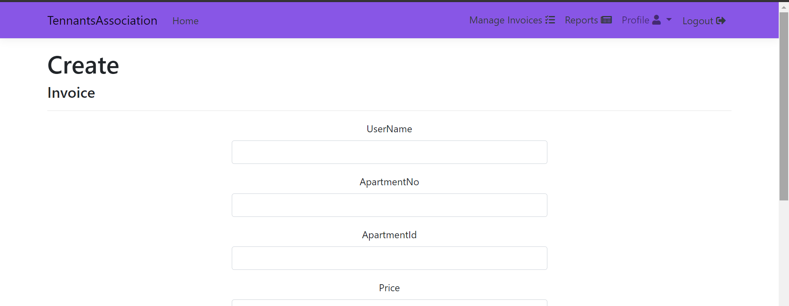
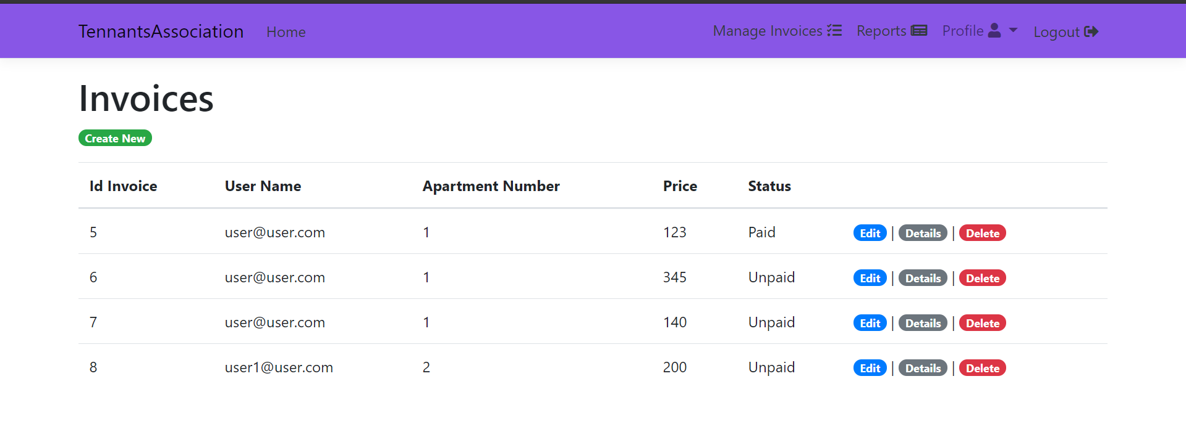
Manage Invoice
This form is meant for only the administrator to send invoices to one user.
After completing the form, he/she will be ale to see all the invoices that are send and also edit/delete them.

Slide 10
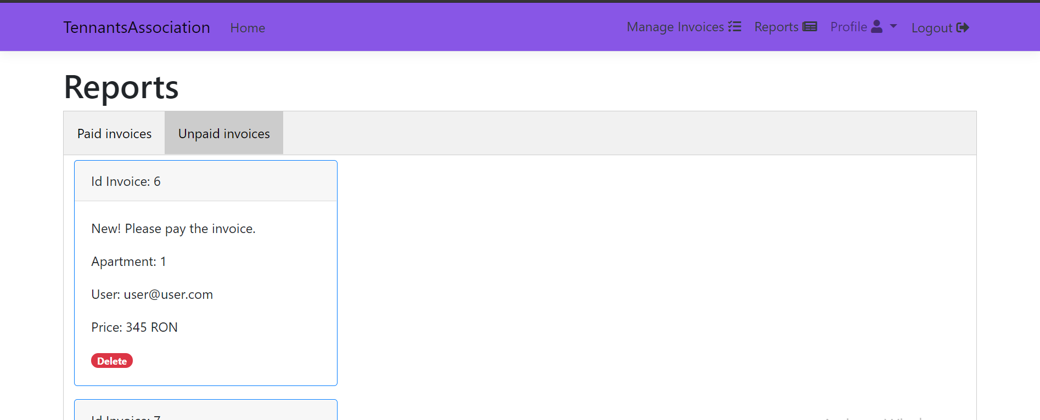
Paid / Unpaid Invoices
This page is also just for administrator. Here she/he can keep track of any of the invoices. There are generated the reports about the paid or unpaid invoices whit some data/information.

Slide 11
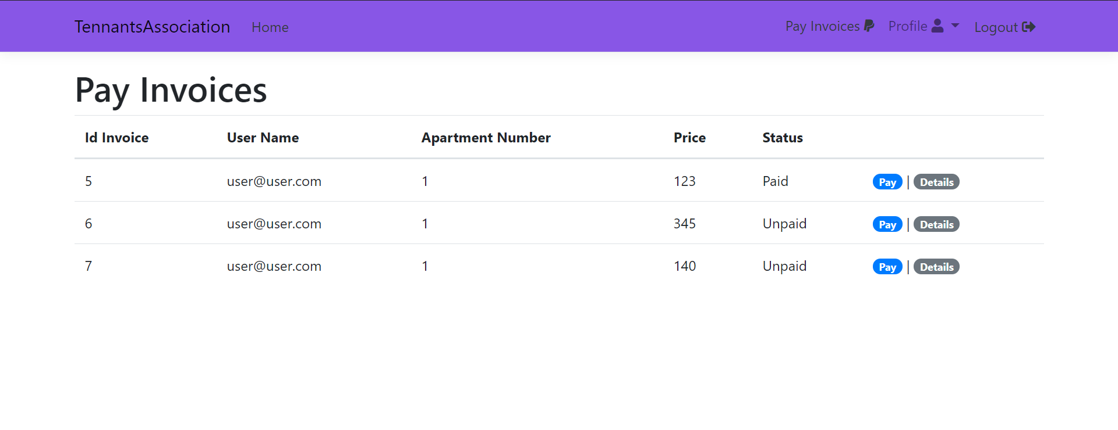
Pay invoices
This page is used by the user to pay invoices. Here he/she cand see details about the invoices and choose to pay them.

Slide 12
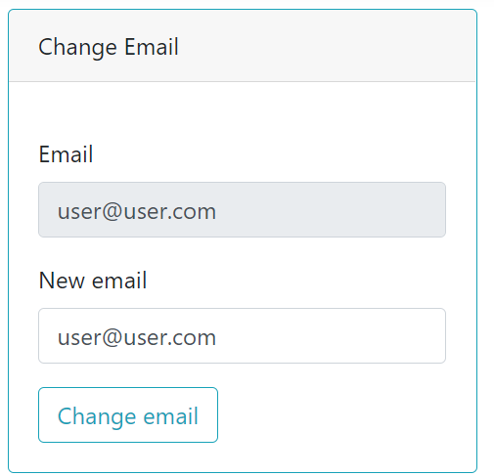
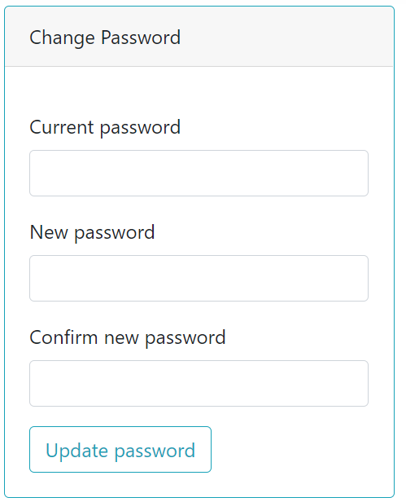
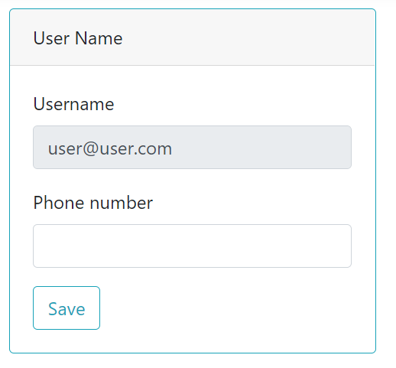
Profile
User and admin have access to a profile page where they can change the email, password or add more information.

