Slide 1


Relatório: 2020-02

Slide 2
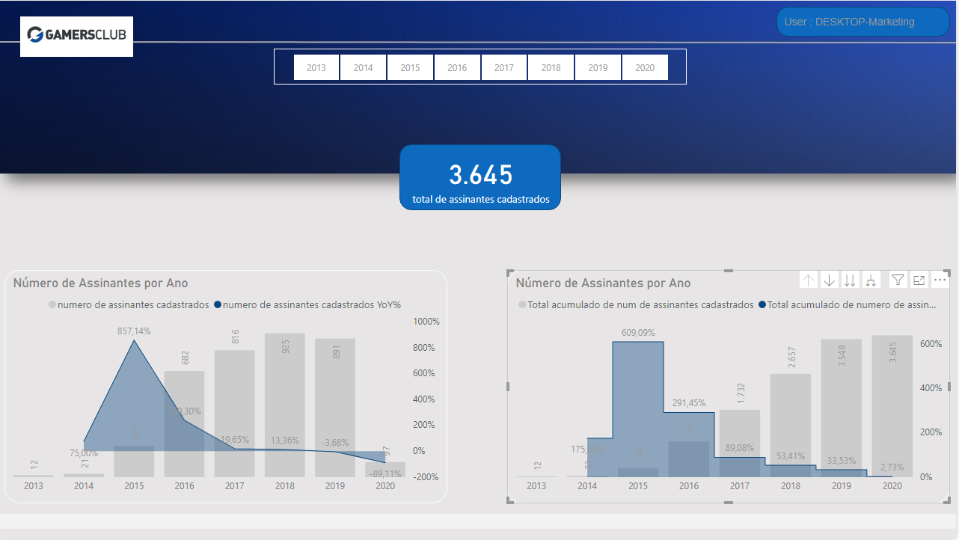

Slide 3
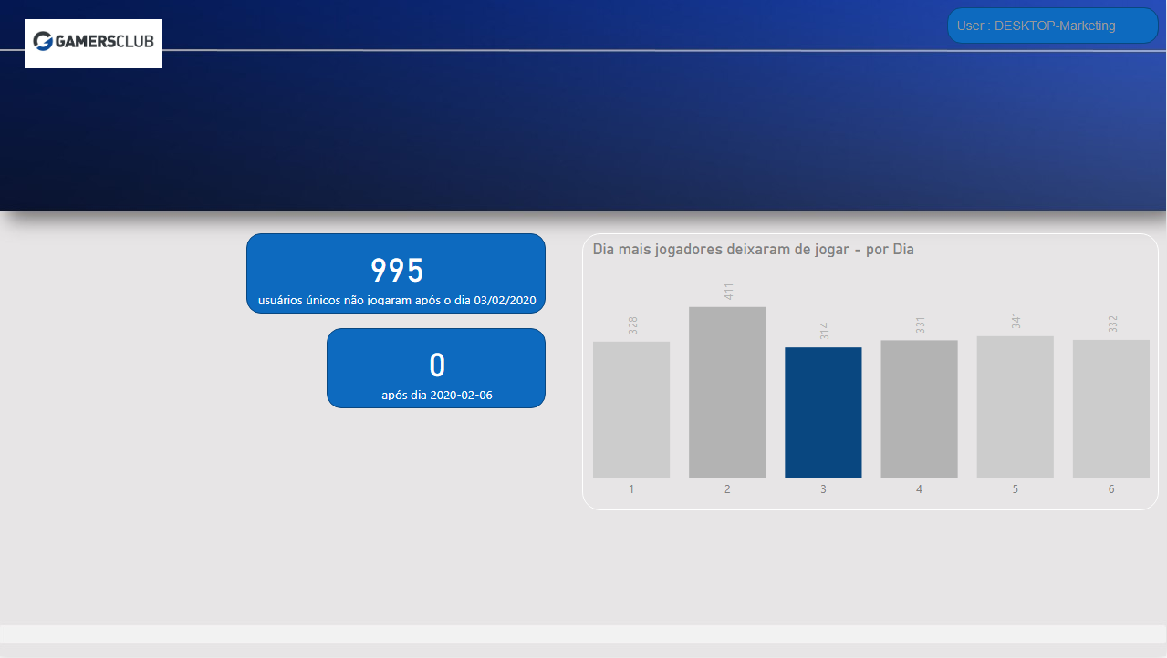

Slide 4
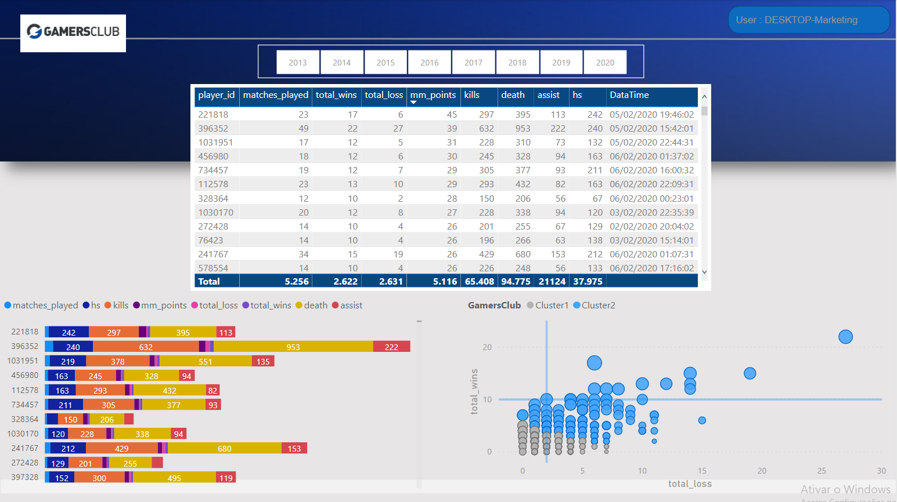

Slide 5
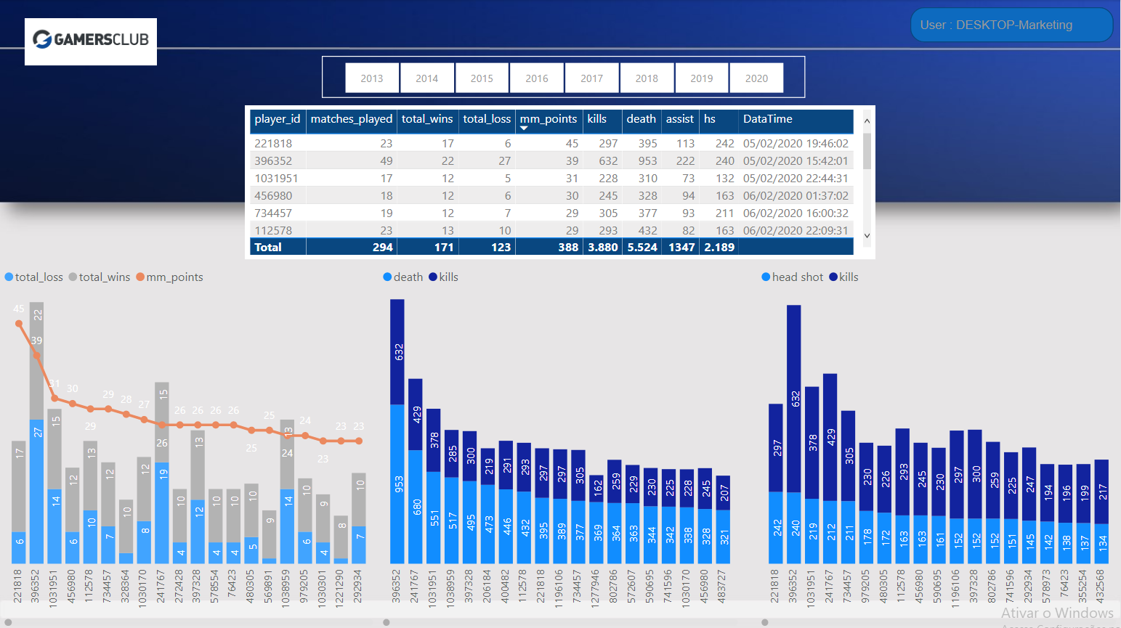

Slide 6
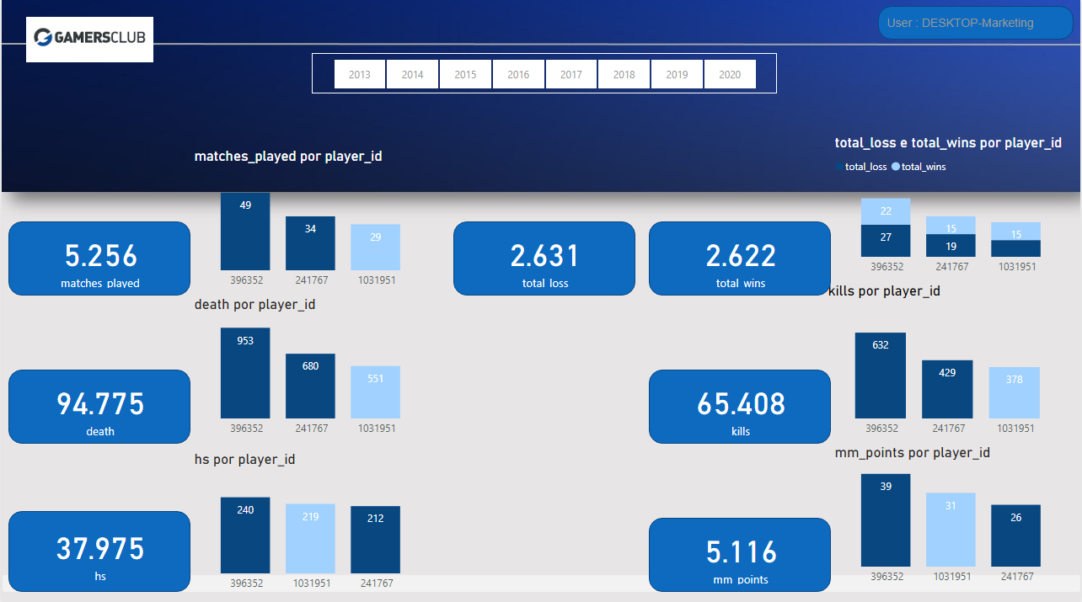

Slide 7
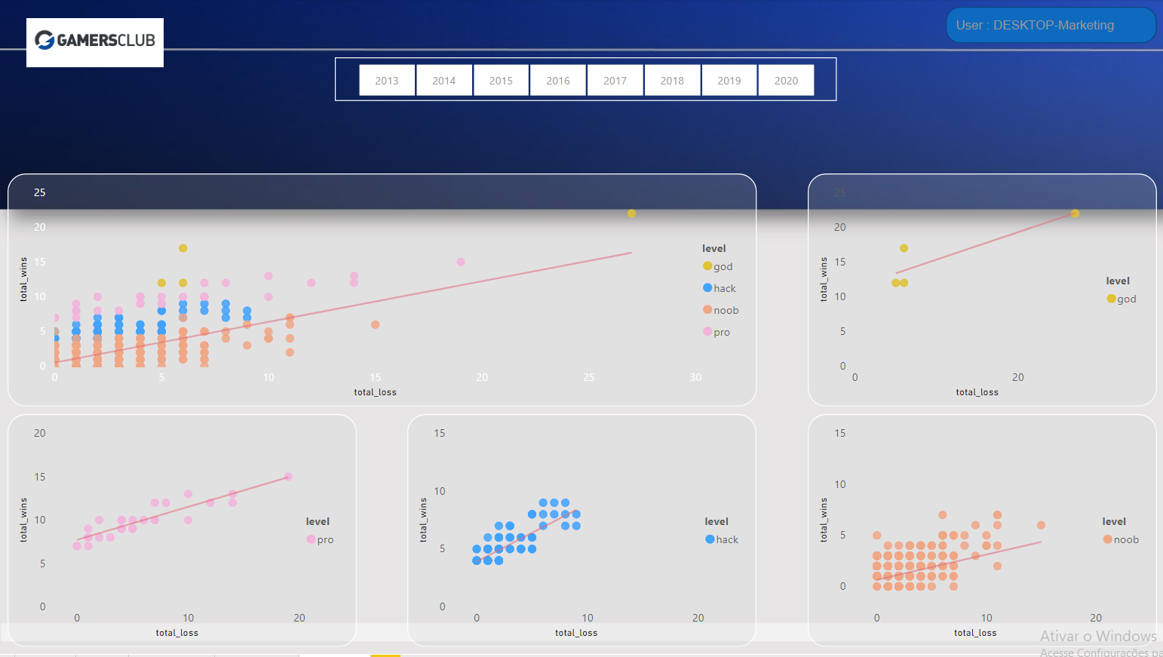

Slide 8

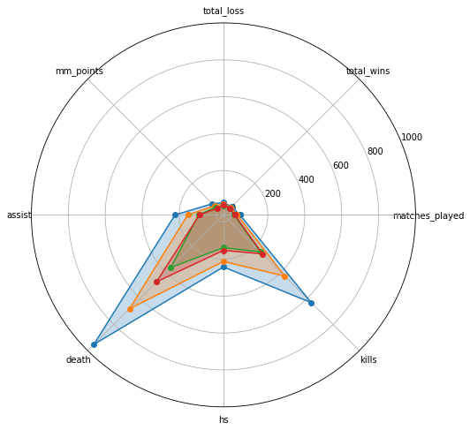
Grouping the entire base by 'level' and maximum achieved in decreasing order

Slide 9

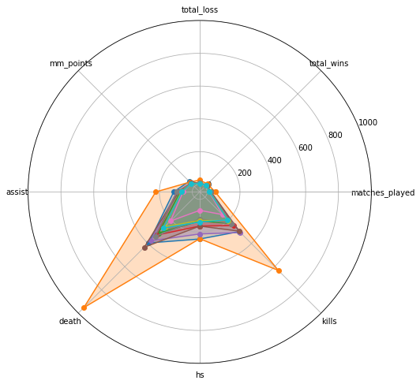
Selecting the top 10 in descending order of 'mm_points'

Slide 10

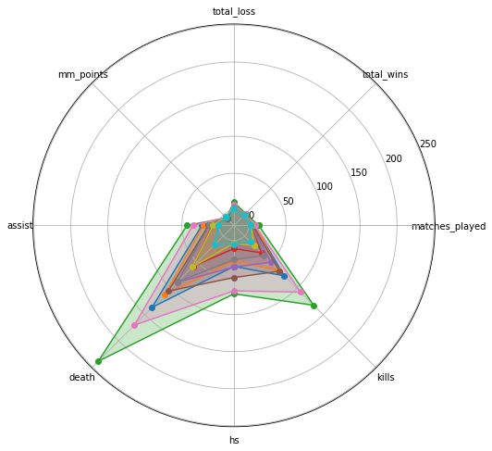
Selecting the last 10 placed in descending order of 'mm_points'

