Slide 1
VOIP
LabVIEW Project

Slide 2
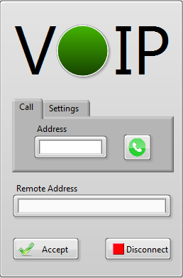
VOIP

Slide 3
VOIP
Indicator
Address
Call
Call button

Slide 4
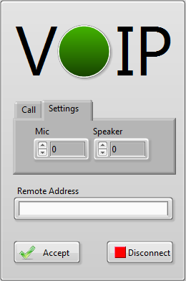
VOIP
Indicator
Address
Call
Call button
Mic
Settings
Speaker

Slide 5
VOIP
Indicator
Address
Remote Address
Call
Call button
Accept
Mic
Disconnect
Settings
Speaker

Slide 6
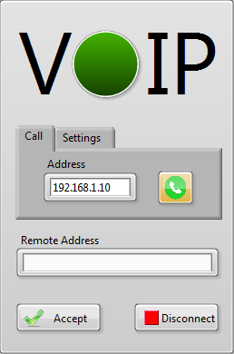
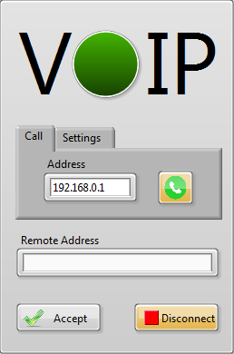
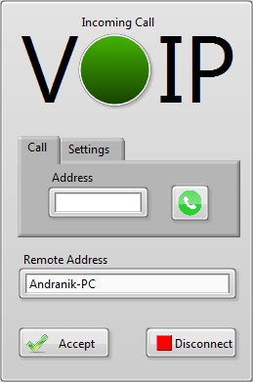
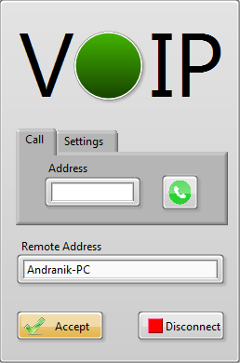
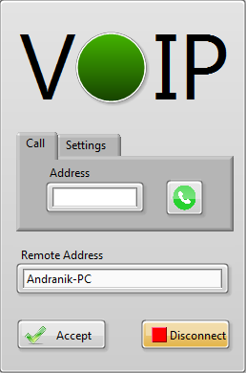
VOIP

Slide 7
Thank You

