Slide 1
Document Scanner Project
Image Processing ELEC-412 BRAHMI Nisrin - OBEID Hassan- VOSKANYAN Andranik

Slide 2
Canny Edge Detection Steps
1. Grayscale image
2.Gaussian Blur
3.Sobel Operators
Enables processing on a single value set instead of all color channels
Attenuates noise components concentrated in high-frequency regions
Fast way to get x and y grads to that we compute grad
4.Magnitude and angles
5.Non-max Suppression
6.Thresholding with hysteresis
Suppress non-maximum pixels along the gradient to retain local maxima
Allows selection of weak edges based on their connection to strong ones
Compute gradient magnitude and the direction

Slide 3
Gaussian Blur
Why ?

Slide 4
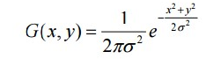
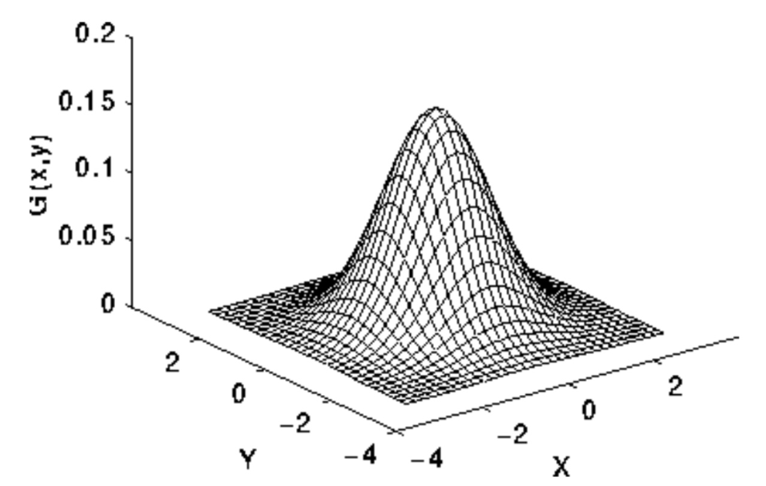
What does it look like ?
Blurring removes high-frequency components (like noise).
Noise could otherwise lead to false edge detections.
Thus operating on meaningful intensity changes rather than random noise.

Slide 5
Sobel Operators
Efficient method to compute image gradients

Slide 6
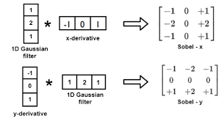
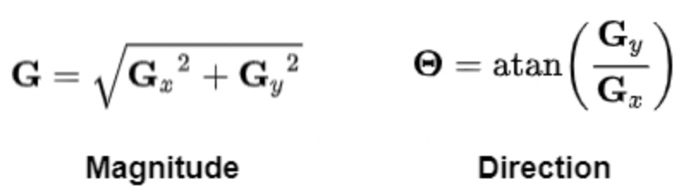
Sobel Operators
Sobel operators approximate image gradients in the x and y directions.
The center value of both Sobel kernels emphasizes direct intensity differences
Gradient magnitude and direction are now obtainable

Slide 7
Non Max Suppresion
Keeps strongest edges by removing non-maximum pixels along the gradient direction.

Slide 8
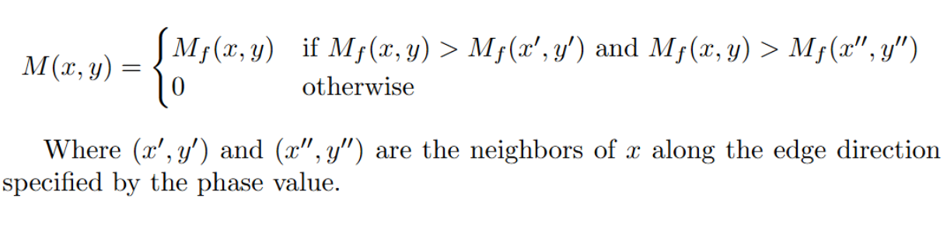
Non Max Formalism

Slide 9
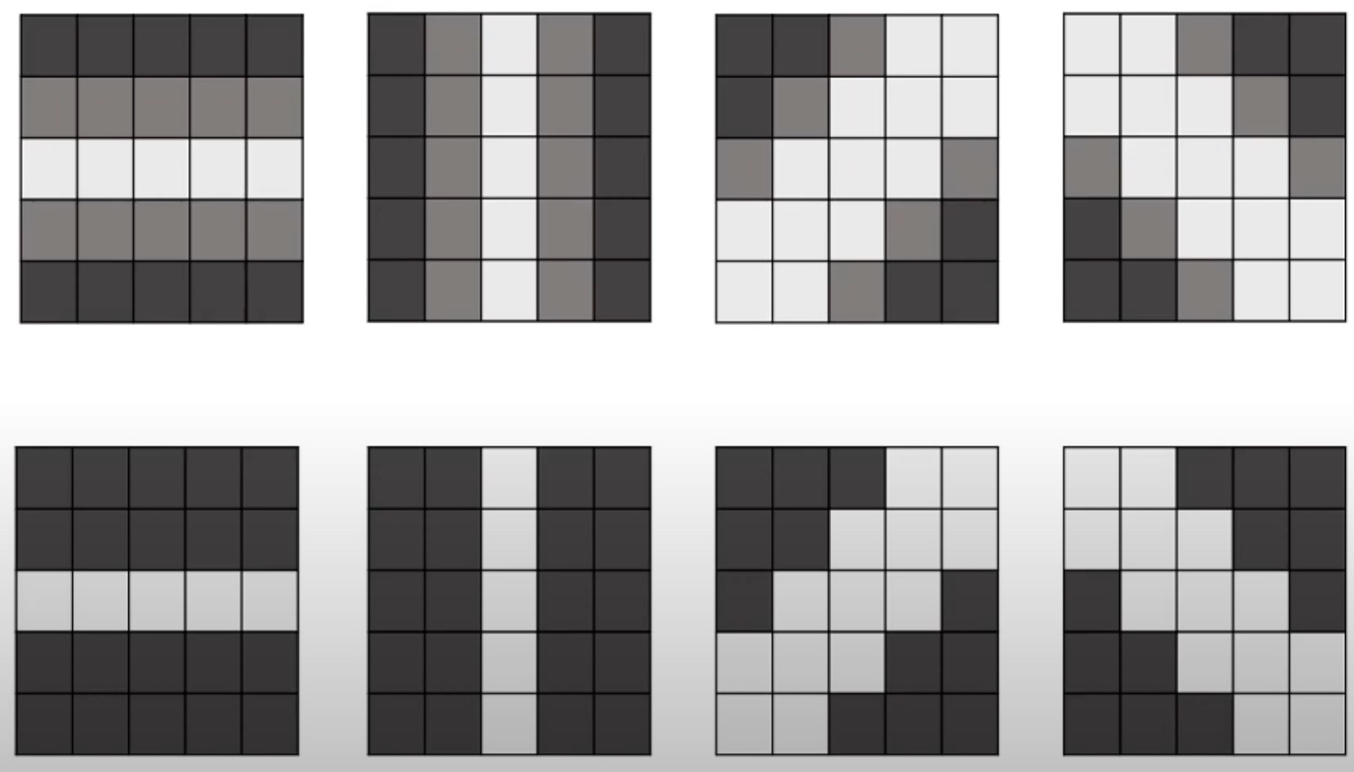
Resulting output
Observe that the gradient direction is always perpendicular to the edge

Slide 10
Double thresholding with hysteresis
Canny’s innovative idea

Slide 11
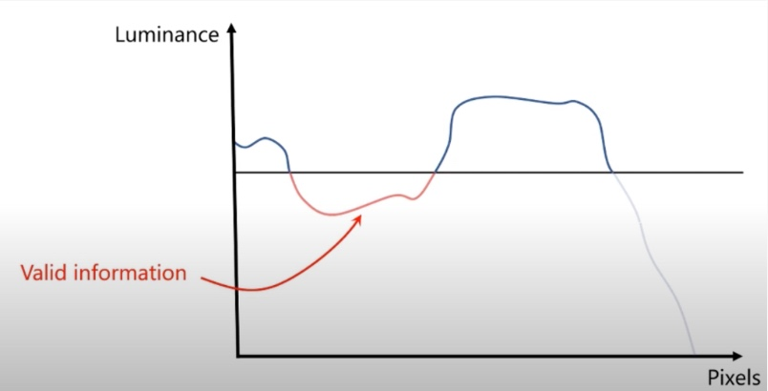
Why double thresholding ?
Using a single threshold risks discarding valuable edge information.

Slide 12
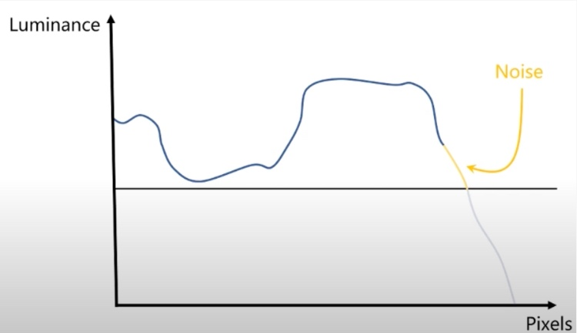
Lowering the threshold
Problem: Valuable information is preserved, but some noise remains.

Slide 13
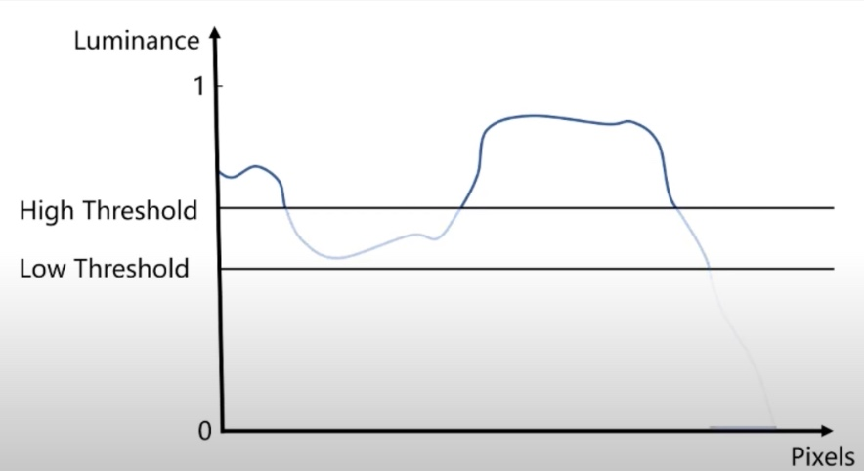
Solution ? Double thresholding
Strong edges
Weak edges
Out of interest
Allows definitive removal of noise, while uncertain edges are evaluated later based on connectivity.

Slide 14
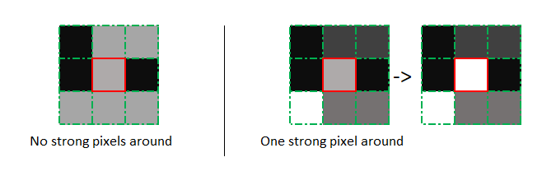
Hysteresis
Based on connectivity
If a strong pixel is nearby, the weak edge likely belongs to a true edge: it is then promoted.

Slide 15
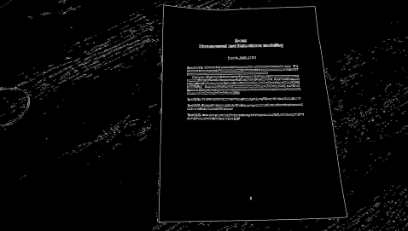
Experimental result

Slide 16
Hough Transform
Line Detection through Pixel Alignment Analysis

Slide 17
Hough Transform
2. Thresholding
1. Accumulator Array
3. Orthogonal pairs
For each x,y we calculate the associated parameters
We identify lines by detecting groups of pixels that are consistently aligned
Fast way to get x and y grads to that we compute grad
4. Corners Detection
Finding the largest rectangle based on corners
5. Document Isolation and Rectification

Slide 18
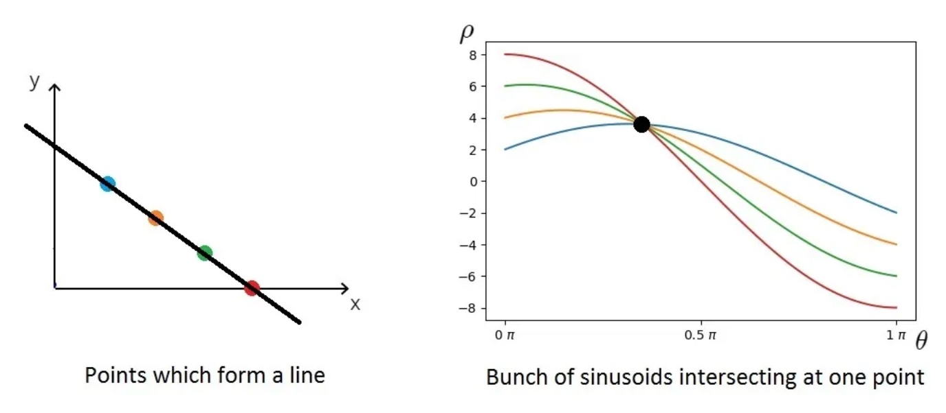


Hough transform: Fundamental idea
Equation Space
Parameter Space

Slide 19
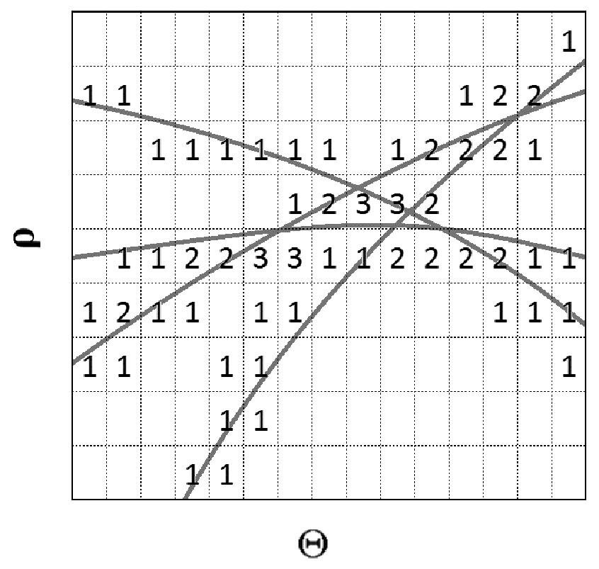
1. Accumulator array

Slide 20
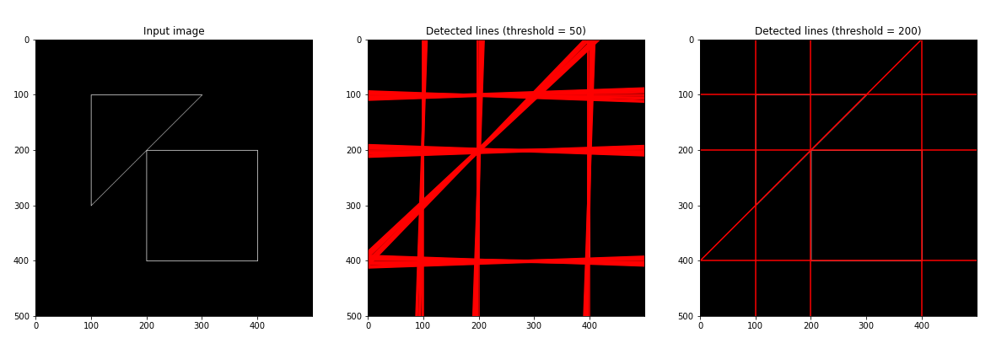
2. Thresholding

Slide 21
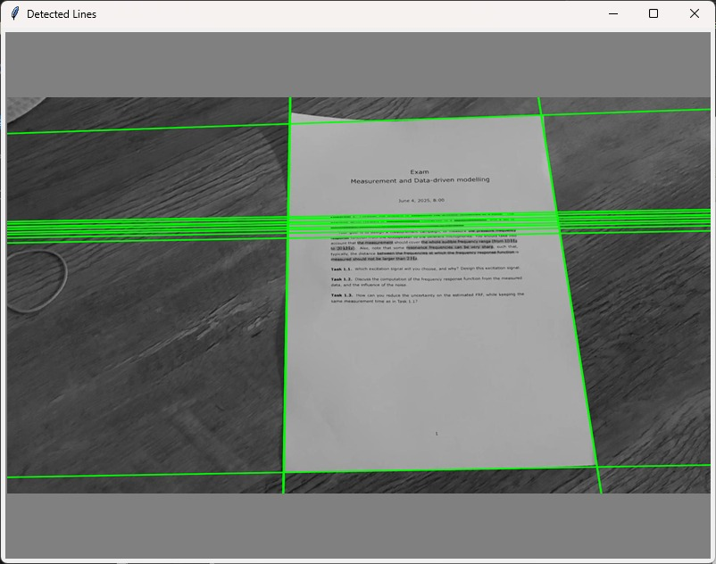
3. Orthogonal pairs

Slide 22
4. Corner detection

Slide 23
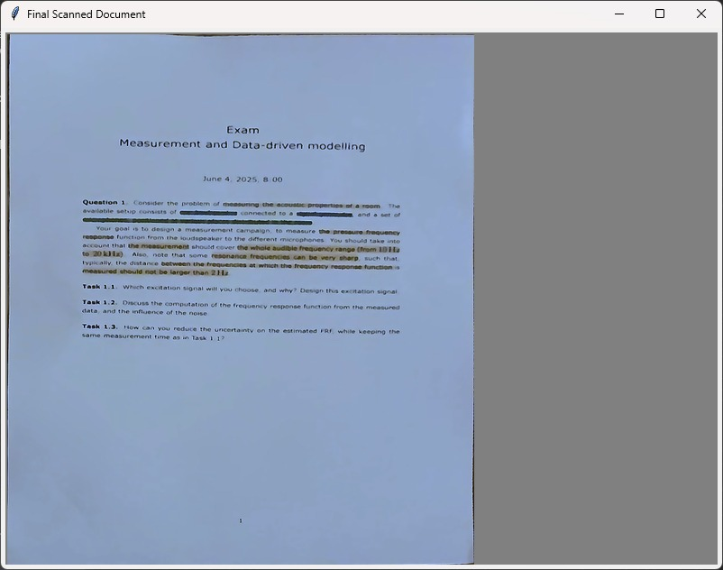
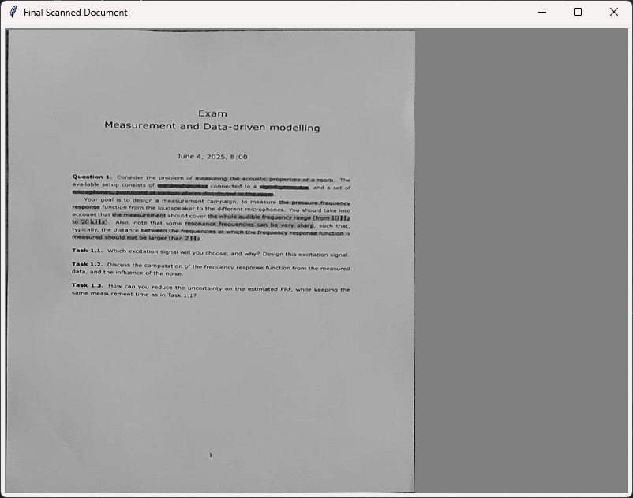
5. Document Isolation and Rectification

Slide 24
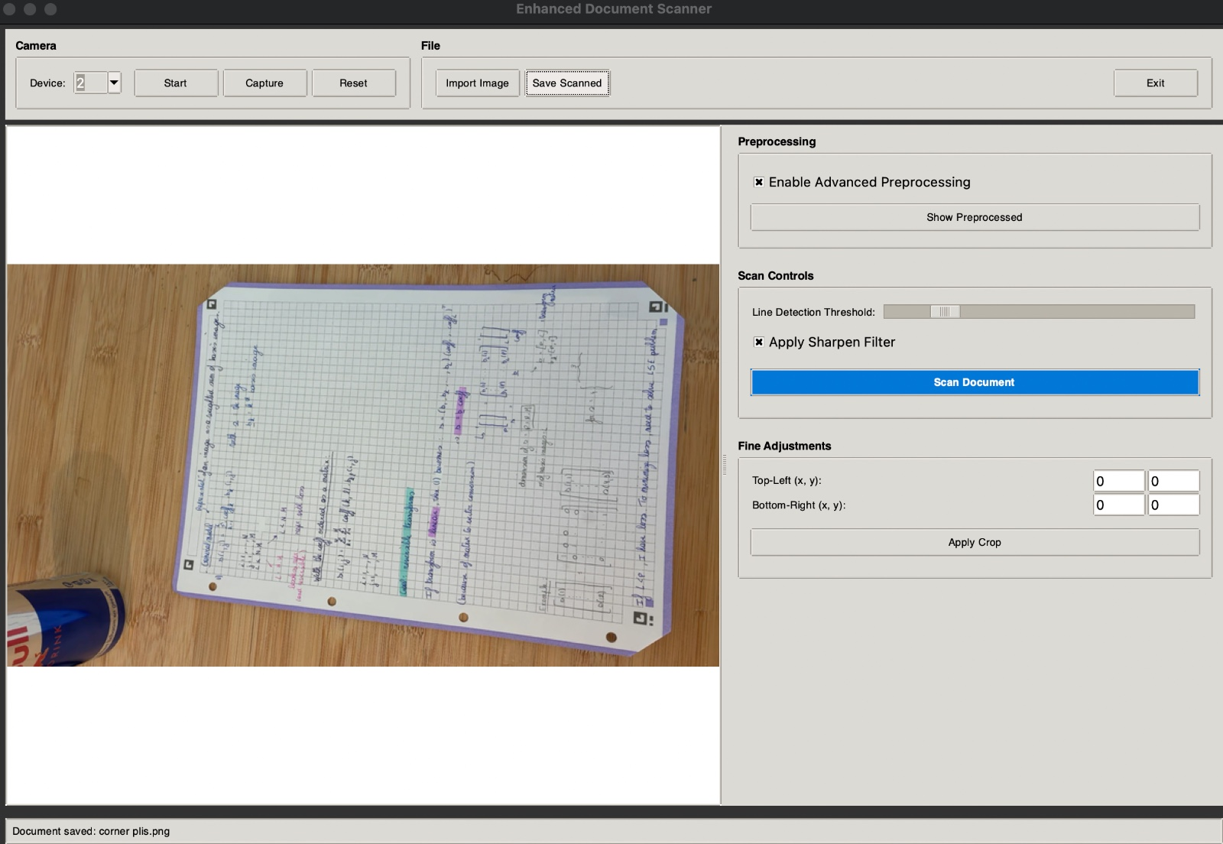
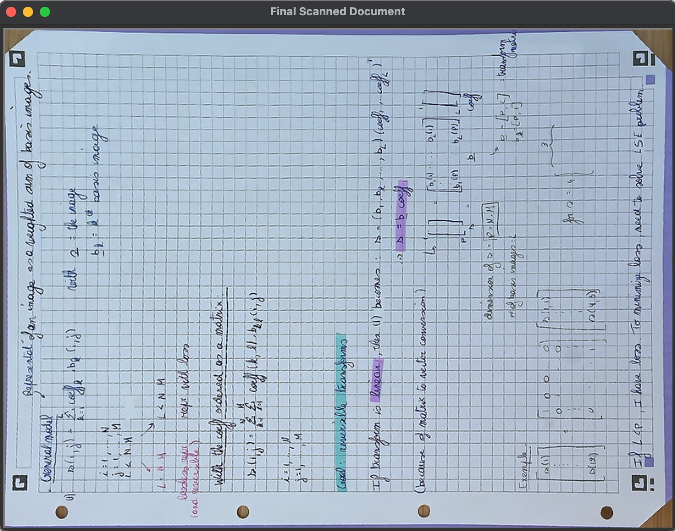
More results

Slide 25
Extra Features
You can delete this slide when you’re done editing the presentation
Manual Hough transform threshold tunning | Tune manually the threshold of Hough transform
Capture picture through phone | Use your phone for capturing better picture
See preprocessed image | Check Filtered image before scanning
Save | Save scanned document
Crop | Crop extra parts if there exist
Import | Import existing picture for scunning

Slide 26
Thank you

