Slide 1

Final Demonstration – Wishbone
BY AXIOM

Slide 2
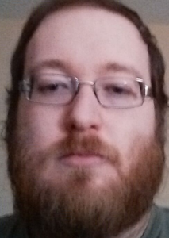
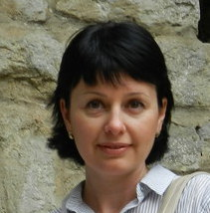
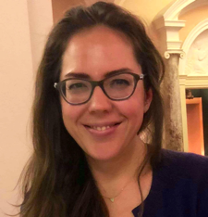
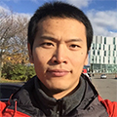
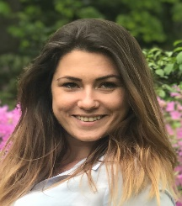

Andrew Archibald
Svetlana Netchaeva
Ksenia Lopukhina
Zeyang Hu (Tom)
Oksana Shapoval
Minyi Yang

Slide 3
Wishbone Prototype Demo
15 minute presentation from Axiom Team

Slide 4
Technical Discussion
Q&A with professor and clients

Slide 5
Thank you for attending our presentation
Thank you from the Axiom team.

