Slide 1
Receptive Field Analysis
in Convolutional Neural Networks
Datasets: MNIST · CIFAR-10 · CIFAR-100 Models: SimpleCNN · DeepCNN · DepthwiseCNN Kernel sizes: 1 · 2 · 3 · 5 · 7 · 9 · 11 · 15 · 21 · 28
Portfolio mini-study
90 training runs · 5 epochs · AdamW optimizer · CrossEntropyLoss

Slide 2
Experiment Setup
Datasets
Models
Metrics
MNIST - 28×28 grayscale
60,000 train / 10,000 test
CIFAR-10 - 32×32 RGB, 10 classes
50,000 train / 10,000 test
CIFAR-100 - 32×32 RGB, 100 classes
50,000 train / 10,000 test
Preprocessing: ToTensor() + Normalize()
SimpleCNN - 1 convolutional layer
DeepCNN - 3 convolutional layers
DepthwiseCNN - 3 depthwise-separable blocks
Global Average Pooling makes the architectures compatible with both 28×28 and 32×32 inputs.
Test accuracy
Macro-F1 score
Trainable parameter count
Training time (s)
Theoretical convolution-stack receptive field
Kernel sizes k ∈ {1, 2, 3, 5, 7, 9, 11, 15, 21, 28} · 3 datasets × 3 models × 10 kernels = 90 runs
CNN Receptive Field Study

Slide 3
Model Overview
SimpleCNN
Shallow baseline with one kernel-size-dependent convolutional layer.
RF = k
Conv(k) → BN → ReLU → MaxPool → GAP → FC(32→64) → FC(64→C)
Small RF · fast training · low parameter count
DeepCNN
Three kernel-size-dependent convolutions with 32→64→128 channels.
RF = 1 + 3(k−1)
Conv(k)×3 → BN → ReLU → MaxPool×2 → GAP → FC(128→128) → FC→C
Larger RF and capacity · highest accuracy · expensive for large kernels
DepthwiseCNN
Three depthwise-separable blocks: depthwise spatial filtering + 1×1 pointwise mixing.
RF = 1 + 3(k−1)
[DW(k) + PW(1×1)] ×3 → MaxPool×2 → GAP → FC(128→128) → FC→C
Same convolution-stack RF as DeepCNN · far fewer parameters for large kernels
CNN Receptive Field Study

Slide 4
Standard vs. Depthwise Convolution
SimpleCNN
One standard convolutional layer.
RF = k
Conv(k) → BN → ReLU → MaxPool → GAP → FC
Standard convolution mixes spatial and channel information jointly.
Standard convolution learns spatial patterns and cross-channel relationships at the same time.
Each filter operates across all input channels simultaneously.
DeepCNN
Three standard convolutions.
RF = 1 + 3(k−1)
Conv(k)×3 → BN → ReLU → MaxPool×2 → GAP → FC
Each filter spans all input channels, so cost grows rapidly with k².
DepthwiseCNN
Depthwise spatial filters followed by pointwise channel mixing.
RF = 1 + 3(k−1)
[DW(k) + PW(1×1)] ×3 → MaxPool×2 → GAP → FC
Spatial filtering is channel-wise; 1×1 convolutions combine channels afterward.
CNN Receptive Field Study

Slide 5
How Depthwise Convolution Works
1. Input
2. Depthwise convolution
3. Output
4. Pointwise convolution (1×1)
5. Final output
Filter 1
→
×
→
×
→
Filter 2
1×1 filters
Filter 3
C channels
H × W
same number
of channels
K channels
Summary
Advantages
• Depthwise: one spatial 2D convolution per input channel
• Channels are not mixed during the spatial step
• Pointwise 1×1 convolution then combines channels
• The spatial receptive field is unchanged
• Fewer parameters
• Lower computational cost (FLOPs)
• Faster, more efficient models
• Used in architectures such as MobileNet

Slide 6
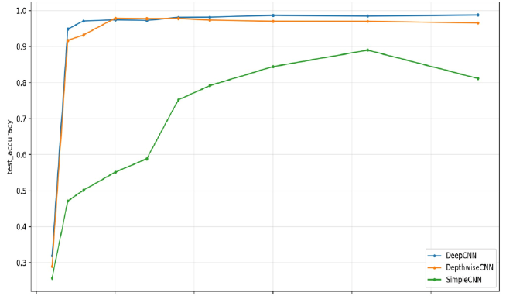
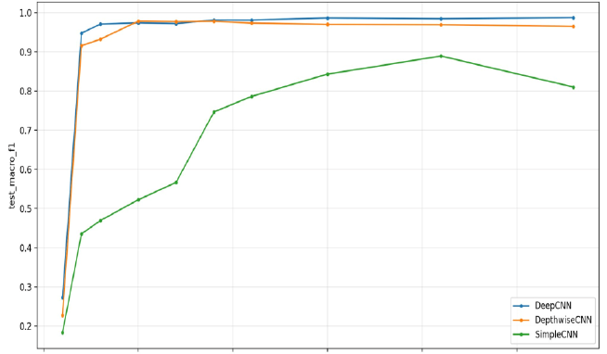
MNIST Results - Test Accuracy & Macro-F1
Test Accuracy vs. Kernel Size
Test Macro-F1 vs. Kernel Size
DeepCNN & DepthwiseCNN: ~97–99% from k=3 onward · SimpleCNN: 26% at k=1, peak ~89% at k=21 · Larger kernels partly compensate for a shallow model
CNN Receptive Field Study

Slide 7
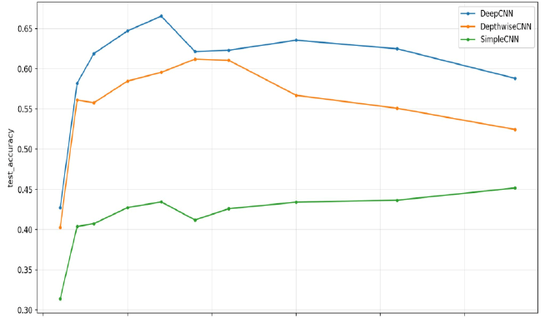
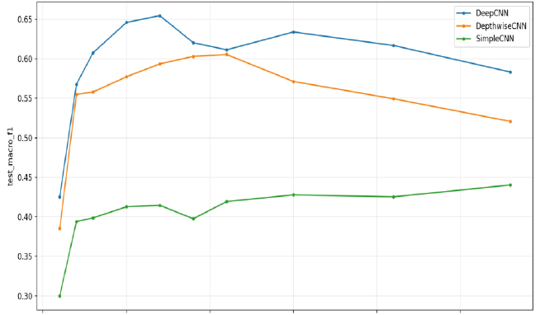
CIFAR-10 Results - Test Accuracy & Macro-F1
Test Accuracy vs. Kernel Size
Test Macro-F1 vs. Kernel Size
DeepCNN peaks at ~67% around k=7 · DepthwiseCNN reaches ~61% around k=9–11, then declines · SimpleCNN remains ~31–45%
CNN Receptive Field Study

Slide 8
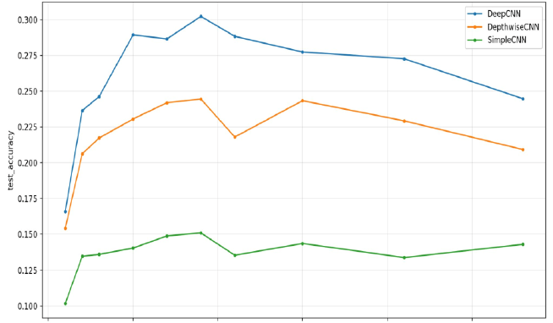
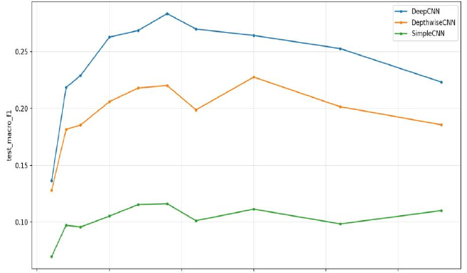
CIFAR-100 Results - Test Accuracy & Macro-F1
Test Accuracy vs. Kernel Size
Test Macro-F1 vs. Kernel Size
DeepCNN peaks at ~30% around k=9 · Performance drops for very large kernels · SimpleCNN stagnates around ~10–15%, indicating insufficient capacity for 100 classes
CNN Receptive Field Study

Slide 9
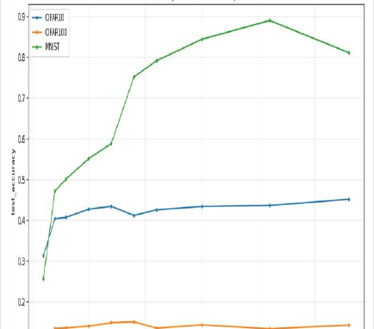
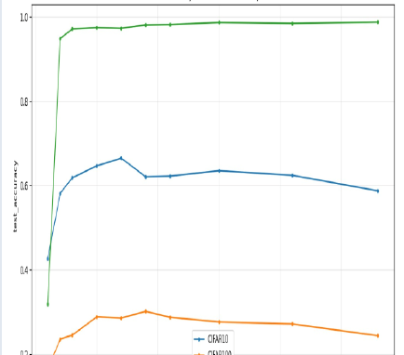
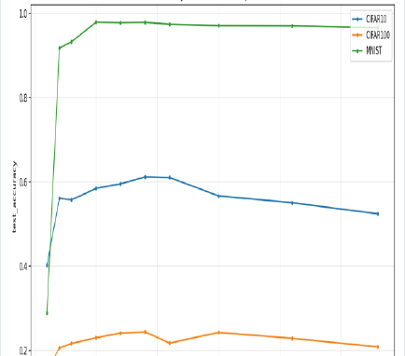
Comparison by Model Type Across Datasets
SimpleCNN
DeepCNN
DepthwiseCNN
Across all architectures: MNIST is easiest, CIFAR-10 is intermediate, and CIFAR-100 is hardest because of the 100-class setting and small image size
CNN Receptive Field Study

Slide 10
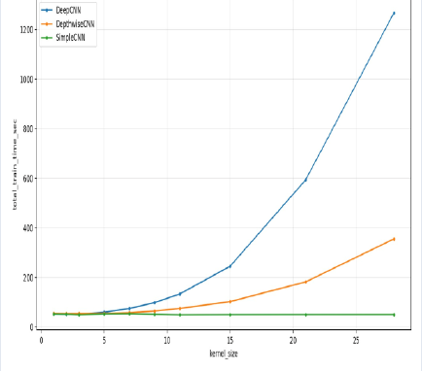
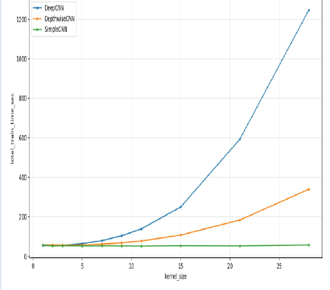
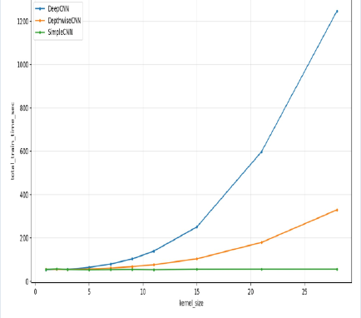
Training Time vs. Kernel Size
MNIST
CIFAR-10
CIFAR-100
At k=28: DeepCNN ~1250 s (>20 min) · DepthwiseCNN ~350 s (~3.5× faster) · SimpleCNN ~50 s · Standard convolution cost grows roughly with k²
CNN Receptive Field Study

Slide 11
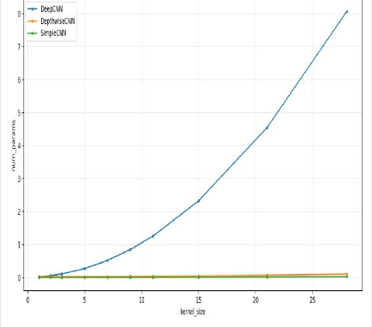
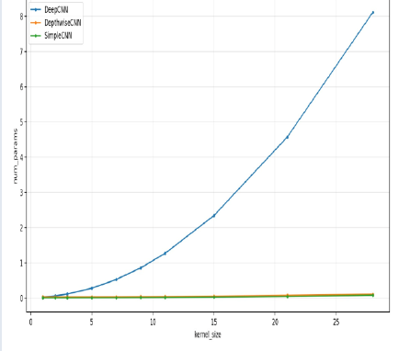
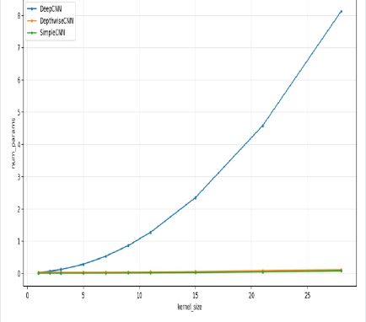
Parameter Count vs. Kernel Size
MNIST
CIFAR-10
CIFAR-100
At k=28: DeepCNN ~8M parameters · DepthwiseCNN ~130k (~60× smaller) · SimpleCNN ~90k · Separating depthwise and pointwise convolution dramatically reduces parameters
CNN Receptive Field Study

Slide 12
Global Average Pooling (GAP)
What does GAP do?
Feature maps (128 × H × W)
convolution output
A pooling layer for CNNs
Averages each feature map
Produces one value per channel
Reduces the number of classifier parameters
↓
AdaptiveAvgPool2d((1,1))
global average pooling
↓
128 × 1 × 1
one value per channel
↓
Flatten
2D → vector
↓
Linear(128→128)
fully connected layer
self.classifier = nn.Sequential(
nn.AdaptiveAvgPool2d((1, 1)),
nn.Flatten(),
nn.Linear(128, 128),
nn.ReLU(inplace=True),
nn.Dropout(0.3),
nn.Linear(128, num_classes),
)
↓
ReLU
activation
↓
Dropout(0.3)
regularization
↓
Linear(128→num_classes)
class logits
Adaptive pooling automatically handles different spatial input sizes.
CNN Receptive Field Study

Slide 13
Summary & Conclusions
Optimal kernel size depends on the dataset
Depth matters more than kernel size for accuracy
01
02
MNIST: k=21 for SimpleCNN, k≈3–5 for Deep/DW. CIFAR-10/100: k≈7–9 is usually strongest; very large kernels tend to hurt.
DeepCNN consistently outperforms SimpleCNN at the same kernel size. More layers provide higher capacity and stronger feature extraction.
Receptive field ≠ performance
05
A larger receptive field is not automatically better: oversized kernels reduce performance for several model–dataset combinations.
DepthwiseCNN is an efficient compromise
Training cost rises sharply with kernel size
03
04
Around 60× fewer parameters and ~3.5× faster training than DeepCNN at k=28, with only a modest accuracy loss.
DeepCNN grows from roughly ~50 s at small kernels to ~1250 s at k=28. Large standard kernels are computationally expensive.
90 runs · 3 datasets · 3 models · 10 kernel sizes · 5 epochs

