Slide 1
Iadi Project.
Bernardo Silva 57654
André Cordeiro 57797
Alexandre Oliveira 58059

Slide 2
Languages/Frameworks/Libraries
Server Application
Kotlin
Spring framework:
Spring Web
Spring Security
Spring Data
Spring Boot
Client Application
Typescript
React
CSS
Redux

Slide 3
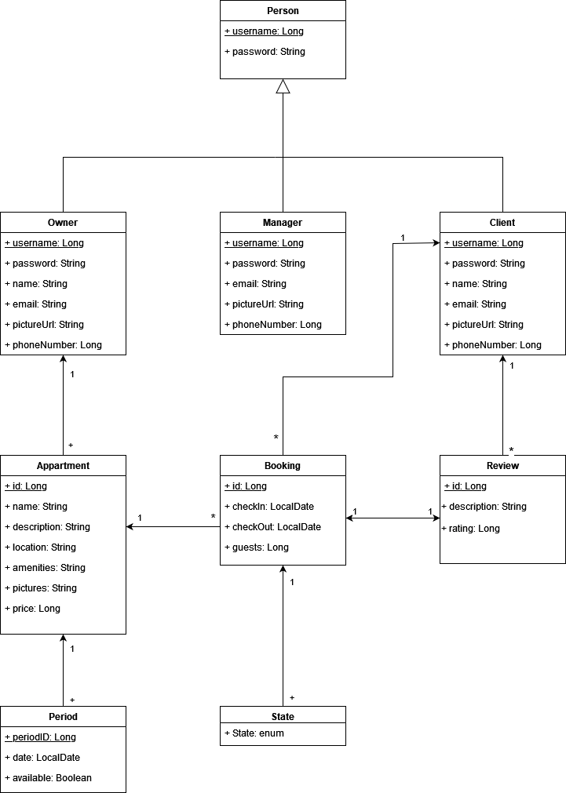
Database

Slide 4
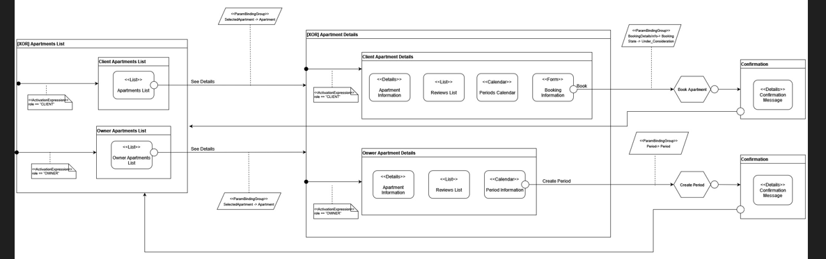
User stories and IFML diagrams
1. As a client, I want to see the first page of a list of apartamentos so that I can choose one to rent and see its details.
2. As a client, I want to see the next page in the list of apartamentos so that I can choose one to rent and see its details.
3. As a client, I want to see the details of an apartamento so that I can read its description and amenities and decide if I want to rent it.
4. As a client, I want to see the calendar of an apartment so that I can decide when to rent it.
5. As a client, I want to see the reviews of an apartment so that I can decide if I want to rent it.
12. As an owner, I want to see the list of my apartments so that I can select one apartment and see its details.
13. As an owner, I want to see the details of an apartment so that I can add a period of availability and see the result in the calendar.

Slide 5
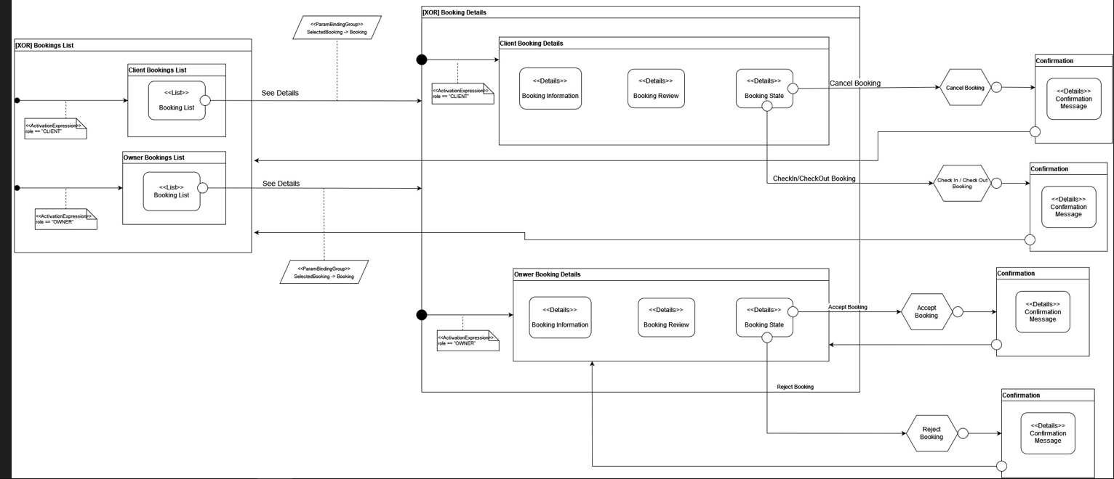
User stories and IFML diagrams
6. As a client, I want to select a starting date and an ending date in the calendar of an apartment to start making a reservation.
7. As a client, I want to fill a form with the number of people to finish making a reservation.
8. As a client, I want to see the details of a reservation so that I can see if it was accepted.
9. As a client, I want to see the details of a reservation so that I can cancel it and see the result in the details of the reservation.

Slide 6
User stories and IFML diagrams
10. As a client, I want to see the details of a reservation so that I can check-in and see the result in the details of the reservation.
11. As a client, I want to see the details of a reservation so that I can check-out and see the result in the details of the reservation.
14. As an owner, I want to see the details of an apartment so that I can see the list of reservations for it.
15. As an owner, I want to see the details of a reservation so that I can accept it and see the result in the list of reservations.

Slide 7
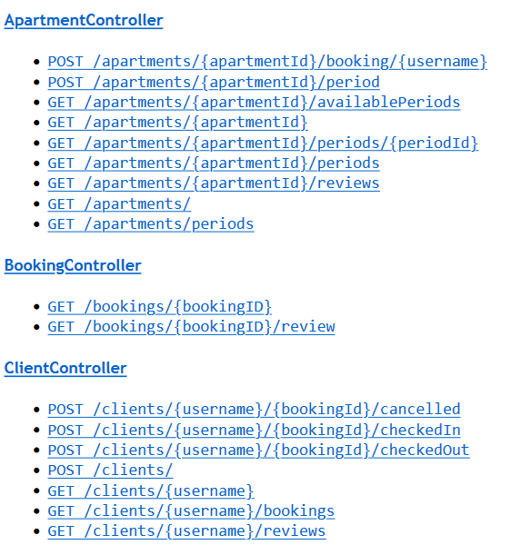
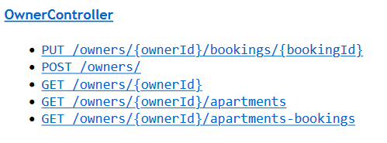
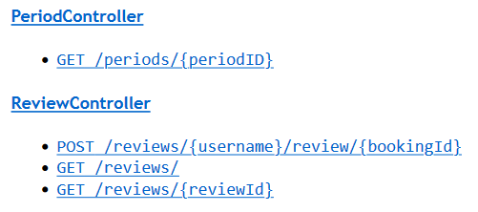
API - Endpoints

Slide 8
Security Rules
CanListApartments: always true.
CanCreateApartmentPeriod: verifies if the user trying to create a period for an apartment is the owner of the given apartment.
CanBookApartment: verifies if the user trying to book an apartment is a client to which the shipment will belong (a client cannot create a shipment on behalf of
another client).
CanGetApartmentPeriods: always true.
CanListApartmentAvailablePeriods: always true.
CanListApartmentReviews: verifies if the user trying to list the reviews an apartment is the owner of the apartment or if it is a client.
CanChangeBookingStatus: verifies if the user trying to accept or reject a booking is the owner of the apartment or if it is a manager.
CanGetOwnerApartments: verifies if the user trying to see the apartments of an owner is that owner of them.
CanCheckIn: verifies if the user trying to check-in a booking is the client who made the booking or if it is a manager.
CanCheckOut: verifies if the user trying to check-out a booking is the client who made the booking or if it is a manager.
CanCancel: verifies if the user trying to cancel a booking is the client who made the booking or if it is a manager.
CanGetClientBookings: verifies if the user trying to see the bookings of a client is the client to whom the bookings belong to.
CanGetClientReviews: verifies if the user trying to see the reviews of a client is the client to whom the reviews belong to.
CanCreateReview: verifies if the user trying to review a booking is the client who made the booking.
CanGetAllReviews: always true.
CanGetReview: always true.
CanGetBooking: verifies if the user trying to see a booking is the client who made the booking or if it is the owner of the apartment booked.
CanGetBookingReview: verifies if the user trying to see the review of a booking is the client who made the booking or if it is the owner of the apartment booked.

Slide 9
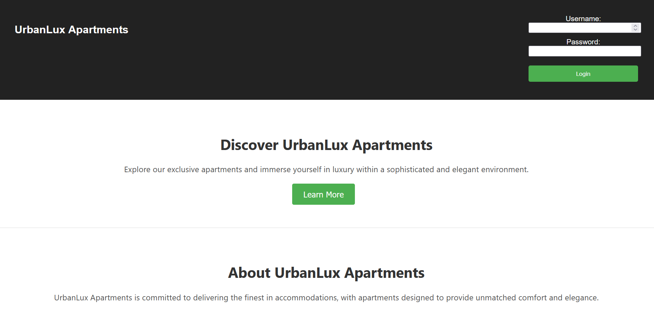
UI-Login Page

Slide 10
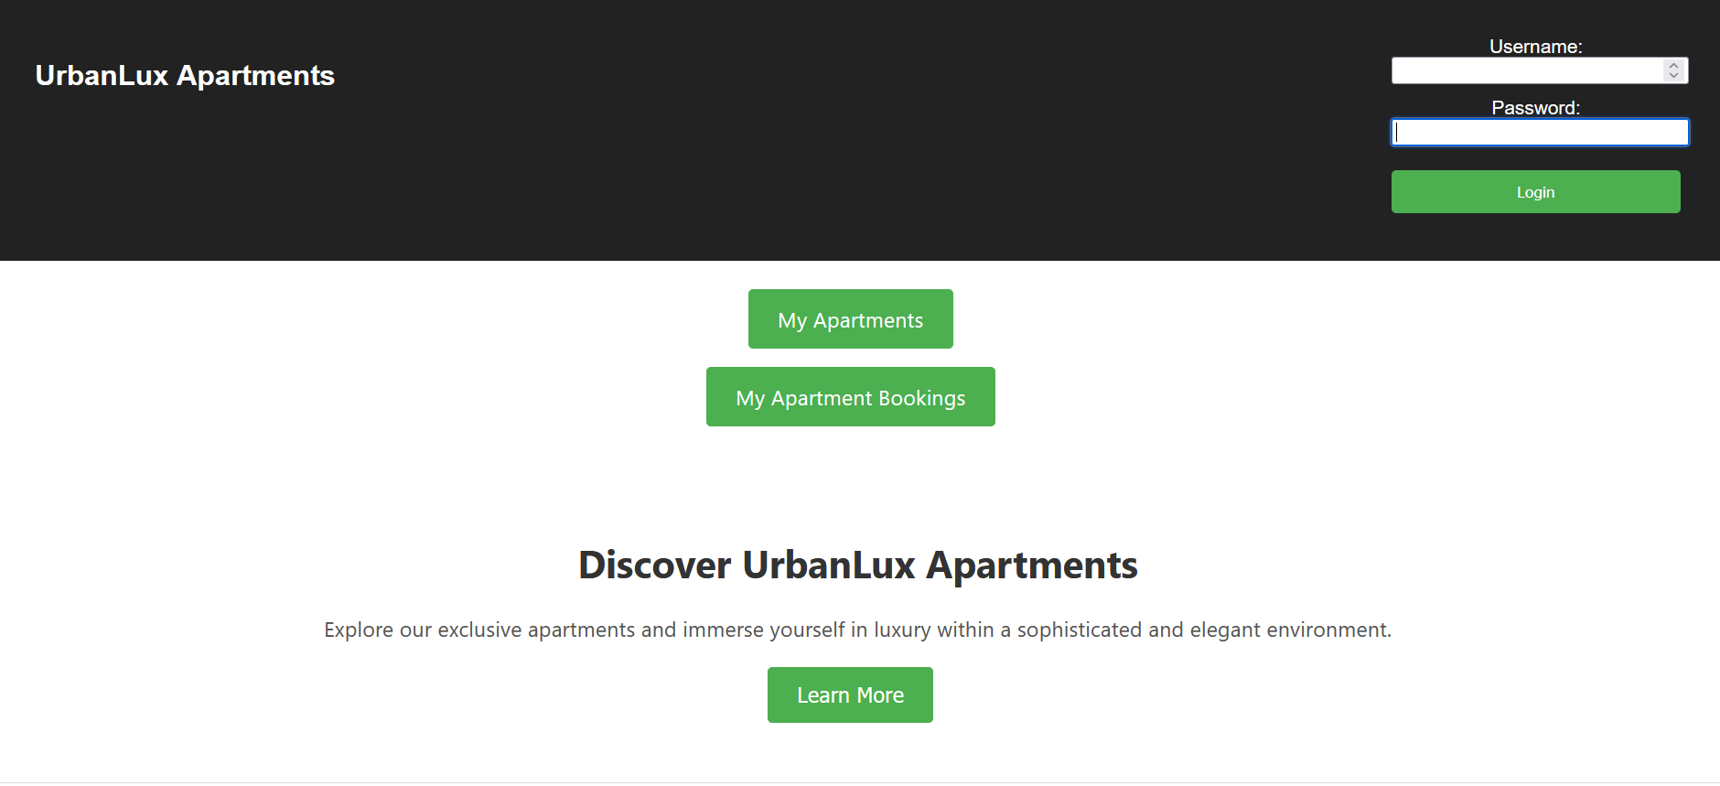
UI-Owner HomePage

Slide 11
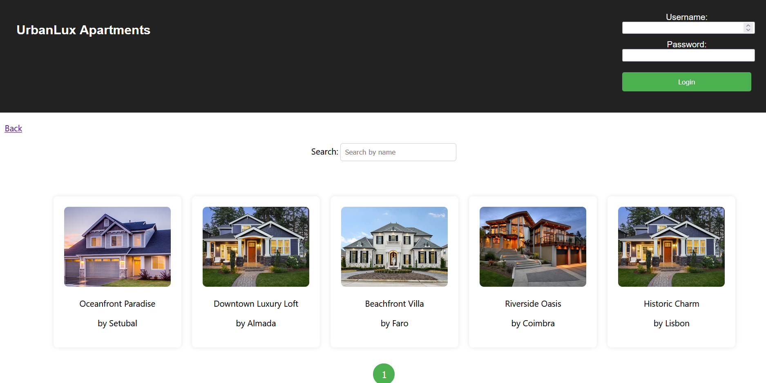
UI-Owner Apartments Page

Slide 12
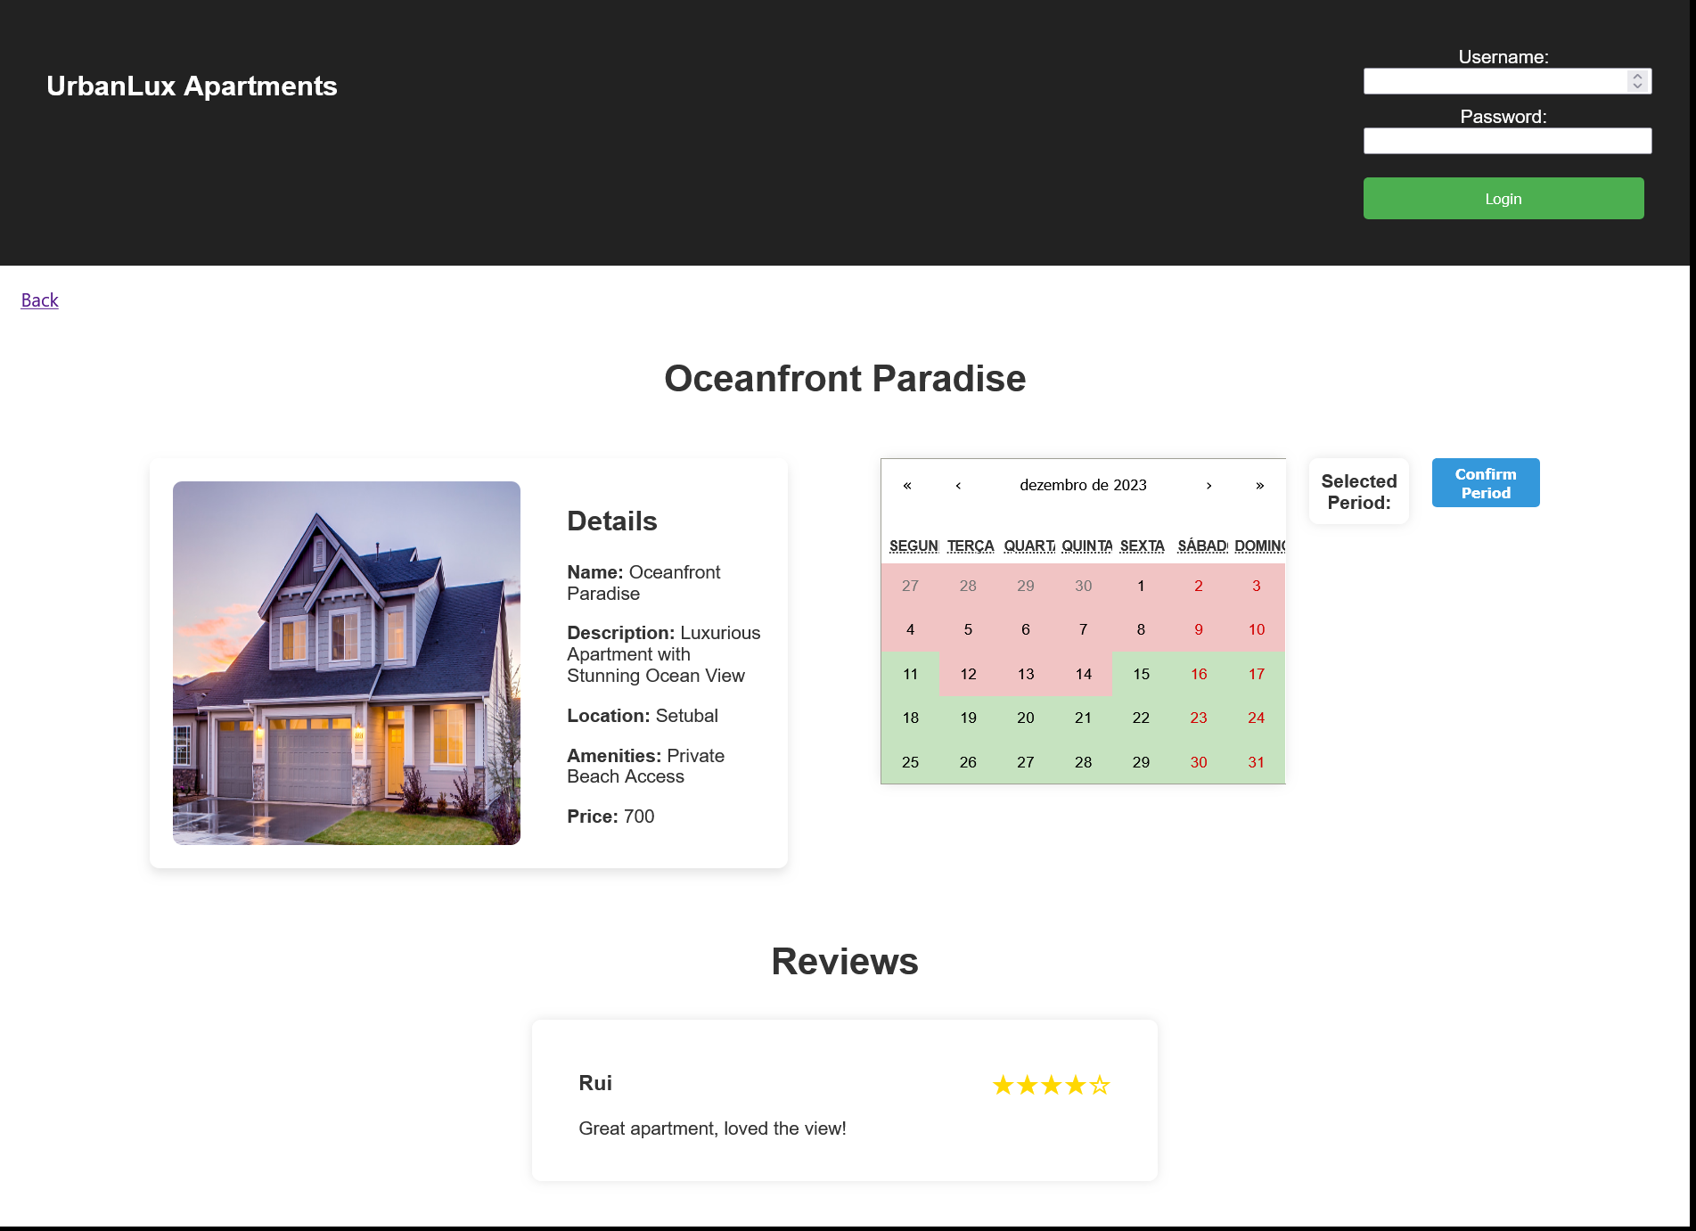
UI- Owner Apartment Details Page (Create Periods for Apartment)

Slide 13
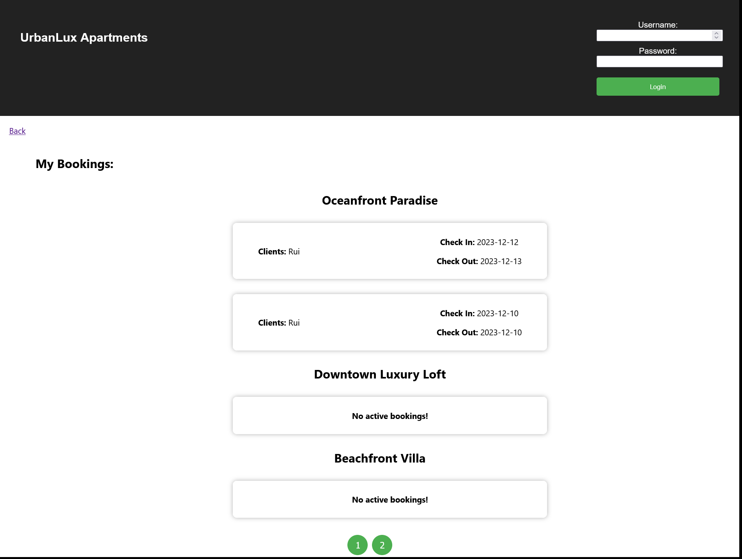
UI-Owner Apartments Bookings List

Slide 14
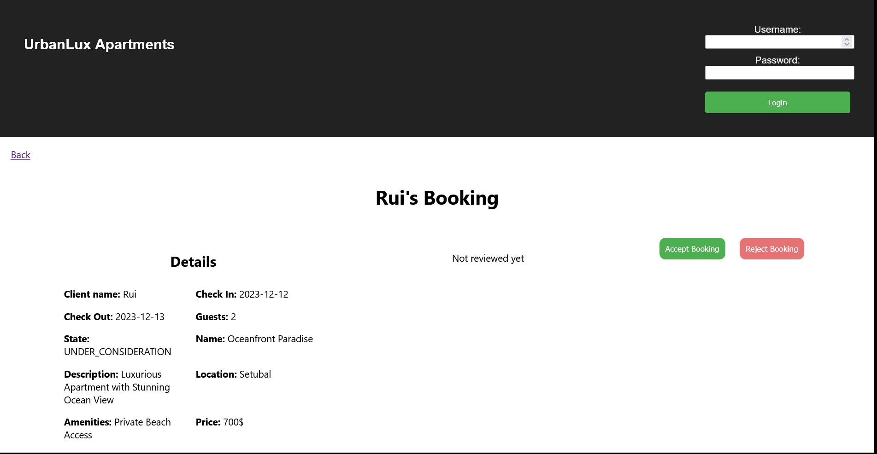
UI-Owner Accept/Reject Booking

Slide 15
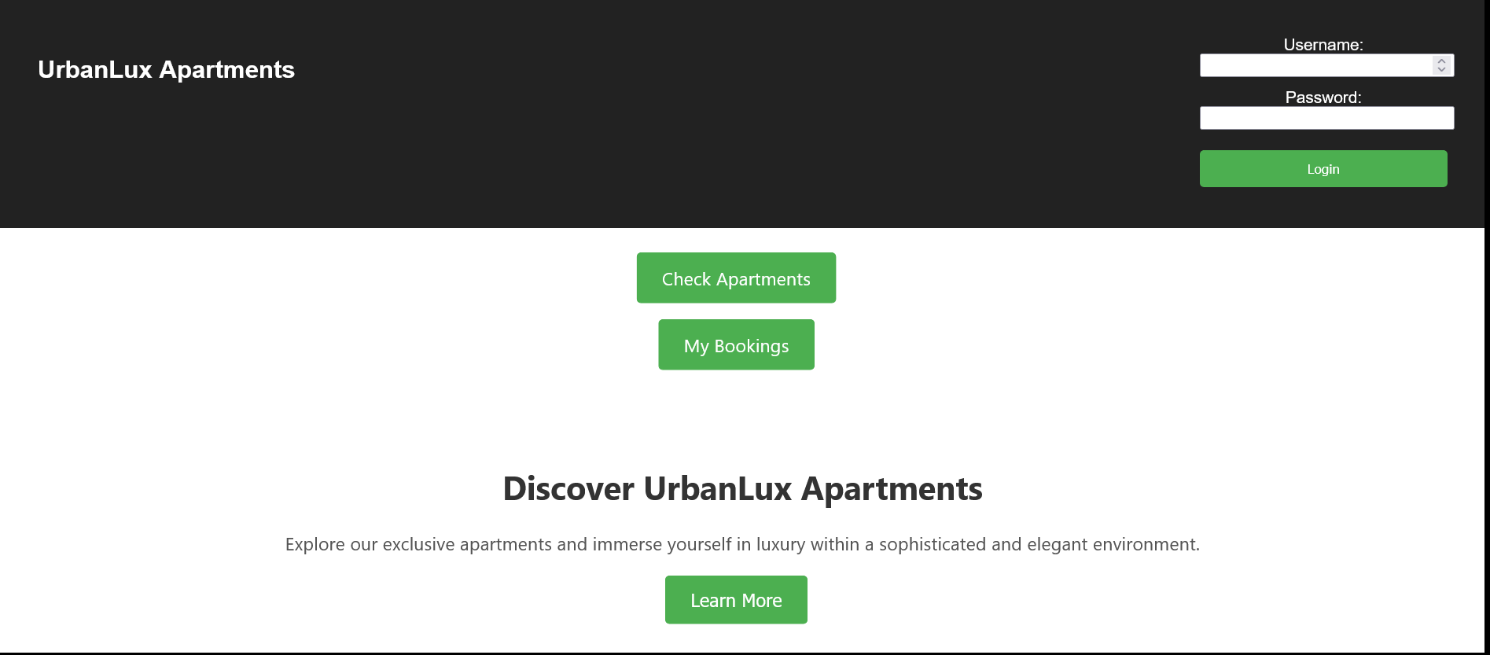
UI-Client Home Page

Slide 16
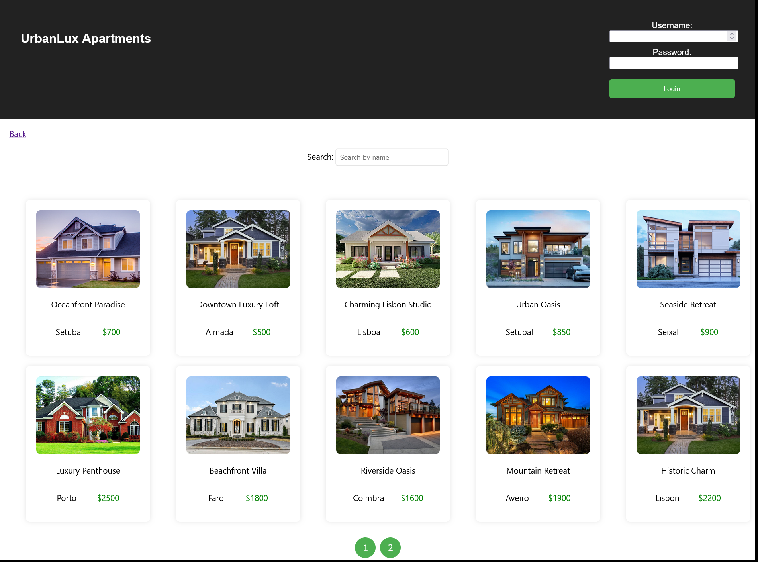
UI- Client Apartments List

Slide 17
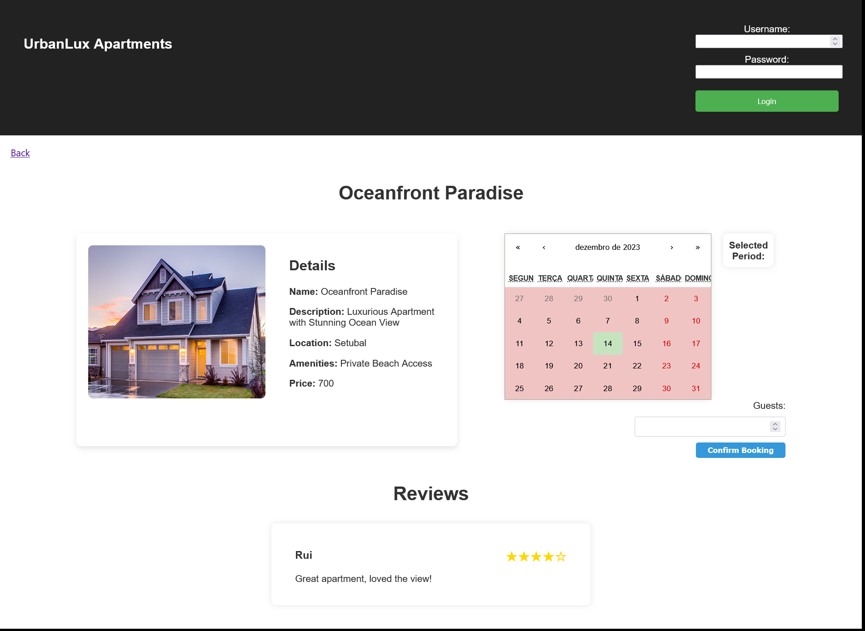
UI-Client Book Apartment Page

Slide 18
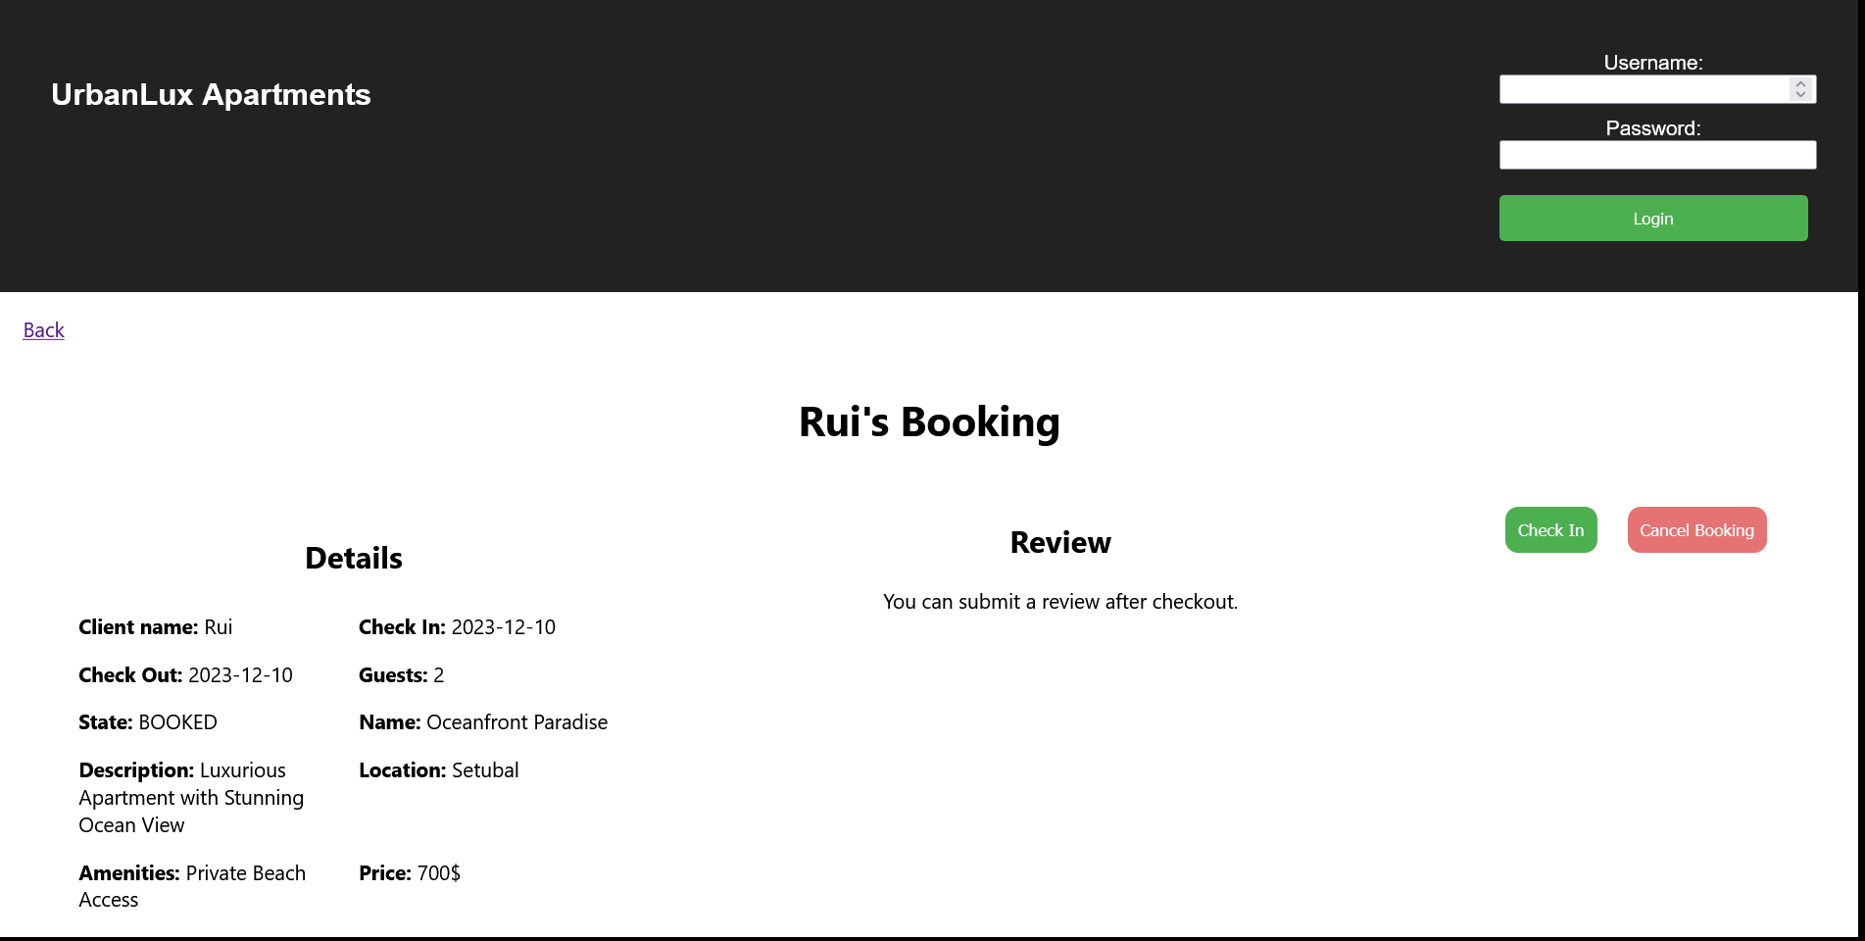
UI-Client CheckIn/CheckOut Page

Slide 19
Lessons Learned
Previously designing the database schema helped us understand and defining the relationships between objects.
Redux is a very useful tool, increasing efficiency, maintainability and scalibility by centralizing the state of an application into a single store
Designing the ifml aid us in acknowledging how interactions and data flows through the cliente side app.

