Slide 1
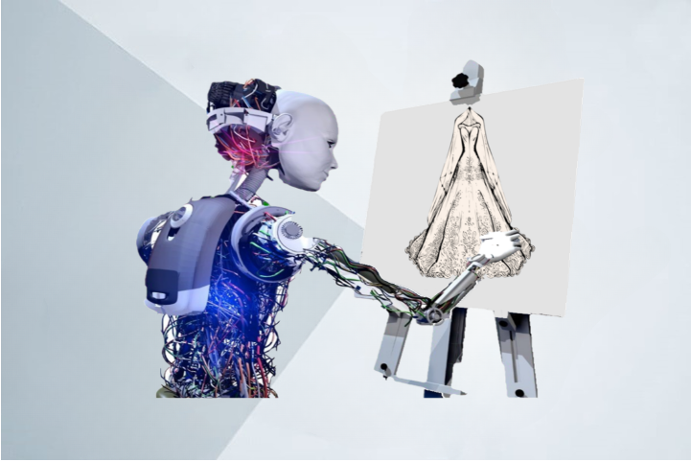


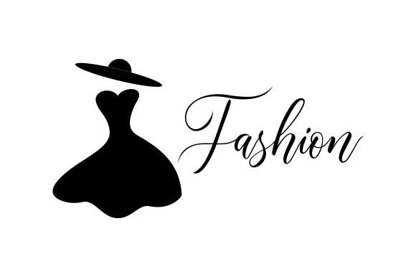

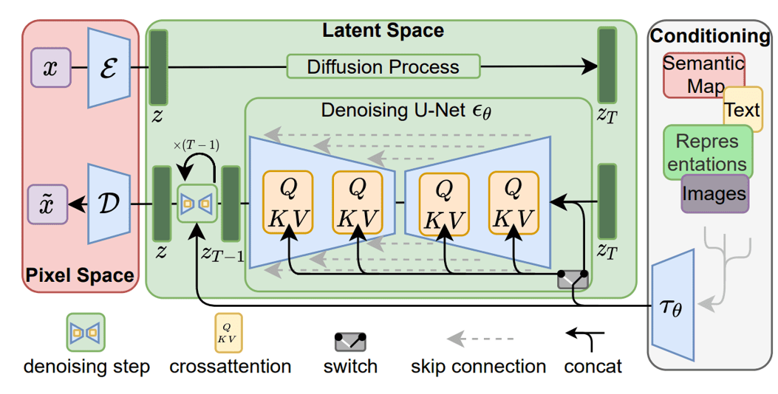
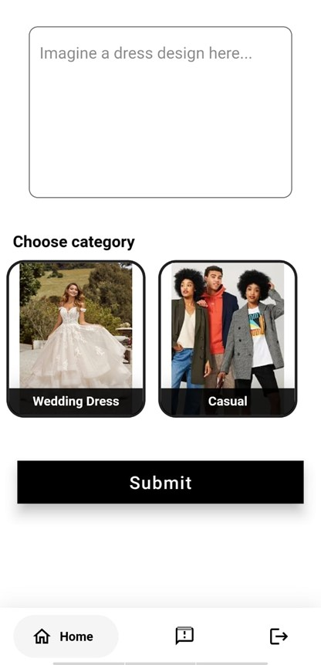

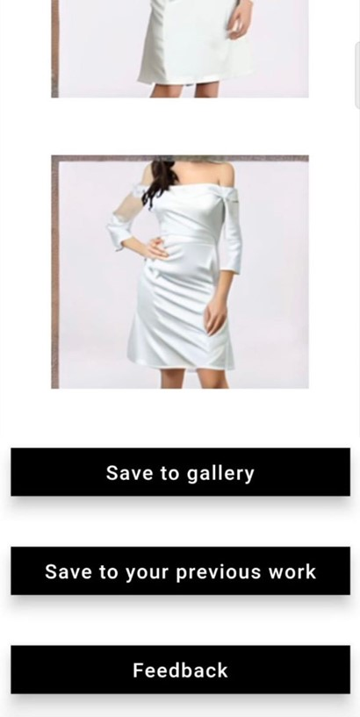
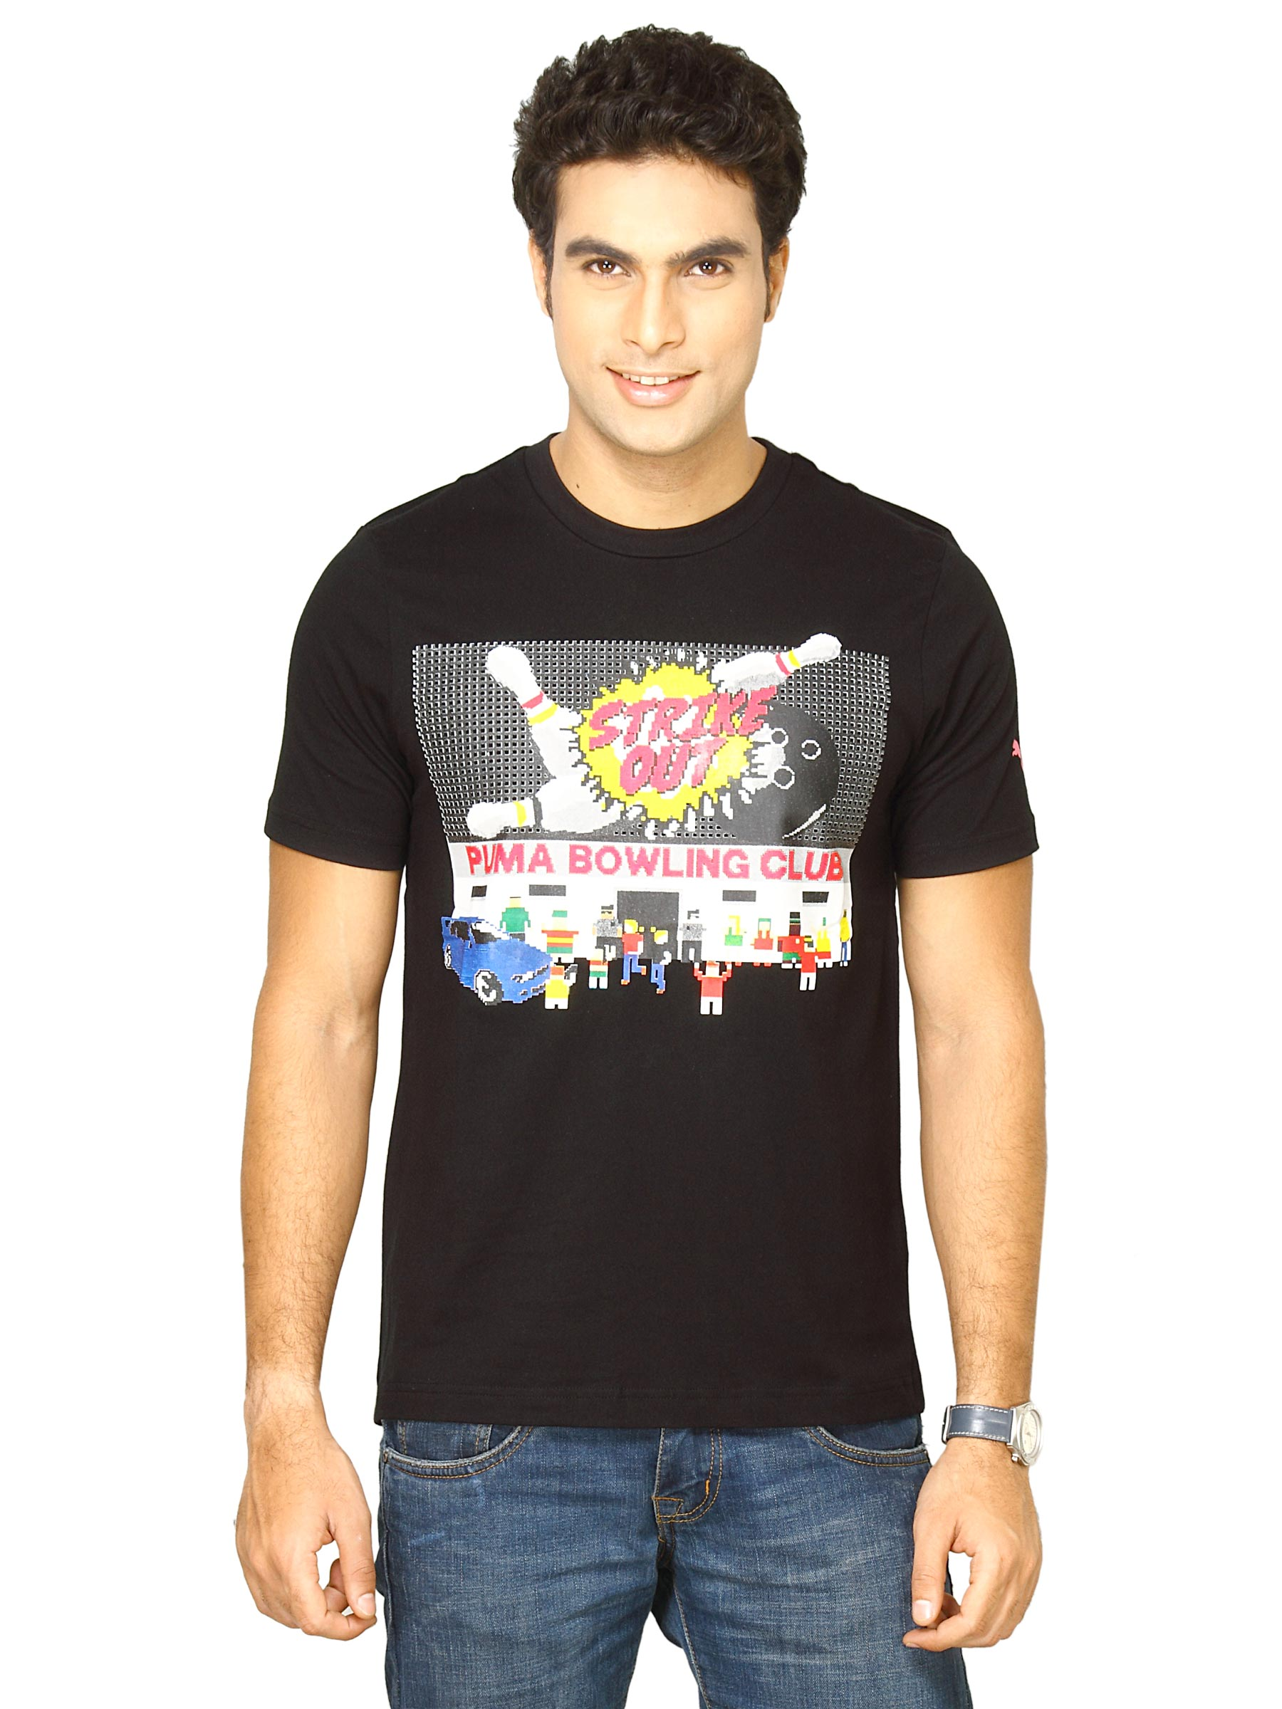
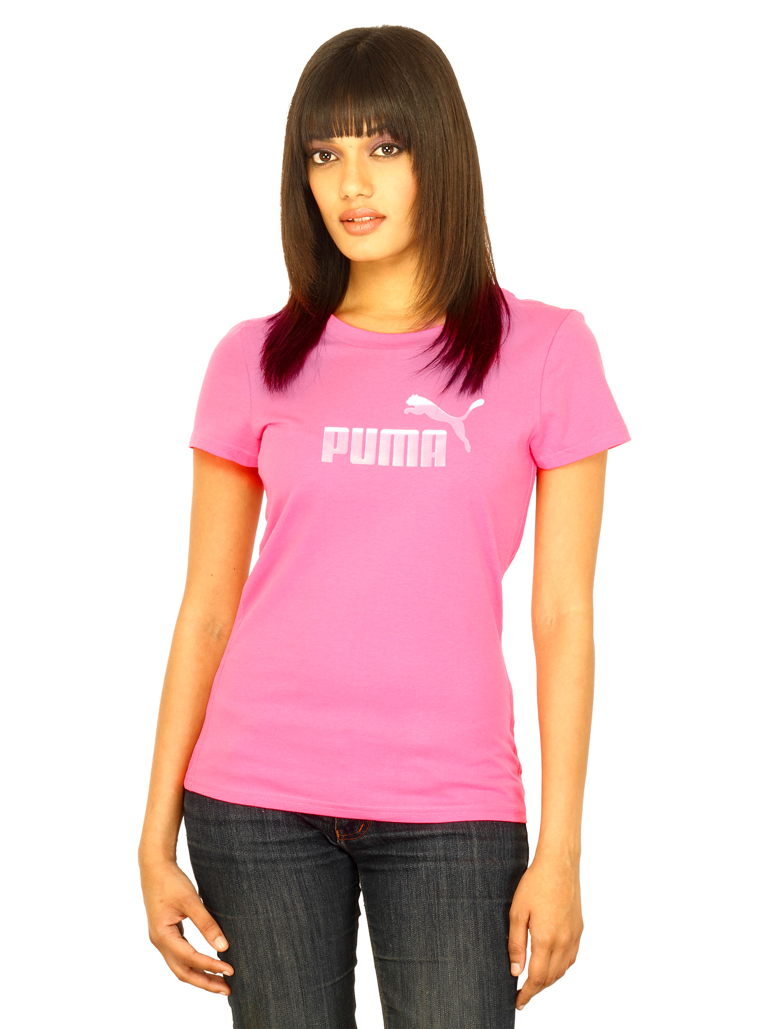
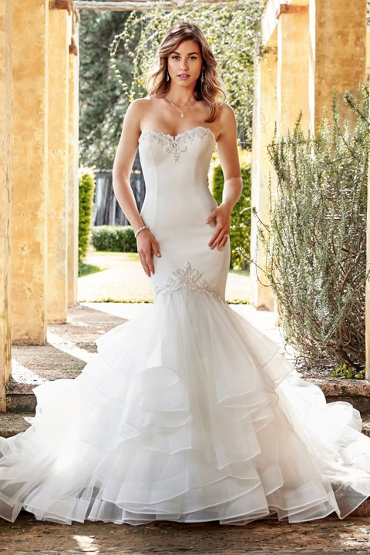
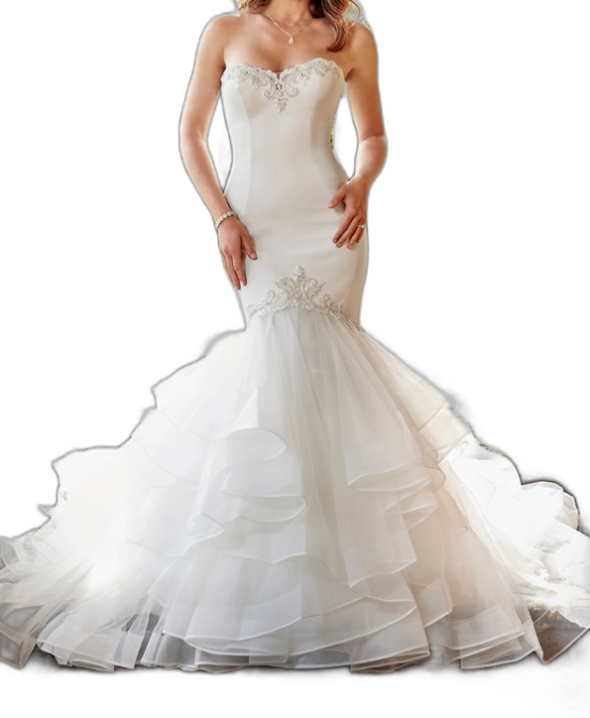

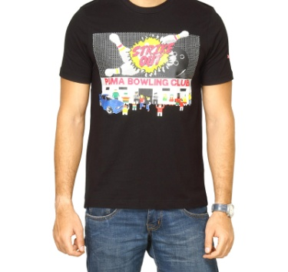
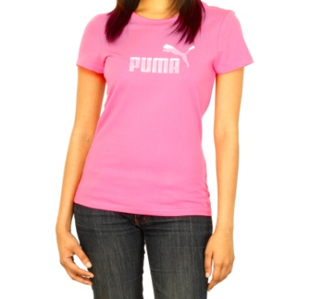
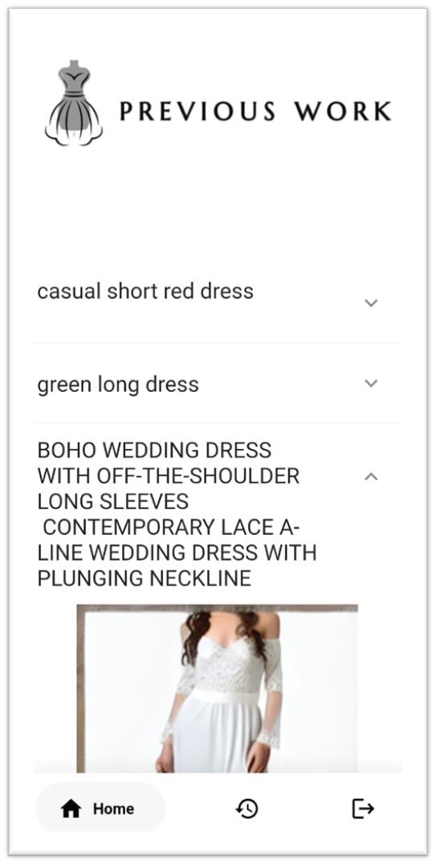
TAIlor
Faculty of Computer and information Science / Ain Shams University Computer Science Department
Supervisor: Dr. Salsabil Amin
Amgad Abd El Baset
Andrew Nassef Amin
Andre Adel Ibrahim
Supervisor: T.A. Mohamed Essam
Maria Maurice Ayoub
Mayve Ehab Ramzy
Mina Sami Anwar
Abstract
Materials
Results
Conclusion
Firstly, we used Stable Diffusion for finetuning as it is trained on millions of images of different categories.
Google Colab: is a powerful and convenient platform for developing and running machine learning and deep learning models.
Dart: used to Develop flutter Mobile Application
After Running the two model, the models achieved different accuracies which are shown in the table below:
1. The User must Sign In to be able to enter the application, he uses his google account to sign in and enter a prompt or access previously generated images.
2. After login, home page contains a selection
between the two models and textbox to
enter your description of the
clothing that you want figures(2).
3. After we enter the description of the clothes
We start generating the image from the entered
text.
4. Then you can either save the image
on your phone, save it in the
application itself or give a feedback
about the accuracy of the
generated images and help us
improve the models even more.
figure(3).
5. And finally you can access the history
of all previously generated images
figure(4).
6. And all the generated images and
feedbacks provided by the users are saved in
our database where they can be viewed by
the admins to help us work on the models’
week points and improve them to perfection.
In this project, we have developed a virtual clothing customization system that allows users to generate realistic clothing images based on textual descriptions of desired attributes. Throughout the project, we have discussed the various components, methodologies, and techniques employed to design and implement the system. Now, let us provide a complete summary of the project, including the results obtained. Overall, this project has been a valuable exploration into the realm of virtual clothing customization and has yielded promising results.
TAIlor AI Art Generator is a mobile application designed to provide users with the ability to generate unique and creative fashion designs using artificial intelligence.
In recent times, there has been a growing interest in creating models that can generate high-quality images from input text. We present a new model that uses a large clothing dataset to generate images of casual clothes and wedding dresses, leveraging stable diffusion finetuning and state-of-the-art language models.
The text-to-image generator project is essential because it enables the creation of high-quality images from input text, which can have multiple practical applications. Our model is focused on the fashion industry which could use this technology to generate images of clothing items to showcase their designs to customers or create virtual try-on systems.
Models | FID
General model | 72.333
Wedding dresses model | 94.666
Discussion
Figure(1) Architecture of Stable Diffusion
Figure (2)
We used two datasets to train two models, the first one is a general clothes model and the second one is specialized in wedding dresses. We found the general model dataset on Kaggle, but the wedding dresses dataset wasn’t as easy we had to collect images of wedding dresses manually from the internet and use a model for describing it perfectly to be as detailed as possible. Then we searched different models to use, and we decided that stable diffusion is the best candidate. So, we started the finetuning process which too a very long time and needs a very powerful machine to run on. That’s why we used Colab pro as our platform for finetuning this model.
Introduction
Methods
1. We used two different datasets that consisted of General clothes in one dataset and the other had wedding dresses only.
2.The dataset was then pre-processed by using segmentation to remove the faces, hands, legs and background, we also scaled all the images and refined their quality to produce the best results.
3. Next, we decided to use Stable Diffusion for finetuning as it is an open-source model, and it was trained on a huge amounts of images from different categories.
4.After training was complete, we tested the model using FID(Fréchet Inception Distance) which measures the coherence between the real images and the generated images, and the distance needs to be as low as possible to achieve the best results.
Time and cost savings: the average cost of a wedding dress design depending on whom you select to make your dress but typically it can range from $2,000 - $8,000, and the average cost of casual wear design $200 - $250, which can be a significant expense for many people. By providing a tool that allows users to create their own unique designs, that can help save them time and money. Customization: According to a survey by The Wedding Report, 83% of brides want a personalized wedding dress. By using an AI text to image generator, users can create a dress that is tailored to their specific preferences and style, rather than having to settle for a pre-made design.
Accessibility: Not everyone has access to high-end fashion designers or the budget to purchase expensive clothing. By providing a tool that allows users to create their own designs, you can help make fashion more accessible to a wider range of people. Additionally, according to a report by the UNDP, Egypt has a high youth unemployment rate, which can make it difficult for young people to afford high-end fashion or to find employment in the fashion industry. By providing a tool that allows users to create their own designs, your AI art generator can help make fashion more accessible and provide opportunities for young people to develop their skills and creativity.
z
General Dataset
Dresses Dataset
References
Figure (3)
[1] Blattmann, A., Rombach, R., Oktay, K. and Ommer, B., 2022. Retrieval Augmented Diffusion Models. arXiv preprint arXiv:2204.11824.
[2] Yu, J., Xu, Y., Koh, J.Y., Luong, T., Baid, G., Wang, Z., Vasudevan, V., Ku, A., Yang, Y., Ayan, B.K. and Hutchinson, B., 2022. Scaling autoregressive models for content-rich text-to-image generation. arXiv preprint arXiv:2206.10789.
[3] Ruiz, N., Li, Y., Jampani, V., Pritch, Y., Rubinstein, M. and Aberman, K., 2023. Dreambooth: Fine tuning text-to-image diffusion models for subject-driven generation. In Proceedings of the IEEE/CVF Conference on Computer Vision and Pattern Recognition (pp. 22500-22510).
[4] Gal, R., Alaluf, Y., Atzmon, Y., Patashnik, O., Bermano, A.H., Chechik, G. and Cohen-Or, D., 2022. An image is worth one word: Personalizing text-to-image generation using textual inversion. arXiv preprint arXiv:2208.01618.
[5] Balaji, Y., Nah, S., Huang, X., Vahdat, A., Song, J., Kreis, K., Aittala, M., Aila, T., Laine, S., Catanzaro, B. and Karras, T., 2022. ediffi: Text-to-image diffusion models with an ensemble of expert denoisers. arXiv preprint arXiv:2211.01324.
[6] Li, R., Li, W., Yang, Y., Wei, H., Jiang, J. and Bai, Q., 2022. Swinv2-Imagen: Hierarchical Vision Transformer Diffusion Models for Text-to-Image Generation. arXiv preprint arXiv:2210.09549.
Preprocessed General Dataset
Preprocessed Dresses Dataset
Figure (4)

