Slide 1
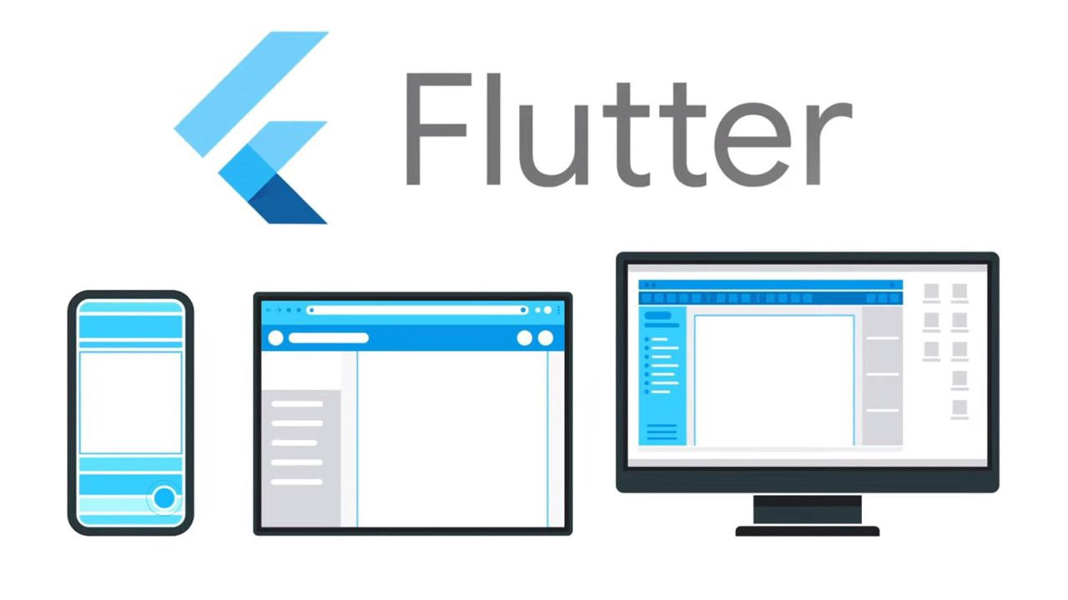
Develop an app with…
« disclaimer » :
Contains comparisons with React-Native!
Android, iOS, macOS, Windows, Linux, Web…
André Masson 2022-05-19

Slide 2
Look & Feel and out of the box components
Create a Theme and customize Typography (headline6, bodyText2, ...) https://docs.flutter.dev/cookbook/design/themes
Dark theme mode
Flexible is a built-in widget in flutter which controls how a child of base flex widgets that are Row, Column, and Flex will fill the space available to it
The Expanded widget in flutter is shorthand of Flexible with the default fit of FlexFit
Scroll view, list view, Drawer menu
Lottie animations while loading
Prefer SVG images over PNG
Background images
Add ability to (input modal) add any text_to_guess on the fly
Orientation locking
Conditional layout depending on device orientation
Example of a FadeIn animation

Slide 3
Internationalization
I18n configurations
Plugin labels maintenance
Re-generate ARB (application resource bundle) & Dart: Analysis server

Slide 4
Rich dev environment
Debug live VSCode (Android, iOS…)
PlugIns VSCode (c.f. Awesome Flutter Snippets)
Powerful refactoring tooling, for adding widgets wrappers or sub-widgets extraction
Example of a SimpleCategoryWidget extraction
network trafic demo
layout editor demo

Slide 5
State management
setState & InheritedWidget (similar to useState, useContext)
State management with MobX
MobX Store annotations via the mobx_codegen package
Preferences page & shared preferences

Slide 6
Tests automation
e2e tests (called "integration tests" by Flutter team https://docs.flutter.dev/cookbook/testing/integration/introduction)
Testing & code coverage
unit
mocks
widget
e2e

Slide 7
Dart language
Modern, functionnal programming, assign fonction to var, destructure, named parameters, mixins, elvis & bang operator (? et !), double elvis operator (??), cascade operator (..), late, const vs final, etc.
https://medium.com/flutter-community/the-ultimate-javascript-vs-dart-syntax-guide-2f7d8ad8bde6
Async API services
Factory pattern to create services singleton
Power of Dart extensions
JSON serialization
Clone vs copy(...) with adjusted params

Slide 8
Other subjects…
Example of lib integration 1:[barcode generator](https://pub.dev/packages/barcode) to create a text to guess challenge
Example of lib integration 2: [barcode scanner](https://pub.dev/packages/flutter_barcode_scanner) feature to accept (scan) challenge
Deep link navigation for both platforms

Slide 9
Diff. And frustrations Flutter vs RN
Pas de Codepush c.f. Discussion https://github.com/flutter/flutter/issues/14330
Sérialisation JSON pas naturelle comme avec JS en général
Librairies commencent à être intéressante mais on est à des années lumières de la richesse des librairies JS !
manque un npm trends 🙂
Injection des dépendances vs les tests unitaires vs mocks (puissance de Jest non trouvée, même avec mockito)
functional programming all the way vs classes et héritage
Material design est built-in (on peut faire un opt-out, mais pas besoin de librairies comme RN paper)
nouveaux patterns propres à Dart à apprendre comme factory, part, mixin, extensions, etc.
Pas besoin de 3rd parties comme Detox pour les e2e
Pas besoin de 3rd parties (Flipper) pour débugger (c.f. network, etc.) car env. de développement riche et on le sent solide et intégré, même dans VSCode
Tooling CLI de développement top (flutter cli, doctor, run, tests, etc.)
lib qui génèrent du code (.g.dart) à partir d'annotations, mais aussi pour d'autres aspects comme le i18n
pubspec.yaml plus "platform agnostic approach", genre Expo, que RN barebone (package.json, Info.plist, AndroidManifest.xml)
Animations plus faciles ?

