Slide 1

fake news identifier
Team Members:
Andrea Aurrecoechea Diaz
Edrin
Nestor Pardo

Slide 2

Objective
To develop and optimize a machine learning model capable of accurately distinguishing between real and fake news, leveraging advanced natural language processing techniques to improve reliability and decision-making in media consumption.

Slide 3
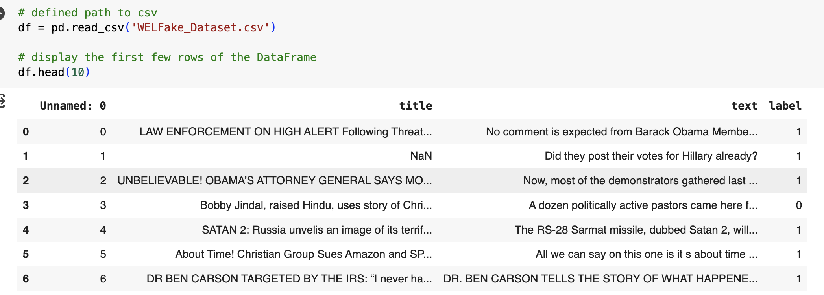

The Dataset
WELFake – made up of our popular news datasets (i.e. Kaggle, McIntire, Reuters, BuzzFeed Political)
- 72,134 news articles
- Columns: Serial Number, Title, Text and Label (0 = Fake and 1=Real)

Slide 4
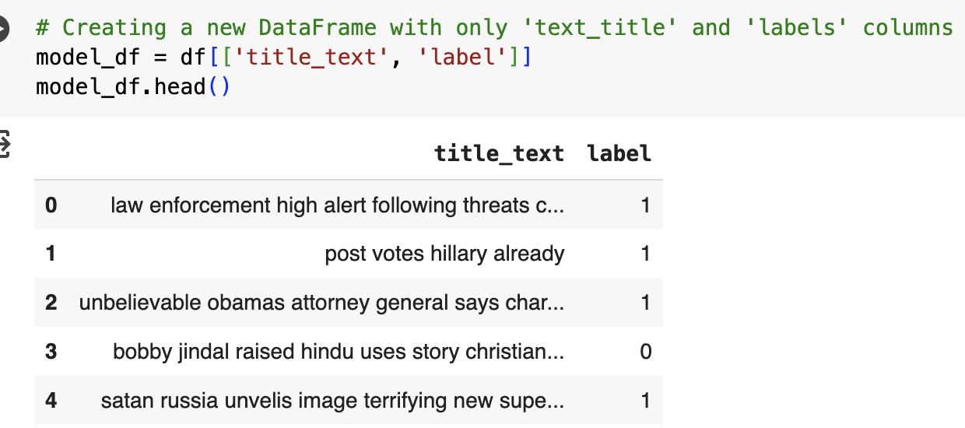
Natural Learning Processing Pipeline
Removing special characters and numbers
Tool: Regex
Lowercasing
Tool: pyhton
Removing stop words
Tool: nltk - stopwords
Handling missing values
Tokenization
Stemming and Lemmatization
Vectorization

Slide 5
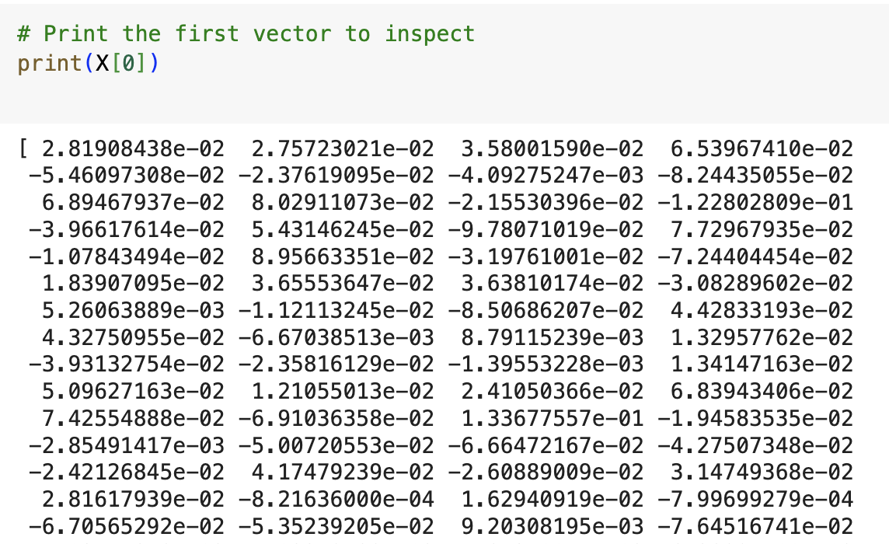
Paths to vectorization
Vectorization
Path A
Path B
Word2Vec
tensorflow.keras - Tokenizer
tensorflow.keras – pad_sequences
Path A

Slide 6
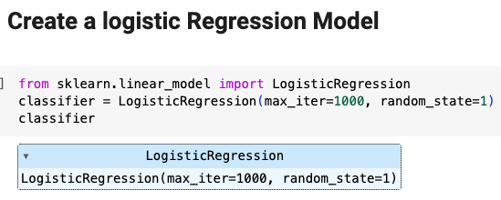
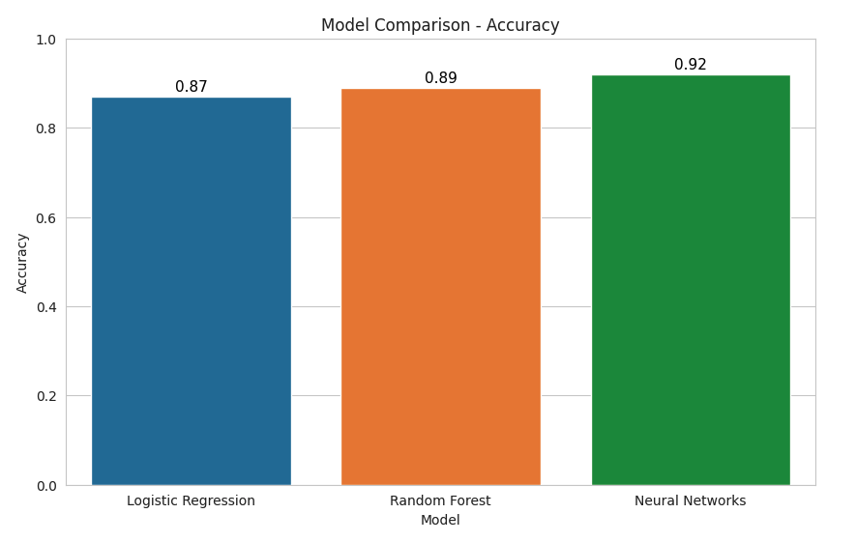
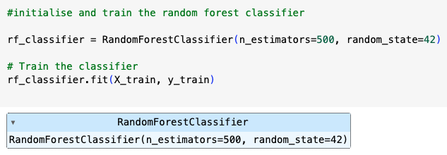
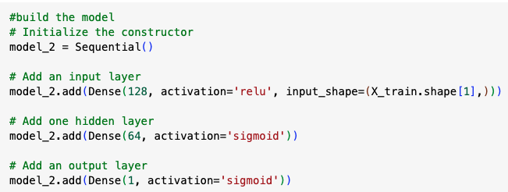
Word2Vec

Slide 7
TensorFlow.Keras

Slide 8
Selected Model

Slide 9

Application – Fake News Detector (FND)
Technology used
Gradio
https://www.gradio.app/
Python

Slide 10
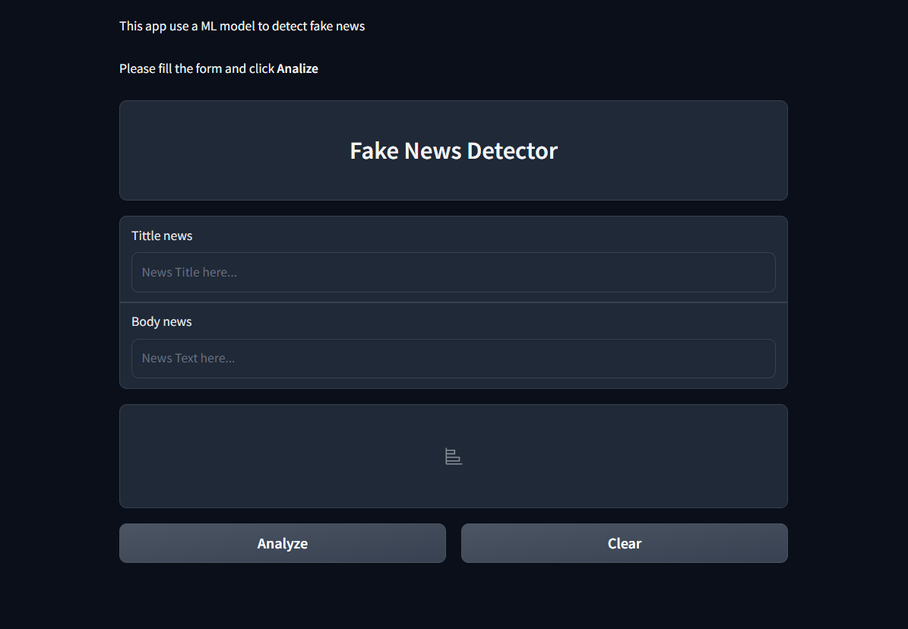
Demonstration -

