Slide 1

fake news identifier
Team Members:
Andrea Aurrecoechea Diaz
Edrin Ngadze
Nestor

Slide 2

Objective
To develop and optimize a machine learning model capable of accurately distinguishing between real and fake news, leveraging advanced natural language processing techniques to improve reliability and decision-making in media consumption.
Notes:
"For our project, we aimed to delve into and learn about Natural Language Processing (NLP). Our primary objective was centered around developing and optimizing a machine learning model capable of accurately distinguishing between real and fake news. Additionally, we wanted to create a user-friendly application where users could conveniently input an article. And the application would then analyze the article and predict whether it was fake or real."

Slide 3
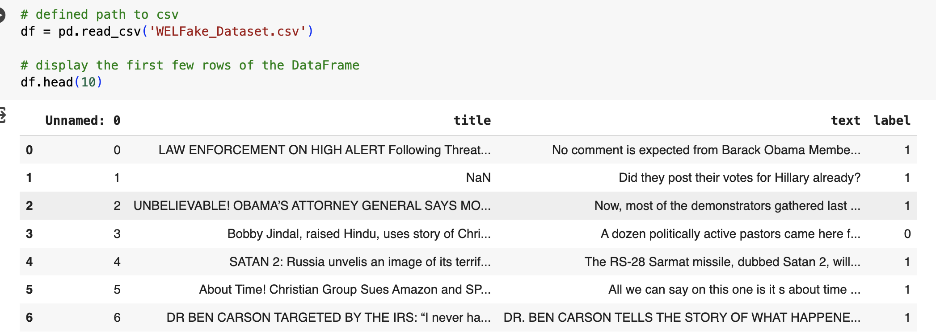

The Dataset
WELFake – made up of four popular news datasets (i.e. Kaggle, McIntire, Reuters, BuzzFeed Political)
- 72,134 news articles
- Columns: Serial Number, Title, Text and Label (0 = Fake and 1=Real)

Slide 4
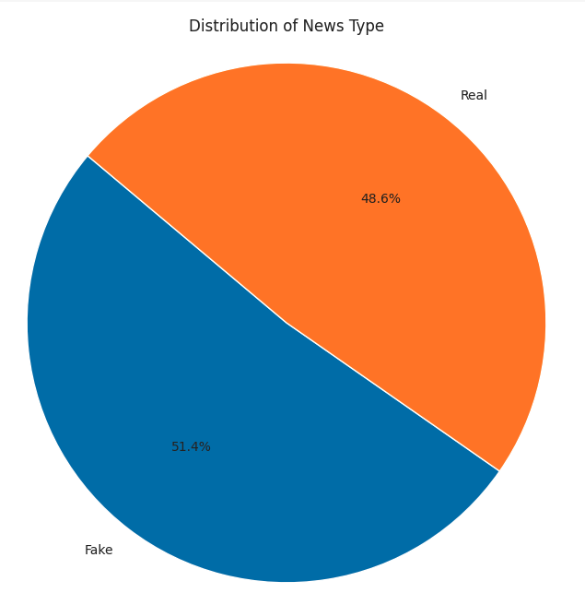
Distribution of News Type

Slide 5
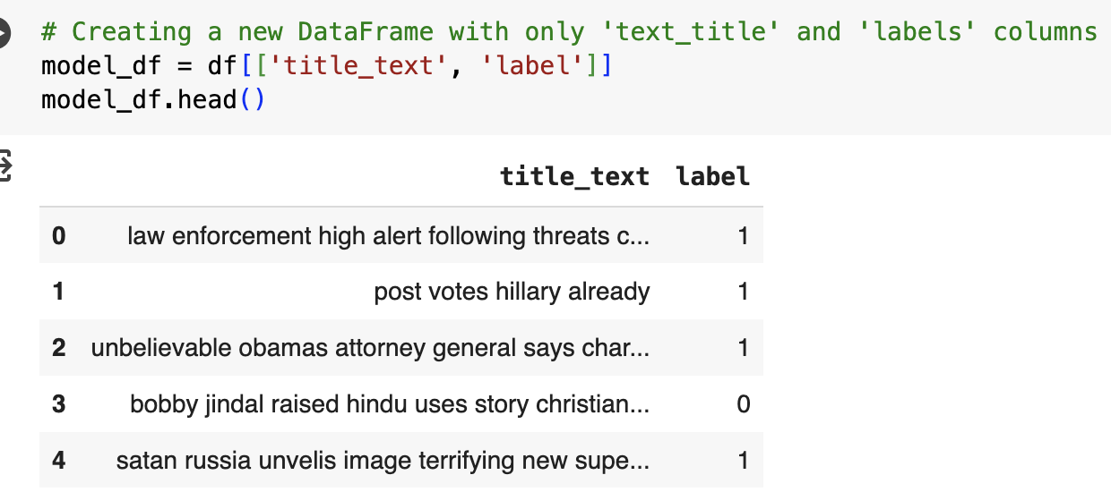
Natural Learning Processing Pipeline
Removing special characters and numbers
Tool: Regex
Lowercasing
Tool: pyhton
Removing stop words
Tool: nltk - stopwords
Handling missing values
Stemming and Lemmatization
Tokenization
Vectorization

Slide 6
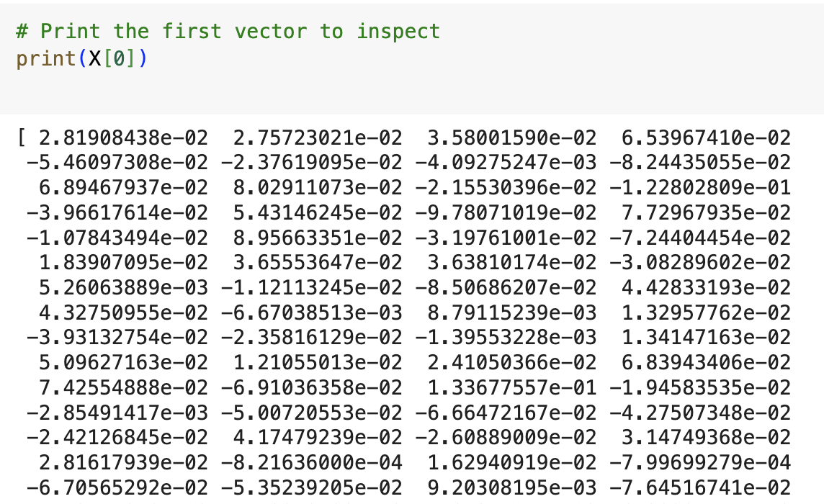
Paths to vectorization
Vectorization
Path A
Path B
Word2Vec
tensorflow.keras - Tokenizer
tensorflow.keras – pad_sequences
Keras.layers - Embedding, Conv1D, GlobalMaxPooling1D, Dense
Path A

Slide 7
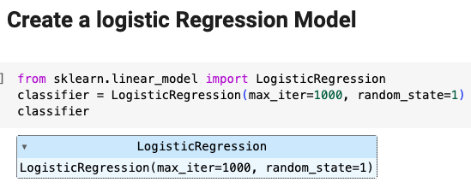
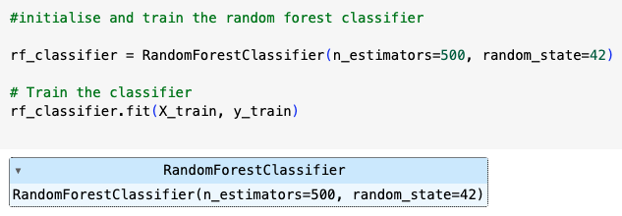
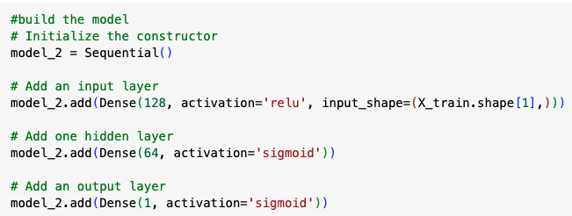
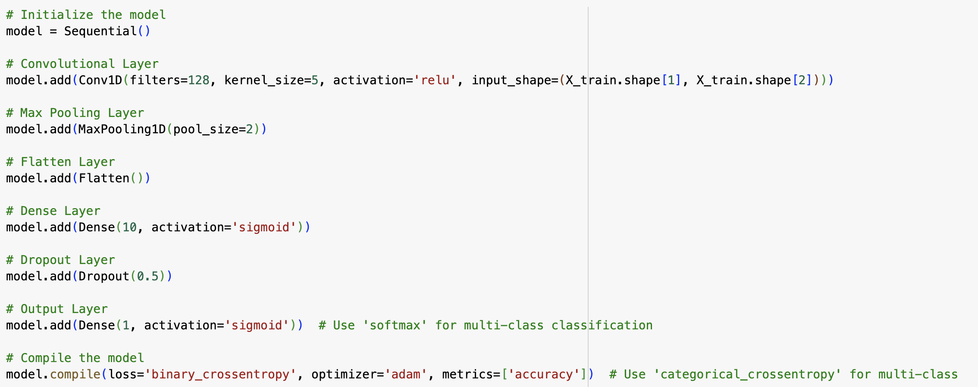
Word2Vec
Used pre-trained Google Word2Vec model to obtain work embeddings.
For vectorizing we averaged word vectors – created a single vector that represented all the text.
LR
RF
Neural NW
CNN

Slide 8
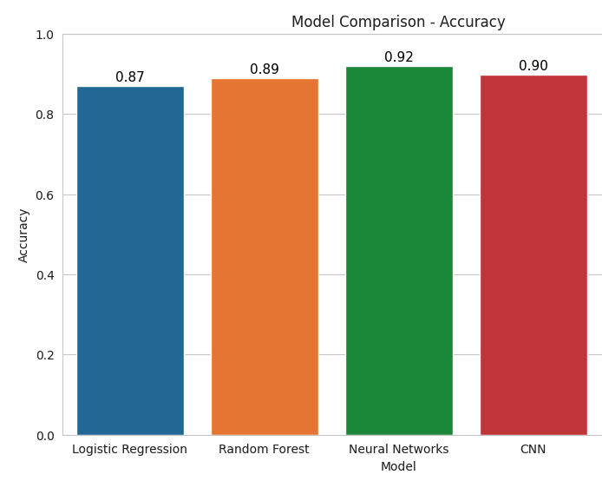
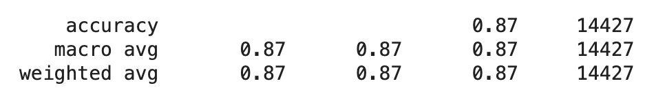
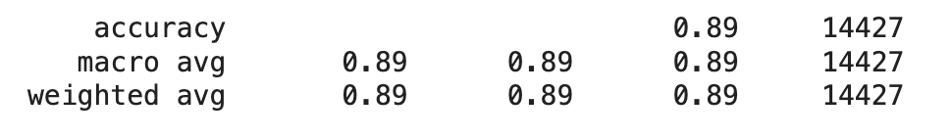
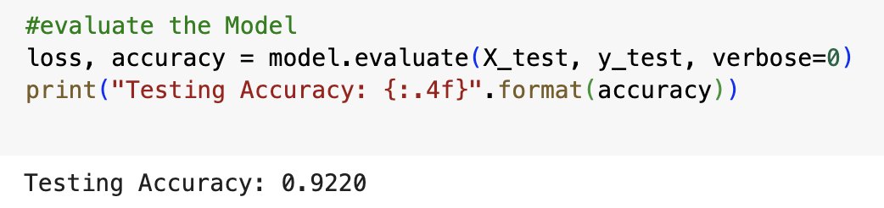
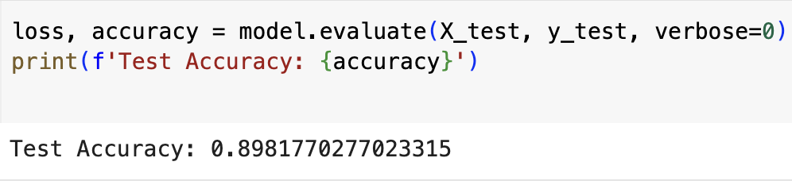
Word2Vec
Word2Vec
LR
RF
Neural NW
CNN

Slide 9

TensorFlow.Keras
User-Friendly: Offers a simple and consistent interface optimized for common use cases, providing clear feedback upon user error.
Modular and Composable: Keras models are made by connecting configurable building blocks together, with few restrictions.
Easy to Extend: Write custom building blocks, new layers, loss functions, etc., for advanced research.

Slide 10
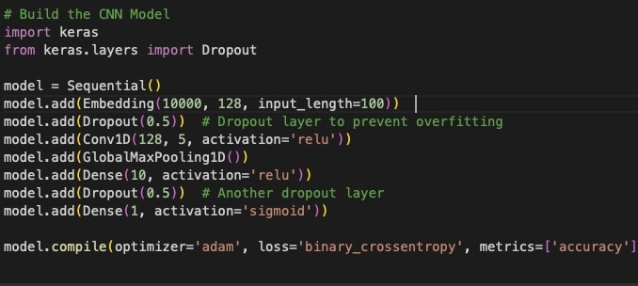
Selected Model
Sequential Model
Embedding layer: 128 Dimension vector output, 10 000 for input
Convolution layer with filter 128 and kernel size 5
Reduces dimensionality to condense the entire sequence into 1 layer
Dense fully connected layers, 10 neurons
1 layer sigmoid
Compile layer with Adam optimizer.

Slide 11
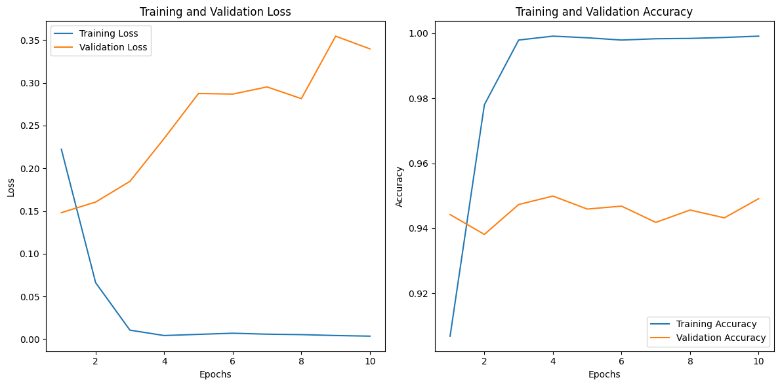
Selected Model
Training Loss; Starts at 0.2222 and ends at 0.0036
Training Accuracy: Starts at 90.68% and ends at 99.91%
Validation loss: Starts at 0.1481 and ends at 0.3397, with fluctuations
Validation Accuracy: Starts at 94.42% and ends at 94.91%, with fluctuations:
The primary concern here is overfitting.
while the model is learning to predict the training data very well, it's not as good at predicting unseen data.

Slide 12
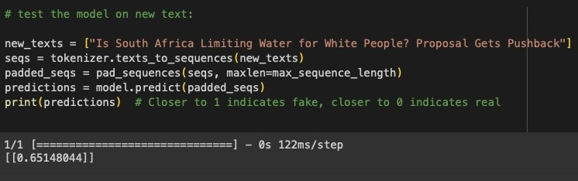
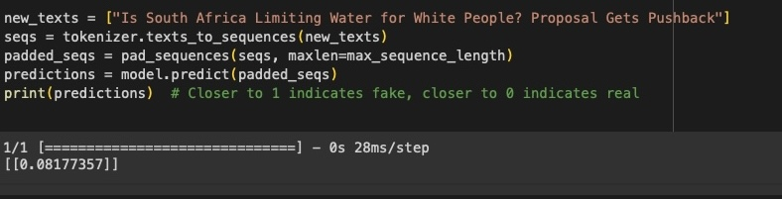
Model Comparison
Performance:
The first result has a higher accuracy (94.65% vs. 93.71%).
The second result has a lower loss (0.1608 vs. 0.3533).
A lower loss typically indicates the model is better at making precise predictions, as confirmed by the test shown

Slide 13
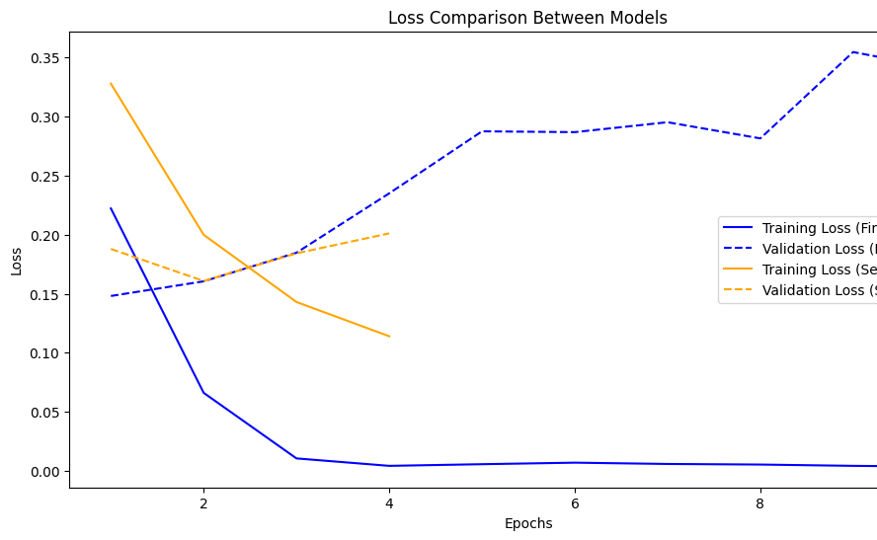
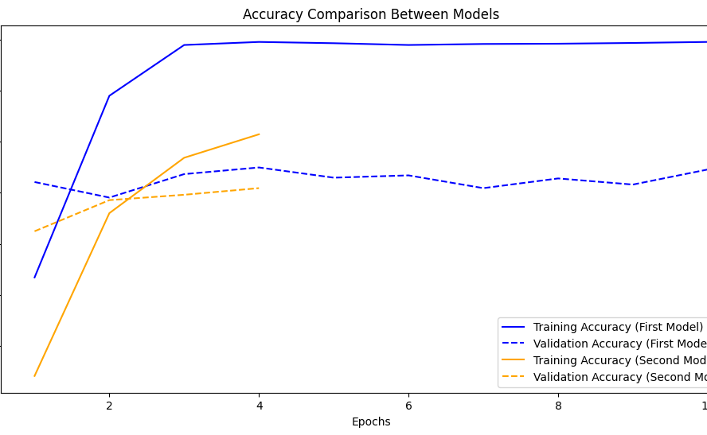
Training Performance
The first model has a better final training accuracy (99.91% vs. 96.29%) and lower final training loss (0.0036 vs. 0.1140).
The first model fits the training data better.
Validation Performance
The validation accuracy of the first model is slightly higher than the new model (94.91% vs. 94.18% highest). However, the first model shows signs of overfitting with an increasing validation loss. The new model's validation loss also increases, but it doesn't start as low or end as high as the first model, indicating much less overfitting.

Slide 14

Application – Fake News Detector (FND)
Technology used
Gradio
https://www.gradio.app/
Python

Slide 15
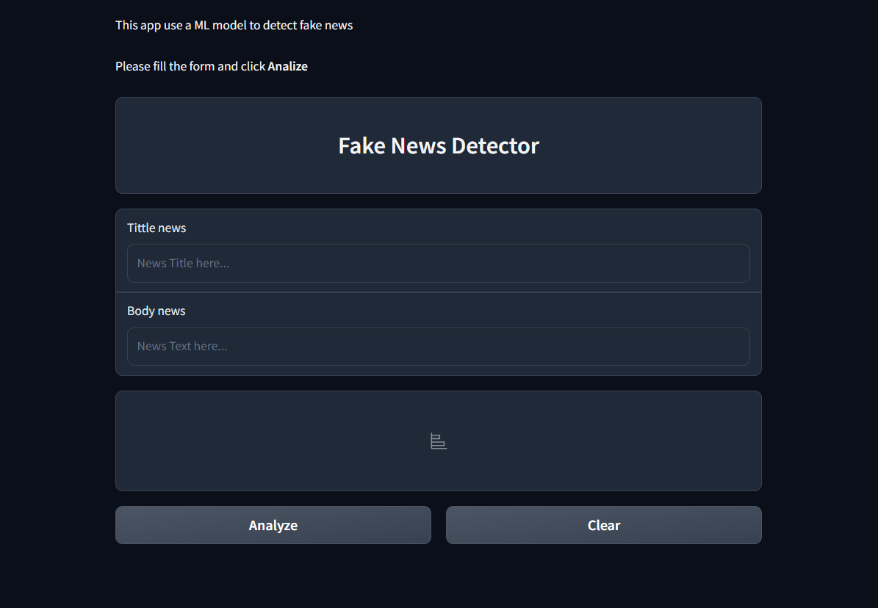
Demonstration -

