Slide 1

L1 - Overview
Bernhard Scholz
The University of Sydney

Slide 2
Datalog as DSL for Static Program Analysis
Datalog in static program analysis
Reps’94, Engler’96, …
Datalog is restricted Horn-Logic
Declarative programming for recursive relations
Finite constant set
No back-tracking for evaluation / fast
Extensional/Intensional database
Extractor
Syntactic translation to logical relations
Datalog Engine
Extensional Database/Facts: input relations
Intensional Database/Rules: program analysis specification
Extractor
Input Relations
Input Program
Program
Analysis
Datalog
Engine
Result

Slide 3
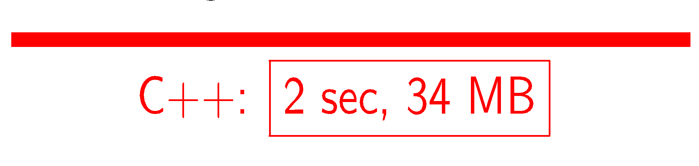
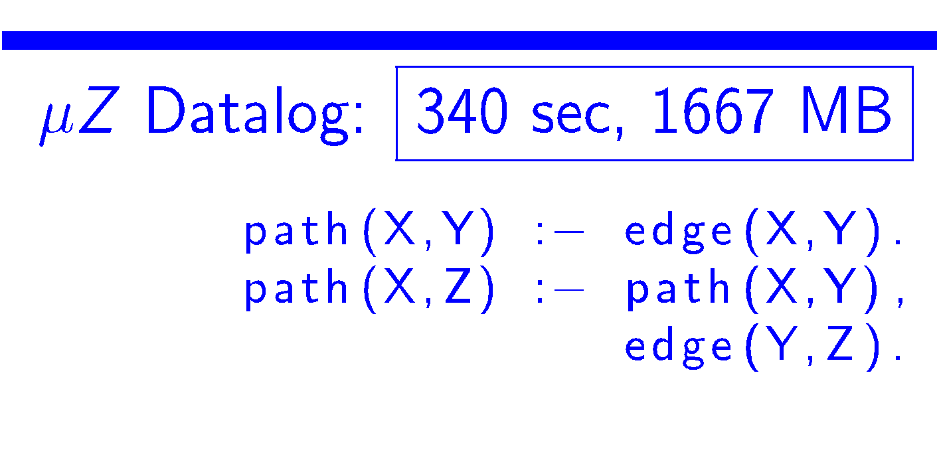
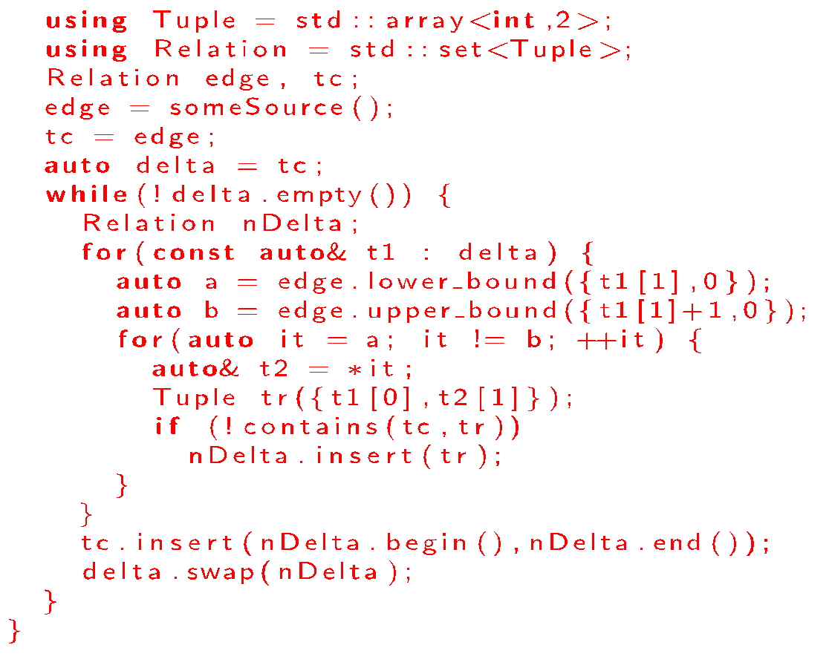
Hand crafted vs Datalog
Why the gap?
General evaluation algorithms
Bad data-structures
No index management
What can we do?

Slide 4
: A Datalog Synthesis Tool
Datalog as DSL for analysis problems
New Paradigm for Evaluating Datalog Programs
To achieve similar performance to hand-written C++ code
Assumptions
Rules do not change in static program analysis tools
Facts ( = input program representation) may change
Executed on large multi-core shared-memory machines
In-memory / highly parallelized data-structures
Solution:
Synthesis with Futamura projections (CAV’16, CC’16)
Apply partial specialization techniques
Synthesis in stages
Each stage opens are new opportunities for optimisations

Slide 5
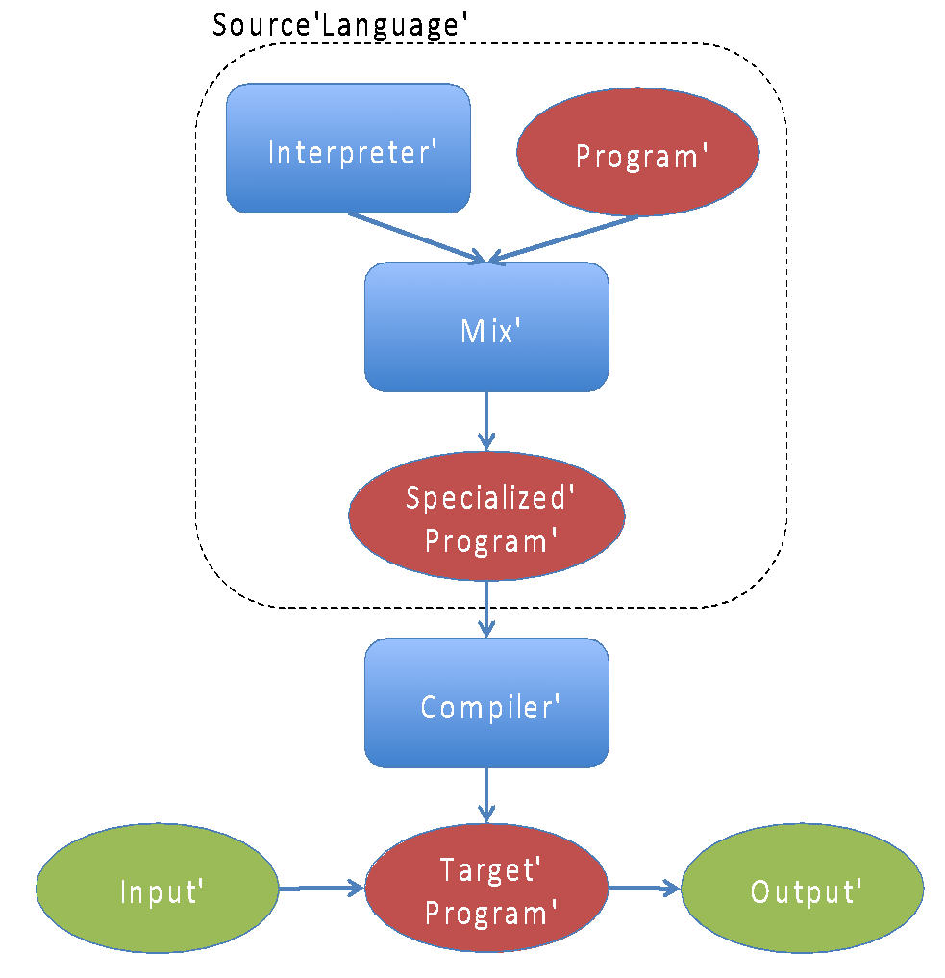
Futamura Projections
Specialization
Specialization
Hierarchy
Datalog Specialization
RAM Specialization
C++ Specialization

Slide 6
How does Soufflé work?
Inputs
Facts
Modes of Evaluation
Interpreter
Synthesiser: Standalone tool (binary/library)
Fact Extractor
Spec
Result
SOUFFLÉ
Interpreter
Synthesiser
Facts
AST
AST
RAM
RAM
Result
Facts
Interpreter
Result
C++
ANALYZER

Slide 7
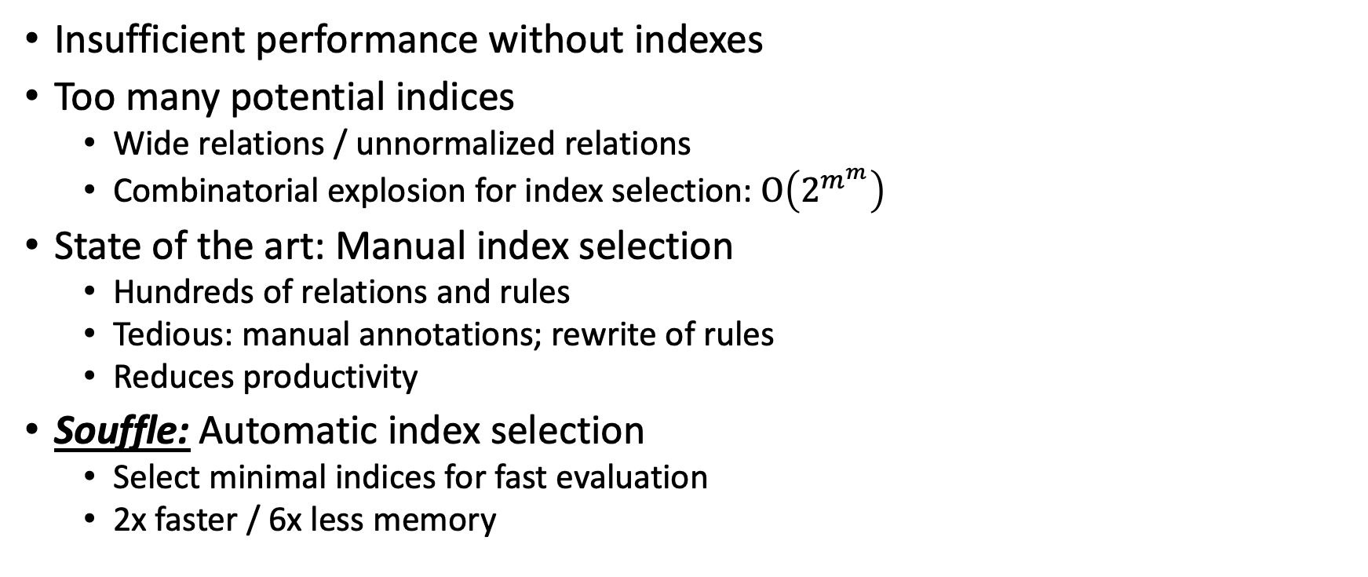
Index Selection (VLDB’18)

Slide 8
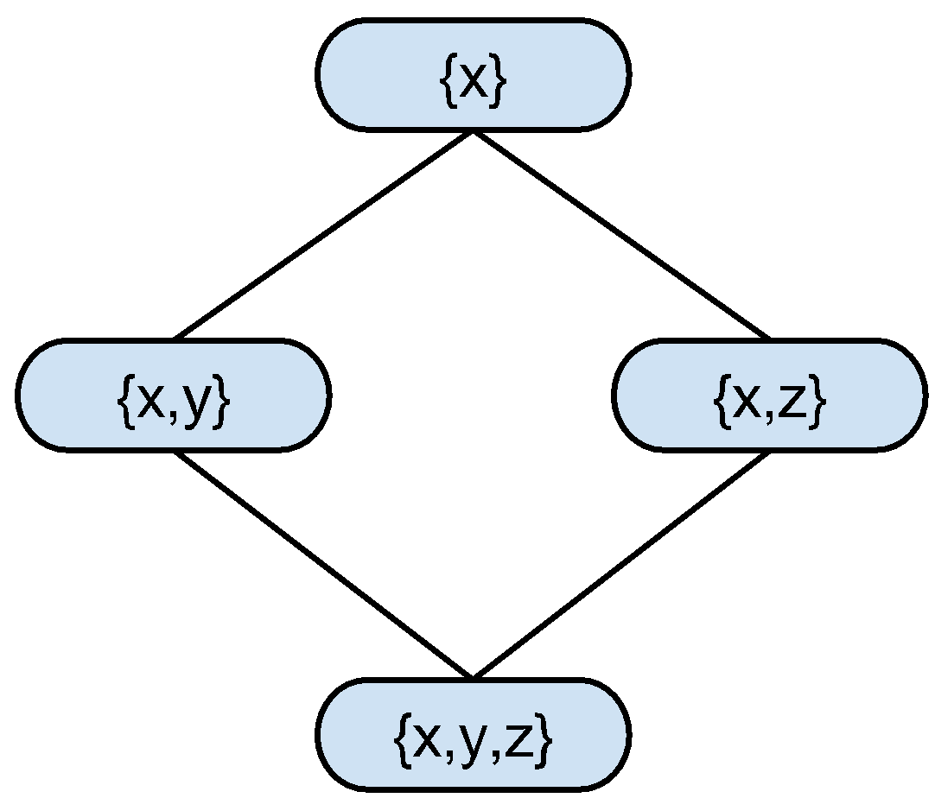
Index Cover
Rules composed of “primitive searches”
Rules are mostly conjunction of equality constraints; unconstrained otherwise
..,A(10,11,_),.. ⇔ select * from A where x=10 and y=11
Primitive search {x,y} of relation A(x,y,z)
Single index covers multiple primitive searches
Eg., lexorder index x<y<z on A(x,y,z) covers select * from A where x=x0 select * from A where x=x0 and y=y0 select * from A where x=x0 and y=y0 and z=z0
Primitive searches form a lattice on attributes
A chain in a lattice represents an index
Find minimal chain cover using Dilworth’s theorem
Chain 1: {x},{x,y}, {x,y,z}
⇒ Index: x<y<z
Chain 2: {x,z}
⇒ Index: x<z

Slide 9
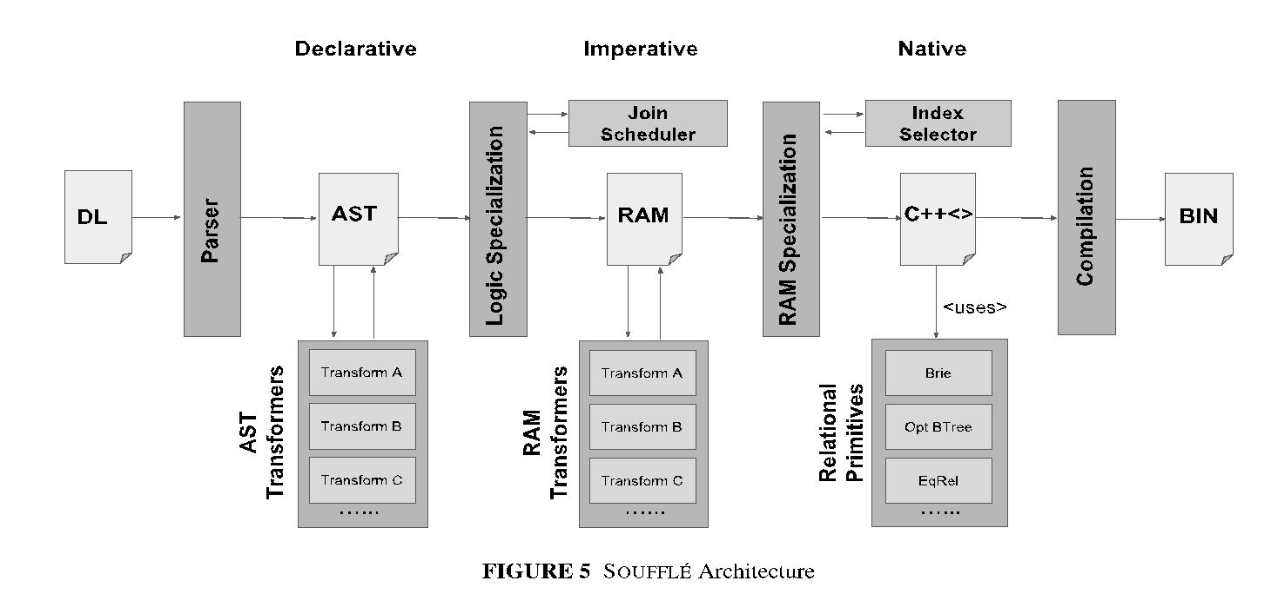

Algorithmics & Implementation
Primitive Searches
S₁
S₂
…..
S_{k}
MISP
MISP
MCCP
Max Matching
L₁
L₂
…..
L _{r}
Lexorder Indexes

Slide 10
Souffle’s Data-Structures
Portfolio of Data-Structures (CCPE’20)
Datalog Enabled Relation (DER) data-structures
Templated C++ data-structures
B-Trees (PPoPP’19)
Complexity of evaluating searches is bounded by the size of the output
Tree structures provide natural opportunities for parallelism
Effectively exploits caches available in modern computer architectures
Brie (PMAM’19)
Useful for dense and low-dimensional data
Equivalence Relation (PACT’19)
Symbolic rewrite-systems etc.
Others
Rtrees, infos, etc.

Slide 11
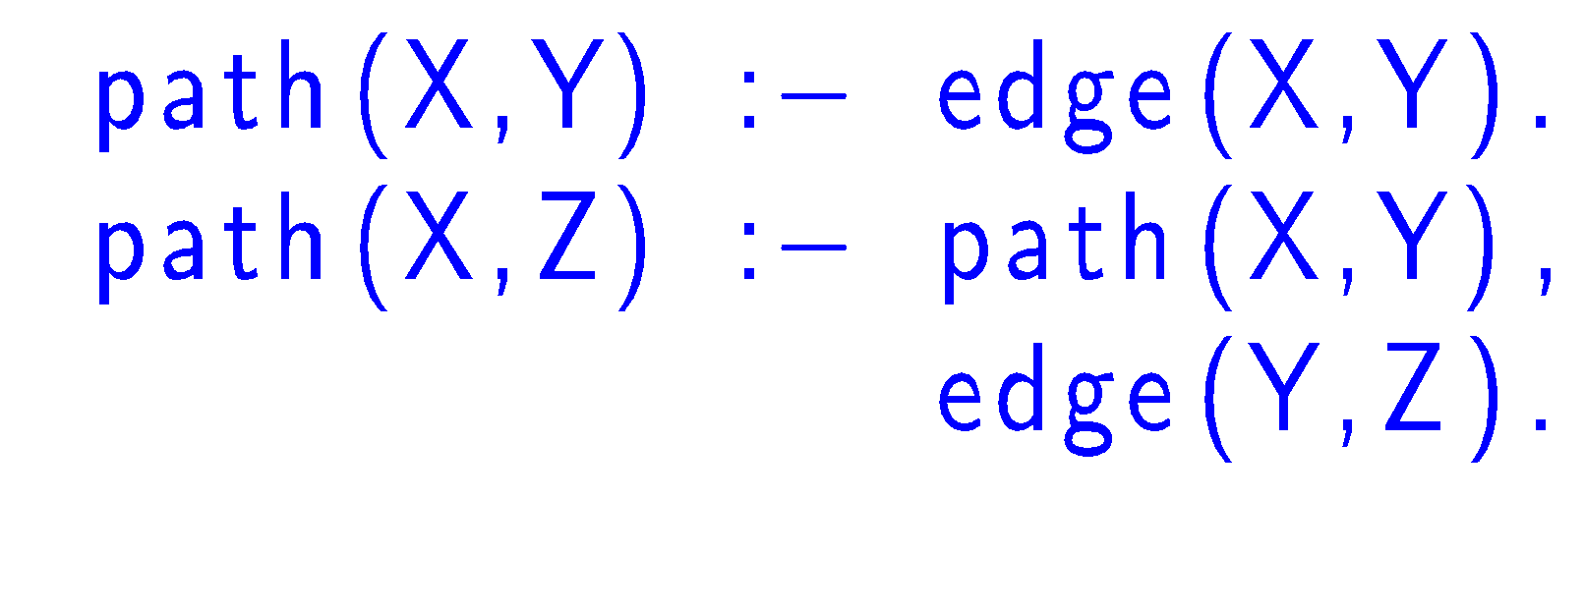
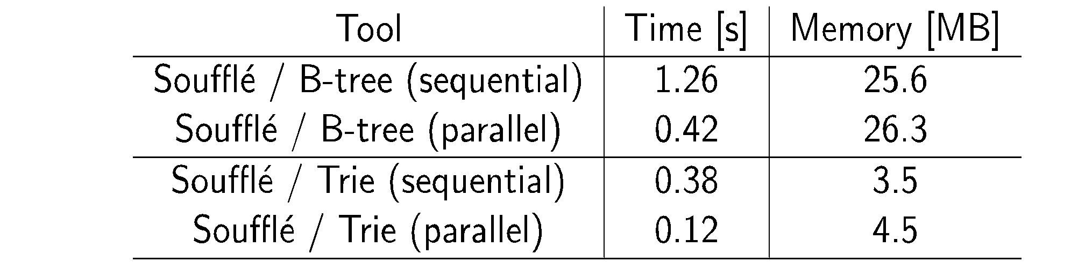
Soufflé's Performance
Example
Performance Numbers
Vs. Hand-crafted: 2s / 34MB

Slide 12

USE CASE A: Security In Open JDK7
Open JDK 7: 7M LOC, 1.4M variables, 350K heap objects, 160K methods, 590K invocations, 1G tuples
Security
Analysis X.dl
Points-to.dl
Soufflé –c
JDK X build Y
Analyzer X
Results

Slide 13

USE CASE B: AWS VPC Networks
~10-100K Instances in networks
Results
External Tool
Java Interface
Soufflé lib
Analysis + Data

Slide 14
Other USE CASES
Doop: Java points-to analysis
DDISASM: GrammaTech’s Binary Disassembler
Gigahorse, Vandal: Smart-Contract Analysis
Many more …

Slide 15
Souffle as a Language

Slide 16
Language
Datalog
Lack of a standard
Every implementation has its own language
Soufflé
Syntax inspired by bddbddb, muZ/z3, Logicblox, …
Soufflé Language
Turing-Equivalent
arithmetic functors, records, ADTs, aggregates, ...
Software engineering features for large-scale logic-oriented programming
Performance
Rule and relation management via components

Slide 17
Installation
Supported system
UNIX: Debian, FreeBSD, MAC OS X, Win10 subsystem, etc.
Releases are issued regularly
http://github.com/souffle-lang/souffle/releases
Current release V1.1
As a Debian Package
As a MAC OS X Package
From source code
http://github.com/souffle-lang/souffle/

Slide 18
Invocation of Soufflé
Invocation of soufflé: souffle <flags> <program>.dl
Evaluate input program <program>.dl
Set input fact directory with flag –F <dir>
Specifies the input directory for relations (default: current)
Set output directory with flag –D <dir>
Specifies the output directory for relations (default: current)
If <dir> is ”-”; output is written to stdout.
Synthesiser flag –c (default is interpreter)
Generate executable with synthesiser only –o <exe>

Slide 19
Transitive Closure Example
Type the following in file reachable.dl
.decl edge (n: symbol, m: symbol)
edge(“a”, “b”). /* facts of edge */ edge(“b”, “c”). edge(“c”, ”b”). edge(”c”, ”d”).
.decl reachable (n: symbol, m: symbol) .output reachable // output relation reachable
reachable(x, y):- edge(x, y). // base rule
reachable(x, z):- edge(x, y), reachable(y, z). // inductive rule
Evaluate: souffle -D- reachable.dl
Notes:
Run with flag –c / notice difference
Comments in Souffle

Slide 20
Same Generation Example
Given a tree, find who belongs to the same generation
.decl Parent(n: symbol, m: symbol)
Parent("d", "b"). Parent("e", "b"). Parent("f","c").
Parent("g", "c"). Parent("b", "a"). Parent("c","a").
.decl Person(n: symbol)
Person(x) :- Parent(x, _). Person(x) :- Parent(_, x).
.decl SameGeneration (n: symbol, m: symbol)
SameGeneration(x, x):- Person(x).
SameGeneration(x, y):- Parent(x,p), SameGeneration(p,q), Parent(y,q).
.output SameGeneration
a
b
c
d
e
f
g

Slide 21
Soufflé’s Input: Remarks & C-Preprocessor
Soufflé uses two types of comments (like in C++)
Example: // this is a remark /* this is a remark as well */
C preprocessor processes Soufflé’s input
Includes, macro definition, conditional blocks
Example: #include “myprog.dl” #define MYPLUS(a,b) (a+b)

Slide 22
Declarations of Relations
Relations must be declared before being used: .decl edge(a: symbol, b: symbol ) .decl reachable(a: symbol, b: symbol ) .output reachable edge(“a”, ”b”). edge(“b”, ”c”). edge(“b”, ”c”). edge(“c”, ”d”). reachable(a,b) :- edge(a,b). reachable(a,c) :- reachable(a,b), edge(b,c).
Type

Slide 23
I/O Directives
Input directive
Read from a tab-separated file <relation-name>.facts
Still may have rules/facts in the source code
Example: .input <relation-name>
Output directive
Facts are written to file <relation-name>.csv (or stdout)
Example: .output <relation-name>
Print size of a relation
Example: .printsize <relation-name>
Notes:
Note that relations that are not used for the computation of output relations are automatically removed.

Slide 24
Exercise: Relation Qualifier
.decl A (n: symbol ) .input A
.decl B (n: symbol)
B(n) :- A(n).
.decl C(n: symbol) .output C C(n) :- B(n).
.decl D(n: symbol) .printsize D D(n) :- C(n).
Read from file A.facts facts
Copy facts from A to B
Copy facts from B to C and output it to file C.csv
Copy facts from C to D and output the number of facts on stdout
Notes:
Create a file A.facts with a list of symbols

Slide 25
No Goals in Soufflé
Soufflé has no traditional Datalog goals
Goals are simulated by output directives
Advantage
several independent goals by one evaluation

Slide 26
More Info about I/O Directives
Relations can be loaded from/stored to
Arbitrary CSV files (change delimiters / columns / filenames / etc.)
Compressed text files
SQLITE3 databases
JSON Format
The features are controlled via a list of parameters
Example: .decl A(a:number, b:number) .output A(IO=sqlite, dbname="path/to/sqlite3db")
Documentation: http://souffle-lang.org/docs/io/

Slide 27
L2 - Rules & Type System
Bernhard Scholz
The University of Sydney

Slide 28
Remarks on Rules

Slide 29
Rules
Rules
Head is an atom
Body
Atoms
Constraints
Negation
Example
A(x,y) :- // Head B(x,y), // Atom
x != y, // Constraint
!C(x,y). // Negation

Slide 30
Negation / Constraints in Rules
Negation and constraints
Used variables must be grounded
Negation by stratification
.decl edge,path(x:number, y:number) edge(1,2). edge(2,3). edge(1,4). edge(4,3).
path(x,y) :- edge(x,y); edge(x,q), path(q,y), q!= 4, !edge(3,2). .output path
Inequality constraint
Negation

Slide 31
Grounded Variables
Binding of variables in body atoms necessary:
direct(x) :- edge(x,y), x!=y, !edge(y,x).
Bind variable values to tuple elements while iterating over relations
Not valid rule because x, y are not grounded:
// no positive atom
simple(x) :- x!=y, !edge(y,x).
// variable i not bound due to functor usage
fib(i,x1+x2) :- fib(i-1, x1), fib(i-2, x2).
// but fib(i+1,x1+x2) :- fib(i, x1), fib(i-1, x2). works!
Grounded Variables

Slide 32
Exceptions for Ungrounded Variables
Equivalence constraints propagate values
A(a, b) :- B(a, b), y = a, y != b.
It still works because of rule rewriting to,
A(a, b) :- B(a, b), a != b.
Future plan
Extend rewrite system for ungrounded rules
Example:
A(a, b) :- B(a+1, b). can be rewritten to A(a-1, b) :- B(a, b).
Ungrounded Variables

Slide 33
Unnamed Variables
Rules may have (named) unnamed variables.
Start with underscore
.decl edge(x:number, y:number) edge(1,2). edge(2,3).
.decl sources(x:number) sources(x) :- edge(x,_).
.decl targets(x:number)
Targets(x) :- edge(_source,x)
.output sources, targets
Unnamed Variable
Named unnamed Variable

Slide 34
Rules with Multiple-Heads
Rules with multiple heads permitted
Syntactic sugar to minimize coding effort
Single declaration for multiple relations
Example:
B(x), C(x) :- A(x). .output B,C
.decl B(x:number) B(x) :- A(x). .decl C(x:number) C(x) :- A(x). .output B,C
Equivalent

Slide 35
Disjunctions in Rule Bodies
Disjunction in bodies permitted
Syntactic sugar to shorten code
Example:
.decl edge,path(x:number, y:number) edge(1,2). edge(2,3). path(x,y) :- edge(x,y); edge(x,q), path(q,y). .output path
.decl edge(x:number, y:number) edge(1,2). edge(2,3).
.decl path(x:number, y:number) path(x,y) :- edge(x,y).
path(x,y) :- edge(x,q), path(q,y). .output path
Equivalent

Slide 36
Primitive Types

Slide 37
Type System
Soufflé's type system is static
Defines the domains of attributes
Types are enforced at compile-time
Supports programmers to use relations correctly
No dynamic checks at runtime
Evaluation speed is paramount
Primitive Type Sizes
Default size: 32 bit
Configurable at build-time to 64bit ( --enable-64bit-domain )

Slide 38
Primitive Types
Primitive types
Symbol type: symbol
Number type: number
Unsigned type: unsigned
Float type: float
Symbol type
Universe of all strings
Internally represented by an ordinal number
E.g., ord(“hello”) represents the ordinal number
Symbol table used to translate between symbols and number id
Number / Unsigned type
Simple signed/unsigned numbers
Float Type
IEEE-754 floating point number

Slide 39
Example: Primitive Types
.decl Name(n: symbol )
Name(“Hans”).
Name(“Gretl”).
.decl Translate(n: symbol , o: number )
Translate(x,ord(x)) :- Name(x). .output Translate
Functor ord(x) converts a symbol to its ordinal number
Primitive Types

Slide 40
Primitive Type Conversions
Polymorphic functors for simple conversions
Conversion across all primitive type pair
Functor class: to_type (arg) where type is either symbol, number, unsigned, float.
Example
.decl R(a:number, b:unsigned, c:symbol, d:float)
R(to_number(“-1”), to_unsigned(“1”), to_string(1), to_float(“1.3”)) :- true. .output R

Slide 41
Arithmetic Expression
Arithmetic functors are permitted
Extension of pure Datalog semantics
Termination might become a problem
Example: .decl A(n: number) .output A A(1). A(x+1) :- A(x), x < 9.
Notes:
No symbolic functors like Prolog!
Try to omit the constraint x < 9 => endless loop

Slide 42
Fibonacci Number
Create the first 10 numbers of series of Fibonacci Numbers
First two numbers are 1
Every number after the first two elements is defined by the sum of the two preceding elements:
.decl Fib(i:number, a:number) .output Fib Fib(1, 1). Fib(2, 1). Fib(i + 1, a + b) :- Fib(i, a), Fib(i-1, b), i < 10.

Slide 43
Arithmetic Functors and Constraints
Arithmetic Functors
Addition: x + y
Subtraction: x - y
Division: x / y
Multiplication: x * y
Modulo: a % b
Power: a ^ b
Counter: $
Min/Max: min(a₁,…,a_{k}) and max(a₁,…,a_{k})
Bit-Operations:
x band y, x bor y, x bxor y, x bshl y, x bshr y, x bshru y, and bnot x
Logical-Operations
x land y, x lor y, x lxor y, and lnot x
Arithmetic Constraints
Less than: a < b
Less than or equal to: a <= b
Equal to: a = b
Not equal to: a != b
Greater than or equal to: a >= b
Greater than: a > b

Slide 44
Numbers in Soufflé
Numbers in decimal, binary, and hexadecimal system
Example: .decl A(x:number) A(4711). A(0b101). A(0xaffe).
Decimal, hexadecimal, and binary numbers in the source code
Restriction: in fact-files decimal numbers only!

Slide 45
Logical Operation: Number Encoding
Numbers as logical values like in C
0 represents false
<>0 represents true
Used on for logical operations
x land y, x lor y, x lxor y, and lnot x
Example: .decl A(x:number) .output A A(0 lor 1).
Bitwise logical operations available as well:
x band y, x bor y, x bxor y, x bshl y, x bshr y, x bshru y, and bnot x
Notes:
Proposal to have a new Boolean type for attributes

Slide 46
String Functors and Constraints
String Functors
Concatenation: cat(x,y)
String Length: strlen(x)
Sub-string: substr (x,idx,len) where idx is the start position counting from 0 and len is the length of the sub-string of x.
Retrieve Ordinal number: ord(x)
Conversions: to_string(x)
String Constraints
Substring check: contains(sub, str)
Matching: match(regexpr, str)

Slide 47
Example: String Functors & Constraints
.decl S(s: symbol) S(“hello”). S(“world”). S(“souffle”).
.decl A(s: symbol) A(cat(x, cat(“ “, y))) :- S(x), S(y). // stitch two symbols together w. blank
.decl B(s:symbol)
B(x) :- A(x), contains(“hello”, x).
.decl C(s:symbol) C(x) :- A(x), match (“world.*”, x). .output A, B, C // output directive

Slide 48
Base & Union Types
Primitive types
Large projects require a rich type system
Several hundred relations & rules (e.g., DOOP)
How to ensure that programmers don’t bind wrong attribute types?
Partition primitive type universe via base types
Form union-types over base types

Slide 49
Base Type
Base types are defined by .type name <: primitive-type
Example: .type City <: symbol .type Town <: symbol .type Village <: symbol
Defining (assumingly) distinct/different sets in a symbol universe
City
Town
Village
Symbol Universe

Slide 50
Union Type
Union type is a compositional type
Unifies a fixed number of base/union types
Syntax .type <ident> = <ident₁> | <ident₂> | … | <ident_{k}>
Example .type Place = City | Town | Village
Place
City
Town
Village
Symbol Universe

Slide 51
Example
.type City <: symbol .type Town <: symbol .type Village <: symbol .type Place = City | Town | Village
.decl Data(c:City, t:Town, v:Village)
Data(“Sydney”, ”Ballina”, “Glenrowan”). .decl Location(p:Place) Location(p) :- Data(p,_,_); Data(_,p,_); Data(_,_,p).
Set Location receives values from cells of type City, Town, and Village.
Note that ; denotes a disjunction (i.e., or)

Slide 52
Limitations of a Static Type System
Disjoint set property not enforced at runtime
Example: .type City <: symbol .type Town <: symbol .type Village <: symbol .type Place = City | Town | Village .decl Data(c:City, t:Town, v:Village)
Data(“Sydney”, ”Sydney”, “Sydney”).
Element “Sydney” is member of type City, Town, and Village.

Slide 53
Base/Union Types for Numbers
Base type is defined by .type name <: number
Example: .type Even <: number .type Odd <: number .type All = Even | Odd
All
Odd
Even
Number Universe

Slide 54
Example: Base / Union Types for Numbers
.type Even <: number .type Odd <: number
.type Zero <: number .type All = Even | Odd
.type AllWithZero = All | Zero
.decl myEven(e:Even) myEven(2).
.decl myOdd(o:Odd) myOdd(1). .decl myAll(a:AllWithZero) .output myAll myAll(x) :- myOdd(x); myEven(x).
Notes:
Try to change type for myAll to Even.
Change type of a in relation myAll from All to Even

Slide 55
Type Conversion
Souffle supports type conversion using functor as(expr, type)
.type Variable <: symbol
.type StackIndex <: symbol
.type VariableOrStackIndex = Variable | StackIndex
.decl A(a: VariableOrStackIndex)
A(“var”).
.decl B(a: Variable)
B(as(a, Variable)) :- A(a).

Slide 56
Limitations of Union Type
Base types defined with different primitive types cannot be mixed
Example gives a type clash error:
.type myNumber <: number .type mySymbol <: symbol .type All = myNumber | mySymbol
If mixed types are really needed, use Abstract Data Types/Records!

Slide 57
Records
Relations are two dimensional structures in Datalog
Large-scale problems may require more complex structure
Related to terms in Prolog (but typed!)
Records break out of the flat world of Datalog
At the price of performance (i.e., extra table lookup)
Record semantics similar to Pascal/C
No polymorph types (cf. Abstract Data Type)
Record Type definition .type name = [ name₁ : type₁, …, name_{k}: type_{k}]

Slide 58
Example: Records
// Pair of numbers
.type Pair = [a:number, b:number]
.decl A(p: Pair) // Declare a set of pairs A([1,2]). A([3,4]). A([4,5]).
// Flatten relation A
.decl Flatten(a:number, b:number)
Flatten(a,b) :- A([a,b]).

Slide 59
Records: How does it work?
Each record type has a hidden type relation
Translates the elements of a record to a number
While evaluating, if a record does not exist, it is created on the fly.
Example:
.type Pair = [a: number, b: number] .decl A(p: Pair)
A([1,2]). A([3,4]). A([4,5]).
A
Pair
p
1
2
3
Ref | a | b
1 | 1 | 2
2 | 3 | 4
3 | 4 | 5
References

Slide 60
Recursive Records
Recursively defined records permitted
Termination of recursion via nil record
Example
.type IntList = [next: IntList, x: number] .decl L(l: IntList)
L([nil,10]). L([r1,x+10]) :- L(r1), r1=[r2,x], x < 30. .decl Flatten(x: number) Flatten(x) :- L([_,x]). .output Flatten
L
IntList
l
1
2
3
Ref | next | x
1 | 0 | 10
2 | 1 | 20
3 | 2 | 30
nil
References

Slide 61
Recursive Records
Semantics is tricky
Relations/sets of recursive elements (i.e., set of references)
Monotonically grow
Structural equivalence by identity
New records are created on-the-fly
seamless for the programmer
Closer to a functional programming semantics

Slide 62
Abstract Data Types (ADT)
Introduces polymorphism for records
Similarities to unions/variants in languages such as C and Pascal
Slower than records due to branches
Applications
Complex data-structures, symbolic rewriting, etc.
ADT Type declaration .type name = bname₁ { name₁₁ : type₁₁, …, name_{1k1}: type_{1k1}} |
bname₂ { name₂₁ : type₂₁, …, name_{2k2}: type_{2k2}} | …
branches bname_{i} form own records
Access a branch via $bname(…) in rules

Slide 63
Example: ADT
// Either a number or a symbol
.type T = N {a:number} |
S {b:symbol}
.decl A(p: T) // set of numbers or symbols A($N(1)). A($S(“hello world”)).
// Flatten relation A
.decl Flatten(a:number, b:symbol)
Flatten(a, ””) :- A($N(a)).
Flatten(0, b) :- A($S(b)).

Slide 64
L3 – Aggregates & Components
Bernhard Scholz
The University of Sydney

Slide 65
Aggregates

Slide 66
Aggregation
Summarizes information of queries
Aggregates on stable relations only (cf. negation in Datalog)
Restrictions on complexity of aggregates
Stratified aggregates
Semantics: aggregation is a functor with a sub-clause
Various types of aggregates:
Counting
Minimum
Maximum
Sum

Slide 67
Aggregation: Counting
Count the set size of its sub-goal
Functor Syntax: count:{<sub-goal>}
No information flow from the sub-goal to the outer scope
Example: .decl Car(name: symbol, colour:symbol) Car(“Audi”, ”blue”). Car(“VW”, “red”). Car(“BMW”, “blue”). .decl BlueCarCount(x: number) BlueCarCount(c) :- c = count:{Car(_,”blue”)}. .output BlueCarCount

Slide 68
Aggregation: Maximum
Find the maximum of a set
No information flow from the sub-goal to the outer scope, i.e., no witness
Syntax: max <expr>:{<sub-goal>}
Example: .decl A(n:number) A(1). A(10). A(100). .decl MaxA(x: number) MaxA(y) :- y = max x+1:{A(x)}. .output MaxA

Slide 69
Aggregation: Minimum & Sum
Find the minimum/sum of a sub-goal
No information flow from the sub-goal to the outer scope
no witness
Min syntax: min <expr>:{<sub-goal>}
Sum syntax: sum <expr>:{<sub-goal>}

Slide 70
Aggregation: Witnesses not permitted!
Witness: tuples that produces the minimum/maximum of a sub-goal
Example: .decl A(n:number, w:symbol) A(1, ”a”). A(10, ”b”). A(100, ”c”). .decl MaxA(x: number,w:symbol) MaxA(y, w) :- y = max x:{A(x, w)}. <= not permitted!!
Witness is bound in the max sub-goal and used in the outer scope
Future Plan: working on transformation that reveal witnesses.
Simple transformation: MaxA(y, w) :- y = max x:{A(x, _)}, A(y,w).

Slide 71
Aggregate Transformations
Souffle transformation pipeline transforms complex aggregates to simple one.
A simple aggregate is an aggregate with at most one single relation and an arbitrary constraint:
X=count : {A(x),B(x), C(x)} ⬄ X = count : {T(x)} where T(x) :- A(x), B(x), C(x).
Advantages of Simple Aggregates
Memoisation idea
Indexes for min/max aggregates
Partial sums for sums
Parallel reductions

Slide 72
Components

Slide 73
Components in Soufflé
Logic programs have no structure
Amorphous mass of rules & relation declarations
Creates serious software engineering challenges
Encapsulation: separation of concerns
Replication of code fragments
Adaption of code fragments, etc.
Solution: Soufflé's Component Model
Meta semantics for Datalog
Generator for Datalog code; dissolved at evaluation time
Similar ideas as C++ templates

Slide 74
Anatomy of Components
Support multiple inheritance
Component namespace
Component parameters
Component may contain
Component definition
Component instantiation (no recursion!)
Type declarations
Relation declarations
Rules
Directives
Override mechanism for inheritance
Suppression of rules
A
B
C

Slide 75
Component Declaration
Definition
Defines a new component either from scratch or by inheritance
Permitted: component definitions inside component definitions
Syntax: .comp <name> [< params,… >] [: <super-name>₁[< params,… >], …, <super-name>_{k} [< params,… >]] { <code> }
Example
.comp A {
.decl R(x:number)
}

Slide 76
Component Instantiation
Instantiation
Each instantiation has its own name for creating a name space
Type and relation definitions inside component inherit the name space
Syntax: .init <name> = <name>[< params,… >]
Example
.init myA = A

Slide 77
Component & Instantiation & Name Scoping
.comp myComp {
.decl A(x:number) .output A
A(1).
A(2). }
.init c1 = myComp
.init c2 = myComp
.decl c1.A(x:number) .output c1.A
c1.A(1).
c1.A(2).
.decl c2.A(x:number) output
.output c2.A c2.A(1).
c2.A(2).
Expansion
after
instantiation
Instantiation creates own name space for relation declarations and types

Slide 78
Component Parameters
Substitution scheme for types and other component parameters
Example:
.comp A<mytype> {
.decl R(x:mytype)
.output R
}
.init myA = A<number>
myA.R(1)
Type can be changed at instantiation: .init myB = A<unsigned>
.decl myA.R(x:number) .output myA.R
myA.R(1).
Expansion
after
instantiation

Slide 79
Cased-based instantiation
Example
.decl A(x:number) .output A
.comp case<option> {
.comp one {
A(1). }
.comp two { A(2).
} .init c1 = option
}
.init c2 = case<one>
Component one and two reside in component case with parameter option
Depending on value of option
Component one or two expanded
Conditional expansion of macros
Parametrization of components
Notes:
Change parameter one to two? What will happen

Slide 80
Example: Component Inheritance
.type s <: symbol
.decl A(x:s, y:s) .input A
.comp myC {
.decl B(x:s, y:s) .output B
B(x,y) :- A(x,y). }
.comp myCC: myC { B(x,z) :- A(x,y), B(y,z).
}
.init c = myCC
// outer scope: no name space
.decl A(x:s, y:s) .input A
// name scoping
// B is declared inside myC/myCC
.decl c.B(x:s, y:s) .output c.B
c.B(x,y) :- A(x,y). c.B(x,z) :- A(x,y), c.B(y,z).
Expansion
After
Instantiation
Component myCC inherits from component myC

Slide 81
Design Patterns with Inheritance/Parameters
.comp Impl {
.decl R(x: number)
R(0). R(1). R(2).
}
.comp A<T> {
.init impl = T
.decl Base(x: number)
Base(x) :- impl.R(x).
}
.comp Derived<K> : A<T> {
.decl Deriv(x:number)
Deriv(42).
Deriv(n) :- Base(n).
}
.init d = Derived<Impl>
.init a = A<Impl>
.decl DerivedOut(x: number)
.output DerivedOut()
.decl AOut(x: number)
.output AOut()
DerivedOut(x) :- d.Deriv(x).
AOut(x) :- a.Base(x).

Slide 82
Overriding Rules of Super Components
Example:
.comp myC {
.decl A(x:number) overrideable
.output A A(1). A(x+1):-A(x), x < 5. }
.comp myCC: myC { .override A
A(5). A(x+1):-A(x), x < 10.
}
.init c = myCC
Instantiation result: .decl c.A(x:number) output c.A(5). c.A(x+1):-c.A(x), x < 10.
Rules/facts of the derived component overrides the rules of the super component
Relation must be defined with qualifier overrideable in super component
Component that overwrites rules requires: .override <rel-name>

Slide 83
Summary: Components
Encapsulation of specifications
Name spaces provided for types/relations
Instantiation produces a scoping name of a component
Repeating code fragments
Write once / instantiated multiple times
Components
Inheritance of several super-components, i.e., multiple inheritance
Hierarchies of functionalities
Parameters
Adapt components / specialize

Slide 84
L4 – Provenance & Performance & Interfaces
Bernhard Scholz
The University of Sydney

Slide 85
Provenance

Slide 86
Provenance
Mechanism to debug Datalog programs
Enable provenance
souffle <program> -t none|explain|explore
Light—weight implementation with very little runtime overhead
20-30% for larger benchmarks
Generate proof-trees interactively
Describe how a tuple is derived
Root is the tuple itself
Command-Line interface after evaluation

Slide 87
Example

Slide 88
Constructing Proof-Trees

Slide 89
Command-Line Interface
Run with ./souffle <program> -t explain

Slide 90
Explain Negation
Interactively explore why a tuple cannot exist

Slide 91
Command-line Interface
Modes
none: no command-line interface
explain: simple console interface
explore: ncurses interface for displaying larger proofs
Commands
explain <tuple> explain tuple
subproof <sub-proof> expand sub-proof
explainnegation <tuple> explain non-existence of a tuple
setdepth <nr> sets proof-depth of sub-proof
query <query> display query result
output <file> write output into a file
format <json|proof> change format

Slide 92
Profiling

Slide 93
Soufflé's Performance
How to gain faster Datalog programs?
Compile to achieve peak performance
Scheduling of queries
User annotations or automated
Find faster queries
Find faster data models
Profiling is paramount
Textual and graphical user interface for profiling programs
Practical observation
Only a handful of rules will dominate the execution time of a program

Slide 94
Performance: Souffle’s Compilation Flags
Compile and execute immediately
Option –c
Example: souffle –c test.dl
Generate stand-alone executable
Option –o <executable>
Example: souffle –o test test.dl

Slide 95
Performance Tuning
Soufflé computes optimal data-representations for relations
For high-performance:
Programmer re-orders the atoms in the body of a rule
Provide your own query schedule
Syntax: <rule>. .plan { <#version> : (idx₁, …, idx_{k}) }

Slide 96
Performance Example
.decl Edge(x:number, y:number) Edge(1,2).
Edge(500,1).
Edge(i+1,i+2) :- Edge(i,i+1), i < 499.
.decl Path(x:number, y:number) .printsize Path
Path(x,y) :- Edge(x,y).
// Path(x,z) :- Path(x,y), Path(y,z). .plan 0:(0,1), 1:(1,0)
// Path(x,z) :- Path(x,y), Edge(y,z). .strict
// Path(x,z) :- Edge(x,y), Path(y,z). .strict

Slide 97
Profiling
Profiling flag for Soufflé: -p <profile>
Produces a profile log after execution
Use souffle-profile to provide profile information souffle-profile <profile>
Simple text-interface and HTML output with JavaScript
Commands
Help: help
Rule: rul [<id>]
Relations: rel [<id>]
Graph plots for fixed-point: graph <id> <type>

Slide 98
Profiling (cont’d)
Option –j produces HTML file; Graphical Representation of Performance

Slide 99
User-Defined Functors

Slide 100
User-Defined Functors
Soufflé is extensible with user-defined functors
Build own domain-specific extension for Souffle
Must be pure functions (same result for same arguments)
UDFs are typed and required a declaration
Shared library contains UDFs which is loaded by Souffle at runtime
Command-line option: -l <library-name> -L <library-path>
Declaration
.functor <name> (<primitive-type>,…):<primitive-type>

Slide 101
User Defined Functors
Example
.functor f(number):number
.functor g():symbol
C++ code #include <cstdint> extern "C" { int32_t f(int32_t x) { return x + 1; } const char *g() { return "Hello world"; } }
Note that stateful expose symbol and record table.

Slide 102
C++ Interface

Slide 103
C++ Interface / Integration into other Tools
Souffle produces a C++ class from a Datalog program
C++ class is a program on its own right
Can be integrated in own projects seamlessly
Interfaces for
Populating EDB relations
Running the evaluation
Querying the output tables
Use of iterators for accessing tuples
Examples: souffle/tests/interfaces/ of repo

Slide 104
Example: C++ Interface
Example
…
if(SouffleProgram *prog=ProgramFactory::newInstance(”mytest")) {
prog->loadAll(”fact-dir”); // or insert via iterator
prog->run();
prog->printAll(); // or print via iterator
delete prog;
}
…

Slide 105
C++ Interface: Input Relations
Insert method for populating data if(Relation *rel = prog->getRelation(”myRel")) {
for(auto input : myData) {
tuple t(rel);
t << input[0] << input[1];
rel->insert(t);
}
}

Slide 106
C++ Interface: Output Relations
Access output relation via iterator
if(Relation *rel = prog->getRelation(”myOutRel")) {
for(auto &output : *rel ) {
output >> cell1 >> cell2;
std::cout << cell1 << "-" << cell2 << "\n";
}
}

Slide 107
SWIG

Slide 108
SWIG Interface
SWIG connects with a variety of high-level programming
SWIG for Souffle builds on the C++ interface
Configure SWIG
./configure --enable-swig
Generates DLLs for SWIG supported languages
./souffle -s <language> <.dl file>
Imitates C++ interface in target language
Target languages
Python, Java, etc.

Slide 109
Other features

Slide 110
Miscellaneous
Inlining
Relations can be inlined with the keyword .inline .decl A(x:number) inline
Restrictions apply
Magic-Set Transformation at relation level
.pragma "magic-transform" "A₁, ..., A_{n}"
Choice Operator
Relation-based choice using keyword .choice-domain keys, …
Generative Functors A(x) :- x = range(1,5,1).
Portfolio of relation representations
Btree (direct/indirect), brie, equivalence, …

