Slide 1


Commercial-Grade Static Analyzers in Datalog
Bernhard Scholz
The University of Sydney Fantom Research

Slide 2
Static Program Analysis Tools
Many applications for static program analysis
Bug finding, compiler optimisation, decompiler, testing, …
Fully functional analysis for real languages is expensive!
State-of-the-art industrial tools
Developed in non-declarative languages like C++
Testing
Fine-Tuning: scalability vs. precision vs. developing effort
Need to develop static analysers rapidly
Deep design space explorations
Fast analysis essential for real-world programs with MLOCs
Notes:
Mention 1 1/2y person years; how much time it takes with existing tools etc.; numbers!

Slide 3
History of Datalog
Variant of Prolog emerged from deductive databases (late 70s)
No back-tracking for evaluation / fast
Datalog has restricted Horn-Clauses
Declarative programming for recursive relations
Simple and clean syntax/semantics
Bottom-up solvers
Set Lattice
Fix-Point semantics for query calculation
Semi-Naïve Evaluation (Bancilhon & Ramakrishnan’86)
Transitive Closure:
P(X,Y):-E(X,Y). P(X,Z):-E(X,Y),P(Y,Z).

Slide 4
Connection beween Static Analysis & Datalog
Abstract Interpretation
Datalog Evaluation
⍺
Initial State
Approx. Initial State
EDB
Transfer
Function
Approximation
Rules
Fix Point
Approx. Fix Point
Ɣ
IDB
Concrete Domain
Abstract Domain
Tuple Set-Lattice

Slide 5
Datalog as DSL for Static Program Analysis
Extractor
Syntactic translation to logical relations
Datalog Engine
Extensional Database
Input relations
Rules
Program analysis specification
Language semantics
Intensional Database
Analysis results
Early examples in literature
Ullman/Engler/Reps/…
Input Program
Extractor
Input Relations
Program
Analysis
Datalog
Engine
Result

Slide 6
Security Analysis in Datalog
Vulnerable statement must be protected in the code
Safe and Unsafe regions in the CFG as gen/kill DFA problem
Source:
CFG:
Datalog Program:
s
Unsafe(”s”).
Unsafe(y) :- Unsafe(x), Edge(x, y), !Protect(y).
Violation(x) :- Vulnerable(x),
Unsafe(x).
l1
l2
l3
Notes:
Mention that in C++ several pages of code required to implement this by hand.

Slide 7
Why hasn’t Datalog been used for Commercial-Grade Analyzers over decades?
Standard Datalog implementations are too slow
Mainly disk-based / no large memory in early days
Data-centric view / no rule specialization
Complexity of analyzers
Plain Datalog is not expressive enough in practical setups
Finite constant assumption
No functors
No typing of rules
Deletion of tuples

Slide 8

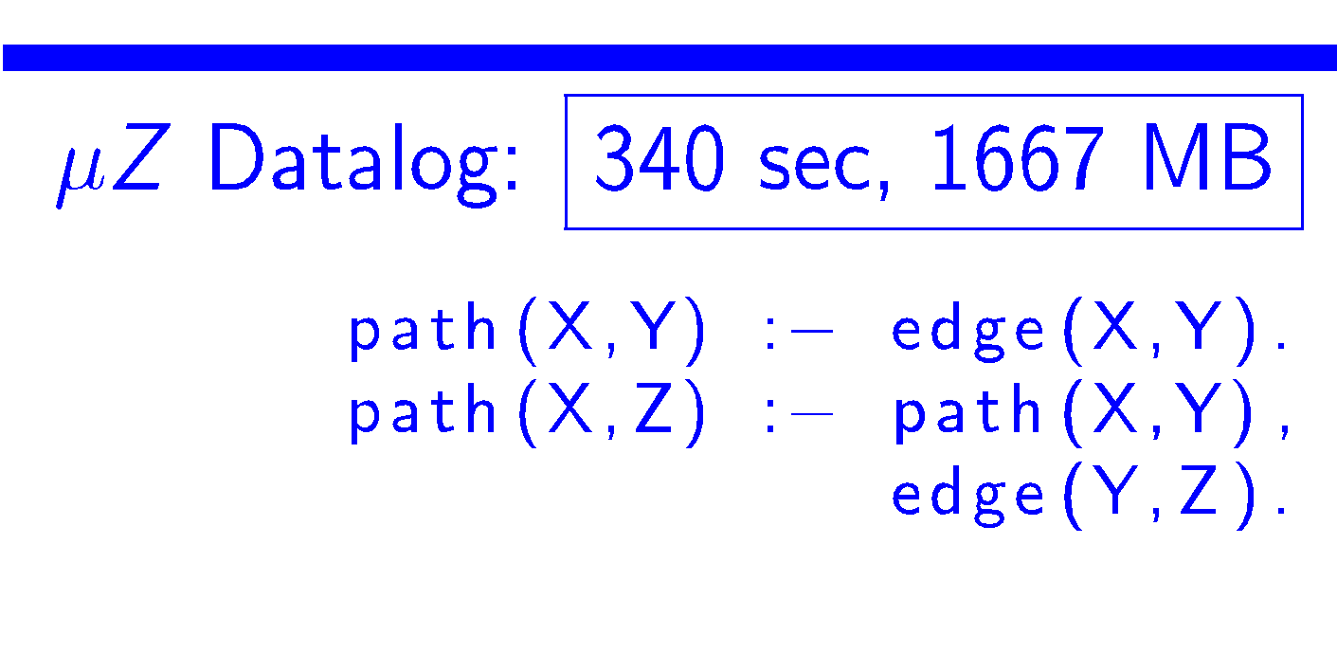
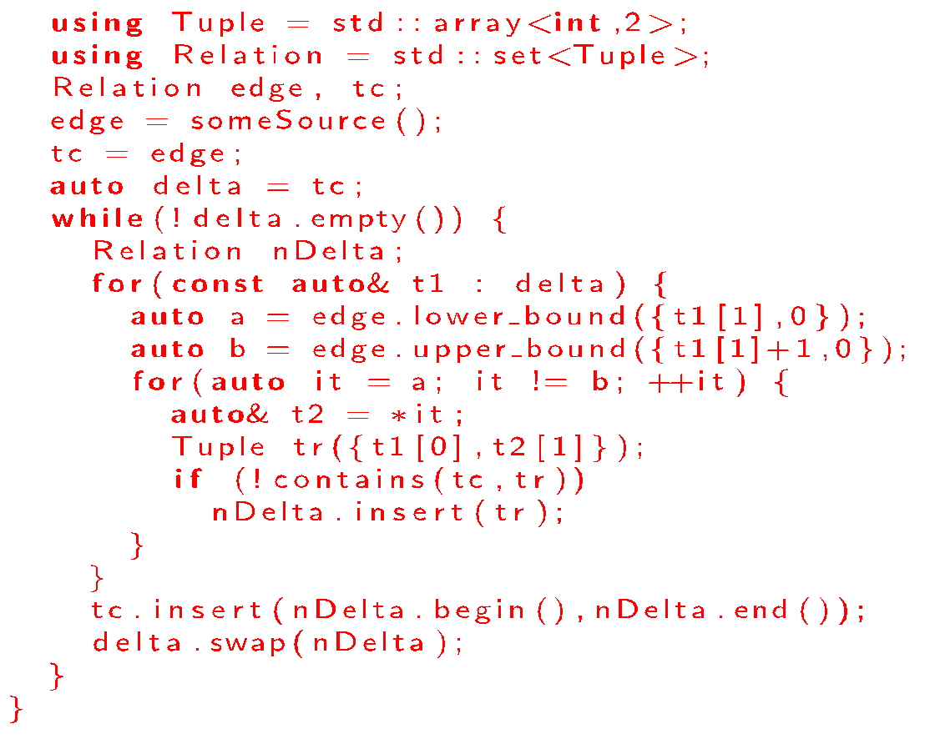
Hand crafted vs Datalog
Why the gap?
General evaluation algorithms
Bad data-structures
No index management
What can we do?

Slide 9
: A Datalog System
Datalog as DSL for static analyzer
8 years of research and industrial effort!!
New Language and Language Implementation
similar performance as hand-written C++ code
Assumptions
Rules do not change in static program analysis tools
Facts ( = input program representation) may change
Executed on large multi-core shared-memory machines
In-memory / highly parallelized data-structures

Slide 10
Design Philosophy
Process of Language Extensions & Implementation
Language Feature to improve SW-Engineering
Implementation: Faster Execution & Tooling (Profiler, Debugger, …)
Application
Implementation
Requirement

Slide 11
Language Features

Slide 12
: Souffle Language
Language
Syntax inspired by bddbddb, muZ/z3, Logicblox, …
Strongly Typed
Union/Base types
Records
Algebraic Data Types
Extensions
Components for structuring large Datalog programs
Arithmetic functors
Aggregates, ...
User-Defined Functors

Slide 13
Breaking Termination with Functors
Introduction of arithmetic functors
Constants 2 to 10 are introduced by functor i+1
Functor Requirement for Static Analysis
Example: introducing new contexts for points-to
.decl A(x: number)
A(1).
A(i+1) :- A(i), i < 10.
Notes:
Redo for context and points-to

Slide 14
Constructors as Records
Introducing complex data types in Datalog
First use case: contexts for points-to
Record semantics similar to Pascal/C
Record Type definition: .type name = [ name₁ : type₁, …, name_{k}: type_{k}]

Slide 15
Records: How does it work?
Each record type has a hidden lookup table
Translates record to a number
If not found, construct a new Pair with a new number
Example:
.type Pair = [a: number, b: number] .decl A(p: Pair)
A([1,2]). A([3,4]). A([4,5]).
A
Pair
p
1
2
3
Ref | a | b
1 | 1 | 2
2 | 3 | 4
3 | 4 | 5
References

Slide 16
Recursive Record Constructors
Lists can be formed via termination with nil record
Useful for unbounded contexts in points-to
.type List = [next: List, x: number]
^{.decl L(l: List)}
^{L([nil, 10]).} ^{L([r1, x+10]) :-} ^{L(r1), r1=[_r2, x], x < 30.}
L
List
l
1
2
3
Ref | next | x
1 | 0 | 10
2 | 1 | 20
3 | 2 | 30
nil
References

Slide 17
Symbolic Rewriting w. Algebraic Data Types
Extensions of records are Algebraic Data Types
Implementation of SMT solver for static analysis
.type Term = Zero {} | Succ{ x: Term} | Add {x:Term, y:Term} ^{.decl E(x:Term, y:Term) eqrel}
^{// a + 0 => a}
E(p, a) :- p = $Add(a, $Zero()), E(p,p).
^{// a + succ(b) => succ(a + b)}
E(p, $Succ($Add(a,b))) :- p = $Add(a, $Succ(b)), E(p,p).

Slide 18
Deletion via Subsumption
Interval domains frequently used in static analyzers
If not normalized, too expensive
Subsumption permits deletion of tuples
.decl R(lb:number, ub:number)
R(1,10).
R(2,5). // subsumed interval
// Subsume interval
R(lb1,ub1) <= R(lb2, ub2) :- lb2 <= lb1, ub1 <= ub2.

Slide 19
Open Question in Language Design
Symbolic Computations in Datalog
Term Rewriting (e.g., EGG)
Recursive Aggregation (for Data Analytics)
Higher-Order logic programming aspects
How to enrich the language without losing performance?
Example: Reflection
Composable logic languages
Develop a new calculus with Software-Engineering in mind (libraries?)

Slide 20
Implementation of Souffle

Slide 21
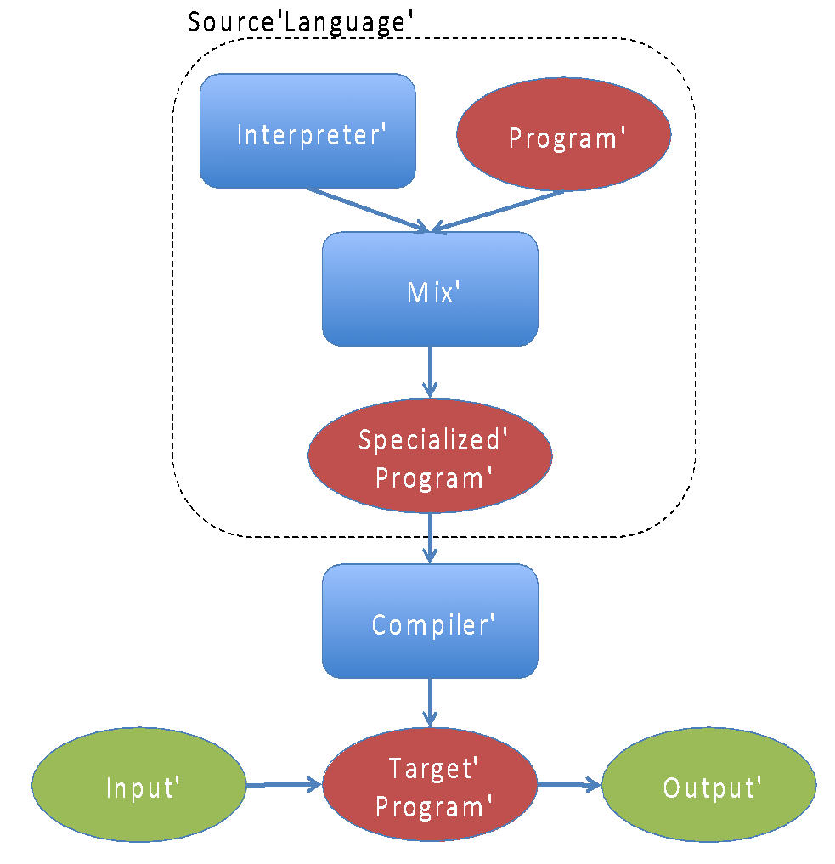
Futamura Projections
Specialization
Specialization Hierarchy
Datalog Specialization
RAM Specialization
C++ Specialization

Slide 22
How does Soufflé work?
Inputs
Facts
Modes of Evaluation
Interpreter (PLDI’21)
Synthesiser (CC’16, CAV’16, …)
Standalone tool (binary/library)
Fact Extractor
Spec
Result
SOUFFLÉ
Interpreter
Synthesiser
Facts
AST
AST
RAM
RAM
Result
Facts
Interpreter
Result
C++
ANALYZER
Notes:
Explain the translation to C++ (for speed)
Explain interpreter for convenience

Slide 23
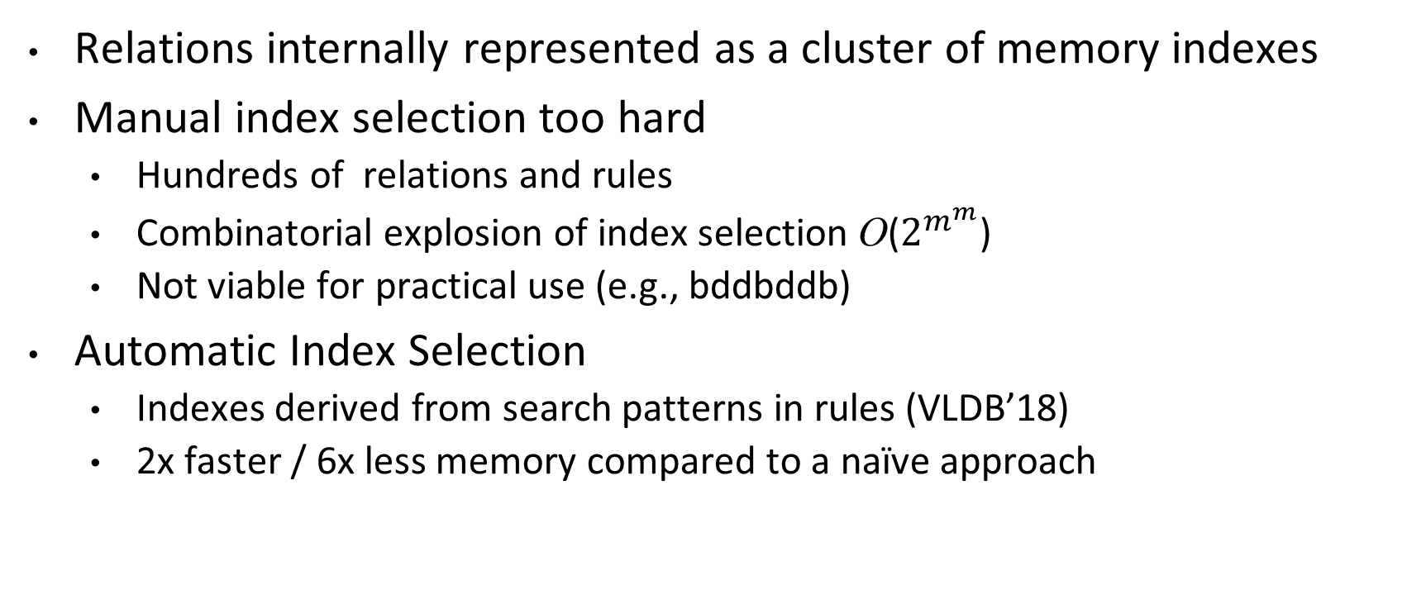
Relations as Indexes
Relations internally represented as a cluster of memory indexes
Manual index selection too hard
Hundreds of relations and rules
Combinatorial explosion of index selection O($2^{m^{m}}$)
Not viable for practical use (e.g., bddbddb)
Automatic Index Selection
Indexes derived from search patterns in rules (VLDB’18)
2x faster / 6x less memory compared to a naïve approach

Slide 24
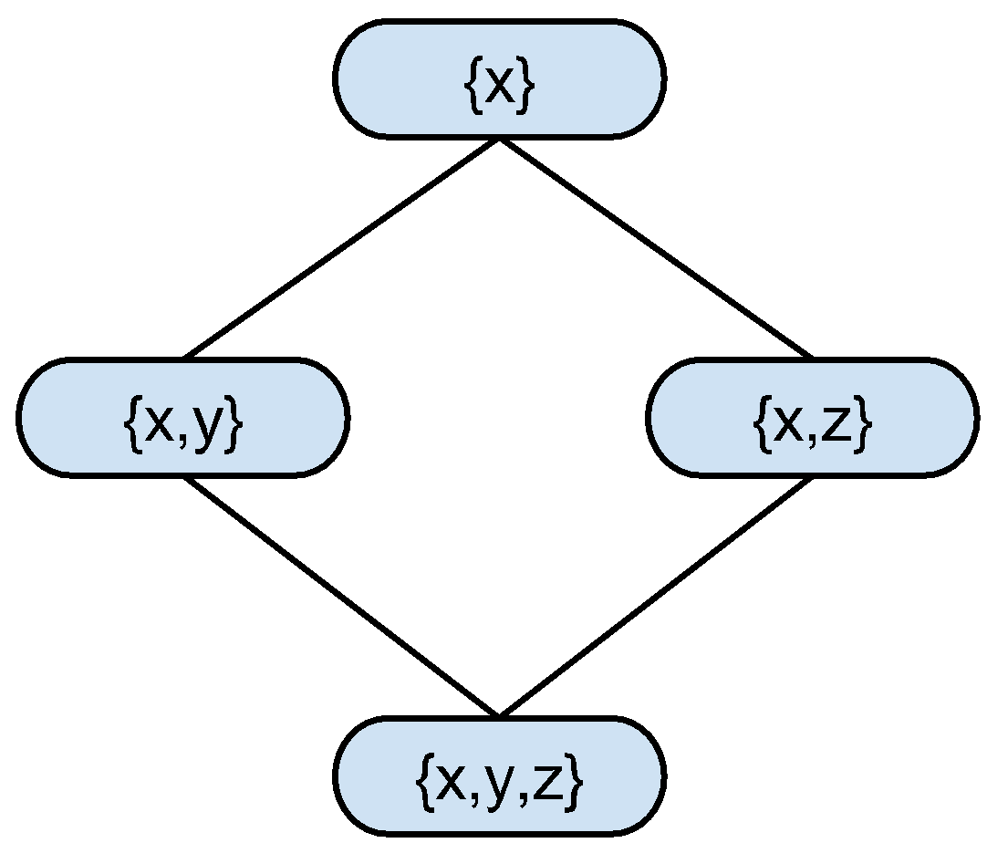
Index Selection as a Cover Problem
Rules composed of “primitive searches”
Rules are mostly conjunction of equality constraints; unconstrained otherwise
..,A(10,11,_),.. ⇔ select * from A where x=10 and y=11
Primitive search {x,y} of relation A(x,y,z)
Single index covers multiple primitive searches
Eg., lexorder index x<y<z on A(x,y,z) covers select * from A where x=x0 select * from A where x=x0 and y=y0 select * from A where x=x0 and y=y0 and z=z0
Primitive searches form a lattice on attributes
A chain in a lattice represents an index
Find minimal chain cover using Dilworth’s theorem
Chain 1: {x},{x,y}, {x,y,z}
⇒ Index: x<y<z
Chain 2: {x,z}
⇒ Index: x<z

Slide 25
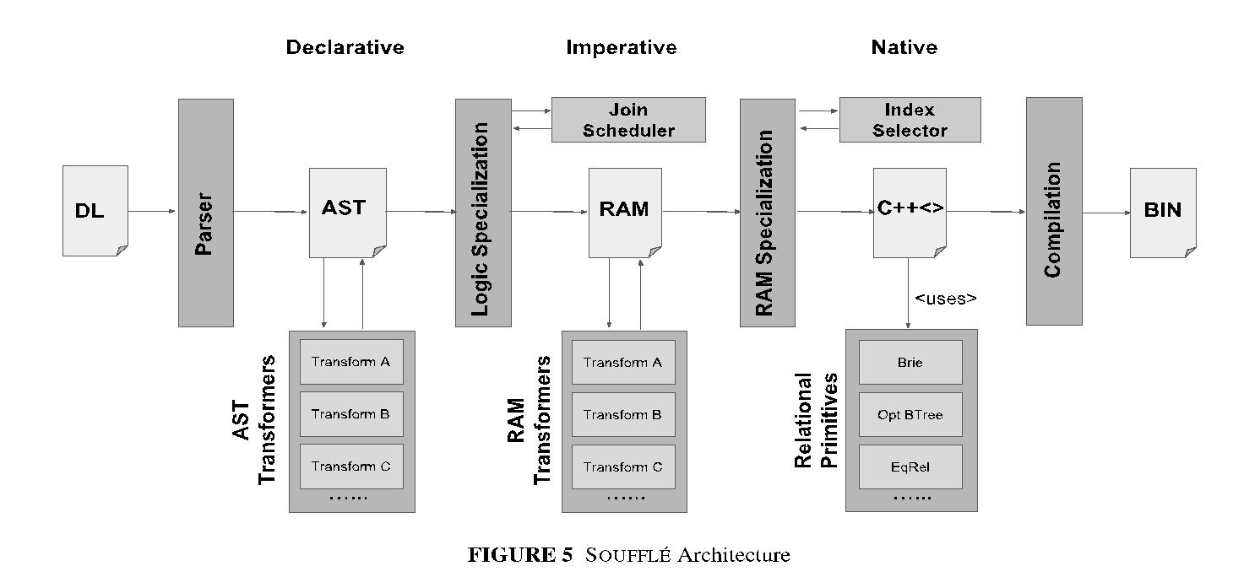

Algorithmics & Implementation
Primitive Searches
S₁
S₂
…..
S_{k}
MISP
MISP
MCCP
Max Matching
L₁
L₂
…..
L _{r}
Lexorder Indexes

Slide 26
Souffle’s Data-Structures for Indexes
Portfolio of Data-Structures (CCPE’20)
Datalog Enabled Relation (DER) data-structures
Templated C++ data-structures
B-Trees (PPoPP’19)
Complexity of evaluating searches is bounded by the size of the output
Tree structures provide natural opportunities for parallelism
Effectively exploits caches available in modern computer architectures
Brie (PMAM’19)
Useful for dense and low-dimensional data
Equivalence Relation (PACT’19)
Symbolic rewrite systems etc.

Slide 27
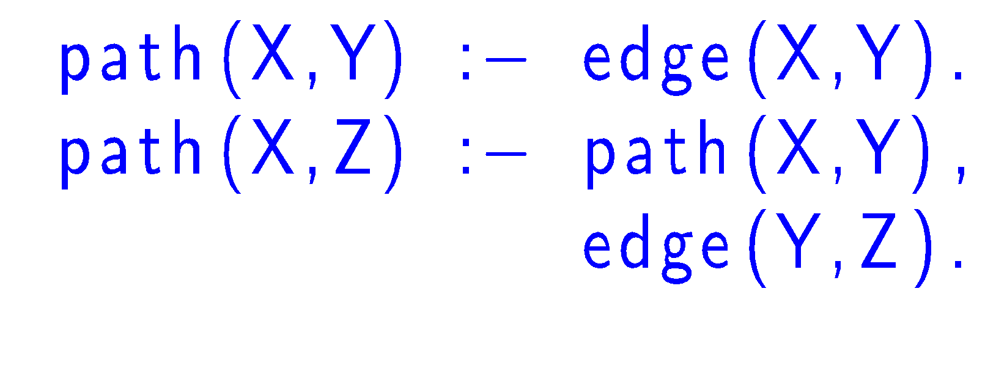

Soufflé's Performance
Example
Performance Numbers
Vs. Hand-crafted: 2s / 34MB

Slide 28
Open Questions
Better data structures than B-trees (PPoPP’19)
Self-computing data-structures
Union/find for equivalence relations (PACT’19)
Join Orders using feedback-directed compilation (LOPSTR’22)
Worst-case optimal joins?
Incremental Evaluation (PPDP’22)
Automatic proving the correctness of the translation
Recent automated testing effort
Verification

Slide 29
Tooling
Provenance and Profiling

Slide 30
Provenance
Mechanism to debug Datalog programs (TOPLAS’20)
Light—weight implementation with very little runtime overhead
20-30% for larger benchmarks
Use proof annotations for post-mortem proof re-construction
Generate proof-trees interactively
Describe how a tuple is derived
Root is the tuple itself
Command-Line interface after evaluation

Slide 31
Example

Slide 32
Constructing Proof-Trees

Slide 33
Explain Negation
Interactively explore why a tuple cannot exist

Slide 34
Improve Performance with Profiling
How to gain faster Datalog programs?
Compile to achieve peak performance
Scheduling of queries
User annotations or automated
Find faster queries
Find faster data models
Profiling is paramount
Textual and graphical user interface for profiling programs
Practical observation
Only a handful of rules will dominate the execution time of a program

Slide 35
Profiling (cont’d)
Option –j produces HTML file; Graphical Representation of Performance

Slide 36
Open Questions
Automated Testing Tools
Extraction tools for arbitrary languages
IDE with code refactoring

Slide 37
Applications

Slide 38

USE CASE A: Security In Open JDK7
Open JDK 7: 7M LOC, 1.4M variables, 350K heap objects, 160K methods, 590K invocations, 1G tuples
Security
Analysis X.dl
Points-to.dl
Soufflé –c
JDK X build Y
Analyzer X
Results

Slide 39

USE CASE B: AWS VPC Networks
~10-100K Instances, 90% static rules, 10% dynamic rules
Results
External Tool
Java Interface
Soufflé compiler
90%
Soufflé Interpreter
10%
Analysis + Data

Slide 40


USE CASE C: Static Parallel C/C++ Code Analysis Framework
Insieme Compiler Framework
parallel
C++
parallel
C++
Frontend
IR
Backend
exe
parallel
C++
Optimizer
Analysis
Transformation
Insieme’s Datalog based
Analysis Module
Result Extractor
Analysis Results
Output
Facts
points to
escape
…
IR
Fact Extractor
Insieme’s Datalog
Analysis Framework
Input Facts
Souffle

Slide 41
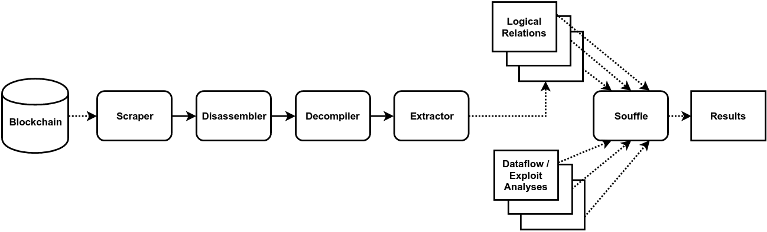
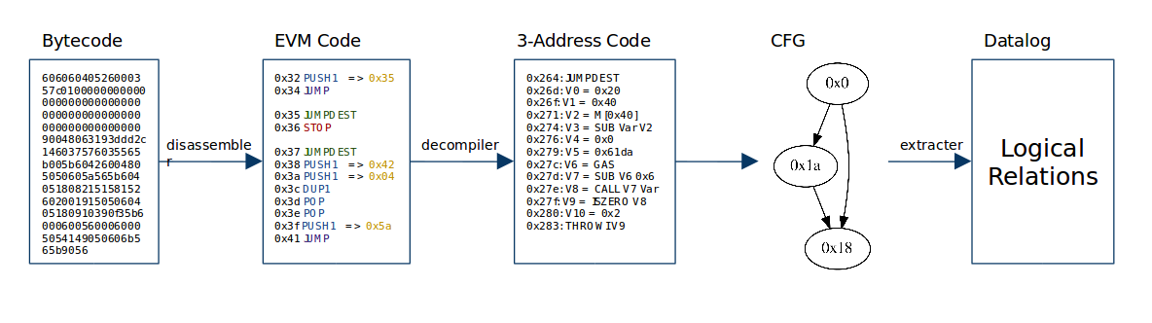
USE CASE D: Security In Smart Contracts

Slide 42
USE CASE E: Points-To Analysis
Java Points-To Analysis in Datalog
Builds memory abstractions for Java programs
Feature-Rich: various types of points-to contexts
Efficient implementation
Pipeline
SOOT for extracting semantic relations
Parameterizable analysis
Recently ported to Soufflé
SOAP’17
Variables
x
Heap Objects
a
vP
y
f
hP
z
b

Slide 43
Conclusion
Commercial-Grade Static Analyzers in Datalog is hard
New language extensions for Datalog necessary
New implementation strategies for Datalog necessary
Enormous strides have been made in recent years
Still many remaining open challenges
Compositional language extensions for libraries
Symbolic computations
Incremental evaluation
Better data-structures
Join the effort
http://souffle-lang.github.io

