Slide 1
Semester project presentation
1. Introduction
Extending Dynamic Structure in Memory Network for Response Generation
Supervisor: Mi Fei
Director: Boi Faltings
Myself: André Cibils
Plan:
1. Introduction
2. RNN: LSTM, GRU and MemNN
3. DMN
4. DMN+
5. DMN&DMN results
6. Futur work & conclusion
Extending Dynamic Structure in Memory Network for Response Generation
Notes:
So today...
12 credits HTC
4th week

Slide 2
Quick Presentation
1. Introduction
Bachelor here at EPFL in informatics
This is my 2nd semester as a master student in computer science
Big interest in ML, and more precisely NN
Goal of the project is to answer (rightfully!) with a sentence to a question about a text
Extending Dynamic Structure in Memory Network for Response Generation
Notes:
First, let me introduce myself
I followed PCML & URLNN (NLP)
Last year I did my bachelor project here at LIA
Given some sentences and a question about them, try to answer it
My approach will be based on NN

Slide 3
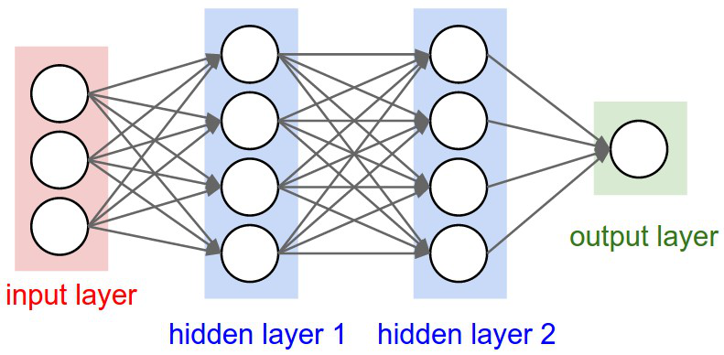
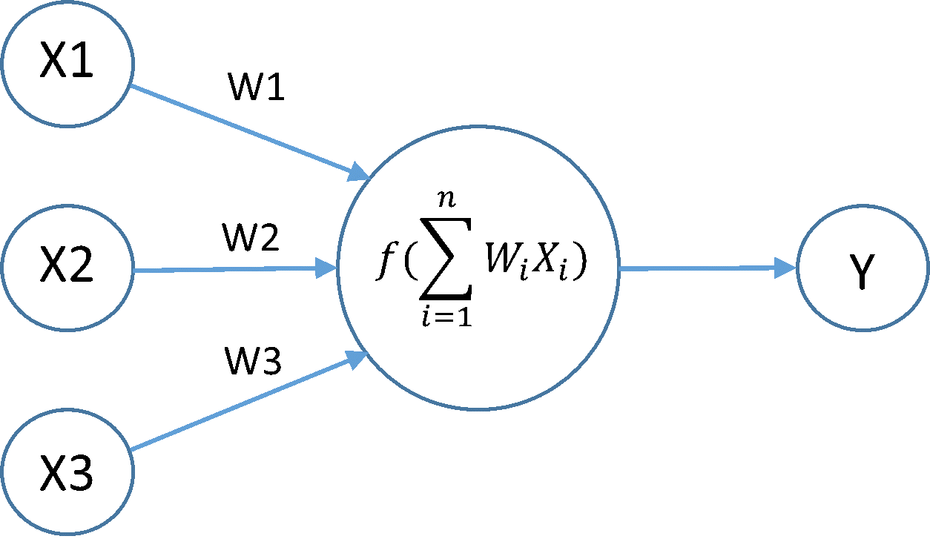
Speaking of NN
1. Introduction
You all know what NN are
Extending Dynamic Structure in Memory Network for Response Generation
Notes:
"Traditional" Feed forward NN

Slide 4
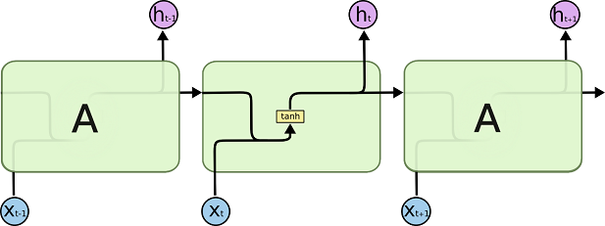
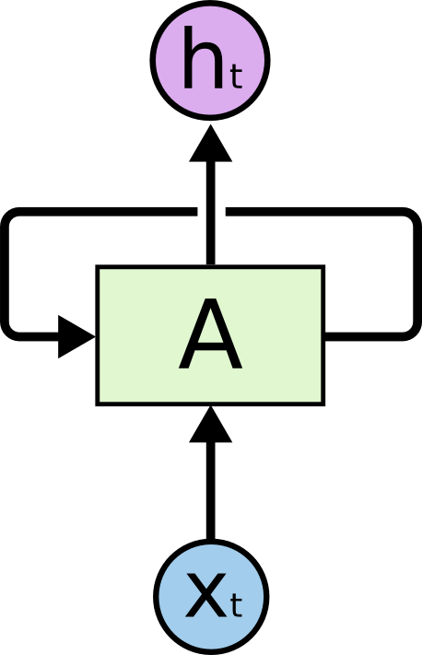
Recurrent Neural Networks (RNN)
2. RNN: LSTM, GRU and MemNN
A specific and powerful type of NN
Main idea: the cells of the NN keep trace of theirs states and use it to do more complex computation
Extending Dynamic Structure in Memory Network for Response Generation
Notes:
Connections between units form a directed cycle
Allow dynamic temporal behavior
Many types of RNN exist
Basic one is tanh, which uses 2 matrix of weights and the tanh function to determine its new state

Slide 5
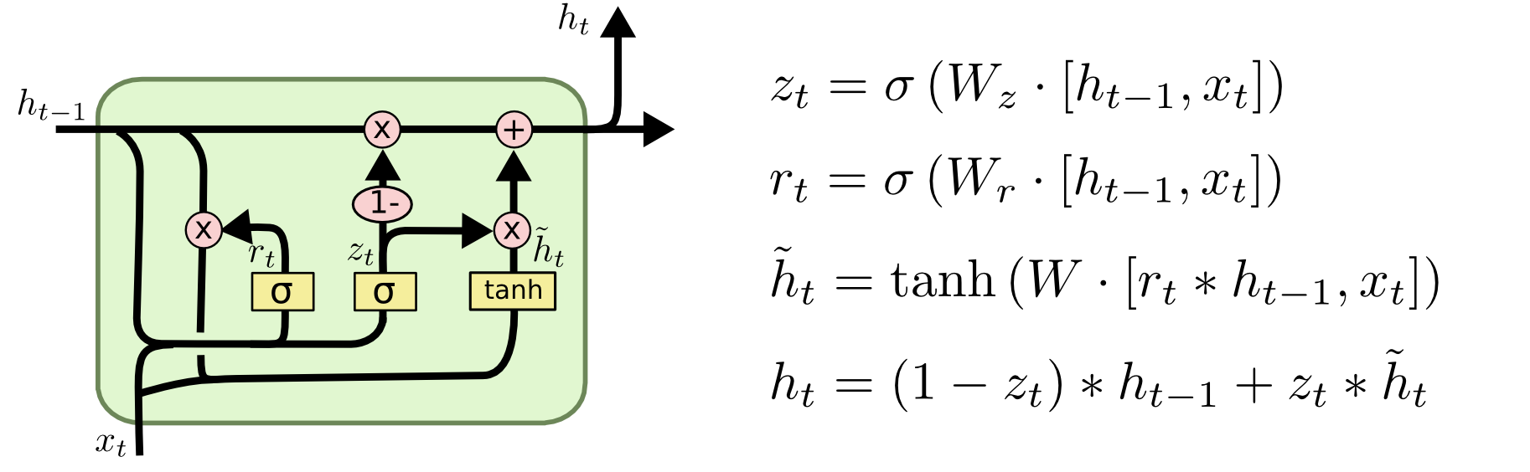
Long and Short Term Memory (LSTM) & Gated Recurrent Unit (GRU)
2. RNN: LSTM, GRU and MemNN
LSTM & GRU are some specific RNN architecture
Compute their states using different variables
zt is called the update gate
rt is called the reset gate
~ht is the potential state
ht is the updated state
Extending Dynamic Structure in Memory Network for Response Generation
Notes:
LSTM are old (1997)
GRU are new (2014)
Both dodge gradient vanishing problem
GRU is a bit simpler and thus need less computation. I'll mainly use this. Comes from LSTM
Trying to summerise LSTM or GRU with schema is a really complex task :p
Main idea is that it uses different gates to allow complex modification like specific update or reset to their states
Gates & States are vector (there is some hyperparameters to fix), also bias but not showed here. We can see tanh is back

Slide 6
Memory Network (MemNN)
2. RNN: LSTM, GRU and MemNN
Really recent! ~2015 [1]
Base idea is to have a memory m (an array of objects) and some components interacting with it, for example:
  Input feature map
  Generalization
  Output feature map
  Response
Extending Dynamic Structure in Memory Network for Response Generation
Notes:
I: converts the incoming input to the internal feature rpz
G: update old memory. There is an opportunity for the network to compress and generalize its memories
O: produces output given input and memory
R: decodes output
Really powerful, a lot of people are playing with it

Slide 7
Dynamic Memory Network
(DMN & DMN+)
3. DMN
An enhanced version of MemNN
Even more recent! ~March 2016 [2]
This is what I'm doing & working with
Four parts:
  Input Module
  Question Module
  Episodic Memory Module
  Answer Module
Extending Dynamic Structure in Memory Network for Response Generation
Notes:
Capable of multi task (Q&A, sentiment analysis, part of speech tagging, visual Q&A)
(posp = mark up a word in a text as corresponding to a particual part of speech (nouns, verbs, etc.)
Lot of GRU connected together
Can be train end-to-end (no gradient vanishing)

Slide 8
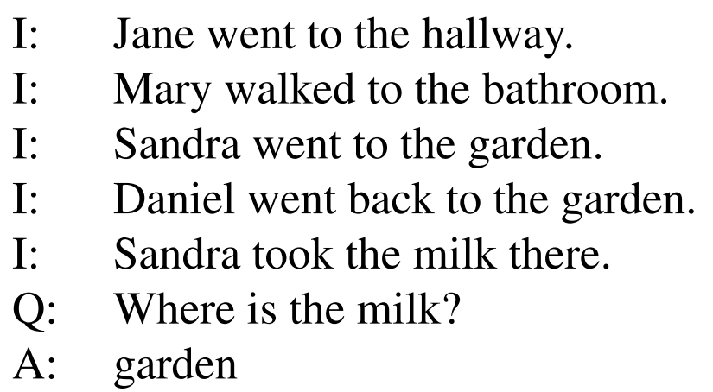
Reminder: goal of the project
3. DMN
Given some facts, answer a question with a sentence.
State of the art:
I'll be using the bAbi dataset
Later, I'll try training my network with my own generated dataset or other datasets found online
Extending Dynamic Structure in Memory Network for Response Generation
Notes:
Babi dataset is from facebook
State of the art is a classification problem
With some clever rules, generation of my own dataset can be done (already done by other people)
The (6) dialog bAbi tasks

Slide 9
Input Module
3. DMN
In NLP, the input is a sequence of words (w1, ... wTi)
At each timestep t, update the hidden state
ht = RNN(L[wt], ht-1)
L is the embedding matrix, wt is the word index of the t^{th} word of the input sequence
Uses a GRU as RNN
Output a sequence of TC facts representations
Extending Dynamic Structure in Memory Network for Response Generation
Notes:
If the input is a single sentence, input module outputs the hidden states of the RNN
If a list of sentence, we concatenate the sentences into a long list of word tokens with end-of-sentence token. Final representation is the hidden states at each eos token
GRU>LSTM>tanh
LSTM does similar but is more computationally expensive
L (embedding matrix) can either be found online (GloVe) or be done by the IM
So input can be a sentence, a long story, a movie review, or event several Wikipedia articles

Slide 10
Question Module
3. DMN
Similar to input module, input is a sequence of words (= the question)
Similar to input module, this module encodes the question using qt = GRU(L[wt], qt-1)
Output a representation of the question q
Extending Dynamic Structure in Memory Network for Response Generation
Notes:
Very similar to IM
Unlike IM, the QM produces as output only the final hidden state

Slide 11
Episodic Memory Module
3. DMN
Attention mechanism: a "simple" two-layer feed forward NN which gives a score to each fact ct given the memory state mt-1 and the question q
Memory update mechanism: a modified GRU
The EMM iterates over representation outputted by the input module
Extending Dynamic Structure in Memory Network for Response Generation
Notes:
Update its internal memory
At each ite, the attention mechanism looks at the fact representation c (output of the IM) while taking q in consideration and the previous memory to produce an episode e
This episode is used to update the memory
For some task, it is beneficial to do multiple passes over the input.
The final memory is given as input to the answer module

Slide 12
Answer Module
3. DMN
Generates an answer given a vector
Uses a modified GRU
This is the important part to produce sentences rather than words!
Extending Dynamic Structure in Memory Network for Response Generation
Notes:
Depending on the task, it is either triggered once at the end of the EM or at each time step
Takes the last memory, it's previously predicted output yt-1 and of course its current state to compute yt
at = GRU([yt-1, q], at-1)
Yt = softmax(Wat)

Slide 13
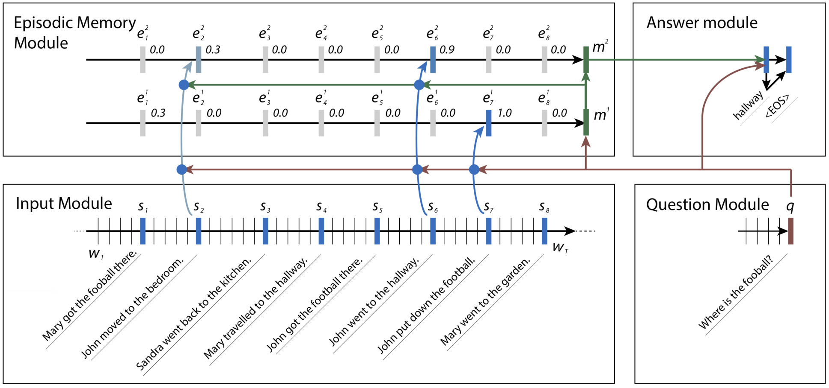
Summary of DMN
3. DMN
Extending Dynamic Structure in Memory Network for Response Generation
Notes:
Input sentences and questions are transformed into vector by the IM & QM
EMM iterates over this representation to focus itself on important parts of the input. It produces some memory representation of the input and the question.
This memory representation is then passed to then answer module which produces comprehensive data
DMN+ is very similar but performs better thanks to some improvements

Slide 14
DMN+ improvements
4. DMN+
Modification to the input module and the episodic memory module [3].
  IM is now made of 2 components, one for encoding words into a sentence embedding and the second is responsible for the interaction between sentences
  EMM has now an attention based GRU (slightly modified GRU) and a ReLU memory update mechanism
  mt = ReLU(W(t)[mt-1;ct;q] + b)
Extending Dynamic Structure in Memory Network for Response Generation
Notes:
IM: Classic GRU allow sentence to have context from sentence before them, but not after, thus preventing information propagation from futur sentences.
EMM: It would be great if the attention mechanism could be aware of the positioning and the ordering of the input facts->GRU

Slide 15
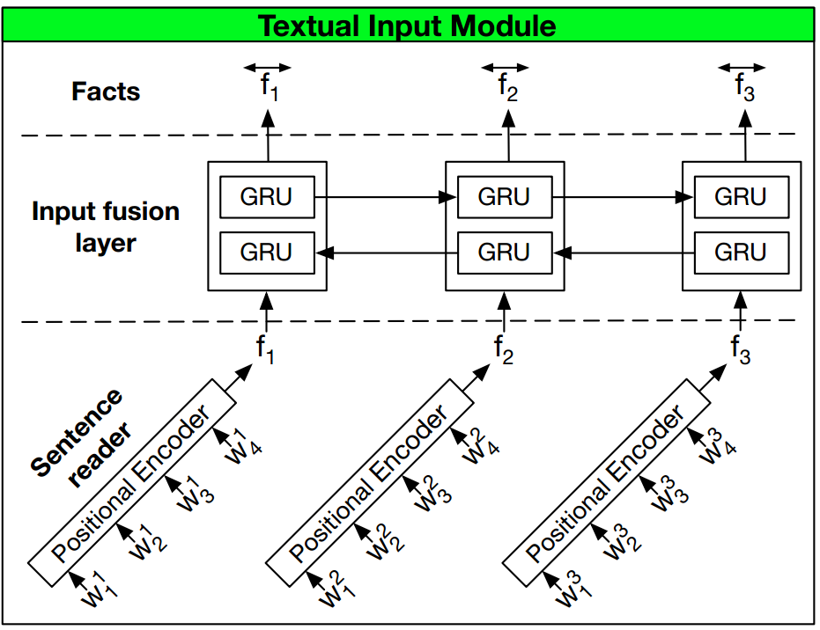
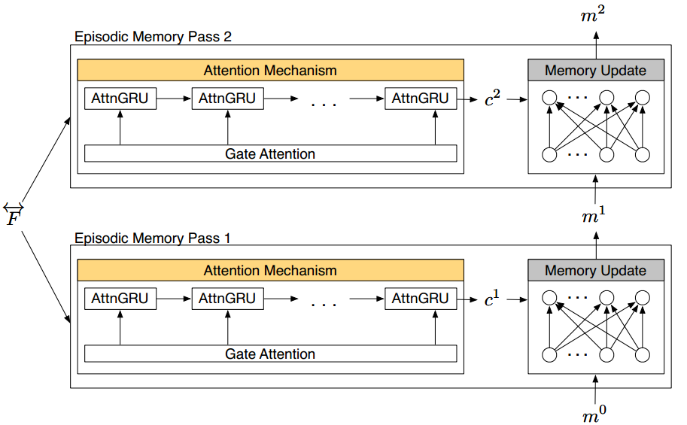
DMN+ improvements
4. DMN+
Extending Dynamic Structure in Memory Network for Response Generation
Notes:
DMN+:
Fusion layer is a bidirectional GRU, more precisely, 2 GRU, which the sums of their hidden state is are the facts
AttentionGRU is modified GRU
MemUpdate: ReLU is a classic rectifier. No need for GRU as AttGRU works. DMN: mt = GRU(et, mt-1)
Attention gate: replace the update gate by an attention gate g, which depends of the facts, the memory and the query to produce a scalar for each fact
Tied/untied mem weights: the model contains only one set of weights for all episodic passes over the input. Untied is when there is different weights for all episodic passes.

Slide 16
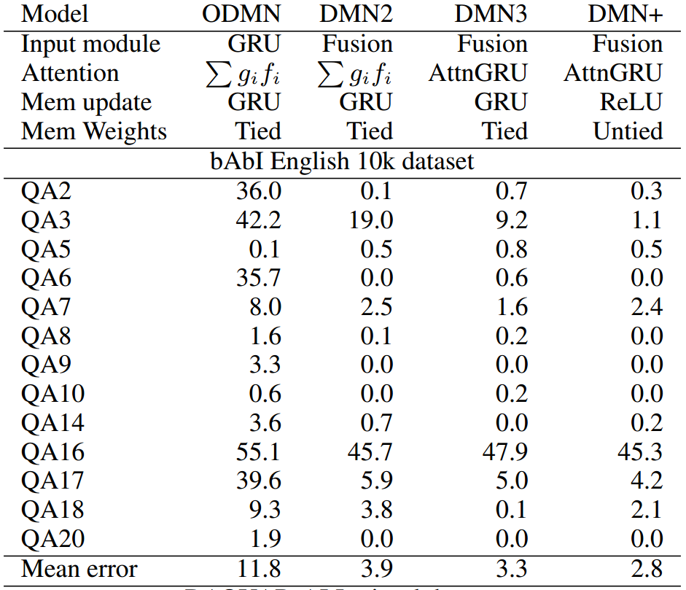
Results of DMN & DMN+
5. DMN&DMN+ results
Obtained using 3 passes
For some tasks (QA3, QA17, Q18) accuracy is not stable accross multiple runs
Extending Dynamic Structure in Memory Network for Response Generation
Notes:
My code is running right now! Thoses are not my results
Skipped tasks achieved 0 error across all models

Slide 17
Results of DMN & DMN+
5. DMN&DMN+ results
QA16: Basic induction. An simpler model achieve an error rate of 0.4 [3]
Overall, really good results!
Extending Dynamic Structure in Memory Network for Response Generation
Notes:
QA16: An untied model using only summation for memory update perfomed better->it suggests that the more complex memory update component may prevent convergence on certain simpler tasks
#QA17:PosReas only involves minimal supervision->two sentences for input, yes/no answers for supervision

Slide 18
Potential Modifications
6. Futur work & conclusion
Final Goal: Use of Extended DMN(+) as a chatbot!
Modify the answer module to produce a sentence
  Similar architecture to recurrent encoder-decoder? Used with success in the query suggestion task [4]
Mark the sentence so the model know if a sentence is from the user or itself (and be able to use this information!)
Extending Dynamic Structure in Memory Network for Response Generation
Notes:
HRED: A GRU encode the answers individually (word by word) and produce a vector qm for each answer. A second gru recode the answer sm = GRU(sm-1,qm). Thanks to this GRU, the model is time sensitive and takes into account the older answer. A final GRU is used to predict the next sentence: dm,n = GRU(dm,n-1,wm,n)
Wm,n calculated using
P(wm,n=v|wm,1:n-1,q1:m-1) = exp(o_v*w(dm,n, wm,n-1))/sum{k}(exp(o_k*w(dm,n-1,wm,n-1))
where o is the output embedding of word v

Slide 19
References
6. Futur work & conclusion
[1] Memory Networks, 29 Nov 2015
[2] Ask Me Anything: Dynamic Memory Network for Question Answering, 5 Mar 2016
[3] Dynamic Memory Network for Visual and Textual Question Answering, 4 Mar 2016
[4] A Hierarchical Recurrent Encoder-Decoder for Generative Context-Aware Query Suggestion, 8 Jul 2015
Extending Dynamic Structure in Memory Network for Response Generation

Slide 20
Questions?
6. Futur work & conclusion
Extending Dynamic Structure in Memory Network for Response Generation
Notes:
<3

