Slide 1
No API? No problem!
API mocking with WireMock
An open source workshop by
Tobias Verhoog
&
André Koene
Originally created by Bas Dijkstra – bas@ontestautomation.com – https://www.ontestautomation.com
Notes:
Please replace the … with your own name. I would really like it if you left the bottom line intact though, as a way of thanking me. That’s really all I’m asking for, the rest of the workshop is yours to butcher (erm, improve).
1

Slide 2
What are we going to do?
Stubbing, mocking and service virtualization
WireMock (Java) or WireMock.Net
Exercises, examples, …
Notes:
The workshop starts with a background on how stubbing, mocking and service virtualization can help you remove bottlenecks in your test environment. Then, we’re going to take a look at how WireMock enables you to write mocks in Java or C# using a powerful and intuitive API. And of course, most importantly, the participants are going to do the hard work..
2

Slide 3
Preparation
Was everyone able to prepare/successfully install everything we need?
Notes:
3

Slide 4
Section 0: An introduction to service virtualization

Slide 5
Problems in test environments
Systems are constructed out of of many different components
Not all of these components are always available for testing
Parallel development
No control over testdata
Fees required for using third party component
…

Slide 6
Problems in test environments
Mobile app
SaaS dependency
Under development
Access fees
System under test
No suitable test data
Limited access
Backend system
Mainframe

Slide 7
Simulation during test execution
Simulate dependency behaviour
Regain full control over test environment
Available on demand
Full control over test data (edge cases!)
No third party component usage fees
…

Slide 8
Problems in test environments
Mobile app
SaaS dependency
Under development
Access fees
System under test
No suitable test data
Limited access
Backend system
Mainframe

Slide 9
Simulation in test environments
Virtualized mobile app
Virtualized SaaS dependency
Unrestricted access
Unrestricted access
System under test
Unrestricted access
Unrestricted access
Virtualized backend system
Virtualized mainframe

Slide 10
API consumer
request
API provider
response
System
System

Slide 11
Simulating APIs for more efficient testing and automation
request
Simulation
API consumer
API provider
response
System

Slide 12

Our system under test
ParaBank
The world’s least safe
online bank
Request Loan process
Loan application is processed by 3rd party loan provider component
Notes:
Explain why this API was chosen (simple, lots of features, very ‘real’ data, something lots of people can relate to)
12

Slide 13
ParaBank development team
3rd party development team
Frontend
/
API client
API
ParaBank middleware
API
Loan Processor service

Slide 14
ParaBank development team
WireMock.Net
Frontend
/
API client
API
ParaBank middleware
API
Simulated Loan Processor service

Slide 15
What might we want to simulate?
Start testing against features under development
Easy setup of state for edge cases
Delays, fault status codes, malformatted responses, …
…

Slide 16
Time to get hands-on-experience So let’s split Java vs C#

Slide 17
Section 1: Getting started with WireMock.Net

Slide 18
WireMock
https://github.com/WireMock-Net/WireMock.Net/
C#
HTTP mock server
only supports HTTP(S)
open source
developed and maintained by Stef Heyenrath

Slide 19
Configuring WireMock.Net
Install as a NuGet package
Notes:
19

Slide 20
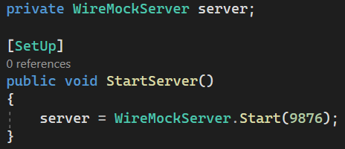
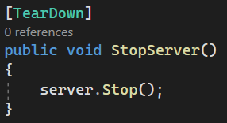
Starting and stopping the WireMock.Net server
Starting the server
Stopping the server

Slide 21
Starting WireMock.Net (standalone)
Useful for exploratory testing purposes
Allows you to share WireMock.Net instances between teams
Long-running instances
Use WireMock.Net.StandAlone library
We’re not going to run WireMock in that mode in this workshop

Slide 22
Configure responses
In C# code
This is what we’ll do in the workshop
Using JSON mapping files
See https://github.com/WireMock-Net/WireMock.Net/wiki/Stubbing#json-mapping-example for an example how to get started with JSON mapping files

Slide 23
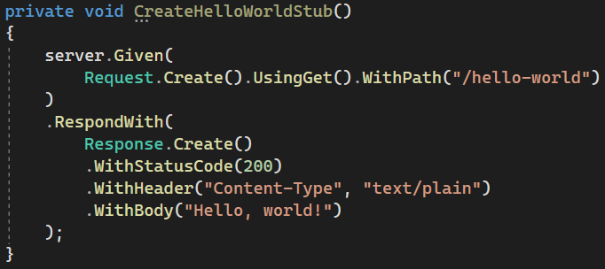
An example mock defined in C#

Slide 24
Now it’s your turn!
Exercises > Exercises01.cs
Create a couple of basic mocks
Implement the responses as described in the comments
Verify your solution by running the tests in the same class
Answers are in Answers > Answers01.cs
Examples are in Examples > Examples01.cs

Slide 25
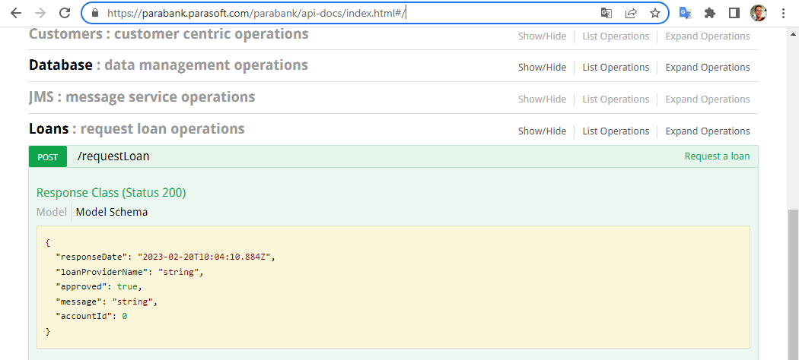
Now it’s your turn!
Simplification of request loan operation from: https://parabank.parasoft.com/parabank/api-docs/index.html#/
Exercises01.cs
Implement the responses
as described in the
comments
Verify your solution by
running the tests in the
same class

Slide 26
Section 2: Request matching strategies and fault simulation

Slide 27
Request matching
Send a response only when certain properties in the request are matched
Options for request matching:
URL
HTTP method
Query parameters
Headers
Request body elements
…

Slide 28
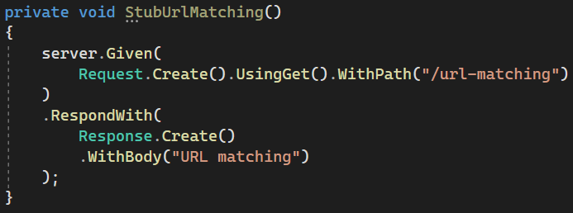
Example: URL matching
Matchers can be used for more flexible matching
https://github.com/WireMock-Net/WireMock.Net/wiki/Request-Matching#two-matchers

Slide 29
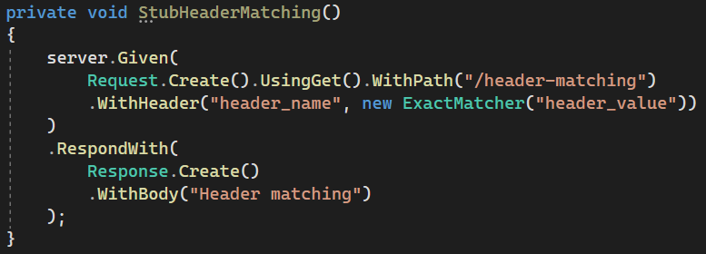
Example: header matching
Matchers can be used for flexible matching
https://github.com/WireMock-Net/WireMock.Net/wiki/Request-Matching#two-matchers

Slide 30

Example: cookie matching
Matchers can be used for flexible matching
https://github.com/WireMock-Net/WireMock.Net/wiki/Request-Matching#two-matchers

Slide 31
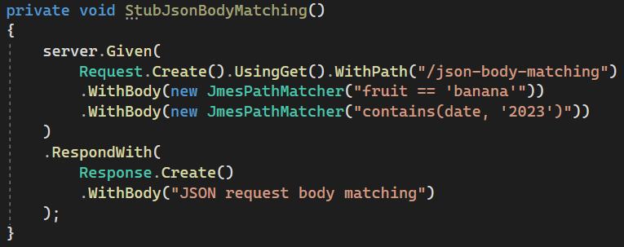
Example: JSON body matching
Matchers can be used for flexible matching
https://github.com/WireMock-Net/WireMock.Net/wiki/Request-Matching#two-matchers

Slide 32
Fault simulation
Extend test coverage by simulating faults
Often hard to do in real systems
Easy to do using stubs or mocks
Used to test the exception handling of your application under test

Slide 33
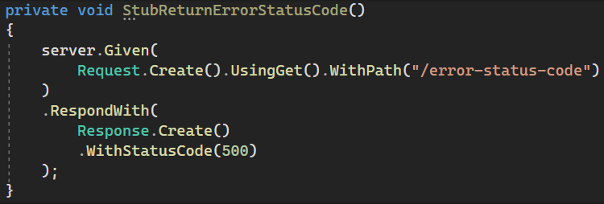
Example: HTTP status code
Some often used HTTP status codes:
Consumer error Provider error
403 (Forbidden) 500 (Internal server error)
404 (Not found) 503 (Service unavailable)

Slide 34
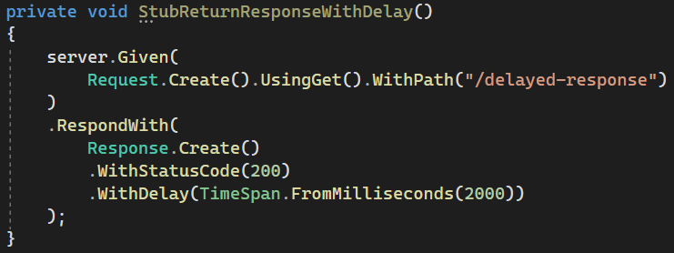
Example: delays

Slide 35
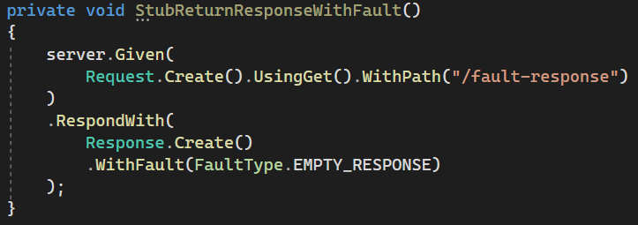
Example: faults
Options:
NONE (no fault)
EMPTY_RESPONSE (does what it says on the tin)
MALFORMED_RESPONSE_CHUNK (HTTP 200, garbage in body)

Slide 36
Now it’s your turn!
Exercises > Exercises02.cs
Practice fault simulation and different request matching strategies
Implement the responses as described in the comments
Verify your solution by running the tests in the same class
Answers are in Answers > Answers02.cs
Examples are in Examples > Examples02.cs

Slide 37
Section 3: Creating stateful mocks

Slide 38
Statefulness
Sometimes, you want to simulate stateful behaviour
Shopping cart (empty / containing items)
Database (data present / not present)
Order in which requests arrive is significant

Slide 39
Stateful mocks in WireMock.Net
Supported through the concept of a Scenario
Essentially a finite state machine (FSM)
States and state transitions
Combination of current state and incoming request determines the response being sent
Exercises before, it was only the incoming request

Slide 40
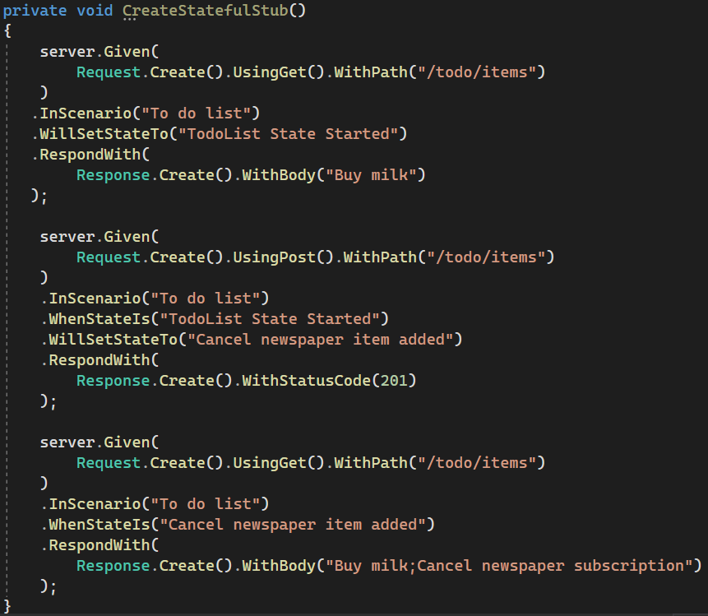
Stateful mocks: an example
Responses are grouped by scenario name
Response depends on both the incoming request as well as the current state
The first mock should define the initial state
Incoming requests can trigger state transitions

Slide 41
Now it’s your turn!
Exercises > Exercises03.cs
Create a stateful mock that exerts the described behaviour
Implement the responses as described in the comments
Verify your solution by running the tests in the same class
Answers are in Answers > Answers03.cs
Examples are in Examples > Examples03.cs

Slide 42
Section 4: Response templating

Slide 43
Response templating
Often, you want to reuse elements from the request in the response
Request ID header
Unique body elements (client ID, etc.)
Cookie values
WireMock.Net supports this through response templating

Slide 44
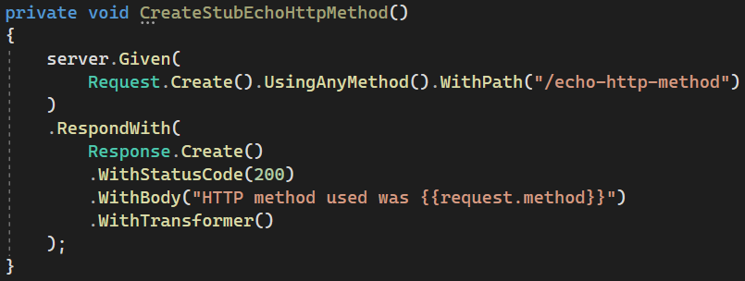
Enable/apply response templating
This template reads the HTTP request method (GET/POST/PUT/…) using {{request.method}} and returns it as the response body
This call to WithTransformers() is necessary to activate response templating for this stub

Slide 45
Request attributes
Many different request attributes available for use
request.method : HTTP method (example)
request.PathSegments.[<n>] : n^{th} path segment
request.query.<key> : query parameter value
…
All available attributes listed at
https://github.com/WireMock-Net/WireMock.Net/
wiki/Response-Templating#the-request-model

Slide 46
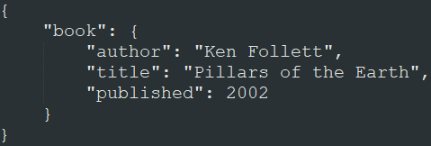
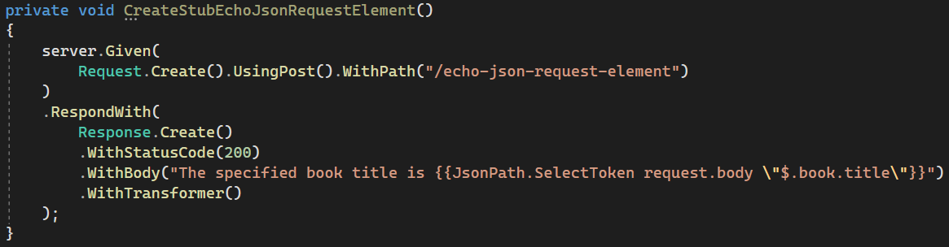
JSON extraction example
When sent this JSON
request body:
This stub returns a response with body “The specified book title is Pillars of the Earth”:

Slide 47
Now it’s your turn!
Exercises > Exercises04.cs
Create dynamic mock by using response templating
Implement the responses as described in the comments
Verify your solution by running the tests in the same class
Answers are in Answers > Answers04.cs
Examples are in Examples > Examples04.cs

Slide 48
Section 5: Verification

Slide 49
Verifying incoming requests
Apart from returning responses, you might also want to verify that incoming requests have certain properties
Fail a test if these verifications aren’t met
The server keeps a log of the received requests.
https://github.com/WireMock-Net/WireMock.Net/wiki/Stubbing#verify-interactions

Slide 50
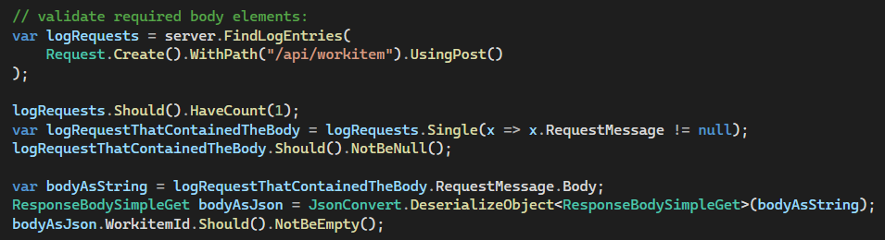
Verification example
You can use FindLogEntries() method, defining routes in a very same way as the mock setup itself:

Slide 51
Now it’s your turn!
Exercises > Exercises05.cs
Add WireMock verifications to the tests
Verify request properties as described in the comments
Verify your solution by running the tests in the same class
Answers are in Answers > Answers05.cs
Examples are in SwaggerPetStoreExamples > SwaggerPetStoreMock.cs

Slide 52
?

