Slide 1

Group № 17
Mentor Anton Shvechikov

Slide 2


What is

Slide 3
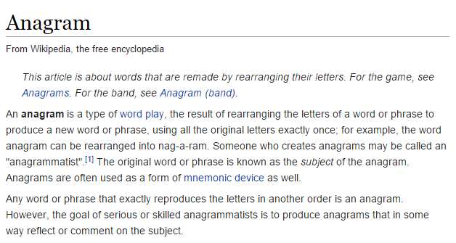


Slide 4
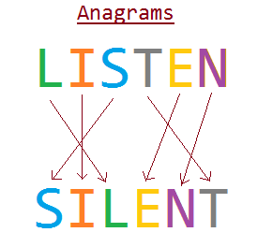
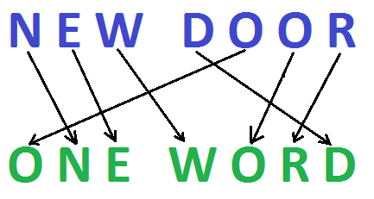


Slide 5
isAnagram method is the key method of the class, that works as follows:
isAnagram(«Listen», «Silent») - ?
«Listen» ≠ «Silent»
{[L], [i], [S], [T], [E], [N] } ≠ {[S], [I], [L], [E], [N], [T]}
{[E], [I], [L], [N], [T], [S]} = {[E], [I], [L], [N], [T], [S]}

Slide 6
Description of the methods:
public static boolean isAnagram(String str1, String str2) –
checks whether two strings are anagrams.
public static List<String> getAnagramsFromList(List<String> words) –
Seeking anagrams in the collection of words, and returns them in the collection of String :
«Andrew, warned, wander»
«Later, Alert»
public static String getAnagramInList(List<String> wordsList, String word)
Seeking anagram to a specific word in the collection and returns the first found.

Slide 7

Unit
testing

Slide 8
