Slide 1
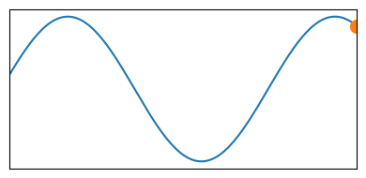

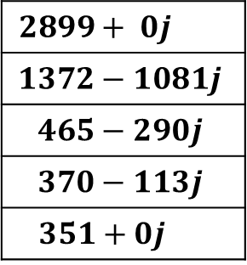
ADC_Buffer
Buffer full
1023
949
749
480
220
45
5
112
334
608
854
1001
1007
870
629
958
Buffer half full
RFFT
RFFT_Output
$$2899+ 0j$$
$$1372−1081j$$
$$465−290j$$
$$370−113j$$
$$351+0j$$
ADC

Slide 2
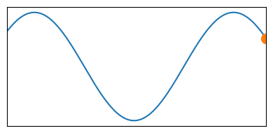
ADC_Buffer
Buffer full
1023
949
749
480
220
45
5
112
334
608
854
1001
1007
870
779
958
Buffer half full
RFFT
RFFT_Output
$$2899+ 0j$$
$$1372−1081j$$
$$465−290j$$
$$370−113j$$
$$351+0j$$
ADC

Slide 3
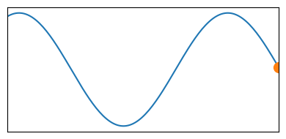
ADC_Buffer
Buffer full
1023
949
749
480
220
45
5
112
334
608
854
1001
1007
532
779
958
Buffer half full
RFFT
RFFT_Output
$$2899+ 0j$$
$$1372−1081j$$
$$465−290j$$
$$370−113j$$
$$351+0j$$
ADC

Slide 4
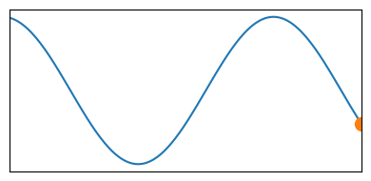
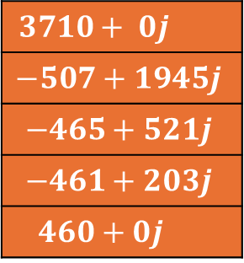
ADC_Buffer
Buffer full
1023
949
749
480
220
45
5
112
334
608
854
1001
280
532
779
958
Buffer half full
RFFT
RFFT_Output
$$3710+ 0j$$
$$−507+1945j$$
$$−465+521j$$
$$−461+203j$$
$$460+0j$$
ADC

Slide 5
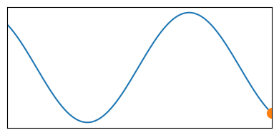
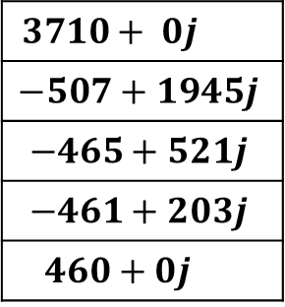
ADC_Buffer
Buffer full
1023
949
749
480
220
45
5
112
334
608
854
87
280
532
779
958
Buffer half full
RFFT
RFFT_Output
$$3710+ 0j$$
$$−507+1945j$$
$$−465+521j$$
$$−461+203j$$
$$460+0j$$
ADC

Slide 6
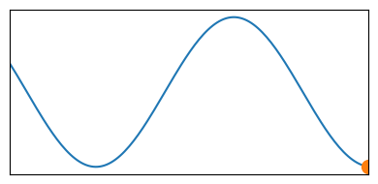
ADC_Buffer
Buffer full
1023
949
749
480
220
45
5
112
334
608
3
87
280
532
779
958
Buffer half full
RFFT
RFFT_Output
$$3710+ 0j$$
$$−507+1945j$$
$$−465+521j$$
$$−461+203j$$
$$460+0j$$
ADC

Slide 7
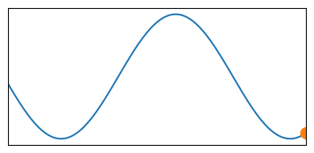
ADC_Buffer
Buffer full
1023
949
749
480
220
45
5
112
334
48
3
87
280
532
779
958
Buffer half full
RFFT
RFFT_Output
$$3710+ 0j$$
$$−507+1945j$$
$$−465+521j$$
$$−461+203j$$
$$460+0j$$
ADC

Slide 8
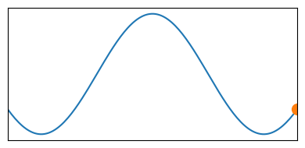
ADC_Buffer
Buffer full
1023
949
749
480
220
45
5
112
212
48
3
87
280
532
779
958
Buffer half full
RFFT
RFFT_Output
$$3710+ 0j$$
$$−507+1945j$$
$$−465+521j$$
$$−461+203j$$
$$460+0j$$
ADC

Slide 9
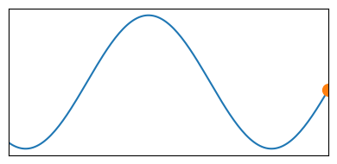
ADC_Buffer
Buffer full
1023
949
749
480
220
45
5
452
212
48
3
87
280
532
779
958
Buffer half full
RFFT
RFFT_Output
$$3710+ 0j$$
$$−507+1945j$$
$$−465+521j$$
$$−461+203j$$
$$460+0j$$
ADC

Slide 10
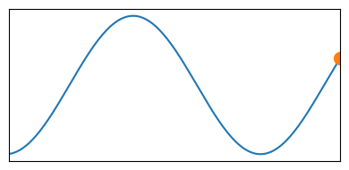
ADC_Buffer
Buffer full
1023
949
749
480
220
45
708
452
212
48
3
87
280
532
779
958
Buffer half full
RFFT
RFFT_Output
$$3710+ 0j$$
$$−507+1945j$$
$$−465+521j$$
$$−461+203j$$
$$460+0j$$
ADC

Slide 11
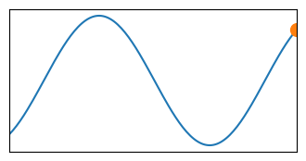
ADC_Buffer
Buffer full
1023
949
749
480
220
913
708
452
212
48
3
87
280
532
779
958
Buffer half full
RFFT
RFFT_Output
$$3710+ 0j$$
$$−507+1945j$$
$$−465+521j$$
$$−461+203j$$
$$460+0j$$
ADC

Slide 12
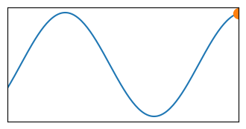
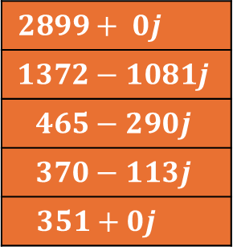
ADC_Buffer
Buffer full
1023
949
749
480
1017
913
708
452
212
48
3
87
280
532
779
958
Buffer half full
RFFT
RFFT_Output
$$2899+ 0j$$
$$1372−1081j$$
$$465−290j$$
$$370−113j$$
$$351+0j$$
ADC

Slide 13
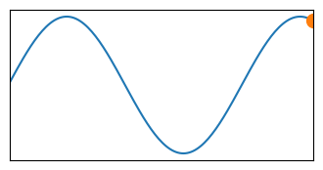
ADC_Buffer
Buffer full
1023
949
749
991
1017
913
708
452
212
48
3
87
280
532
779
958
Buffer half full
RFFT
RFFT_Output
$$2899+ 0j$$
$$1372−1081j$$
$$465−290j$$
$$370−113j$$
$$351+0j$$
ADC

Slide 14
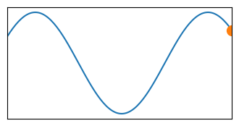
ADC_Buffer
Buffer full
1023
949
844
991
1017
913
708
452
212
48
3
87
280
532
779
958
Buffer half full
RFFT
RFFT_Output
$$2899+ 0j$$
$$1372−1081j$$
$$465−290j$$
$$370−113j$$
$$351+0j$$
ADC

Slide 15
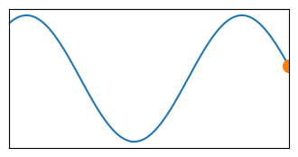
ADC_Buffer
Buffer full
1023
612
844
991
1017
913
708
452
212
48
3
87
280
532
779
958
Buffer half full
RFFT
RFFT_Output
$$2899+ 0j$$
$$1372−1081j$$
$$465−290j$$
$$370−113j$$
$$351+0j$$
ADC

Slide 16
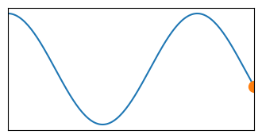
ADC_Buffer
Buffer full
354
612
844
991
1017
913
708
452
212
48
3
87
280
532
779
958
Buffer half full
RFFT
RFFT_Output
$$2899+ 0j$$
$$1372−1081j$$
$$465−290j$$
$$370−113j$$
$$351+0j$$
ADC

Slide 18




