Slide 1

TIP
ANDRES LOPEZ

Slide 2
SOLUTION
CLEANING THE FILES AND CALCULATING KPI’S WITH A FUNCTION THAT DELIVERS A CSV FILE FOR EACH MONTH
TOTAL SIZE OF THE CSV WITH THE KPI IS 2 KB
So each year you will have 6 *2 = 12 kb of data
In 5 years you will have 60 kb of data
10 years 120 kb of data
remember:
1 Byte = 8 Bit.
1 Kilobyte = 1.024 Bytes
1 Megabyte = 1.048.576 Bytes.
1Gigabyte = 1.073.741.824 Bytes.
1 Terabyte = 1.099.511.627.776 Bytes.
Why using a DB?
DEVELOPING THE APP USING FLASK AND DASH
TEST LOCALLY THE APP
DEPLOY IT TO AWS ELASTICBEANTALK
TEST THE WEBSITE

Slide 3
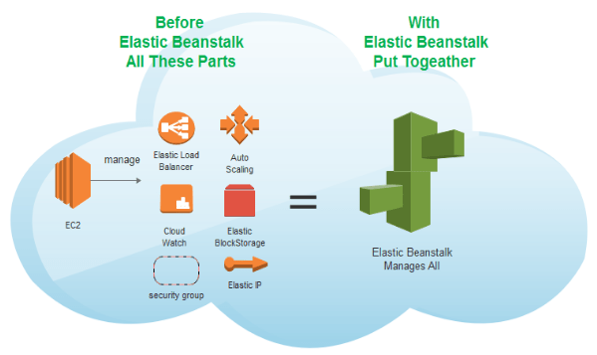
AWS
PROVISIONING
LOAD BALANCING
APP HEALTH MONITORING
SCALING

Slide 4
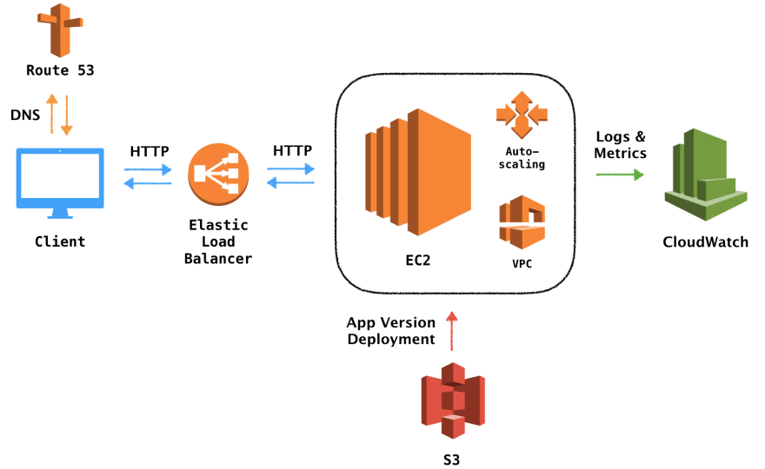
ARCHITECTURE

Slide 5
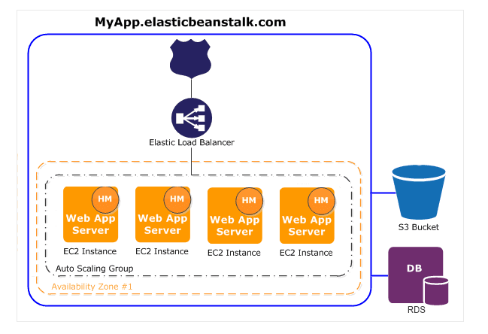
LOG TERM SOLUTION

