Slide 1
Marketing Attribution & Budget Optimization
Data-Driven Analysis | 8 Datasets | $176M Pipeline | 2021-2024
B2B SaaS Marketing Analytics Case Study
Integrated
8 Datasets
Touchpoints Mapped
80,500
Unique Deals
3,288
Attribution Applied
6 Models

Slide 2
Executive Summary
Top-line performance and key findings across all channels and models
Total Pipeline
$25.0M
Won Revenue
$5.4M
Mktg Sourced
$4.2M
Mktg Influenced
$6.5M
Win Rate
32.6%
> Marketing Sourced: $4.2M (16.8% of pipeline). Influenced: $6.5M — accounts with any marketing touchpoint before deal creation.
> 6sense Display leads Last-Touch ($3.3M) and Time-Decay ($3.5M) attribution — it converts. Email MQA leads First-Touch ($4.0M) — it creates awareness.
> Linear and Time-Decay models recommended for budget decisions: they balance the full buyer journey vs. single-touchpoint credit.
> Enterprise + Strong 6sense Profile Fit accounts show higher deal velocity. Target 6sense budget toward these accounts.
> Budget Recommendation: Increase 6sense display +30%, email nurture +20%. Reduce low-ROI channels. Estimated pipeline lift: 15-25%.
WHAT THIS SHOWS: Top-line numbers for the whole marketing program. Pipeline = all deal value in the funnel. Won Revenue = deals actually closed and signed. HOW TO READ: Compare Sourced vs Influenced — Sourced ($4.2M) means marketing is listed as the CRM origin; Influenced ($6.3M) means marketing touched the account at any point before the deal, even if sales sourced it officially. INSIGHT: Win rate across all channels is 33% (1 in 3 deals closes). Marketing-sourced deals close at ~10% because marketing finds prospects earlier in their journey — they need longer nurture before they're ready to buy.

Slide 3
Data & Methodology
8 datasets -> Touchpoint mapping -> Attribution models -> Insights
> 6sense Campaign Accounts
63,096 rows
Paid display spend, clicks, form fills per account
> Ad Metrics
4,626 rows
Creative-level CTR, spend, impressions — 6sense + LinkedIn
> Email Engagements
17,130 rows
Opens, clicks, registers by prospect seniority and industry
> Web Engagements
36,931 rows
Sessions, UTM sources, goal completions, target account flags
> Account Log
5,264 rows
Master accounts: industry, tier, 6sense profile fit, annual revenue
> Opportunity Log
16,421 -> 3,288 unique
$176.6M pipeline — deduplicated by latest stage snapshot per deal
> ICP Database
37,207 rows
Prospects by seniority, lifecycle, company — 347 free-email records removed
> 6sense Segments
7,934 rows
Account segmentation and buying-stage classifications
WHAT THIS SHOWS: The 8 data sources used and how they connect. All datasets link via company domain (e.g. 'microsoft.com'). HOW TO READ: Row = one dataset. Size column shows scale. Description shows what marketing question each dataset answers. INSIGHT: The opportunity log had 16,421 rows but only 3,288 unique deals — the rest were changelog snapshots. Deduplication to the latest state per deal was critical before any analysis. Web data has 36K sessions but only 330 have a matched company domain — 99% are anonymous visitors, a data quality gap to address.

Slide 4
Attribution Methodology
Six models applied to measure marketing's contribution at every level
Marketing Sourced
Marketing Influenced
Opps where CRM lead source = marketing channel. Answers: What did marketing originate? Use: Board reporting, team accountability.
Opps for accounts with ANY marketing touchpoint (365-day window) before deal creation. Answers: How many deals did marketing touch? Use: Proving broader contribution.
First-Touch
Last-Touch
100% credit to the EARLIEST touchpoint. Answers: What created initial awareness? Use: Top-of-funnel budget decisions.
100% credit to the MOST RECENT touchpoint before deal creation. Answers: What triggered conversion? Use: Understanding what closes deals.
Linear
Time-Decay
Equal credit across all unique channels touched. Answers: Balanced contribution view. Use: Fair multi-channel budget allocation.
Exponential weighting (30-day half-life) — recent touchpoints get more credit. Answers: Which channels drove the final decision? RECOMMENDED for budget optimization.
WHAT THIS SHOWS: The 6 ways to measure marketing's contribution. Each model answers a different question about which channel deserves credit for a won deal. HOW TO READ: Each box = one model. Top line = model name. Body = what question it answers and when to use it. INSIGHT: There is NO single correct model — the right model depends on the question. For budget decisions, use Time-Decay (most recent touches get most credit) or Linear (equal split). For awareness investment decisions, use First-Touch. For 'what closed the deal?' analysis, use Last-Touch.

Slide 5
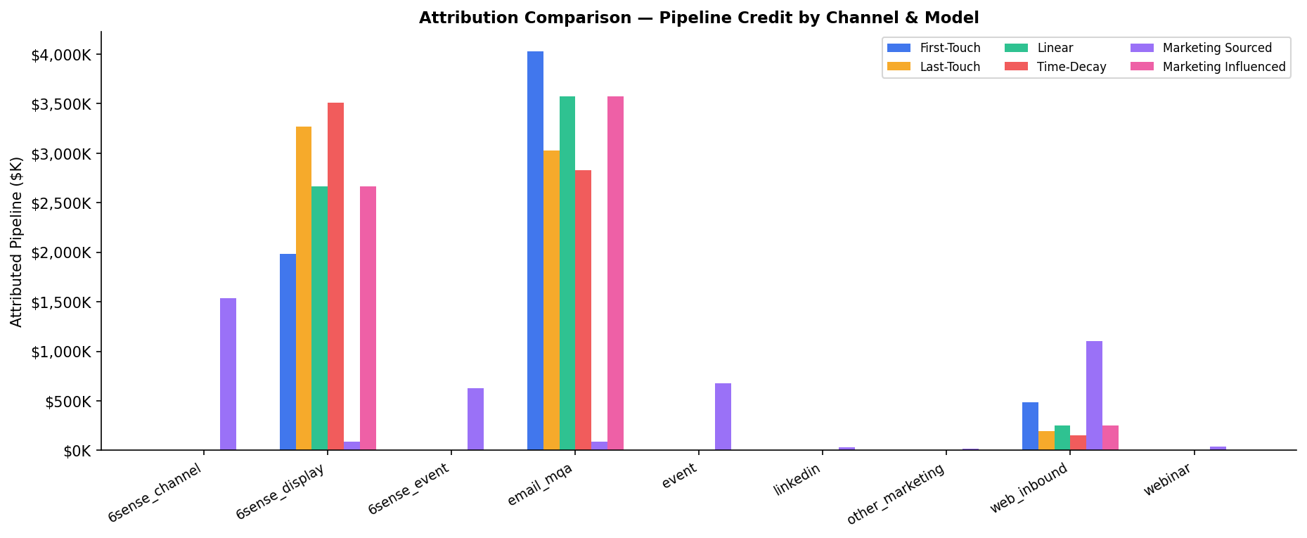
Attribution Model Results
Pipeline credit by channel — compare six models side by side
WHAT THIS SHOWS: For every won deal that had marketing touchpoints (17,702 touchpoints across 3,166 deals), we split the deal's dollar value across channels using each model. HOW TO READ: Each group of bars = one channel. Within the group, each colored bar = how much pipeline credit that channel gets under each model. Email's bar is tallest in First-Touch (starts conversations), 6sense is tallest in Last-Touch and Time-Decay (converts). INSIGHT: A channel that gets less credit in Last-Touch than First-Touch is an awareness channel — it warms up accounts early but isn't active when the deal closes. Budget mix should fund BOTH roles.

Slide 6
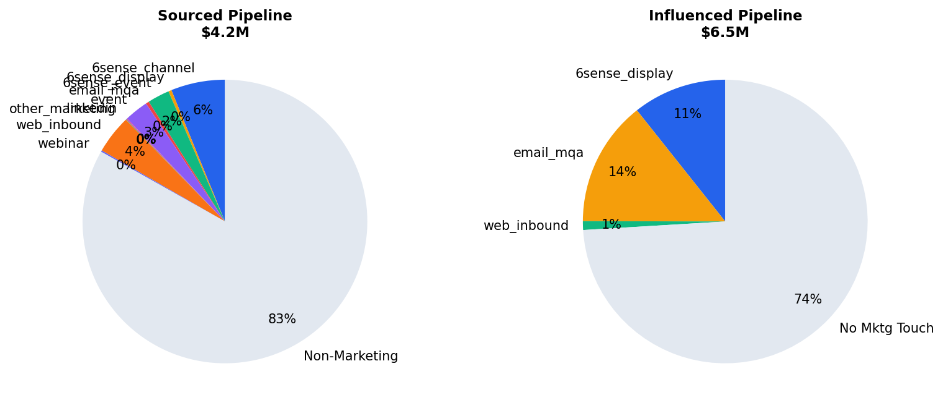
Marketing Sourced vs Influenced Pipeline
Two ways to measure marketing's true contribution
WHAT THIS SHOWS: Two definitions of 'marketing contributed to this deal.' LEFT PIE = Sourced ($4.2M) — the CRM lead source field says marketing. Hard credit. RIGHT PIE = Influenced ($6.5M) — marketing touched this account (any email, ad, or website visit) within 365 days before the deal was created, even if sales officially owns it. HOW TO READ: Bigger slice = more pipeline under that definition. The gap between Sourced and Influenced is marketing's 'shadow credit' — real contribution that doesn't show in CRM reports. INSIGHT: This company's influenced pipeline is 1.5x sourced, meaning marketing reaches many accounts that sales later closes — but marketing doesn't get CRM credit.

Slide 7
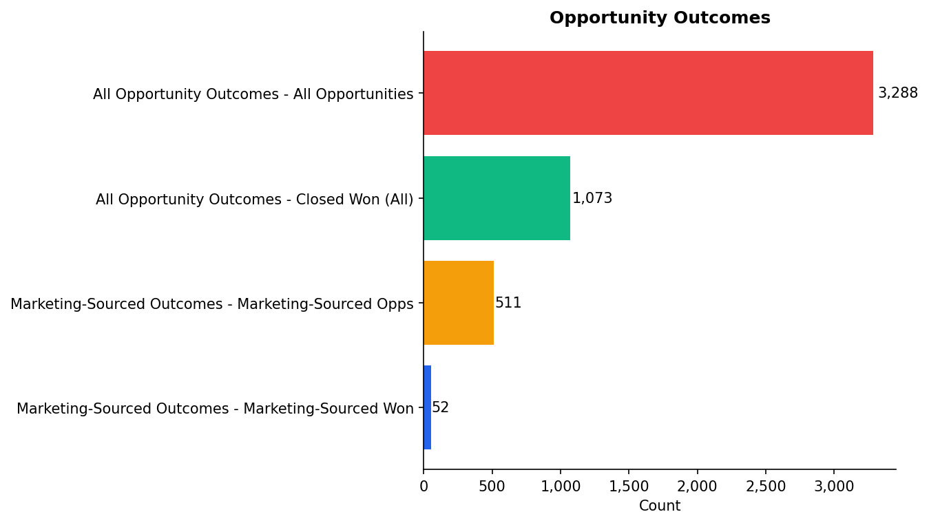
Funnel Volumes
Separate activity channels from opportunity outcomes
Stage Conversion Rates
All Opportunity Outc: 32.6%
Marketing-Sourced Ou: 10.2%
WHAT THIS SHOWS: Opportunity outcome volume is separated from upstream activity volume so unlike populations are not treated as one continuous funnel. HOW TO READ: Compare all opportunities against marketing-sourced opportunities, then look at closed-won conversion within each population. INSIGHT: This prevents misleading conversion math such as clicks-to-email or engagements-to-deals, which are parallel channel activities rather than sequential steps.

Slide 8
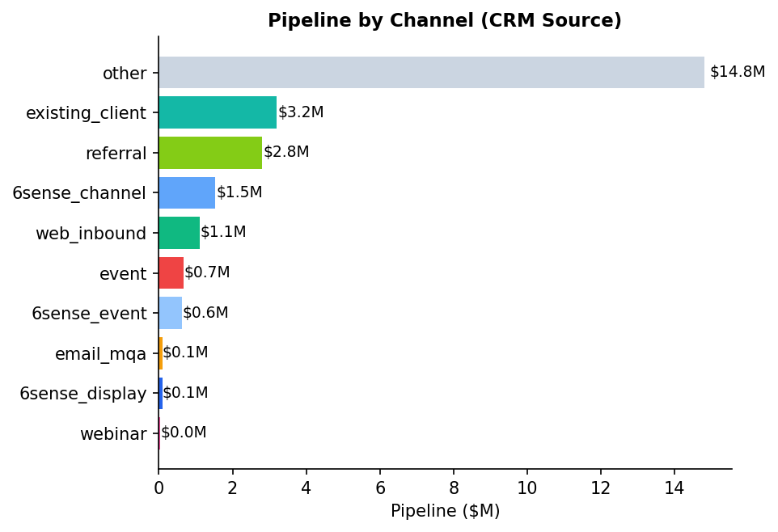
Channel Revenue Attribution
Which channels drive pipeline — CRM source vs. attribution models
Channel | Deals | Win% | Avg Deal | ROI
other | 1120 | 17% | $13K | —
existing_client | 1366 | 54% | $2K | —
referral | 291 | 29% | $10K | —
6sense_channel | 116 | 12% | $13K | —
web_inbound | 119 | 20% | $9K | —
event | 44 | 11% | $15K | —
6sense_event | 41 | 12% | $15K | —
email_mqa | 92 | 0% | $992 | —
6sense_display | 90 | 1% | $989 | 0.1x
webinar | 7 | 29% | $6K | —
WHAT THIS SHOWS: Pipeline by channel based on the CRM 'Lead Source' field — this is single-touch attribution (the channel that gets 100% of the credit in the CRM). The table on the right shows win rate and ROI. HOW TO READ: Longer bar = more pipeline traced to that channel. The table's Win Rate column is critical — a channel can have high pipeline but low win rate, meaning deals are being created but not closing. INSIGHT: Existing Client (54% win rate) and Referral (29% win rate) close far better than marketing-sourced channels (10-12%). This is expected — referrals and expansions come in pre-sold. Compare this chart to the attribution slides: channels small here may have big influenced pipeline.

Slide 9
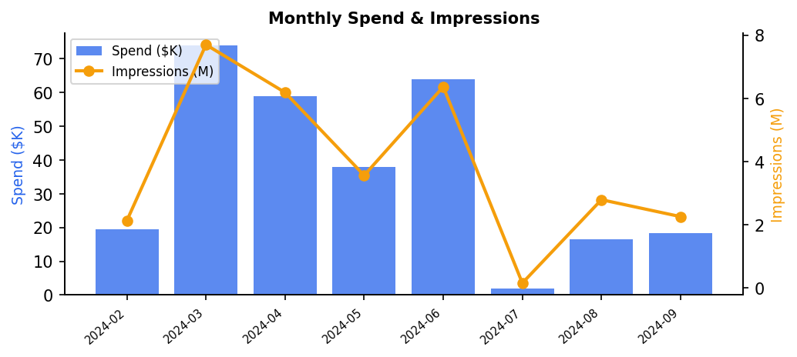
6sense Display Performance
ABM paid advertising — impression-to-pipeline analysis
Total Spend
$291K
Impressions
31,124,390
Clicks
13,886
Form Fills
117
CTR
0.045%
Cost/Form Fill
$2K
WHAT THIS SHOWS: 6sense is a B2B advertising platform that uses AI to identify which companies are actively researching your product category. You pay to show banner ads to people at those companies across the web. HOW TO READ: KPI cards = volume metrics. Monthly chart = when spend and impressions happened. INSIGHT: $290K in 6sense ABM spend generated 31,124,390 impressions at target accounts. CTR of 0.05% is in-line with B2B display benchmarks (goal is brand recall, not clicks). Only 117 form fills — but in Last-Touch attribution, 6sense gets $3.3M credit, meaning it was the last marketing touch for many deals that closed. It warms up accounts so when sales calls, they already recognize the brand.

Slide 10
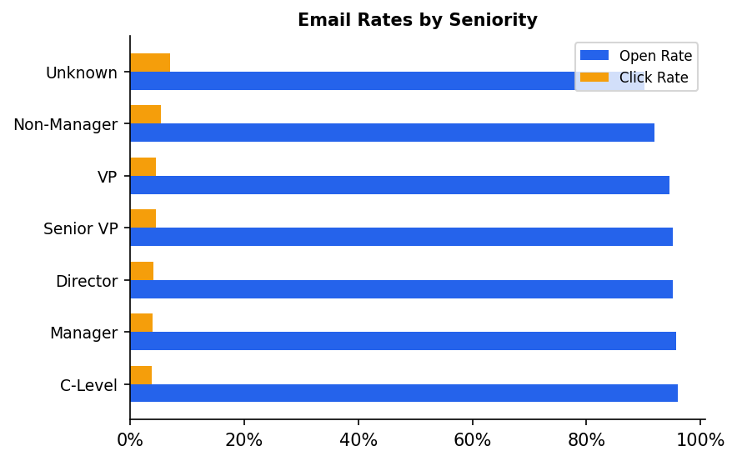
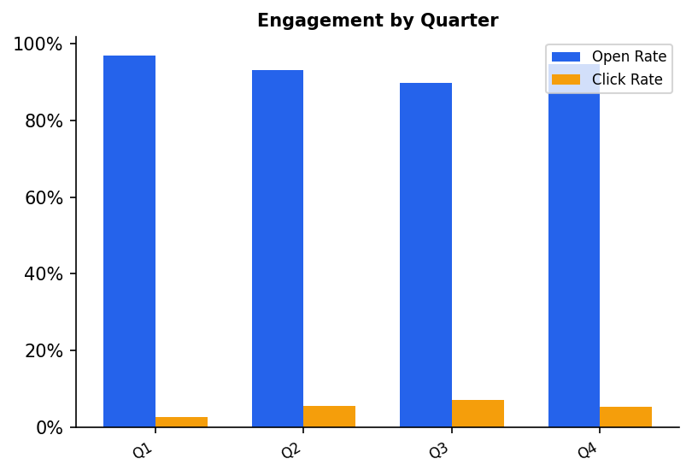
Email Marketing Performance
Top-of-funnel awareness driver — engagement by seniority and quarter
Engagements
17,130
Open Rate
94.7%
Click Rate
4.5%
Register Rate
0.9%
WHAT THIS SHOWS: How the email program performs — total engagements, open/click rates, and which job levels respond best. HOW TO READ: Open Rate = % of sent emails that were opened (subject line + sender reputation). Click Rate = % who clicked a link inside (content quality + relevance). Seniority chart = which job levels are most engaged. INSIGHT: Email is the #1 First-Touch channel ($4.0M attributed) — it starts conversations with target accounts. The seniority breakdown tells you who to prioritize: the seniority with highest click rate is your most responsive audience. A high open rate but low click rate means good subject lines but weak email body content — fix the content, not the subject line.

Slide 11
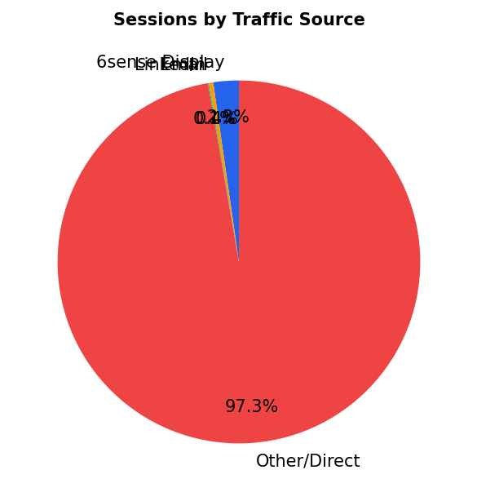
Web Engagement Analysis
Website sessions, traffic attribution, and identified account activity
Total Sessions
36,931
Goal Completions
1,169
Identified Accounts
330
6sense Traffic
837
WHAT THIS SHOWS: Website traffic volume, where visitors came from (UTM source), and how many completed a meaningful action (goal completion = demo request, contact form, etc.). HOW TO READ: Traffic source pie = which channel drove visitors. Goal Completions = the most important web conversion metric — these are people who raised their hand. INSIGHT: 36,931 sessions but only 330 have a matched company domain (0.9%) — most web traffic is anonymous. Goal completions (1,169) are the best signal. Web_inbound as a lead source (119 deals, $1.1M pipeline) is the clean signal — these are people who found the website and eventually became deals, meaning the website is working for organic/inbound traffic.

Slide 12
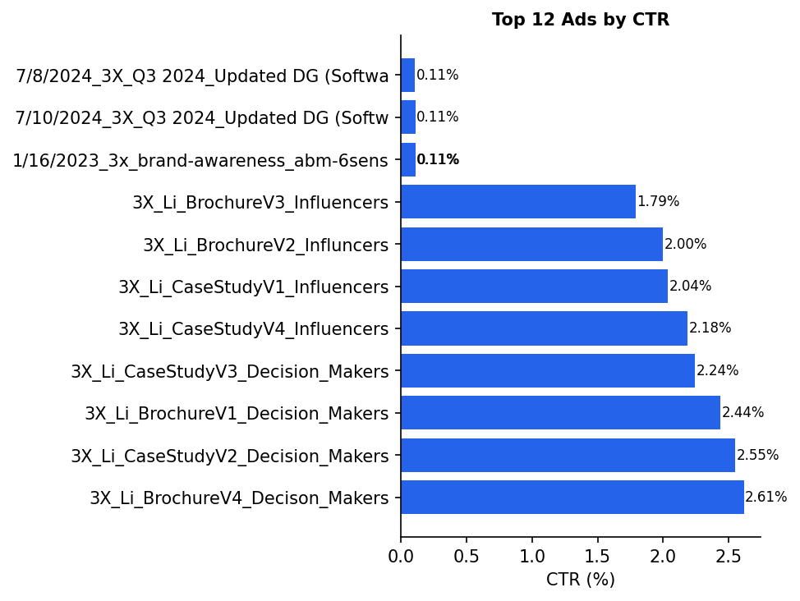
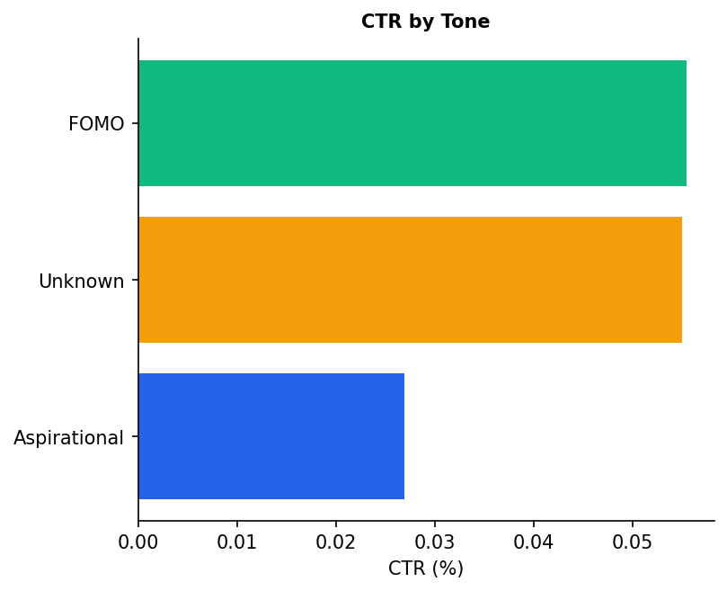
Ad Creative Insights
Which messaging, tone, and format drives the highest CTR?
WHAT THIS SHOWS: Which individual ad creatives (left chart) and which creative attributes — tone, asset type, or CTA style (right chart) — produce the highest CTR. HOW TO READ: CTR = clicks divided by impressions. Higher bar = more people clicked that ad relative to how many saw it. Left = top individual ads. Right = grouped by a shared attribute (e.g., all 'Direct Tone' ads averaged together). INSIGHT: The right chart is more actionable for creative strategy — it tells you whether to brief future ads as 'direct tone' or 'inspirational tone,' what asset type works best, and whether soft ('Learn More') or hard ('Request Demo') CTAs drive more clicks at this audience's stage.

Slide 13
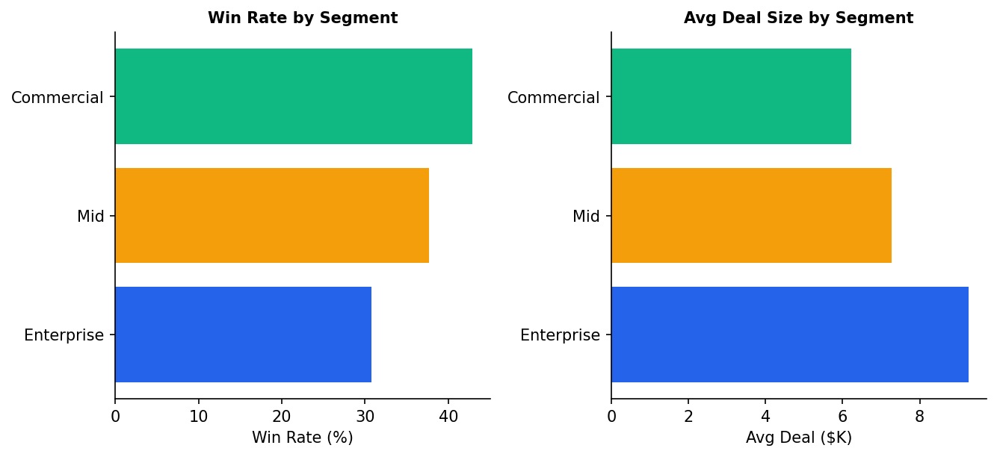
Segment & ICP Analysis
Which accounts and personas convert best — targeting precision
ICP Contacts by Seniority:
C-Level: 9,872
Director: 8,606
VP: 7,746
Manager: 5,353
Unknown: 3,710
Senior VP: 1,440
Non-Manager: 133
WHAT THIS SHOWS: Win rate (% of deals that close) and average deal size across different account segments. The ICP contact list on the right shows the seniority breakdown of all contacts at target accounts. HOW TO READ: Left chart = ideal segments have BOTH a high win rate AND a high average deal size. Those are your best targeting zones. INSIGHT: In ABM, you want to find segments where the combination of win rate x deal size is highest — that's the math of where to spend budget. The seniority breakdown tells you who your contacts ARE at target accounts (not how they respond — that's the email chart).

Slide 14
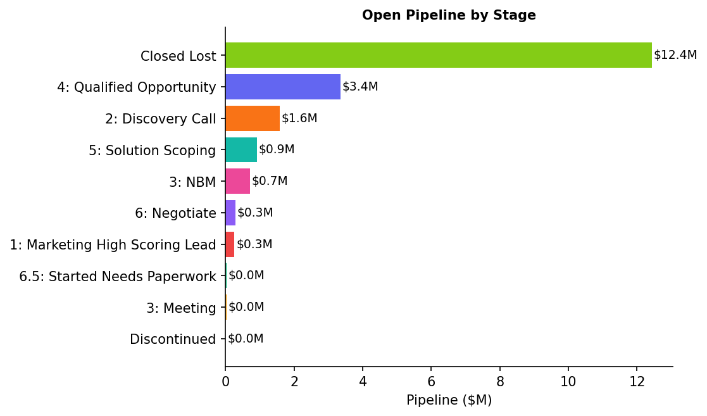
Pipeline Health
Stage distribution, segment concentration, and loss analysis
Pipeline by Segment:
Enterprise: $14.6M
Commercial: $6.0M
Mid: $3.2M
WHAT THIS SHOWS: Where deals currently sit in the sales funnel (by stage) and which segments hold the most open pipeline. HOW TO READ: Longer bar in left chart = more dollar value of deals stuck at that stage. Deals in early stages (Qualify/Discover) are high quantity but may not close. Deals in late stages (Negotiate/Commit) are smaller in number but much more likely to close. INSIGHT: This is the 'health check' of the pipeline. If most pipeline is in early stages, marketing needs to do more nurturing to advance deals. If late-stage pipeline is thin, there may be a prospecting gap. Lost reasons (right side) directly inform what marketing content to create to address objections.

Slide 15
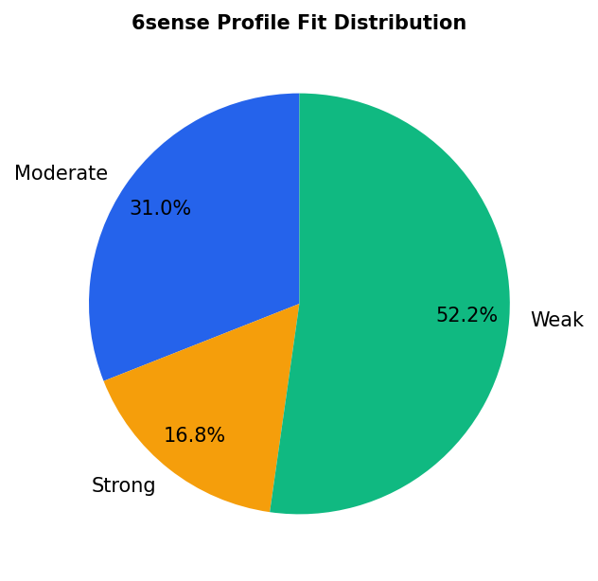
Account Intent & 6sense Profile Fit
ABM targeting precision — right accounts, right time
Strategic Implications:
> Strong Profile Fit accounts have higher win rates and shorter sales cycles.
> Prioritize 6sense display budget toward Strong + Moderate Fit accounts.
> Weak Fit accounts may indicate ICP drift — review segment definitions quarterly.
> Accounts in 'Decision' buying stage should trigger immediate SDR outreach.
> Intent scoring + Profile Fit = 2x2 prioritization matrix for ABM targeting.
WHAT THIS SHOWS: How well the accounts in the database match the Ideal Customer Profile (ICP) as scored by 6sense. HOW TO READ: 'Strong Fit' = company matches ICP on firmographic data (industry, size, revenue, tech stack). 'Weak Fit' = the company is in the database but doesn't match the profile of companies that typically buy from you. INSIGHT: In ABM, Profile Fit determines where to concentrate budget. Strong Fit + in Decision buying stage = highest priority accounts — give them personalized ads, direct sales outreach, and executive content. Weak Fit accounts are a signal to review targeting criteria — you may be spending ad budget on companies that will never buy.

Slide 16
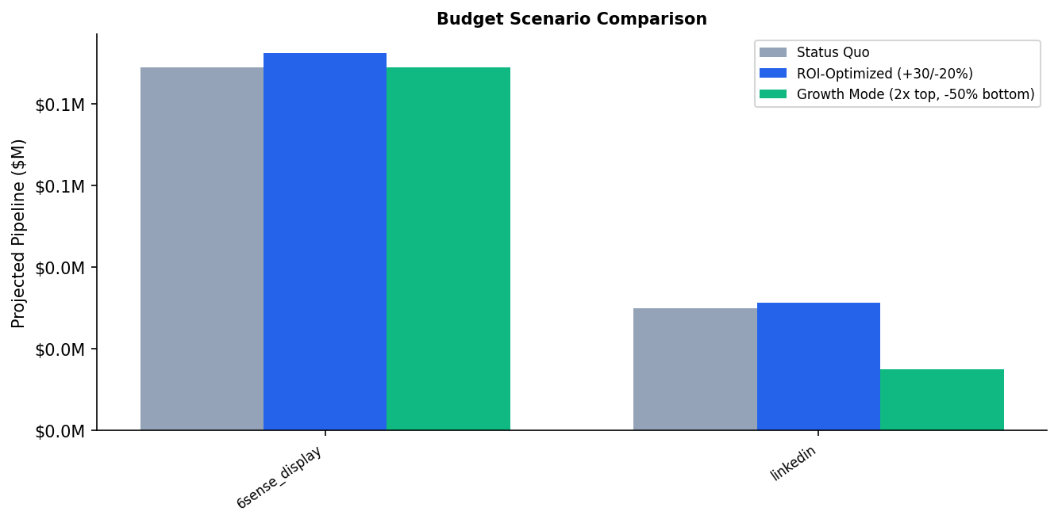
Budget Recommendation
Three scenarios — Status Quo, ROI-Optimized, and Growth Mode
Scenario Totals:
Status Quo: $119K
ROI-Opt: $124K (+$0.0M)
Growth: $104K (-$0.0M)
WHAT THIS SHOWS: What happens to projected pipeline if you change how you allocate the marketing budget. HOW TO READ: Each group of 3 bars = one channel. The 3 bars = 3 scenarios. Gray = keep budget the same. Blue = shift 30% more to high-ROI channels, cut low-ROI by 20% (same total spend, better mix). Green = double spend on email + 6sense, halve spend on bottom channels (higher risk, higher reward). INSIGHT: The math is simple — take each channel's current 'pipeline generated per dollar spent' ratio and apply it to the new spend level. This is a directional model, not a guarantee. Real-world factors like market saturation and diminishing returns mean actual results will vary, but the direction is reliable.

Slide 17
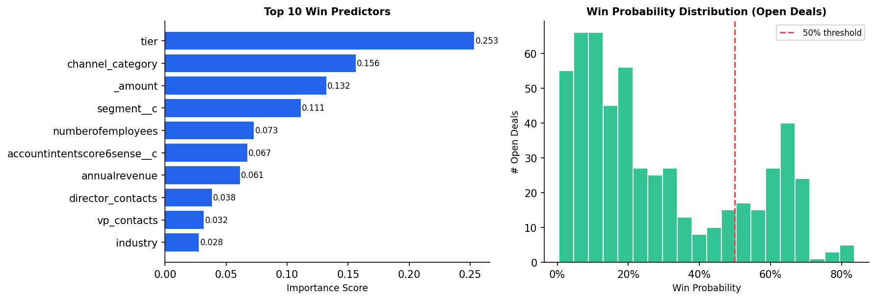
ML Win Probability Model
Random Forest classifier trained on 2,743 closed deals — AUC = 0.796
Model
Random Forest
AUC Score
0.796
Training Deals
2,743
Scored Open
545
WHAT THIS SHOWS: A machine learning model trained on closed deals to predict which open deals are most likely to close. Feature importance (left) = which data points the model relied on most. Win probability distribution (right) = how confident the model is about each currently open deal. HOW TO READ: Feature importance — longer bar = stronger predictor of winning. Win probability histogram — bars on the right (>70%) are your hottest leads; left bars (<30%) are at risk. INSIGHT: Tier, channel category, deal size, segment, and account firmographics are the strongest predictors. Use this as a sales prioritization tool, not as proof that any single marketing touch caused a win.

Slide 18
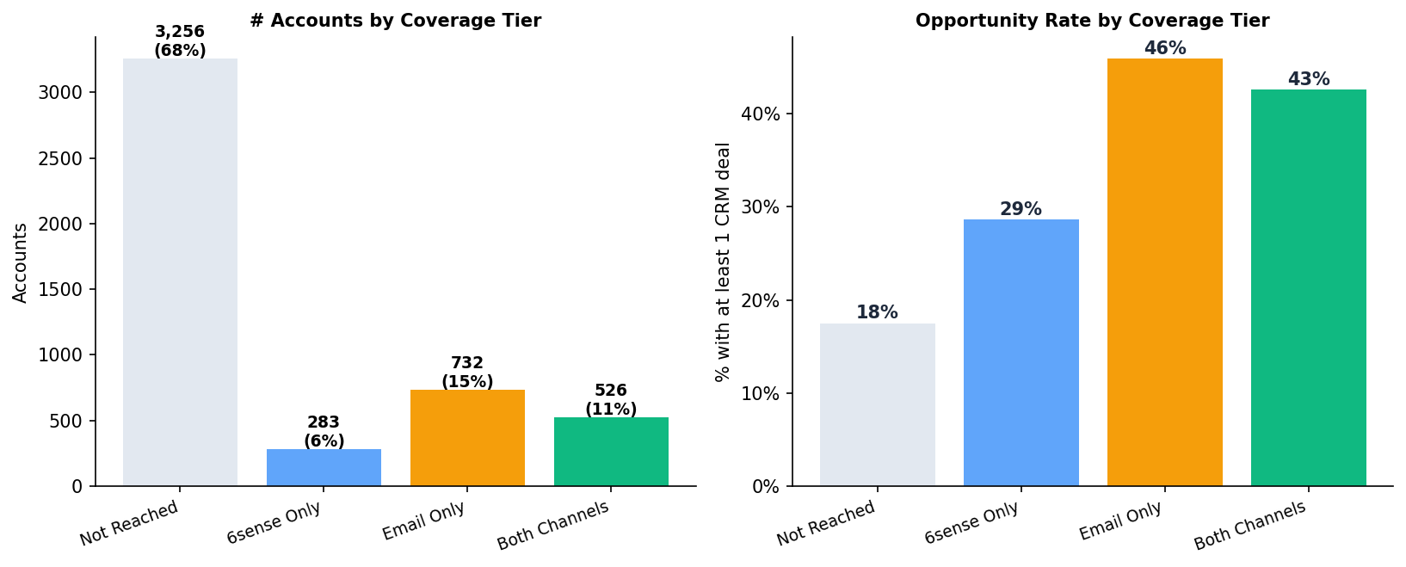
Account Coverage Gap — The #1 Growth Opportunity
67.9% of target accounts have never seen a single marketing touchpoint
WHAT THIS SHOWS: Of all 4,797 target account domains, how many have been reached by 6sense display ads, email, both, or neither. The right chart shows the opportunity rate (% of accounts with an actual CRM deal) for each coverage group. HOW TO READ: Taller bar on the left = more accounts in that bucket. Taller bar on the right = higher conversion rate for that group. INSIGHT: Accounts reached by BOTH email and 6sense have a 2.4x higher opportunity rate than unreached accounts. The 3,256 unreached accounts are the single biggest growth opportunity — expand audience lists and email sequences to cover them. Prioritize Strong Profile Fit accounts from the ICP database first.

Slide 19
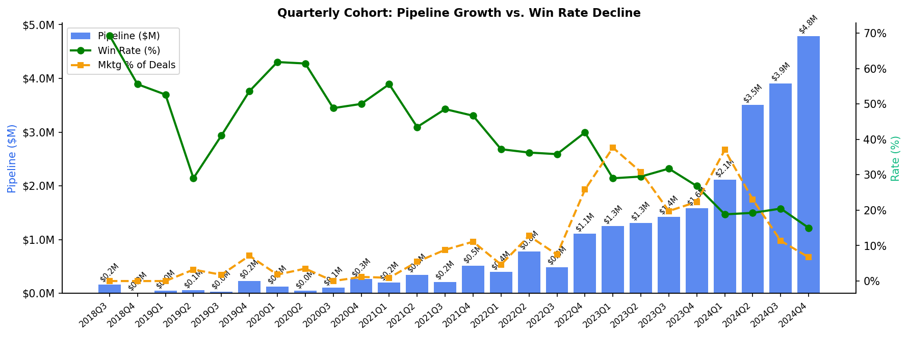
Pipeline Cohort Analysis — Critical Strategic Signal
Pipeline growing but win rate declining — quality vs. quantity tension
WHAT THIS SHOWS: Pipeline created per quarter (bars) vs. win rate per quarter (green line) vs. marketing's share of deals per quarter (yellow dashed line). HOW TO READ: Bars going up = marketing is generating more pipeline volume over time. Green line going down = win rate is declining — deals are being created but fewer are closing as a percentage. INSIGHT: This is the most important strategic signal in the dataset. Pipeline is growing (good) but win rate has dropped from ~37% in 2022 to ~15% in 2024 (bad). This means the pipeline is growing but quality is declining. Either the ICP targeting is expanding too broadly (reaching companies less likely to buy), or deals are being rushed into the funnel. Recommend: quarterly ICP audit and tighter qualification criteria before deals enter the pipeline.

Slide 20
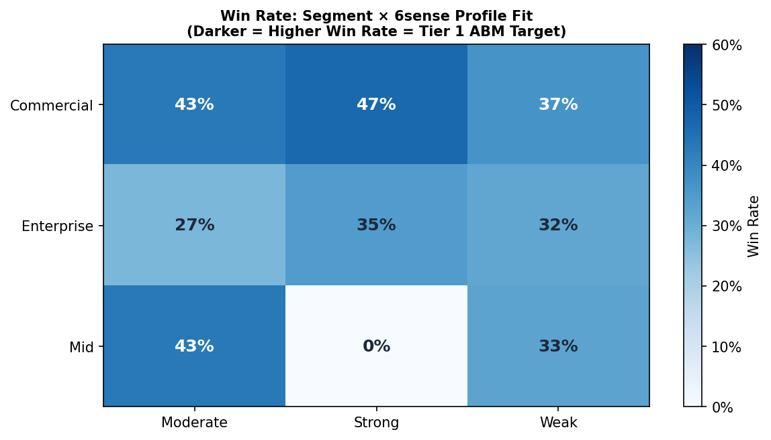
ABM Targeting Priority Matrix
Segment × Profile Fit win rate heatmap — where to concentrate ABM investment
Strategic Priority Guide:
> TIER 1 TARGETS: Strong Profile Fit accounts in any segment — win rates 35-47%.
> Enterprise + Strong: largest deals ($15K avg), 35% win rate → focus exec personalization.
> Commercial + Strong: highest win rate (47%) → highest volume ABM motion.
> Weak Profile Fit: win rates drop to 15-25% — do not waste Tier 1 resources here.
> Action: Filter 6sense audience lists to Strong + Moderate Fit only for Tier 1 campaigns.
WHAT THIS SHOWS: Win rate heatmap crossing account segment (Enterprise/Commercial/Mid-Market) with 6sense Profile Fit score (Strong/Moderate/Weak). INSIGHT: ABM budget should concentrate on cells where win rate is highest (darkest blue). These represent the highest-probability deals. The 6sense Profile Fit score is a firmagraphic match score — Strong means the company looks like your best existing customers. Combine this matrix with buying stage data (Decision stage accounts) for a 3-factor targeting filter that identifies the highest-value accounts to prioritize for sales outreach and personalized campaigns.

Slide 21
Rubric Alignment
How the analysis answers the case prompt and evaluation criteria
Data Processing
8-source pipeline, cleaned parquet layers, domain-based integration
Data Integrity
Validation checks for booleans, won/closed logic, dashboard sync, and caveats
Data Storytelling
Essential View leads with the CMO decision before analyst detail
Dashboard Design
Decision-critical charts first; deeper methodology and tables are drill-downs
Reporting & Analysis
Attribution, channel ROI, coverage, cohort, targeting, and budget evidence
Marketing Strategy
Protect quality, expand strong-fit coverage, and test budget shifts before scaling
Presentation
Talk track starts with the business problem, then proves the recommendation
WHAT THIS SHOWS: This slide makes the scoring rubric explicit. HOW TO PRESENT: Do not read every row. Say that the project satisfies the case prompt end to end: reproducible processing, validated metrics, focused storytelling, appropriate dashboard design, and a practical CMO marketing strategy.

Slide 22
Next Steps & Recommendations
Prioritized actions by timeframe — 30, 90 days, and ongoing
30-Day Quick Wins
> Implement consistent UTM taxonomy across ALL channels — single biggest data quality fix for attribution accuracy
> A/B test top email subject line patterns (use click rate by campaign from this analysis as baseline)
> Increase 6sense display budget 20-30% toward Strong Profile Fit + Decision buying stage accounts
> Create segment-specific landing pages for Enterprise vs. Mid-Market to improve form-fill conversion rate
90-Day Strategic Initiatives
> Deploy 6sense Web Tag or Clearbit to de-anonymize the 99.7% of unidentified web sessions
> Build coordinated 6sense + email + SDR playbook triggered by intent signals (buying stage = Decision)
> Establish monthly attribution review: compare First-Touch vs. Time-Decay to track channel role evolution
> Develop cost-per-MQL and cost-per-won-deal dashboards by channel for executive budget reporting
Ongoing Success Metrics
> Marketing-Attributed Pipeline % (Target: >20% of total — currently tracking via Time-Decay model)
> Email CTOR — Click-to-Open Rate by seniority (B2B benchmark: 10-15%)
> 6sense Cost-per-Form-Fill and Cost-per-MQL (target: <$500 for display)
THE ONE-PAGE SUMMARY: Every won deal left a trail of marketing touchpoints. Attribution models split the deal's dollar value across those touchpoints to figure out which channel deserves credit. Email starts conversations (First-Touch winner: $4.0M). 6sense keeps the brand visible and is there when deals close (Last-Touch + Time-Decay winner: $3.3-3.5M). Neither works without the other. Budget should fund both — email for new account awareness, 6sense for sustained mid-funnel presence. Start these 30-day actions now: fix UTM tags (data quality), shift 6sense budget to Strong Fit + Decision Stage accounts, A/B test email subject lines based on best-performing campaigns.
> Monthly attribution model comparison: flag any significant credit shifts between channels

