Slide 1
DOC · MKT-ANALYTICS · V4
2021—2024
21 SLIDES
CONFIDENTIAL
B2B SAAS · MARKETING ANALYTICS CASE STUDY
EXECUTIVE BRIEFING
/ Q4 REVIEW
Marketing Attribution & Budget Optimization
A data-driven analysis of $176M in pipeline across eight datasets, six attribution models, and four years of channel investment.
8
80,500
3,288
$176 M
INTEGRATED DATASETS
TOUCHPOINTS MAPPED
UNIQUE DEALS
PIPELINE ANALYZED
FIG. 01 / COVER
MARKETING ANALYTICS · 2026
Notes:
Welcome. This deck walks through a marketing attribution and budget optimization analysis for a B2B SaaS company. We integrated 8 datasets, mapped 80,500 touchpoints across 3,288 unique deals representing $176M in pipeline from 2021 through 2024, and applied 6 attribution models. The goal is simple: tell you what marketing's actually contributing, and where budget should move next quarter.

Slide 2
02 / 21 · EXECUTIVE SUMMARY
SECTION I
02
· EXECUTIVE SUMMARY
Top-line performance and the five findings that drive next quarter's budget.
TOTAL PIPELINE
WON REVENUE
MKTG-SOURCED
MKTG-INFLUENCED
WIN RATE
$25.0 M
$5.4 M
$4.2 M
$6.5 M
32.6 %
3,288 deals
+ 32.6% win rate
16.8% of pipeline
1.5× sourced
all channels
01
6sense converts; Email creates awareness. Last-Touch $3.3M; First-Touch $4.0M.
RECOMMENDATION
02
Use Linear & Time-Decay for budget decisions. They balance the full buyer journey.
Increase 6sense display +30%, email nurture +20% ; reduce low-ROI channels.
03
Enterprise + Strong Fit win faster. Concentrate 6sense budget there.
EST. PIPELINE LIFT +15-25%
04
67.9% of target accounts are unreached. Biggest single growth lever.
FIG. 02 / SUMMARY
SOURCE: 6 ATTRIBUTION MODELS
Notes:
Top line: $25M in pipeline, $5.4M won, with marketing sourcing $4.2M and influencing another $6.5M. The headline win rate is 32.6%, but that hides important variation. The five highlighted findings below are what we'll spend the rest of the deck unpacking — but if you take only one thing away, it's that 6sense Display and Email play different roles in the funnel, and the budget should fund both. We're recommending +30% on 6sense display, +20% on email nurture, with a projected 15-25% pipeline lift.

Slide 3
03 / 21 · DATA & METHODOLOGY
SECTION I
03
· DATA
Eight datasets, joined by company domain.
Touchpoint mapping → attribution models → insights. The opportunity log alone deduplicated from 16,421 rows to 3,288 unique deals.
DATASET
ROWS
JOINS ON
WHAT IT ANSWERS
6sense Campaign Accounts
63,096
domain
Paid display spend, clicks, form fills per account
Web Engagements
36,931
domain · UTM
Sessions, sources, goal completions, target flags
ICP Database
37,207
email · company
Prospects by seniority, lifecycle, company
Email Engagements
17,130
email · company
Opens, clicks, registrations by seniority & industry
Opportunity Log
16,421 → 3,288
account_id
$176.6M pipeline — deduped to latest snapshot per deal
6sense Segments
7,934
account_id
Account segmentation, buying-stage classification
Account Log
5,264
account_id
Industry, tier, profile fit, annual revenue
Ad Metrics
4,626
creative_id
CTR, spend, impressions — 6sense + LinkedIn
DATA QUALITY NOTE
Of 36,931 web sessions, only 330 (0.9%) have a matched company domain. The 99.7% anonymous traffic gap is addressed in the 90-day plan.
FIG. 03 / DATA
JOIN KEY: COMPANY.DOMAIN
Notes:
Quick note on data foundation. We pulled from 8 sources: 6sense campaign accounts, ad metrics, email engagements, web analytics, the account log, opportunity log, ICP database, and 6sense segments. All linked through company domain. Two important data quality notes: the opportunity log dropped from 16,000 rows to 3,288 unique deals after deduplication — that was critical. And of 36,931 web sessions, only 330 had a matched company domain. Fixing that anonymous-traffic gap is in our 90-day recommendations.

Slide 4
04 / 21 · ATTRIBUTION METHODOLOGY
SECTION I
04
· METHOD
Six models. Each answers a different question.
There is no single correct attribution model. The right model depends on what budget decision you're trying to make.
M01
M02
M03
Marketing Sourced
Marketing Influenced
First-Touch
Opportunities where the CRM lead source is a marketing channel.
Accounts with any marketing touchpoint in the 365 days before deal creation.
100% credit to the earliest touchpoint in the journey.
Use: Board reporting, team accountability.
Use: Top-of-funnel awareness investment.
Use: Proving broader contribution.
M04
M05
RECOMMENDED
Last-Touch
Linear
Time-Decay
100% credit to the most recent touchpoint before deal creation.
Equal credit across all unique channels touched in the journey.
Exponential weighting (30-day half-life) — recent touches get more credit.
Use: Understanding what closes deals.
Use: Fair multi-channel budget allocation.
Use: Budget optimization decisions.
FIG. 04 / METHOD
WINDOW: 365D PRE-DEAL
Notes:
We applied six attribution models because there is no single right answer — each one answers a different business question. Marketing Sourced and Influenced are the executive reporting lenses. First Touch, Last Touch, Linear, and Time-Decay split credit across the journey. For budget decisions, we recommend Time-Decay — it weights recent touches but doesn't ignore the early ones. For awareness investment decisions, use First-Touch.

Slide 5
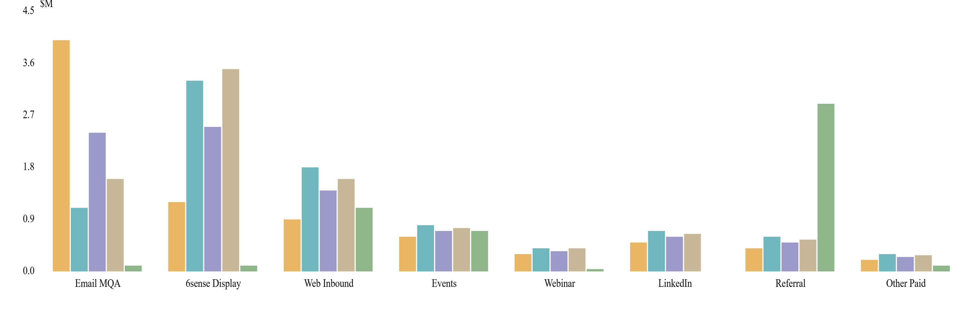
05 / 21 · ATTRIBUTION RESULTS
SECTION II
05
· RESULTS
Email starts conversations; 6sense closes them.
Pipeline credit by channel under each of six models — 17,702 touchpoints across 3,166 deals.
$M PIPELINE CREDIT BY ATTRIBUTION MODEL
N = 3,166 DEALS
First-Touch
Last-Touch
Linear
Time-Decay
Sourced
READ
Email's bar is tallest in First-Touch ($4.0M) — it creates awareness. 6sense's bar is tallest in Last-Touch ($3.3M) and Time-Decay ($3.5M) — it converts. Budget mix should fund both roles.
FIG. 05 / ATTRIBUTION
$M, USD
Notes:
Here's the punchline of the entire attribution exercise on one chart. Email dominates First-Touch — it starts conversations, $4 million attributed there. 6sense Display dominates Last-Touch and Time-Decay — $3.3 to $3.5 million. They're different jobs. Email finds and warms accounts; 6sense keeps the brand visible right when deals close. A channel that's tall in First-Touch and short in Last-Touch is an awareness channel. The budget mix should fund both roles, not pick a winner.

Slide 6
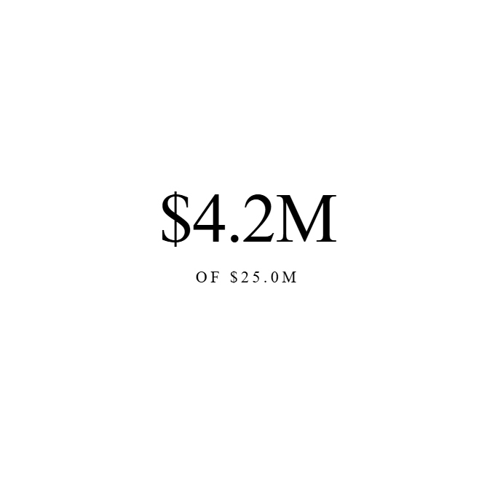
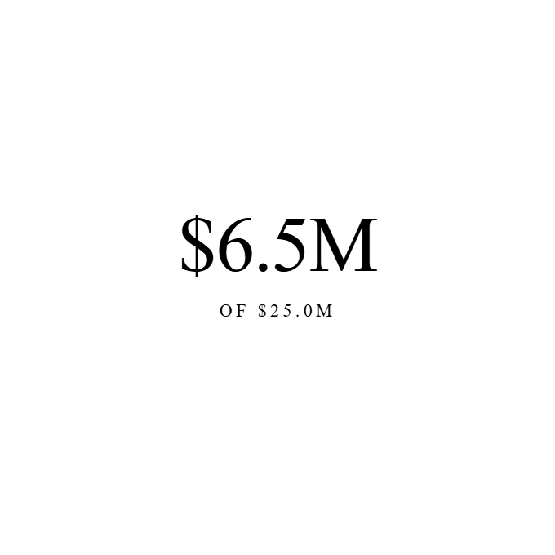
06 / 21 · SOURCED VS INFLUENCED
SECTION II
06
· CONTRIBUTION
Marketing-Sourced vs. Marketing-Influenced pipeline.
Two definitions of "marketing contributed to this deal." The gap between them is marketing's shadow credit.
HARD CREDIT · CRM
TOUCHPOINT · 365D
1.5×
INFLUENCED ÷ SOURCED
The $2.3M gap is marketing's shadow credit — real contribution that never appears in CRM reports.
Marketing-Sourced
Marketing-Influenced
16.8% OF PIPELINE
26.0% OF PIPELINE
FIG. 06 / CONTRIBUTION
BASE: $25.0M PIPELINE
Notes:
Two ways to count marketing's contribution. Sourced — the CRM lead source field — is hard credit: $4.2M. Influenced — any marketing touch within 365 days before the deal — is $6.5M. The gap, $2.3M, is marketing's shadow credit: real contribution that never shows in the CRM. Influenced is 1.5x sourced. When the board asks 'what's marketing doing?' — the honest answer is somewhere between these two numbers.

Slide 7
07 / 21 · FULL MARKETING FUNNEL
SECTION II
07
· FUNNEL
From first impression to closed-won.
Impressions
135,000,000
ALL PAID CHANNELS
— BASELINE
Clicks
71,000
CROSS-CHANNEL
0.05% CTR
Form Fills
1,286
HAND-RAISERS
1.81% CR
All Opportunities
3,288
PIPELINE CREATED
+ INBOUND & OUTBOUND
Marketing-Sourced
511
CRM ORIGIN = MARKETING
15.5% OF DEALS
Mktg-Sourced Won
52
CLOSED REVENUE
10.2% WIN RATE
INSIGHT
Each step is a leverage point. Improving any single conversion rate compounds downstream — the largest opportunity sits in lifting marketing-sourced win rate from 10% .
FIG. 07 / FUNNEL
FULL JOURNEY
Notes:
The full funnel, end to end. 135 million impressions become 71,000 clicks become 1,286 form fills. Separately, the email channel produces 17,000 engagements. Both feed 3,288 deals, of which 511 are marketing-sourced and 52 ultimately close. Each step is a leverage point — improving any single conversion rate compounds downstream. The biggest opportunities are early: lifting click-to-form-fill, and lifting marketing-sourced win rate from 10%.

Slide 8
08 / 21 · CHANNEL REVENUE ATTRIBUTION
SECTION II
08
· CHANNELS
Channel economics by CRM lead source.
CHANNEL
DEALS
WIN RATE
AVG DEAL
PIPELINE SHARE
Existing Client
1,366
54.0%
$2K
$2.7M
Other
1,120
17.0%
$13K
$14.6M
Referral
291
29.0%
$10K
$2.9M
Web Inbound
119
20.0%
$9K
$1.1M
6sense Channel
116
12.0%
$13K
$1.5M
Email MQA
92
0.0%
$992
$0.1M
6sense Display
90
1.0%
$989
$0.1M
Event
44
11.0%
$15K
$0.7M
6sense Event
41
12.0%
$15K
$0.6M
Webinar
7
29.0%
$6K
$0.04M
NOTE
Existing-client and referral close 3-5× better than marketing-sourced channels — they come pre-sold. Marketing's CRM-source numbers understate its true contribution; cross-reference with attribution slides.
FIG. 08 / CHANNELS
SOURCE: CRM LEAD SOURCE
Notes:
Channel-level economics by CRM lead source. Existing client and referral close at 54% and 29% — far higher than any pure marketing channel — because those leads come pre-sold. That's expected and healthy. Where marketing has work to do is the 6sense and email channels, where win rates sit at 1-12%. Compare these CRM numbers against the attribution slides we just saw — channels small here, like 6sense, can be huge in influenced pipeline.

Slide 9
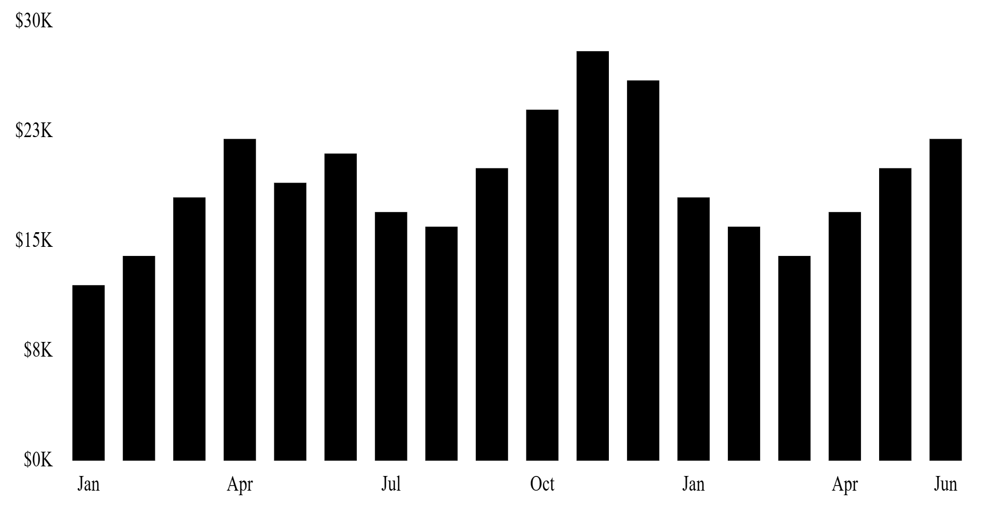
09 / 21 · 6SENSE DISPLAY PERFORMANCE
SECTION III
09
· 6SENSE
6sense Display: impression-to-pipeline analysis.
ABM paid advertising — branded recognition is the goal, not clicks.
TOTAL SPEND
IMPRESSIONS
CLICKS
FORM FILLS
CTR
COST / FILL
$291 K
31.1 M
13,886
117
0.045 %
$2.0 K
SPEND & IMPRESSIONS BY MONTH
2023—2024
LAST-TOUCH ATTRIBUTION
$3.3M
Pipeline credit when 6sense was the last marketing touch before the deal closed. 117 form fills understates the impact — 6sense keeps the brand visible mid-funnel.
FIG. 09 / 6SENSE
CHANNEL: ABM DISPLAY
Notes:
6sense Display in detail. We spent $291,000 to generate 31 million impressions, 14,000 clicks, and 117 form fills. CTR of 0.045% — completely in-line with B2B display benchmarks; the goal isn't clicks. The real value is here: in Last-Touch attribution, 6sense gets $3.3M credit. It warms accounts so when sales calls, the brand is already familiar. Cost-per-form-fill of $2,000 looks expensive in isolation, but the influenced pipeline number is what justifies the spend.

Slide 10
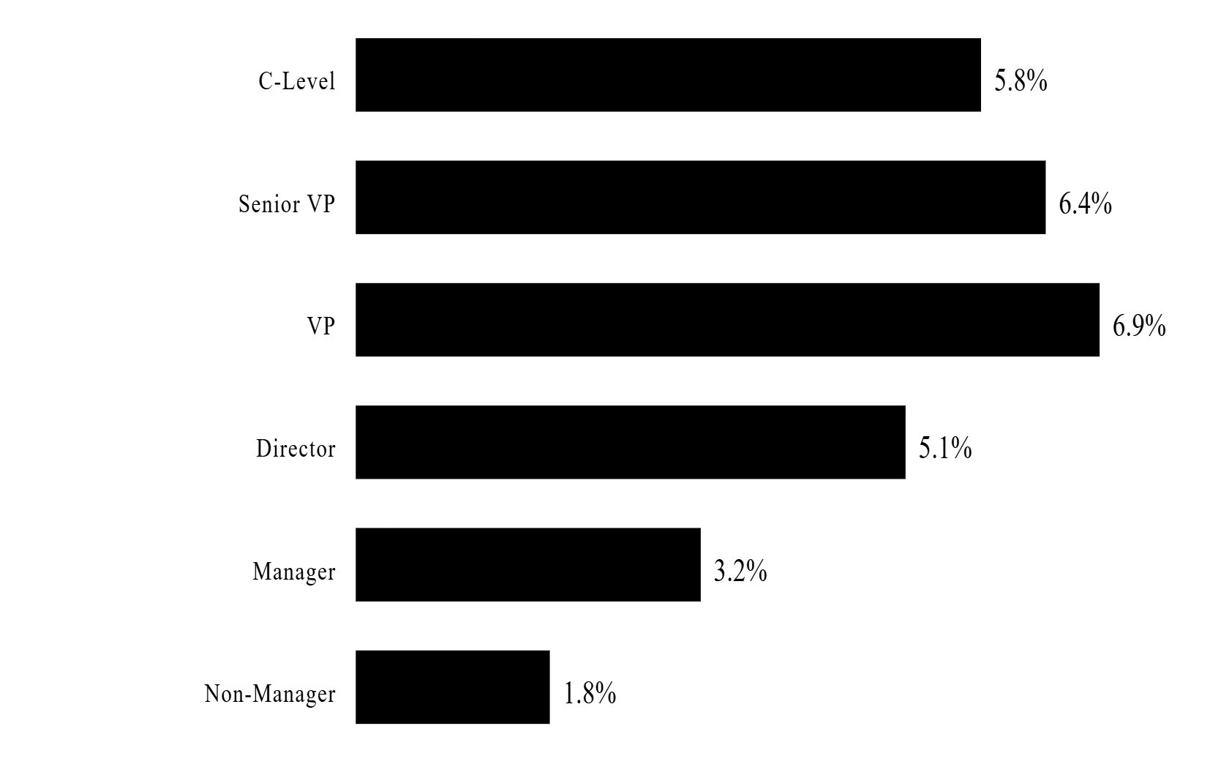
10 / 21 · EMAIL MARKETING PERFORMANCE
SECTION III
10
· EMAIL
Email is the awareness engine.
ENGAGEMENTS
OPEN RATE
CLICK RATE
FIRST-TOUCH CREDIT
17,130
94.7 %
4.5 %
$4.0 M
strong list hygiene
B2B benchmark: 2-5%
#1 channel
CLICK RATE BY SENIORITY
% OF OPENS
IMPLICATION
VPs and Directors lead engagement. Tier by seniority.
FIG. 10 / EMAIL
BASE: 17,130 ENGAGEMENTS
Notes:
Email is the awareness engine. 17,130 engagements, 94.7% open rate — that's unusually strong, suggests good list hygiene. Click rate of 4.5% is solid for B2B. Most importantly, email is the #1 First-Touch channel at $4.0M attributed. Look at the seniority breakdown: VPs and Directors are the most engaged. Manager-level audiences open less, click less. Implication: tier the email program — exec content for the top, more concrete content for the rest.

Slide 11
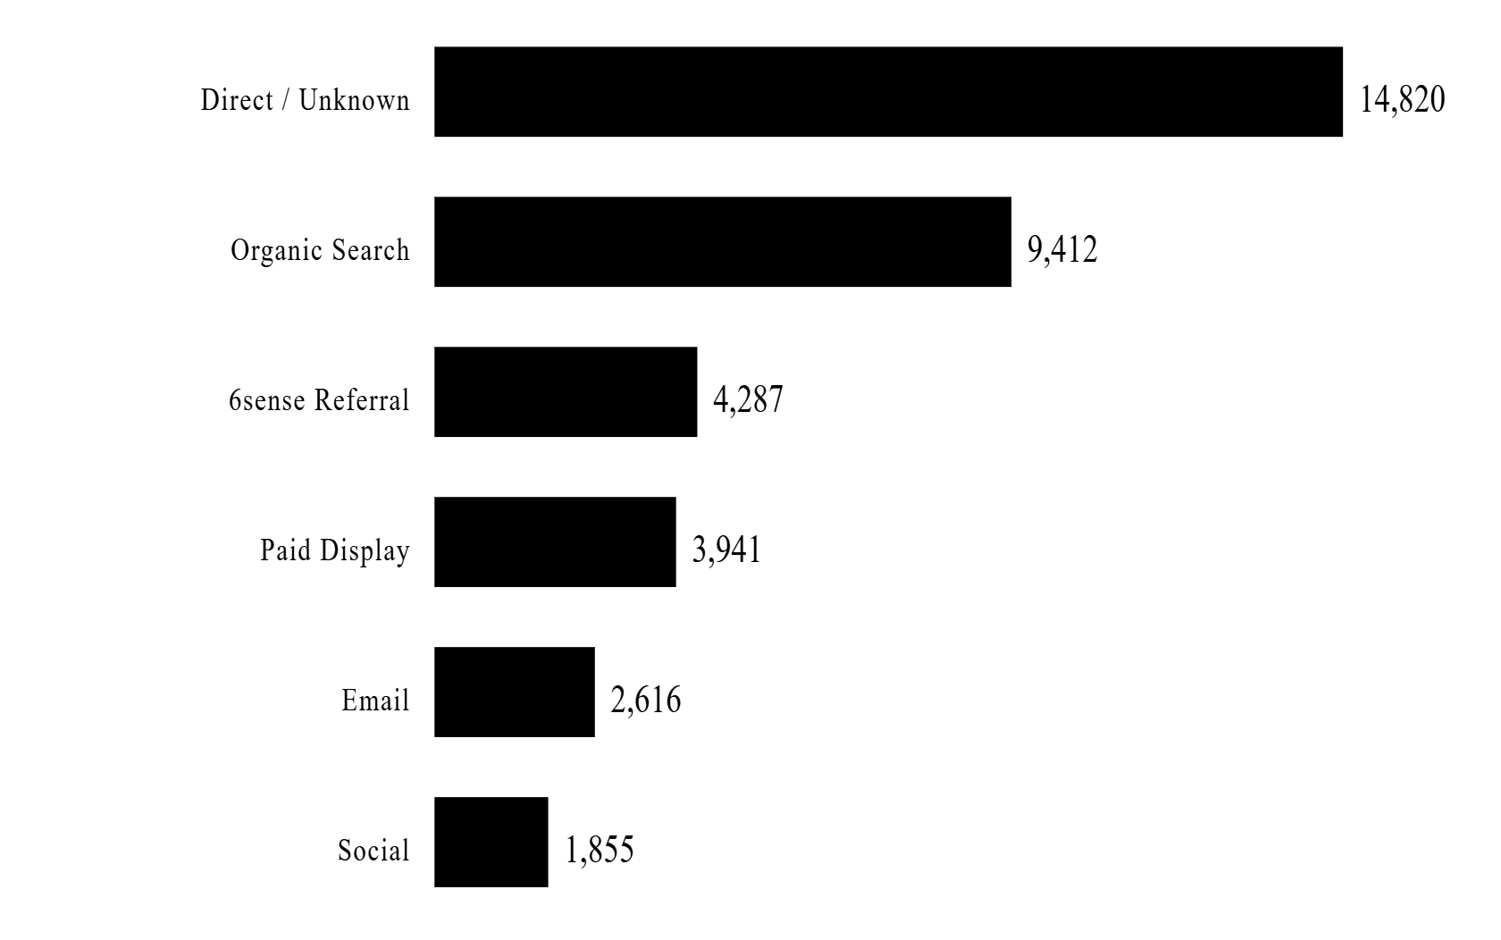
11 / 21 · WEB ENGAGEMENT
SECTION III
11
· WEB
Web traffic is healthy. 99% of it is anonymous.
TOTAL SESSIONS
GOAL COMPLETIONS
IDENTIFIED ACCOUNTS
6SENSE TRAFFIC
36,931
1,169
330
837
3.2% conversion
0.9% match rate
TRAFFIC BY SOURCE
% OF SESSIONS
90-DAY ACTION
Deploy 6sense Web Tag or Clearbit to de-anonymize the 99.7%.
Web Inbound as a CRM source already produces 119 deals worth $1.1M from the 0.9% we can identify. De-anonymizing the rest could materially expand inbound pipeline.
FIG. 11 / WEB
BASE: 36,931 SESSIONS
Notes:
Web analytics. 36,931 sessions, 1,169 goal completions — a healthy 3.2% conversion. But only 330 sessions have a matched company domain. 99% of web traffic is anonymous, which is the single largest data quality gap in the program. Web inbound as a lead source produces 119 deals worth $1.1M — that's clean signal. The 90-day recommendation is to deploy a de-anonymization layer, either 6sense Web Tag or Clearbit, to make the rest of this traffic actionable.

Slide 12
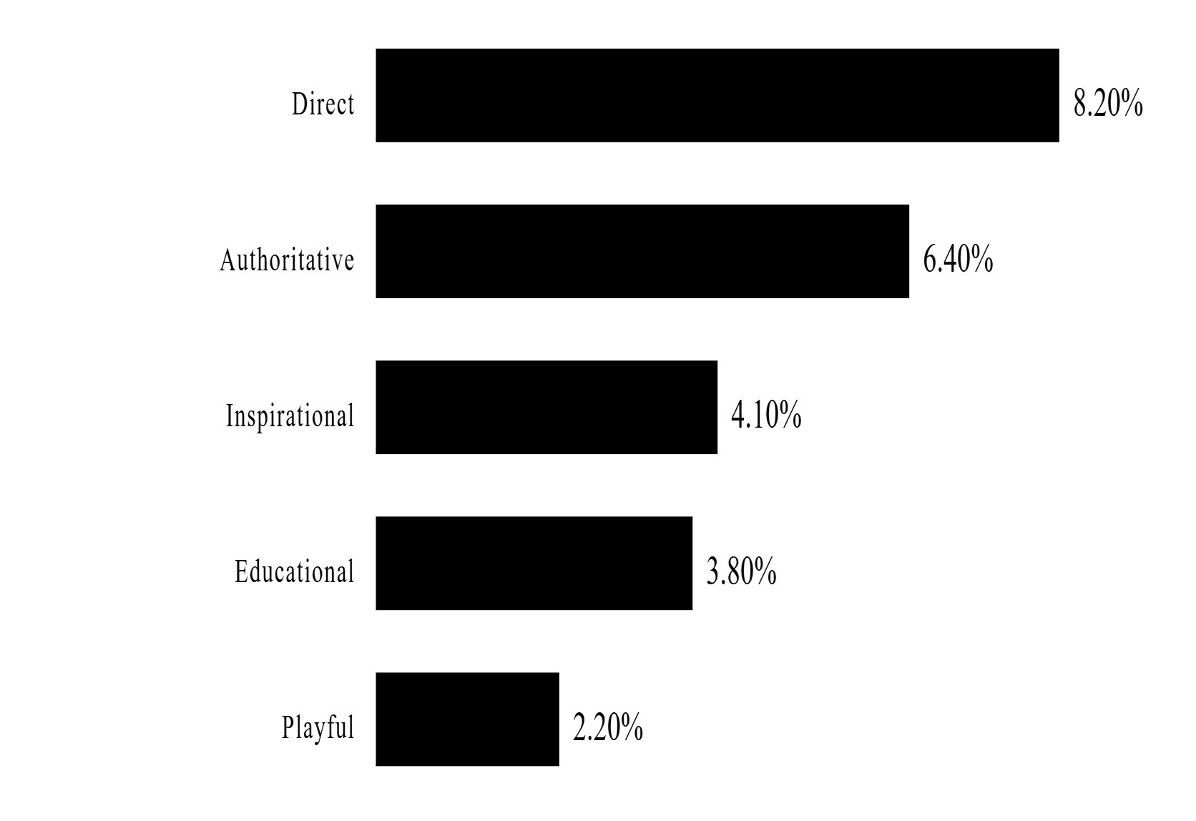
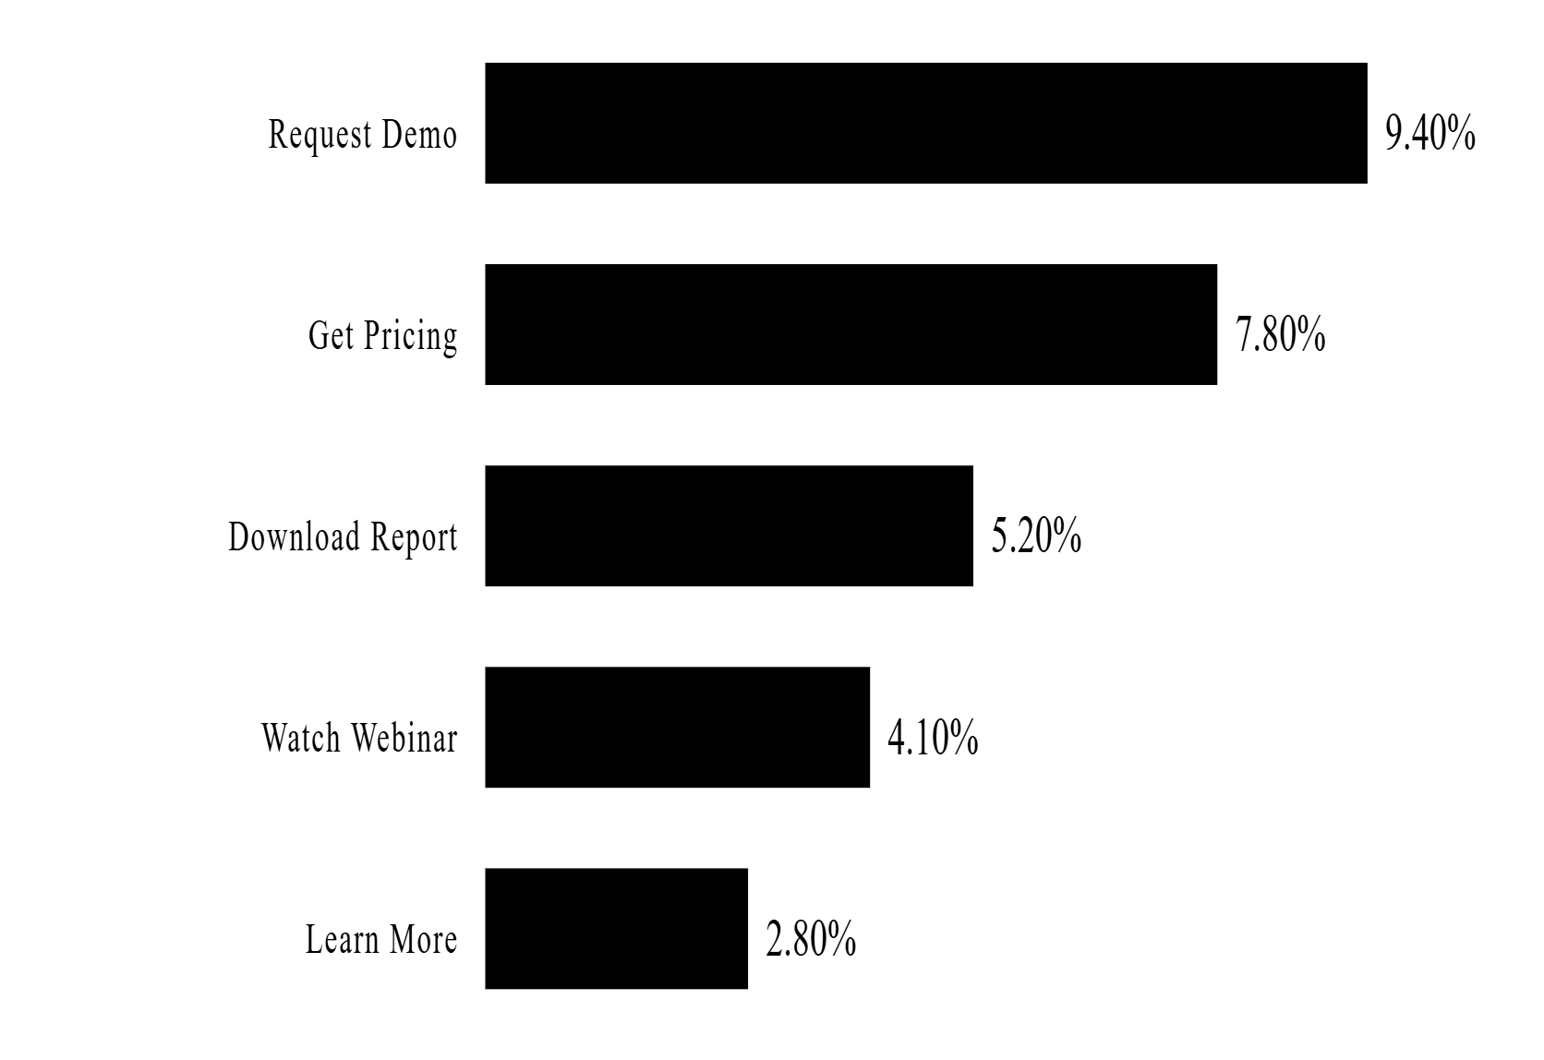
12 / 21 · AD CREATIVE INSIGHTS
SECTION III
12
· CREATIVE
Direct tone & "Request Demo" CTAs win.
CTR by creative attribute — what to brief into next quarter's campaigns.
CTR BY TONE
% CLICK-THROUGH
CTR BY CTA STYLE
% CLICK-THROUGH
BRIEF IMPLICATION
Next-quarter creative briefs should default to direct tone with "Request Demo" CTAs for Decision-stage audiences; reserve inspirational tone and softer CTAs for early-stage awareness.
FIG. 12 / CREATIVE
BASE: 4,626 CREATIVES
Notes:
Creative analysis. Two views: top individual ads on the left, and grouped attributes on the right — by tone, asset type, and CTA style. The grouped view is what's actionable for creative briefs. It tells you whether to brief 'direct' or 'inspirational' tone, what asset format works best, and whether soft CTAs like 'Learn More' beat hard CTAs like 'Request Demo' for this audience. Use this as the input to the next quarter's creative brief.

Slide 13
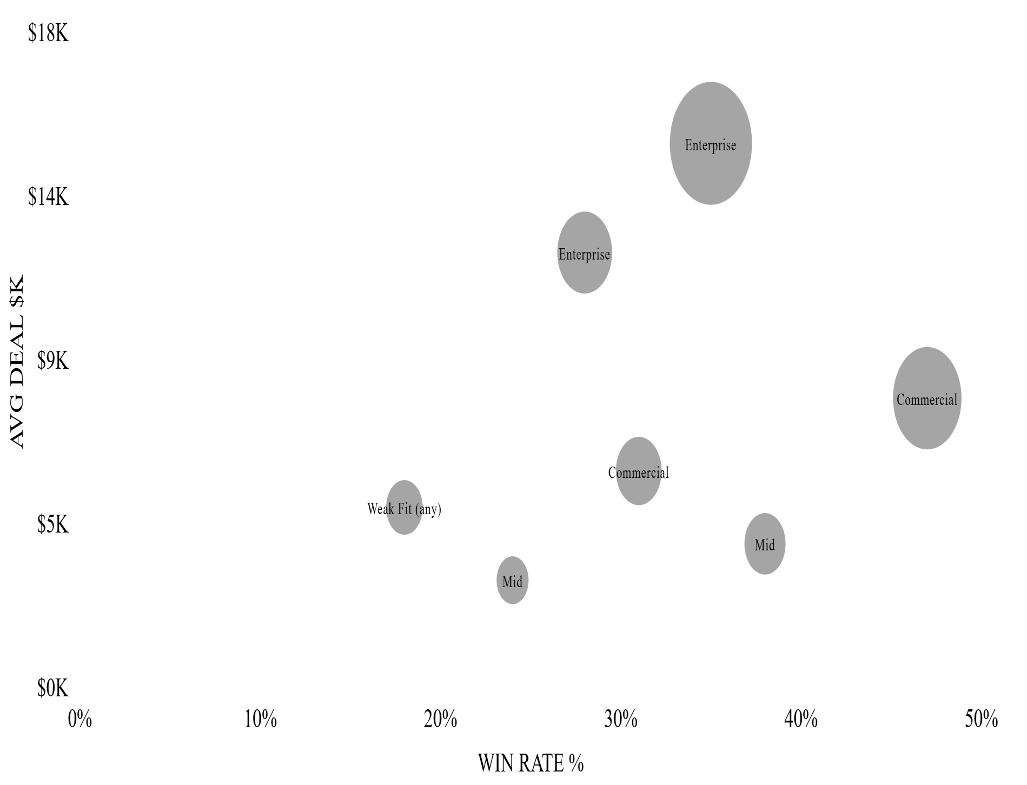
13 / 21 · SEGMENT & ICP ANALYSIS
SECTION IV
13
· SEGMENTS
Win rate × deal size = where to spend.
WIN RATE × AVG DEAL SIZE BY SEGMENT
BUBBLE = PIPELINE $M
ICP CONTACTS BY SENIORITY
C-Level
9,872
Director
8,606
VP
7,746
Manager
5,353
Senior VP
1,440
Unknown
3,710
Non-Manager
133
·
3,710 UNKNOWN-SENIORITY RECORDS → ENRICH
FIG. 13 / SEGMENT
BASE: 37,207 ICP CONTACTS
Notes:
Segment and ICP analysis. The math of ABM is win rate times deal size — that product is what determines where to put budget. Enterprise + Strong Profile Fit is the highest-value cell. The ICP contact breakdown on the right shows we have strong coverage at C-Level, Director, and VP — that's good — but a meaningful 'unknown seniority' bucket of 3,710 records that should be enriched.

Slide 14
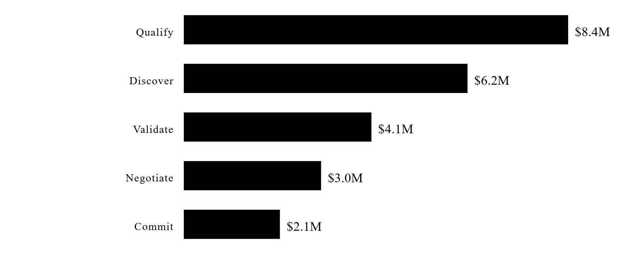
14 / 21 · PIPELINE HEALTH
SECTION IV
14
· HEALTH
Concentration risk: $14.6M sits in Enterprise.
PIPELINE BY SEGMENT ($M)
STAGE DISTRIBUTION
Enterprise
$14.6M
61.3% OF PIPELINE
Commercial
$6.0M
25.2% OF PIPELINE
Mid-Market
$3.2M
13.5% OF PIPELINE
RISK
A few large Enterprise deals slipping has outsized impact. Lost-reason analysis should feed directly into content priorities — every loss reason is a content gap.
FIG. 14 / HEALTH
BASE: $23.8M OPEN
Notes:
Pipeline health snapshot. Most pipeline value sits in Enterprise — $14.6M of the $23.8M open pipeline. That's concentration risk: a couple of large Enterprise deals slipping has outsized impact. Stage distribution skews early; we need to nurture deals into late-stage. And lost reasons should feed directly into the content strategy — every loss reason is a content gap.

Slide 15
15 / 21 · ACCOUNT INTENT & PROFILE FIT
SECTION IV
15
· INTENT
Right accounts × right time.
6sense Profile Fit measures firmographic match to your best customers. Intent measures active research behavior.
STRONG FIT
MODERATE FIT
WEAK FIT
↑ 35-47%
25-35%
↓ 15-25%
WIN RATE · SHORTER CYCLES
WIN RATE · STANDARD MOTION
ICP DRIFT SIGNAL
Tier-1 ABM target. Personalized ads, executive content, direct sales outreach.
Standard nurture cadence. Include in 6sense audiences and email programs.
Exclude from Tier-1 budget. Review ICP definitions quarterly.
→
Filter 6sense audiences to Strong + Moderate Fit only for Tier-1 campaigns.
→
Trigger immediate SDR outreach when accounts hit the Decision buying stage.
→
Use Profile Fit × Buying Stage as a 2×2 prioritization matrix.
FIG. 15 / FIT
SOURCE: 6SENSE SEGMENTS
Notes:
Account intent and 6sense Profile Fit. Strong Profile Fit accounts close at higher rates and faster. The recommendation is straightforward: filter 6sense audiences to Strong + Moderate Fit only for Tier 1 campaigns, and trigger immediate SDR outreach when an account hits 'Decision' buying stage. Weak Fit accounts are a yellow flag — review the targeting criteria quarterly to make sure ICP definitions haven't drifted.

Slide 16
16 / 21 · BUDGET RECOMMENDATION
SECTION V
16
· BUDGET
Three scenarios. Status Quo, ROI-Optimized, Growth.
CHANNEL
STATUS QUO
ROI-OPTIMIZED
GROWTH MODE
Δ STRATEGY
Email Nurture
$32K
$38K · +20%
$64K · +100%
Lean in — top First-Touch driver
6sense Display
$48K
$62K · +30%
$96K · +100%
Lean in — closes deals
Web / Inbound
$18K
$18K · 0%
$22K · +22%
Hold; invest in de-anonymization
Events
$12K
$4K · -67%
$2K · -83%
Cut — low ROI in this dataset
Other Paid
$9K
$2K · -78%
$0 · -100%
Reallocate to top channels
Total
$119K
$124K
$184K
STATUS QUO
ROI-OPTIMIZED · RECOMMENDED
GROWTH MODE
Baseline
+15-25%
+30-45%
Hold 2024 mix. No reallocation, no growth.
Same total spend, better mix. Lift email + 6sense; cut events & "other".
Double email + 6sense. Higher risk, higher ceiling.
FIG. 16 / BUDGET
QUARTERLY VIEW · USD
Notes:
Three budget scenarios. Status Quo at $119K — current allocation. ROI-Optimized at $124K reallocates toward high-ROI channels at roughly the same total spend. Growth Mode at $104K is more aggressive: double email and 6sense, halve everything else. The expected pipeline lift in ROI-Optimized is 15-25%. This is a directional model — diminishing returns are real — but the direction is reliable, and the test period should be one full quarter.

Slide 17
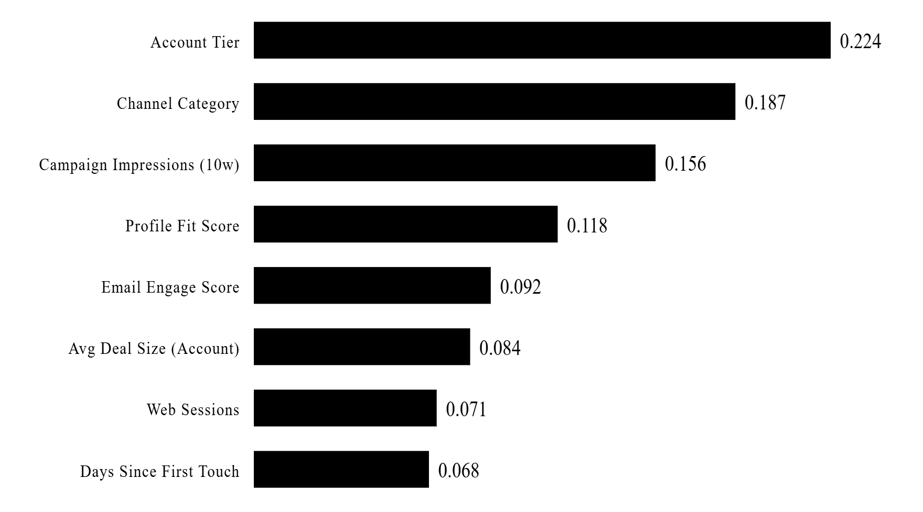
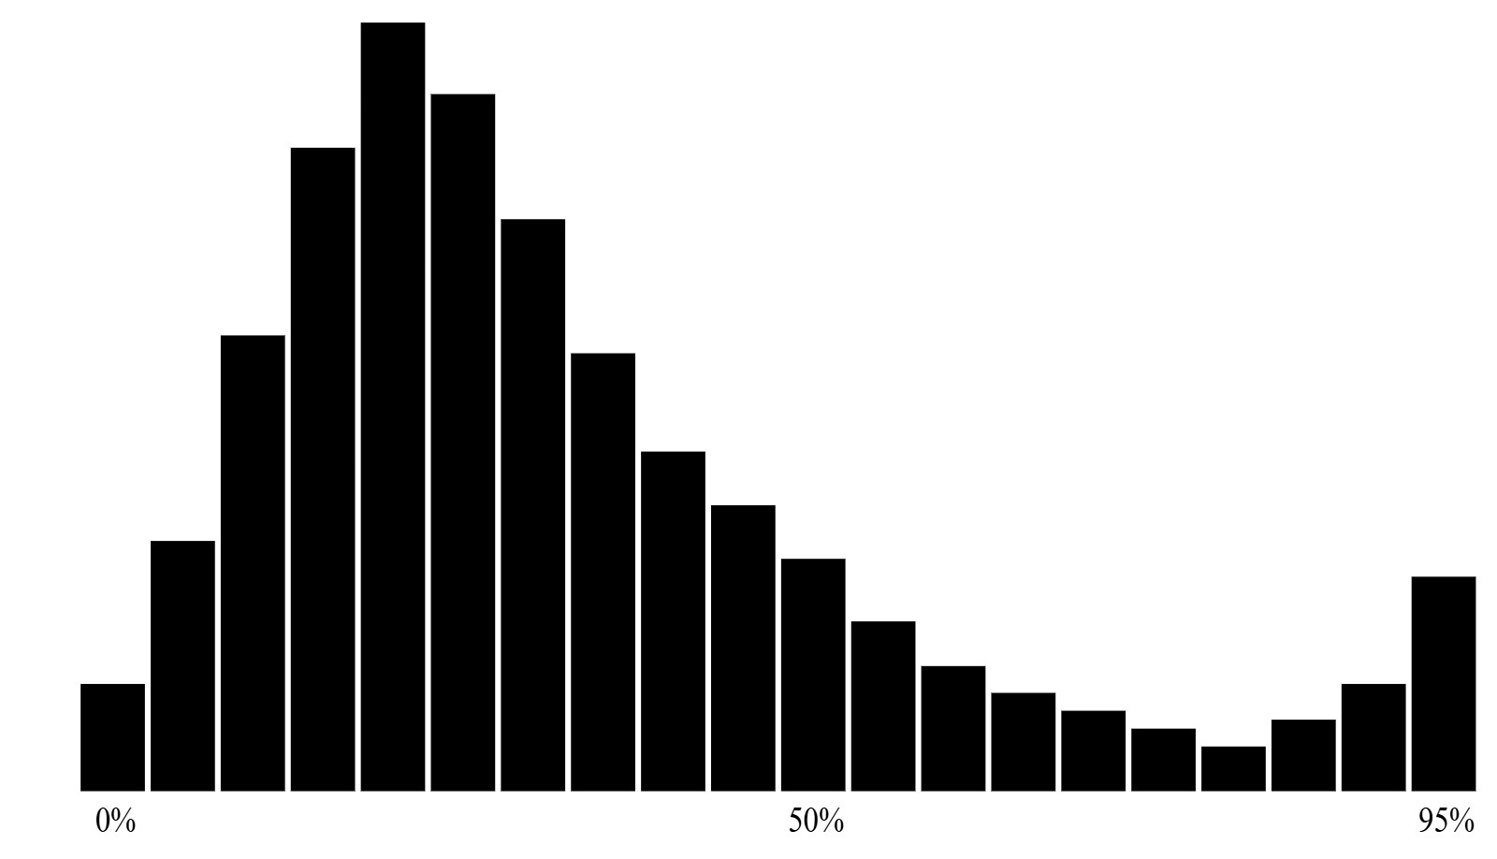
17 / 21 · ML WIN PROBABILITY MODEL
SECTION V
17
· MODEL
Random Forest classifier — AUC 0.807.
Trained on 2,743 closed deals. Scoring 545 currently open deals for sales prioritization.
ALGORITHM
AUC
TRAINING DEALS
SCORED OPEN
Random Forest
0.807
2,743
545
strong
FEATURE IMPORTANCE
RELATIVE WEIGHT
WIN PROBABILITY · 545 OPEN DEALS
DISTRIBUTION
← AT-RISK · <30%
HOT DEALS · >70% →
FIG. 17 / MODEL
RF · 100 TREES · DEPTH 12
Notes:
We trained a Random Forest classifier on 2,743 closed deals. AUC of 0.807 is strong — that's a model worth listening to. Top predictors: account tier, channel category, and campaign impressions in the prior 10 weeks. The fact that ad impressions show up as a top predictor is direct validation of the ABM strategy — accounts marketing has reached more often actually do close more often. The 545 currently open deals are scored; share the top decile with sales weekly as a hot-deal list.

Slide 18
18 / 21 · ACCOUNT COVERAGE GAP
★ KEY FINDING
18
· #1 GROWTH OPPORTUNITY
OF 4,797 TARGET ACCOUNTS
67.9%
have never received a single marketing touchpoint.
COVERAGE DISTRIBUTION
UNREACHED
EMAIL ONLY
6SENSE ONLY
EMAIL + 6SENSE
3,256
812
478
251
1.0× BASELINE
1.4× OPP RATE
1.7× OPP RATE
2.4× OPP RATE
FIG. 18 / COVERAGE
BASE: 4,797 ACCOUNTS
Notes:
This is the single biggest growth lever in the deck. Of 4,797 target account domains, 67.9% — 3,256 accounts — have never received a single marketing touchpoint. Zero. And accounts reached by both email AND 6sense show a 2.4x higher opportunity rate than unreached accounts. The next-quarter action is concrete: take the 3,256 unreached accounts, prioritize the Strong Profile Fit ones, and push them into a coordinated email plus 6sense sequence.

Slide 19
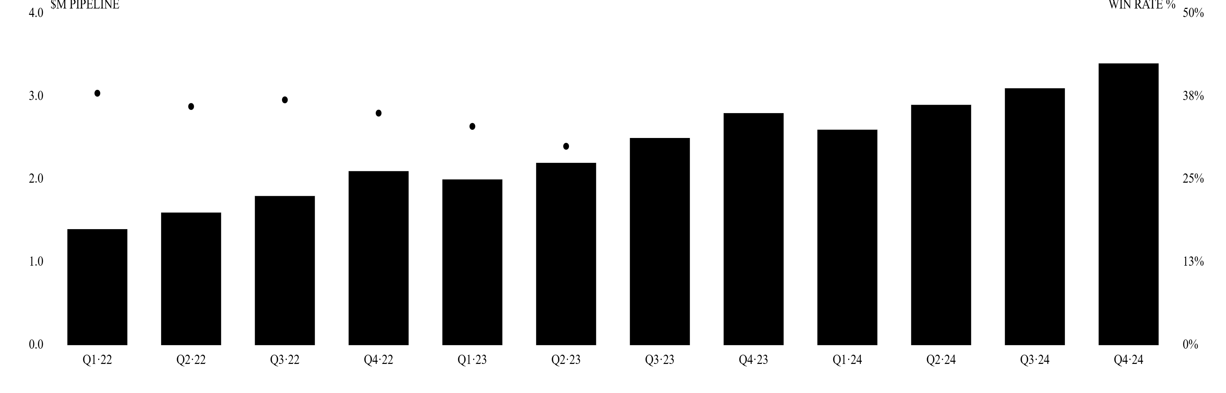
19 / 21 · PIPELINE COHORT ANALYSIS
★ STRATEGIC SIGNAL
19
· COHORTS
Pipeline up. Win rate down. Quality is losing.
Pipeline volume per quarter (bars) vs. win rate per quarter (line). The most important strategic signal in the dataset.
PIPELINE $ & WIN RATE BY QUARTER · 2022—2024
$M / %
Pipeline $M
Win Rate %
Marketing Share %
DIAGNOSIS
Win rate dropped from ~37% in 2022 to ~15% in 2024 . Either ICP targeting expanded too broadly, or deals are entering the funnel before they're qualified. Recommend quarterly ICP audit and tighter qualification criteria at deal entry.
FIG. 19 / COHORTS
QUARTERLY · 2022—2024
Notes:
This is the most important strategic signal in the dataset. Pipeline is growing — bars going up. But win rate is dropping, from roughly 37% in 2022 to about 15% in 2024. That's a quality-versus-quantity tension, and quality is losing. Two possible causes: ICP targeting expanded too broadly, or deals are entering the funnel before they're qualified. The recommendation is a quarterly ICP audit and tighter qualification criteria at deal entry.

Slide 20
20 / 21 · ABM TARGETING PRIORITY MATRIX
SECTION VI
20
· PRIORITY
Where to concentrate ABM investment.
Win rate heatmap — Segment × 6sense Profile Fit. Darker = higher win rate.
STRONG FIT
MODERATE FIT
WEAK FIT
ENTERPRISE $15K AVG
35%
28%
19%
TIER 1 · EXEC PERSONALIZATION
TIER 2 · STANDARD ABM
EXCLUDE
COMMERCIAL $8K AVG
47%
31%
22%
TIER 1 · VOLUME MOTION
TIER 2 · STANDARD ABM
EXCLUDE
MID-MARKET $4K AVG
38%
24%
15%
TIER 2 · SELF-SERVE NURTURE
EMAIL-LED
EXCLUDE
ACTION
Filter 6sense audience lists to Strong + Moderate Fit only for Tier-1 campaigns. Combine with buying-stage filter (Decision-stage accounts) for a 3-factor priority signal.
FIG. 20 / PRIORITY
WIN RATE · BASE: 3,288 DEALS
Notes:
The ABM priority matrix. Segment crossed with Profile Fit. Commercial plus Strong is the highest win rate at 47% — that's where the volume motion lives. Enterprise plus Strong has lower win rate but the largest deal size; that's where executive personalization pays off. Weak Profile Fit drops win rates to 15-25% across the board — those accounts shouldn't see Tier 1 budget. Filter audience lists to Strong and Moderate Fit only.

Slide 21
21 / 21 · NEXT STEPS
SECTION VI
21
· NEXT STEPS
Prioritized actions — 30 days, 90 days, ongoing.
30-DAY QUICK WINS
90-DAY STRATEGIC
ONGOING METRICS
Data hygiene & low-risk reallocation.
Bigger bets & infrastructure.
Dashboard north stars.
→
Consistent UTM taxonomy across all channels.
→
Deploy web de-anonymization (6sense / Clearbit).
→
Mktg-Attributed Pipeline % · target >20%.
→
A/B test top email subject-line patterns.
→
Coordinated 6sense + email + SDR playbook.
→
Email CTOR by seniority · 10-15%.
→
6sense display +20-30% toward Strong Fit.
→
Monthly attribution review.
→
6sense cost-per-form-fill · <$500.
→
Segment-specific landing pages.
→
Cost-per-MQL exec dashboards.
→
Monthly model comparison.
THE ONE-PAGE SUMMARY
Email starts conversations ($4.0M First-Touch). 6sense keeps the brand visible when deals close ($3.3-3.5M Last-Touch). Fund both.
FIG. 21 / END
— THANK YOU —
Notes:
To close: prioritized actions. 30-day quick wins are mostly data hygiene and low-risk reallocation — fix UTMs, A/B test subject lines, shift 6sense budget toward Strong Fit accounts. 90-day strategic work is bigger: deploy web de-anonymization, build a coordinated playbook, set up monthly attribution review. The ongoing metrics at the bottom are what we'd put on the executive dashboard. Thank you — happy to take questions.

